Slide 1

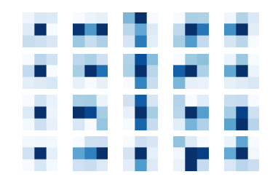
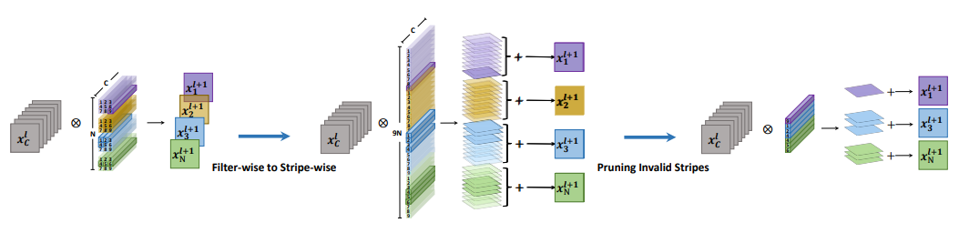
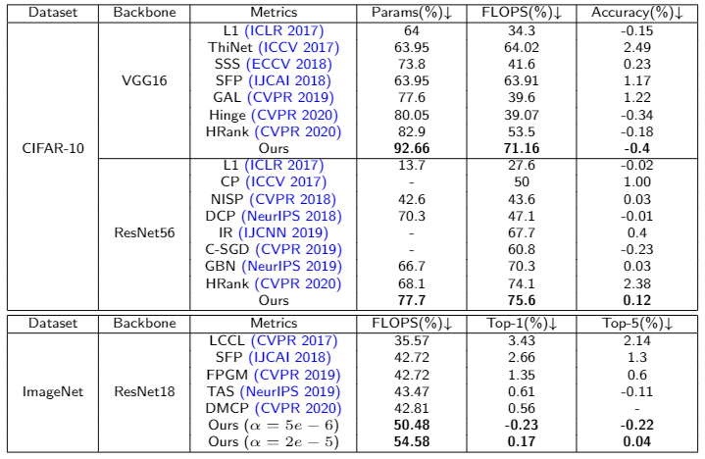
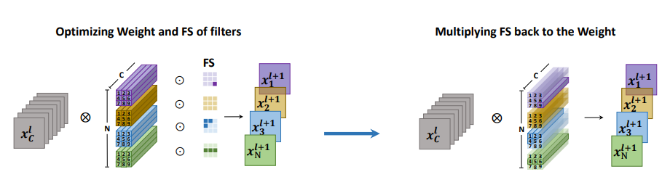
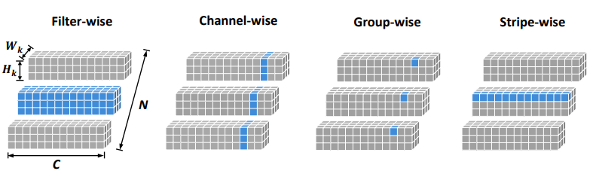

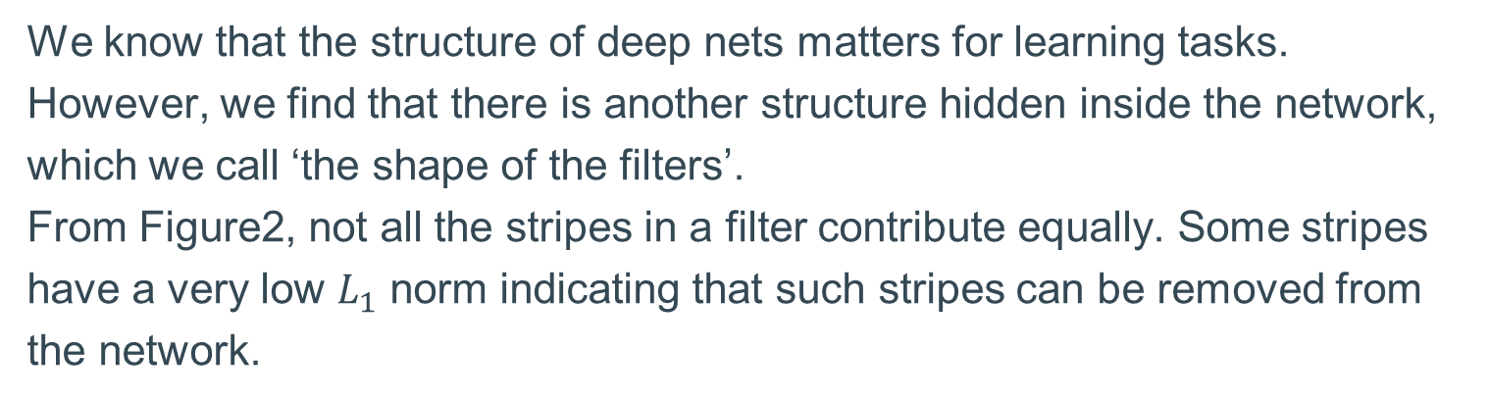
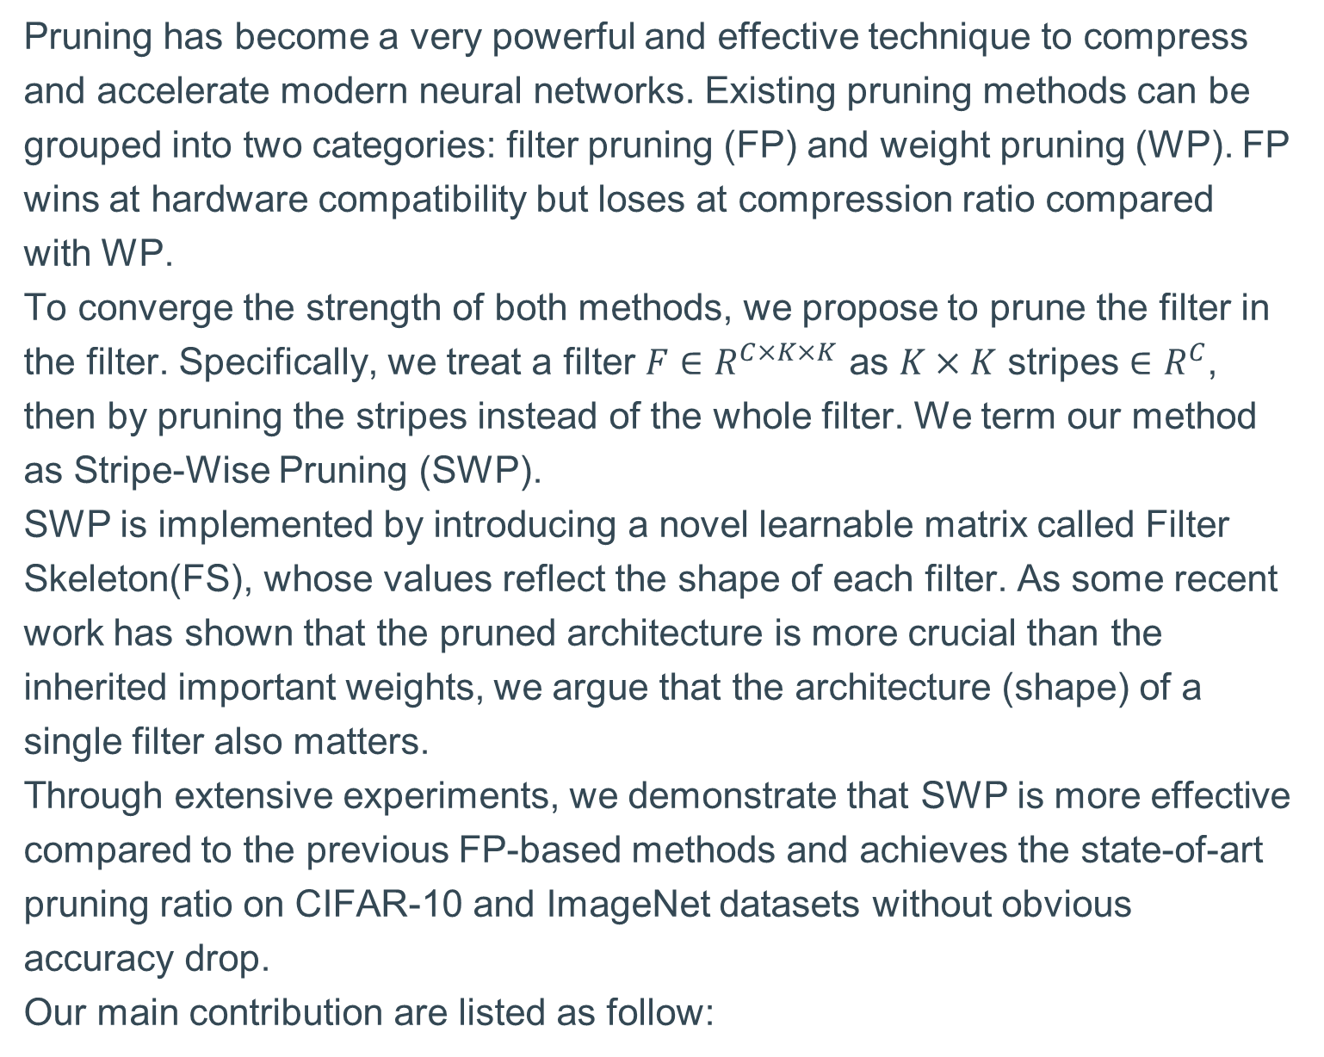
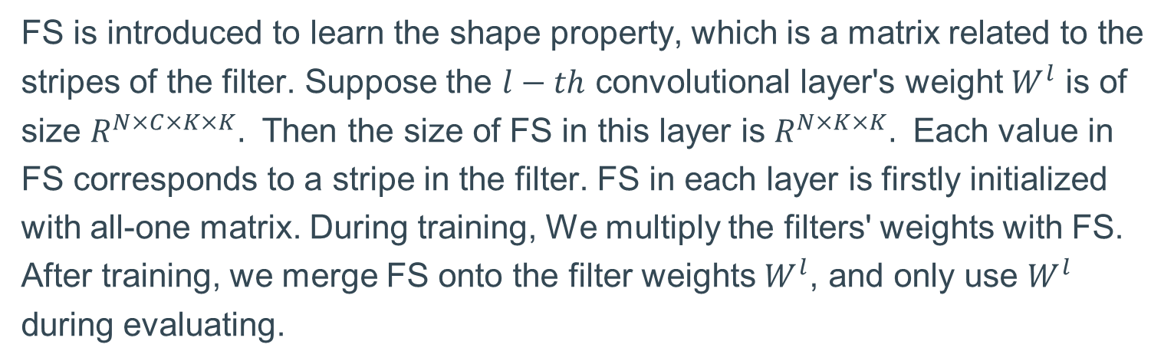
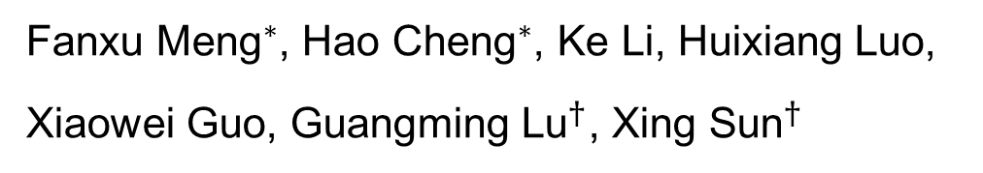
Pruning Filter in Filter
${\text{Fanxu} \text{Meng}}^{∗}$, ${\text{Hao} \text{Cheng}}^{∗}$, Ke Li, Huixiang Luo,
Xiaowei Guo, ${\text{Guangming} \text{Lu}}^{†}$, ${\text{Xing} \text{Sun}}^{†}$
Abstract
Filter Skeleton
Stripe Wise Pruning
Pruning has become a very powerful and effective technique to compress and accelerate modern neural networks. Existing pruning methods can be grouped into two categories: filter pruning (FP) and weight pruning (WP). FP wins at hardware compatibility but loses at compression ratio compared
with WP.
To converge the strength of both methods, we propose to prune the filter in the filter. Specifically, we treat a filter ${F∈R}^{C×K×K}$ as $K×K$ stripes ${∈R}^{C}$, then by pruning the stripes instead of the whole filter. We term our method as Stripe-Wise Pruning (SWP).
SWP is implemented by introducing a novel learnable matrix called Filter Skeleton(FS), whose values reflect the shape of each filter. As some recent work has shown that the pruned architecture is more crucial than the inherited important weights, we argue that the architecture (shape) of a single filter also matters.
Through extensive experiments, we demonstrate that SWP is more effective compared to the previous FP-based methods and achieves the state-of-art pruning ratio on CIFAR-10 and ImageNet datasets without obvious accuracy drop.
Our main contribution are listed as follow:
Figure4 Shape implied in the parameters for the filter
By sparse FS while training, we learn filters’ shape needed prune to. However we can not directly use the filter as a whole to perform convolution on the input feature map since the filter is broken. Instead, we need to change Filter-Wise-Convolution to Stripe-wise-Convolution, and play pruning on each stripe.
Figure2 Shape hidden inside the parameters for the filter
We know that the structure of deep nets matters for learning tasks. However, we find that there is another structure hidden inside the network, which we call ‘the shape of the filters’.
From Figure2, not all the stripes in a filter contribute equally. Some stripes have a very low $L_{1}$ norm indicating that such stripes can be removed from the network.
We propose a new pruning paradigm called SWP. SWP achieves a finer granular than traditional filter pruning and the pruned network can still be inferred efficiently.
We introduce FS to efficiently learn the shape of each filter and deeply analyze the working mechanism of FS. Using FS, we achieve the state-of-art pruning ratio on CIFAR-10 and ImageNet datasets without obvious accuracy drop.
Figure3 Shape implied in the parameters for the filter
image
FS is introduced to learn the shape property, which is a matrix related to the stripes of the filter. Suppose the $l−th$ convolutional layer's weight $W^{l}$ is of size $R^{N×C×K×K}.$ Then the size of FS in this layer is $R^{N×K×K}.$ Each value in FS corresponds to a stripe in the filter. FS in each layer is firstly initialized with all-one matrix. During training, We multiply the filters' weights with FS. After training, we merge FS onto the filter weights $W^{l}$, and only use $W^{l}$ during evaluating.
Hinge and IR are group-wise pruning methods, the others except ours are filter-wise or channel-wise methods. We can see SWP outperforms other methods by a large margin. For example, when pruning VGG16, SWP can reduce the number of parameters by 92.66% and the number of Flops by 71.16% without losing network performance. On ImageNet, SWP can reduce the FLOPs by 54.58% without obvious accuracy drop.
Figure1 Comparison of different type of pruning

