Slide 1
Presentation3
트랜스포머는 정교한 모델이다
Bumjin Park

Slide 2









Training
Inference
Output Probability
Output Probability
It’s like a bag of words
$$×α(0.05)$$
Softmax
Softmax
Softmax
Linear(ZtoV)
Linear(XtoV)
Linear(ZtoV)
Linear(XtoV)
$z_{x}$
$z_{y}$
$z_{x}$
$z_{y}$
Encoder
Decoder
Encoder
Decoder
Input
Embedding
Output
Embedding
Output
Embedding
Input
Embedding
$$X$$
$Y\text{(}\text{shifted} \text{right}\text{)}$
$Y\text{(}\text{shifted} \text{right}\text{)}$
$$X$$

Slide 3
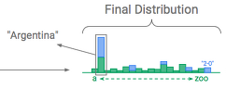
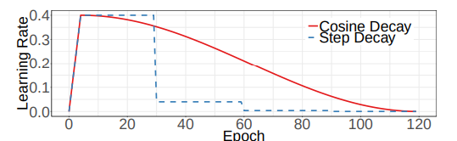



Transformer is a sophisticated model
Warm UP
1. Parameter of Finetuned model is adapted to the small learning rate
2. Variance of $z_{y}$ may corrupt the model heavily
Output Probability
Softmax
Independent path of latent generation
Linear(ZtoV)
Linear(XtoV)
$z_{x}$
$z_{y}$
Transformer Flow
Encoder
Decoder
Input
Embedding
Output
Embedding
$$X$$
$Y\text{(}\text{shifted} \text{right}\text{)}$

Slide 4
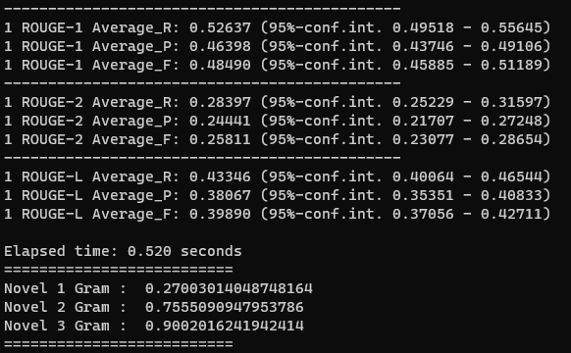
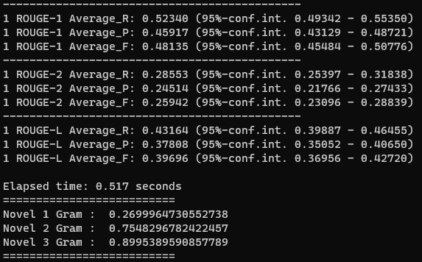
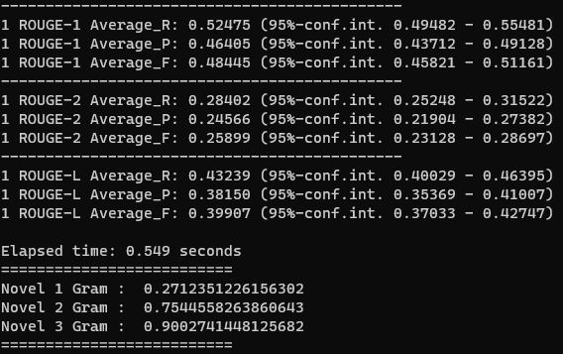
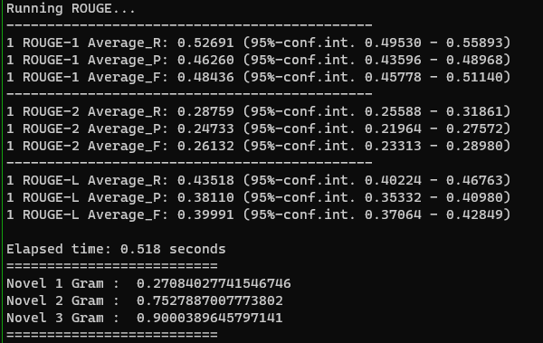
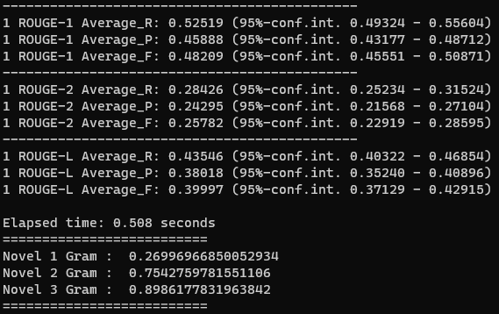
Train a model with 1% of the Total Sample
CVAE running 4 times
Different Result whenever I run it.
BART

Slide 5
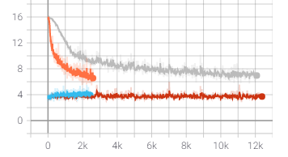
Training CVAE
To get a meaningful result we should drop the Cross Entropy loss to 4
With Latent Variable it is hard to get that point.
Trade Off
Variation vs CrossEntropy
Finetuned BART

Slide 6
Training of CVAE
BART condition
Freezing the BART
How to Use Latent
(Level)
Initial parameter
BART Freeze
Generate Vocab
pretrained parameter
BART Unfreeze
Decoder Last Feature Concatenation
Finetuned parameter

Slide 7

Experiments Decision
Training
Inference
Output Probability
Output Probability
$$×α(0.05)$$
1 Freezing or Not
2 New_Linear Layer or Not
3 Separate Softmax or Addition
Softmax
Softmax
Softmax
Linear(ZtoV)
Linear(XtoV)
Linear(ZtoV)
Linear(XtoV)
$z_{x}$
$z_{y}$
$z_{x}$
$z_{y}$
Encoder
Decoder
Encoder
Decoder
Input
Embedding
Output
Embedding
Output
Embedding
Input
Embedding
$$X$$
$Y\text{(}\text{shifted} \text{right}\text{)}$
$Y\text{(}\text{shifted} \text{right}\text{)}$
$$X$$

Slide 8
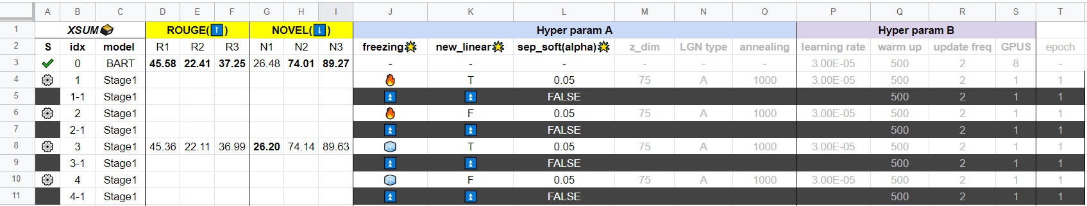
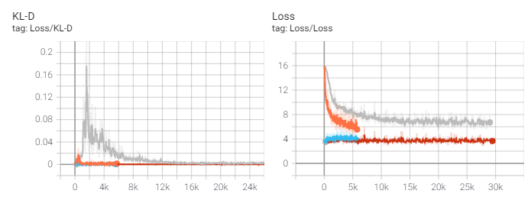

BART : Finetuned parameter
How to Use Latent :Generate Vocab
>3 Converge high → Low ROUGE score
>1 Appropriate
> 2 Increasing, not freezed
> 4 No change, because I BART is freeze

Slide 9
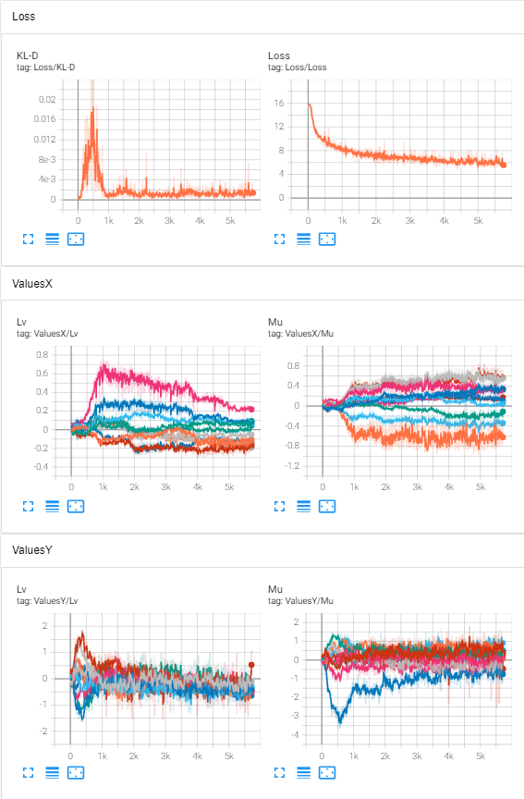
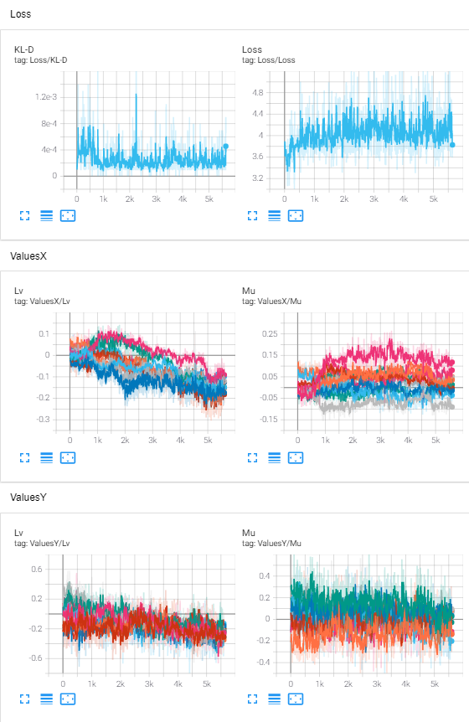
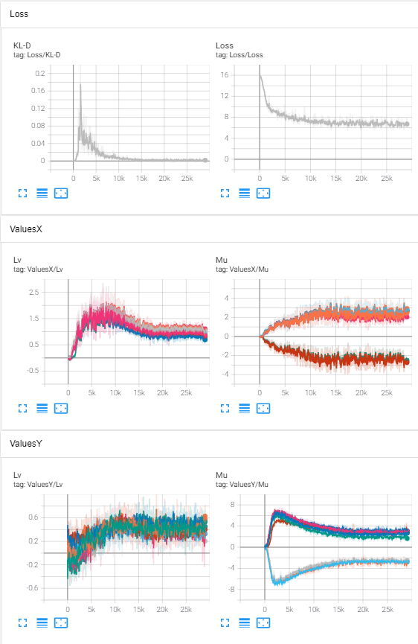
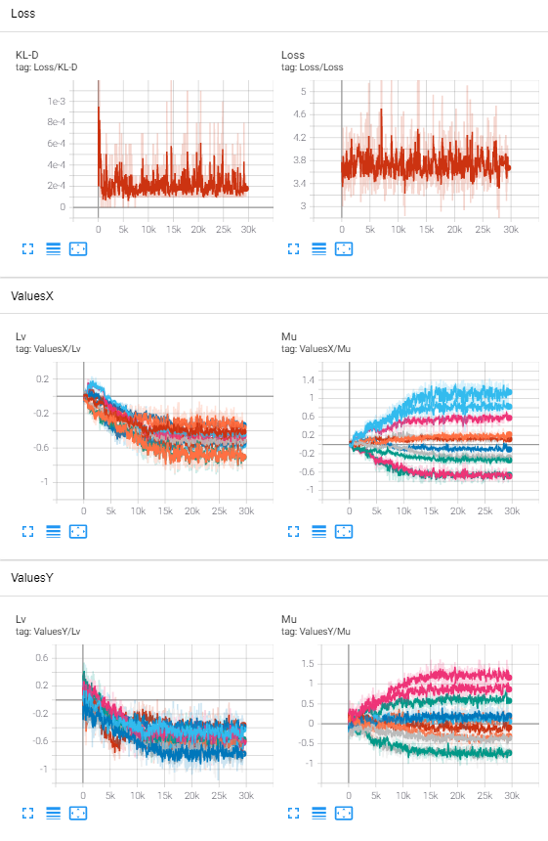
🦄
🐴
💀
🐴
Hot, New Linear
Hot, Existing Linear
Freeze, New Linear
Freeze, Existing Linear

