Slide 1
Transformer Text Summarization with CVAE

Slide 2
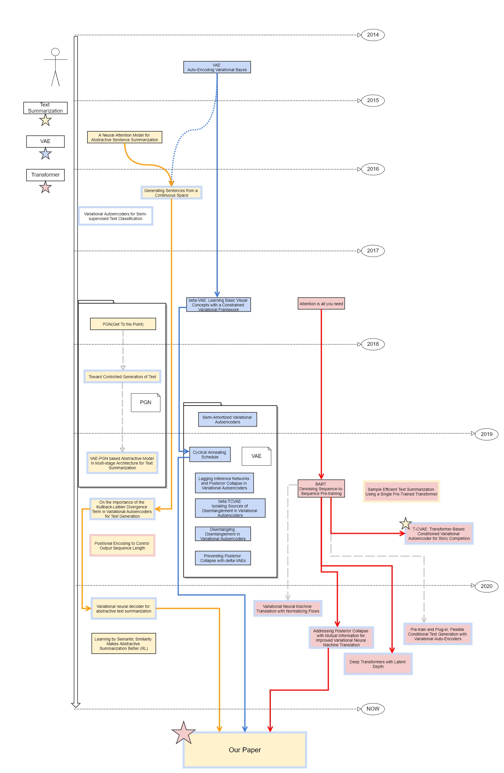
Previous Work
VAE → beta CVAE → Cyclic Annealing → Marginal KL
RNN based Text Summarization → Point Generator Network → Transformer

Slide 3
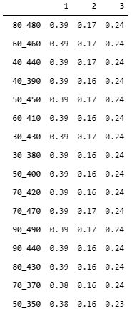
[Copy] ROUGE Score by just Copying Source
CNN_DM data Target =Source[start_end]
Xsum data Target =Source[start_end]
BART
CNN-DM
44.16/21.28/40.90
XSUM
45.14/22.27/37.25.
ROUGE1-F1 0.193
ROUGE2-F1 0.022
ROUGEL-F1 0.129
test.hypo_get_source_0_300
ROUGE1-F1 0.196
ROUGE2-F1 0.026
ROUGEL-F1 0.125
test.hypo_get_source_0_350
ROUGE1-F1 0.193
ROUGE2-F1 0.027
ROUGEL-F1 0.122
test.hypo_get_source_20_120
ROUGE1-F1 0.153
ROUGE2-F1 0.015
ROUGEL-F1 0.114
test.hypo_get_source_20_220
ROUGE1-F1 0.19
ROUGE2-F1 0.023
ROUGEL-F1 0.126
test.hypo_get_source_20_320
ROUGE1-F1 0.195
ROUGE2-F1 0.026
ROUGEL-F1 0.123
test.hypo_get_source_20_370
ROUGE1-F1 0.192
ROUGE2-F1 0.027
ROUGEL-F1 0.12
https://paperswithcode.com/sota/document-summarization-on-cnn-daily-mail

Slide 4











Intuition1 (Not Tested Yet)
Intuition2
Part 1
$$X_{1}$$
$$P(X_{2}|X_{1})$$
Part 2
$$X_{2}$$
X
$$X$$
$$P(Y|X)$$
Select few words in X
$$≈$$
$$Y$$
$$Y$$
$$X′$$

Slide 5




CVAE(Approach1)
Approach2
Part 1
$$X_{1}$$
$$P(X_{2}|X_{1})$$
$$P(Y|X)$$
Part 2
$$X_{2}$$
$$X$$
$$X$$
$$P(Y|X)$$
$$Y$$
$$Y$$

Slide 6


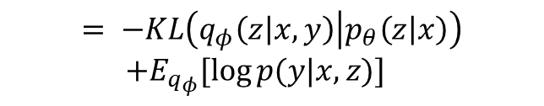

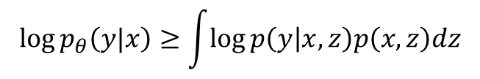

Approach1
Approach2
Solid : Generation process
Dashed : Variational Approximation
Part 1
$$X_{1}$$
$$P(Y|X)$$
$$P(X_{2}|X_{1})$$
Part 2
$$X_{2}$$
$$X$$
$$X$$
$$P(Y|X)$$
$z$
$$Y$$
$$\log{p_{θ}\left(y|x\right)≥\int{\log{p\left(y | x,z\right)p\left(x,z\right)dz}}}$$
?
$$Y$$
$$= −KL\left(q_{φ}\left(z | x,y\right) | p_{θ}\left(z | x\right)\right)$$
$+E_{q_{φ}}[\log{p(y|x,z)}]$

Slide 7
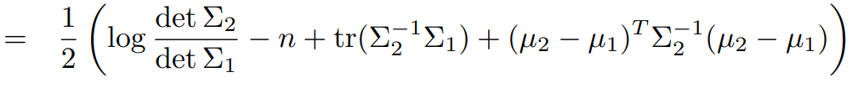







Approach1
Model
Output Probability
Solid : Generation process
Dashed : Variational Approximation
N
N
N
N
N
N
N
N
N
N
Softmax
Linear
$$P(Y|X)$$
$$D_{KL}(P||Q)$$
Add & Norm
Feed Forward
$$X$$
Add & Norm
$z_{y}$
$z_{x}$
Multi-Head Attention
$z$
DECODER
Add & Norm
$$Y$$
Encoder
Encoder
Masked Multi-Head Attention
$$\log{p_{θ}\left(y|x\right)≥\int{\log{p\left(y | x,z\right)p\left(x,z\right)dz}}}$$
Input
Embedding
Input
Embedding
Output
Embedding
$$= −KL\left(q_{φ}\left(z | x,y\right) | p_{θ}\left(z | x\right)\right)$$
$+E_{q_{φ}}[\log{p(y|x,z)}]$
$$Y\text{(}\text{shifted} \text{right}\text{)}$$
$$X$$
$Y\text{(}\text{shifted} \text{right}\text{)}$

Slide 8

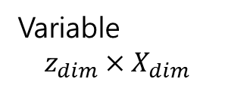
Approach1
Model
Output Probability
Solid : Generation process
Dashed : Variational Approximation
Softmax
N
N
N
N
N
N
N
N
N
N
Linear
$$P(Y|X)$$
$z_{y}$
$$D_{KL}(P||Q)$$
Add & Norm
Feed Forward
$$X$$
Add & Norm
$z_{x}$
Multi-Head Attention
Variable $$z_{dim}×X_{dim}$$
DECODER
$z$
Add & Norm
$$Y$$
Encoder
Masked Multi-Head Attention
$$\log{p_{θ}\left(y|x\right)≥\int{\log{p\left(y | x,z\right)p\left(x,z\right)dz}}}$$
Input
Embedding
Output
Embedding
$$= −KL\left(q_{φ}\left(z | x,y\right) | p_{θ}\left(z | x\right)\right)$$
$+E_{q_{φ}}[\log{p(y|x,z)}]$
$$X$$
$Y\text{(}\text{shifted} \text{right}\text{)}$

Slide 9





Model
Output Probability
N
N
N
N
N
N
N
N
N
N
Softmax
$$P(Y|X)$$
Linear
$$X$$
$$D_{KL}(P||Q)$$
Extractive
Add & Norm
Feed Forward
Abstractive
Add & Norm
$z$
$$Y$$
$z_{y}$
$z_{x}$
Multi-Head Attention
DECODER
Add & Norm
Encoder
Encoder
Masked Multi-Head Attention
$$\log{p_{θ}\left(y|x\right)≥\int{\log{p\left(y | x,z\right)p\left(x,z\right)dz}}}$$
Input
Embedding
Input
Embedding
Output
Embedding
$$= −KL\left(q_{φ}\left(z | x,y\right) | p_{θ}\left(z | x\right)\right)$$
$+E_{q_{φ}}[\log{p(y|x,z)}]$
$$Y\text{(}\text{shifted} \text{right}\text{)}$$
$$X$$
$Y\text{(}\text{shifted} \text{right}\text{)}$

Slide 10
Intuition1 (Not Tested Yet)
Intuition2
Part 1
$$X_{1}$$
$$P(X_{2}|X_{1})$$
Part 2
$$X_{2}$$
X
$$X$$
$$P(Y|X)$$
Select few words in X
$$≈$$
$$Y$$
$$Y$$
$$X′$$

Slide 11













Model
Approach2
Output Probability
N
N
N
N
N
N
N
N
N
N
Softmax
Part 1
Linear
$$X_{1}$$
$z_{1}$
$$D_{KL}(P|\left|Q\right)+D_{KL}(P||Q)$$
$$P(X_{2}|X_{1})$$
Add & Norm
Feed Forward
Part 2
$$X_{2}$$
$z_{x}$
$$X$$
Add & Norm
$z_{y}$
$z_{x_{1}}$
$z_{x_{2}}$
Multi-Head Attention
$$P(Y|X)$$
DECODER
Add & Norm
Encoder
Encoder
Masked Multi-Head Attention
$z_{2}$
Input
Embedding
Input
Embedding
Output
Embedding
$$Y$$
$$Y\text{(}\text{shifted} \text{right}\text{)}$$
$$X$$
$Y\text{(}\text{shifted} \text{right}\text{)}$

Slide 12



Model
Approach2
Output Probability
N
N
N
N
N
N
N
N
N
N
Softmax
Part 1
Linear
$$X_{1}$$
$z_{1}$
$$D_{KL}(P|\left|Q\right)+D_{KL}(P||Q)$$
$$P(X_{2}|X_{1})$$
Add & Norm
$$X_{2}$$
Feed Forward
Part 2
$z_{x}$
$$X$$
Add & Norm
$z_{y}$
$z_{x_{1}}$
$z_{x_{2}}$
Multi-Head Attention
$$P(Y|X)$$
DECODER
Add & Norm
Encoder
Encoder
Masked Multi-Head Attention
$z_{2}$
Input
Embedding
Input
Embedding
Output
Embedding
$$Y$$
$$Y\text{(}\text{shifted} \text{right}\text{)}$$
$$X$$
$Y\text{(}\text{shifted} \text{right}\text{)}$

Slide 13


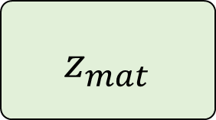










$z_{mat}$
$$Dim_{latent}×{Dim}_{model}$$
$x$
$z_{i}\sim p(z_{i}|x_{i})$
$$Dim_{latent}×Dim_{model}$$
$x$
$x$
$x_{i}$
$$\frac{soft\left(QK\right)}{dim}V$$
Multi Head
$z_{mat}$
$x_{i}$
$x_{i}$
$$Batch×Token×{Dim}_{model}$$
$$Dim_{latent}×{Dim}_{model}$$
$${Dim}_{model}×Tokens$$
$$Token×{Dim}_{model}$$

Slide 14
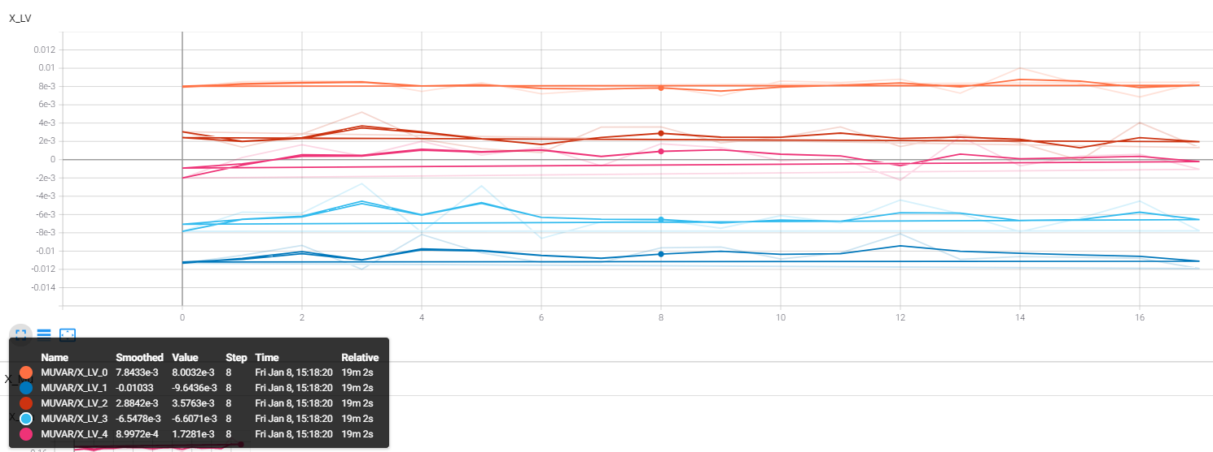

Slide 15
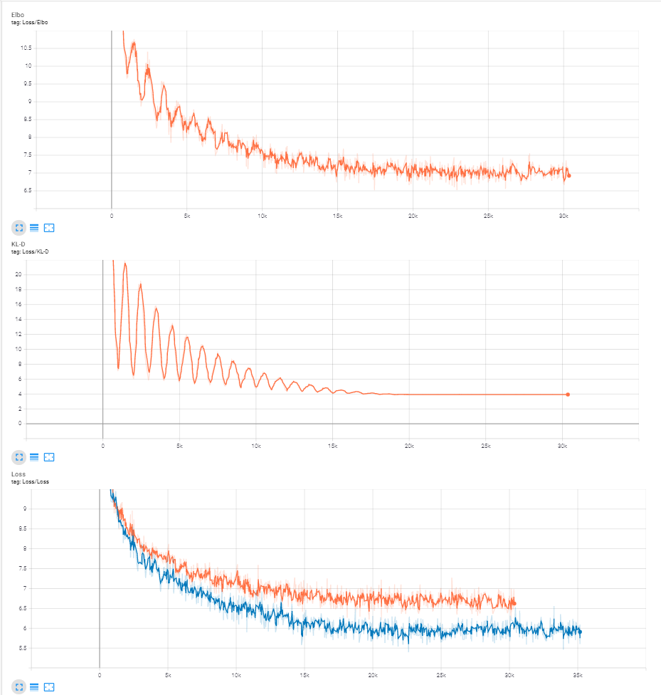
ELBO
KL Div
Cross Entropy
BART

Slide 16
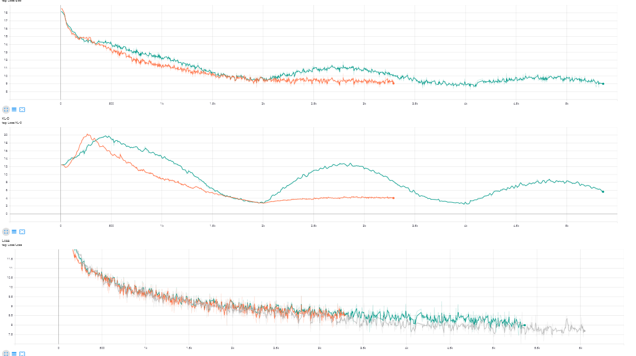
ELBO
KL Div
Cross Entropy
Orange: Add to prob
BART
Gray:BART

