Slide 1
Transformer Text Summarization with CVAE
Report 2

Slide 2
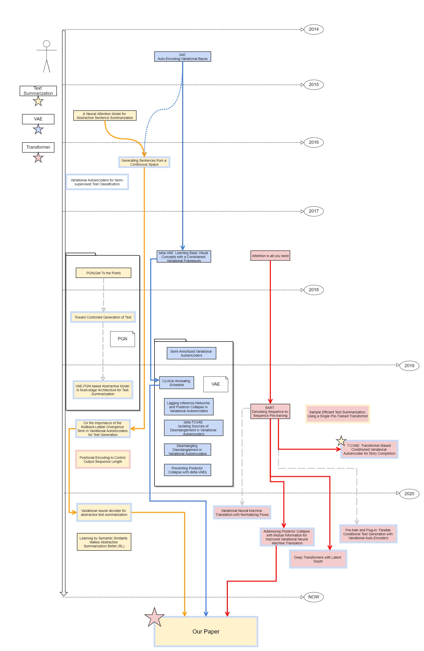
Previous Work
VAE → beta CVAE → Cyclic Annealing → Marginal KL
RNN based Text Summarization → Point Generator Network → Transformer

Slide 3
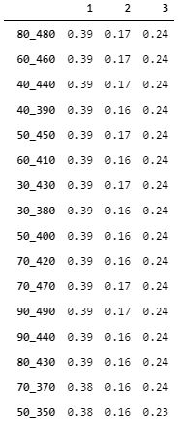
[Copy] ROUGE Score by just Copying Source
CNN_DM data Target =Source[start_end]
Xsum data Target =Source[start_end]
BART
CNN-DM
44.16/21.28/40.90
XSUM
45.14/22.27/37.25.
ROUGE1-F1 0.193
ROUGE2-F1 0.022
ROUGEL-F1 0.129
test.hypo_get_source_0_300
ROUGE1-F1 0.196
ROUGE2-F1 0.026
ROUGEL-F1 0.125
test.hypo_get_source_0_350
ROUGE1-F1 0.193
ROUGE2-F1 0.027
ROUGEL-F1 0.122
test.hypo_get_source_20_120
ROUGE1-F1 0.153
ROUGE2-F1 0.015
ROUGEL-F1 0.114
test.hypo_get_source_20_220
ROUGE1-F1 0.19
ROUGE2-F1 0.023
ROUGEL-F1 0.126
test.hypo_get_source_20_320
ROUGE1-F1 0.195
ROUGE2-F1 0.026
ROUGEL-F1 0.123
test.hypo_get_source_20_370
ROUGE1-F1 0.192
ROUGE2-F1 0.027
ROUGEL-F1 0.12
https://paperswithcode.com/sota/document-summarization-on-cnn-daily-mail

Slide 4

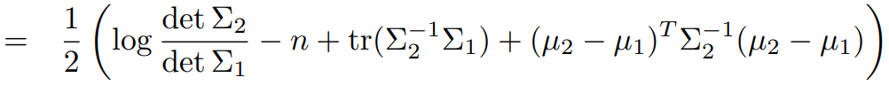





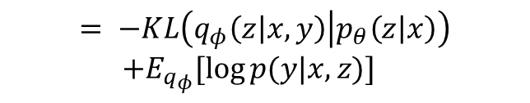



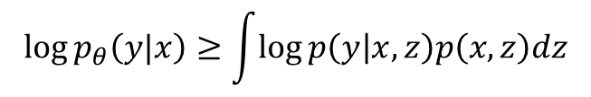


Model
Output Probability
N
N
N
N
N
N
N
N
N
N
Softmax
$$P(Y|X)$$
Linear
$$X$$
$$D_{KL}(P||Q)$$
Extractive
Add & Norm
Feed Forward
$z$
Abstractive
Add & Norm
$$Y$$
$z_{y}$
$z_{x}$
Multi-Head Attention
DECODER
Add & Norm
Encoder
Encoder
Masked Multi-Head Attention
$$\log{p_{θ}\left(y|x\right)≥\int{\log{p\left(y | x,z\right)p\left(x,z\right)dz}}}$$
Input
Embedding
Input
Embedding
Output
Embedding
$$= −KL\left(q_{φ}\left(z | x,y\right) | p_{θ}\left(z | x\right)\right)$$
$+E_{q_{φ}}[\log{p(y|x,z)}]$
$$Y\text{(}\text{shifted} \text{right}\text{)}$$
$$X$$
$Y\text{(}\text{shifted} \text{right}\text{)}$

Slide 5
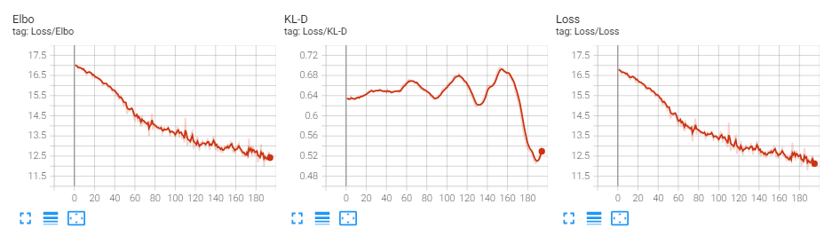
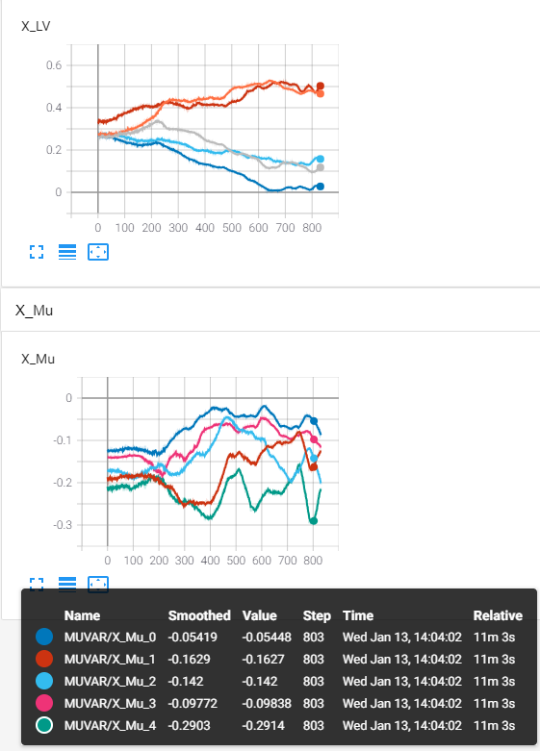







Training
Different Samples
Model
N
N
N
N
N
N
N
N
N
N
Output Probability
Softmax
$$D_{KL}(P(z|x,y||p\left(x|z\right))$$
Linear
Concat
Add & Norm
$$μ_{1}$$
$$μ_{2}$$
$$μ_{3}$$
$$μ_{4}$$
$$μ_{5}$$
Feed Forward
Add & Norm
$z_{y}$
$z_{x}$
Multi-Head Attention
Add & Norm
Encoder
Encoder
Masked Multi-Head Attention
Input
Embedding
Input
Embedding
Output
Embedding
$$Y\text{(}\text{shifted} \text{right}\text{)}$$
$$X$$
$Y\text{(}\text{shifted} \text{right}\text{)}$

Slide 6
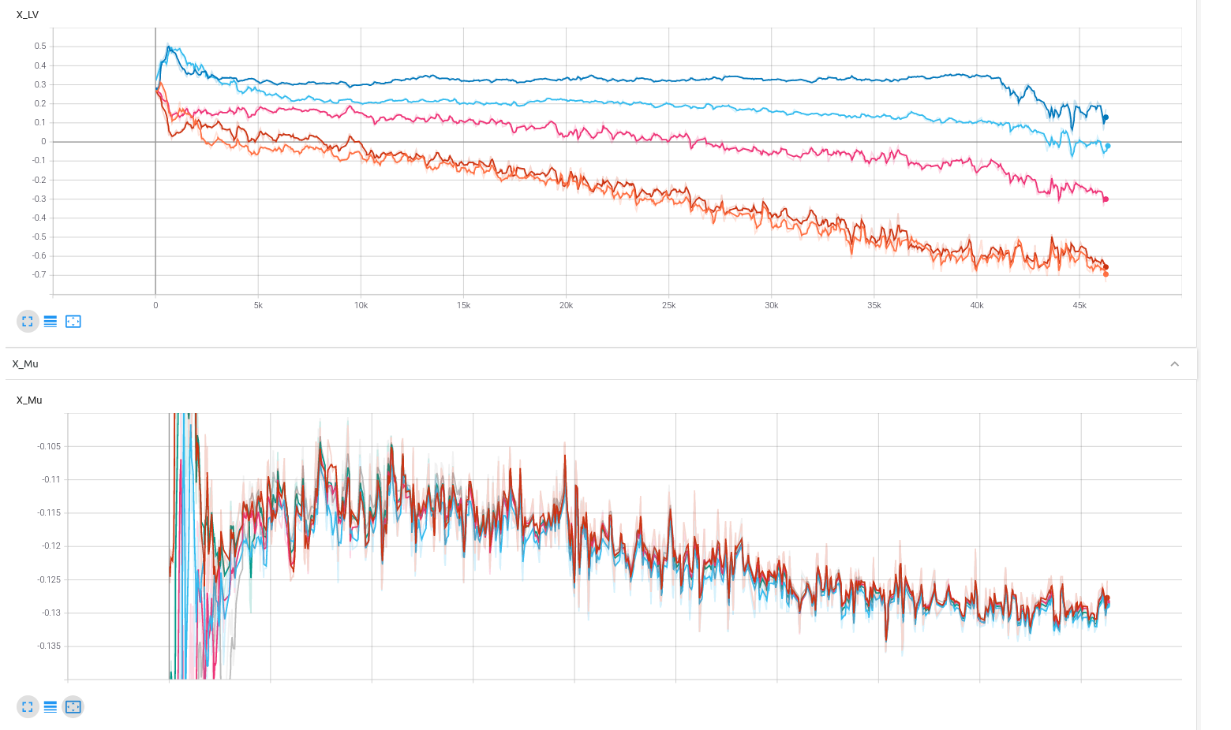
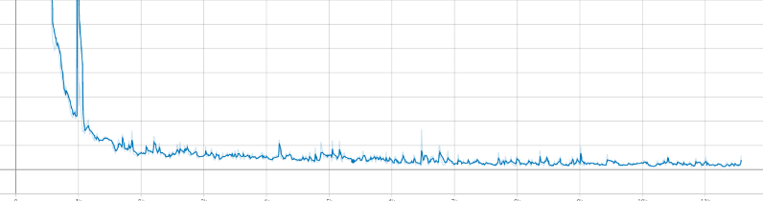
1 epoch (45K updates)
Zdim = 10
Head num = 2
LV
Mu
KL

Slide 7


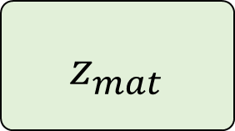










$z_{mat}$
Similar to the Context Vector
$$Dim_{latent}×{Dim}_{model}$$
$x$
$z_{i}\sim p(z_{i}|x_{i})$
$$Dim_{latent}×Dim_{model}$$
$x$
$x$
$x_{i}$
$$\frac{soft\left(QK\right)}{dim}V$$
Multi Head
$z_{mat}$
$x_{i}$
$x_{i}$
$$Batch×Token×{Dim}_{model}$$
$$Dim_{latent}×{Dim}_{model}$$
$${Dim}_{model}×Tokens$$
$$Token×{Dim}_{model}$$

Slide 8
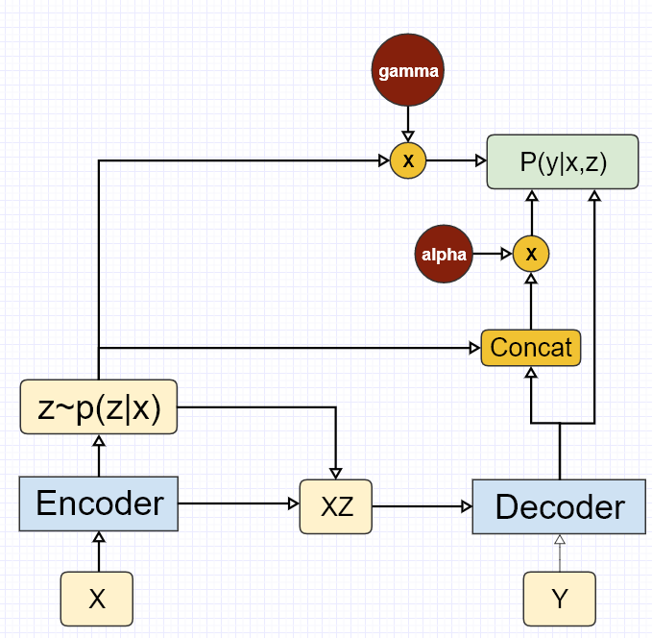
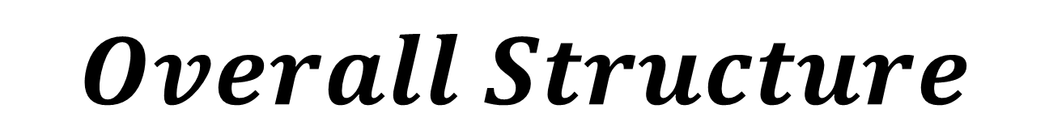
$$Overall Structure$$

Slide 9
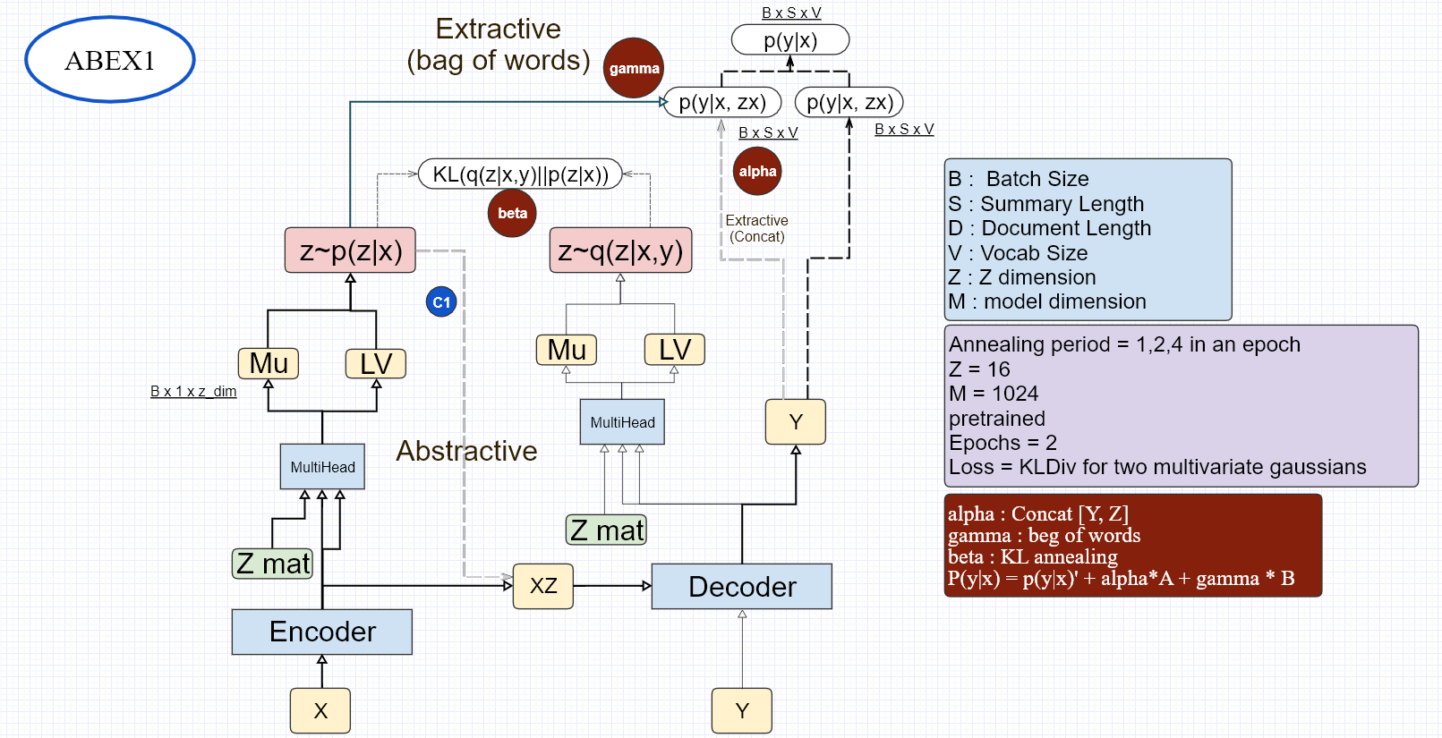

Slide 10
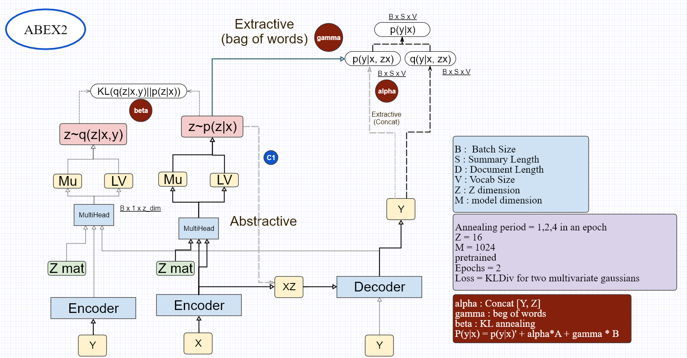

Slide 11
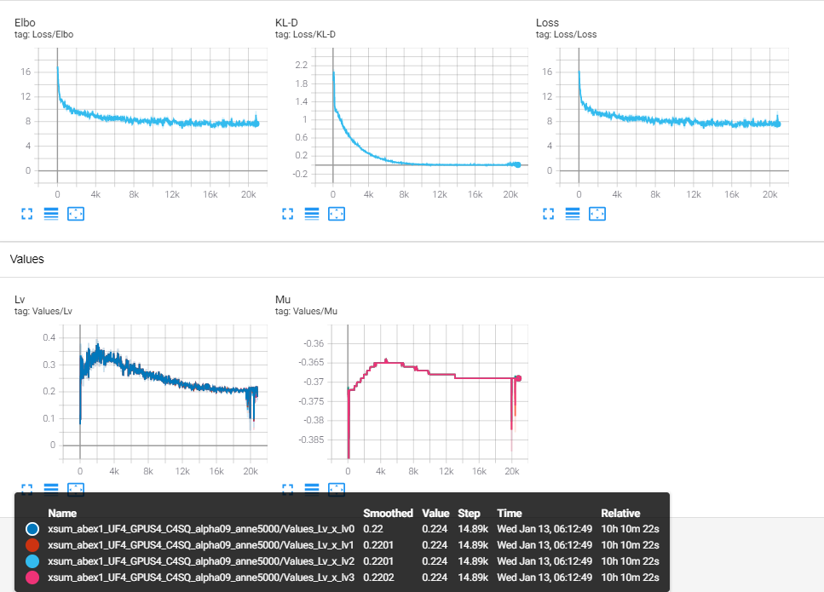
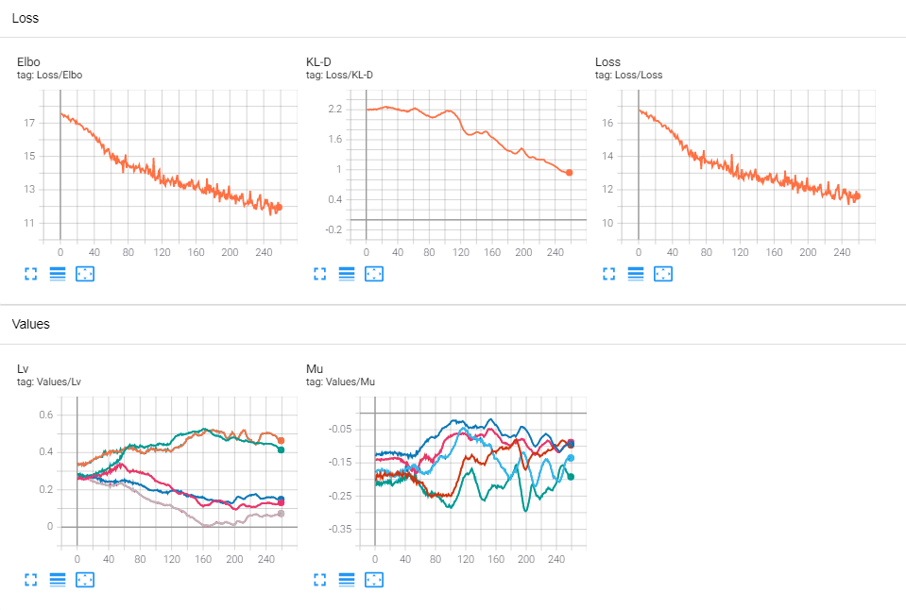
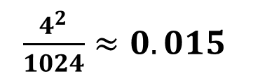
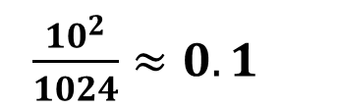
[Solved] Training Problem
Concatenation proportion
Head = 2
Head = 2
X Dim=1024
$\frac{4^{2}}{1024}≈0.015$
X Dim=1024
$\frac{{10}^{2}}{1024}≈0.1$
Z Dim=4
Z Dim=10

Slide 12
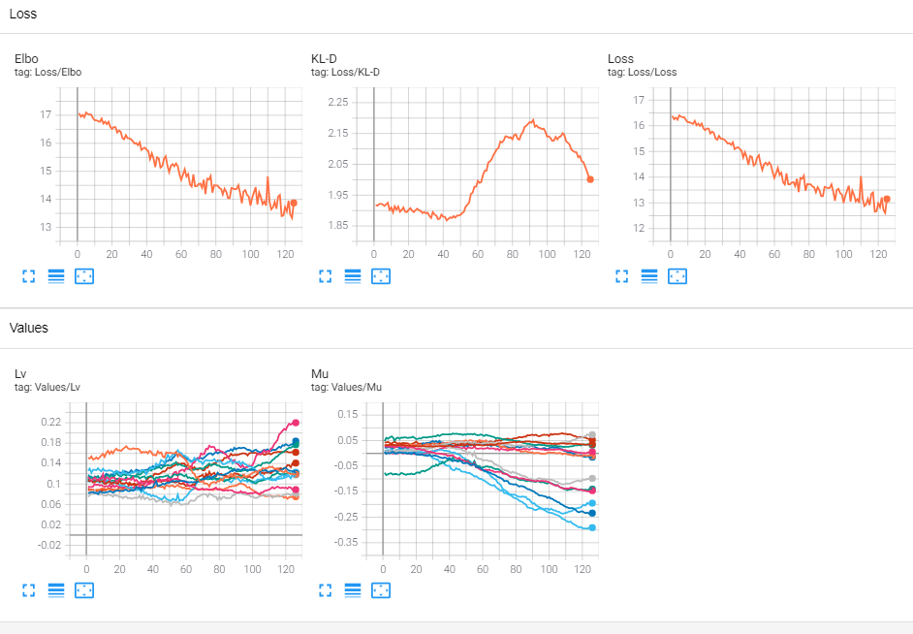
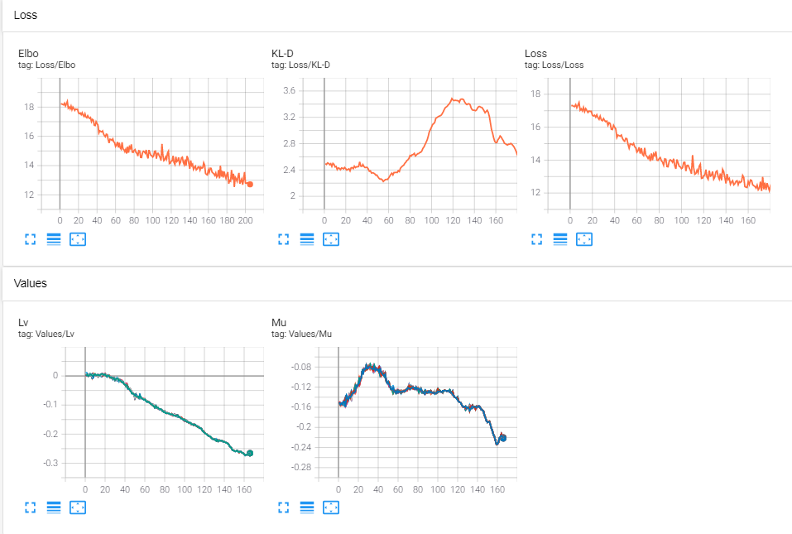
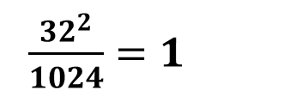
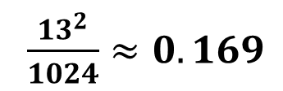
[Solved] Training Problem
Head = 1
Concatenation proportion
Head = 1
X Dim=1024
$\frac{{13}^{2}}{1024}≈0.169$
X Dim=1024
$\frac{{32}^{2}}{1024}=1$
Z Dim=13
Z Dim=32

Slide 13
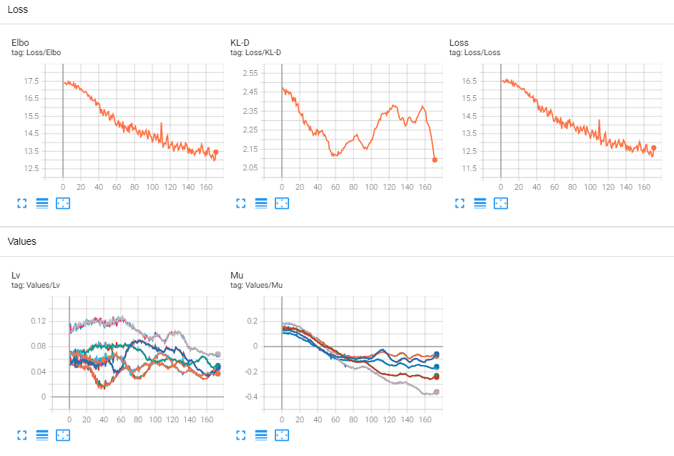
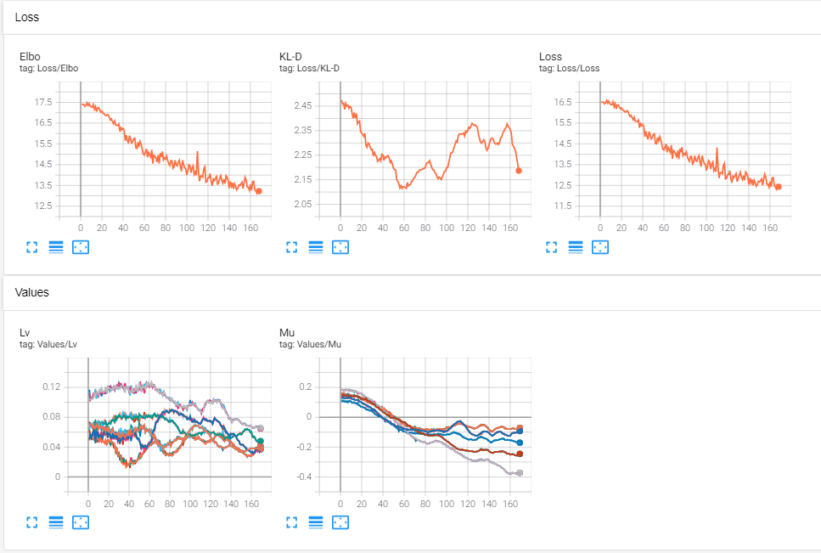
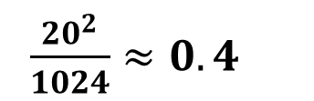
[Solved] Training Problem
Head = 1
Concatenation proportion
Head = 2
X Dim=1024
X Dim=1024
$\frac{{20}^{2}}{1024}≈0.4$
Z Dim=20
Z Dim=20

Slide 14
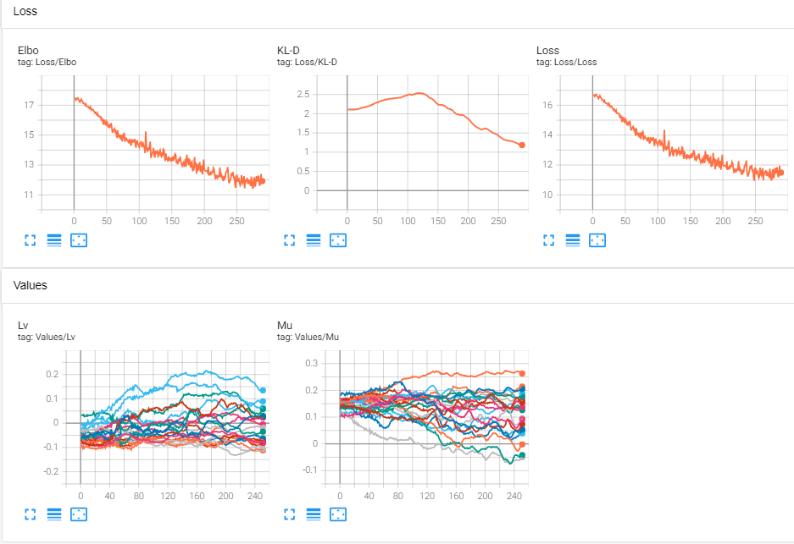
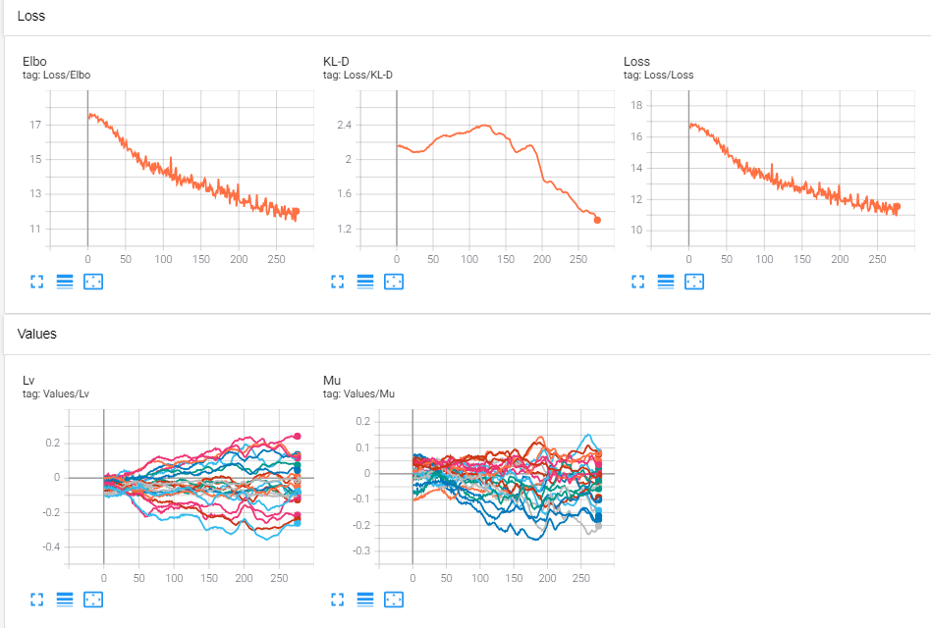
Head = 1
Head = 1
X Dim=1024
X Dim=1024
Z Dim=21
Z Dim=23

Slide 15
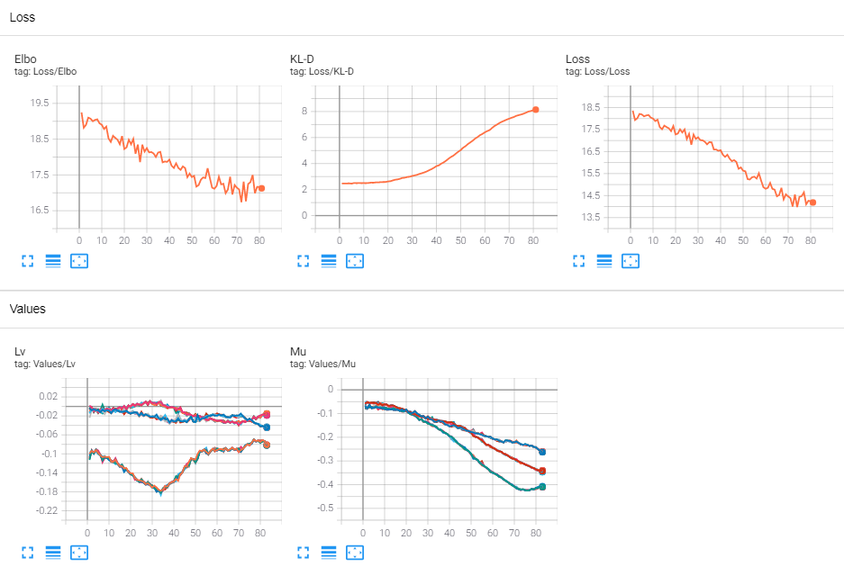
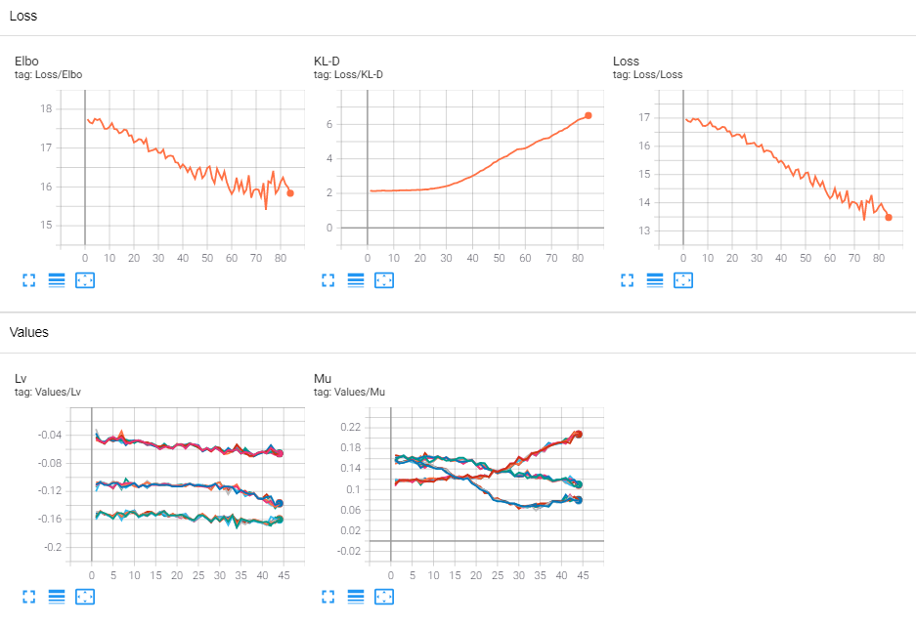
Head = 1
Head = 1
X Dim=1024
X Dim=1024
Z Dim=48
Z Dim=24

Slide 16
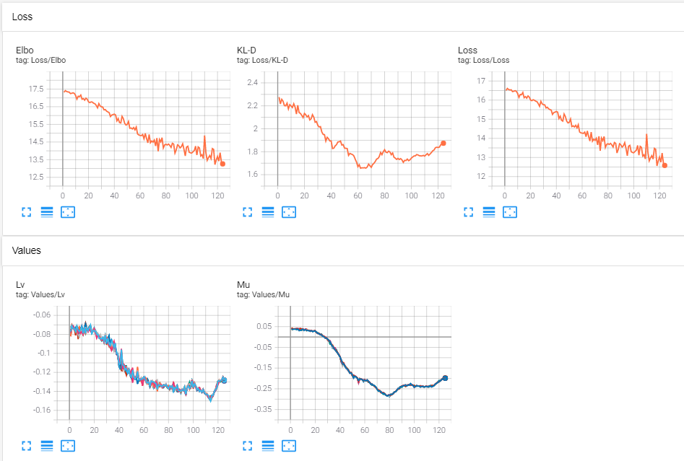
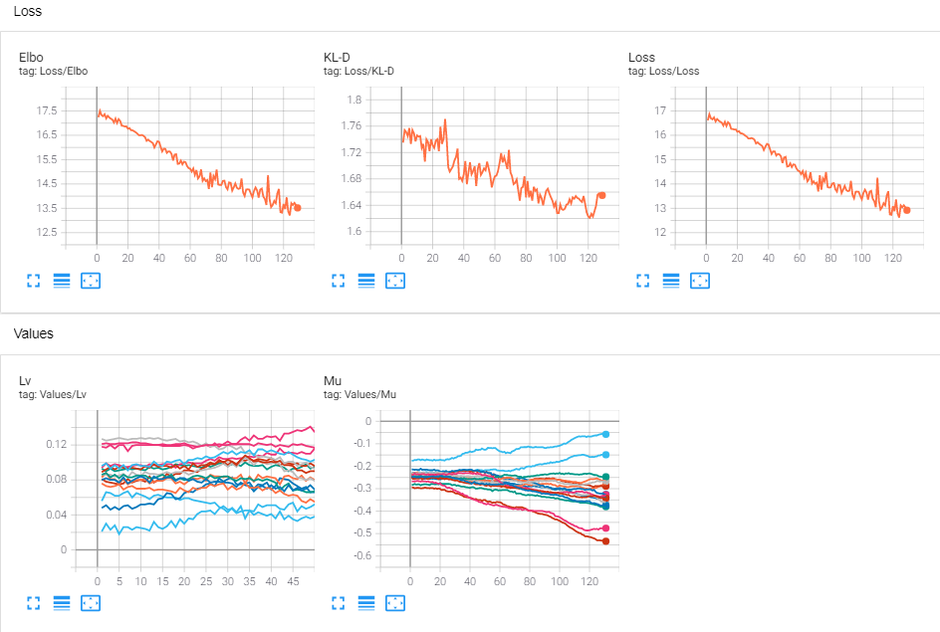
Head = 1
Head = 1
X Dim=1024
X Dim=1025
Z Dim=16
Z Dim=16

Slide 17
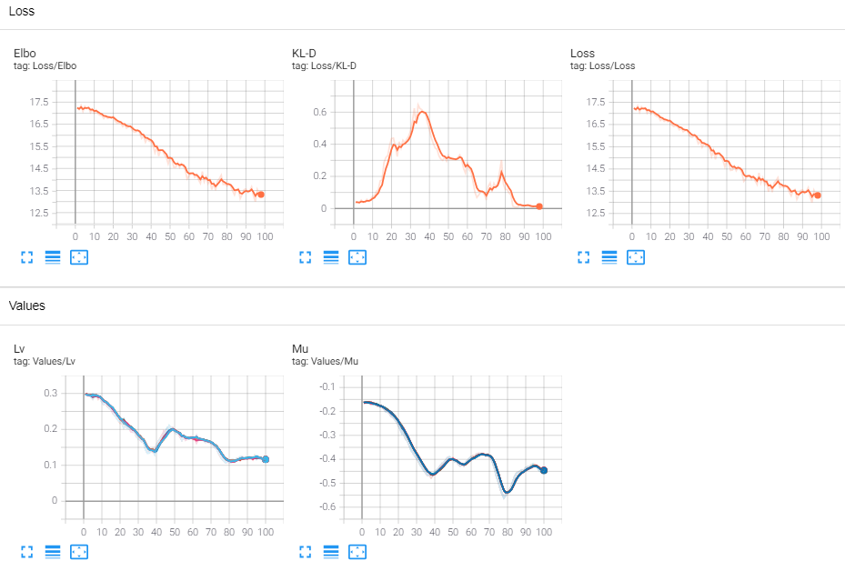
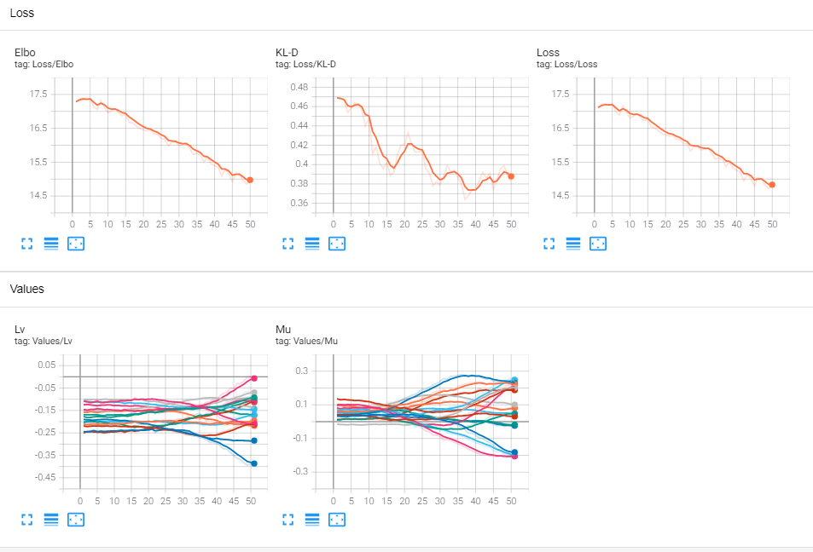
X Dim=1024
X Dim=1024
Z Dim=16
Z Dim=17

Slide 18
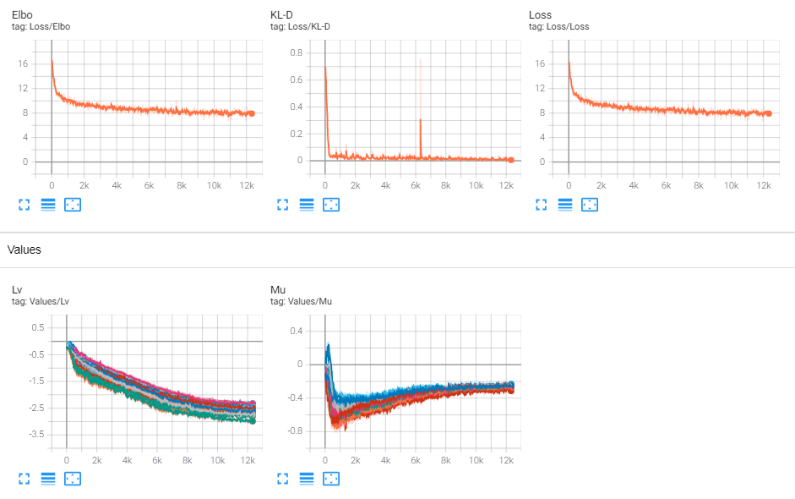
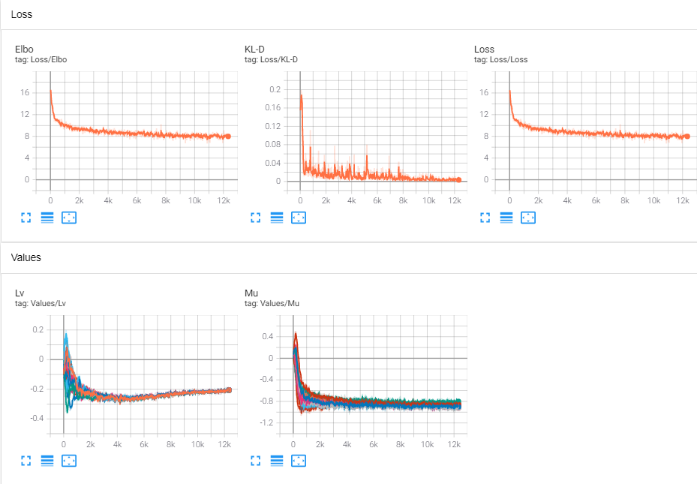
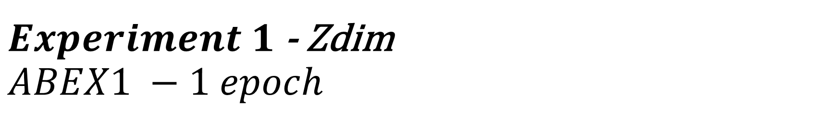
$Experiment 1$ - Zdim $ABEX1 −1 epoch$
$$Z Dim=25, alpha=1$$ | $$Z Dim=125, alpha=1$$

Slide 19
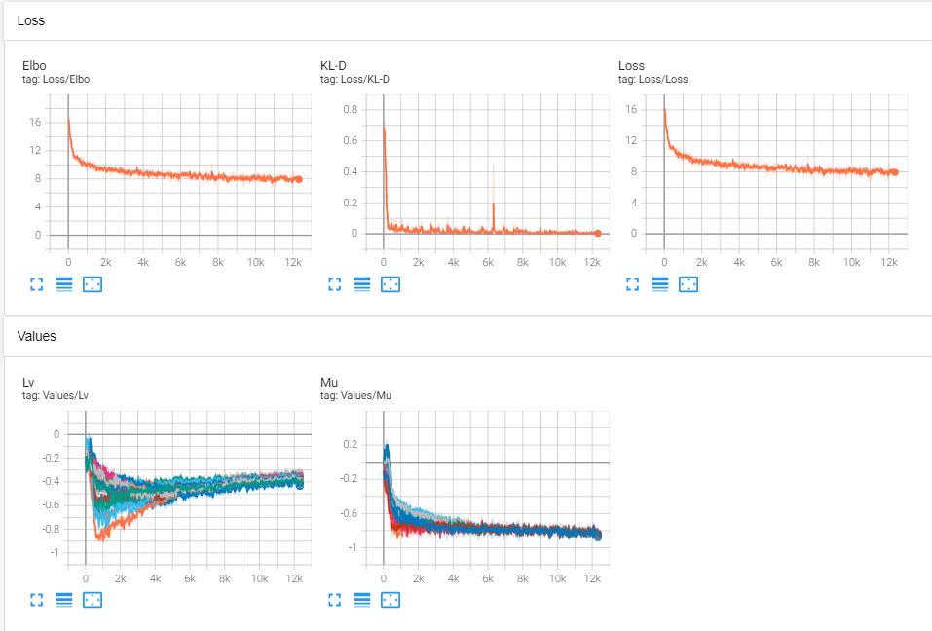
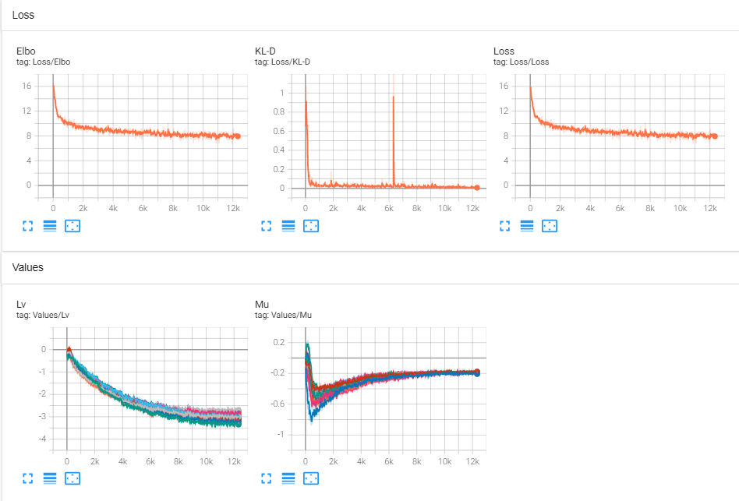
$Experiment 1$ - Zdim $ABEX1 −1 epoch$
$$Z Dim=25, alpha=1$$ | $$Z Dim=25, alpha=0.8$$ | $$Z Dim=25, alpha=0.2$$

Slide 20
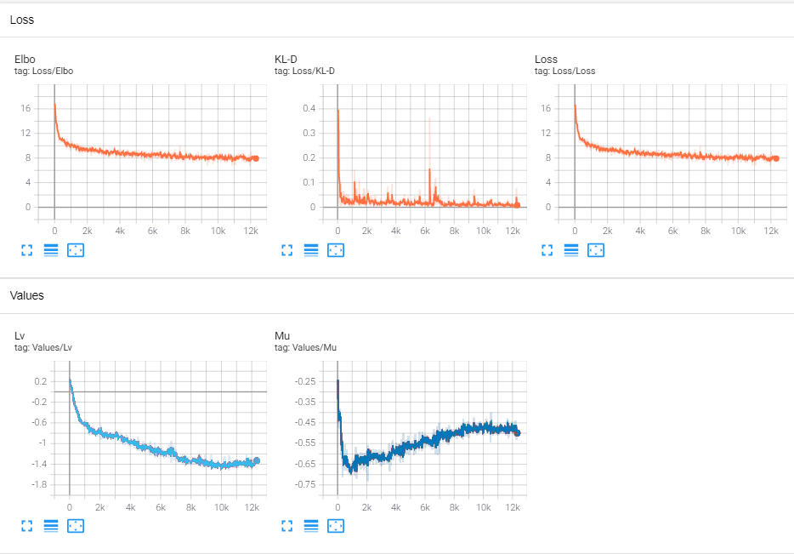
$Experiment 1$ - Zdim $ABEX1 −1 epoch$
$$Z Dim=16, alpha=1$$ | $$Z Dim=25, alpha=1$$

Slide 21
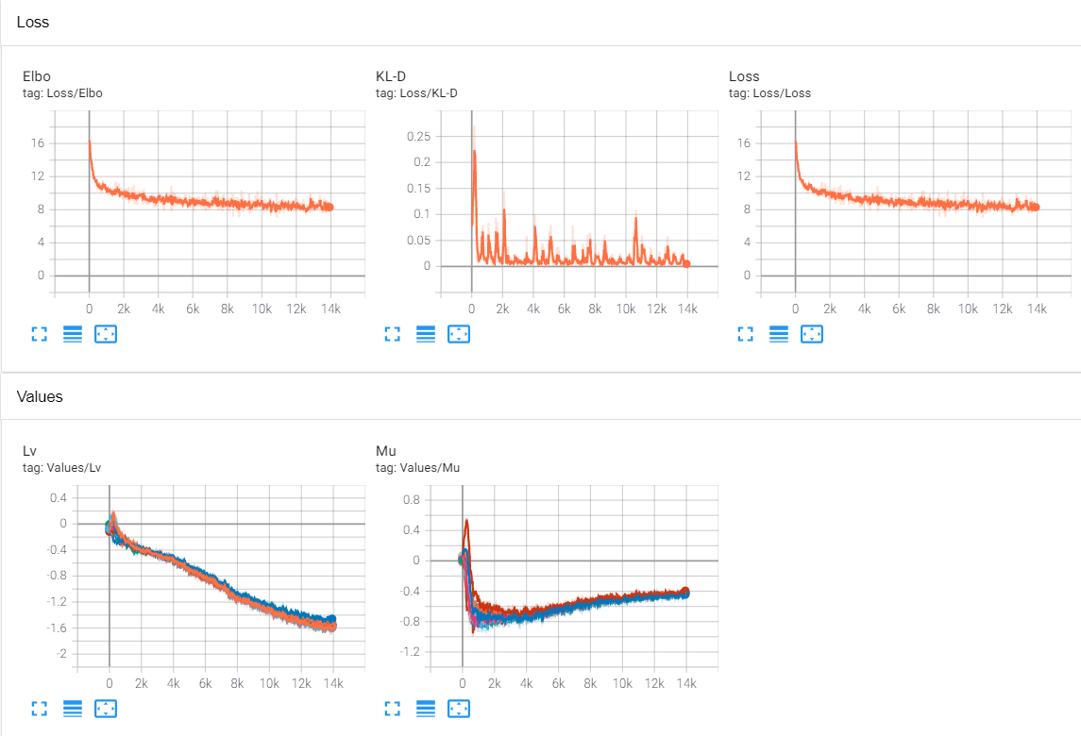
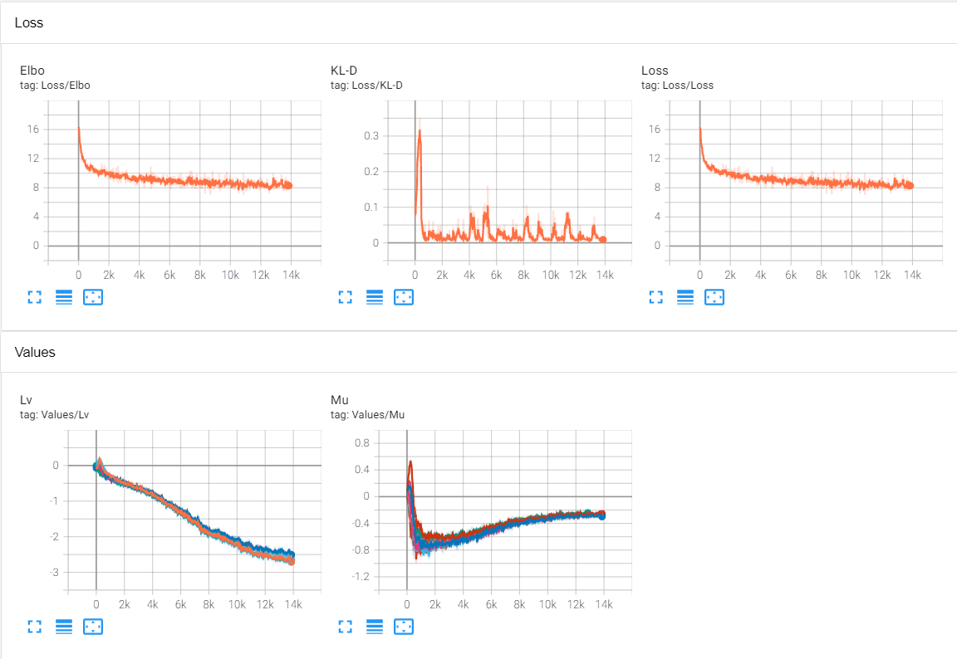
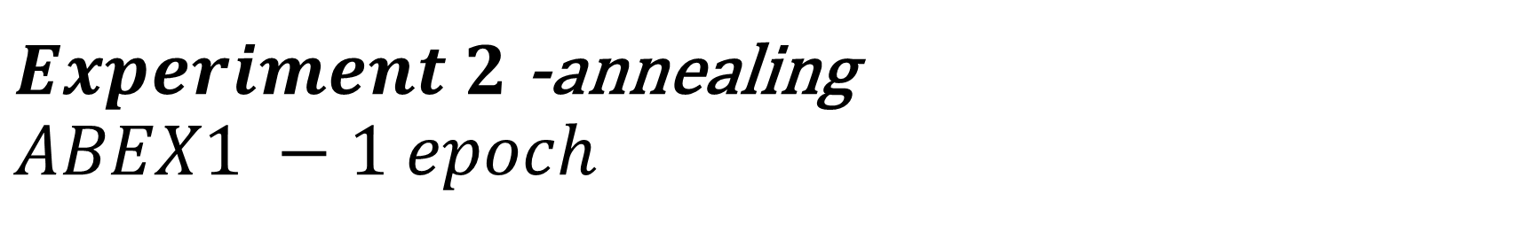
$Experiment 2$ -annealing $ABEX1 −1 epoch$
$$Z_{Dim}=125, α=0.8, P_{annealing}=500$$ | $$Z_{Dim}=125, α=0.8, P_{annealing}=1000$$

Slide 22
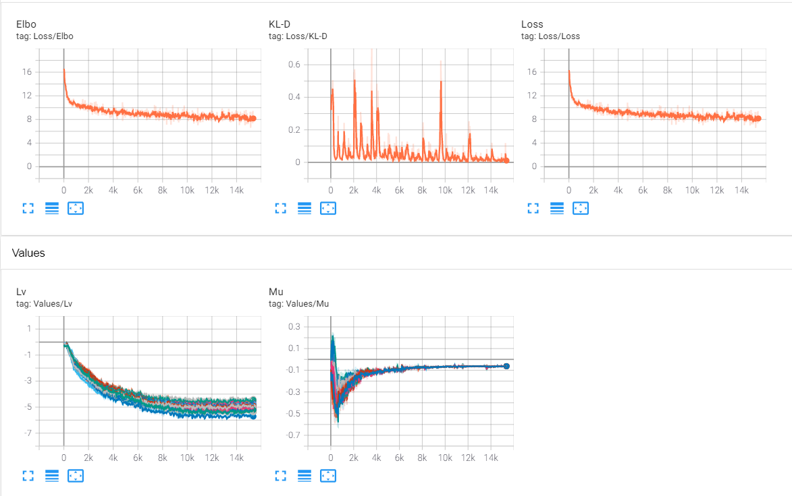
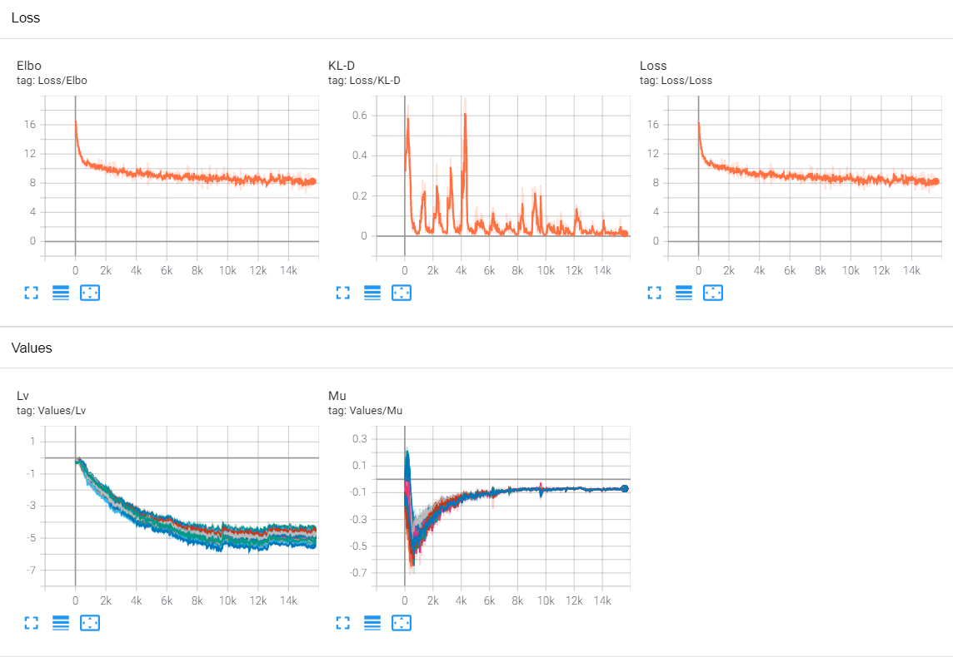
$Experiment 2$ -annealing $ABEX1 −1 epoch$
$$Z_{Dim}=25, α=0.8, P_{annealing}=500$$ | $$Z_{Dim}=25, α=0.8, P_{annealing}=1000$$

Slide 23
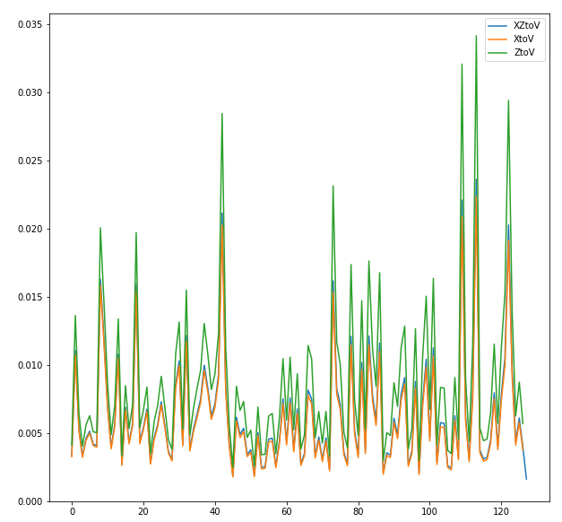
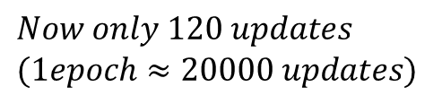
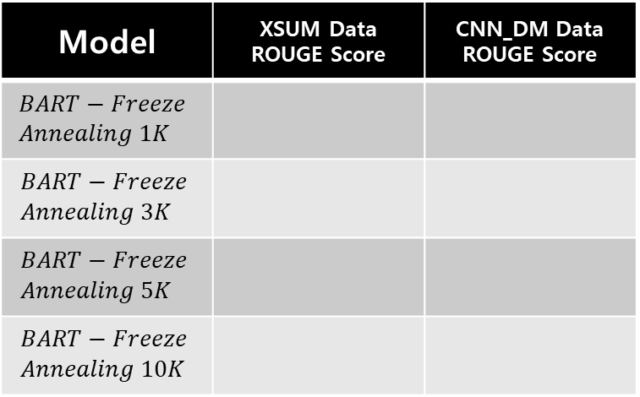



$$Next Work$$
$$1. Gradient Norm$$
$$2. ROUGE Score and Sampling$$
Model | XSUM Data ROUGE Score | CNN_DM Data ROUGE Score
$$BART−Freeze \\ Annealing 1K$$
$$BART−Freeze \\ Annealing 3K$$
$$BART−Freeze \\ Annealing 5K$$
$$BART−Freeze \\ Annealing 10K$$
$$Now only 120 updates \\ (1epoch≈20000 updates)$$

Slide 24




$$What is right gradient norm \\ for Linear Layer(D_{1} × D_{2})?$$
$$1. Gradient Norm :L2$$
2$. Gradient Norm absolute →mean$

