Slide 1
Presentation3
Bumjin Park

Slide 2
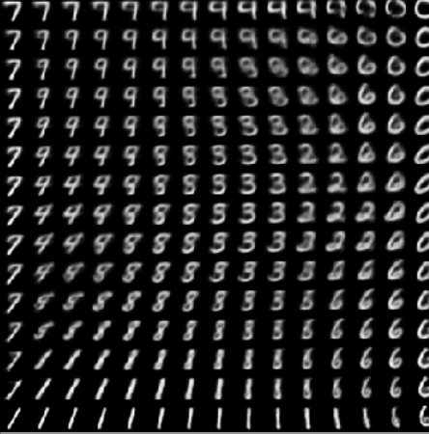
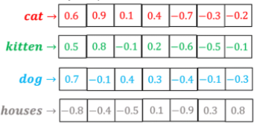
Problems
Sampling in NLP Space (Discrete)
Sampling in Vision Space (Continuous)
VS
X
X
S
X
S
What does the Sample mean?
Meaning(X, S) is close

Slide 3




Whoops!!
Output Probability
Softmax
Discrete Space
😧
Linear(ZtoV)
Linear(XtoV)
Continuous Space
$z_{x}$
$z_{y}$
🤨
🤨
Encoder
Decoder
Discrete Space
Input
Embedding
Output
Embedding
$$X$$
$Y\text{(}\text{shifted} \text{right}\text{)}$

Slide 4
Discrete vs Continuous in the Transformer
Output Probability
Discrete
Embedded Token
Encoder Features
Decoder Feature
Last Linear Layer
Softmax
Linear
Add & Norm
Feed Forward
Add & Norm
Add & Norm
Feed Forward
Multi-Head Attention
Continuous
Positional Encoding
Attention matrix
Add & Norm
Add & Norm
Multi-Head Attention
Masked Multi-Head Attention
Positional Encoding
Positional Encoding
+
+
Input
Embedding
Output
Embedding
Inputs
Outputs (shifted right)

