Slide 1
Output Probability
Softmax
Linear
Add & Norm
Feed Forward
Add & Norm
Add & Norm
Feed Forward
Multi-Head Attention
Add & Norm
Add & Norm
Multi-Head Attention
Masked Multi-Head Attention
Positional Encoding
Positional Encoding
+
+
Input
Embedding
Output
Embedding
Inputs
Outputs (shifted right)

Slide 2








Output Probability
Softmax
Linear
$$D_{KL}(q(z|x)||q\left(z | x,y\right))$$
Add & Norm
$$D_{KL}(p(z)||q\left(z | x\right))$$
Feed Forward
$q(z|x)$
Add & Norm
Multi-Head Attention
$p(z)$
$q(z|x,y)$
Add & Norm
Encoder
Encoder
Masked Multi-Head Attention
Input
Embedding
Input
Embedding
Output
Embedding
$$X$$
$Y\text{(}\text{shifted} \text{right}\text{)}$
$Y\text{(}\text{shifted} \text{right}\text{)}$

Slide 3
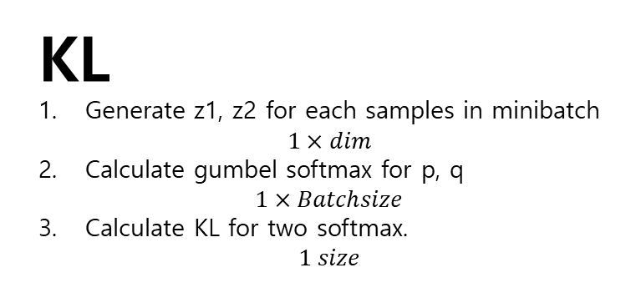





Output Probability
KL
Generate z1, z2 for each samples in minibatch $1×dim$
Calculate gumbel softmax for p, q $1×Batchsize$
Calculate KL for two softmax. $1 size$
Softmax
$KL$
Linear
Add & Norm
Feed Forward
$q(z|y)$
$p(z|x)$
Add & Norm
Generate Z1, Z2
q(z|y) -> mean the matrix dim=1(tok)… haha
p(x|y) -> mean the matrix dim=1(tok)… haha
Multi-Head Attention
Add & Norm
Encoder
Encoder
Masked Multi-Head Attention
+ Annealing We don’t optimize it in the early stage
+
Input
Embedding
Input
Embedding
Output
Embedding
$Y\text{(}\text{shifted} \text{right}\text{)}$
$$X$$
$Y\text{(}\text{shifted} \text{right}\text{)}$

Slide 4


Output Probability
Softmax
Linear
Add & Norm
Feed Forward
Add & Norm
$$con$$
Multi-Head Attention
Add & Norm
Encoder
Encoder
Masked Multi-Head Attention
Input
Embedding
Input
Embedding
Output
Embedding
$$X$$
$X; Y\text{(}\text{shifted} \text{right}\text{)}$
$Y\text{(}\text{shifted} \text{right}\text{)}$

Slide 5
Output Probability
Softmax
Linear
Add & Norm
Feed Forward
Add & Norm
$$con$$
Multi-Head Attention
Add & Norm
Encoder
Encoder
Masked Multi-Head Attention
Input
Embedding
Input
Embedding
Output
Embedding
$$X$$
$X; Y\text{(}\text{shifted} \text{right}\text{)}$
$Y\text{(}\text{shifted} \text{right}\text{)}$

Slide 6





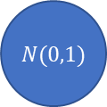




BroadCasting
$$S$$
$$D×dim$$
$$D×dim$$
$$X$$
Encoder
Decoder
$$X$$
+
$$Z$$
$$D×dim$$
$$1×dim$$
$$D$$
$N(0,1)$

Slide 7






$N(0,1)$
$$1×dim$$
$$Z$$
$$S×dim$$
$$D×dim$$
Encoder
$$X$$
Decoder
$$D×dim$$
$$D$$

Slide 8

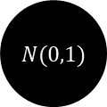








$N(0,1)$
$$S$$
$$Z$$
$Encoder$
$$1×dim$$
$$Z$$
$$X$$
$$1×dim$$
$$D×dim$$
$Decoder$
$$X$$
$$D×dim$$
$$D$$

Slide 9


$$S$$
Encoder
Decoder
Hello you like me
$$D$$
Hello I like you

