Slide 1

THE MIKAELSON ACADEMY
FARHAN ANSARI
HARSH MAKHWANA
RAHUL KULKARNI
REHAN PATHAN

Slide 2
CONTENT
Introduction
Modules
Diagram
Screenshots

Slide 3
INTRODUCTION
This project “Student Management System” provides us a simple interface for maintenance of student information. It can be used by educational institutes or colleges to maintain the records of students easily.
Achieving this objective is difficult using a manual system as the information is scattered, can be redundant and collecting relevant information may be very time consuming. All these problems are solved using this project.
Throughout the project the focus has been on presenting information in an easy and intelligible manner.

Slide 4
MODULS
There are mainly 3 modules in this software
ADMIN MODULE
STUDENT MODULE
TEACHER MODULE
the Software we can register as a user and user has of two types, student and administrator . Administrator has the power to add new user and can edit and delete a user. A student can register as user and can add edit and delete his profile. The administrator can add edit and delete marks for the student.
All the users can see the marks.

Slide 5
DIGRAMS

Slide 6
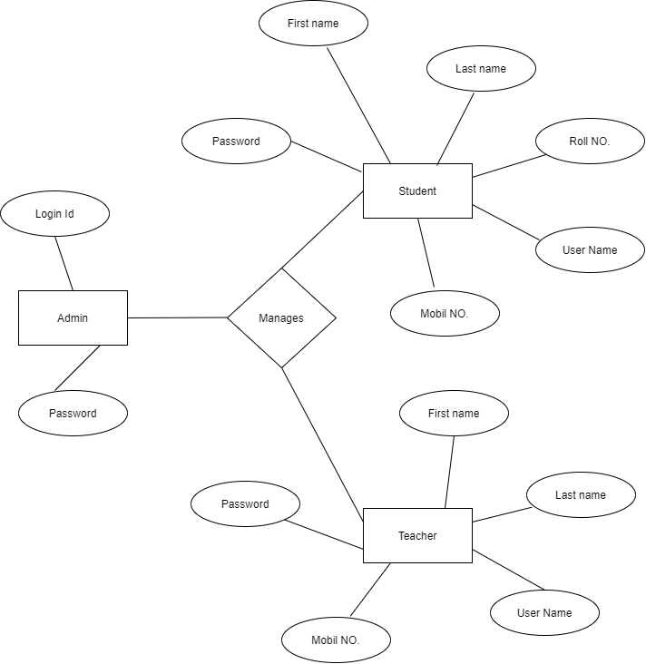
E-R DIAGRAM

Slide 7
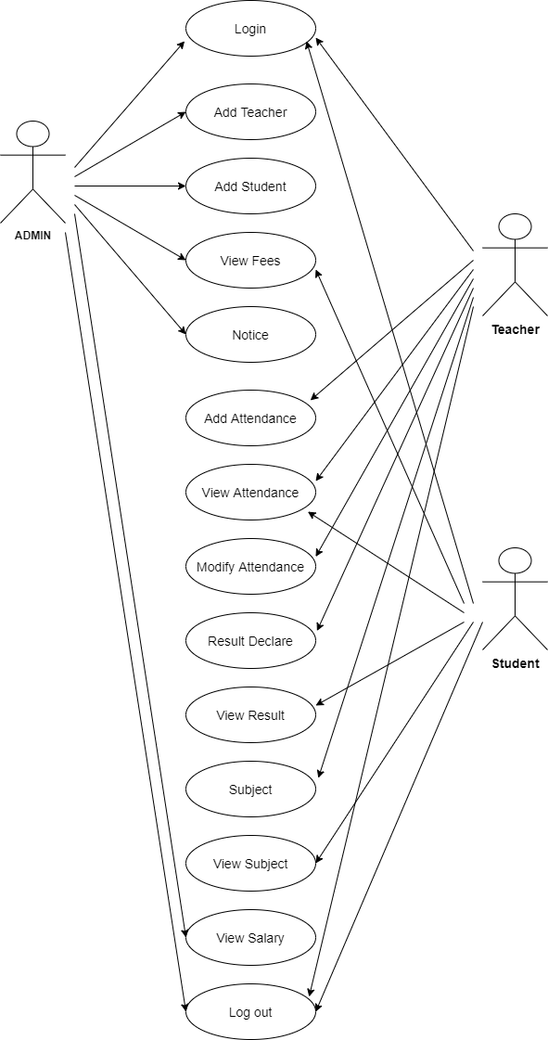
USECASE DIAGRAM

Slide 8
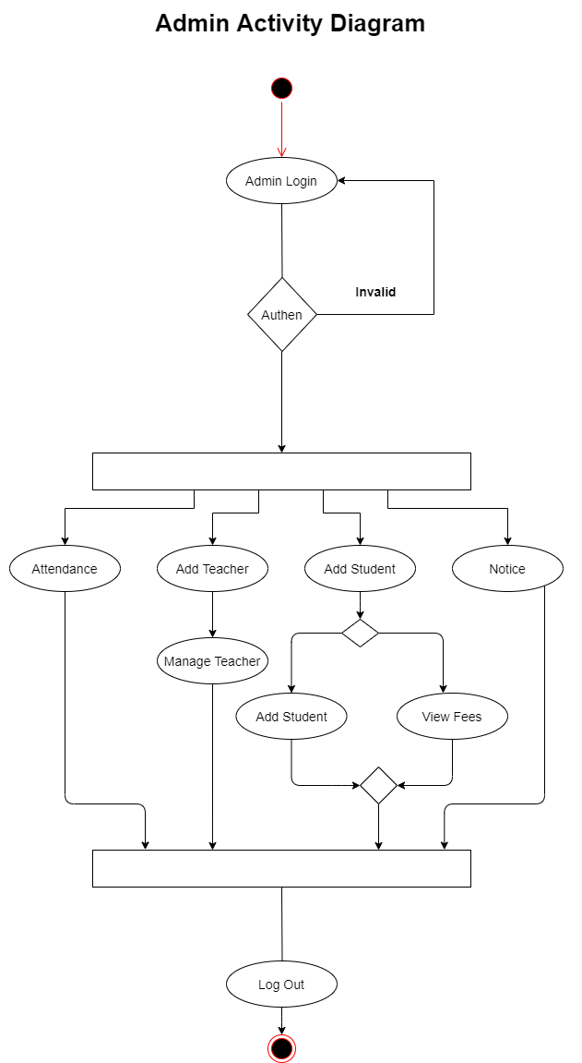

Slide 9
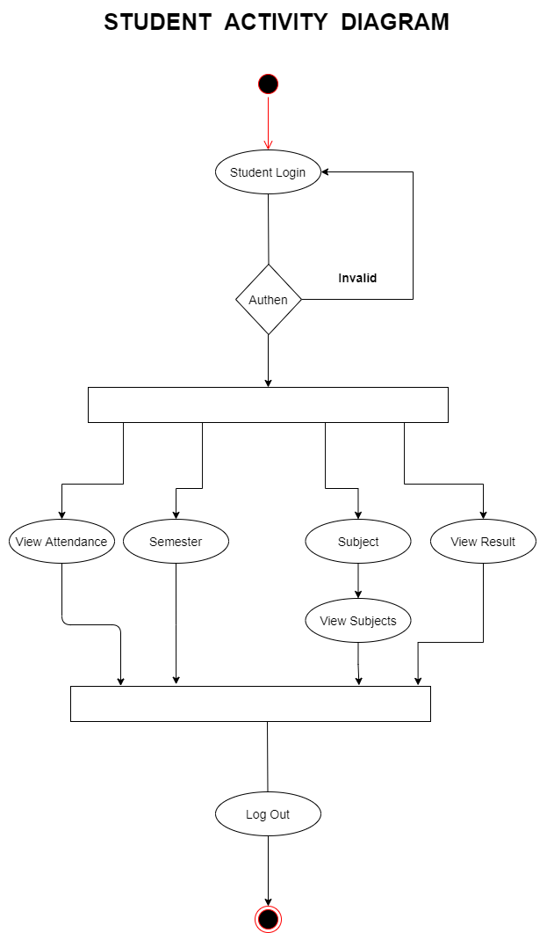

Slide 10
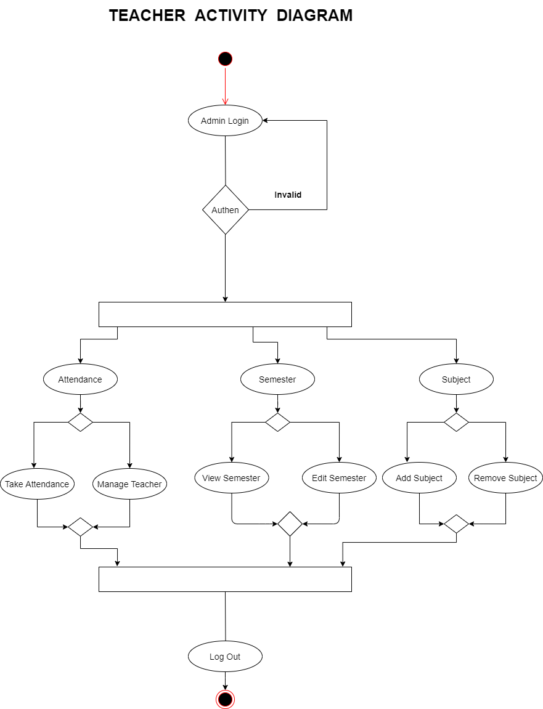

Slide 11
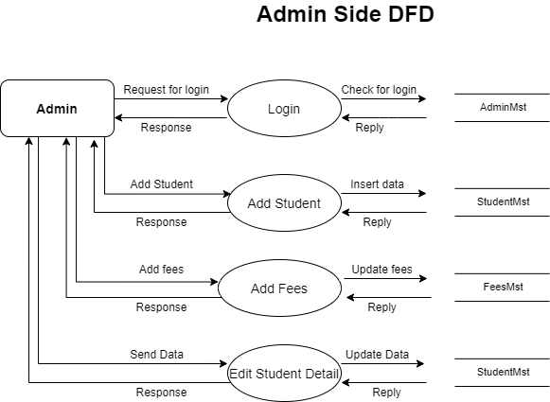

Slide 12
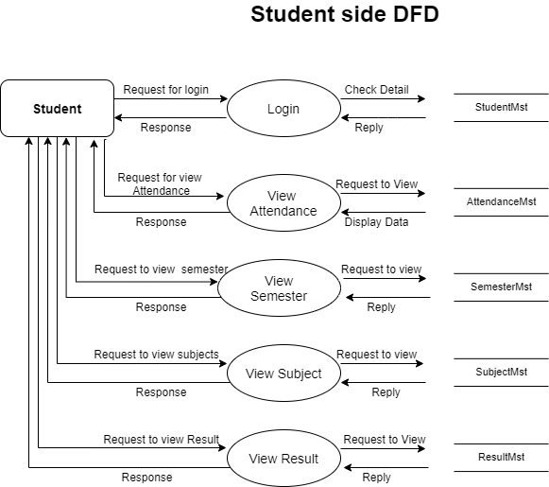

Slide 13


Slide 14
SCREENSHOTS

Slide 15

HOME PAGE

Slide 16
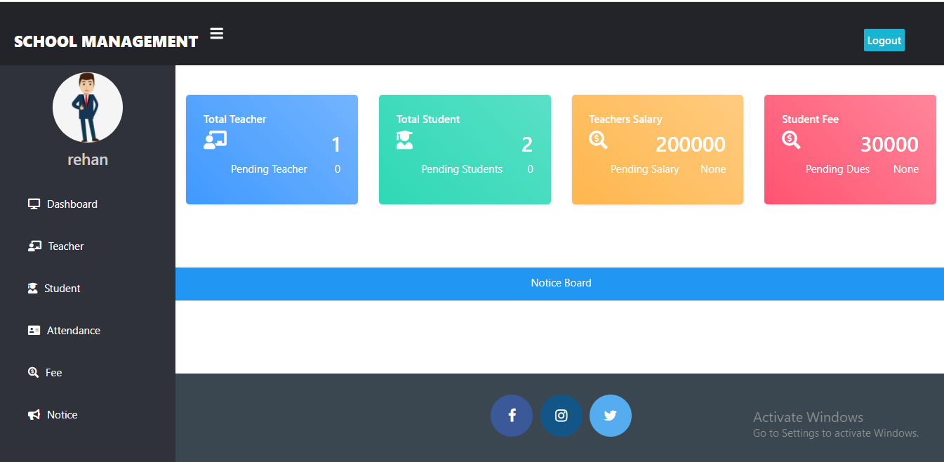
ADMIN DASHBOARD

Slide 17
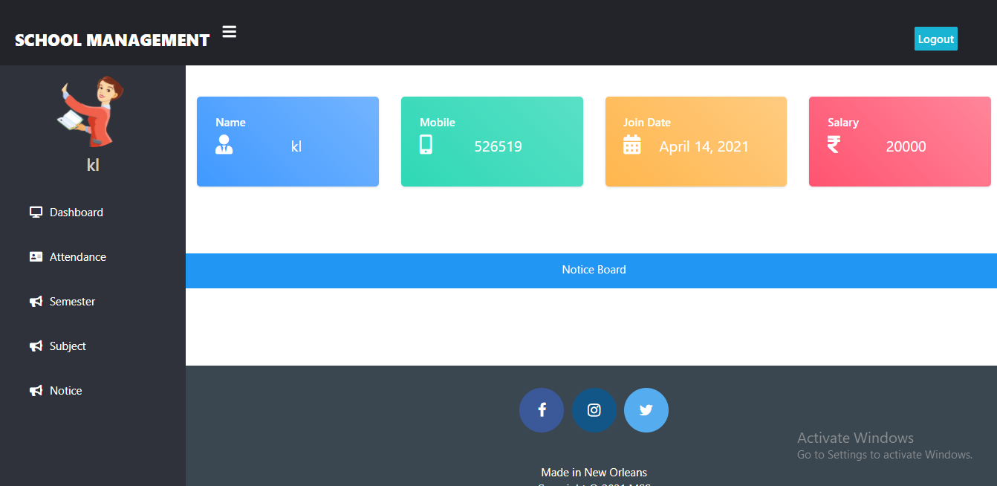
TEACHER DASHBOARD

Slide 18
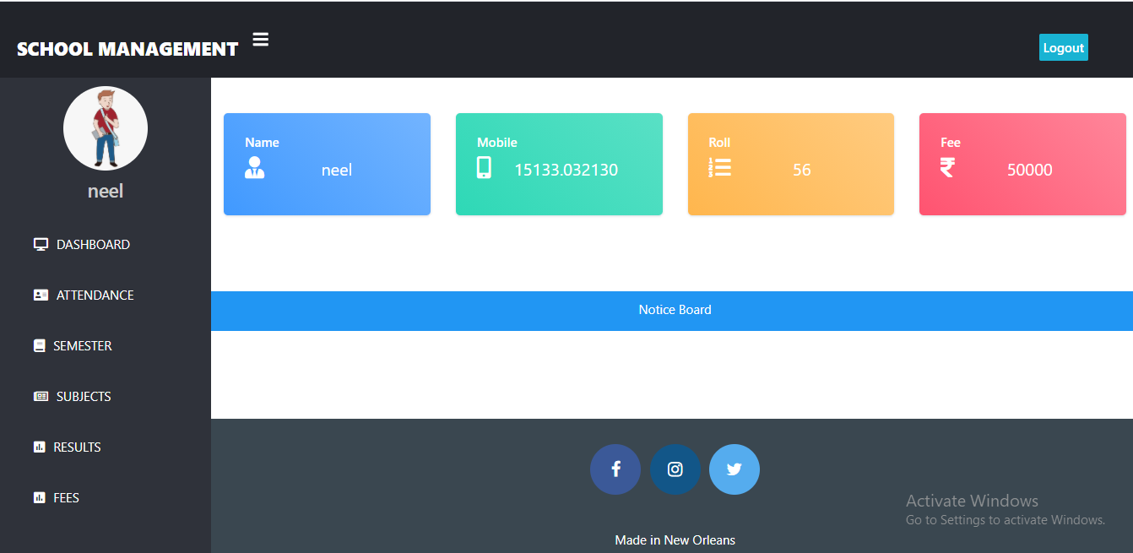
STUDENT DASHBOARD

Slide 19
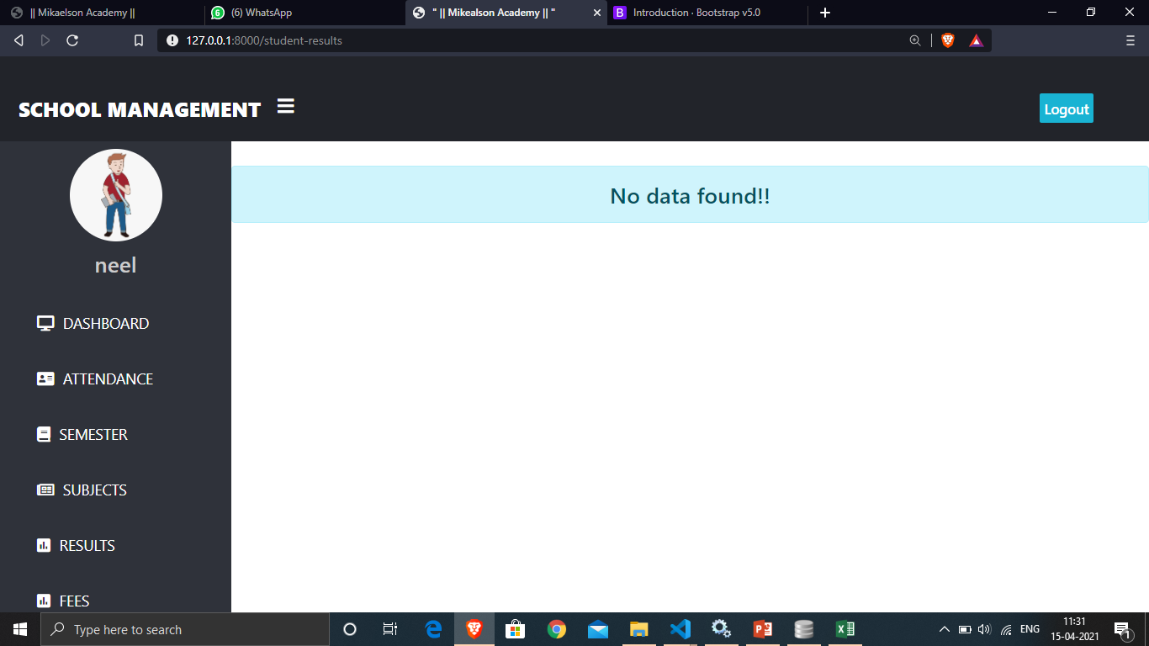
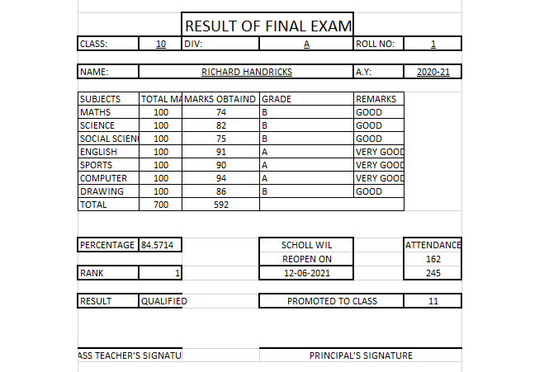
MARKSHEET

Slide 20
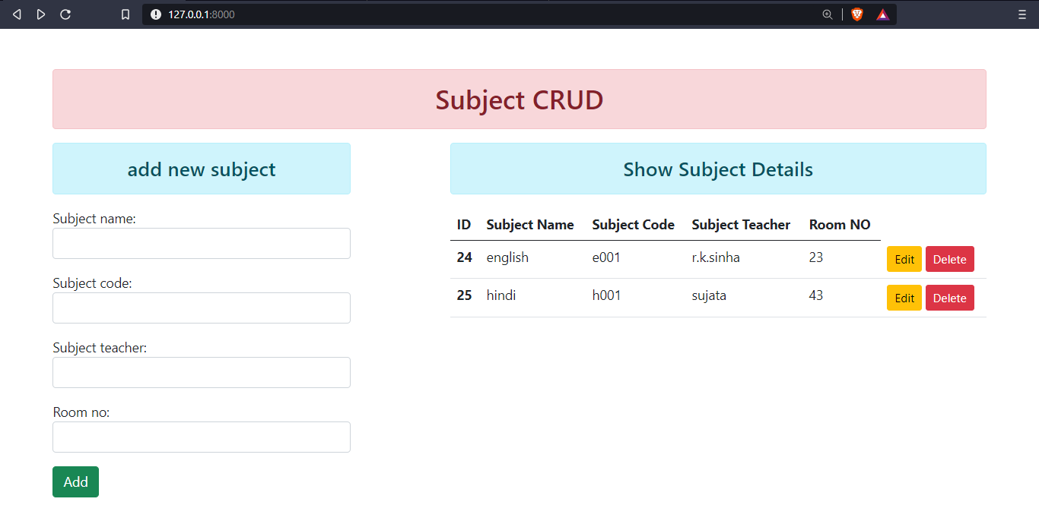

Slide 21
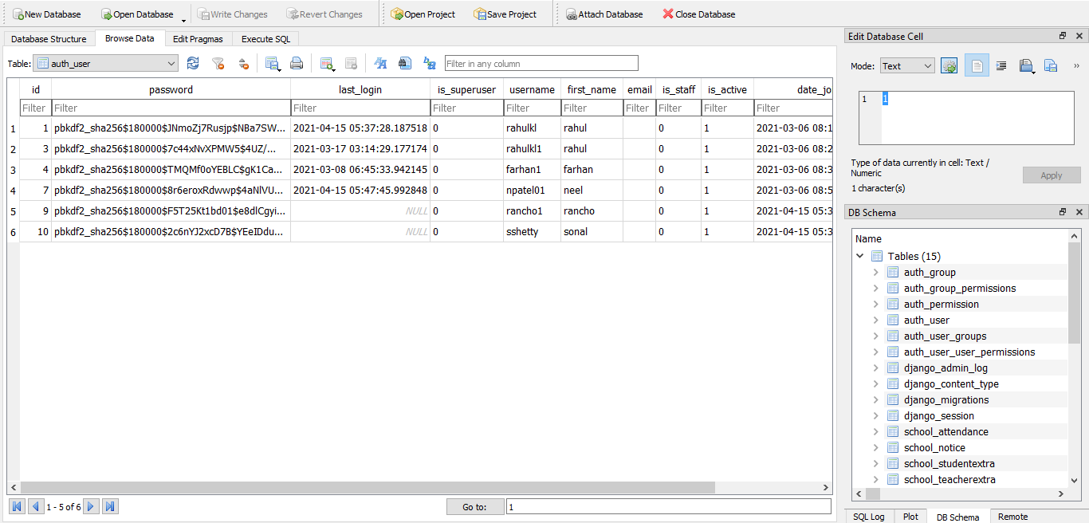

Slide 22
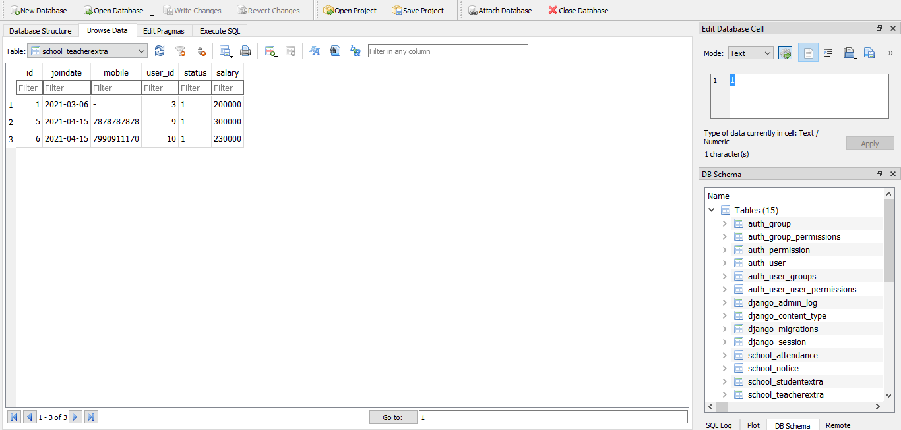

Slide 23
THANK YOU

