Slide 1

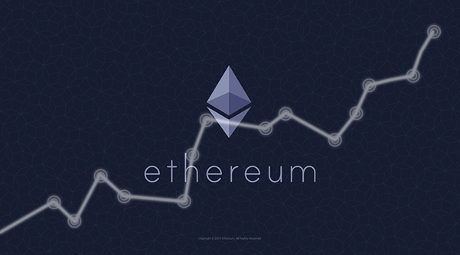
RAHUL KULKARNI

Slide 2
WHAT IS ETHEREUM?
Ethereum is a decentralized, open-source blockchain with smart contract functionality. Ether is the native cryptocurrency of the platform.
Ethereum is a technology that lets you send cryptocurrency to anyone for a small fee. It also powers applications that everyone can use and no one can take down.
Ethereum is open access to digital money and data-friendly services for everyone – no matter your background or location. It's a community-built technology behind the cryptocurrency ether (ETH) and thousands of applications you can use today.
This means Ethereum is for more than payments. It's a marketplace of financial services, games and apps that can't steal your data or censor you.

Slide 3
HISTORY OF ETHEREUM
Original author(s) | Vitalik Buterin Gavin Wood
Developer(s) | Ethereum Foundation, Hyperledger, Nethermind, OpenEthereum, EthereumJS
Initial release | 30 July 2015; 5 years ago
Stable release | Muir Glacier / 1 January 2020; 15 months ago
Development status | Active
Written in | Go, Rust, C#, C++, Java, Python
Size | 300 GB (2020-03)
Type | Distributed computing
License | Open-source licenses
Active hosts | 10,335 (2021-01)
Ethereum was proposed in 2013 by programmer Vitalik Buterin. Development was crowdfunded in 2014, and the network went live on 30 July 2015, with an initial supply of 72 million coins.

Slide 4

Ethereum industrial use cases
LAW
BANKING
ENERGY
REAL ESTATE
IDENTITY
OIL AND GAS
INSURANCE
SUPPLY CHAIN

Slide 5
ADVANTAGES OF ETHEREUM
Banking for everyone
A more private internet
A peer-to-peer network
Censorship-resistant
Commerce guarantees
Compatibility for the win

Slide 6
PLATFORMS WHICH ACCEPTS THE etH
GamerAll
CryptoKitties
Crypto-Games
My Crypto Heroes
0xUniverse
Instant Gaming
Everdragons
MMOGA.com
Airstream Jets

Slide 7
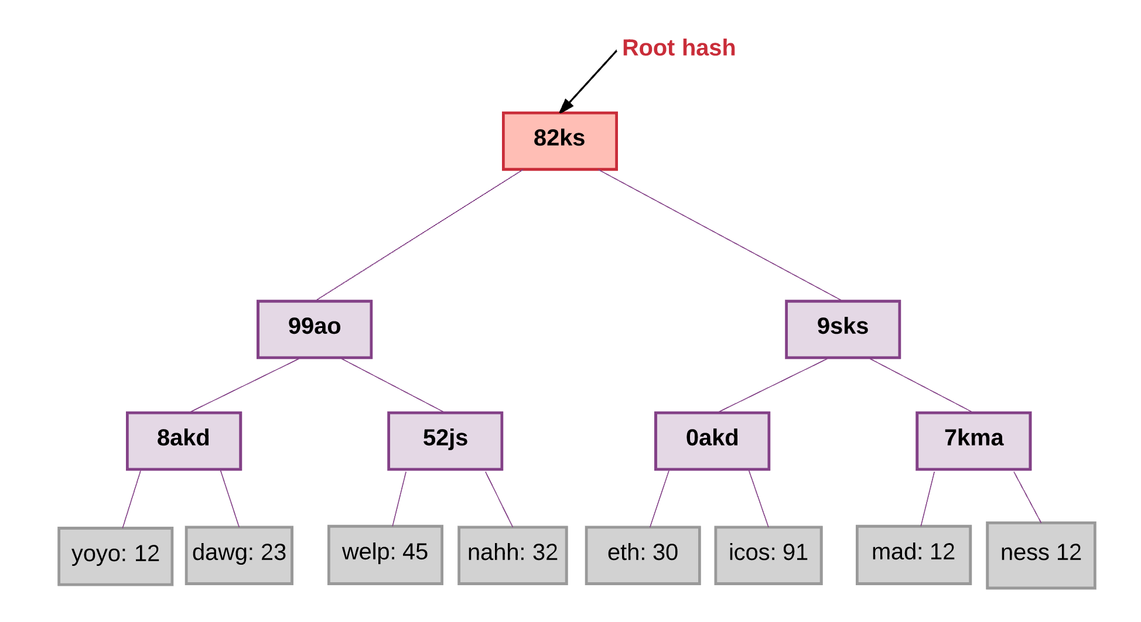
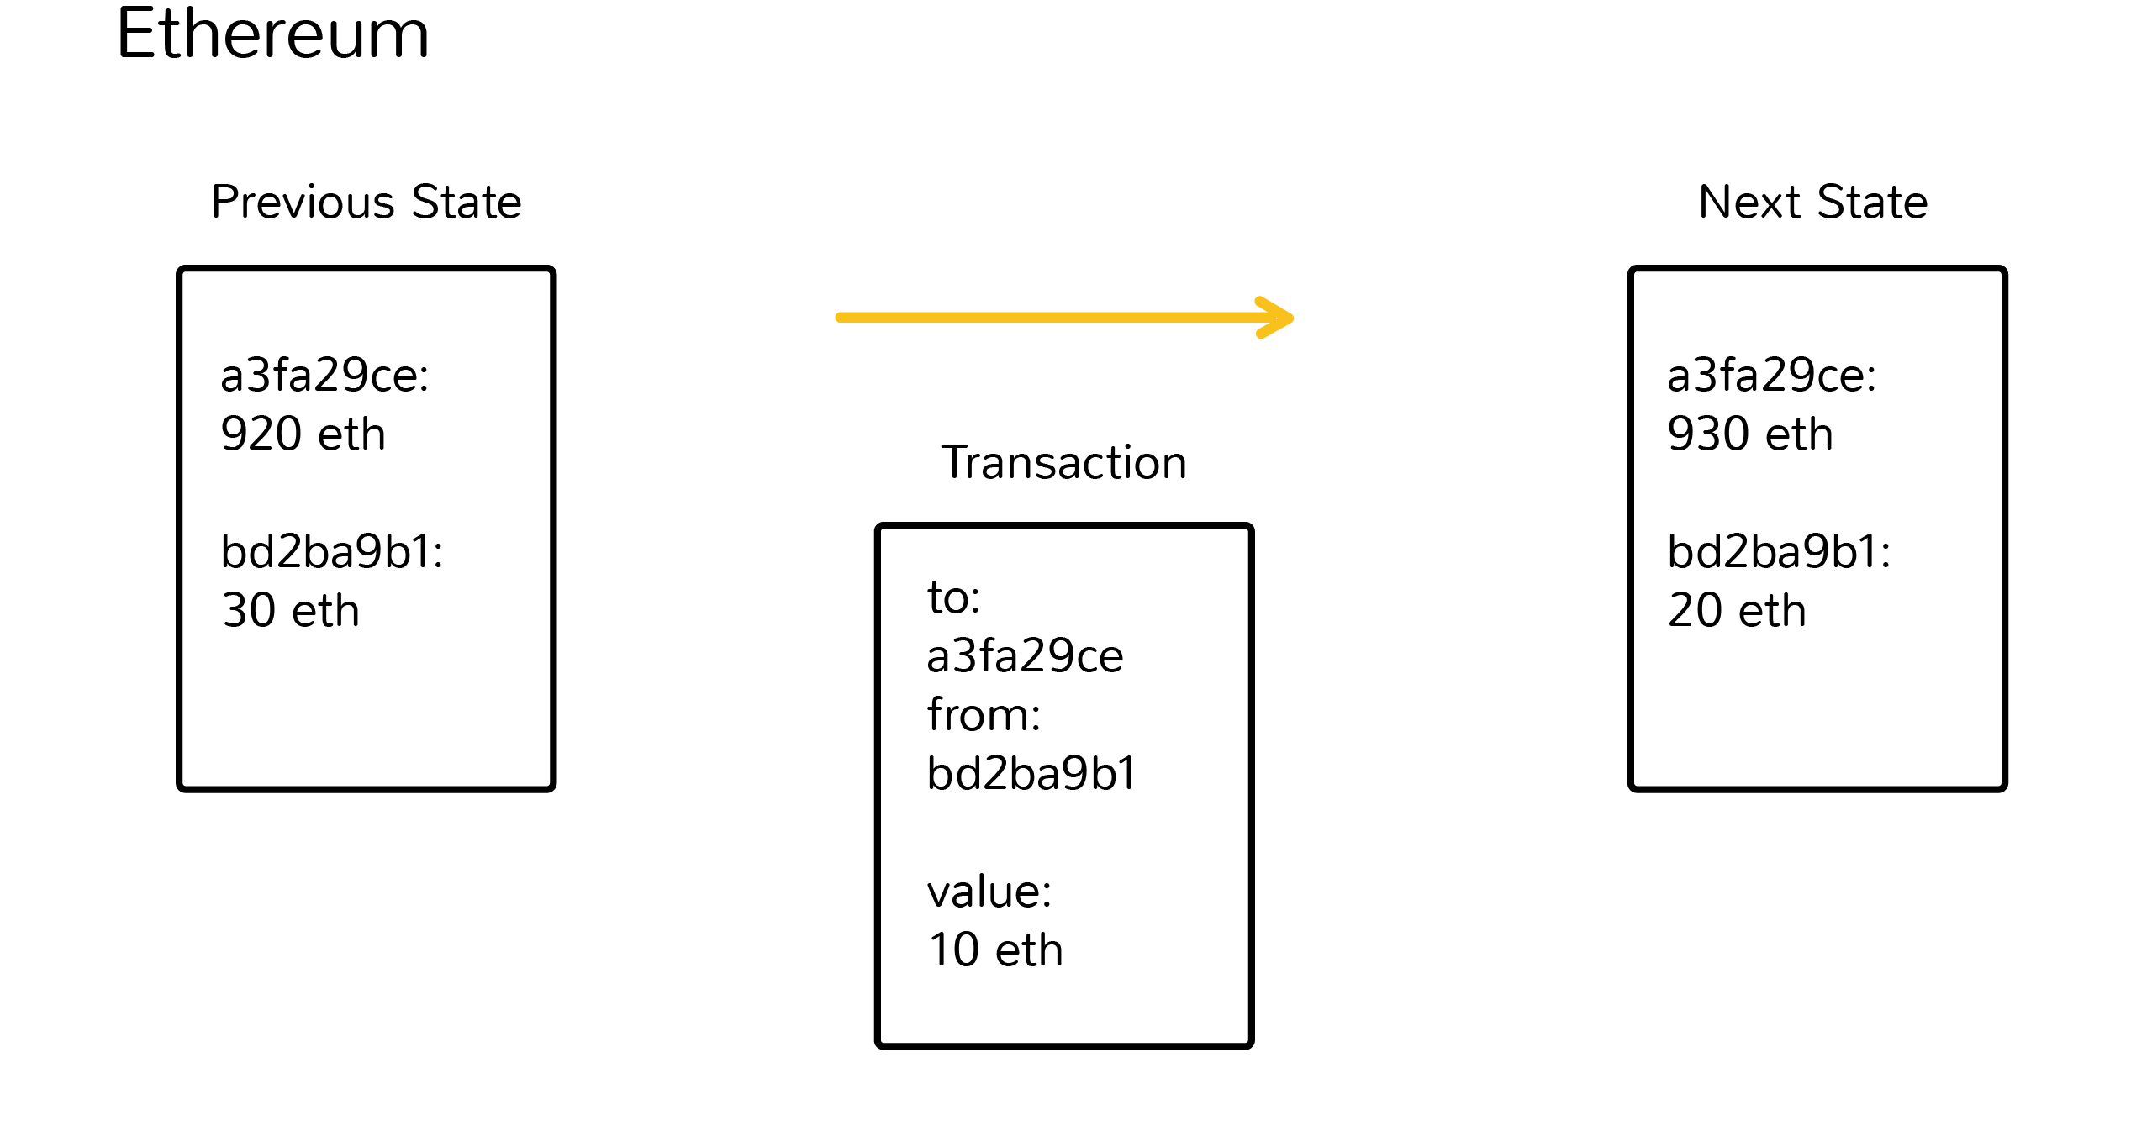

Slide 8
HOW DOES ETHEREUM MAKE MONEY?
The most popular way to earn money from Ethereum is through long-term investing. Long-term investing is similar to trading — you'll watch the market and convert fiat currency into Ether when you believe the cryptocurrency's token is undervalued.
The price of 1 ETH is 2107.50 $ (1,54,665.21 Indian Rupee)

Slide 9
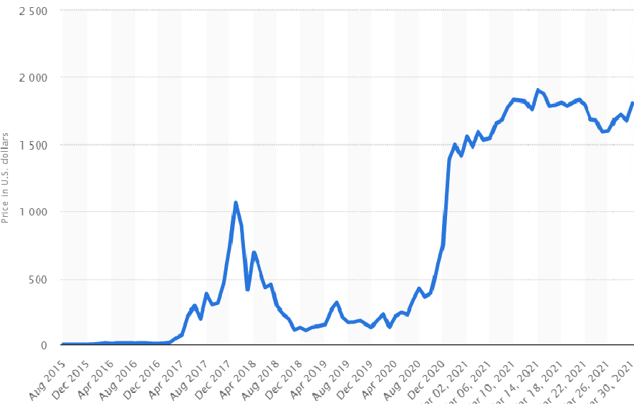
Daily Ethereum value from August 2015 to March 30, 2021 in U.S. dollars

Slide 10
WHERE TO BUY ETHEREUM?
There are a few options when it comes to cryptocurrencies with some of the top platforms including: Coinbase, Kraken, Bitstamp, Gemini, Binance, and Bitfinex. All of these exchanges offer ethereum.

Slide 11
THANK YOU

