Slide 1
STUDENT MANAGEMANT SYSTEM
TEAM MEMBERS
FARHAN ANSARI
REHAN PATHAN
RAHUL KULKARNI
HARSH MAKHWANA

Slide 2
INTRODUCTION
This project “Student Management System” provides us a simple interface for maintenance of student information. It can be used by educational institutes or colleges to maintain the records of students easily.
Achieving this objective is difficult using a manual system as the information is scattered, can be redundant and collecting relevant information may be very time consuming. All these problems are solved using this project.
Throughout the project the focus has been on presenting information in an easy and intelligible manner.

Slide 3
MODULES
There are mainly 3 modules in this software
ADMIN MODULE
STUDENT MODULE
TEACHER MODULE
the Software we can register as a user and user has of two types, student and administrator . Administrator has the power to add new user and can edit and delete a user. A student can register as user and can add edit and delete his profile. The administrator can add edit and delete marks for the student.
All the users can see the marks.

Slide 4
Technologies USED IN PROJECT
• PYTHON + DJANGO (frame-work)
• MYSQL (database)
• JAVASCRIPT (behaviour)
• HTML (structure of information)
• CSS (styling)

Slide 5
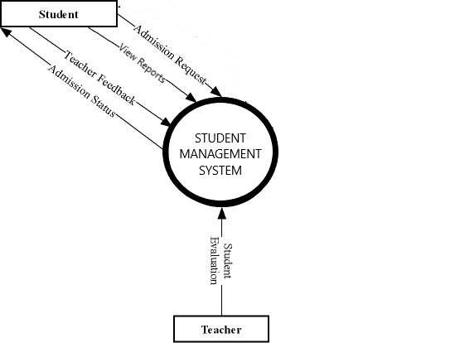
DATA FLOW DIAGRAM

Slide 6
CASE MODEL

Slide 7
Entity Relationship Diagram

Slide 8
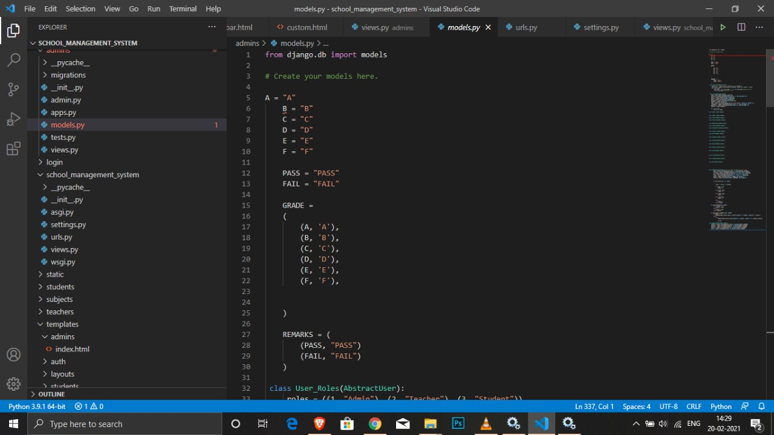
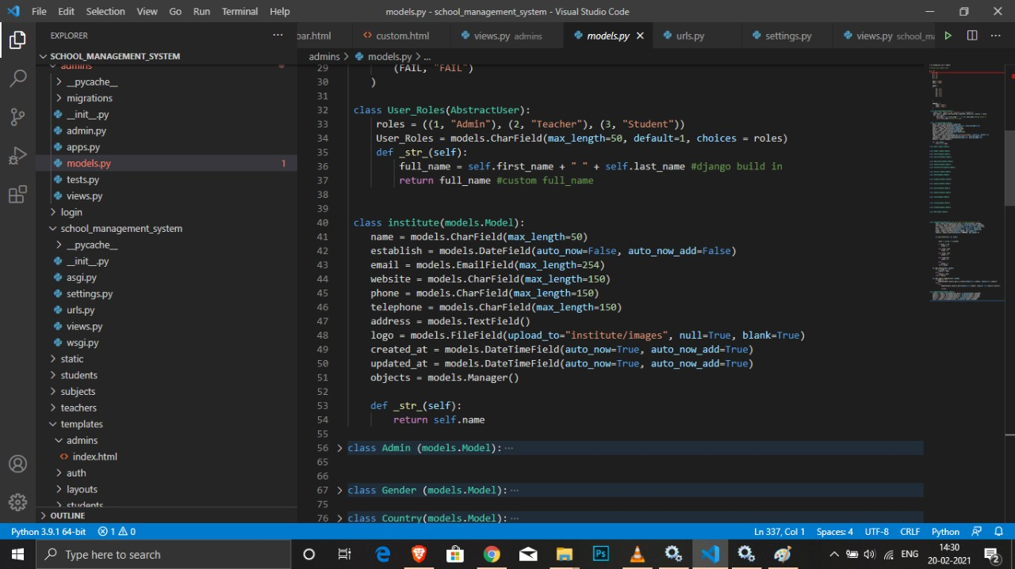
WORK IN IMPLEMANTATION

Slide 9
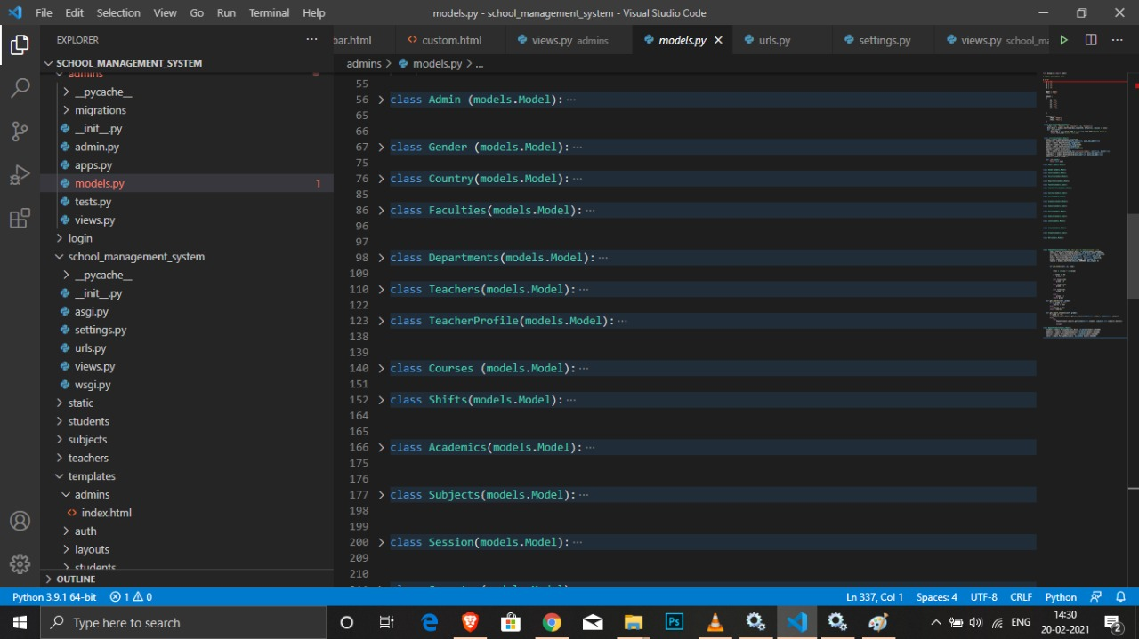
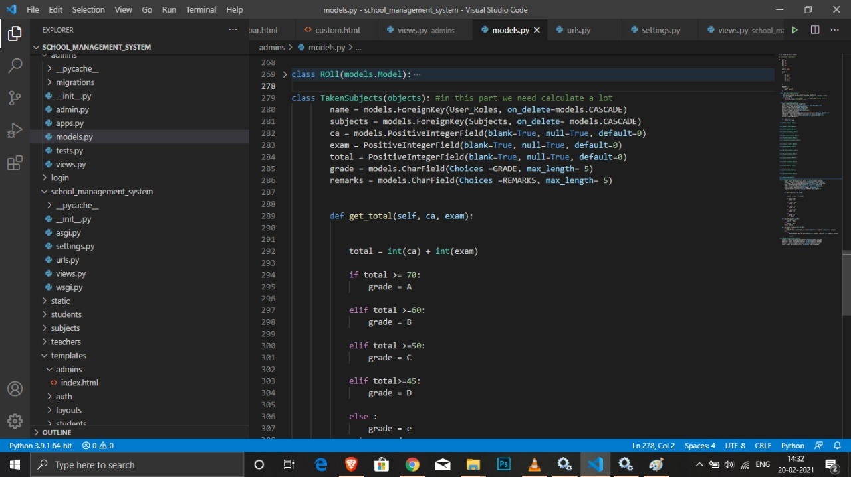

Slide 10
THANK YOU

