Slide 1
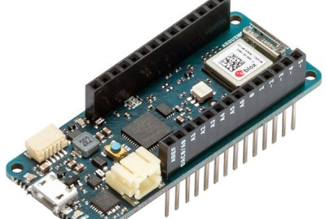

Introduction to Arduino
This Photo by Unknown Author is licensed under CC BY-SA-NC
This Photo by Unknown Author is licensed under CC BY

Slide 2
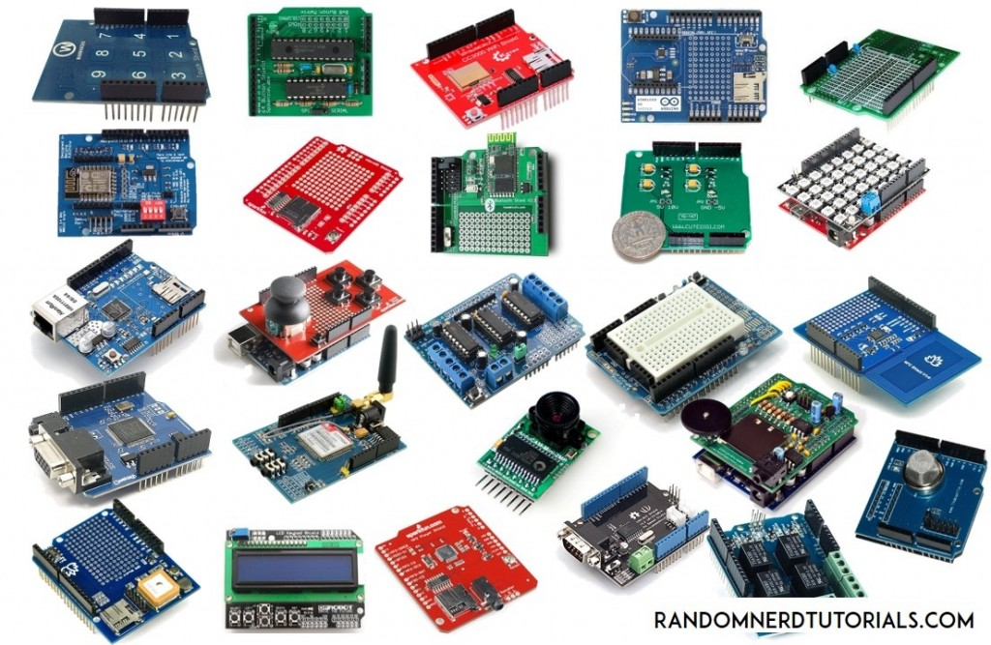
What’s an Arduino
Open-source electronics platform.
Based on easy-to-use hardware and software.
Designed for makers, hobbyists, and educators.
This Photo by Unknown Author is licensed under CC BY-SA

Slide 3
Why Arduino
Versatility: Suitable for various applications, from simple to complex.
Community: Large supportive community, countless tutorials, and resources.
Affordability: Budget-friendly for both beginners and experts.

Slide 4
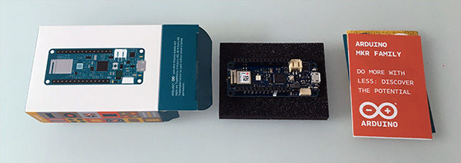
Arduino MKR WiFi 1010
Compact form factor designed for IoT projects.
Integrated WiFi & Bluetooth connectivity.
Based on the SAMD21 Cortex-M0+ 32bit low power ARM MCU.
This Photo by Unknown Author is licensed under CC BY-SA-NC

Slide 5
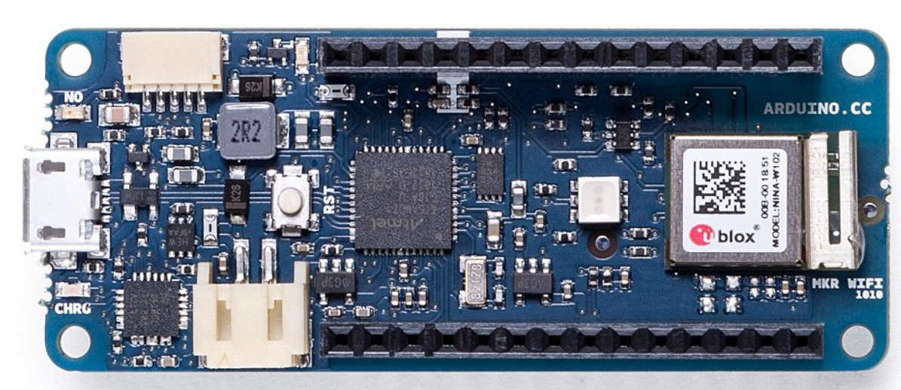
MKR WiFi 1010 Features
On-board IMU (Inertial Measurement Unit).
Secure ECC508 crypto chip for secure connection to Wi-Fi.
Battery operation with solar panel charging provision.

Slide 6
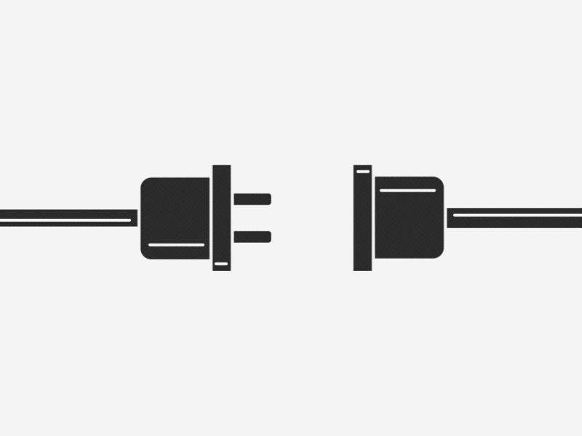
Getting Started with Arduino
Download and install the Arduino IDE.
Connect Arduino to PC via USB.
Select the correct board and port in the IDE.
Demo…

Slide 7
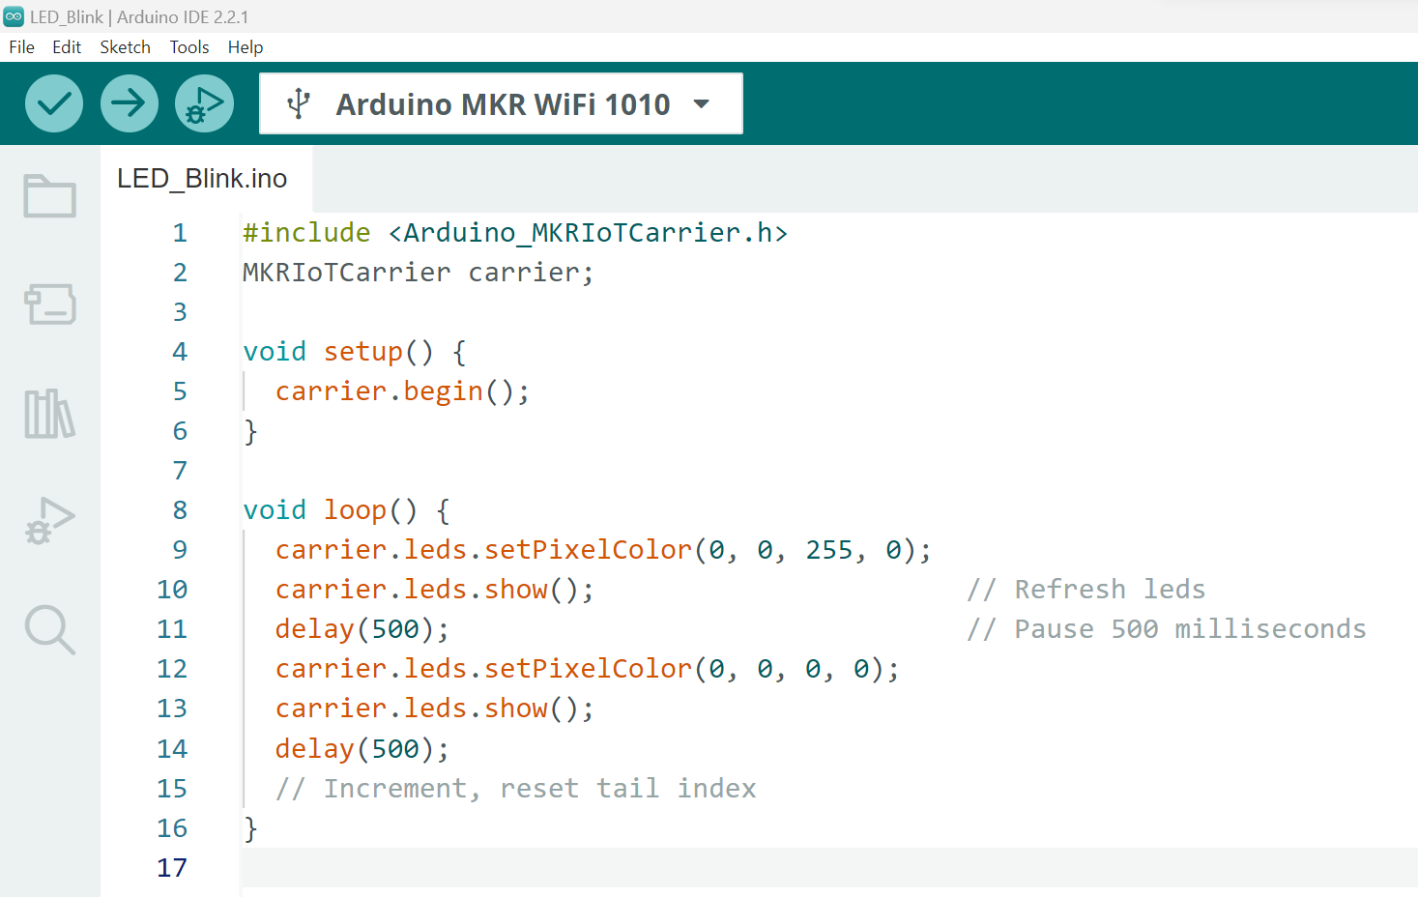
Hello World!
Create a new sketch in the Arduino IDE.
Write a simple program (e.g., Blink an LED).
Compile and upload to the board.

Slide 8
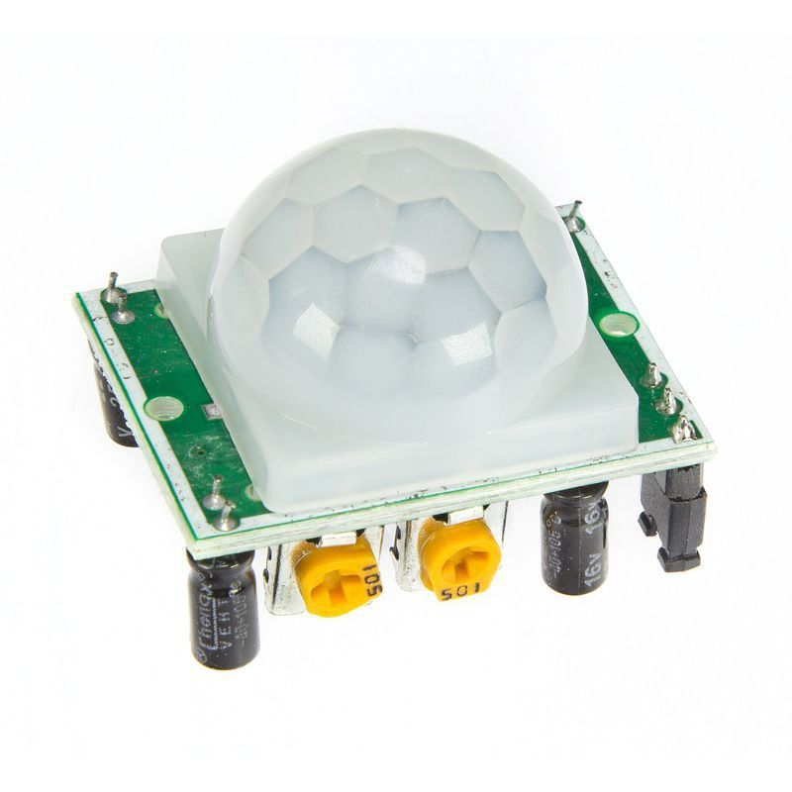
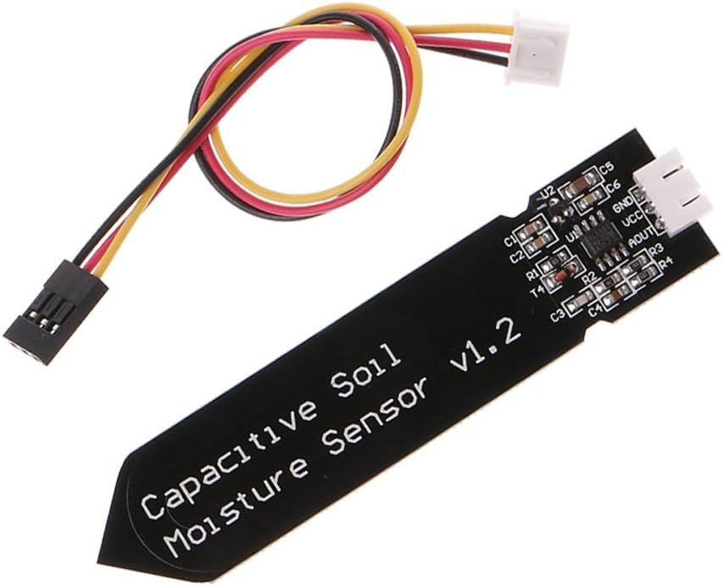
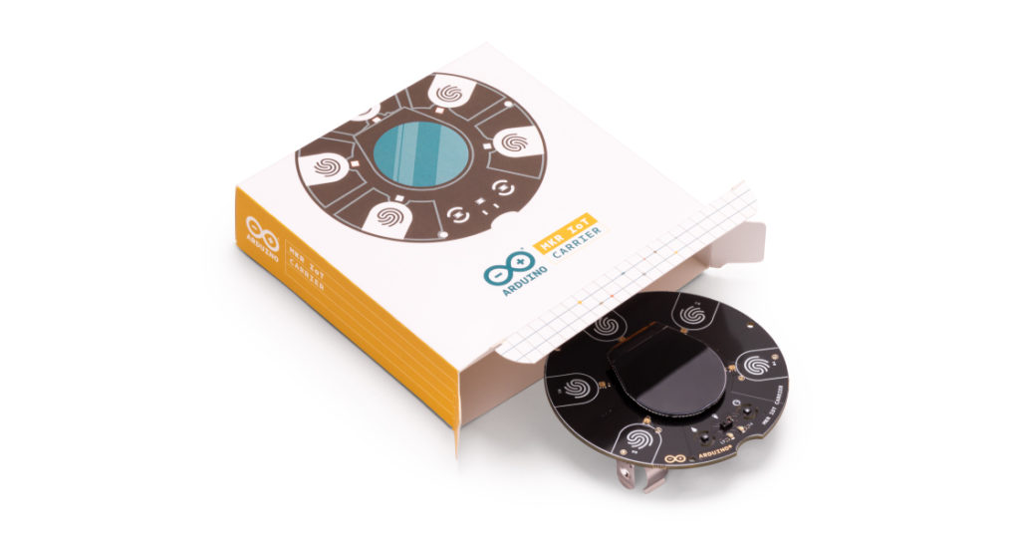
Sensors Actuators
This Photo by Unknown Author is licensed under CC BY-SA-NC
Use libraries to enhance functionality.
Connect sensors, actuators, and modules.
Create interactive projects, home automation, and more
This Photo by Unknown Author is licensed under CC BY-SA
This Photo by Unknown Author is licensed under CC BY-SA-NC
This Photo by Unknown Author is licensed under CC BY-SA-NC

Slide 9
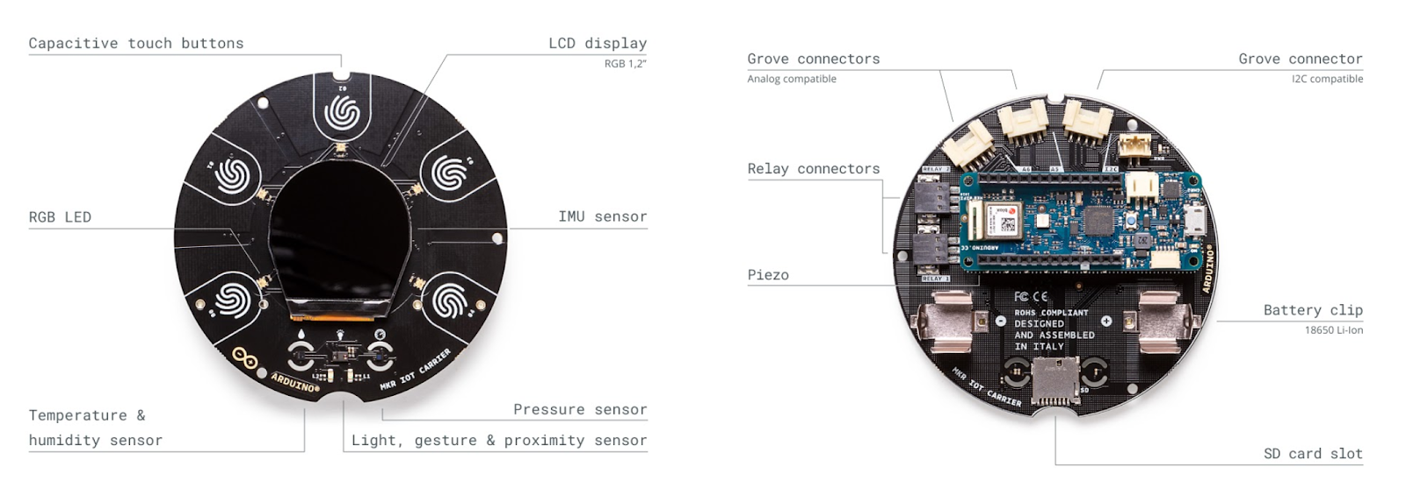
MKR Carrier
Hardware On Top
“The sensors, circuits and display integrated on the MKR IoT Carrier leave you free to focus on prototyping and programming your next IoT projects.”

Slide 10
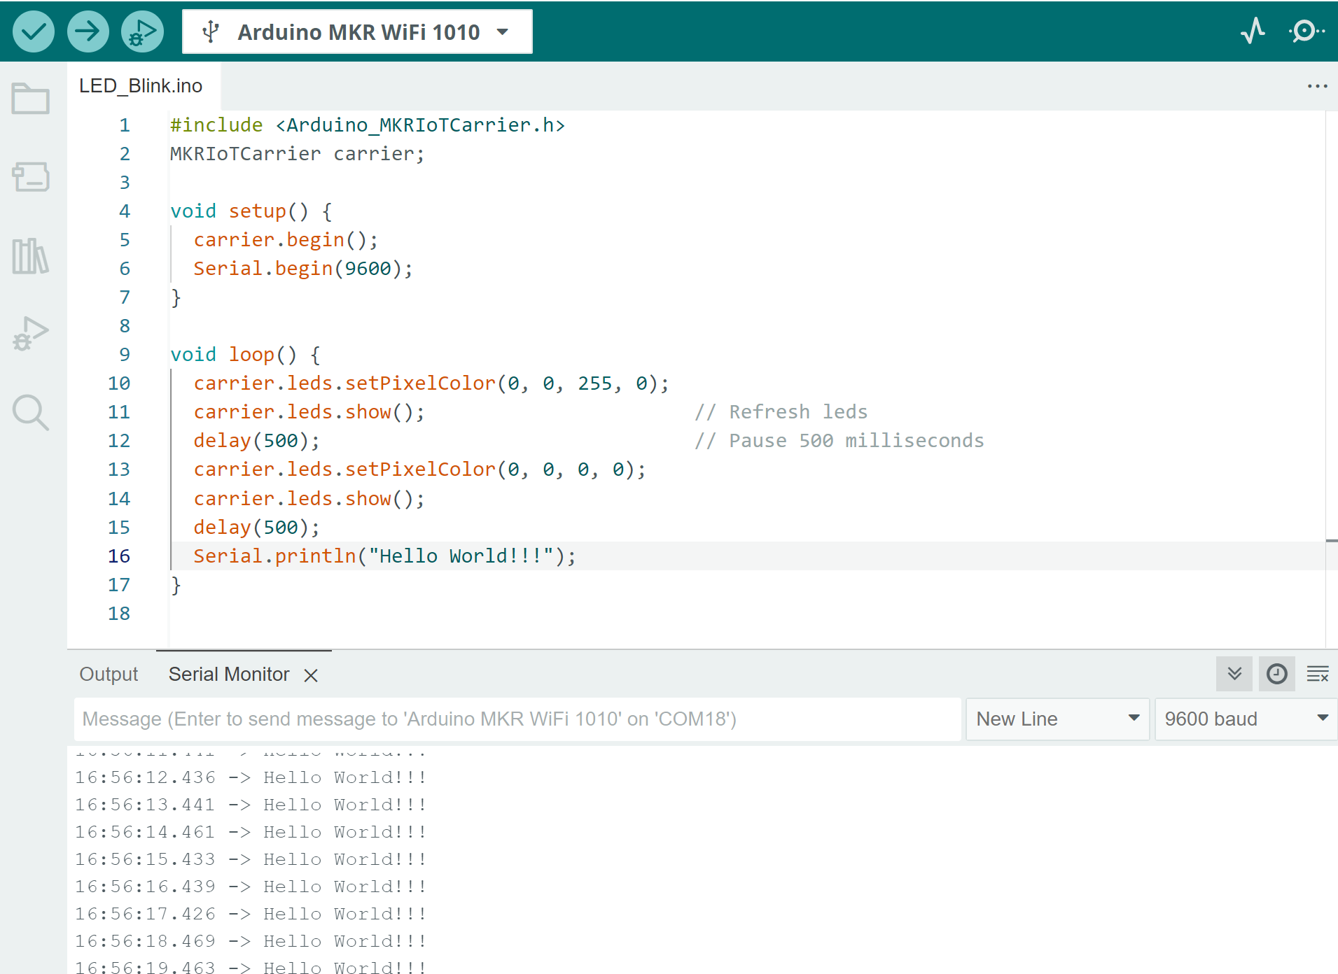
What could possibly go wrong?
As with any development cycle, there will be bugs
Using the Serial Monitor for debugging.
Common issues: Incorrect connections, wrong board settings, software compatibility.
Community forums and online resources for help.

