Slide 1
Security Lights
Subscribes
Event Broker
Motion Sensor
Camera
Publish
Subscribes
Subscribes
Push Notification
Subscribes
Future Process

Slide 2
Part 1: All on the Rpi
Part 2: Deployed to Cloud
Part 3: Event Driven
Press the Button
capture a photo
Saves Event data
Saves photo to cloud
Can view last visitor on App deployed to hosting platform
Rpi publishes event data to Message Broker
Deployed app subscibes to Broker

Slide 3
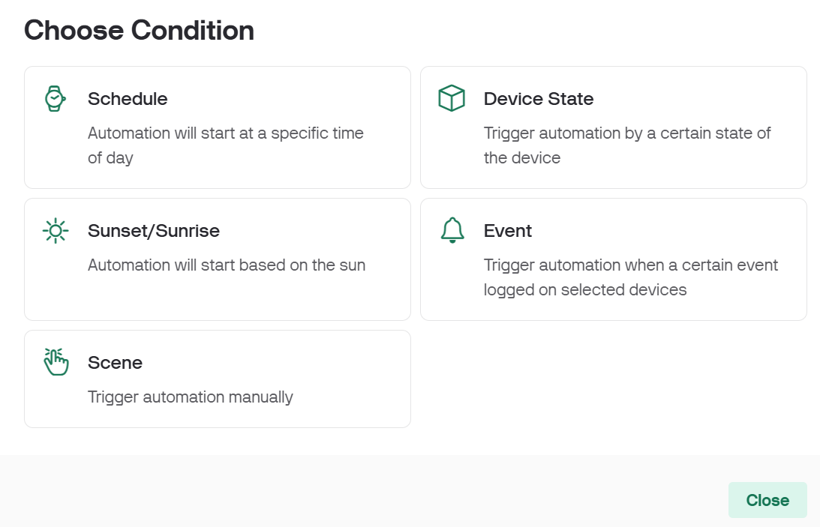
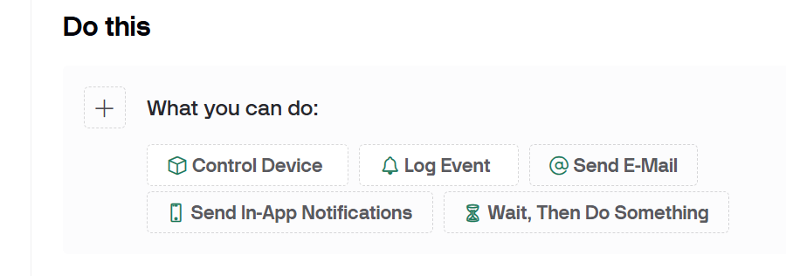
Condition
Action(s)

Slide 4
Security Lights
Request/Resp
Motion Sensor
Camera
Request/Resp
Request/Resp
Push Notification
Future Process

Slide 5
Security Lights
Request/Resp
Motion Sensor
Camera
Request/Resp
Request/Resp
Push Notification
Future Process

Slide 6





Event Producers
Event Consumers
Event Channel
Event DB
Event Processor

Slide 7
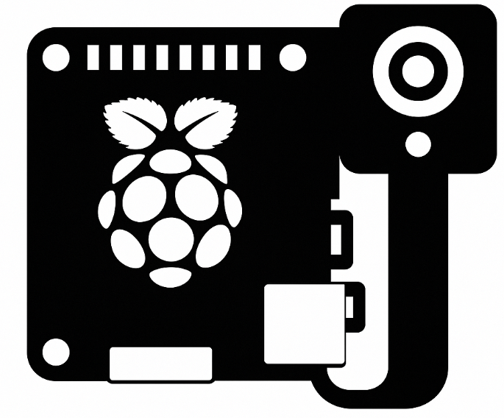
Event Producer
Event Consumers
Event Channel
Event DB

