Slide 1
Analog to Digital Conversion(ADC)
Recap and Types
Frank Walsh

Slide 2
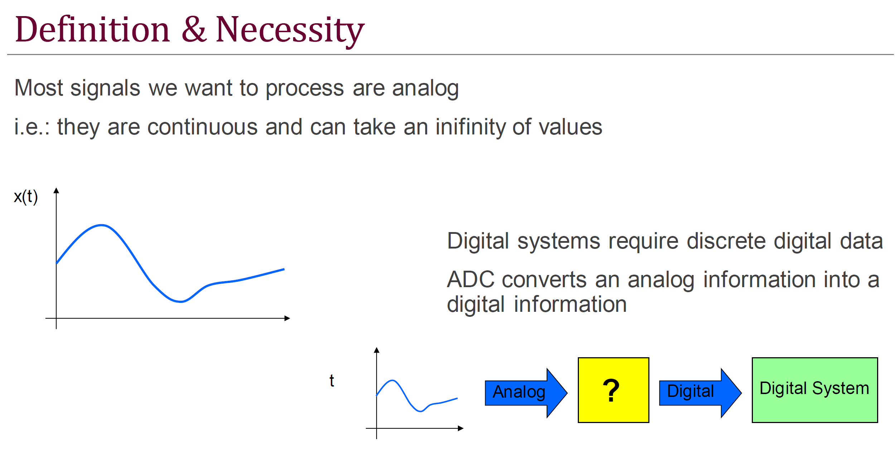

Slide 3
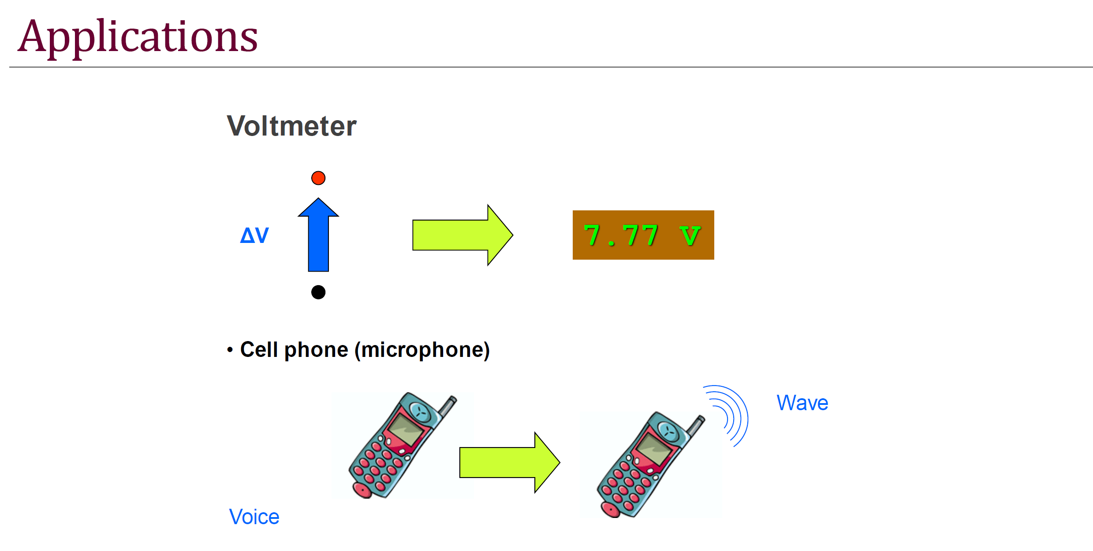

Slide 4
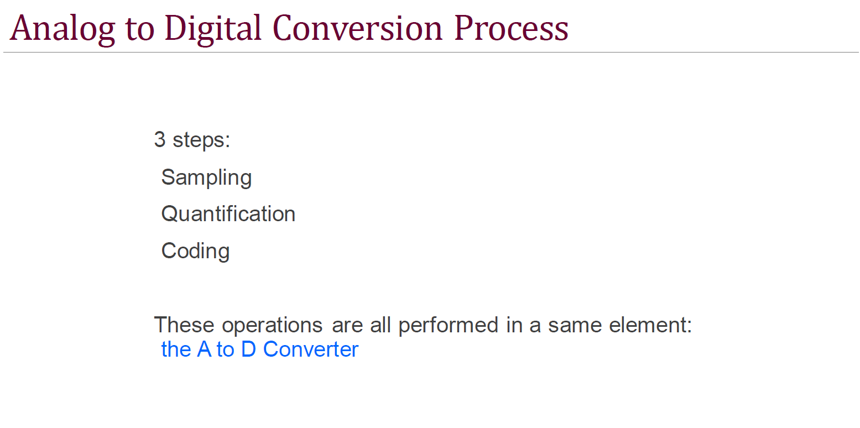

Slide 5
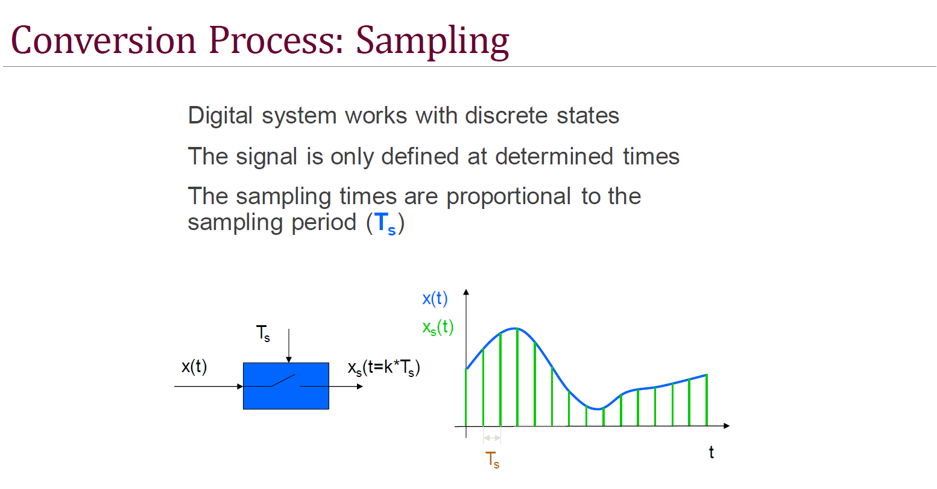

Slide 6
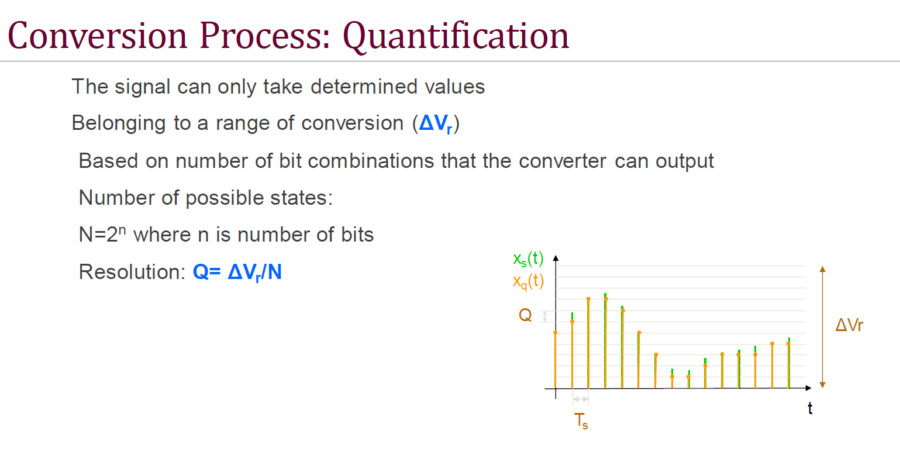

Slide 7
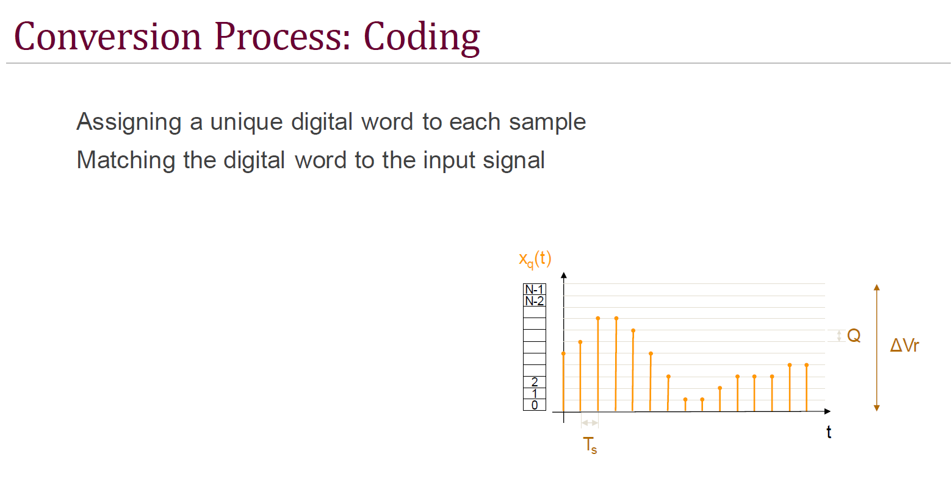

Slide 8
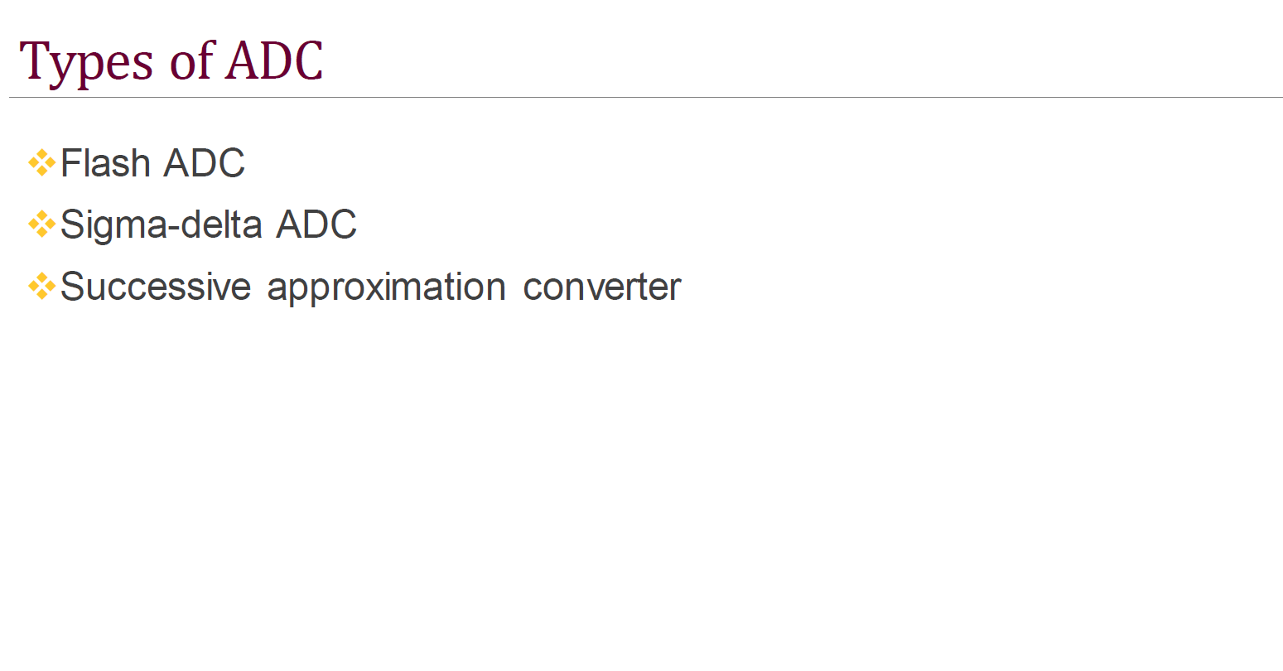

Slide 9
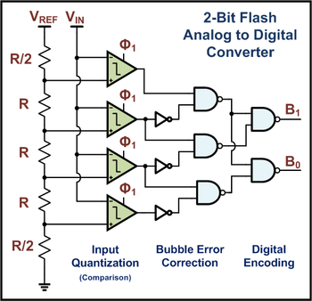
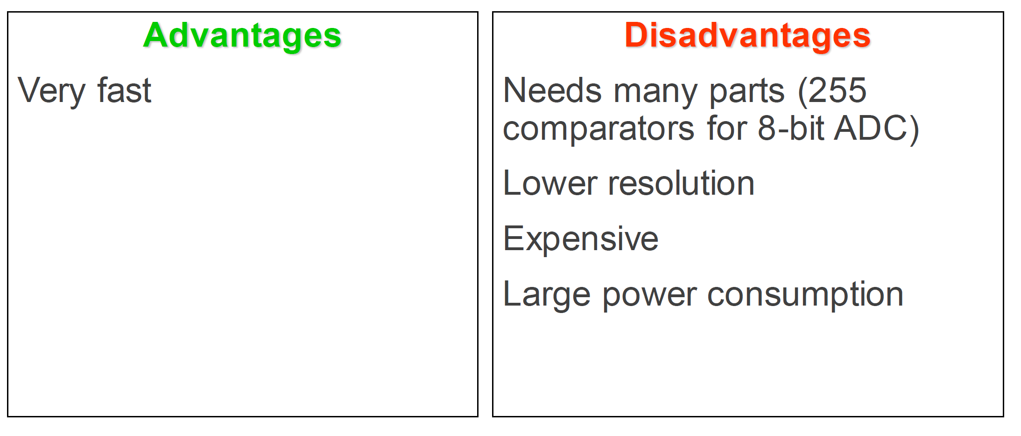
Flash ADC
https://www.analog.com/en/technical-articles/understanding-flash-adcs.html
Uses a linear voltage ladder with a comparator at each "rung" of the ladder to compare the input voltage to successive reference voltages.
The output of these comparators is generally fed into a digital encoder, which converts the inputs into a binary value

Slide 10
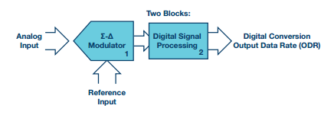
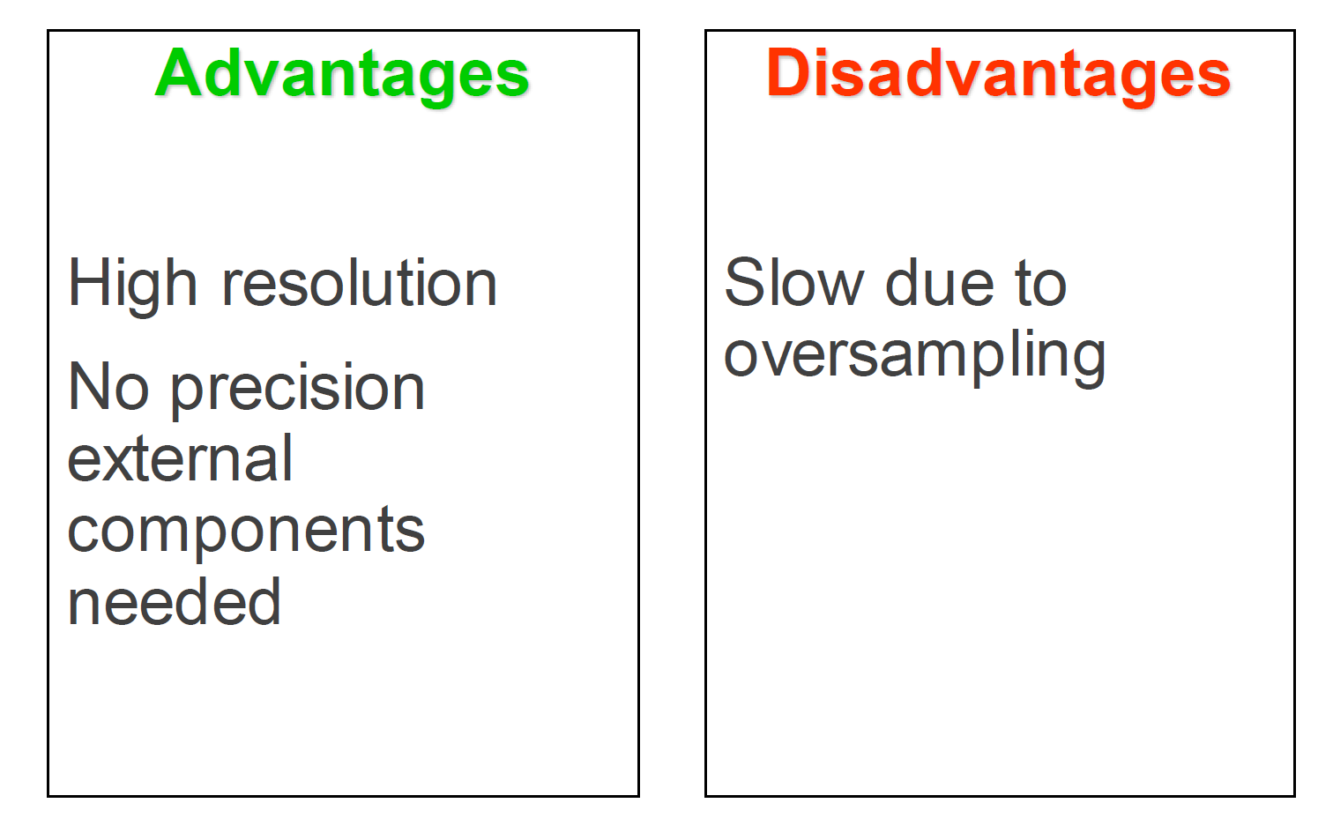
Sigma-Delta ADC
Typically there are two parts:
  the Σ- modulator
  digital signal processing block, usually a digital filter.
More info here: https://www.analog.com/en/design-center/interactive-design-tools/sigma-delta-adc-tutorial.html

Slide 11
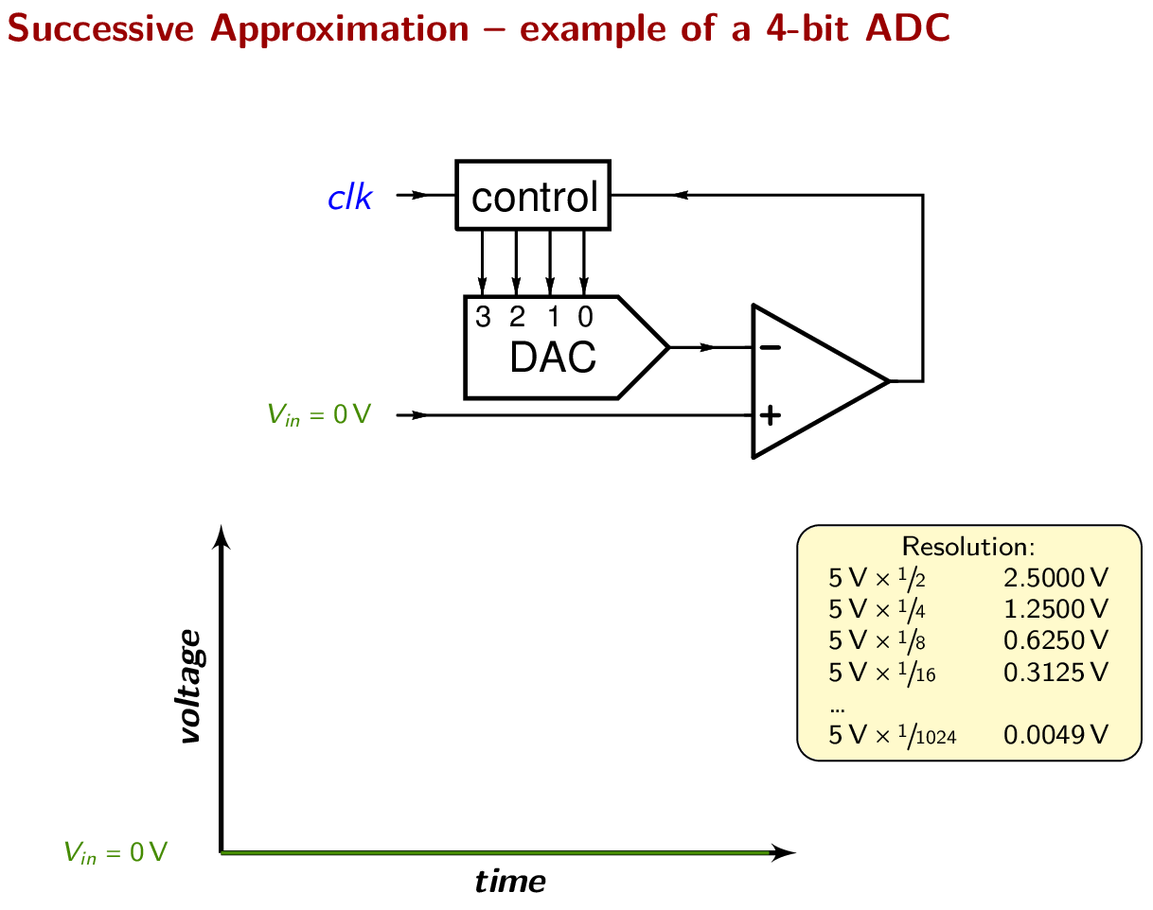
Successive Approximation ADC
Sets most significant bit (e.g. 0b1000)
Converts to analog using DAC
Compares guess to input
Sets bit
Moves to next bit
Operates by successively dividing the voltage range by half.

Slide 12
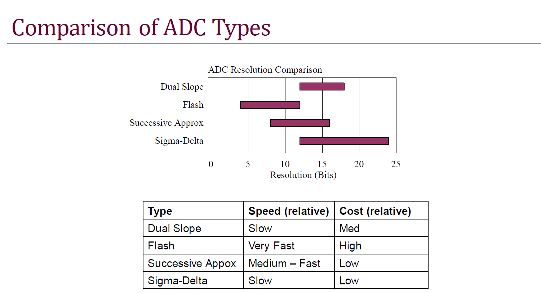

Slide 13
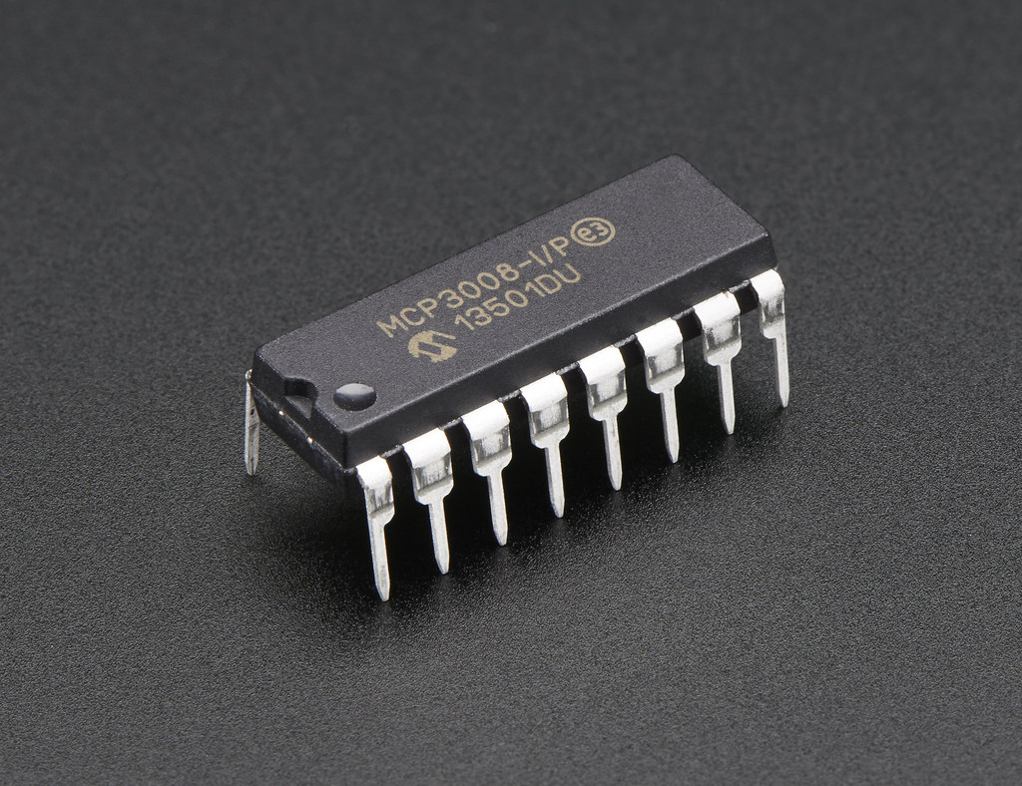
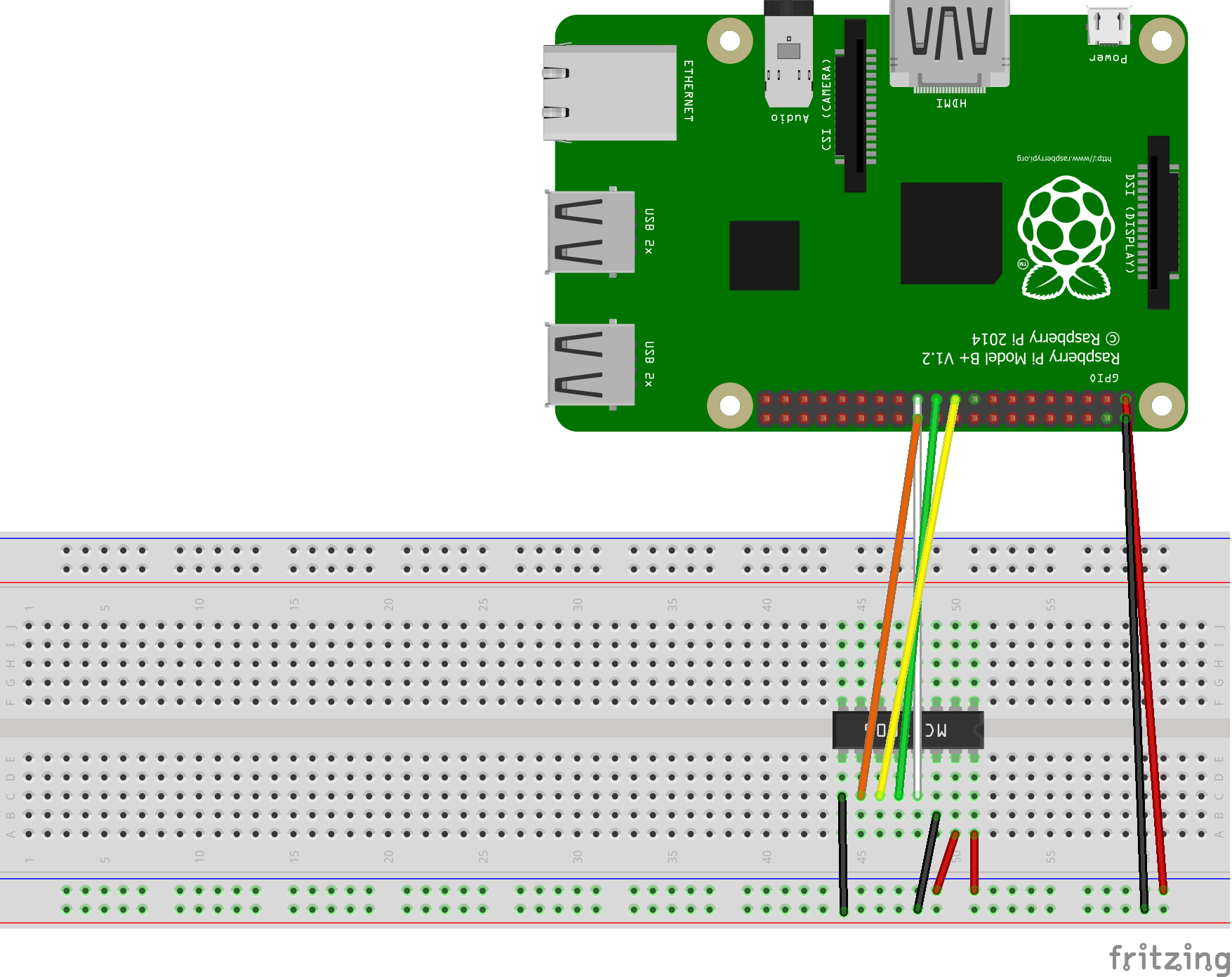
MCP3008
Popular analog-to-digital converter (ADC) chip
Uses Successive Approx for ADC conversion
10 bit resolution
8 channel input (connect 8 analog inputs)
SPI (Serial Peripheral Interface) for communication with a microcontroller or processor.
This Photo by Unknown Author is licensed under CC BY-SA-NC

