Slide 1
Indirect Messaging
Frank Walsh

Slide 2

Agenda
Indirect Messaging
  MQTT
  Firebase Realtime DB
Example: RealTime DB for Environment Sensor
This Photo by Unknown Author is licensed under CC BY-SA

Slide 3
Indirect Messaging
Publish Subscribe

Slide 4
Using the “Middleman”
Direct Communication
A
B
  Communication between processes using an intermediary
    Sender → “The middle-man” → Receiver
    No direct coupling
  Up to now, only considered Direct Coupling
    Introduces a degree of rigidity
  Consider…
    What happens if a device fails during communication in Direct Coupling?
    What if you'd like to add
  Two important properties of intermediary in communication
    Space uncoupling (devices don't need to "know" about each other)
    Time uncoupling (devices don't need to be "available" at the same time)
Indirect Communication
A
B
Intermediary

Slide 5
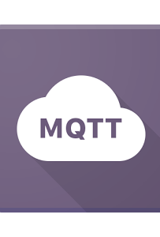
MQTT
MQ Telemetry Transport (MQTT)
Telemetry
  Remote measurements
Created by IBM
  from message queueing (MQ) architecture used by IBM for service oriented networks.
  Telemetry data goes from devices to a server or broker.
  Uses a publish/subscribe mechanism.
Lightweight both in bandwidth and code footprint

Slide 6
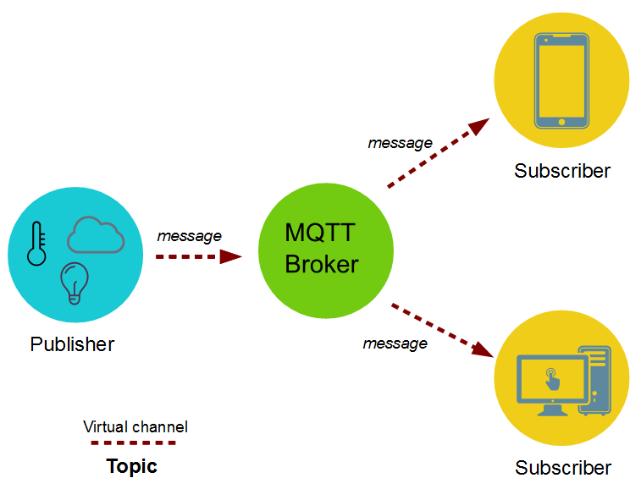
MQTT – publish subscribe
Topics/Subscriptions: Messages are published to topics.
  Clients can subscribe to a topic or a set of related topics
Publish/Subscribe: Clients can subscribe to topics or publish to topics.

Slide 7
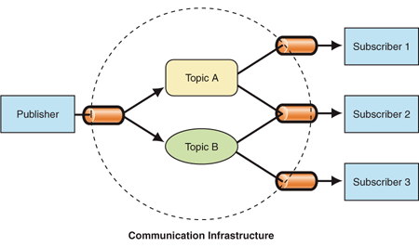
Publish Subscribe Process
A message is published once by a publisher.
Many things can receive the message.
The messaging service, or “broker”, provides decoupling between the producer and consumer(s)
A producer sends (publishes) a message (publication) on a topic (subject)
A consumer subscribes (makes a subscription) for messages on a topic (subject)
A message server / broker matches publications to subscriptions
  If no matches the message is discarded
  If one or more matches the message is delivered to each matching subscriber/consumer

Slide 8
Publish-Subscribe Characteristics
A published messages may be retained
  A publisher can mark a message as “retained”
  The broker / server remembers the last known good message of a retained topic
  The broker / server gives the last known good message to new subscribers
A Subscription can be durable or non-durable
  Durable: messages forwarded to subscriber immediately, if subscriber not connected, message is stored and forwarded when connected
  Non-Durable: subscription only active when subscriber is connected to the server / broker

Slide 9
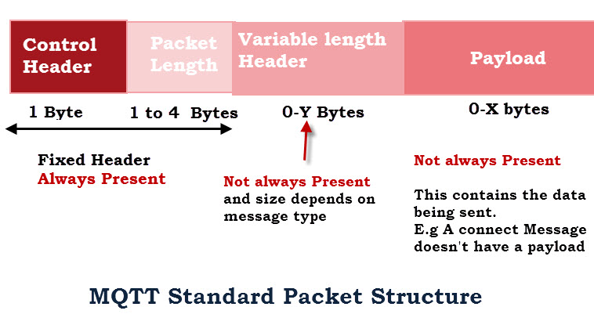
MQTT Characteristics
MQTT protocol compresses to small number of bytes
  Smallest packet size 2 bytes
  Supports always-connected and sometimes connected
  Provides Session awareness
  “Last will and testament” enable applications to know when a client goes offline abnormally
  Typically utilises TCP-based networks.

Slide 10
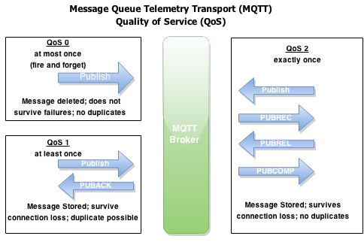
MQTT Characteristics
Three quality of service levels:
  0 = At most once (Best effort, No Ack),
  1 = At least once (Acked, retransmitted if ack not received),
  2 = Exactly once [Request to send (Publish), Clear-to-send(Pubrec), message (Pubrel), ack (Pubcomp)]
https://dzone.com/articles/internet-things-mqtt-quality

Slide 11
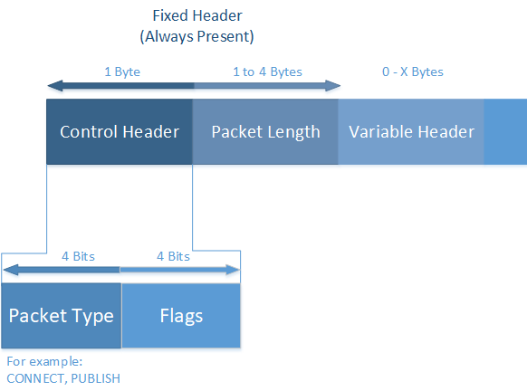
MQTT Control Packets
The MQTT protocol uses MQTT Control Packets using the Control Header.
Control Packet consists of three parts:
  fixed header(present in all packets),
  variable header(optional)
  Payload(optional)
https://docs.devicewise.com/Content/Products/IoT_Portal_API_Reference_Guide/MQTT_Interface/MQTT-Control-Packets.htm

Slide 12
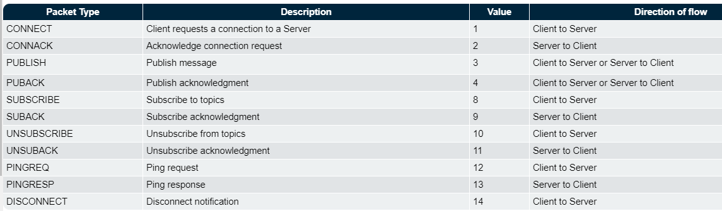
MQTT Control Packets
MQTT Control Packet Types

Slide 13
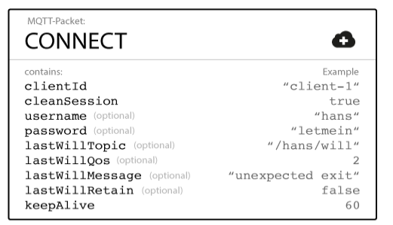
MQTT Last Will and Testament
Notify other clients about an ungraceful disconnected client.
Client can specify its last will message when it connects to a broker.
  normal MQTT message with a topic, retained message flag, QoS, and payload
  When an “ungraceful disconnect” occurs, the broker sends the last-will message to all subscribed clients of the last-will message topic.
https://www.hivemq.com/blog/mqtt-essentials-part-9-last-will-and-testament/

Slide 14

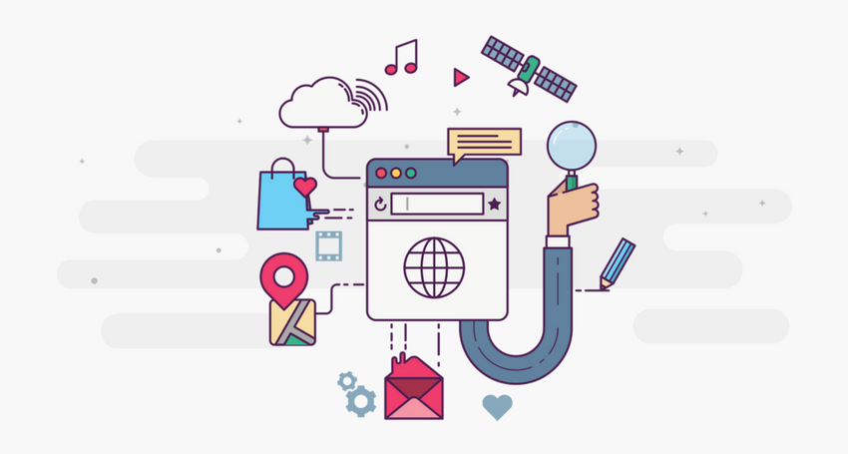

MQTT is Open Source
Lots of implementations:
    Mosquitto
    Micro broker
    Really small message broker (RSMB): C
    Cloud broker services

Slide 15
MQTT vs HTTP
Push delivery of messages / data / events
  MQTT – low latency push delivery of messages from client to server and server to client. Helps bring an event oriented architecture to the web
  HTTP – push from client to server but poll from server to client
Reliable delivery over fragile network
  MQTT will deliver message to QOS even across connection breaks
  Decoupling and publish subscribe – one to many delivery

Slide 16
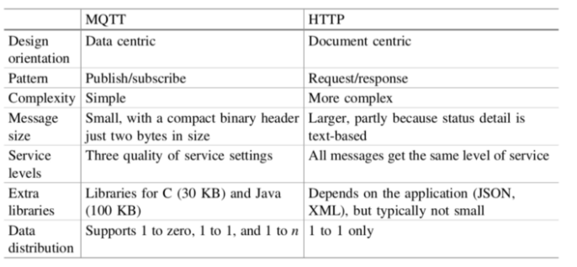
MQTT vs HTTP

Slide 17
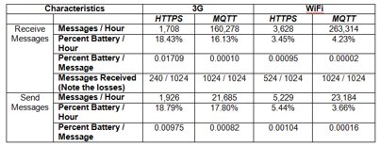
*sending and receiving 1024 messages of 1 byte each.(source: https://www.ibm.com/developerworks)

Slide 18
Application Example
Home care monitoring solution
  Home and patient instrumented with sensors.
    E.g. door motion, blood pressure, pacemaker/defib.
  Collected by monitoring service (broker) using MQTT
  Subscribed by a health care service in the hospital
  Alerts relations/health care profs. if anything is out-of-order

Slide 19
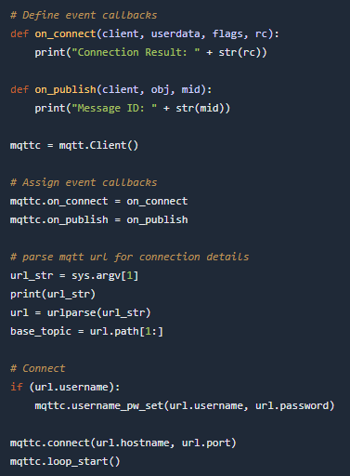
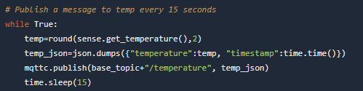
Code Example: Python

Slide 20
Persistence with IoT

Slide 21
IoT and Web Apps
From Labs, you have a device that can sense data and make it accessible
  Using TCP sockets
  Using Web API
  Now using MQTT
New requirement:
  Store historical environmental data for analysis while still providing notification of latest data(current state)?
Need persistence
Need a database…

Slide 22
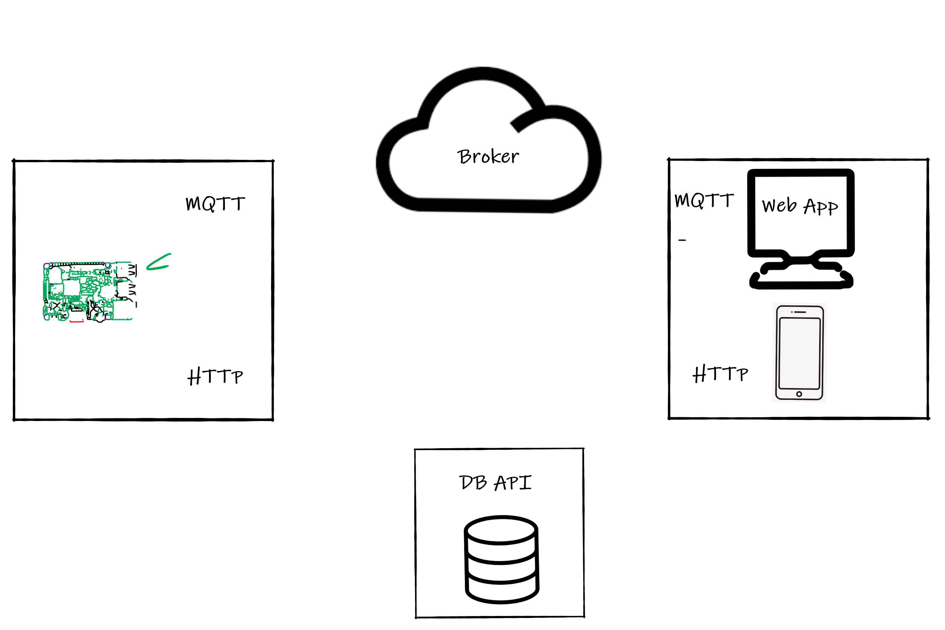

Possible Solution:

Slide 23
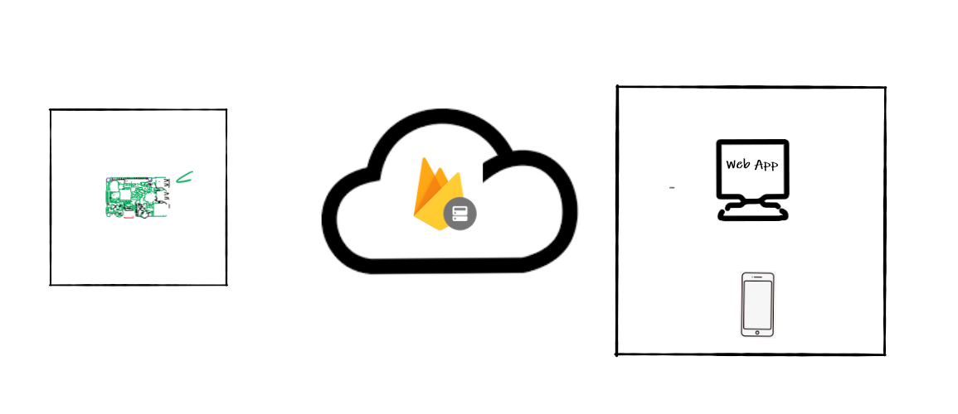
Better Solution ?

Slide 24
What is firebase
It's basically a platform that allows you do lots of stuff( and for free!):
  Analytics
    is a free and unlimited analytics tool to help you get insight on app usage and user engagement. No extra code needed, only console.
  Cloud Messaging
    Firebase Cloud Messaging lets you deliver and receive messages across platforms reliably.
  Notifications
    helps you re-engage with users at the right moment. No extra code needed, only console
  Authentication
    a key feature for protecting the data in your database and storage.
  Realtime Database
    lets you sync data across all clients in realtime and remains available when your app goes offline.
  Cloud Firestore
    Combines cloud database and functions together. Uses a scalable NoSQL cloud database to store and sync data.
  Storage
    lets you store and serve user-generated content, such as photos or videos. Firebase Storage is backed by Google Cloud Storage

Slide 25
What is firebase (2)
Functions
  Run your mobile backend code without managing servers
Hosting
  provides fast and secure static hosting. No backend, but delivers .html,.css, etc files.

Slide 26
What is firebase (3)
ML Kit
  uses machine learning to solve problems. Currently, it is updated the Vision APIs for text recognition, face detection, barcode scanning, plus image labeling and landmark recognition. This would use the cloud based systems instead of just the device cpu.
A/B Testing
  Let you optimize your app experience based on analytics. Change it for different demographics, make it different experience for say a teenage group verses a retired group. Without having to deploy two version of the app. Needs remote config.
  Deploy a new feature to a group and evaluate the effect of the changes on app use.
Predictions
  Uses remote config, providing a custom experience based on each of your users' predicted behavior.
  You can use Predictions with the Notifications composer to deliver the right message to the right user groups.

Slide 27
Firebase Realtime Database
“A real-time database uses real-time processing to handle workloads whose state is constantly changing. This differs from traditional databases containing persistent data, mostly unaffected by time”
It’s a Cloud-based database that uses live connections to the app.
  The data is stored a json objects and is only intended for text, to allow for fast responses.
  Works even offline, with cached data then sync when online

Slide 28
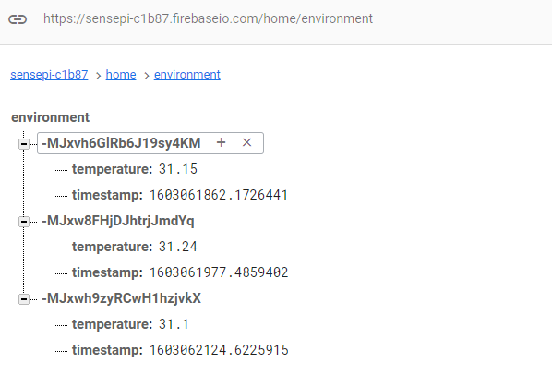

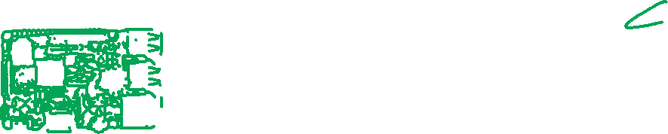
Data
The data is stored as a json object.
  Assigned a unique key.
  Push or Set data from client

Slide 29
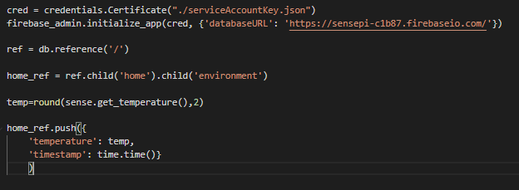
Database – Push data
Setup a connection using credentials from Firebase App.
Create reference.
To add a new value use the push and setValue

Slide 30


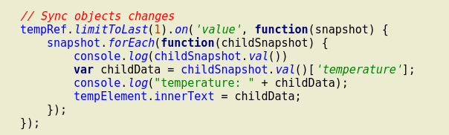
Database – Listen for new data
In a Web App, can use Javascript to access data
  Need to install Firebase CLI

Slide 31
Database notes
Firebase Realtime Database allows nesting data up to 32 levels deep, but where possible avoid nesting deep.

Slide 32
Database and security
By default only authenticated users can read and write the database.
Console:

Slide 33
Database and security (2)
It can be changed, but not recommend.
You can setup very complex rules, where only some users can access data, etc. With cascading rules for the depth of nodes.
See the documentation:
  https://firebase.google.com/docs/database/security/quickstart

