Slide 1
Internet of Things prototyping with Firebase
Tutorial

Slide 2
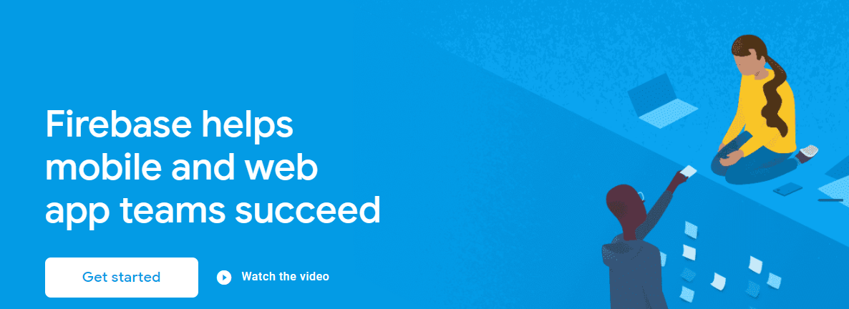
Firebase
Firebase is a Backend-as-a-Service (BaaS)
Generally used for creating mobile and web applications
Also handy for IoT
  Provides persistence, file storage, APIs and SDKs for lots of languages
One stop shop for all the services we need

Slide 3
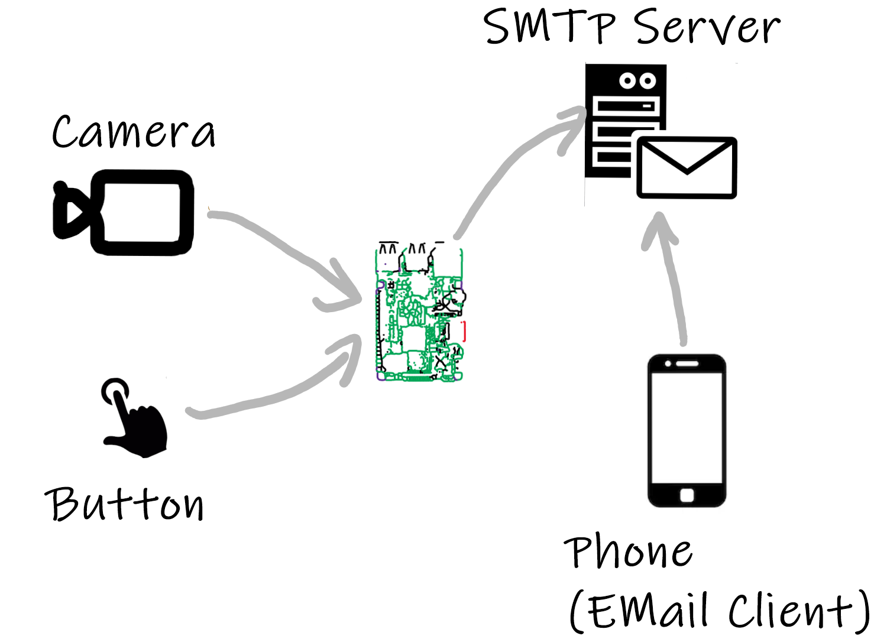
Smart Doorbell – Existing Solution
Email image of person when press doorbell(button)
Pros:
  Everybody has/use email
  Email inbox acts a record of doorbell event (can retrieve after event/later)
Cons:
  Images stored on RPi (not very accessible to other apps/limited space)
  Email not really “dedicated” client(message could be lost/buried/junk)
  Rpi app “tightly coupled” to email server. Any change would require code change on RPi
  Only can be used via email (not very extensible)

Slide 4
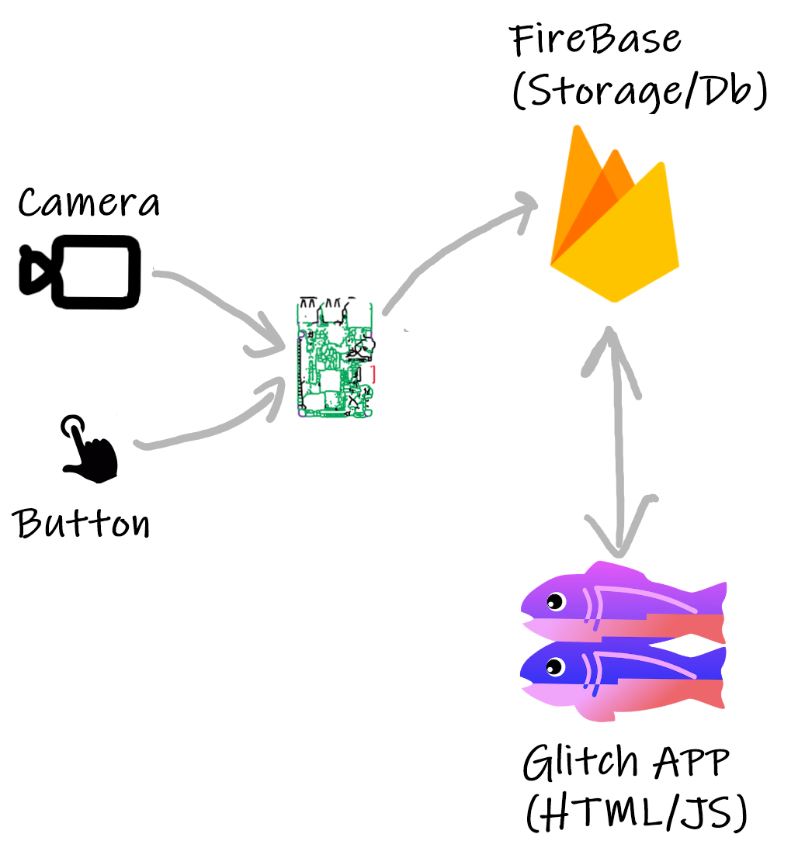
Smart Doorbell: New Solution
BaaS/”Cloud” Computing
Physical Computing
Use “Event-based” architecture
Take a photo when the button is pressed
  Physical Computing
Store image files in accessible file store
  Firebase Storage
Publish “image” events when they happen
  Firebase Realtime DB
View in connected app
  Glitch Web app
Web App Dev

Slide 5
Event-Based Architecture
Nothing new, but really useful for highly scalable and adaptable applications
  Scalable – ability to scale up/increase number of users/devices in a solution.
  Adaptable – ability to change/alter/update a solution, for both small and complex applications
Consider the following for the smart doorbell application:
  “I want to increase the number of users/clients from 1 to 10”
    Email solution: Send email to 10 different emails, need to get 10 email addresses and update program on RPi. 10 emails with attachments stored in different SMTP servers- duplication. NOT VERY SCALABLE.
    Firebase solution: Give the users access to the Glitch Web App. No change to the RPi code. Just increase in traffic to Firebase (no big deal).
  “I want to try more functionality, for example send a SMS/Push Notification to the house owner when the button is pressed”
    Email solution: Update code on RPi to do this as well as the email (SMS/Push Notification/email). Rpi is doing a lot now (not “cohesive”). NOT VERY ADAPTABLE. Best just to get your apps/services to “do one thing and do it well”
    Firebase solution: Develop a separate SMS service that subscribes/receives for “door event” and sends sms when it occurs. No change to existing code at all! (aside: could use Firebase cloud function for this…).

Slide 6
Event Based Architecture
Notification Service

Slide 7
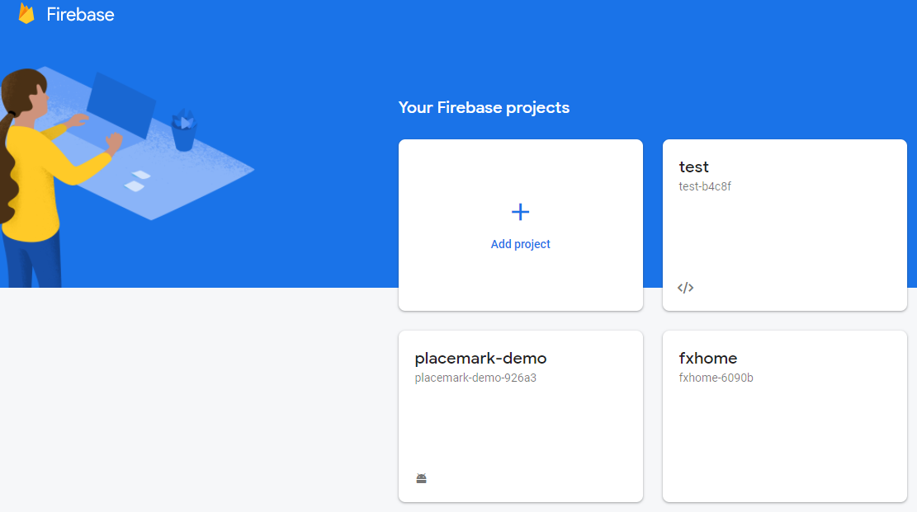


Getting Firebase
It’s free. You just need a Google ID.
Go to the Firebase Console to start creating “projects” and access Firebase Services
Create the services you require

Slide 8
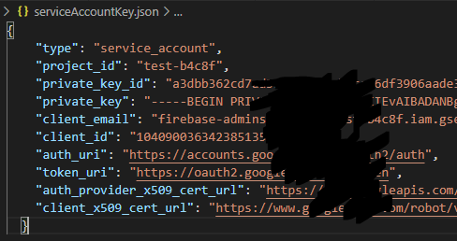


Using Firebase
Firebase software development kit (SDK) allows you to access Firebase programmatically
SDK available for most mainstream programming languages/Environments
  Python
  Javascript
  Android/iOS
Must have authentication details to access services
  For example, serviceAccountKey.json
  Need to “Register an app” with Firebase first.
  Download this from Firebase for your programming language.

Slide 9
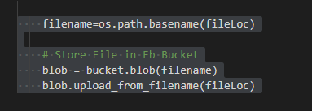
Firebase Storage
Use it to store and manage media generated by devices and apps.
This use case:
  upload images from RPi
  Have accessible using public URL
Stores files in bucket
Programming steps:
  Authenticate with Firebase
  Create reference to a Storage Bucket
  Create a “Blob” in the Bucket (blob is an array of bytes )
  Upload File using the blob

Slide 10
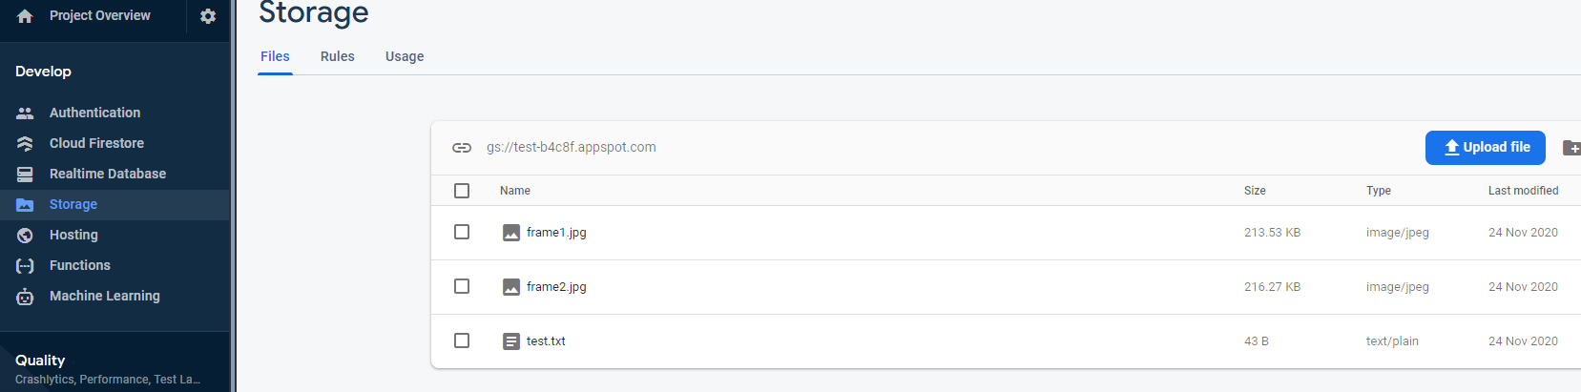
Firebase Storage: Files

Slide 11
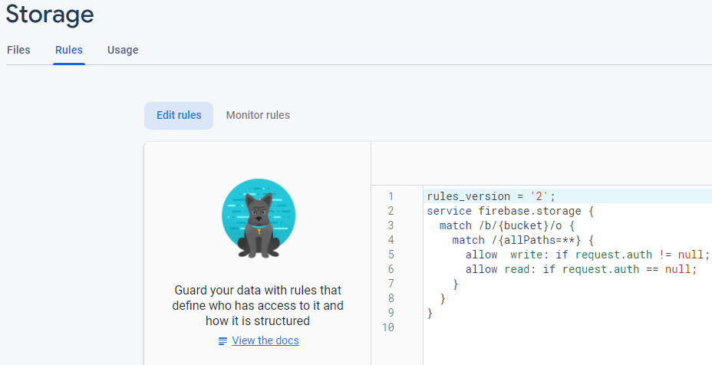
Firebase Storage: Rules
By default, authentication required to read and write
Can change in Rules to allow reads/writes

Slide 12
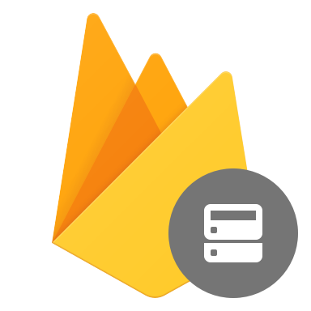
Firebase Realtime DB
Cloud-based database that uses live connections to the app.
  The data is stored a json objects and is only intended for text, to allow for fast responses.
Useful for constantly changing data
  differs from traditional databases containing persistent data, mostly unaffected by time

Slide 13
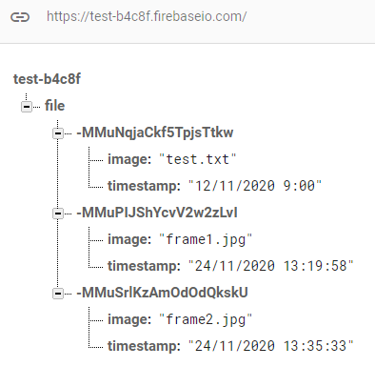

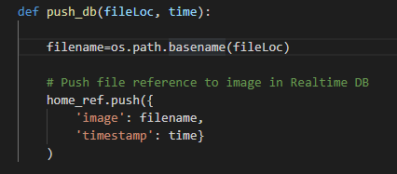


Firebase Realtime DB: Pushing Data
The data is stored as a json object.
  Each new entry assigned a unique key.
  Push or Set data from client
Programming steps:
  Authenticate with Firebase
  Create reference to “node” in DB
  Push JSON data on to DB

Slide 14
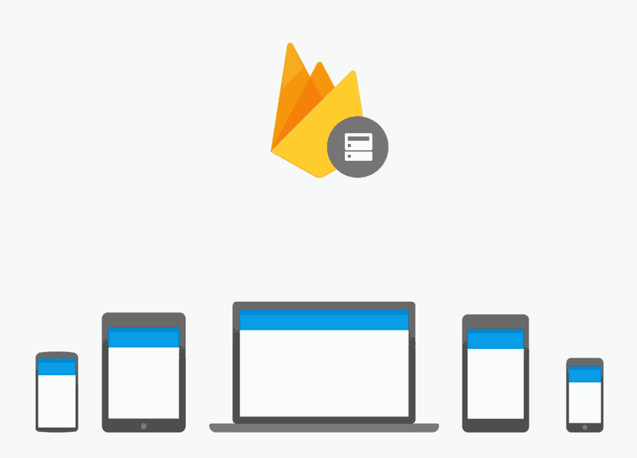
Application: Connecting to DB
Can create connection to Realtime DB from many other services
  Uses Web Sockets
Every change on the DB is passed to all connected processes/devices
Use this to notify web app that new image uploaded
  Or any other app in the future, for example if we develop an Android app tomorrow!

Slide 15
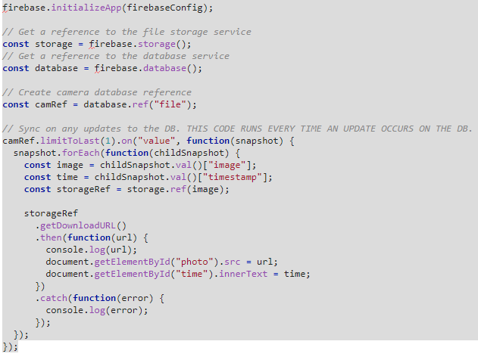
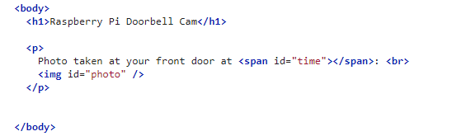


Glitch Web App

Slide 16
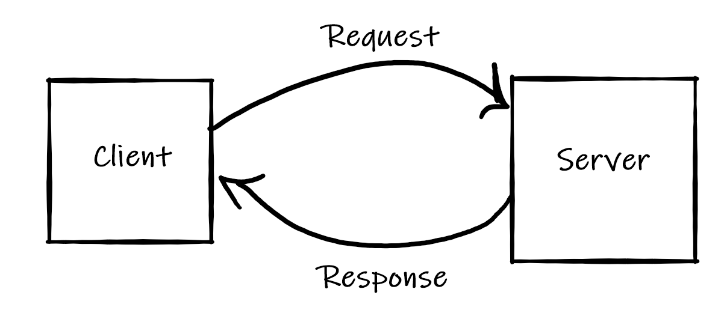
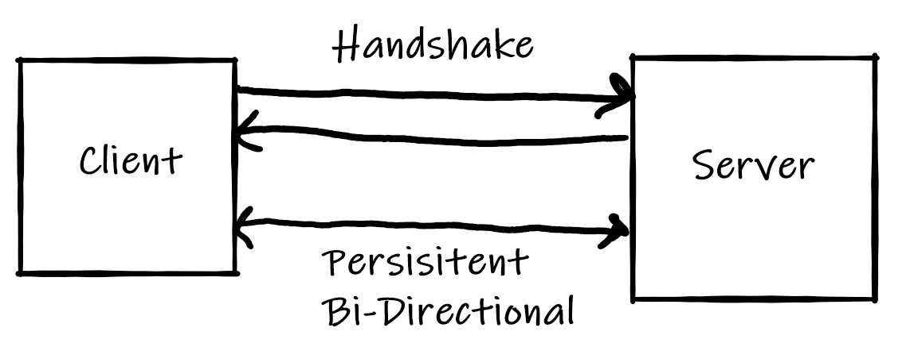

Realtime DB Connection: WebSockets
Allows real-time interactive communication between the client browser and a server
Application layer protocol that allows bidirectional data flow.

Slide 17
HTTP vs WebSockets
WebSockets is TCP based, bi-directional, full-duplex messaging
Establish connection (Single TCP connection)
  Send messages in both direction (Bi-directional)
  Send message independent of each other (Full Duplex)
End connection
HTTP is half-duplex, a one-way communication protocol
▪ Client Polls only, then server send
Complex, Inefficient, Wasteful
It is designed for file transfer, or server any other static resources

Slide 18
HTTP Limitations
Many web apps require near realtime response
  NetFlix, Youtube,...
  Online stock trading, sensor/device monitoring
HTTP is not designed for those applications
  large overhead
  one-way communication, not efficient
WebSockets has lower overhead and more suited for these types of apps.

Slide 19
Websocket vs HTTP Example: Header overhead
Assume HTTP header is 871 bytes (some are 2000bytes!)
After initial handshake, WebSockets only use 2 bytes in each message
HTTP
WebSockets
1,000 clients polling every second: Network traffic is
(871 x 1,000) = 871,000 bytes = 6,968,000 bits per second
(6.6 Mbps)
1,000 clients receive 1 message per second: Network traffic is
(2 x 1,000) = 2,000 bytes = 16,000 bits per second
(0.015 Mbps)

Slide 20
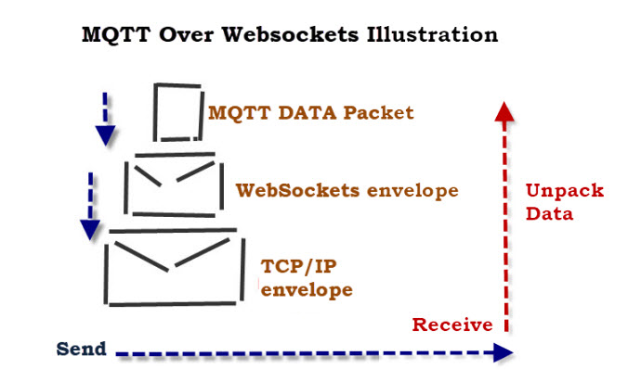
WebSockets vs MQTT (why not use MQTT)
Actually you can do MQTT over Websockets if you want.
Web browsers don’t have MQTT protocol (HTTP and WebSockets)
Broker has to support Web Sockets
This Photo by Unknown Author is licensed under CC BY-SA-NC

