Slide 1
Cosc 5/4735
Firebase

Slide 2
What is firebase
It's basically middle ware that allows you do a number of things cross platform
Analytics
is a free and unlimited analytics tool to help you get insight on app usage and user engagement. No extra code needed, only console.
Cloud Messaging (covered in another lecture)
Firebase Cloud Messaging lets you deliver and receive messages across platforms reliably.
Notifications
helps you re-engage with users at the right moment. No extra code needed, only console
Authentication
a key feature for protecting the data in your database and storage.
Realtime Database (previous covered, so quick refresher)
lets you sync data across all clients in realtime and remains available when your app goes offline.
Cloud Firestore (previous covered, so quick refresher)
Combines cloud database and functions together. Uses a scalable NoSQL cloud database to store and sync data.
Storage
lets you store and serve user-generated content, such as photos or videos. Firebase Storage is backed by Google Cloud Storage

Slide 3
What is firebase (2)
Functions
Run your mobile backend code without managing servers
Hosting (not covered here)
provides fast and secure static hosting. No backend, but delivers .html,.css, etc files.
Remote Config
change the behavior and appearance of your app without publishing an app update.
App Indexing (not covered here)
With Firebase App Indexing, you can drive organic search traffic to your app, helping potential users of your app become your app’s biggest fans.
Dynamic Links (not covered here)
lets you pull users right to the content they were interested in, keeping them engaged and increasing the likelihood that they will continue to use the app.
Invites (depreciated, replaced by dynamic links)
Firebase Invites helps your users share your app with others. referral codes or share content from the app. Uses the Dynamic Links so links survive the install of the app.
AdWords (not covered here)
help you search potential users with online ads.
AdMob (covered in another lecture)
provides easy and powerful ad monetization with full support in Firebase.

Slide 4
What is firebase (3)
ML Kit
"use machine learning to solve problems." Currently, it is updated the Vision APIs for text recognition, face detection, barcode scanning, plus image labeling and landmark recognition. This would use the cloud based systems instead of just the device cpu.
A/B Testing
Let you optimize your app experience based on analytics. Change it for different demographics, make it different experience for say a teenage group verses a retired group. Without having to deploy two version of the app. Needs remote config.
Deploy a new feature to a group and evaluate the effect of the changes on app use.
Predictions
Uses remote config, providing a custom experience based on each of your users' predicted behavior.
You can use Predictions with the Notifications composer to deliver the right message to the right user groups.

Slide 5
Console and project SETUP

Slide 6
Firebase console
Google has a number of "consoles".
These are webpages to control varying things.
Other Examples:
https://partner.android.com/things/console#/ android things
https://console.developers.google.com/apis/ for apis like maps
https://developers.google.com/beacons/dashboard/ for beacons
Firebase has it's own as well.
https://console.firebase.google.com/

Slide 7
Firebase console (2)
You will need to log into the console
And setup a project. As primer guide, I'm skipping all this.
It can be done pretty easy with android studio.
Last part to remember, this is platform independent.
Can be used on IoS, Android, Unity, C++, and on the Web as well.
Firebase versions will be listed in the following slides, but see https://firebase.google.com/docs/android/setup#available_libraries for the current versions.

Slide 8
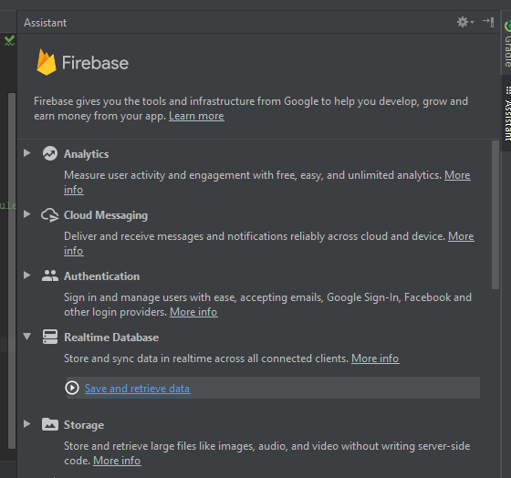
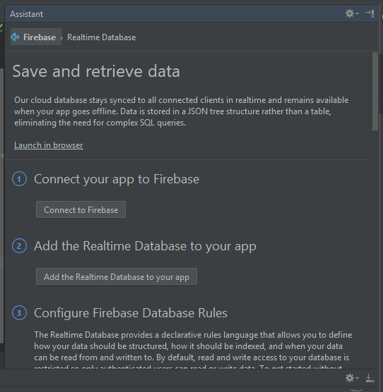
Basic setup
In Studio (this is setup the the Realtime Database)

Slide 9
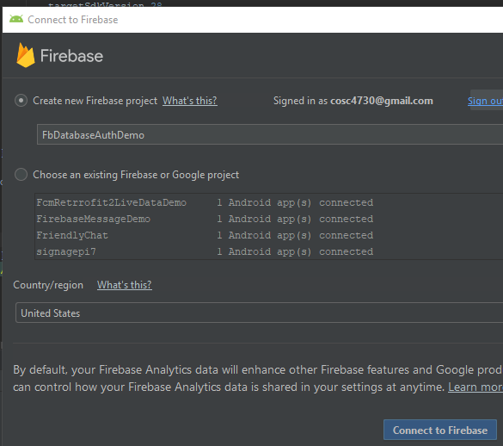
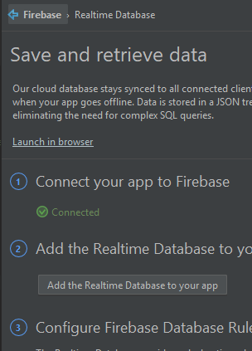
Basic Setup (2)
In the browser Back in Studio

Slide 10
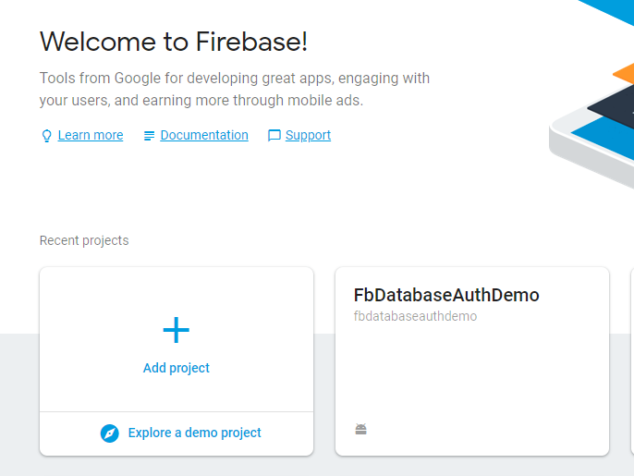
Basic Setup (3)
You should now have the project in the firebase console as well

Slide 11
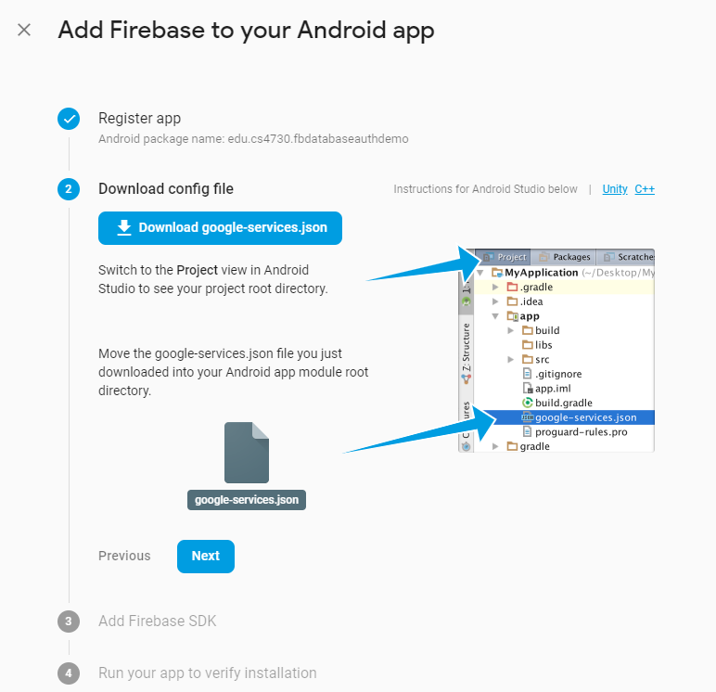
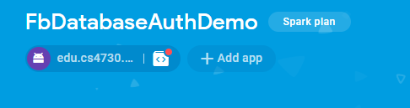
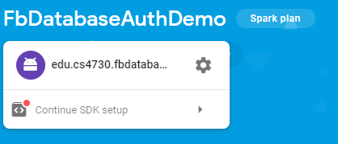
Through the console only
Create a project and
add the app project

Slide 12
Analytics

Slide 13
Analytics
add firebase analytics
implementation 'com.google.firebase:firebase-analytics:17.2.2'
The rest is done within the https://console.firebase.google.com/
You can look many different things, from first time usage, how long the app is up, demographics of users, etc.
Data updates once every 24 hours.

Slide 14
Notifications (not cloud messaging)

Slide 15
Notifications
Not to be confused with cloud messaging
Covered in the next lecture.
This allows you send a notification to the all (or some) of the devices where your app is instead.
You need on include firebase core and message in dependencies
implementation 'com.google.firebase:firebase-messaging:20.1.0'
The rest is done in the console.

Slide 16
Notifications (2)
You create a message in the notifications section.
Send the message.
It will then show up on the device as a notification.
If they click the notification it will launch you app.
Note, if the app is up then the users won't see it (without extra code from cloud messaging).

Slide 17
Realtime database
quick refresher

Slide 18
Realtime Database
Is a cloud based database with live connections to the app.
The data is stored a json objects and is only intended for text, to allow for fast responses.
Authentication is needed.
Works even offline, with cached data then sync when online.
dependencies
implementation 'com.google.firebase:firebase-database:19.2.0'

Slide 19
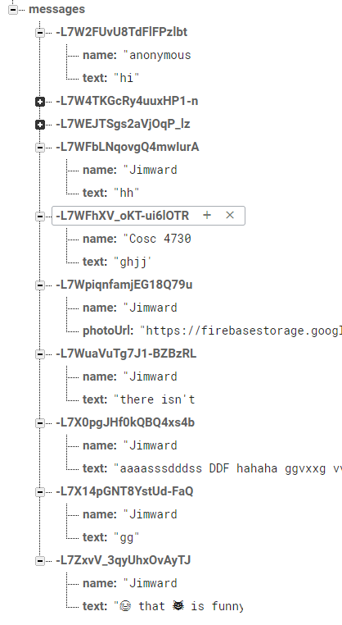
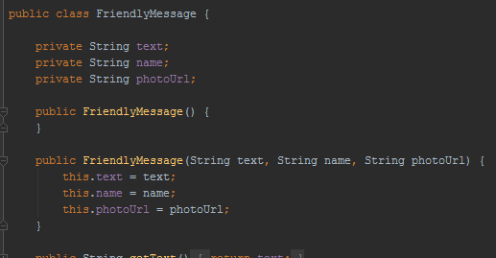
Data
The data is stored as a json object.
The L7W.. Is a unique key, that I didn't have to create.
You will need a POJO class that matches your data names

Slide 20
Database setup and use.
Setup a connection and reference.
FirebaseDatabase database = FirebaseDatabase.getInstance();
DatabaseReference dbReference = database.getReference().child("messages");
To add a new value use the push and setValue
dbReference.push().setValue( friendlyMessage);
Where friendlyMessage is a object holding the data.

Slide 21
Database setup and use. (2)
Listener for new data
ChildEventListener mChildEventListener = new ChildEventListener() { @Override public void onChildAdded(DataSnapshot dataSnapshot, String s) { FriendlyMessage friendlyMessage = dataSnapshot.getValue(FriendlyMessage.class);
//now do something with the data } public void onChildChanged(DataSnapshot dataSnapshot, String s) { } public void onChildRemoved(DataSnapshot dataSnapshot) { } public void onChildMoved(DataSnapshot dataSnapshot, String s) { } public void onCancelled(DatabaseError databaseError) { } }; mMessagesDatabaseReference.addChildEventListener(mChildEventListener);
Don’t forget to remove listeners in onPause, add them in onResume

Slide 22
Database notes
Firebase Realtime Database allows nesting data up to 32 levels deep, but where possible avoid nesting deep.
Also don't use json arrays.

Slide 23
Database and security
By default only authenticated users can read and write the database.
Console:

Slide 24
Database and security (2)
It can be changed, but not recommend.
You can setup very complex rules, where only some users can access data, etc. With cascading rules for the depth of nodes.
See the documentation:
https://firebase.google.com/docs/database/security/quickstart

Slide 25
FIREstore

Slide 26
FireStore Database.
Is going to replace realtime db at some point.
For flexibity, query the database, and scalable.
Like realtime db, realtime updates and offline support.
Uses a NoSQL data model.
You have a collections, which contain documents, which can contain subcollections to build hierarchical data structures.
Allows for efficient questions, by creating shallow queries or nested questions.
https://firebase.google.com/docs/firestore/

Slide 27
Rules
For simple authentication you rules will look like this:
service cloud.firestore {
match /databases/{database}/documents {
match /{document=**} {
allow read, write: if request.auth != null;
}
}
}
this is covered in later slides for authenticiation.

Slide 28
Getting started.
In the console turn on firestore.
First add firestone to gradle
implementation 'com.google.firebase:firebase-firestore:21.4.0'
Access your database
FirebaseFirestore db = FirebaseFirestore.getInstance();
Adding data, create a HashMap
Map<String, Object> data = new HashMap<>();
data.put("back in 5 minutes", et_msg.getText().toString());
data.put("Arrow", "none");

Slide 29
Adding data.
Now Add the data to the level you want it. In this case, /sign/jim/
db.collection("sign").document("Jim")
.set(data) //hashmap previously created.
.addOnSuccessListener(new OnSuccessListener<Void>() {
@Override
public void onSuccess(Void aVoid) {
Log.d(TAG, "DocumentSnapshot successfully written!");
}
})
.addOnFailureListener(new OnFailureListener() {
@Override
public void onFailure(@NonNull Exception e) {
Log.w(TAG, "Error writing document", e);
}
});

Slide 30
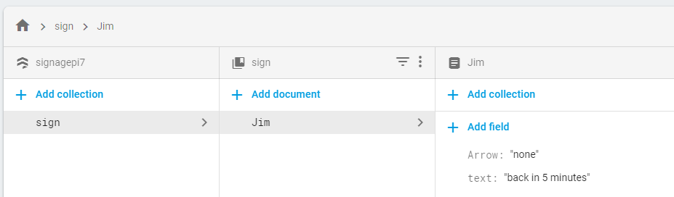
In the console it looks like this

Slide 31
Receive the data
db.collection("users").document("Jim").get()
.addOnCompleteListener(new OnCompleteListener<DocumentSnapshot>() {
@Override
public void onComplete(@NonNull Task<DocumentSnapshot> task) {
if (task.isSuccessful()) {
DocumentSnapshot snapshot = task.getResult();
Map<String, Object> data = snapshot.getData();
TestText = String.valueOf(data.get("text"));
Arr = String.valueOf(data.get("Arrow"));
}
}
});

Slide 32
To get multiple documents from a collection
db.collection("users")
.get()
.addOnCompleteListener(new OnCompleteListener<QuerySnapshot>() {
@Override
public void onComplete(@NonNull Task<QuerySnapshot> task) {
if (task.isSuccessful()) { //iterate over the documents.
for (QueryDocumentSnapshot document : task.getResult()) {
//using document.getData() to get each one.
}
} else {
Log.w(TAG, "Error getting documents.", task.getException());
}
}
});

Slide 33
Retrieve via a listener
DocumentReference docRef = db.collection("sign").document("Jim");
docRef.addSnapshotListener(new EventListener<DocumentSnapshot>() {
@Override
public void onEvent(@Nullable DocumentSnapshot snapshot, @Nullable FirebaseFirestoreException e) {
if (e != null) { Log.w(TAG, "Listen failed.", e); return; }
//retrieve the data if it exists.
if (snapshot != null && snapshot.exists()) {
Map<String, Object> data = snapshot.getData();
TestText = String.valueOf(data.get("text"));
Arr = String.valueOf(data.get("Arrow"));
}
} });

Slide 34
Authentication

Slide 35
Authentication
Allows the user to "login" to your app.
With any number of services using FirebaseUI
Currently: phone number, email and password, google, facebook, twitter, github, yahoo, Microsoft, apple and anonymous.
Note facebook, twitter, github, yahoo, Microsoft, and apple require their api key in order for it to work.
You don't write the code, just call the method for sign in or sign out.
It keeps track, even the password for email.
MAKE sure to enable the ones you want in the console FIRST!
dependencies
implementation 'com.google.firebase:firebase-auth:19.2.0'
implementation 'com.firebaseui:firebase-ui-auth:6.2.0'
See https://github.com/firebase/FirebaseUI-Android

Slide 36
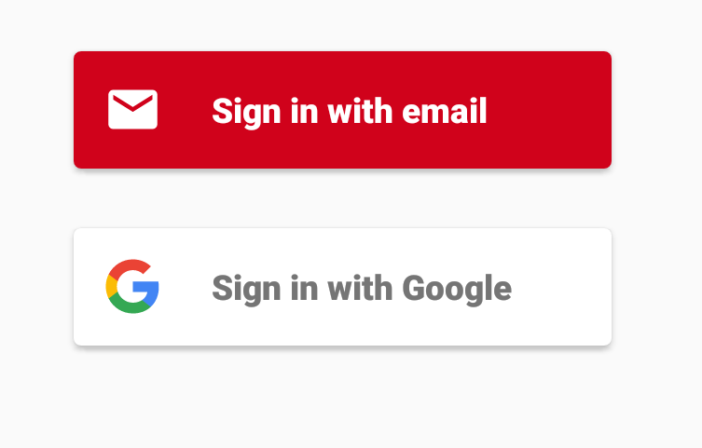
Setup and use
private FirebaseAuth mFirebaseAuth;
private FirebaseAuth.AuthStateListener mAuthStateListener;
mFirebaseAuth = FirebaseAuth.getInstance();

Slide 37
Setup and use (2)
In onResume,
mFirebaseAuth.addAuthStateListener(mAuthStateListener);
Where
mAuthStateListener = new FirebaseAuth.AuthStateListener() { @Override public void onAuthStateChanged(@NonNull FirebaseAuth firebaseAuth) { FirebaseUser user = firebaseAuth.getCurrentUser(); if (user != null) { // User is signed in use user.getDisplayName() to get the name. } else { // User is signed out startActivityForResult( AuthUI.getInstance() //see firebase UI for documentation. .createSignInIntentBuilder() .setIsSmartLockEnabled(false) .setAvailableProviders(Arrays.asList( new new AuthUI.IdpConfig.EmailBuilder().build(),
new AuthUI.IdpConfig.GoogleBuilder().build(),
new AuthUI.IdpConfig.PhoneBuilder().build())) .build(), RC_SIGN_IN); } } };
Again, don't forget to remove the listener in onPause()
mFirebaseAuth.removeAuthStateListener(mAuthStateListener);

Slide 38
Setup and use (3)
In onActivityResult
if (requestCode == MainActivity.RC_SIGN_IN) {
if (resultCode == RESULT_OK) {
mFirebaseUser = mFirebaseAuth.getCurrentUser();
mUsername = mFirebaseUser.getDisplayName();
} else {
//failed login.

Slide 39
storage

Slide 40
Storage
This allows for file storage in the cloud
It handles all the networking and syncing between cloud and device.
Again should use authentication.
Can specify any of rules on what the users are allowed to write to/read from the storage.
dependencies
implementation 'com.google.firebase:firebase-storage:19.1.1'

Slide 41
Setup and use.
private FirebaseStorage mFirebaseStorage = FirebaseStorage.getInstance();
private StorageReference mChatPhotosStorageReference = mFirebaseStorage.getReference().child("photos");
Where photos is directory in storage. See the console to create directories.

Slide 42
Setup and use (2)
Add to storage
StorageReference photoRef = mPhotosStorageReference.child(filename);
Where filename is the name you want to the file to use in storage.
Upload file to Firebase Storage
UploadTask uploadTask = photoRef.putFile(selectedImageUri);
now we need the download url to add the db, but have do it with second task.
Task<Uri> urlTask = uploadTask.continueWithTask(new Continuation<UploadTask.TaskSnapshot, Task<Uri>>() {
@Override
public Task<Uri> then(@NonNull Task<UploadTask.TaskSnapshot> task) throws Exception {
if (!task.isSuccessful()) { throw task.getException(); }
Continue with the task to get the download URL
return photoRef.getDownloadUrl();
}
}).addOnCompleteListener(new OnCompleteListener<Uri>() {
@Override
public void onComplete(@NonNull Task<Uri> task) {
if (task.isSuccessful()) {
Uri downloadUri = task.getResult();
} else { // Handle failures}
}
Download from
Use any method to download with a standard urll

Slide 43
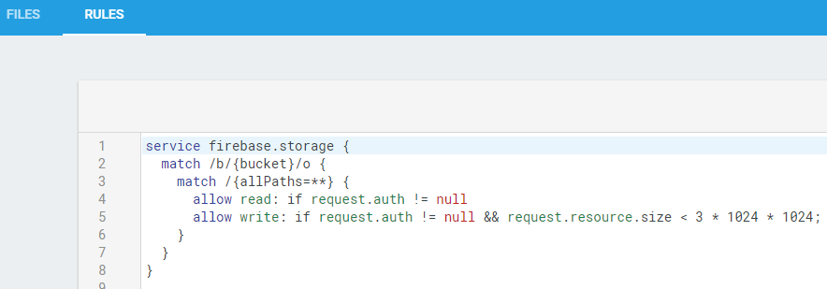
Security and authentication
Storage by default doesn't have any security.
It's suggested you use something like
https://firebase.google.com/docs/storage/security/start

Slide 44
remote config

Slide 45
Remote Config
Allows you to put some variables in the cloud
This allows you change them in the console and push them to the app.
You can push different values to groups of devices as well. (maybe based on what you see in the analytics)
dependencies
implementation 'com.google.firebase:firebase-config:19.1.1'

Slide 46
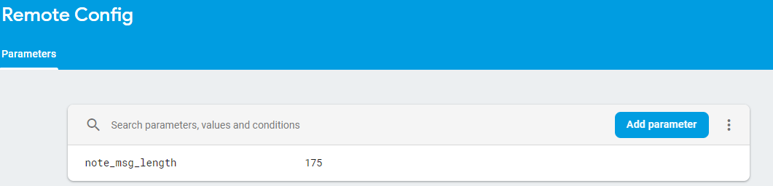
Setup and use.
First in the console add the parameters and values
In the app:
Have default value for all parameters
private FirebaseRemoteConfig mFirebaseRemoteConfig = FirebaseRemoteConfig.getInstance(); FirebaseRemoteConfigSettings configSettings = new FirebaseRemoteConfigSettings.Builder() .setMinimumFetchIntervalInSeconds(0L) //3600L for normal, every 5 minutes. 0 for debug
.build(); mFirebaseRemoteConfig.setConfigSettings(configSettings);

Slide 47
Setup and use (2)
Define default config values. Defaults are used when fetched config values are not available. Eg: if an error occurred fetching values from the server.
Map<String, Object> defaultConfigMap = new HashMap<>();
defaultConfigMap.put(NOTE_LENGTH_KEY, DEFAULT_MSG_LENGTH_LIMIT);
mFirebaseRemoteConfig.setDefaults(defaultConfigMap);
Now fetch the parameters.
mFirebaseRemoteConfig.fetch(cacheExpiration) .addOnSuccessListener(new OnSuccessListener<Void>() { @Override public void onSuccess(Void aVoid) { mFirebaseRemoteConfig.activateFetched();} }) .addOnFailureListener(new OnFailureListener() { @Override public void onFailure(@NonNull Exception e) { // An error occurred when fetching the config. Log.w(TAG, "Error fetching config", e); } });
Somewhere else called likely in success and failure (remember defaults!)
long note_msg_length = mFirebaseRemoteConfig.getLong(NOTE_LENGTH_KEY);

Slide 48
functions

Slide 49
Functions
You can write the "functions" you need (via Node.js) and use them on google cloud systems.
Low maintenance and it keeps your logic private and secure (not within the app itself)
Allows for you to use more cpu power then a device has.
These can connect to storage and database.
https://www.youtube.com/watch?v=bpFAdhNkA6c
You will need Node.js, npm (included in node), and firebase-tools. This all command line, not studio. See https://firebase.google.com/docs/functions/get-started

Slide 50
google authentication

Slide 51
Using Google Authentication with firebase
If you app already uses google authentication, (ie requires a google signin)
Then you can use that to login to firebase as well.
First sign in with Google Authentication
Pass the credentials off to firebase.
https://developers.google.com/identity/sign-in/android/sign-in

Slide 52
Google SignIn
In FireBase UI, we let it do the heavy lifting.
Here we will do it manually.
GoogleSignInOptions gso = new GoogleSignInOptions.Builder( GoogleSignInOptions.DEFAULT_SIGN_IN)
.requestIdToken(getString(R.string.default_web_client_id))
.requestEmail()
.build();
get the sign in client and start the activity for it.
mGoogleSignInClient = GoogleSignIn.getClient(getContext(), gso);
Intent signInIntent = mGoogleSignInClient.getSignInIntent();
startActivityForResult(signInIntent, MainActivity.RC_G_SIGN_IN);

Slide 53
Google SignIn (2)
In onActivityResult
if (requestCode == MainActivity.RC_G_SIGN_IN) {
Task<GoogleSignInAccount> task = GoogleSignIn.getSignedInAccountFromIntent(data);
try {
GoogleSignInAccount account = task.getResult(ApiException.class);
// Google Sign In was successful, authenticate with Firebase
firebaseAuthWithGoogle(account);
} catch (ApiException e) {
//failed to sign in.
}
}

Slide 54
firebaseAuthWithGoogle part.
Get the credential from the account.
AuthCredential credential = GoogleAuthProvider.getCredential(acct.getIdToken(), null);
Now sign in to the firebase.
mFirebaseAuth.signInWithCredential(credential)
.addOnCompleteListener(getActivity(), new OnCompleteListener<AuthResult>() {
@Override
public void onComplete(@NonNull Task<AuthResult> task) {
if sign in fails, display a message to the user. If sign in succeeds the auth state listener will be notified and logic to handle the signed in user can be handled in the listener.
if (!task.isSuccessful()) {
Log.w(TAG, "signInWithCredential", task.getException());
} else {
SignIn Success"
mFirebaseUser = mFirebaseAuth.getCurrentUser();
mUsername = mFirebaseUser.getDisplayName();
} } });

Slide 55
Example code
The FbDatabaseAuthDemo
Has code to firebase sign example
DBlistFragment and DBSimpleFragment use RealTime database example.
RCFragment has remoteconfig
StorageFragment has all the code for storage
MessingService will catch notification message (not cloud) even when the app is running.
InviteAntFragment is an attempt at invites, but doesn't seem to work.
FirebaseFireStoreDemo
uses the firestore db (can't have realtime and firestore in the same project) and authentication.

Slide 56
References
https://console.firebase.google.com/
https://firebase.google.com/docs/
Many of the sub doc's where listed on slides.
Code lab: FriendlyChat app (about 2ish hours)
https://codelabs.developers.google.com/codelabs/firebase-android/#0
Covers database, auth, invites, remote config, admob, analytics, and firebase notifications.
A short course (about 8 hours) Firebase in a weekend
https://classroom.udacity.com/courses/ud0352 (free course)
It's dated, but still pretty good.

Slide 57
Q
A
&

