Slide 1
Sensors, Microcontrollers & Packet Tracer
Frank Walsh

Slide 2
Agenda
Main aim is to provide enough knowledge so we can build and understand basic sensor/actuator systems using SBC/Microcontroller
Can simulate this in PacketTracer for now
Sensors/Transducers
Sensor Types
Connecting to a SBC
Sensors in Packet Tracer

Slide 3

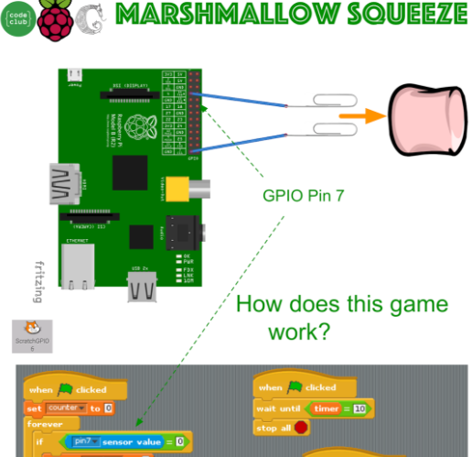
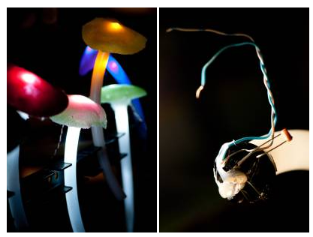
Context: Physical Computing
Break away from conventional input/output peripherals:
Keyboard, mouse, screen
Think about how human/environment signals can be captured and changed into electronic signals that can be interpreted by a computing device.
Physical computing applications tend to depend on people for input (and sometimes output), and transform that input into another form, like an animation, a sound, or motion.
Sometimes powerfully fuses art and technology.

Slide 4
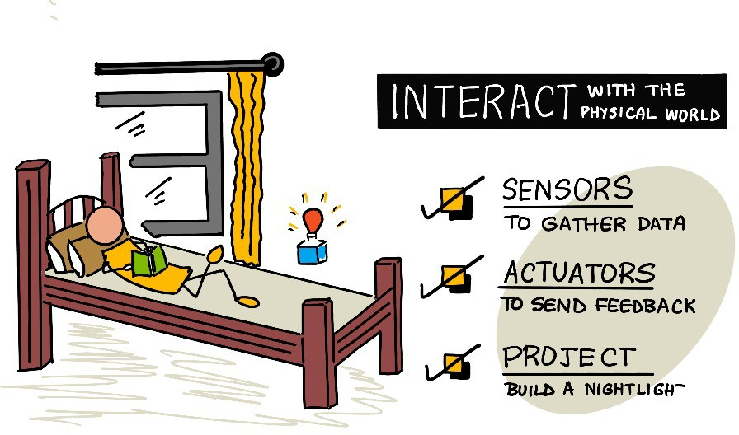
Simple Example: Night Light

Slide 5
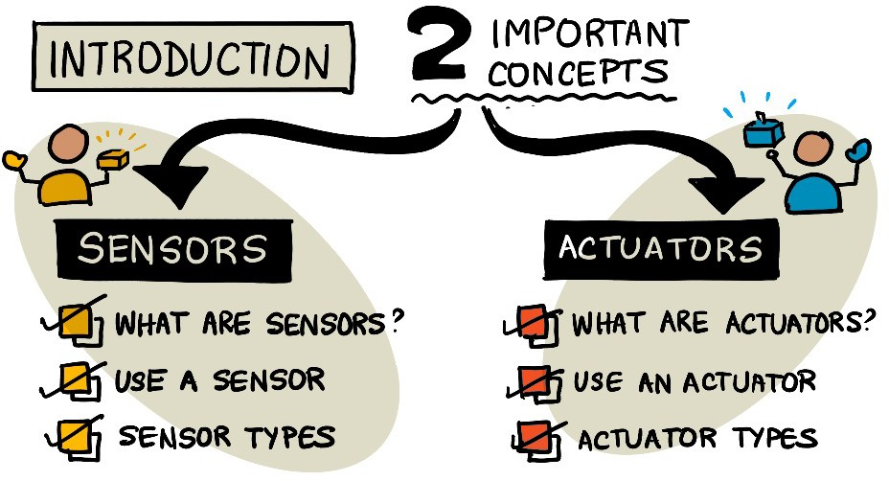

Slide 6
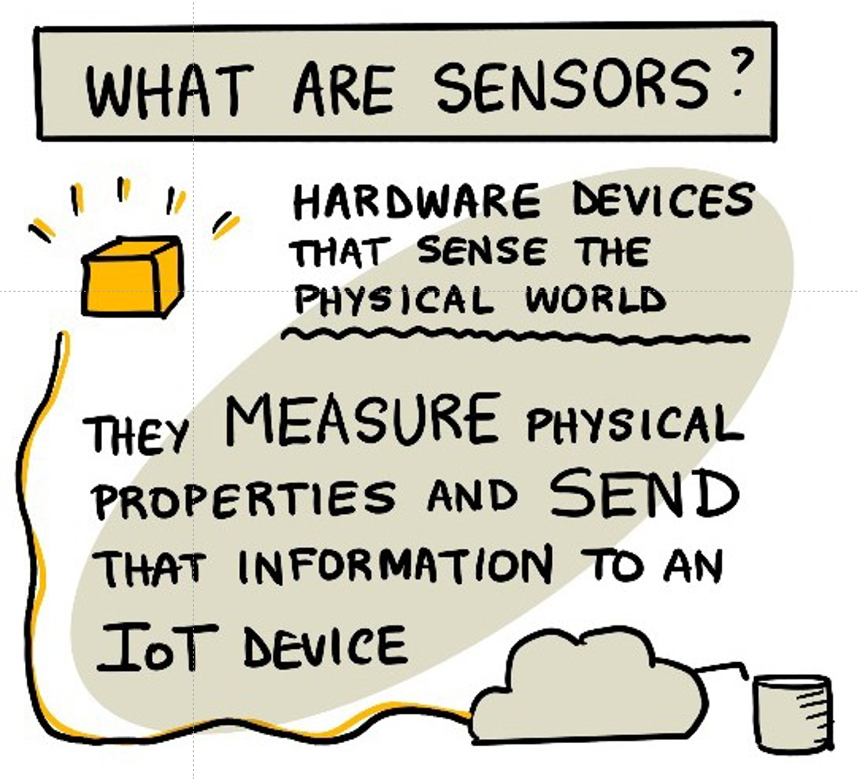
What are Sensors
Transducer
a device that converts a primary form of energy into a corresponding signal with a different energy form
Primary Energy Forms: mechanical, thermal, electromagnetic, optical, chemical, etc.
Can be a sensor or an actuator
A Sensor is a device that detects/measures a signal/stimulus
Acquires data from the “real world”
An Actuator generates a signal or stimulus from electrical signal.
Example: Servo Motor.
Sensors are everywhere
In our bodies, automobiles, airplanes, cellular telephones, radios
Necessary for automation.

Slide 7

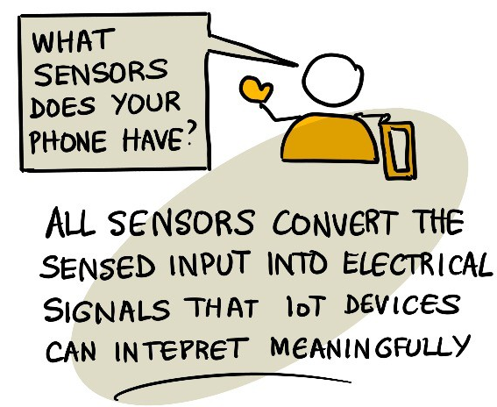
QI
Notes:
1. It’s estimated the less than 10% of the data generated by IoT devices is fully utilized. Yes. Example: Temp monitoring. Video monitoring in guards: While IoT generates vast amounts of data, we currently utilize less than 10% effectively, with most of it processed for immediate actions and discarded. Advances in edge computing, AI, and data integration are expected to improve utilization rates, enabling us to unlock the full potential of IoT-generated data. Examples: Smart Cities – Traffic cameras

Slide 8
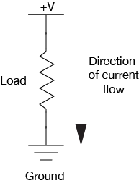
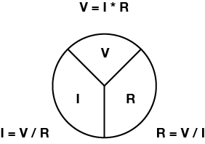
Electricity 101: Ohms Law
Voltage (V), Current (I), and Resistance (R) are all related, by the following formula:
V = I x R
electrical power (P) (measured in watts), as follows:
Watts = Volts * Amps
P = V * I

Slide 9
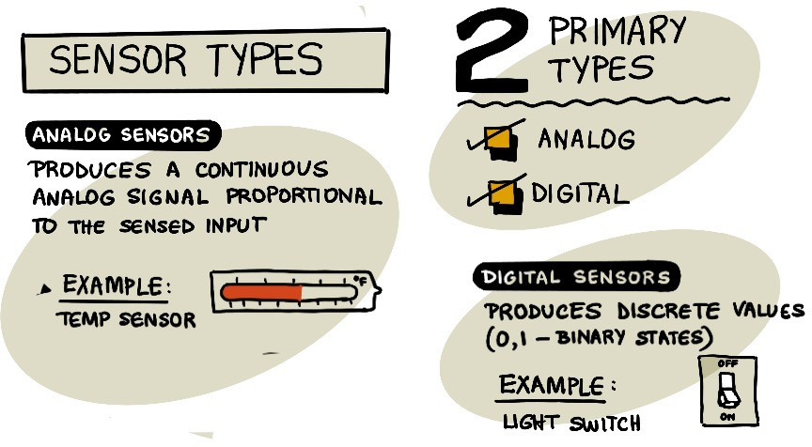

Slide 10
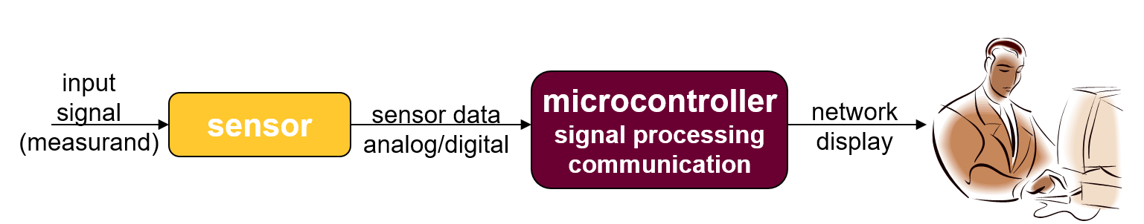
Sensor Systems
Typically interested in electronic sensors
convert desired parameter into electrically measurable signal
A Sensor may include:
primary transducer: changes “real world” parameter into electrical signal
secondary transducer: converts electrical signal into analog or digital values
Simple Electronic Sensor System:

Slide 11
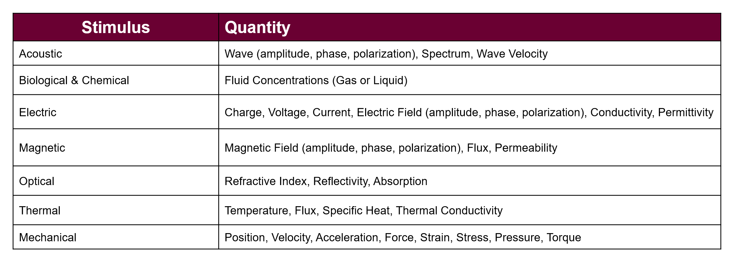
Detectable Phenomena

Slide 12
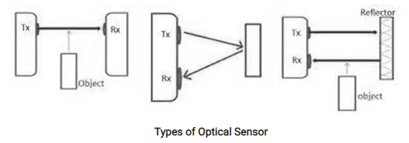
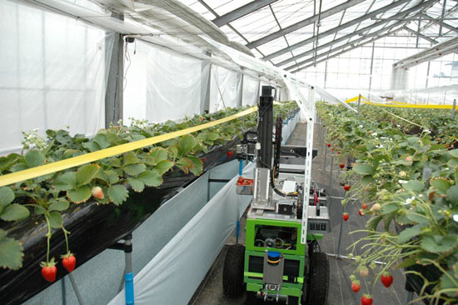
Sensor Use: Project Examples

Slide 13
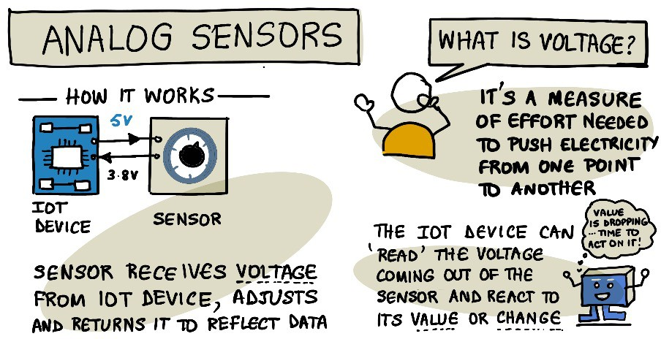

Slide 14
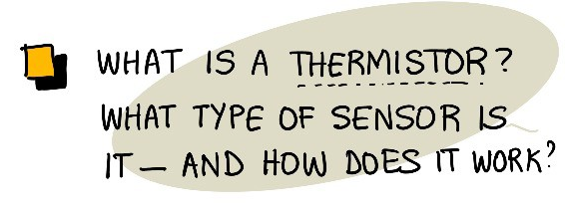
QI

Slide 15
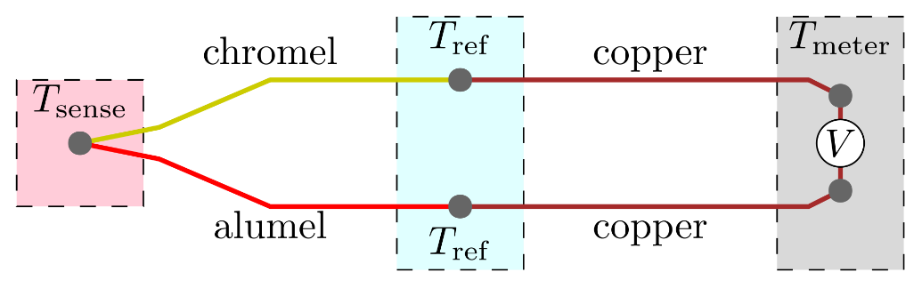
Temperature Sensors
Temperature sensors appear in building, chemical process plants, engines, appliances, computers, and many other devices that require temperature monitoring
Many physical phenomena depend on temperature, so we can often measure temperature indirectly by measuring pressure, volume, electrical resistance, and strain
Type of common temperature transducer
Resistance Temperature Detector (RTD)
Thermistors
Thermocouples

Slide 16
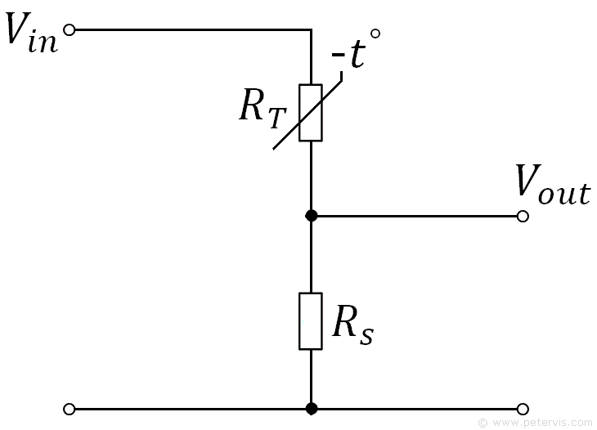
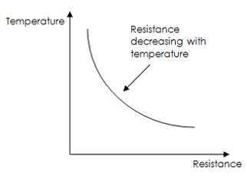
Thermistor
A thermistor is a type of resistor with resistance varying according to its temperature. The resistance is measured by passing a small, measured direct current through it and measuring the voltage drop produced.

Slide 17
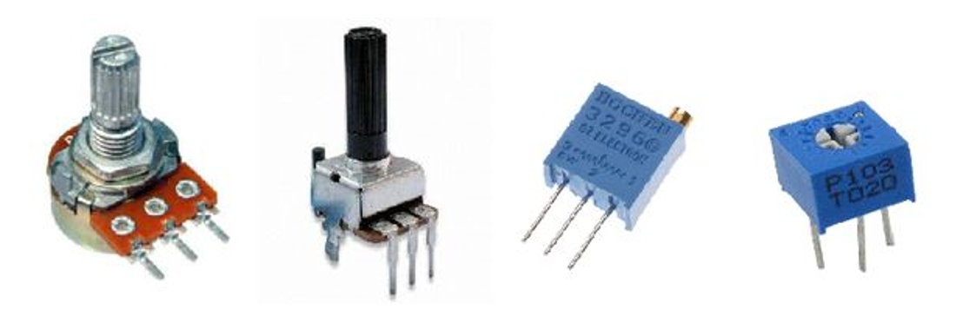
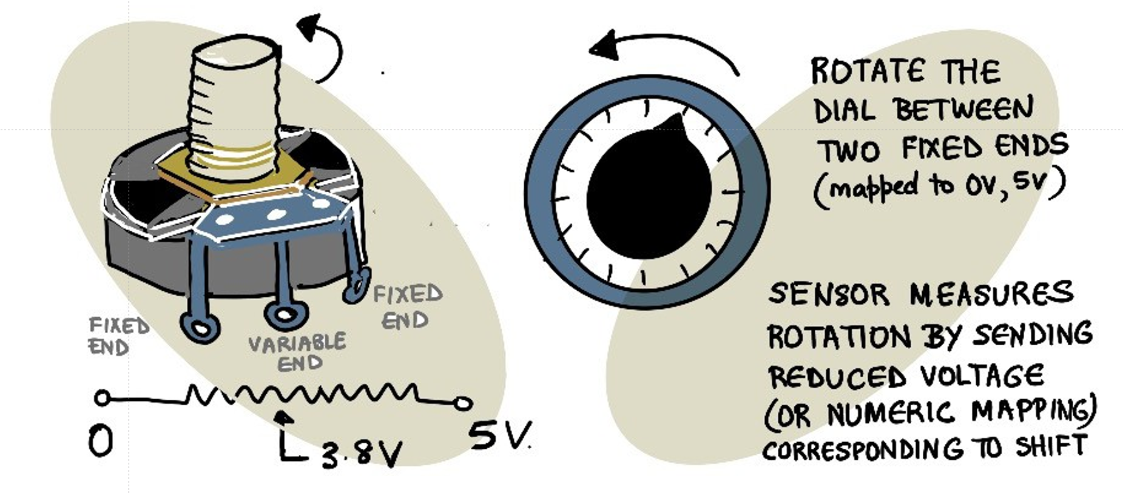
Potentiometer

Slide 18
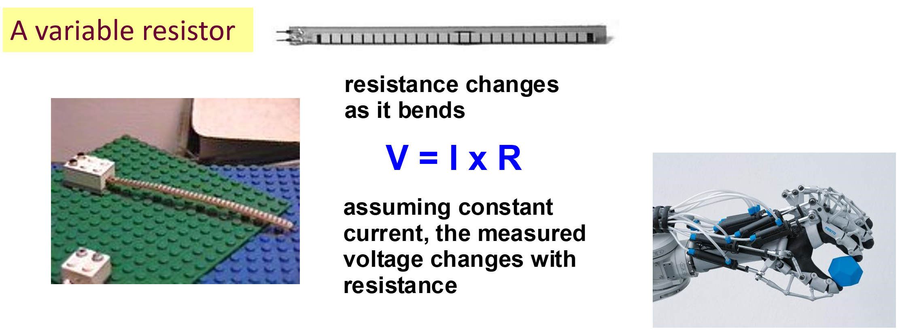
Band Sensor

Slide 19
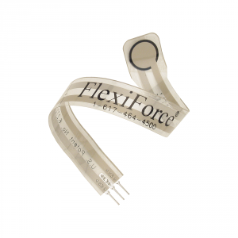
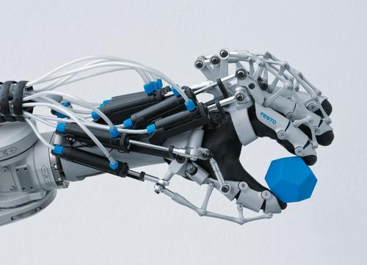
Force Sensor
Detect and measure a relative change in force or applied load
Detect and measure the rate of change in force
Identify force thresholds and trigger appropriate action
Detect contact and/or touch
Applications:
Touch Pads (i.e. VR Gloves, Joysticks)
Alarm Systems
Aerospace
Robotic Grip Force

Slide 20

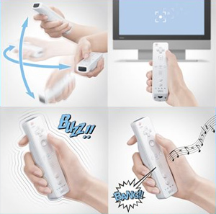
Accelerometers
Measures Acceleration
Application:
Vibrations, blasts, impacts, shock waves
Air bags, washing machines, car alarm
They can come in 1, 2 or 3 axis configurations
With 3 axis it gives a vector of the accelerations direction (after accounting for gravity)
Used in electronics like the Wii and iPhone for user input

Slide 21
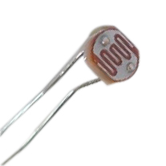
Light Sensor
photoconductor
light → ΔR
photodiode
light → ΔI

Slide 22
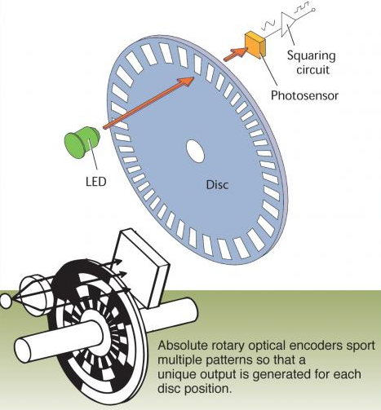
Optical Encoders
Notes:
A rotary encoder, also called a shaft encoder, is an electro-mechanical device that converts the angular position or motion of a shaft or axle to analog or digital output signals.
Incremenntal Encoders, absolute encoders
he output of an absolute encoder indicates the current shaft position, making it an angle transducer. The output of an incremental encoder provides information about the motion of the shaft, which typically is processed elsewhere into information such as position, speed and distance.

Slide 23
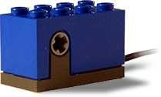
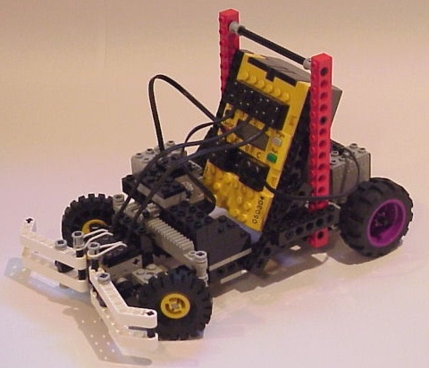
Sample Problem: Sensor Analysis
How far does vehicle travel for 1 encoder count?
How many counts are there per meter of travel?
What should the wheel diameter be for 1cm / count.

Slide 24











Sample Problem: How far does vehicle travel for 1 encoder count?

Slide 25



Sample Problem: How many encoder counts will there be for 1 meter of travel?

Slide 26
Sample Problem: Suppose I want 1.0 cm / count, what wheel diameter

Slide 27
Connecting Sensors to Microcontroller/Single Board Computer
Analog Sensors
many microcontrollers have a built-in ADC
8-bit to 12-bit resolution common
many have multi-channel ADC inputs
Raspberry Pis do not have built in ADC
Digital Sensors
serial I/O
use serial I/O port, store data in memory to analyze later
Synchronous (with clock)
must match byte format, stop/start bits, parity check, etc.
asynchronous (no clock): more common for communication
must match baud rate and bit width, transmission protocol, etc.
sensor
µC
signal timing
memory
keypad
sensor
display
instrument

Slide 28
“Smart” Sensors
“Smart sensor” = sensor with built-in signal processing & communication
E.g., combining a “dumb sensor” and a microcontroller
Data Acquisition Cards (DAQ)
PC card with analog and digital I/O
interface through LabVIEW or user-generated code
Communication Links Common for Sensors
asynchronous serial communication
universal asynchronous receive and transmit (UART)
1 receive line + 1 transmit line. nodes must match baud rate & protocol
RS232 Serial Port on PCs uses UART format (but at +/- 12V)
can buy a chip to convert from UART to RS232
synchronous serial comm.
serial peripheral interface (SPI)
1 clock + 1 bidirectional data + 1 chip select/enable
I2C = Inter Integrated Circuit bus
designed by Philips for comm. inside TVs, used in several commercial sensor systems
IEEE P1451: Sensor Comm. Standard
several different sensor comm. protocols for different applications

Slide 29
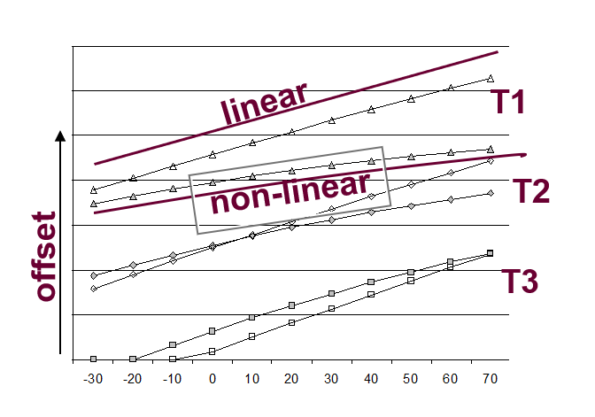
Sensor Calibration
Sensors can exhibit non-ideal effects
offset: nominal output ≠ nominal parameter value
nonlinearity: output not linear with parameter changes
cross parameter sensitivity: secondary output variation with, e.g., temperature
Calibration - adjusting output to match parameter
analog signal conditioning
look-up table
digital calibration
T = a + bV +cV²,
T= temperature; V=sensor voltage;
a,b,c = calibration coefficients
Compensation
remove secondary sensitivities
must have sensitivities characterized
can remove with polynomial evaluation
P = a + bV + cT + dVT + e V², where P=pressure, T=temperature

Slide 30
Sensor Performance
Range
maximum and minimum values that can be measured
Resolution or discrimination
smallest discernible change in the measured value
Error
difference between the measured and actual values
random errors
systematic errors
Accuracy, inaccuracy, uncertainty
accuracy is a measure of the maximum expected error
Linearity
maximum deviation from a ‘straight-line’ response
Sensitivity
a measure of the change produced at the output for a given change in the quantity being measured

Slide 31
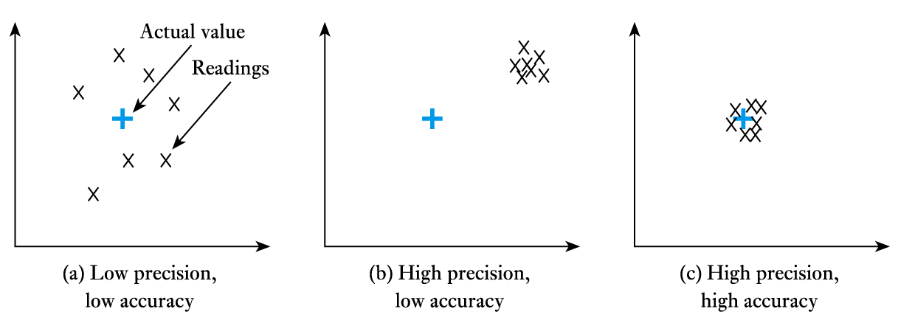
Sensor Performance
Precision/Accuracy
a measure of the lack of random errors (scatter)

Slide 32
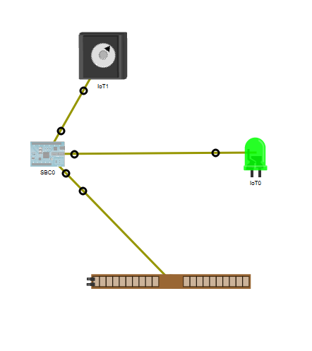
Packet Tracer 8.x and IoT
Packet Tracer 8.x can be used as a prototyping tool.
There is a new group icon contained in Packet Tracer that is labeled Components.
The PT IoT boards contains an MCU and a SBC.
The MCU and SBC are similar to an Arduino and a Raspberry Pi, respectively.
There are also actuators and sensors that can be used in prototypes.
The IoE Custom Cable found in the Connections group can be used to connect IoT things to an MCU board.

Slide 33
Packet Tracer Demo….

