Slide 1
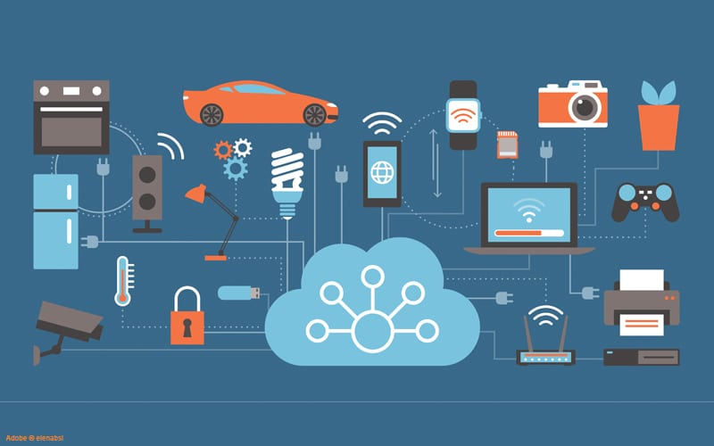
IoT Platforms
Frank Walsh
This Photo by Unknown Author is licensed under CC BY-NC-ND

Slide 2

What is the Cloud?
Before the Cloud
Expensive and Slow
Companies managed their own data centers. They handled everything from hardware to security.
This was costly and required specialized staff. Scaling resources was slow and challenging.
Data centers manage buying computers, hardware maintenance, power and cooling, networking, security, and software installation.

Slide 3
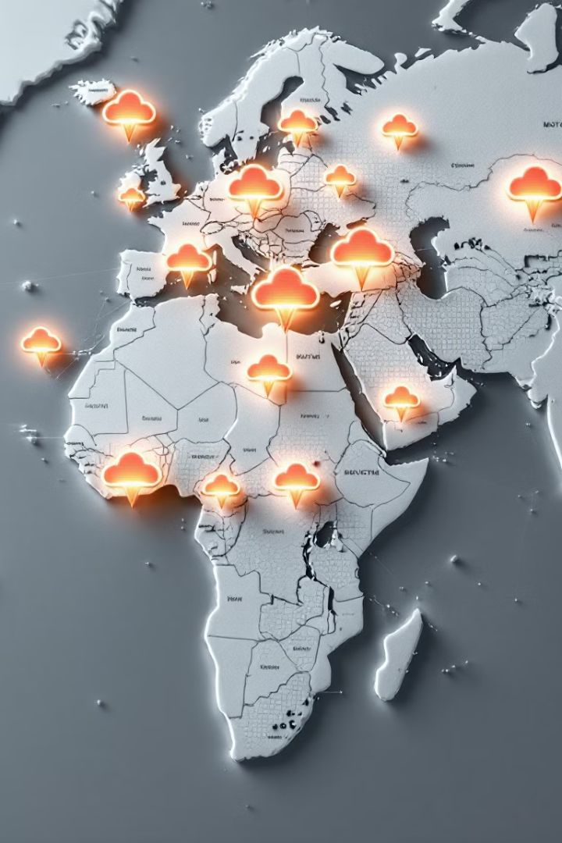
Someone Else's Computer
1
Cloud Computing
2
Global Data Centers
Rent computing power instead of buying hardware. Cloud providers manage the data centers.
Cloud data centers are located worldwide. They are managed by cloud computing providers.
3
Cost Effective
Pay for what you use, scaling resources as needed. This lowers costs and increases efficiency.

Slide 4
What are IoT platforms
IoT applications combine sensors, devices, data, analytics and integrations in a seamless and unified way
  e.g. your project!
IoT Platforms provide software tools and components to:
  connect sensors, devices, and data networks
  Analyse and store data
  Integrate with other apps
So what? We know the tech for that now (I2C, SPI, BLE, MQTT, Python...)
Main selling point of an IoT platform is software that it
  accelerates the IoT development process
  Focuses on IoT: brings in best of breed features
  Provides initial scaffolding for IoT projects

Slide 5
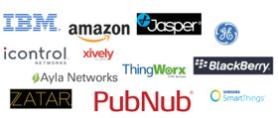
What are IoT Platform
Many(not all) are cloud-based platforms that require subscription
Provide device/language agnostic set of Software Development kits
  Arduino/RPi/beagleboard
IoT development is generally iterative:
  Starts with initial simple use case
  Once operational, data/insights result in new usecased
IoT platforms should promote scalable, iterative development
  Allow for quick app development
  Ability to adapt/optimise apps quickly

Slide 6
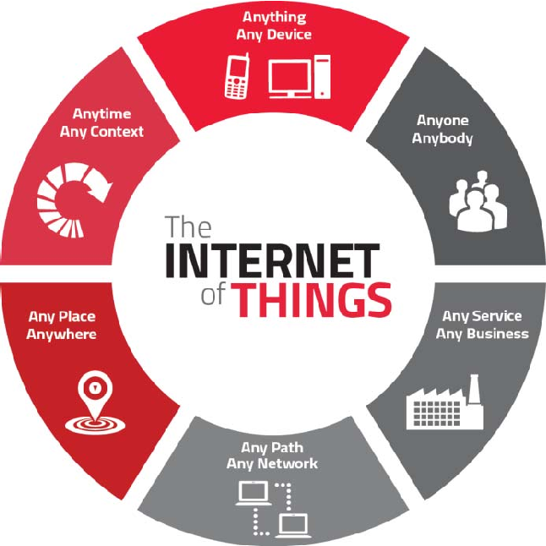
IoT Platform Characteristics
Manage many concurrent device connections
Connectivity across several connection types
"Off-the-peg" IoT protocol stack
Manage/analyse/visualise data
Integrations to other services/apps
App Development

Slide 7

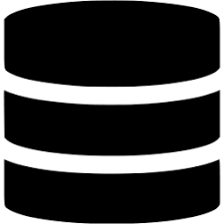





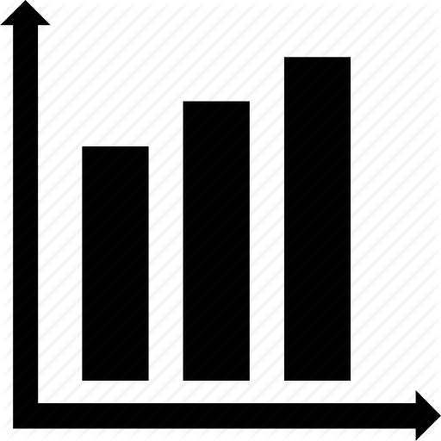
IoT Platform – general architecture
Configure analytics/visuals/apps
Data/commands
IoT Platform
Deploy algorithms to devices

Slide 8
IoT Platform Advantages
Use sofware component that has been pre-built and pre-tested. This increases the reliability of your application and reduces development effort.
IoT frameworks constantly evolve, providing new features, integrations etc.
Encourages better "design pattern" for your IoT app.
Predefined APIs and docs
  Great for collaboration
"Baked-in" standards and features:
  Security, authentication, scalability...

Slide 9

Which one?
Connectivity
  Does the platform provide suitable capability and integrations (WiFi/Cellular/LPWan-Sigfox)
Maturity
  In business for long? Critical mass in developer community?
Free
  Is there a free tier (handy for evaluation)?
Service type
  Platforms try to distinguish themselves – what specialisms/USP does it have?
Security
  What security model do they use? Is there security issues reported in past?
Geographic area
  Does it operate well at your location (can you select edges/data centres)

Slide 10
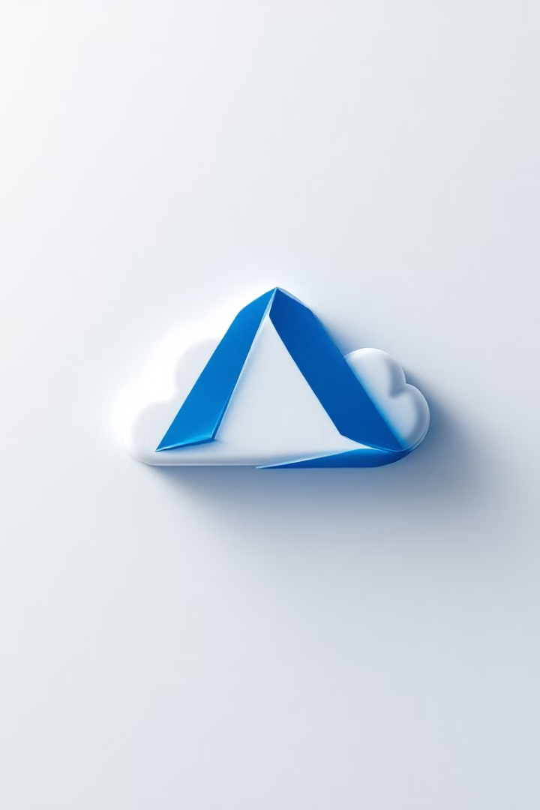
Microsoft Azure
1
Azure
Azure is Microsoft's cloud platform
2
Azure for Students
Students get $100 credit and free IoT services. No credit card is needed.
3
Azure Free Subscription
Free tiers of services. A credit card is required.

Slide 11
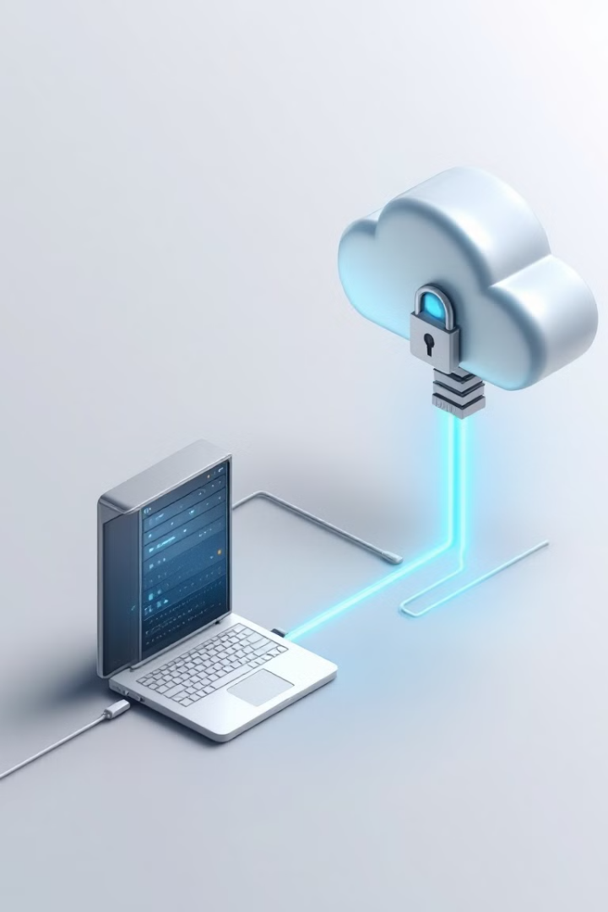



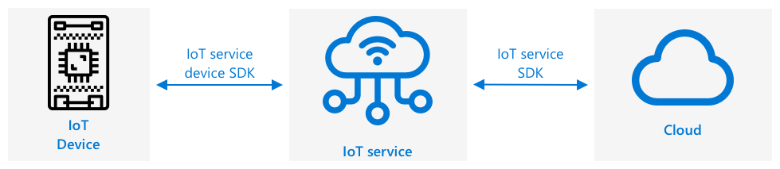
Azure IoT Services
Security
Performance
Device SDK
Security is baked-in to prevent data breaches and rogue commands.
High performance with the ability to handle millions of messages.
Connect using a device SDK or communication protocol like MQTT.
Cloud IoT services solve reliability, security, performance, and discovery issues. Cloud providers offer free versions for development.

Slide 12
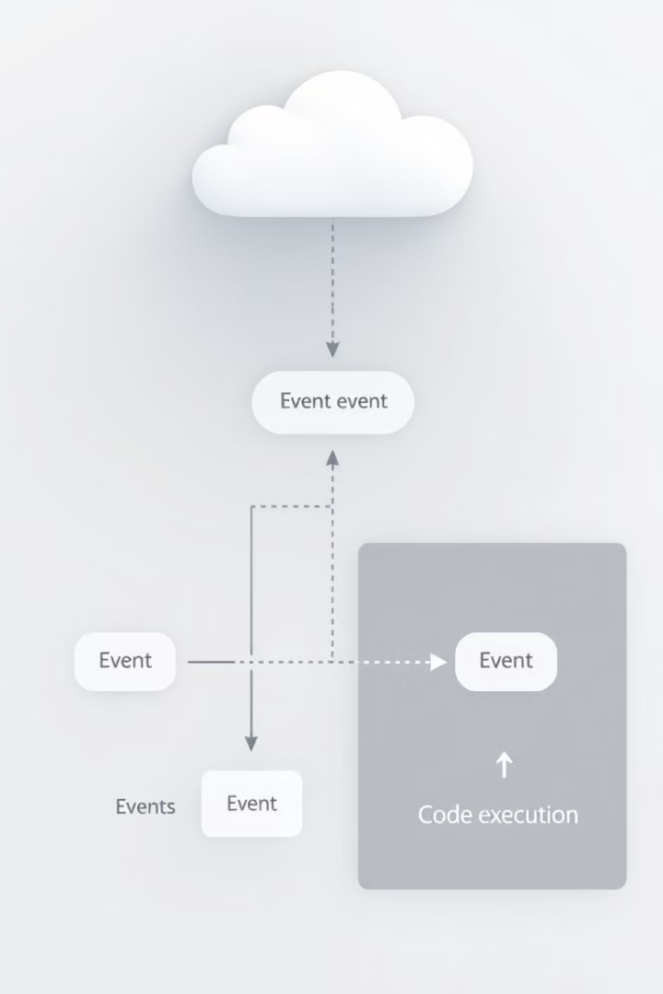
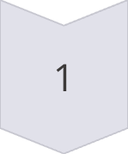
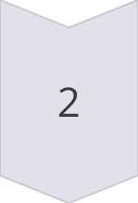
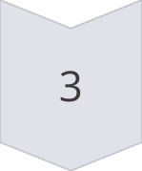
What is Serverless?
Small Code Blocks
Run small blocks of code in response to events.
Event-Driven
Code runs when an event happens, triggered by data changes.
Scalable
Cloud provider runs the function as needed.
Serverless computing creates small code blocks that run in the cloud in response to events. You pay for the time your code is running and the memory used.

Slide 13



Create a Serverless Application
2
Python
1
Azure Functions
Triggers
3
Azure Functions is the serverless computing service from Microsoft. Write functions in Python, JavaScript, C#, or other languages.

Slide 14
Create an IoT Hub Event Trigger
1
Functions App
2
IoT Hub Trigger
3
Event Hub
Add an IoT Hub trigger to respond to IoT Hub events. Connect to the event hub compatible endpoint.

Slide 15

Send Direct Method Requests
Registry Manager
Cloud to Device
Send commands to IoT devices.
Communicate with devices via messages.
Connection String
Connect with the Registry Manager.
Use the Registry Manager to send cloud to device messages. This allows commands to be sent to the IoT device.

