Slide 1
Publish-Subscribe Systems
Ken Birman
Many slides from Aseem Bajaj (2004)

Slide 2
Publish-Subscribe
Often called “event notification”
Producer publishes messages
Consumer expresses interest by subscribing to various topics
Platform accepts messages (“events”), finds matching subscribers, does upcall to deliver

Slide 3
Styles of pub-sub
Multicast – TIBCO or older Isis news platform
Web Services – as a callback infrastructure
  Amazon at one point ran all communication over a pub-sub bus, but found this unstable
  People like location-independent addressing
For routing or filtering in data centers
  Often done in hardware, for load-balancing or to deliver requests to the right server

Slide 4
Origins
Zwaenepoel/Cheriton (V system)
  Mention idea in connection with group communication
ISIS Project
  Process groups & group communication
  ISIS Toolkit, 1987 included “news” system
Tibco
  The Information Bus – An Architecture for Extensible Distributed Systems, 1993

Slide 5
Background (cont.)
Gryphon Project, IBM
  Matching Events in Content-based Subscription System, 1999
  Enterprise Middleware
Siena Project, Univ of Colorado
  Design of Wide Area Event Service, 1998
XML Event Routing
  Mesh based Content Routing using XML, 2001
Cayuga Event Filter – Cornell (Gehrke, Demers)

Slide 6
Issues
Design of the name space
Implementation of matching, routing, low-level protocols
  Choice of ‘information spaces’
  Complexity of subscriptions
  Performance
Application-visible “programming model”
  Can application retrieve “past history”? Does the pub-sub system offer any kind of real semantics?
  What kinds of failures can arise? How are they handled?

Slide 7
Information Bus
Suggests that publish subscribe is a powerful model for distributed systems
Introduces a framework around the information bus: types, classes, objects, services
Shows how to use such a bus to build distributed applications
Introduces Anonymous Communication & Subject Based Addressing

Slide 8
Content-based Subscription System
Assumes publish-subscribe infrastructure
But rather than limiting matching to “topics” goes further and allows queries against the actual content of messages
Problem becomes one of matching at high speeds

Slide 9
TIBCO paper: Benefits of pub-sub
Decouples publisher from subscriber
Easy to add new kinds of subscribers or upgrade components – hence allows continuous operations
  No system downtime for upgrades or maintenance
Dynamic System Evolution
  Start with something simple, then build up over time
  A kind of plug-and-play integration of new components

Slide 10
Extensible Distributed Systems: Principles
Minimal Core Semantics
  Communication system makes least possible assumptions about the application (“weak semantics”)
Self-Describing Objects
  Objects support queries about meta-information like type, attribute names & types, operation signatures
Dynamic Classing
  Introduction of classes at runtime supported by TDL, a small interpreted language
Anonymous Communication
  Subject Based Addressing. Messages sent and received by subject rather than identities.

Slide 11
This turns out to pose serious problems for some applications…. Issue is that some publishers may actually have a specific subscriber in mind and yet there is no way to sense the error case where the subscriber isn’t actually running or the bus drops the message
This turns out to pose serious problems for some applications. Why?
Anonymous Communication
Subject Based Addressing
Publisher produces content without knowing the consumer, labels the content with hierarchically structured subject like news.equity.YHOO
Consumer accepts content based on the Content
  Subscription can be wild carded
System evolution
  Subscriber can be introduced anytime, starts consuming
  Publisher can be introduced anytime, start publishing

Slide 12
Architecture
Types are like interfaces
Classes implement types
Objects are instances of classes
Service Objects
  Encapsulate & control access to system resources e.g. database system, print service
  Cannot be transferred to nodes other than where they reside, invoked from their location using some kind of RPC

Slide 13
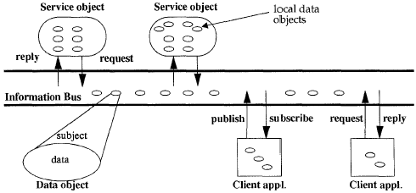
Bus Architecture

Slide 14
Implementation Details
Local Area Networks
  Each node has a daemon running
  Applications register, place subscriptions on daemon
  Ethernet broadcasts (unreliable)
  Daemon gets all messages on Ethernet, forwards to applications based on subscriptions
Wide Area Networks
  Application Level Information Routers
  Routers receive messages by placing subscriptions
  Pass on messages to other routers that then get re-published on another ‘bus’.
  Messages only republished on buses that have subscriptions for that subject

Slide 15
Reliability
How does this happen?
During load surges, network or receiver nodes can become lossy, triggering a further surge of retransmit requests and retransmissions. Effective goodput rate collapses to perhaps 5%. Especially common using Ethernet broadcast (a “broadcast storm”)
After 90 seconds, TIBCO gives up (assumes receiver has crashed) and stops trying. Sender sees no error indication.
When all is working normally (nobody crashes and network is reasonably reliable)
  Message delivered to subscriber exactly once
  Order maintained for same sender, not multiple
Either sender-receiver crash or long-term network partition
  Message delivered to subscriber at most once
When network becomes severely overloaded
  Big users observe strange phenomenon: 90 seconds of complete shutdown of TIBCO, during which all messages vanish, then restart of services… and this repeats.

Slide 16
Asserted semantics
Guaranteed Message Delivery
  Message stored before sending
  Publisher retransmits unless acknowledged
  Message delivered to subscriber at least once
Question: Does TIBCO achieve these?

Slide 17
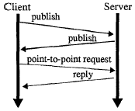
Dynamic Discovery &
Remote Method Invocation
(Who’s out there?)
Dynamic Discovery
(I am)
RMI

Slide 18
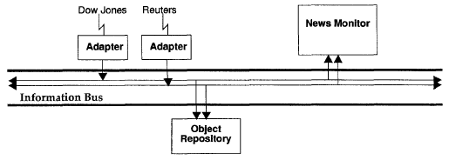
Brokerage Trading Floor

Slide 19
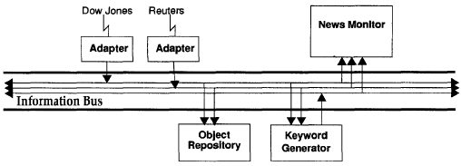
Brokerage Trading Floor
Introduce Keyword Generator
Subscribes and accepts stories
Publishes keywords as property objects
Monitors interprets & displays the property objects

Slide 20
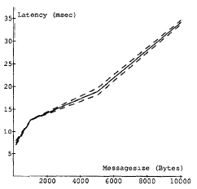
Latency
Sun SPARCstation 2s with 24MB RAM, Sun IPXs with 48MB RAM
Lightly loaded 10Mbps Ethernet
15 nodes: 1 publisher, 14 consumers
1 subject
Latency vs. message Size
*99% confidence intervals in dashed lines
Notes:
Latency=average time between sending and receiving of an event
Latency found to be independent of the number of consumers

Slide 21
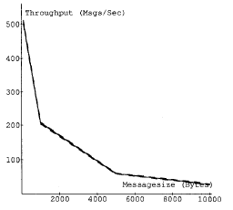
Throughput
Message volume vs. message Size
1 publisher
14 consumers
1 subject
Batch Processing Parameter on
  Delays small messages
  gathers them together
  Improves throughput

Slide 22
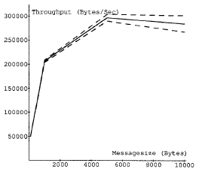
Throughput
Byte volume vs. message Size
1 publisher
14 consumers
1 subject
Batch processing parameter on

Slide 23
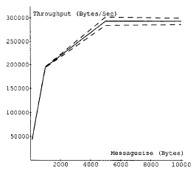
Throughput
Byte volume vs. Message Size
1 publisher
Publishes on 10,000 subjects
14 consumers
Consumer subscribe to all subjects
Batching processing parameter on

Slide 24
Information Bus - Discussion
Are semantics strong enough?
  Recalls Linda: great idea but fuzzy around edges
  Here, issues revolve around handling of overloads and receiver crashes
  Also impossible to implement a history mechanism with strong semantics
But paper argues strongly that end-to-end philosophy supports their model

Slide 25
Content filtering
A rich area
Gryphon really looks at two issues
  Content filtering on a single node
  Routing infrastructure
Most modern systems don’t bother with the routing infrastructure and do content filtering on a server – messages flow through it
  Has obvious capacity limits

Slide 26
The Matching Problem
Instead of a topic subscription, user poses a query over the messages
Our task: combine parts of subscription to reduce the number of tests for each event
Cayuga system here at Cornell takes this idea way beyond what Gryphon offered

Slide 27
Matching Algorithm
Analyze subscriptions
  sub := pr1 ^ pr2 ^ pr3
  Conjunction of elementary predicates
  pri = testi(e) -> resi
  e.g. (city=LA) and (temprature < 40)
  pr1 = test1(…) -> LA
  pr2 = test2(…) -> “<“
  test1 = “examine attribute city”
  test2 = “examine attribute temperature 40”

Slide 28
Matching Algorithm
Preprocess to make matching tree
Each non-leaf node is a test
Each edge from test node is a possible result
Each leaf node is a subscription
Pre-process each of the subscriptions and combine the information to prepare the tree
On receiving events, follow the sequence of test nodes and edges till a leaf node is reached

Slide 29
Gryphon internals
Gryphon implements the Java Messaging Service publish/subscribe specification.
allows arbitrary filters based loosely on SQL where clause semantics.
  More recent systems such as Cayuga have focused on the XML query language

Slide 30
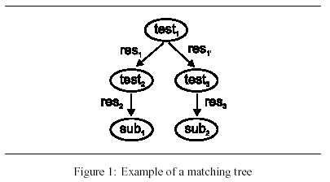
Matching Trees
Note that they really only handle equality queries.
Key feature, result 1 from test 1 leads to exactly one place…

Slide 31
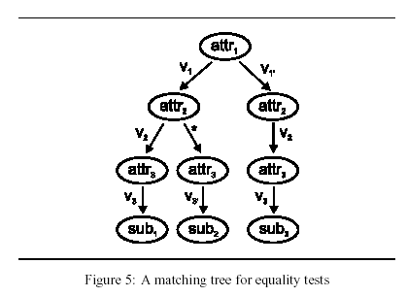
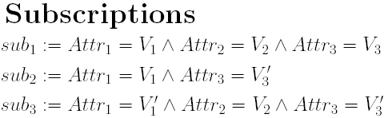
Matching Tree with *-edges

Slide 32

The important formulae
V is the number of possible values an attribute can take
K is the number of attributes
S is the set of subscriptions
C(S) is the expected cost

Slide 33
Optimizations
Collapse a chain of * edges (60% gain)
  Example: collapse B to A
Statically pre-compute successor nodes
  Assumption: non-* edges evaluated before *-edge
  Idea is to use information about traversal to skip over tests including *-edges that are implied
  Example: For any event <1,2,3,8,2> consider successors of node C <a1=1,a2=2,a3=3>
    H:<a1=1,a2=2,a3=*>
    G:<a1=1,a2=*,a3=3>
    D:<a1=*,a2=2,a3=3>
  Since D doesn’t exist, consider it’s successors
    E:<a1=*,a2=*,a3=3>
    F:<a1=*,a2=2,a3=*>

Slide 34
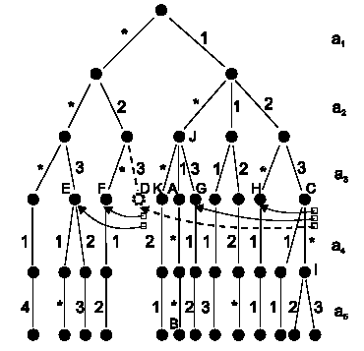
Optimizations

Slide 35
Optimizations
More aggressive static analysis (20% gain)
Separate sub-trees for attributes that rarely have don’t care in subscriptions

Slide 36
Performance
Pentium 100MHz, Java based prototype
Attributes vary in popularity, follow Zipf’s distribution
Tests for 30 attributes with 3 possible values
Distribution always got 100 matches per event

Slide 37
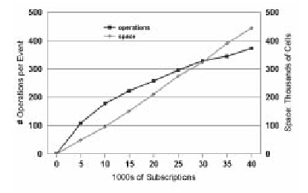
Performance
Operations per Event
Space (thousands of cells)
1000’s of subscriptions
Operations per Event
Space per Event = Edges + Successor nodes
Latency: 4ms for 25,000 subscriptions

Slide 38
Content based subscription
Discussion
  Do applications actually want to query message contents in this manner?
  Gryphon goes to great lengths to optimize its routing structure. But in practice would this feature be useful?
  Could a user launch an unintended denial of service attack by posing a very complex query?

