Slide 1
Indirect Messaging
Frank Walsh

Slide 2

Agenda
Indirect Messaging
  MQTT
  MQTT Security
Example:
  Publish Env data to broker.
This Photo by Unknown Author is licensed under CC BY-SA

Slide 3
Indirect Messaging
Publish Subscribe

Slide 4
Using the “Middleman”
Direct Communication
A
B
  Communication between processes using an intermediary
    Sender → “The middle-man” → Receiver
    No direct coupling
  Up to now, only considered Direct Coupling
    Introduces a degree of rigidity
  Consider…
    What happens if a device fails during communication in Direct Coupling?
    What if you'd like to add
  Two important properties of intermediary in communication
    Space uncoupling (devices don't need to "know" about each other)
    Time uncoupling (devices don't need to be "available" at the same time)
Indirect Communication
A
B
Intermediary

Slide 5

MQTT
MQ Telemetry Transport (MQTT)
Telemetry
  Remote measurements
Created by IBM
  from message queueing (MQ) architecture used by IBM for service oriented networks.
  Telemetry data goes from devices to a server or broker.
  Uses a publish/subscribe mechanism.
Lightweight both in bandwidth and code footprint

Slide 6
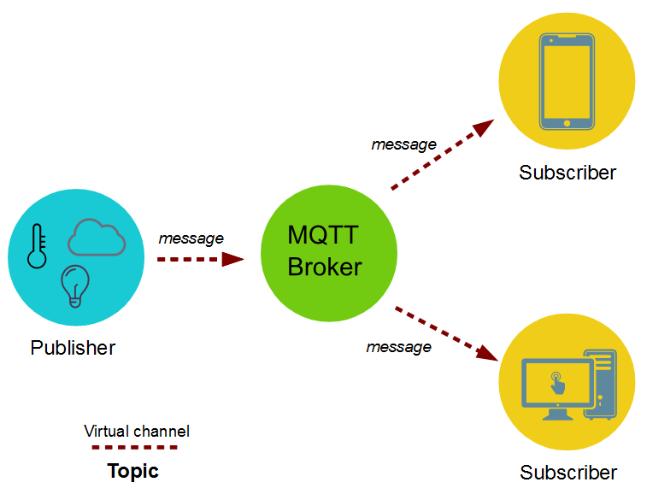
MQTT – publish subscribe
Topics/Subscriptions: Messages are published to topics.
  Clients can subscribe to a topic or a set of related topics
Publish/Subscribe: Clients can subscribe to topics or publish to topics.

Slide 7
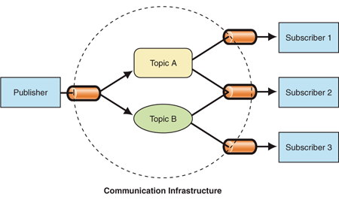
Publish Subscribe Process
A message is published once by a publisher.
Many things can receive the message.
The messaging service, or “broker”, provides decoupling between the producer and consumer(s)
A producer sends (publishes) a message (publication) on a topic (subject)
A consumer subscribes (makes a subscription) for messages on a topic (subject)
A message server / broker matches publications to subscriptions
  If no matches the message is discarded
  If one or more matches the message is delivered to each matching subscriber/consumer

Slide 8
Publish-Subscribe Characteristics
A published messages may be retained
  A publisher can mark a message as “retained”
  The broker / server remembers the last known good message of a retained topic
  The broker / server gives the last known good message to new subscribers
A Subscription can be durable or non-durable
  Durable: messages forwarded to subscriber immediately, if subscriber not connected, message is stored and forwarded when connected
  Non-Durable: subscription only active when subscriber is connected to the server / broker

Slide 9
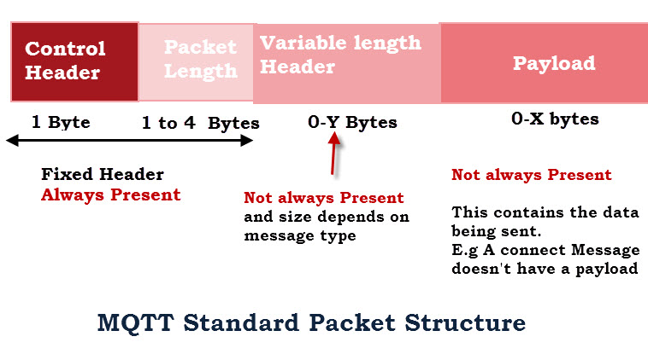
MQTT Characteristics
MQTT protocol compresses to small number of bytes
  Smallest packet size 2 bytes
  Supports always-connected and sometimes connected
  Provides Session awareness
  “Last will and testament” enable applications to know when a client goes offline abnormally
  Typically utilises TCP-based networks.

Slide 10
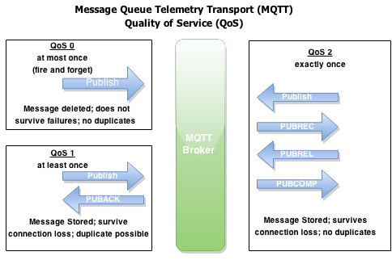
MQTT Characteristics
Three quality of service levels:
  0 = At most once (Best effort, No Ack),
  1 = At least once (Acked, retransmitted if ack not received),
  2 = Exactly once [Request to send (Publish), Clear-to-send(Pubrec), message (Pubrel), ack (Pubcomp)]
https://dzone.com/articles/internet-things-mqtt-quality

Slide 11
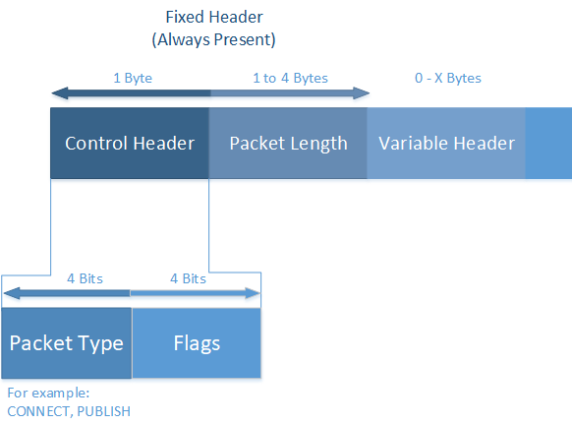
MQTT Control Packets
The MQTT protocol uses MQTT Control Packets using the Control Header.
Control Packet consists of three parts:
  fixed header(present in all packets),
  variable header(optional)
  Payload(optional)
https://docs.devicewise.com/Content/Products/IoT_Portal_API_Reference_Guide/MQTT_Interface/MQTT-Control-Packets.htm

Slide 12
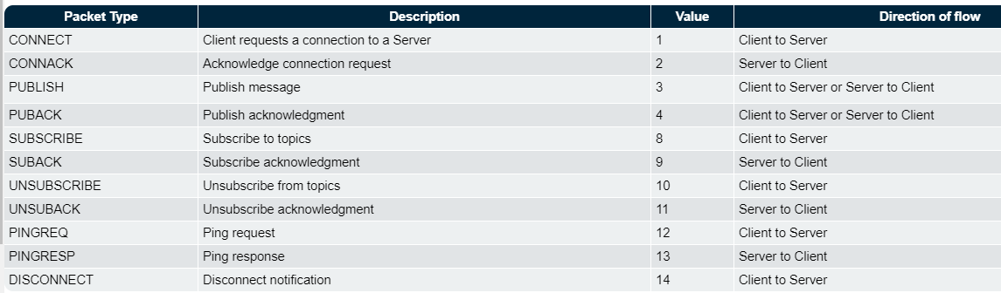
MQTT Control Packets
MQTT Control Packet Types

Slide 13
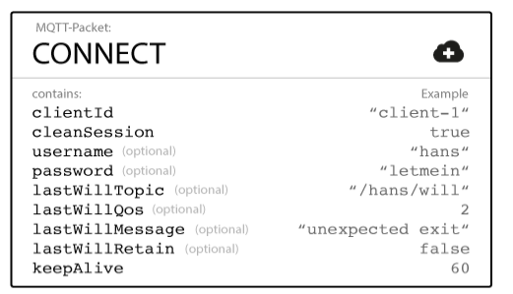
MQTT Last Will and Testament
Notify other clients about an ungraceful disconnected client.
Client can specify its last will message when it connects to a broker.
  normal MQTT message with a topic, retained message flag, QoS, and payload
  When an “ungraceful disconnect” occurs, the broker sends the last-will message to all subscribed clients of the last-will message topic.
https://www.hivemq.com/blog/mqtt-essentials-part-9-last-will-and-testament/

Slide 14



MQTT is Open Source
Lots of implementations:
    Mosquitto
    Micro broker
    Really small message broker (RSMB): C
    Cloud broker services

Slide 15
MQTT vs HTTP
Push delivery of messages / data / events
  MQTT – low latency push delivery of messages from client to server and server to client. Helps bring an event oriented architecture to the web
  HTTP – push from client to server but poll from server to client
Reliable delivery over fragile network
  MQTT will deliver message to QOS even across connection breaks
  Decoupling and publish subscribe – one to many delivery

Slide 16
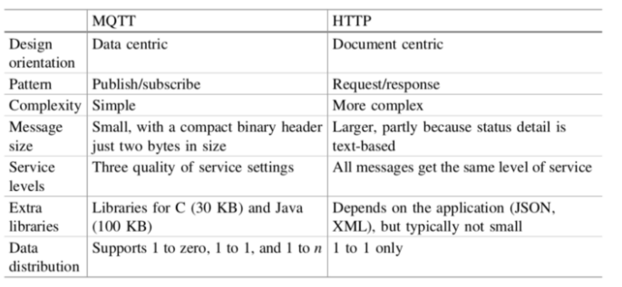
MQTT vs HTTP

Slide 17
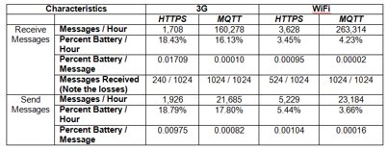
*sending and receiving 1024 messages of 1 byte each.(source: https://www.ibm.com/developerworks)

Slide 18
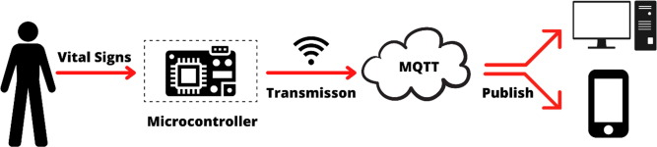
Application Example
Home care monitoring solution
  Home and patient instrumented with sensors.
    E.g. door motion, blood pressure, pacemaker/defib.
  Collected by monitoring service (broker) using MQTT
  Subscribed by a health care service in the hospital
  Alerts relations/health care profs. if anything is out-of-order

Slide 19

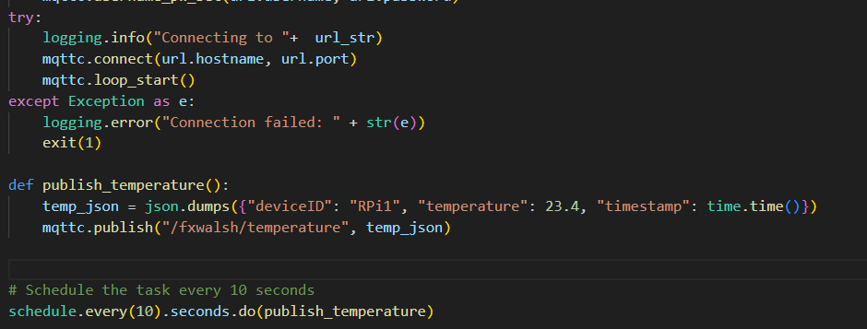
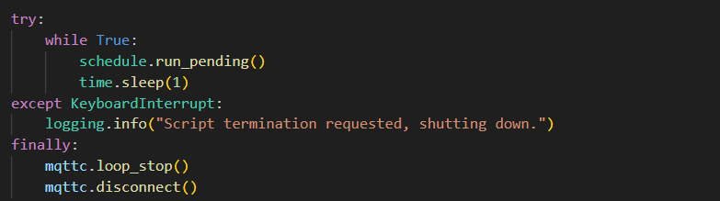
Code Example: Python

Slide 20
MQTT Security
Frank Walsh

Slide 21
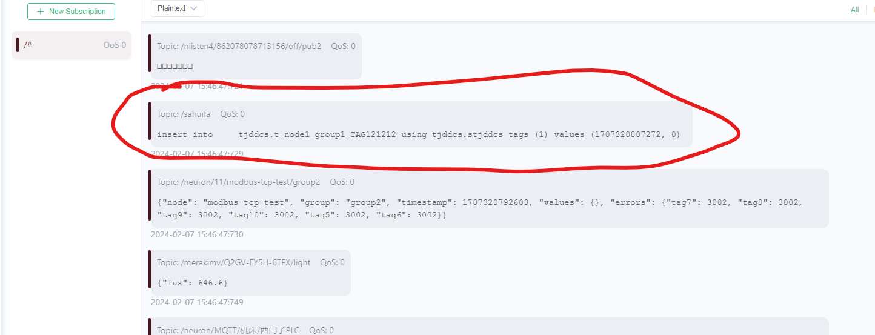
Not good…..

Slide 22

Security in IoT
Internet of Things presents new security implementation challenges
  IoT devices have limited computing power and memory capacity
  Cryptographic algorithms may require more resources than constrained IoT devices possess
  Critical security issues may require updates to be rolled out to all devices simultaneously can be affected by unreliable networks on which many IoT devices
Security is a critical concern for developers of IoT applications.

Slide 23
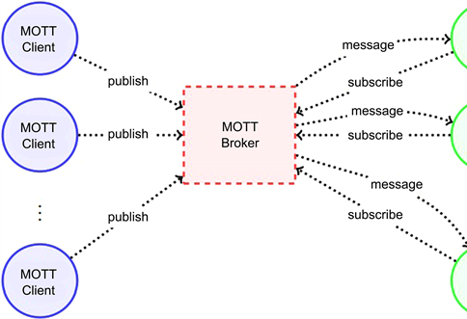
Security in MQTT
We can take a “layered” approach over the protocol stack
MQTT specifies only a few security mechanisms
MQTT uses other accepted security standards at the various levels:
  E.g.SSL/TLS for transport security.
Network Layer: Use a VPN for all communication between clients and brokers. Gateway-based applications, the gateway is connected to devices on the one hand and with the broker over VPN on the other side.
Transport Layer: TLS/SSL
Application Layer: Authorisation using username/password provided by the Protocol
This Photo by Unknown Author is licensed under CC BY

Slide 24
MQTT Authentication
The MQTT protocol provides username and password fields in the CONNECT message for authentication
  Username is an UTF-8 encoded string.
  Password is binary data with a maximum of 65535 bytes.
The MQTT broker evaluates credentials and returns one of the following return codes:
  0 – Connection Accepted
  4 – Connection Refused, bad username/password
  5 – Connection Refused, not authorised
Username/password sent as plain text - Secure transmission of usernames and passwords requires transport encryption

Slide 25

Transport Layer Security (TLS)
TLS provide a secure communication channel between a client and a server at Transport Layer.
TLS is a cryptographic protocol which use a handshake mechanism to negotiate various parameters to create a secure connection between the client and the server.
Servers provide a certificate (typically issued by a trusted authority) that clients use to verify the identity of the server.
While the additional CPU usage is typically negligible on the broker, small constrained devices are not designed for computation-intensive tasks.
If TLS is not possible, payload encryption and at least hash or encrypt the password in the CONNECT message of your client.

Slide 26
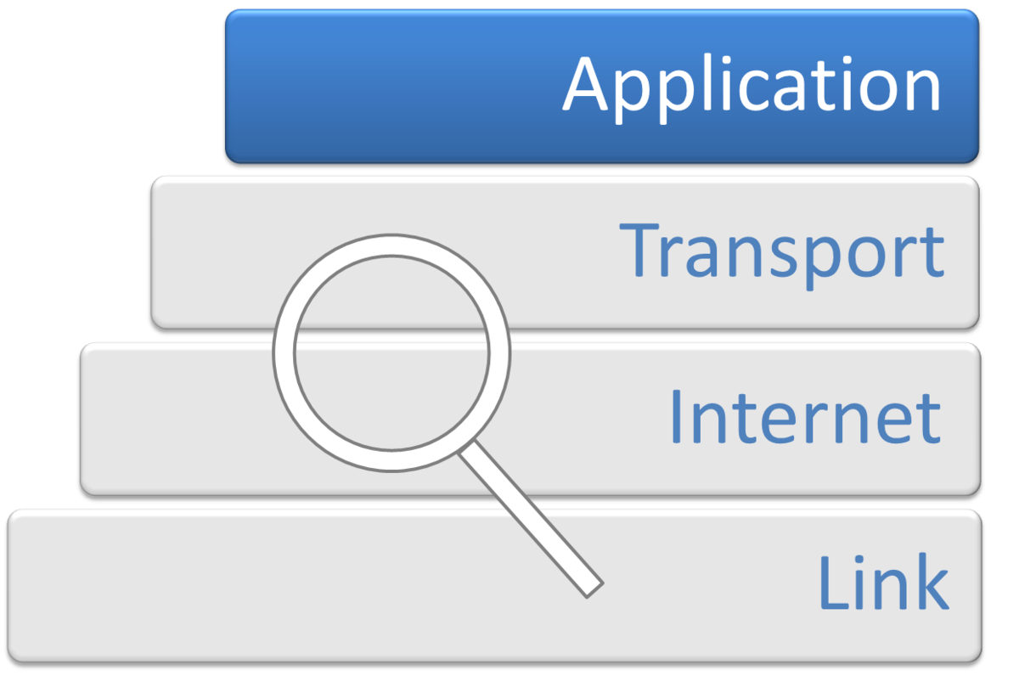
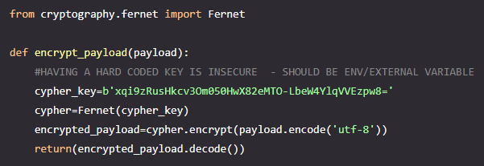
Application Level Encryption
End to End encryption between publisher and subscriber
Encrypt the payload without having to configure the MQTT broker
  Means publisher and subscriber applications have to “know” encryption/decryption method. Has to be coded
Possible alternative for constrained devices that cannot support TLS
Possible (less secure) alternative for using public brokers.
This Photo by Unknown Author is licensed under CC BY-SA

Slide 27
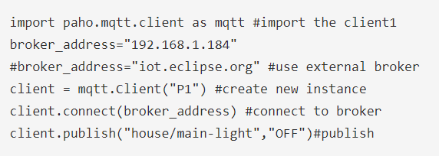
Raspberry Pi: Creating MQTT Clients in Python: Publishing Client
We’ll use Paho MQTT python client from Eclipse
Import the client class to provide functions to publish messages and subscribe to topics on MQTT brokers.
Create instance and connect to a broker:

Slide 28
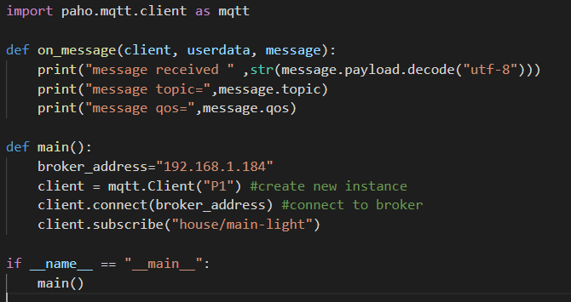
Raspberry Pi: Creating MQTT Clients in Python: Subscribing Client Callback
When the client receives messages it generate the on_message callback.

Slide 29
Arduino: Creating MQTT Clients in a Sketch: Publishing Client
Uses PubSubCLient from Arduino Library
#include <PubSubClient.h>
WiFiClient wifiClient;
PubSubClient client(wifiClient);
client.setServer(mqttServer, mqttPort);
client.connect(connectionId)
client.publish("/fxwalsh/temperature", message);
Construct MQTT client using wifiClient
Set MQTT Server and port
Create Connection
Publish message to topic!

Slide 30
Javascript/Node.js MQTT Client
const mqtt = require('mqtt');
const client = mqtt.connect('mqtt://broker.emqx.io');
const topic = '/fxwalsh/temperature';
client.on('connect', function () {
client.subscribe(topic, function (err) {
if (!err) {
console.log(`Subscribed to ${topic}`);
}
});
});
client.on('message', function (topic, message) {
// message is a buffer
console.log(message.toString());
});

