Slide 1
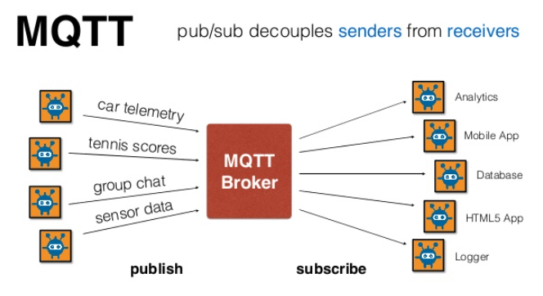
Recap MQTT

Slide 2
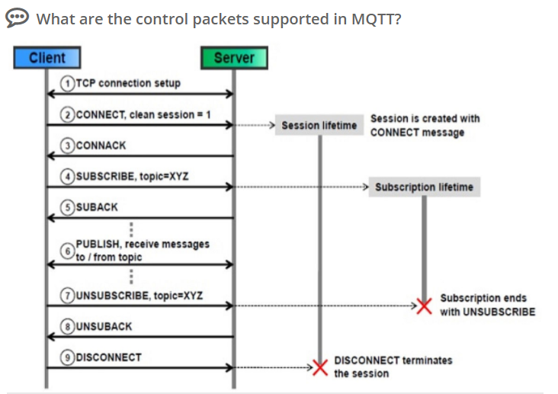
Connection

Slide 3
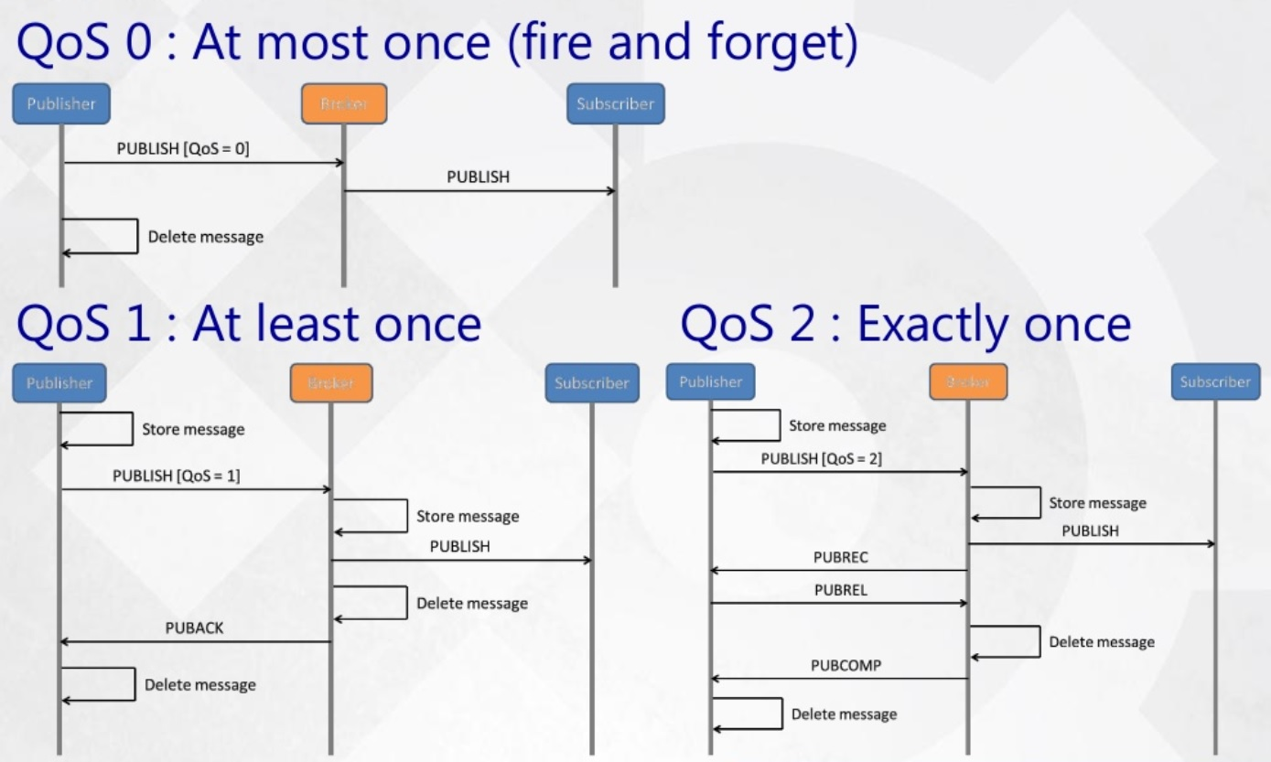
MQTT QoS

Slide 4
MQTT Security
Frank Walsh

Slide 5

Security in IoT
Internet of Things presents new security implementation challenges
  IoT devices have limited computing power and memory capacity
  Cryptographic algorithms may require more resources than constrained IoT devices possess
  Critical security issues may require updates to be rolled out to all devices simultaneously can be affected by unreliable networks on which many IoT devices
Security is a critical concern for developers of IoT applications.

Slide 6
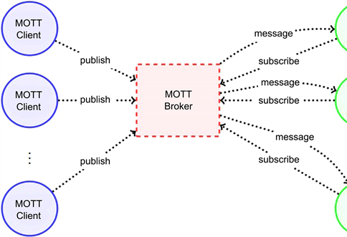
Security in MQTT
As with Web Dev, you can apply a “layered” approach over the protocol stack
MQTT specifies only a few security mechanisms
MQTT uses other accepted security standards at the various levels:
  E.g.SSL/TLS for transport security.
Network Layer: Use a VPN for all communication between clients and brokers. Gateway-based applications, the gateway is connected to devices on the one hand and with the broker over VPN on the other side.
Transport Layer: TLS/SSL
Application Layer: Authorisation using username/password provided by the Protocol
This Photo by Unknown Author is licensed under CC BY

Slide 7
MQTT Authentication
The MQTT protocol provides username and password fields in the CONNECT message for authentication
  Username is an UTF-8 encoded string.
  Password is binary data with a maximum of 65535 bytes.
The MQTT broker evaluates credentials and returns one of the following return codes:
  0 – Connection Accepted
  4 – Connection Refused, bad username/password
  5 – Connection Refused, not authorised
Username/password sent as plain text - Secure transmission of usernames and passwords requires transport encryption

Slide 8

MQTT authentication/authorisation
Authorization specifies access rights to a resource.
In addition to the username and password, MQTT clients provide other information that can be used for authentication.
  Client Identifier (Client ID)
  X.509 Certificate
Without proper authorization, each authenticated client can publish and subscribe to all available topics
  Topic permissions must be implemented on the broker side.
Permissions are configurable as follows:
  Allowed topic (exact topic or wild card topic)
  Allowed operation (publish, subscribe, both)
  Allowed quality of service level (0, 1, 2, all)

Slide 9

Transport Layer Security (TLS) and Secure Sockets Layer (SSL)
TLS and SSL provide a secure communication channel between a client and a server at Transport Layer.
TLS and SSL are cryptographic protocols which use a handshake mechanism to negotiate various parameters to create a secure connection between the client and the server.
Servers provide a X509 certificate (typically issued by a trusted authority) that clients use to verify the identity of the server.
While the additional CPU usage is typically negligible on the broker, small constrained devices are not designed for computation-intensive tasks.
If TLS is not possible, payload encryption and at least hash or encrypt the password in the CONNECT message of your client.

Slide 10
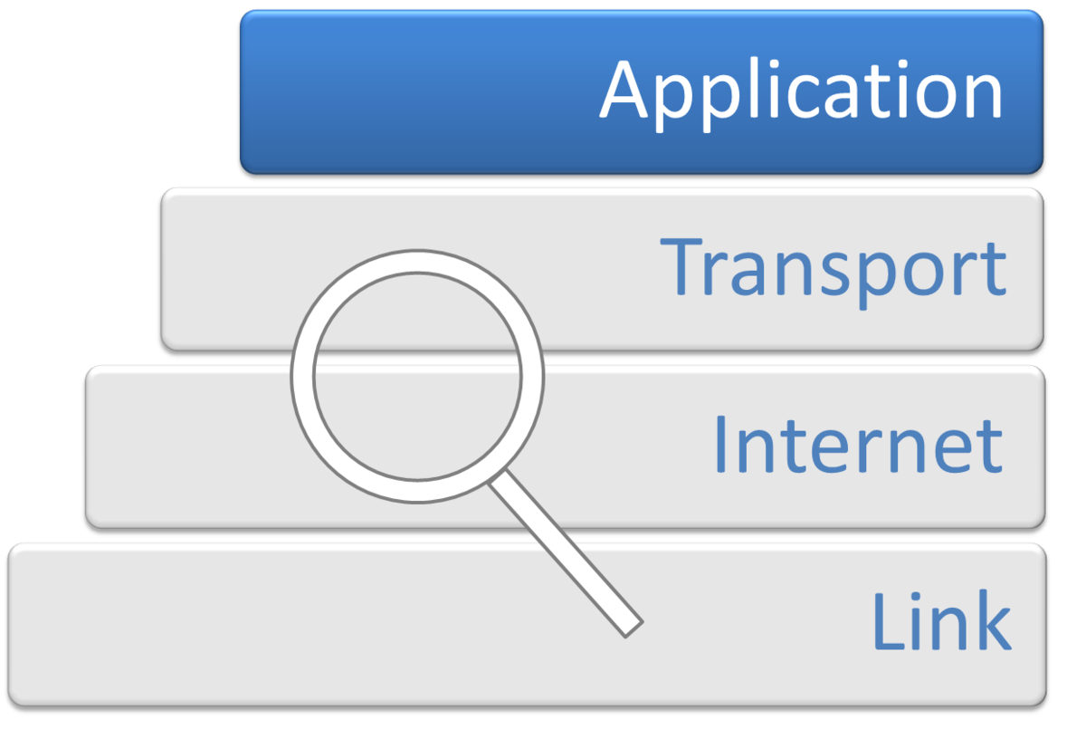
Application Level Encryption
End to End encryption between publisher and subscriber
Encrypt the payload without having to configure the MQTT broker
  Means publisher and subscriber applications have to “know” encryption/decryption method. Has to be coded
Possible alternative for constrained devices that cannot support TLS
Possible (less secure) alternative for using public brokers.
This Photo by Unknown Author is licensed under CC BY-SA

Slide 11
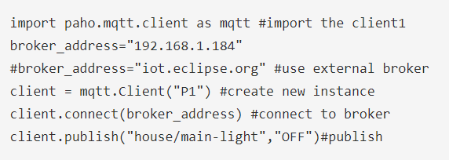
Creating MQTT Clients in Python: Publishing Client
We’ll use Paho MQTT python client from Eclipse
Import the client class to provide functions to publish messages and subscribe to topics on MQTT brokers.
Create instance and connect to a broker

Slide 12
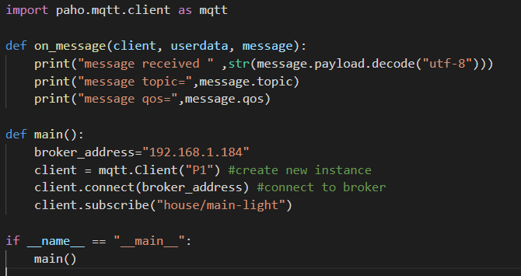
Creating MQTT Clients in Python: Subscribing Client Callback
When the client receives messages it generate the on_message callback.

