Slide 1
Assignment Specification
IoT Standards and Protocols

Slide 2
Context
100% of your overall mark!
Project ethos (1 overall project)
For this assignment you are required to:
Propose a project.
Create a working project using networking/IoT standards & protocols.
Requires a "physical" aspect – sensors/devices(or simulated by request)
Present and communicate your work in a clear, correct manner.
The project should incorporate the different layers (sensor, processing node, gateway, application) of an IoT/connected device architecture.
Project will be assessed on it technical (e.g., features) content, complexity, applicability to domain and project communication/execution

Slide 3
Requirements "Include the different layers (sensor, processing , gateway, application) in an IoT Project.
Design
Propose and design solutions (e.g. See attached work packages)
Apply
Apply suitable IoT protocols and standards.
Model/ implement
Model/implement a solution to your proposal
Use the knowledge, skills and practices from other modules
Should be scoped correctly – can’t build a production standard solution in a few weeks!
Present/ curate
Present/curate your project
Create a short video that demonstrates the project.

Slide 4
IoT Layers of your Project
Sensor Layer: Collects real-time data from the environment.
Processing Node: Raspberry Pi processes and transmits data.
Gateway Layer: Data is relayed through an IoT hub/platform.
Application Layer: Visualises and actuates responses.

Slide 5
Timeline
Mar 20(Week 7)
Proposal document
One page markdown doc in Git repo with general concept.
Doesn't need to be exact!
Sections: Introduction, Proposed technologies (protocols/devices/prog lang)
Proposed Tools (IDEs, cloud platforms)
April 10
Project Graphics
Pictorial (block level) representation of project
Flow chart of potential algorithm/logic
Informational flow diagram
Deliverable: Slides addressing the above
May 1(Week12)
Submission:
Git Repository submission(all code/resources)
Include a 10 min video showing your work. (YouTube video)
Present your work
May (Week 13)
10 mins Presentation of final project.

Slide 6
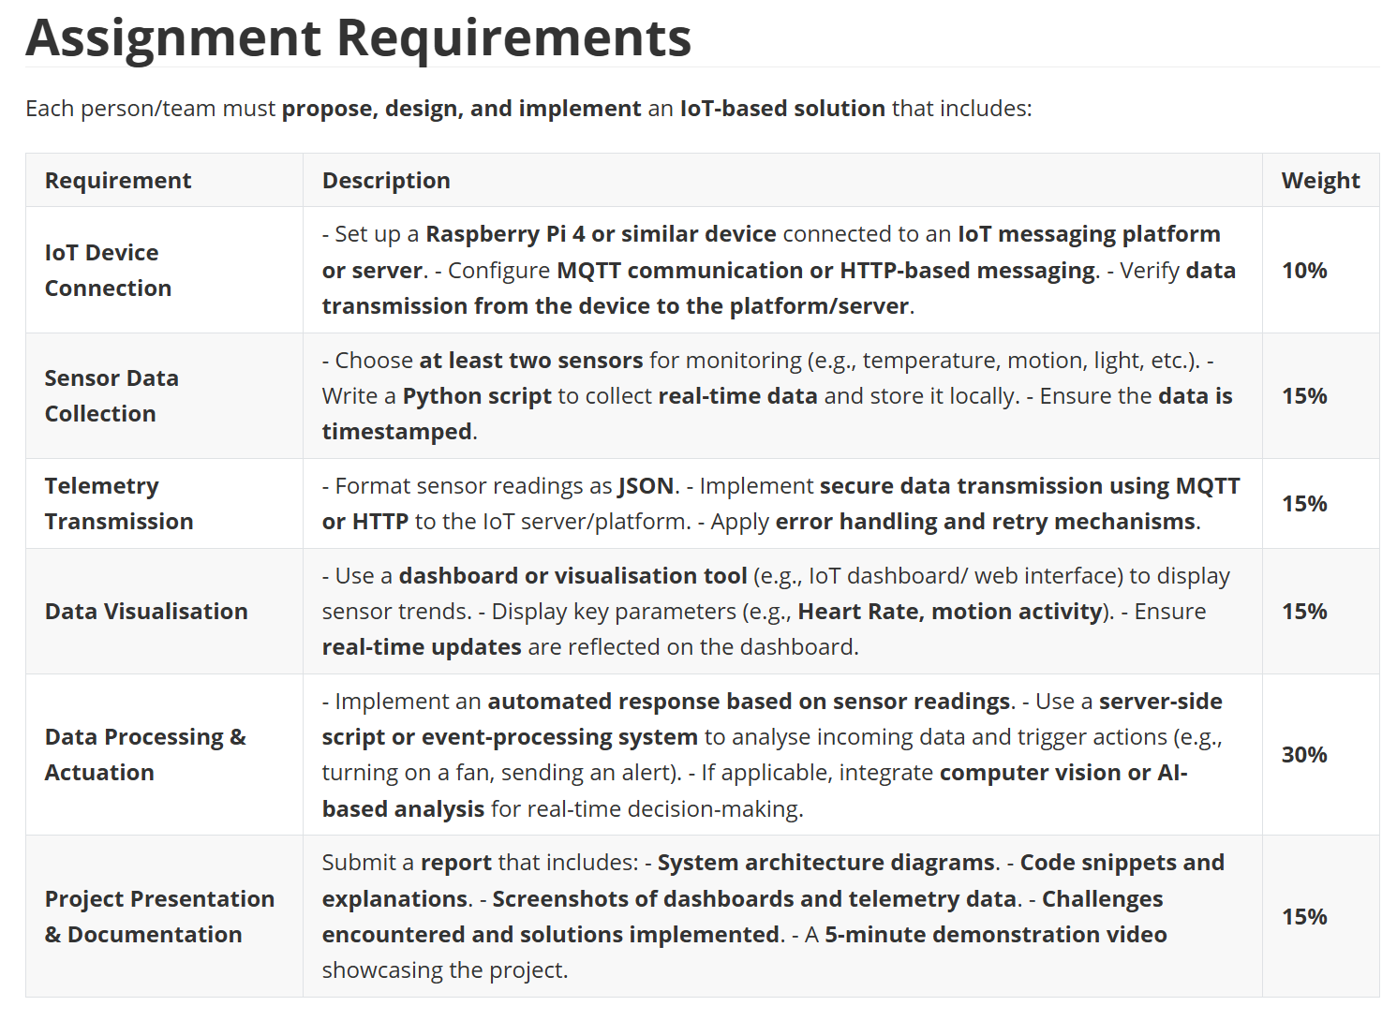

Slide 7


Other Considerations
"Permissionless Innovation"!
You don’t have to limit yourself to module technologies. You can integrate other devices/ systems
We used Python but you can use any other programming languages/ frameworks if you want. (Remember, the RPi can run Node/Java/JavaScript)
Have a look at other IoT project examples for inspiration.
It's OK to "simulate sensors"
You can simulate data (e.g. GPS location.)

Slide 8
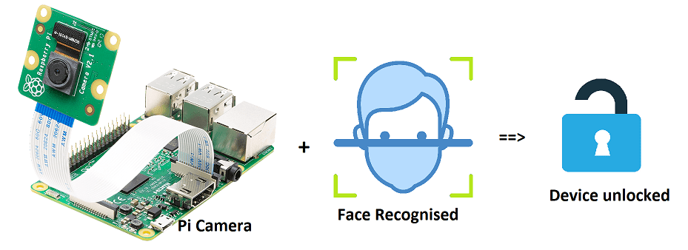
Possible Concept: Home Monitoring/Ambient/Assisted Living

Slide 9
