Slide 1
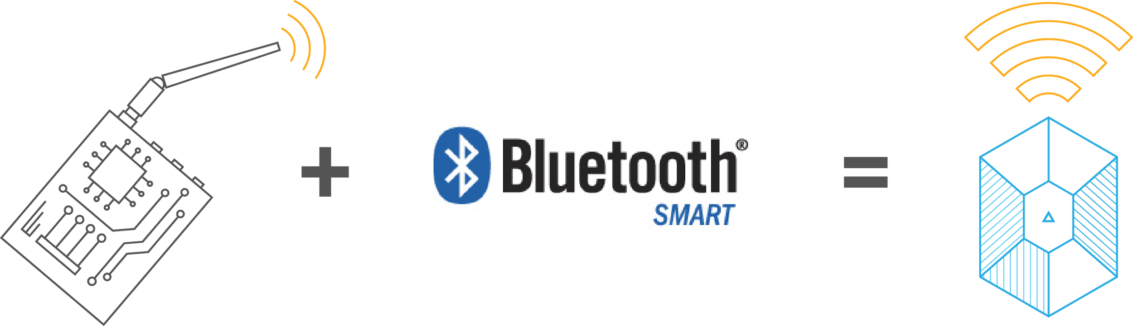

What are beacons?
Low-cost, low-power transmitters equipped with Bluetooth Low Energy or BLE (also called Bluetooth 4.0 or Bluetooth Smart)
Helps mobile devices detect proximity and determine micro-location

Slide 2
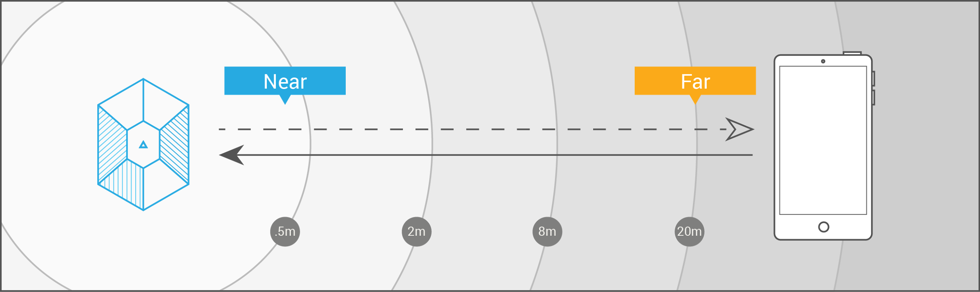
How beacons work
Beacons don’t transmit content; they transmit a series of numbers
The transmitted signal allows another device to identify it and determine the device’s proximity to the beacon

Slide 3

What is Eddystone?
New format for BLE beacon broadcast, developed by Google
Cross-platform and capable of supporting Android, iOS and any platform that supports BLE beacons
Notes:
In case you are wondering how ‘Eddystone’ got its name – it is named after a lighthouse on the Eddystone Rocks in England.

Slide 4
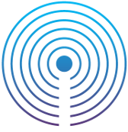
iBeacon vs. Eddystone
Android and iOS compatible, native only for iOS
Broadcasts one advertising packet and a unique ID
Beaconstac SDK can wake up Android apps, even if they are closed
Android and iOS compatible, expected to be native part of Android M
Broadcasts three different advertising packets
Possible to open a closed iOS app, but such a framework hasn’t been released yet

Slide 5
iBeacon vs. Eddystone
Three different packets that Eddystone broadcasts:
Eddystone-UID: 16 bytes long and split into two parts: 10 bytes for the namespace and 6 bytes for the instance
Eddystone-URL: Compressed 17 byte URL instead of a numeric identifier
an app detecting the beacon can go directly to this URL
Eddystone-TLM: Eddystone-TLM, as in ‘telemetry’. This packet contains beacon’s ‘health status’ (e.g., battery life).
mainly intended for fleet management
broadcast less frequently than ‘data’ packets
Notes:
Eddystone-URL: The idea is that an app detecting the beacon can go directly to this URL without the app having to convert a beacon numeric identifier to destination web address. This Eddystone frame is the new replacement for the existing UriBeacon, an open standard also sponsored by Google.
In case of iOS - current implementation requires Chrome browser in iOS ( with Chrome in ‘Today’ notifications) and in Android it is working with Physical Web browser, and in future it is expected to be natively supported in Android M;

Slide 6
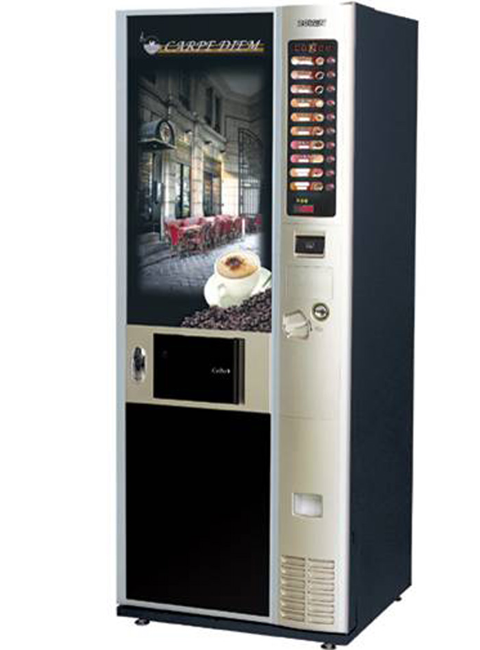
Eddystone Use Cases
# 1 In public spaces
Can be used at coffee/soft drink vending machines
URL could be of a contest on the participating brand’s website
Great scope of reaching a large audience, without using an app

Slide 7
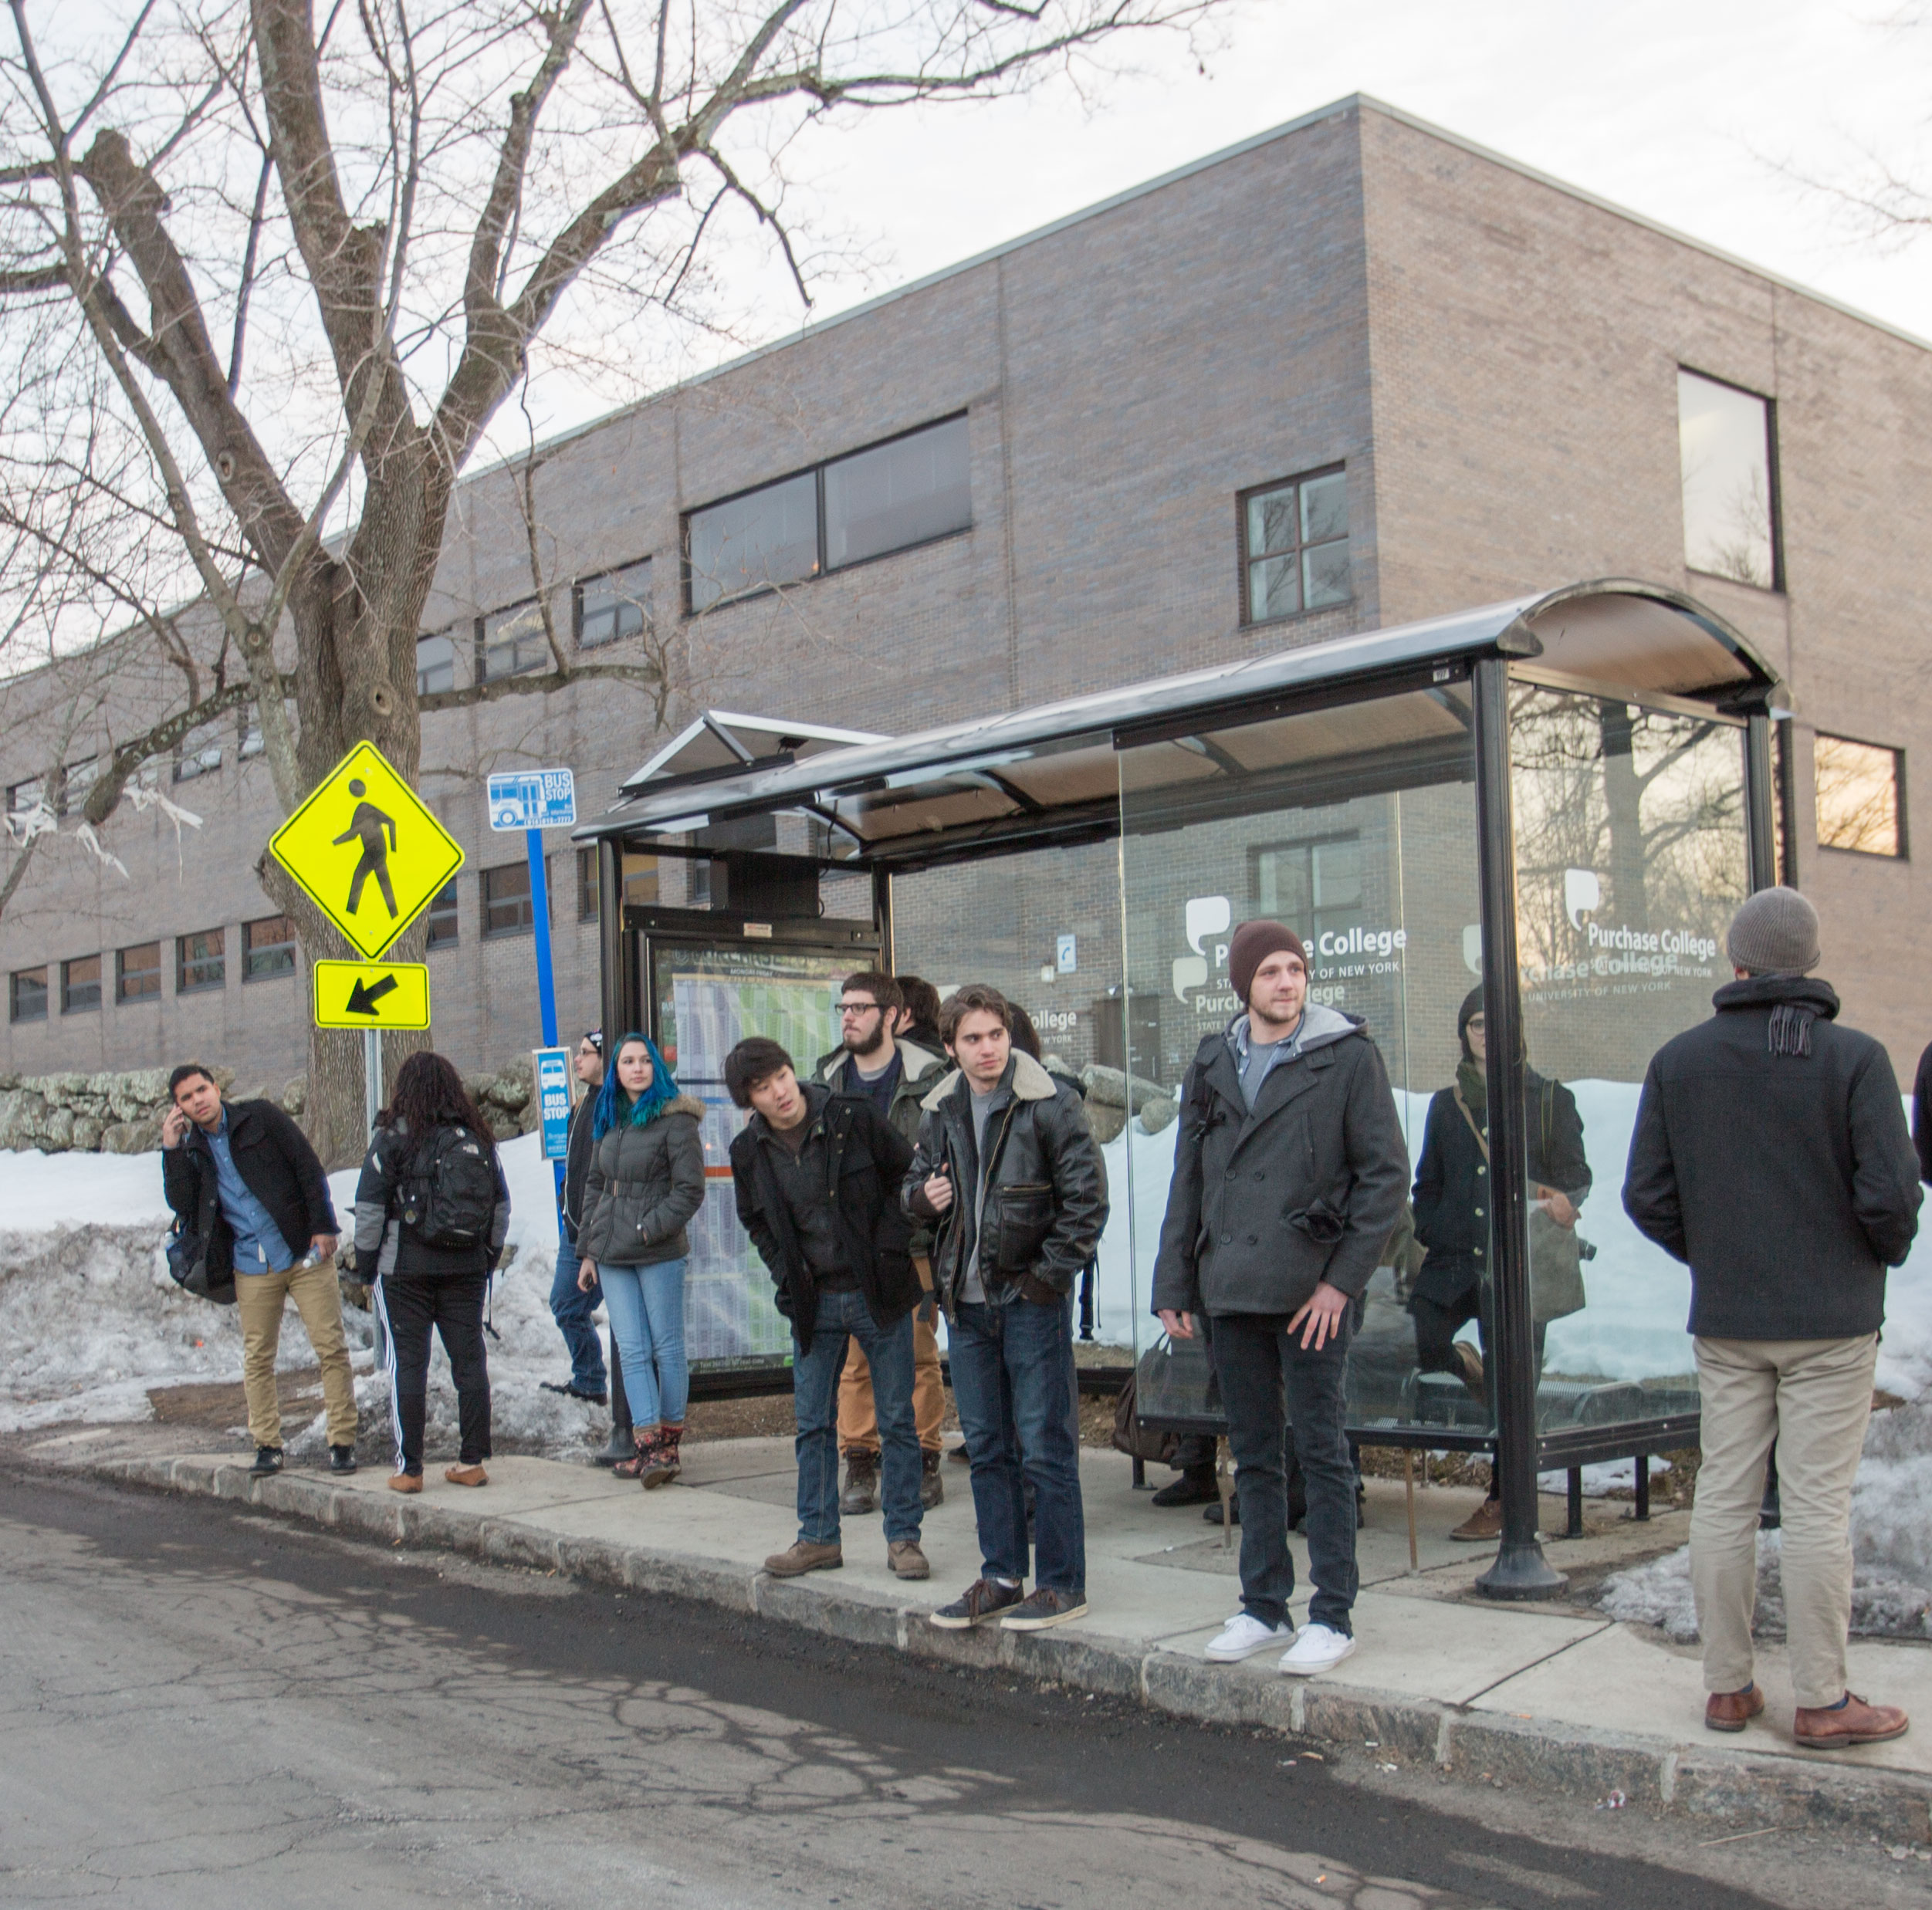
Eddystone Use Cases
# 2 For public utility
Can be used at bus stops/train stations to provide information on schedules, delays etc.
Send links to public surveys
Does away with the need to download apps for fly-by use
Notes:
Does away with the need to download apps for fly-by use: For a traveller – he will not need to download an app for just a few rides, for the business it won’t skew analytics

Slide 8

Eddystone Use Cases
# 3 In commercial settings
Can be used by brands to target customers who have not installed their app
URL could be to incentivize app download/check brand’s website

Slide 9
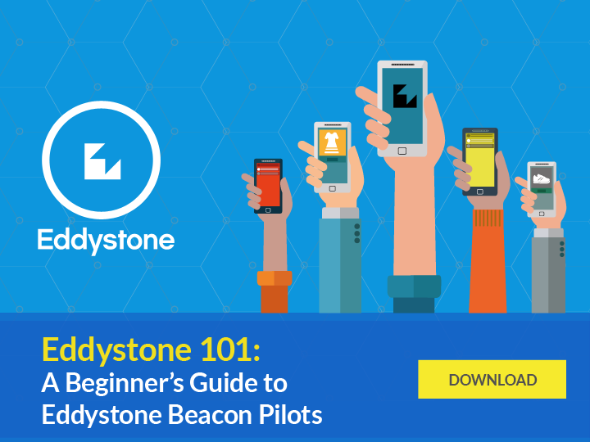

Slide 10
Eddystone FAQs
Can the same beacon support Eddystone as well as iBeacon?
Can a single app work with Eddystone and iBeacon at the same time?
Under what circumstances does Eddystone push content to a phone that has no app installed?
Can I decide to whom I send these URLs?
Notes:
Yes
It is possible, none that we know of currently
You can use the Eddystone-URL frame to transmit relevant URL. However, in case of iOS - current implementation requires Chrome browser in iOS ( with Chrome in ‘Today’ notifications) and in Android it is working with Physical Web browser, and in future it is expected to be natively supported in Android M;
Not possible. You will need to use the Eddystone-UID frame or the iBeacon frame (an app is required).

