Slide 1
Messaging for IoT (MQTT)
Frank Walsh

Slide 2
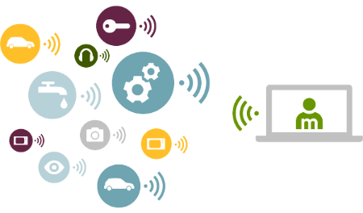
HTTP
HTTP is a key protocol for distributed/web applications.
Simple request/response model
Supports REST
Excellent protocol for requesting data from a known source
Internet of Things has some extra requirements
Emitting data from one thing to many
Event-orientated – reacting to events when they happen.
Large volumes of small data
Constrained devices/things.
Unreliable infrastructure

Slide 3
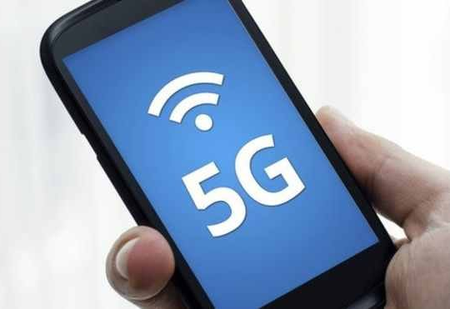
Mobile Comms
Issues with
data charges
Power consumption
Security
Reliability (unreliable connections)
Scalability

Slide 4
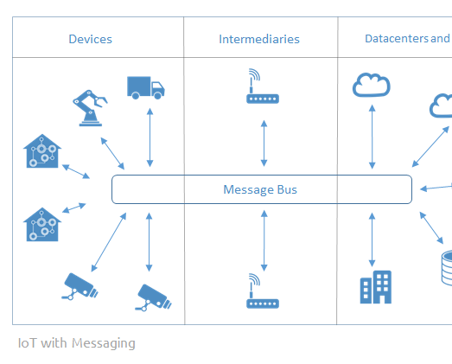
Messaging Requirements for IoT
Lightweight for constrained devices
Low bandwidth
Low code base and computational footprint
Scalable
Reliable
Open accepted standard
Interoperable

Slide 5

MQTT
MQ Telemetry Transport (MQTT)
Telemetry
Remote measurements
Created by IBM
from message queueing (MQ) architecture used by IBM for service oriented networks.
There are no queues in MQTT.
Telemetry data goes from devices to a server or broker.
Uses a publish/subscribe mechanism.
Lightweight both in bandwidth and code footprint

Slide 6

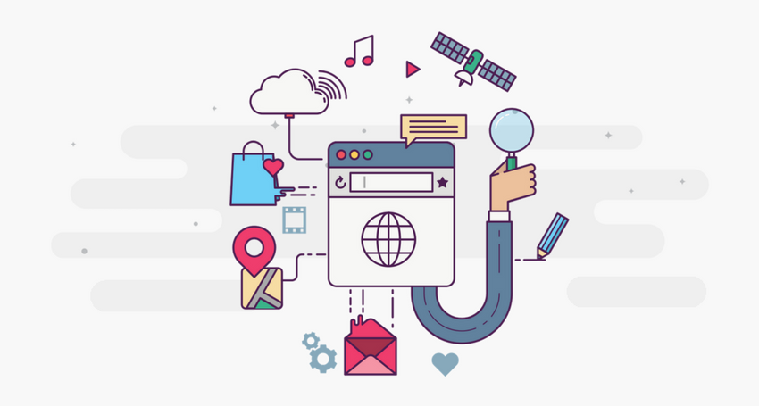

MQTT is Open Source
Lots of implementations:
Mosquitto
Micro broker
Really small message broker (RSMB): C
Cloud services

Slide 7
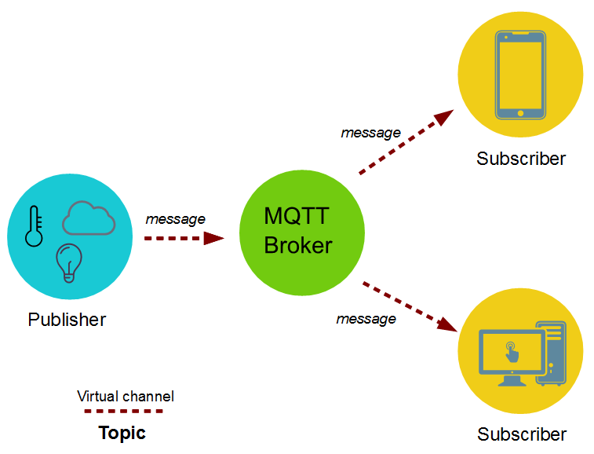
MQTT – publish subscribe
Topics/Subscriptions: Messages are published to topics.
Clients can subscribe to a topic or a set of related topics
Publish/Subscribe: Clients can subscribe to topics or publish to topics.

Slide 8
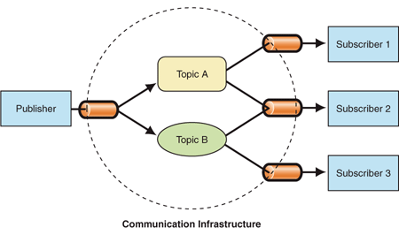
Publish Subscribe
A Publish Subscribe messaging protocol allowing a message to be published once
Many things can receive the message
The messaging service, or “broker”, provides decoupling between the producer and consumer(s)
A producer sends (publishes) a message (publication) on a topic (subject)
A consumer subscribes (makes a subscription) for messages on a topic (subject)
A message server / broker matches publications to subscriptions
If no matches the message is discarded
If one or more matches the message is delivered to each matching subscriber/consumer

Slide 9
Publish Subscribe characteristics
A published messages may be retained
A publisher can mark a message as “retained”
The broker / server remembers the last known good message of a retained topic
The broker / server gives the last known good message to new subscribers
A Subscription can be durable or non-durable
Durable: messages forwarded to subscriber immediately, If subscriber not connected, message is stored and forwarded when connected
Non-Durable: subscription only active when subscriber is connected to the server / broker

Slide 10
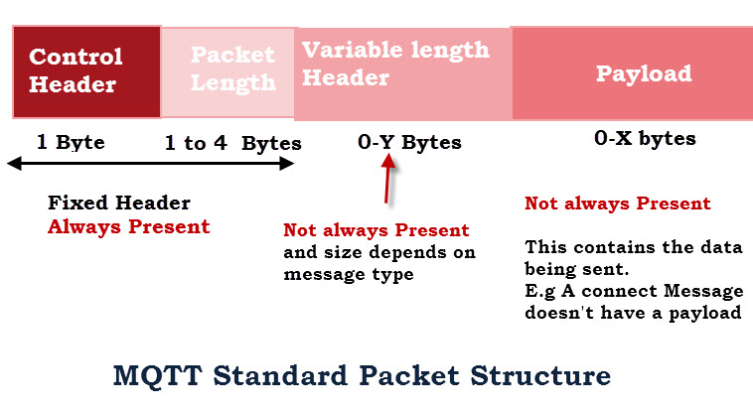
MQTT Characteristics
MQTT protocol compresses to small number of bytes
Smallest packet size 2 bytes
Supports always-connected and sometimes connected
Provides Session awareness
Configurable keep alive providing granular session awareness
“Last will and testament” enable applications to know when a client goes offline abnormally
Typically utilises TCP based networks e.g. Webscokets
Tested on many networks – vsat, gprs, 2G….

Slide 11
MQTT Characteristics
Three quality of service levels:
0 = At most once (Best effort, No Ack),
1 = At least once (Acked, retransmitted if ack not received),
2 = Exactly once [Request to send (Publish), Clear-to-send(Pubrec), message (Pubrel), ack (Pubcomp)]
Retained Messages
Server keeps messages even after sending it to all subscribers. New subscribers get the retained messages

Slide 12
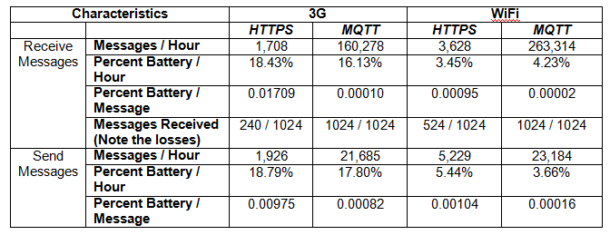
MQTT vs HTTP
Push delivery of messages / data / events
MQTT – low latency push delivery of messages from client to server and server to client. Helps bring an event oriented architecture to the web
HTTP – push from client to server but poll from server to client
Efficient use of network
For an M2M project the number of bytes with MQTT was 137130 bytes per device per month
with HTTP the number of bytes was 801000 bytes per device per month
Reliable delivery over fragile network
MQTT will deliver message to QOS even across connection breaks
Decoupling and publish subscribe – one to many delivery

Slide 13
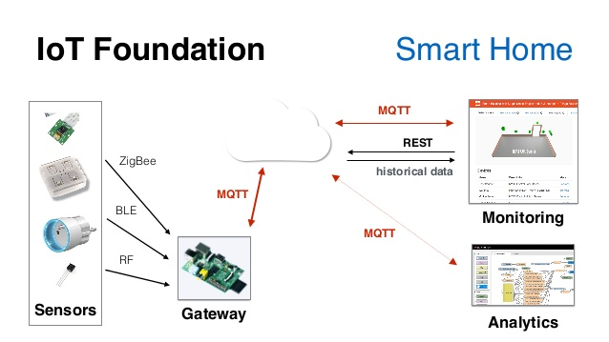
Application Example
Home care monitoring solution
Home and patient instrumented with sensors.
E.g. door motion, blood pressure, pacemaker/defib.
Collected by monitoring service (broker) using MQTT
Subscribed by a health care service in the hospital
Alerts relations/health care profs. if anything is out-of-order

