Slide 1
Comparing Objects
Frank Walsh

Slide 2
Introduction
Four methods underlie many of Java’s important Collection types: equals, compare and compareTo, and hashCode
  To put your own objects into a Collection, you need to ensure that these methods are defined properly
  Any collection with some sort of membership test uses equals (which, in many cases, defaults to ==)
  Any collection that depends on sorting requires larger/equal/smaller comparisons (compare or compareTo)
  Any collection that depends on hashing requires both equality testing and hash codes (equals and hashCode)
  Any time you implement hashCode, you must also implement equals
Some of Java’s classes, such as String, already define all of these properly for you
  For your own objects, you have to do it yourself

Slide 3
Comparing our own objects
The Object class provides public boolean equals(Object obj) and public int hashCode() methods
  For objects that we define, the inherited equals and hashCode methods use the object’s address in memory
  We can override these methods
  If we override equals, we should override hashCode
  If we override hashCode, we must override equals
The Object class does not provide any methods for “less” or “greater”—however,
  There is a Comparable interface in java.lang
  There is a Comparator interface in java.util

Slide 4
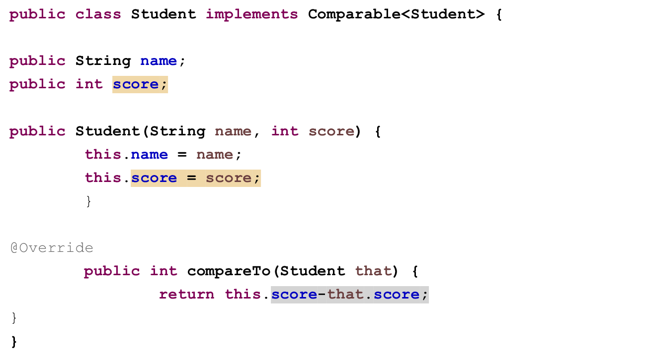
Outline of a Student class

Slide 5
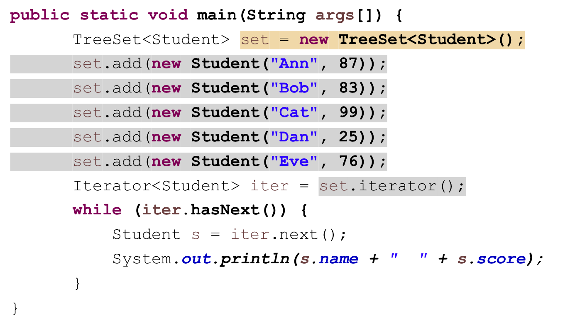
Include a main method

Slide 6
Using the TreeSet
Use an iterator to print out the values in order, and get the following result:
  Dan 25
  Eve 76
  Bob 83
  Ann 87
  Cat 99
Iterator “knows” that it should sort Students by score, rather than, say, by name from the compareTo() method.

Slide 7
Using a separate Comparator
In the program we just finished, Student implemented Comparable
  Therefore, it had a compareTo method
  We could sort students only by their score
  If we wanted to sort students another way, such as by name, we are out of luck
Now we will put the comparison method in a separate class that implements Comparator instead of Comparable
  This is more flexible (you can use a different Comparator to sort Students by name or by score), but it’s also clumsier
  Comparator is in java.util, not java.lang
  Comparable requires a definition of compareTo but Comparator requires a definition of compare

Slide 8
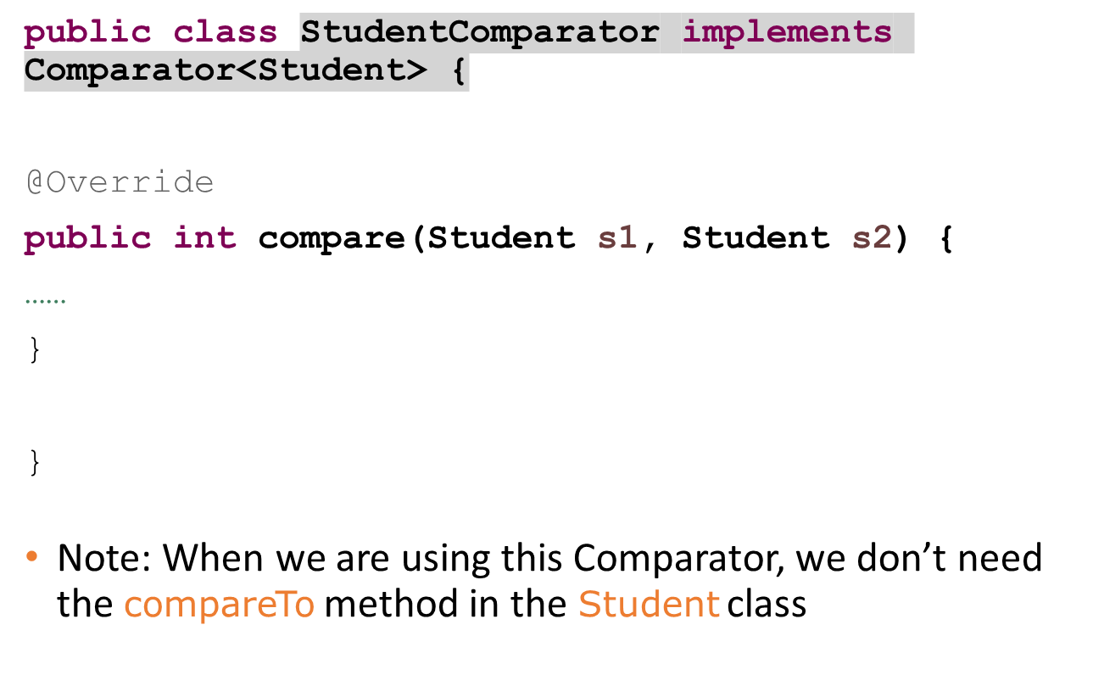
Outline of StudentComparator

Slide 9
The compare method
public int compare(Student s1, Student s2) {
return s1.score – s2.score;
}
This differs from compareTo(Object o) in Comparable in these ways:
  The name is different
  It takes both objects as parameters, not just one

Slide 10
Update main method
The main method is just like before, except that instead of
TreeSet<Student> set = new TreeSet<Student>();
We have
Comparator<Student> comp = new StudentComparator();
TreeSet<Student> set = new TreeSet<Student>(comp);

Slide 11
When to use each
The Comparable interface is simpler and less work
  Your class implements Comparable
  You provide a public int compareTo(…) method
  You will use the same comparison method every time
  Use for “natural” or “default” sort order.
The Comparator interface is more flexible but slightly more work
  Create as many different classes that implement Comparator as you like
  You can sort different data structures
    Construct/sort TreeSet or TreeMap using the comparator you want
  For example, sort Students by score or by name

Slide 12
Sorting differently
Suppose you have students sorted by score, in a TreeSet you call studentsByScore
Now you want to sort them again, this time by name
  Create the following Comparator
public class StudentByNameComparator implements Comparator<Student> {
@Override
public int compare(Student s1, Student s2) {
return s1.name.compareToIgnoreCase(s2.name);
}
}

Slide 13
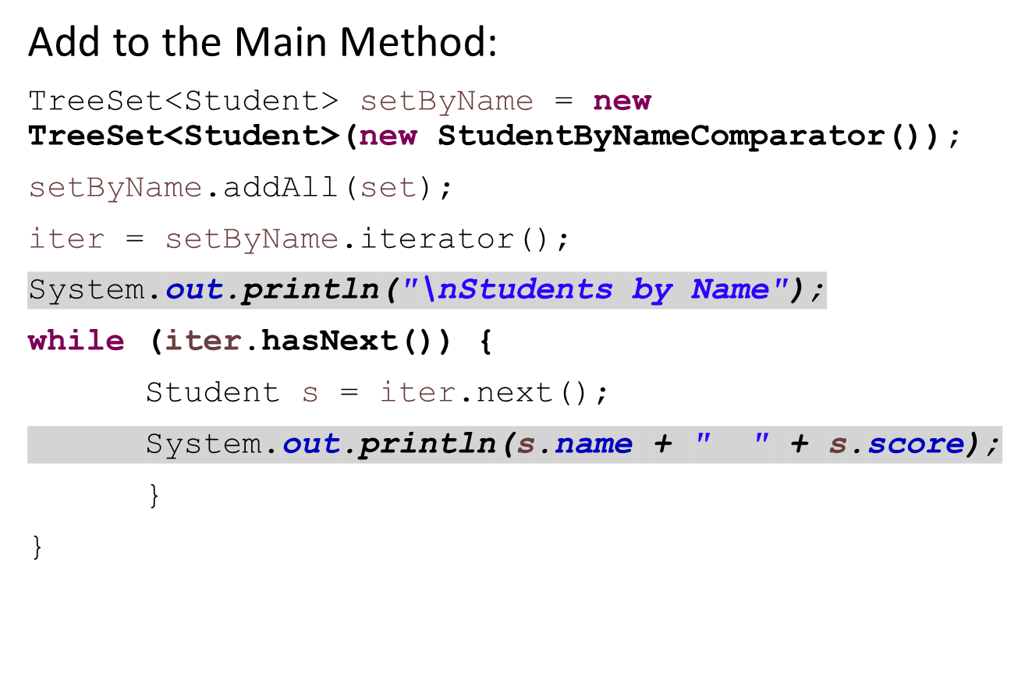
Sorting differently

Slide 14
Solution
See this solution in the examples GitHub Repo…

