Slide 1

Current standard for JavaScript
Diarmuid O’Connor
Frank Walsh

Slide 2

Main goals of ES6
fix (some) ES5 problems
backwards compatible (ES5 code is valid in ES6)
More expressive and intuitive syntax
Suits bigger apps
Bring in new stuff…

Slide 3
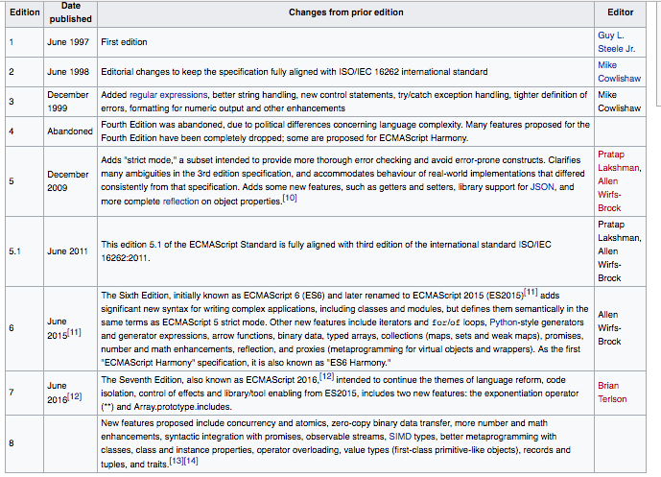
ECMAScript version history

Slide 4

Transpilation (using Babel)
Browsers cannot execute ES6 Javascript
Neither can Node platform (kinda).
Must transpile code first.
The Babel tool suite
Can be a bit sloooow!!

Slide 5
ES6/2015
What’s new?
Block scope variables; Constant variables;
String templates;
Arrow functions;
Classes;
Destructuring;
…. lots more(but not here!)

Slide 6
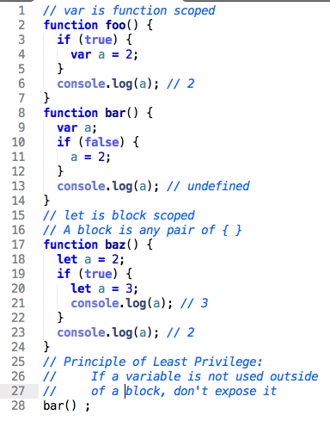
Block scope variables
Block: Code enclosed in curly braces – {….}
if, for, while, function, arbitrary.
Use let instead of var to declare variables
No hoisting

Slide 7
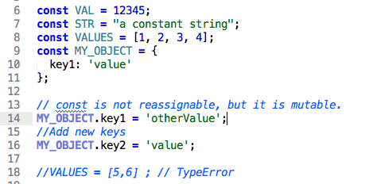
Constant variables
Cannot be reassigned.
Must be assigned at declaration.
Block scoping.
Value (e.g. data object) associated with a const is mutable.

Slide 8
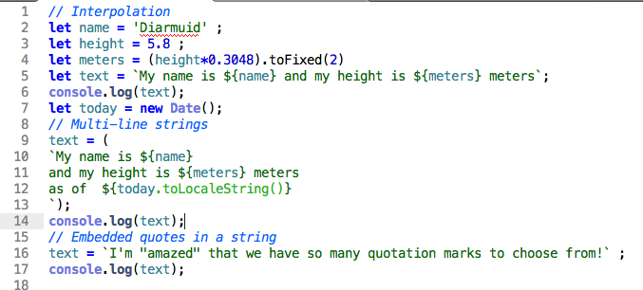
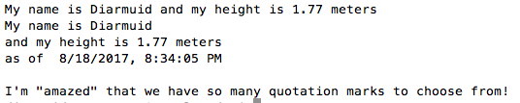
String templates
Must use backquote (`) to enclose string, not single quote.
Interpolation: Embed variable / expressions in strings, using ${ …. }.
Expression is evaluated and result inserted into string
Multi-line strings.

Slide 9
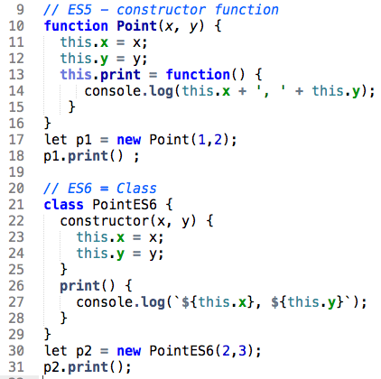
Classes.
Same purpose as constructor functions (ES5) – for declaring a custom object type.
Use new operator, as before.
Custom type (class) has a data part and behavior part.
Behavior declared in methods, e.g. print – like functions.
Data declared/initialized in special method, constructor.
Classes often derived from real world concepts.
No hoisting.
Classes really ‘syntatic sugar’ for constructor functions.

Slide 10
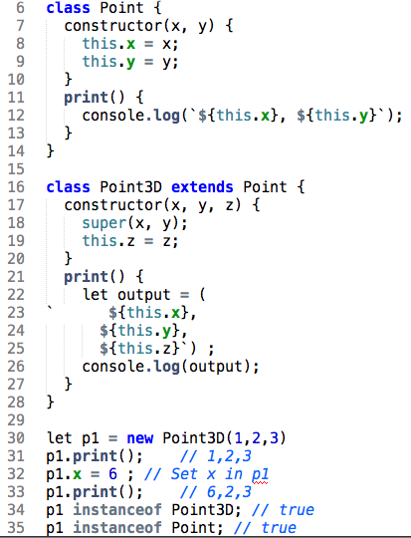
Class inheritance
Used when classes share some common behavior and/or data properties.
Superclasses and subclasses
Use super() to call superclass’ constructor
Occurs naturally in real world modeling.

Slide 11
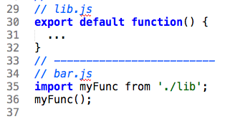
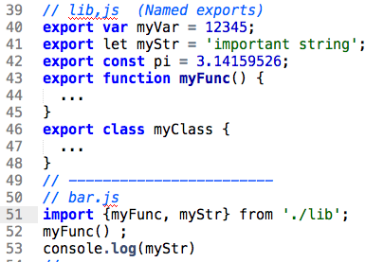
Modularity
Split application code into multiple files, termed modules.
Reusability - make modules available to other modules..
Old JS provided module system via separate library; ES6 modules built into language.
Two options: Default exports; Named exports (also Mixed exports)

Slide 12
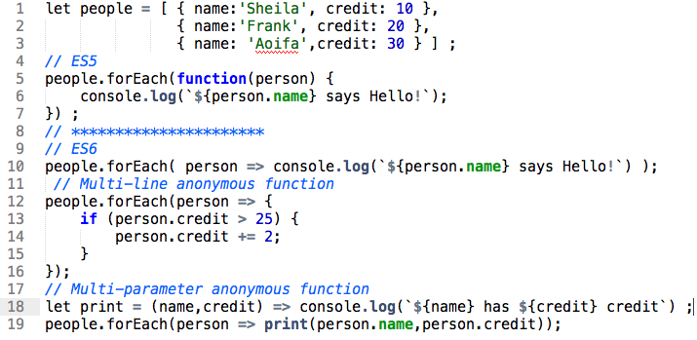
Arrow functions
A cleaner syntax for anonymous functions.
The => (arrow) separates function body from its parameters.
Enclose multi-line body with curly braces, { … }
Enclose multi parameter list with parentheses, ( … ).

Slide 13
Destructuring
Extract multiple values from data stored in Objects and Arrays
Object Destructuring:
Array Destructuring:
const obj = { first: 'Jane', last: 'Doe' };
const {first: f, last: l} = obj;
// f = 'Jane'; l = 'Doe’
// {prop} is short for {prop: prop}
const {first, last} = obj;
// first = 'Jane'; last = 'Doe'
const iterable = ['a', 'b’];
const [x, y] = iterable;
// x = 'a'; y = 'b'

