Slide 1
HTML 5
Frank Walsh
Diarmuid 0’Connor

Slide 2



Agenda
HTML5
Overview
Fundamentals
Elements
CSS
Overview
CSS Rules
Bootstrap
Overview
Example Template

Slide 3
HTML5
Mark up Language of the internet.
Used to structure and present content in the world wide web.
HTML5 is intended to subsume HTML4 and XHTML.
Designed to support latest multimedia
Features include:
New semantic elements(<nav>, <header>, <footer>…
New apis (canvas, geolocation, drag and drop, geolocation…)
See here for a full description…

Slide 4
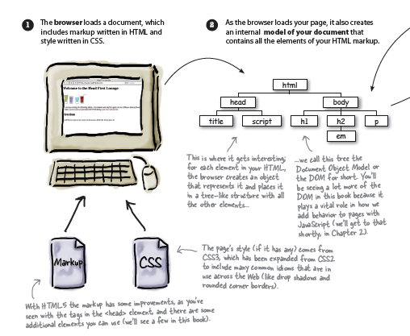
How HTML5 Works 1
Go to
Next
Page =>

Slide 5
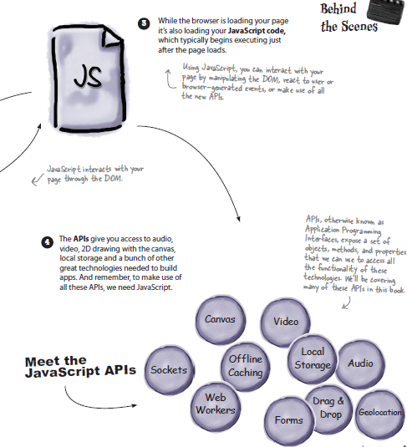
How HTML5 Works 2

Slide 6
HTML Fundamentals: The Web
Protocols & Standards
Protocol : agreed vocabulary to enable to programs to communicate
Standard: an agreed definition of the structure and meaning of a document
Web Protocol
Hyper Text Transfer Protocol - HTTP
Web Standard
Hyper Text Markup Language - HTML
Web Servers and Web Browsers use HTTP to exchange HTML documents

Slide 7
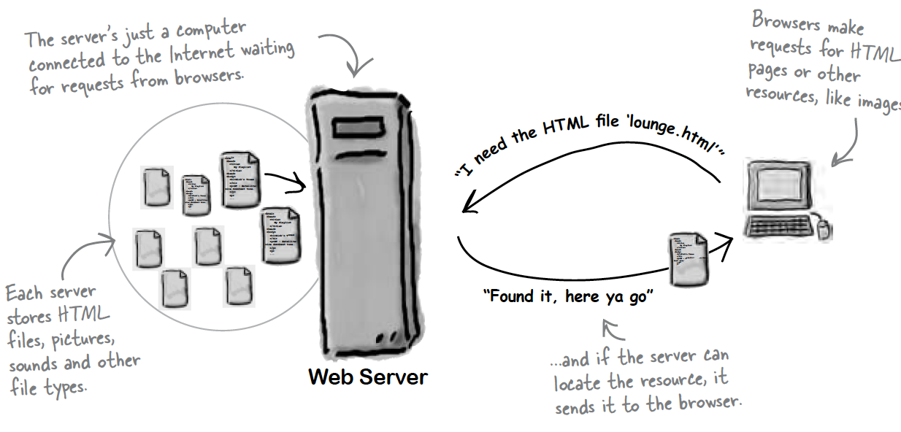
HTML Fundamentals: Role of Server

Slide 8
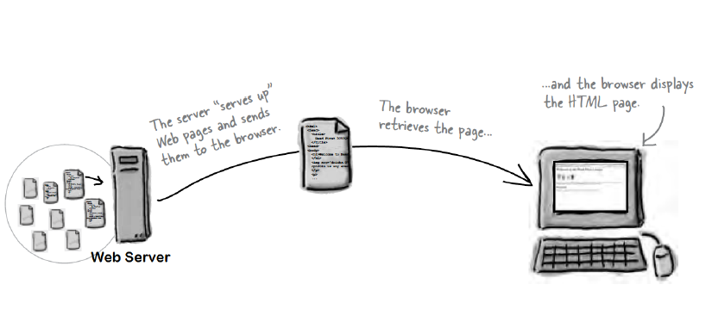
HTML Fundamentals: Role of Client

Slide 9
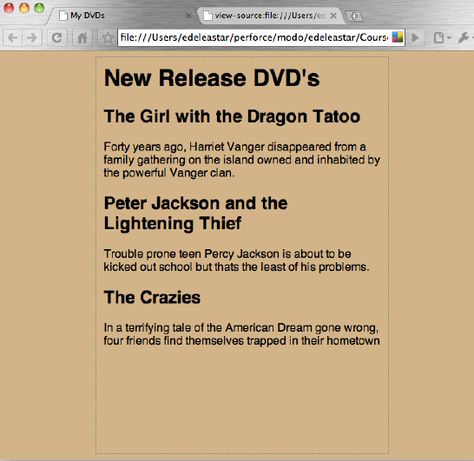
HTML Fundamentals: Rendering

Slide 10
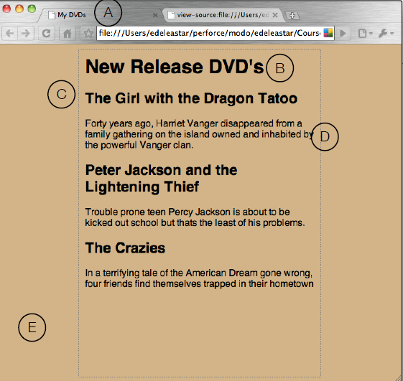
HTML Fundamentals: Elements

Slide 11
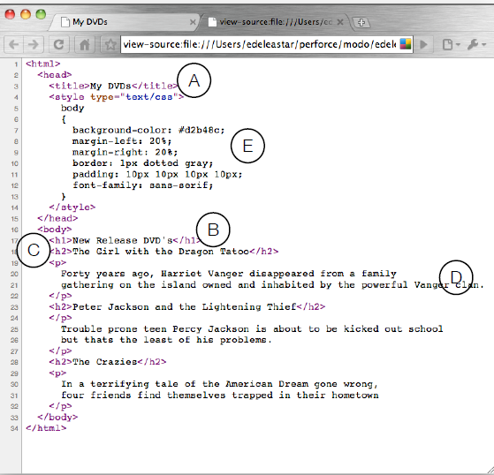
HTML Fundamentals: Source

Slide 12
HTML Fundamentals: HTML
HTML tell the browser about the structure of your document
where the headings are
Where paragraphs are
Where text has emphasis
Where links are
What images are to be displayed
Using HTML alone, browsers have default rules on how to display each element
Information is conveyed using “tags” or “elements”.

Slide 13
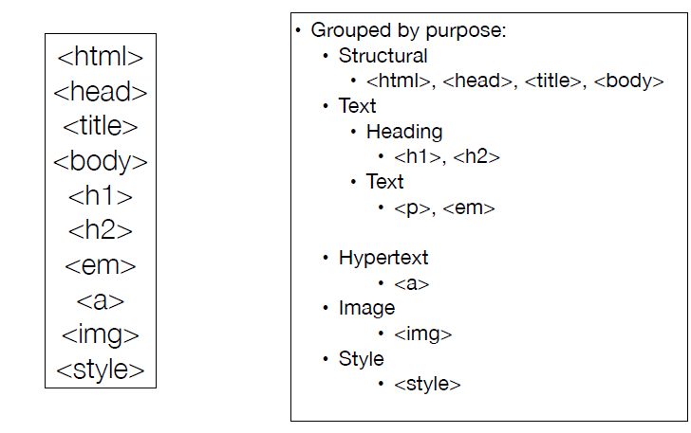
HTML Fundamentals: Elements

Slide 14
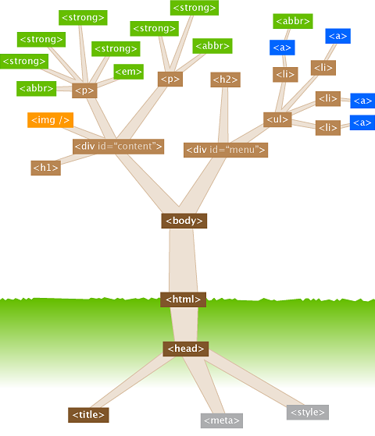
HTML Fundamentals: Element complete list
See here

Slide 15
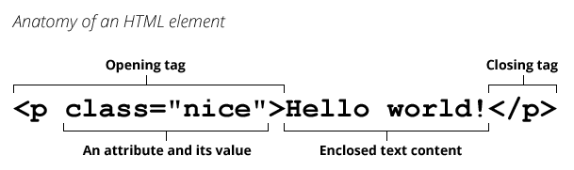
HTML Fundamentals: Anatomy of a HTML Element

Slide 16
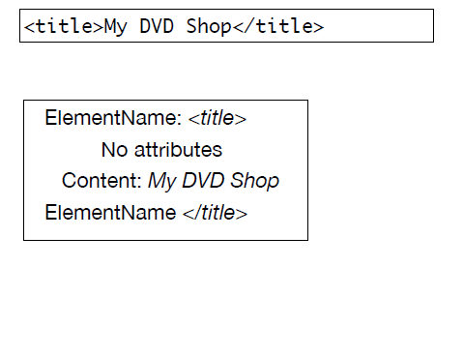
HTML Fundamentals: Element Example

Slide 17
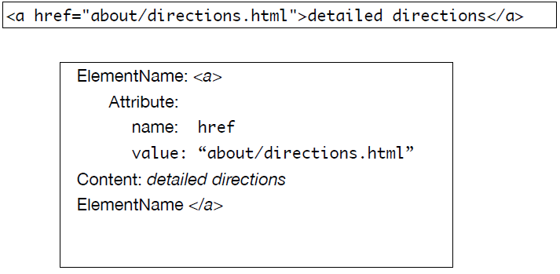
HTML Fundamentals: Element Example

Slide 18
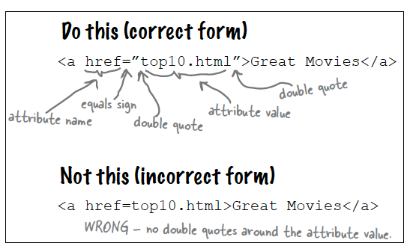
HTML Fundamentals: Attributes
Attributes let you specify additional information about an element.

Slide 19
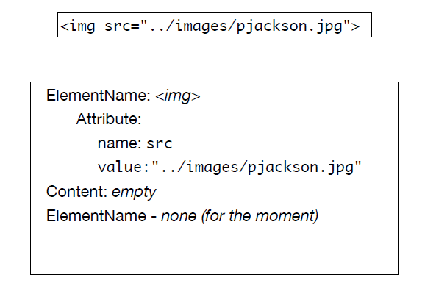
HTML Fundamentals: Images
Use the <img> element

Slide 20
Links

Slide 21
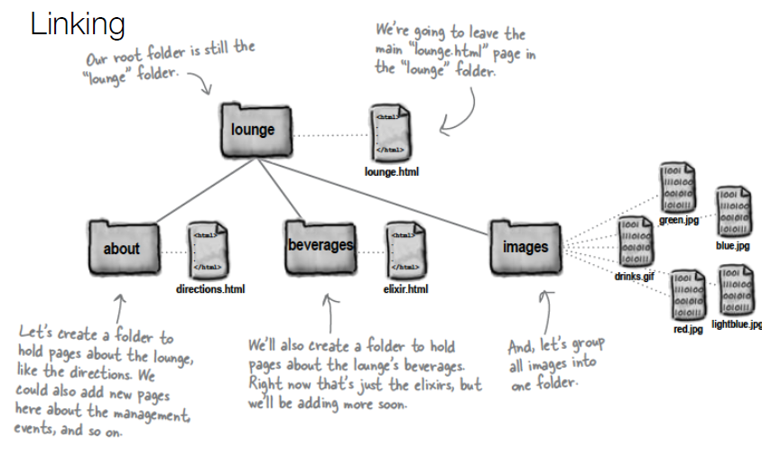
HTML Fundamentals: Links

Slide 22
HTML Fundamentals: Link Referencing
Two ways:
Absolute
Complete path to file
C:\labs\lab02\tatoo.jpg
Relative
Trace route from current position to destination
“..” means go up a level

Slide 23
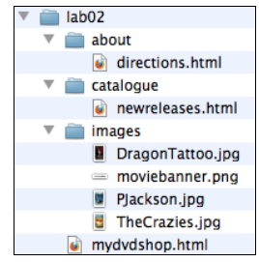
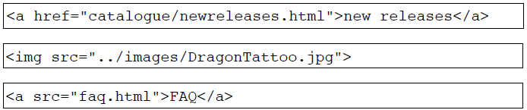
HTML Fundamentals: Example
If in lab02 then “about/directions.html” is a relative link from current folder to directions.html.
If in the catalogue folder then “../images/Pjackson.jpg” means “go up one level and then into images and then link to Pjackson.jpg”.
Avoid absolute links

Slide 24
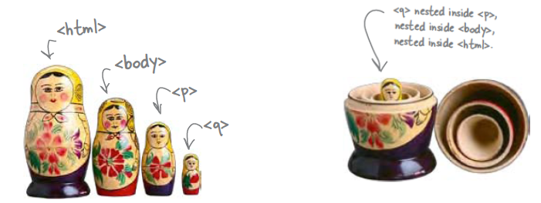
HTML Fundamentals: Nesting
One element inside another is called nesting.

Slide 25
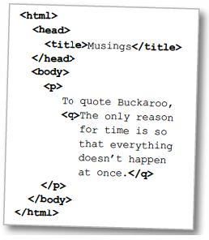
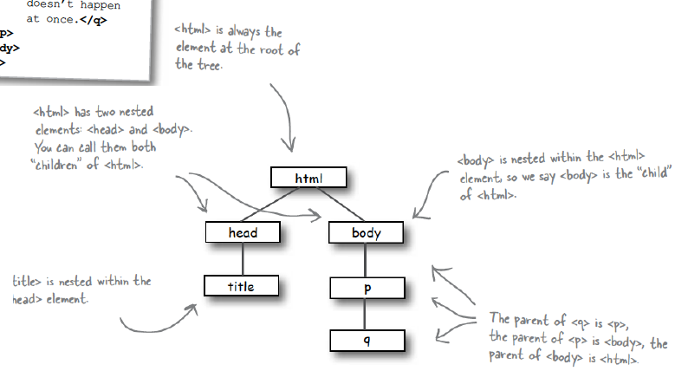
HTML Fundamentals: Nesting

Slide 26
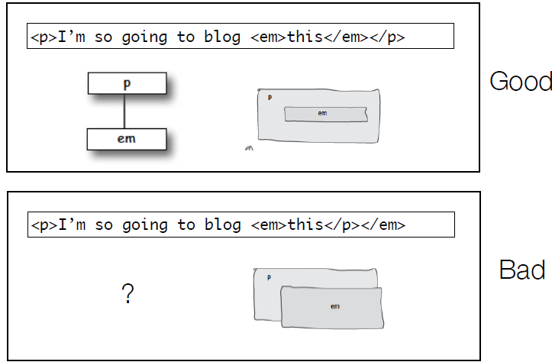
HTML Fundamentals: Nesting

Slide 27
HTML Fundamentals: Line Break
Break element can be:
<br></br>
Or normally just
<br>
Or
<br/>

Slide 28
HTML Fundamentals: Block & Inline
Block elements always displayed as if they have a line break before them
Inline elements appear “in line” with the flow. of text

Slide 29
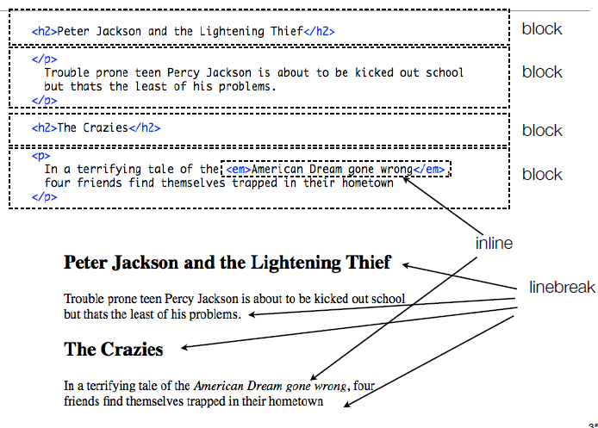
HTML Fundamentals: Block & Inline

Slide 30
HTML Elements

Slide 31
HTML Elements: Categories
Structural Elements
Head Elements
Text Formatting Elements
List Elements
Image and Media Elements
Table Elements
Form Elements
Frame and Window Elements
Deprecated Elements
Proprietary & Nonstandard Elements

Slide 32
HTML Elements: Structural
<html>
The html element is the outer container for everything that appears in an HTML document.
It can only contain two elements as direct descendants, the head element and body or element.
<html>
<head>
<title>Page title goes here</title>
</head>
<body>
<!-- content goes here -->
</body>
</html>

Slide 33
HTML Elements: Structural
<head>
The head element is the wrapper for all the head elements that:
instruct the browser where to find style sheets,
define relationships that the document has to others in the web site;
provide essential meta information;
point to or include scripts that the document will need to apply later on.

Slide 34
HTML Elements: Structural
<body>
The body element wraps around all of the content that will be displayed on screen.
You should not place character data (text) or inline elements such as em, directly into the body.
Instead, these should be contained inside block-level elements such as <p> elements

Slide 35
HTML Elements: Structural
<h1-h6>
The h1 element is used to indicate the most important (or highest-level) heading on the page.
There are six heading levels to—h1 to h6—to add structure to the web page.
A document’s first heading should be an h1, followed by one or more h2 headings; each of these h2 headings can then have a further series of h3 headings below them, and so on
May contain any text content, but it can’t include any block-level elements: only inline elements can be included
<h1>News and Views</h1>
<p>
Bits of news, words of advice
</p>
!
<h2>September 3, 2010</h2>
<p>
<img src="images/robinhood.jpg" alt="Robin Hood">
</p>

Slide 36
HTML Elements: Head
<title>
Displaying a title in the browser toolbar or in the task bar (on Windows).
Providing for the document a name that’s used by the browser when you add the page as a favorite or bookmark.
Displaying a title of the page when it appears in search engine results.

Slide 37
HTML Elements: Head
<meta>
The <meta> element is used to specify page description, keywords, author, and other metadata.
Providing for the document a name that’s used by the browser when you add the page as a favorite or bookmark.
Displaying a title of the page when it appears in search engine results.
See this in Bootstrap section.
Examples:
<meta charset="UTF-8"> <!--specifies character set for page -->
<meta name="description" content="Free Web tutorials on HTML and CSS">

Slide 38
HTML Elements: Text Formatting
<a>
Usually referred to as a link or hyperlink
Has a 7 possible attributes in total, of which we have seen just one: href,
which defines the document to which the link leads. This may be
a web page in the same directory,
a page somewhere else on the same server,
a location within the current page,
a web page—or any another kind of document—stored on another server
<a href=“stock/cars.html">new cars</a>

Slide 39
HTML Elements: List
<ul>
Used to group a collection of items together in a list, but in a way that doesn’t suggest an order of precedence or importance.
<ol>
Same as <ul> except bullets replaced by numbers
<ul>
<li>Air Con</li>
<li>Traction Control</li>
<li>ABS</li>
</ul>
<ol>
<li>Air Con</li>
<li>Traction Control</li>
<li>ABS</li>
</ol>
Air Con
Traction Control
ABS
Air Con
Traction Control
ABS

Slide 40
HTML Elements: div
<div> Tag
defines a division or a section in an HTML document
often used to group block-elements to format them with CSS
Used extensively in front-end Javascript and CSS frameworks (e.g. React and Bootstrap)
<div id="navbar" class="collapse navbar-collapse">
<ul class="nav navbar-nav">
<li class="active"><a href="#">Home</a></li>
<li><a href="#about">About</a></li>
<li><a href="#contact">Contact</a></li>
</ul>
</div>

Slide 41
HTML Elements: script
<script> tag:
used to define a client-side script (JavaScript)
either contains scripting statements, or it points to an external script file through the src attribute.
Use the script tag to pull in client side js frameworks
Jquery, React…
<!DOCTYPE html>
<html>
<body>
<p id="demo"></p>
<script>
document.getElementById("demo").innerHTML = "Hello JavaScript!";
</script>
</body>
</html>

Slide 42
CSS

Slide 43
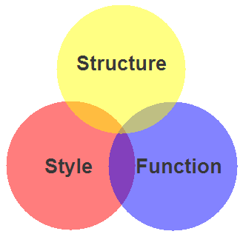
Markup, Style, Function
Markup (HTML)
Structure
Content
Style (CSS)
Style
Presentation
Appearance
Function (Javascript)
Actions
Manipulations

Slide 44
CSS Advantages
CSS provides superior control over presentation than do presentational element types in HTML.
The separation of content from presentation makes it easier for site owners to reuse the content for other purposes, such as RSS feeds or text-to-speech conversion.

Slide 45
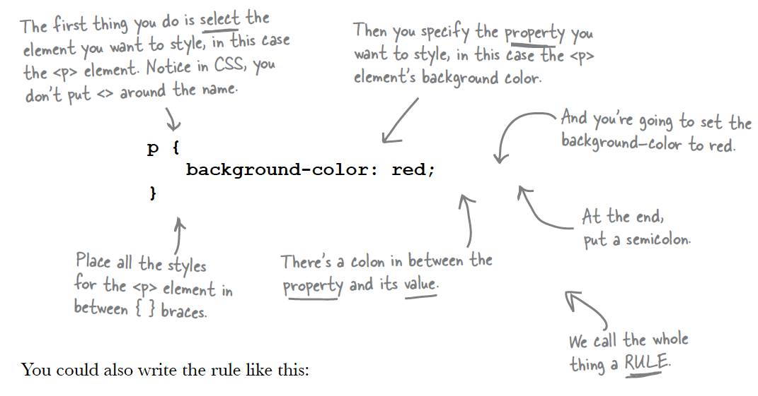
CSS Rules

Slide 46
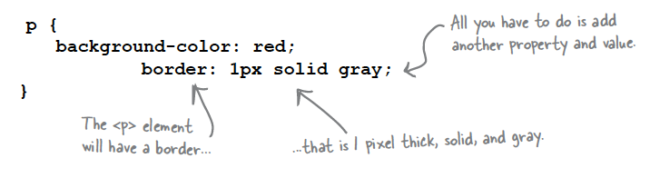
CSS Rules
You can add as many properties and values as you like in each CSS rule.
To put a border around your paragraphs:

Slide 47
How to Use CSS
Inline
<span style="font-size: 20px;margin-left: 10px">
Style CSS tag
<span class=“span-norm”>…</span>
<style> .span-norm {font-size: 20px;margin-left: 10px} </style>
External CSS file (put in <head>)
<link rel=“stylesheet” href=“style.css”/>

Slide 48
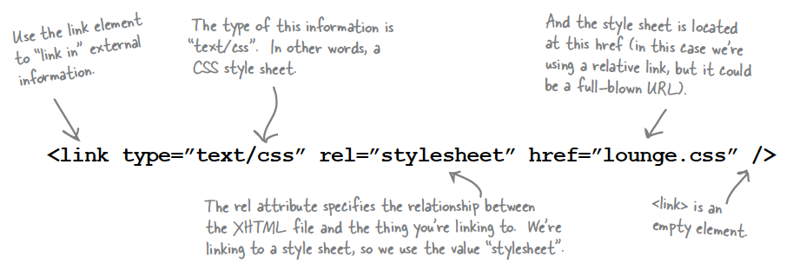
CSS file
Best practice to separate your style out into a css file and link to it in the head element.

Slide 49
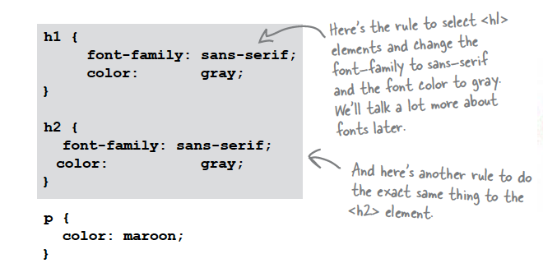
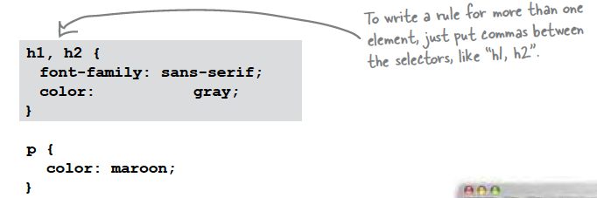
CSS Rules
Rules can be combined if they are identical

Slide 50
CSS Selectors
Class attribute
While the name of an element specifies its type, the class attribute lets you assign to it one or more subtypes.
These subtypes may then be used in CSS code for styling purposes.
In particular, several elements may share a class and only those elements can be identified for restyling

Slide 51
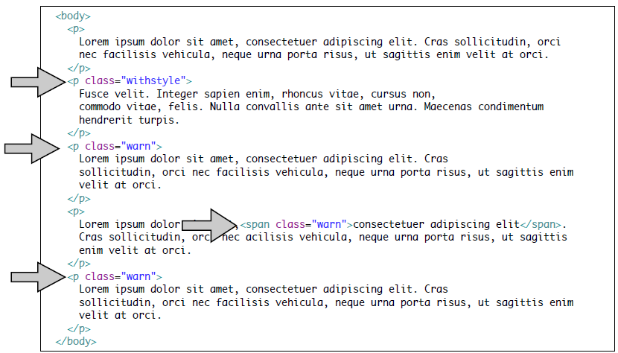
CSS: Using class to identify elements

Slide 52
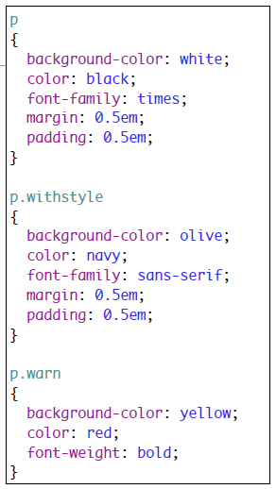
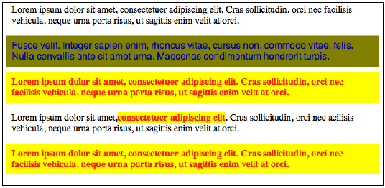
CSS: Using class to identify elements
Class names are referenced in css as element.classname

Slide 53
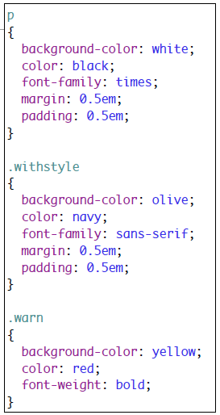
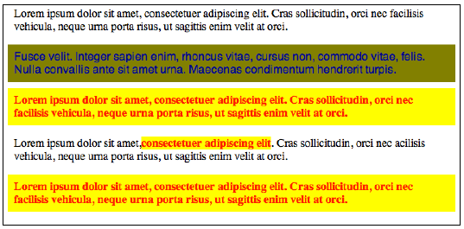
CSS: Using class to identify elements
Also can have just .class name
Selector now matches any element of the given class

Slide 54
CSS: Using class to identify elements
You can also use multiple CSS classes on a single element
For example, this paragraph has three classes: <p class="pullquote featured left">...</p>
Bootstrap example
<ul class="nav navbar-nav">
....
</ul>

Slide 55
IDs
Id attribute provides a unique identifier for an element.
Must be unique – no other element in the same page should have the same id
<p id="mainpoint">
Fusce velit. Integer sapien enim, rhoncus vitae, cursus non,
commodo vitae, felis. Nulla convallis ante sit amet urna. Maecenas condimentum
hendrerit turpis.
</p>S
#mainpoint
{
background-color: yellow;
color: red;
font-weight: bold;
}
Notice that, in a CSS, an id selector starts with a ‘#’.

Slide 56

Aside: SASS
“CSS with superpowers”
CSS extension language
Gives you variables, nested rules, mixins,…
Interpreted to CSS
For more info see: https://sass-lang.com/

Slide 57
Bootstrap

Slide 58
What’s Bootstrap
Bootstrap is a free framework for creating web applications.
It contains HTML and CSS-based design templates for styling text, forms, buttons, navigation
Also has optional JavaScript extensions.

Slide 59
Why Bootstrap
CSS is can be tricky
Cross browser/device support can be a challenge (Chrome, Firefox, Internet Explorer, Safari, and Opera)
“One framework, every device”.
Can Theme a page
Easy to use
Anybody with just basic knowledge of HTML and CSS can start using Bootstrap
Responsive features
Bootstrap's responsive CSS adjusts to phones, tablets, and desktops
Mobile-first approach
In Bootstrap 3, mobile-first styles are part of the core framework

Slide 60
Bootstrap from a CDN
Can include Bootstrap from a Content Delivery Network (CDN).
Already present in many other web apps so cached.
Served from closest cdn server.
CDN example: https://www.maxcdn.com/
Include the following in the head element:
<!-- Latest compiled and minified CSS --> <link rel="stylesheet" href="http://maxcdn.bootstrapcdn.com/bootstrap/3.2.0/css/bootstrap.min.css"> <!-- jQuery library --> <script src="https://ajax.googleapis.com/ajax/libs/jquery/1.11.1/jquery.min.js"></script> <!-- Latest compiled JavaScript --> <script src="http://maxcdn.bootstrapcdn.com/bootstrap/3.2.0/js/bootstrap.min.js"></script>

Slide 61
Bootstrap is “Mobile First”
Designed to work on heterogenous mobile, touchscreen devices.
Use a <meta> tag in the <head> element to ensure proper rendering.
<meta name="viewport" content="width=device-width, initial-scale=1">
The width=device-width part sets the width of the page to follow the screen-width of the device (which will vary depending on the device).
The initial-scale=1 part sets the initial zoom level when the page is first loaded by the browser.

Slide 62
Bootstrap uses Containers
Bootstrap requires a containing element with a container or container-fluid classifier to wrap site contents.
<div class="container"> <h1>My First Bootstrap Page</h1> <p>This is some text.</p> </div>

Slide 63
Bootstrap Grid
Responsive, fluid grid system that appropriately scales up to 12 columns
predefined classes for easy layout options
Use rows and columns
Rows must be placed within a .container class for proper alignment and padding. Create horizontal groups of columns
Content should be placed within columns
classes like .row and .col-xs-4 are available for quickly making grid layouts

Slide 64
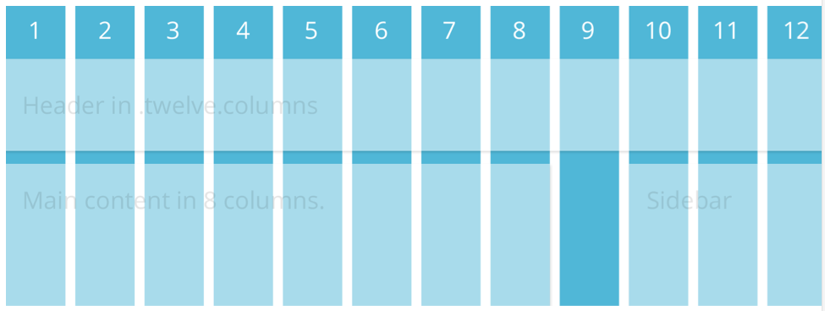
Grids

Slide 65
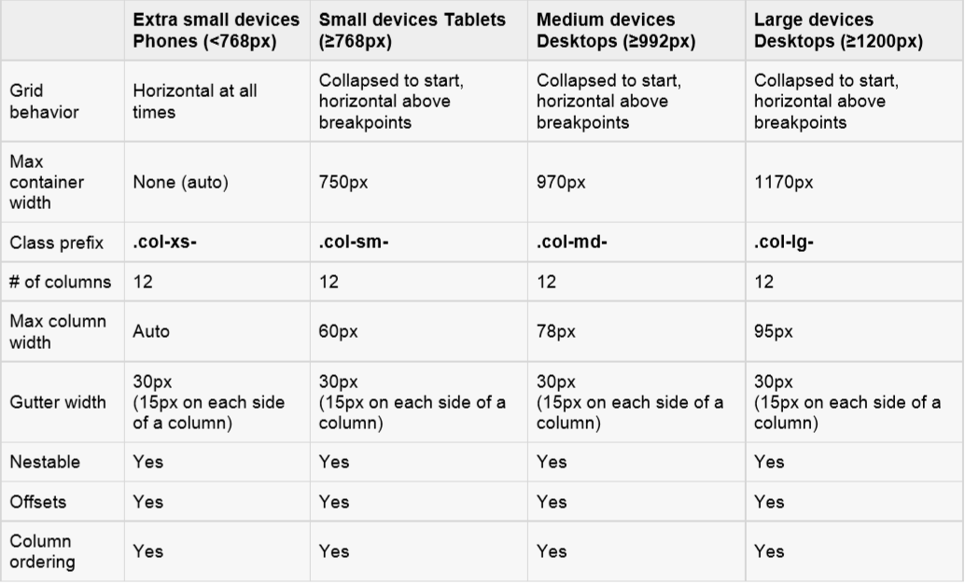
Grid Configurations

Slide 66
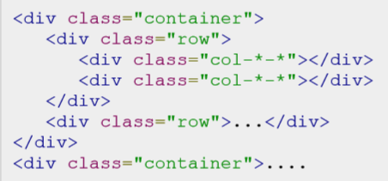
Basic Grid Structure

Slide 67
Bootstrap Template
Example Bootstrap Template
<!DOCTYPE html>
<html lang="en">
<head>
<meta charset="utf-8">
<meta http-equiv="X-UA-Compatible" content="IE=edge">
<meta name="viewport" content="width=device-width, initial-scale=1">
<title>Bootstrap 101 Template</title>
<link rel="stylesheet" href=“https://maxcdn.bootstrapcdn.com/bootstrap/3.3.7/css/bootstrap.min.css”>
<!-- Optional theme -->
<link rel="stylesheet" href=“https://maxcdn.bootstrapcdn.com/bootstrap/3.3.7/css/bootstrap-theme.min.css”>
</head> <body>
<h1>Hello, world!</h1>
<!-- jQuery (necessary for Bootstrap's JavaScript plugins) -->
<script src="https://ajax.googleapis.com/ajax/libs/jquery/1.12.4/jquery.min.js"></script>
<!-- Include all compiled plugins (below), or include individual files as needed -->
<script src="js/bootstrap.min.js"></script>
</body>
</html>

