Slide 1


Slide 2
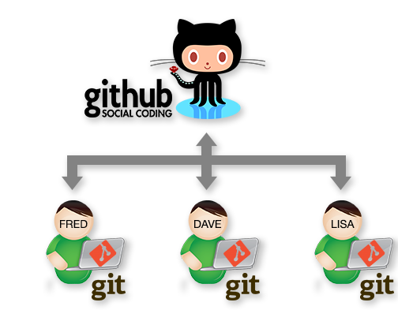
Intro
Developers collaborate
  Source control systems help teams collaborate
Git has had a major impact on how this is achieved.
Agenda:
  Introduction to Git basics.
  Collaborating with git
  Branching

Slide 3
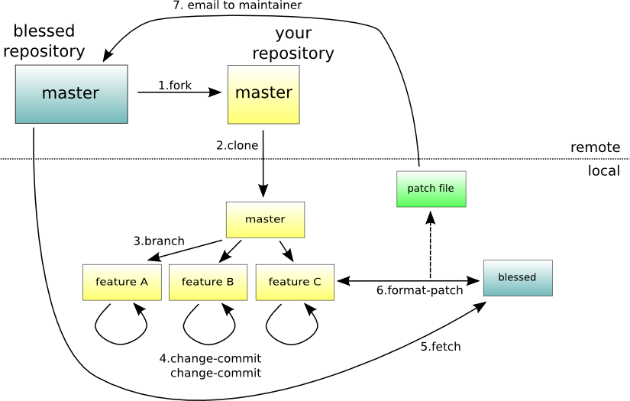
What is Git
Distributed Version Control
Directory Content Management
Tree Based History
Everybody has complete history
I get confused sometimes…

Slide 4
Distributed Content
Everyone has their own copy
Work Offline
No Central Authority
  Except by mutual agreement
Changes can be shared without a server…
  Can be configured to work peer to peer
  Can keep collaborating even if server is gone…
Notes:
Just about everything in Git can be done offline.
Not just that the system works well when it is offline. It is design from the beginning to have no real dependencies on a specific server.
The only actions you do in git where you need a server is when you push or pull changes from other team members.
In git there is no central server required. So the authority is really determined by the conventions your team puts in place.
Given Git’s nature you can even share changes in a peer-to –peer nature.
This does not happen often but Git does enable this ability. If your server is offline for some reason your team can still work.

Slide 5
Centralised vs Distributed
Central Server
Remote Server

Slide 6
Initialising a repo…
$ mkdir myproject
$ cd myproject
$ git init
Initialized empty Git repository in /home/ec2-user/myproject/.git/
$ git config --global user.name “fxwalsh“
$ git config --global user.email fxwalsh@wit.com
$ vi README.txt
$ git add .
$ git commit -m 'initial commit'
[master (root-commit) 7d738f4] initial commit
1 file changed, 1 insertion(+)
create mode 100644 README.txt
master
A
Notes:
most everything in git is done by convention. Master does not mean anything special to git.

Slide 7
Multiple Commits
master
A
B
C
git commit –m “updated text file”
git commit –m “updated text file again”
Notes:
a set of commits, moving master and our current pointer (*) along

Slide 8
Collaborating with Git

Slide 9
Peer – to – Peer
Tom’s Repo
Matt’s Repo
A
B
C
A
B
C
My Local Repo
Tracey’s Repo
You can work this way but it might get complicated…
A
B
C
A
B
C

Slide 10
Central Repository (e.g. GitHub, Bitbucket)
Tom’s Repo
Matt’s Repo
A
B
C
D
A
B
C
D
Remote Repo
A
B
C
D
My Local Repo
Tracey’s Repo
A
B
C
D
A
B
C
D

Slide 11
Adding a Remote Repo to Existing Project
git remote add origin https://github.com/fxwalsh/BSc4Repo.git
git remote -v
origin https://github.com/fxwalsh/BSc4Repo.git (fetch)
origin https://github.com/fxwalsh/BSc4Repo.git (push)

Slide 12
Setting up Remote via Cloning
git clone
……
git remote -v
origin https://github.com/fxwalsh/BSc4Repo.git (fetch)
origin https://github.com/fxwalsh/BSc4Repo.git (push)

Slide 13
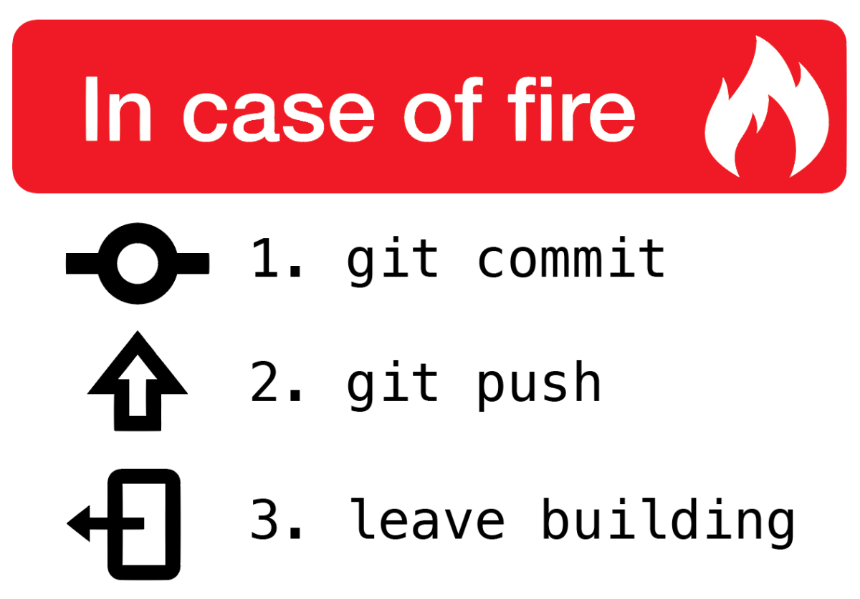
Push..
Pushes your changes to remote
Changes will be rejected if newer changes exist on remote
Good to pull then push
  merge locally, then push the results.

Slide 14
Pushing to Remote Repo
By default, remote repo is labelled origin.
Say you want to stage, commit, and push all your latest changes to origin…
git add --all
git commit –m “some important update to important stuff”
git push origin master

Slide 15
Potential situation 1
$ git push
To https://github.com/fxwalsh/project2.git
! [rejected] master -> master (fetch
first) error: failed to push some refs
….
$git pull
…..
Merge made by the 'recursive' strategy.
README.md | 2 +-
1 file changed,1 insertion(+), 1 deletion(-)
$git push
Counting objects: 5, done.
…
I can’t push to origin, it’s saying “! [rejected] master -> master (fetch first)”
Probably changes on the remote repo that you don’t have locally.
Solution: Do a pull then push.
Should work as long and there’s no conflict

Slide 16
Potential situation 2
I want to replace local repo with remote, don’t care about losing changes
Solution: fetch from the default remote, origin
Reset your current branch (master) to origin's master
$ git fetch
…
$ git reset --hard origin/master

Slide 17
Potential situation 3
I want to replace local repo with remote, don’t care about losing changes on remote
Solution: force the push
$ git push -f origin master

Slide 18
Potential situation 4
Trying to pull but getting “CONFLICT (content): Merge conflict in ….”
Two different versions of the same file(s)
Decide which one you want to keep manually.
Perhaps force push or hard reset.
  d
  Se
$ git push -f origin master

Slide 19
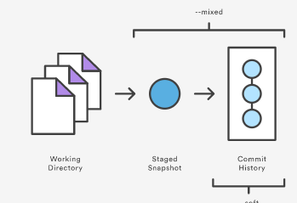
Potential Situation 5
I committed stuff I really didn’t want to. I want to revert to the previous commit.
Do git reset HEAD~1
  Moves Head (pointer to latest commit) back one
  Leaves files alone (but not staged)
Do git reset –hard HEAD~1
  Gets rid of changes completely
Do git reset –soft HEAD~1
  Leaves changes staged

Slide 20
Branching with Git

Slide 21
Branching
Like a label on a graph node
All branching takes place in the same folder/directory
  Things might appear to disappear depending on what branch you work on…
You can switch branches
  Analogous to moving label from one node to another

Slide 22
Branching
master
A
B
C
bug123
git checkout -b bug123
Switched to a new branch 'bug123'
Notes:
create a local “story branch” for this work.
new branch just a pointer to the same commit (C) but our current pointer (*) is moved.

Slide 23
Branching
master
A
B
C
D
E
bug123
git commit –m “bug fix”
git commit –m “another code fix”

Slide 24
Branching
master
A
B
C
D
E
bug123
git checkout master
vi README.txt

Slide 25
Branching
master
A
B
C
D
E
bug123
git merge bug123

Slide 26
Delete Branch
master
A
B
C
D
E
git branch -d bug123
Deleted branch bug123 (was 0e85eb8).

Slide 27
Branching
master
A
B
C
D
E
F
G
bug456
Suppose another bug branch off of (C).
Also, changes have happened in master (bug 123 which we just merged) since then.
Also, two commits in bug456.

Slide 28
Merging
master
A
B
C
D
E
F
G
bug456
git checkout master

Slide 29
Merging
master
A
B
C
D
E
H
F
G
bug456
git merge bug456
if there are conflicts, they need to be resolved manually
Also deleting the bug456 branch can leave a non-linear, messy structure.

Slide 30
Merging - Rebase
master
A
B
C
D
E
F
G
bug456
As before, but this time we rebase first….

Slide 31
Merging: Rebase
master
A
B
C
D
E
F’
G’
bug456
Changes on (C) are undone and applied to (E) instead.

Slide 32
Merging: Rebase
master
A
B
C
D
E
F’
G’
bug456
git checkout master
git merge bug456
Linear, causal flow of changes.
Less snapshots in repository

Slide 33
Branching and Merging: Key points
Quick and Easy to create ‘Feature’ Branches
Very capable tool to manage changes
Rebasing helps keep things clearer.

Slide 34
Branching with Remote
origin/master
master
A
B
C
D
E
bug123
Changes on Bug123 branch are only local.

Slide 35
Branching with Remote
origin/master
master
origin/master
A
F
G
B
C
D
E
bug123
Can have situation where there’s two versions of the origin/master
  what was last known about the upstream master
  what is actually up there (which we don’t know about).

Slide 36
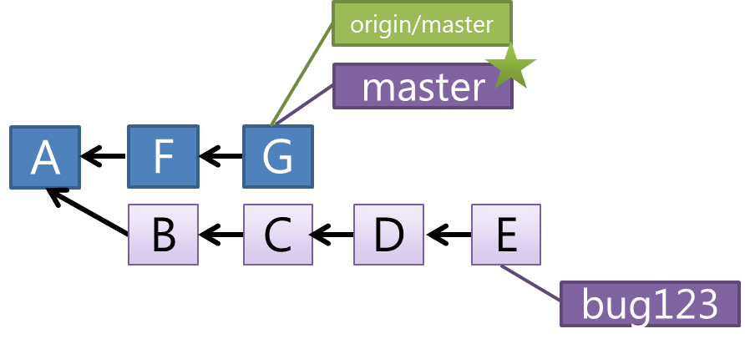
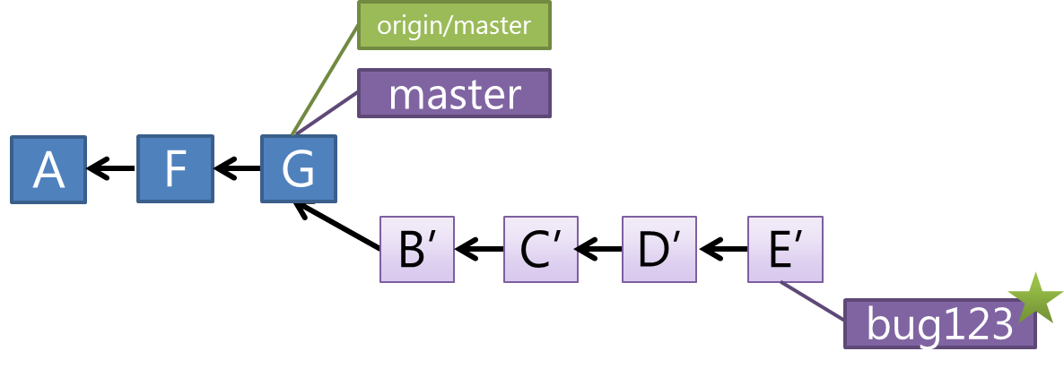
Branching with Remote
Update Master to what’s on remote
git checkout master
git pull origin
Rebase the bug123 branch
git checkout bug123
git rebase

Slide 37
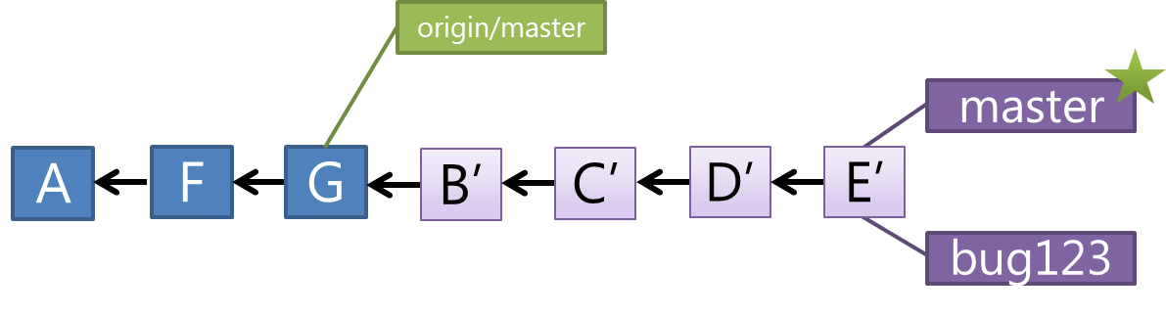
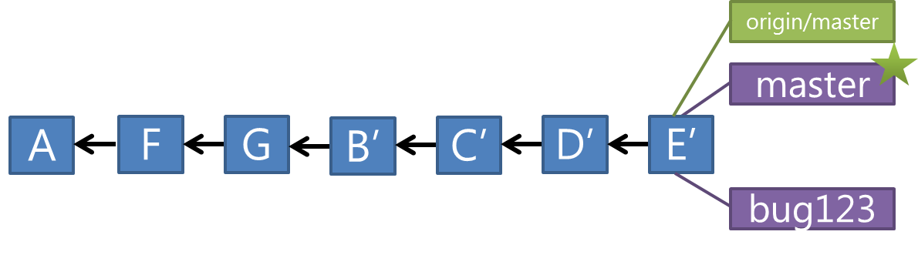
Branching with Remote
git merge bug123
git push origin

Slide 38
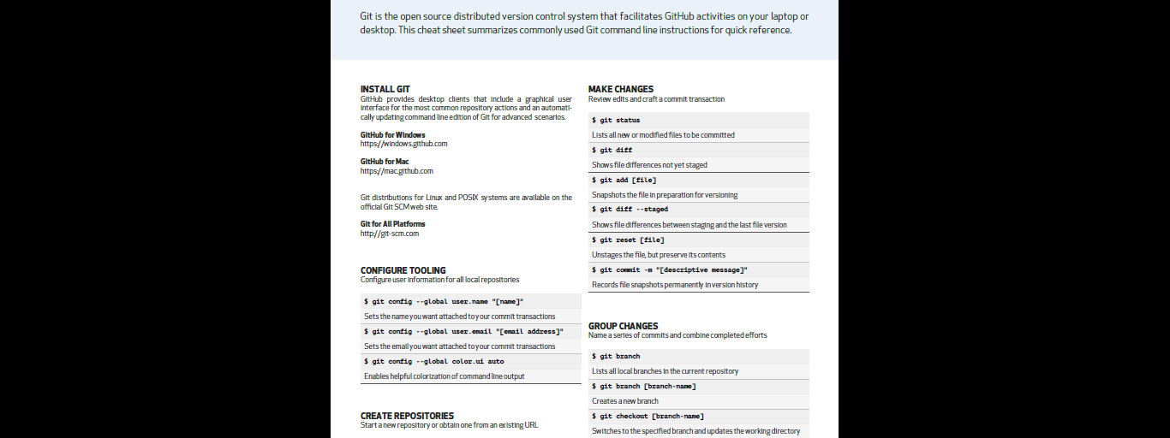
Final Word
Cheat sheet is always handy…

