Slide 1

MongoDB and Cloud Storage
Frank Walsh, Diarmuid O’Connor

Slide 2
Agenda
Cloud Databases
MongoDB
Querying
Integrating with Node.js
The Contacts API implementation

Slide 3
Databases in Enterprise Apps
Most data driven enterprise applications need a database
In traditional enterprise applications, this requires
Backups
Fail over
Maintenance
Capacity provisioning
Usually handled by a Database Administrator.

Slide 4
Databases in the Cloud
For some apps, a traditional database may not be the best fit
Does the app require transactional integrity
Do you need db schema definition
Do you know your scaling requirements, particularly if it’s a web app
One approach is to use the Cloud for you DB
Designed for scale
Can be outsourced so you don’t have to deal with infrastructure requirements.

Slide 5
Cloud DB Advantages
Removes Management costs
Inherently scalable
Latency is predictable and constant
No need to define schemas etc.
Lots of Cloud DB offerings out there
SQL based
NoSQL based
If organisation policy/standards do not allow outsourcing:
- Can host yourself, most NoSQL DBs are free.

Slide 6
Cloud Database Practices
Drop Consistency
this makes distributed systems much easier to build
Drop SQL and the relational model
simpler structures are easier to distribute:
key/value pairs
structured documents
pseudo-tables
tend to be schema-free,accepting data as-is
Offer HTTP interfaces using XML or JSON
Use in-memory storage aggressively

Slide 7
Designing Distributed Data
App data is not homogeneous
some kinds of data will be much larger
consider using different databases for different requirements:
user details,billing - needs consistency
require traditional database
user data,content - needs partition tolerance
replicate to keep safe
analytics,sessions - needs availability
"eventually consistent" is good enough

Slide 8
Mongodb

Slide 9
Introduction
Document-oriented database
but closer to traditional SQL databases than others
Uses JSON natively - perfect fit for Node.js
Query language with many SQL features
Uses JSON too, and has an easy learning curve
Commercial support - 10gen.com product
cloud hosting providers - e.g.mongoLab.com
Community support - popular choice

Slide 10
Mongo Terminology
Each database contains a set of "Collections"
Collections are analogous to SQL tables
Collections contain a set of JSON documents
there is no schema (in the DB)
the documents can all be different
means you have rapid development
adding a property is easy - just starting using in your code
makes deployment easier and faster
roll-back and roll-forward are safe - unused properties are just ignored
Collections can be indexed and queries
Operations on individual documents are atomic

Slide 11
Getting Started (locally)
For complete MongoDB installation instructions, see the manual.
Starting MongoDB:
mongod
This starts the process.
Can add other parameters, for instance location of data.

Slide 12
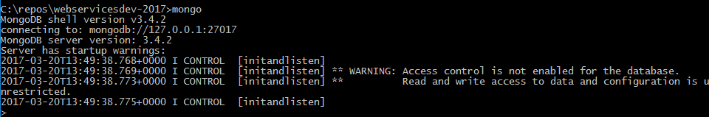
Mongo Shell
Interactive JavaScript interface to MongoDB.
Query/update data and perform administrative operations.
By default, Mongo shell will attempt to connect to the MongoDB instance running on the localhost interface on port 27017.

Slide 13
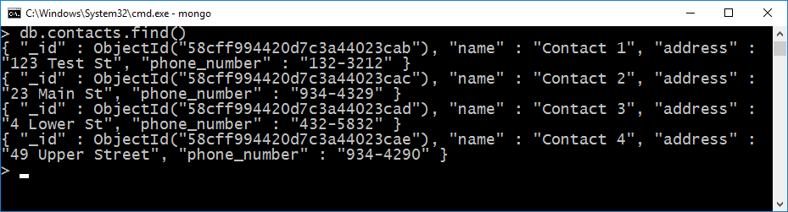
The MongoDB Query Language
MongoDB provides a JavaScript API and JSON-based query language
Use the MongoDB shell to execute queries
similar to usingMySQL console
Example: list of contacts
db - current database
contacts - the contacts collection
.find() - collectionAPI method (coorresponds to collection URL in last lecture…)
The Result Set is a list of JavaScript objects, representing matched documents

Slide 14
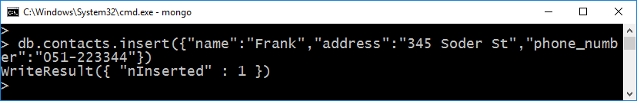
MongoDB: Inserts
Collections do not need to be created explicitly
just insert a document
MongoDB automatically assigns a 12 byte unique identifier to any document
the _id property
Stored internally as binary
the ObjectId wrapper object is provided to work with these identifiers

Slide 15
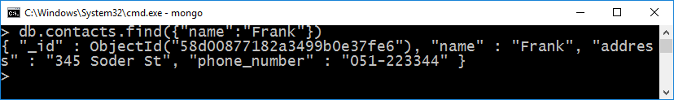
MongoDB:Queries
Documents are retrieved by specifying a set of conditions to match against
simplest case : query-by-example
provide a subset of properties that must match > db.city.find( {name:'Waterford'} ) { "_id" : ObjectId ("4f3a3f530b74e3768d4801ca"), name:'Waterford',country:'Ireland'}
More complex queries use a convention of embedded meta- properties to specify conditions these are signified with a $ prefix.
Example:{name:{$exists:true}}
returns documents that have a name property

Slide 16
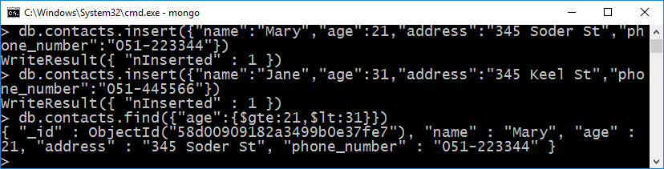
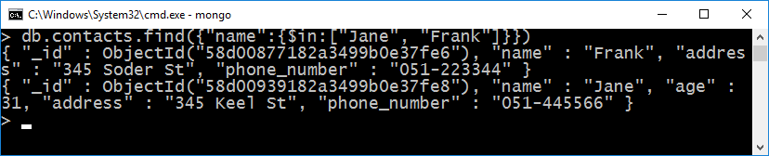
MongoDB: Queries
Common meta-properties used to query data are:
$gt, $gte, $lt, $lte meaning>, >=, <,<=
$or, $in, $nin
regular expressions {word: /th^/i }
+Queries for more

Slide 17
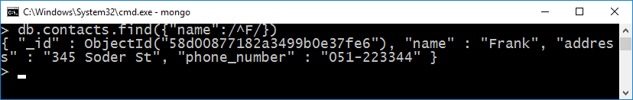
MongoDB: Queries
regular expressions {word: /th^/i }
db.contacts.find().limit(5)
limits the number of documents in the result set.
db.contacts.find().skip( 5 )
Set the Starting Point of the Result Set

Slide 18
MongoDB:Updates
Documents are updated by providing:
a query to select the relevant subset of documents,
an update specification,which is either:
a complete replacement document
meta-properties that modify specific document properties
example: $set changes specific properties Example:complete replacement: > db.city.insert( {name:'dublin'} ) > db.city.update( {name:'dublin'}, {name:'Dublin',county:'Dublin'} )
Example:modify specific properties:
> db.city.insert( {name:'Cork',county:'cork'} )
> db.city.update( {name:'Cork'}, {$set:{county:'Cork'}} )
See http://www.mongodb.org/display/DOCS/Updating for more

Slide 19
MongoDB:Update Properties
Common meta-properties used with the update command are:
$set - sets specified properties,but leaves others alone $set:{name:'New Name'}
$unset - deletes specified properties $unset:{name:1}
$inc - increments a numeric property inc:{ upvotes: 2 } adds 2 to the counter property, or if it does not exist, sets it to 2
$push, $pop - add to or remove values from,an array
$push: { comments: {who:..., msg:...} }
$pop: {comments: -1 }

Slide 20
MongoDB:Upserts
The MongoDB update command can optionally insert a document if it is not found. This is known as an 'upsert'
This is useful when starting counters as it avoids corrupting the count when two independent updates try to initialize the counter.
db.counters.update( {name:'foo'}, {$inc:{value:1}}, true)
The first update will create the counter: {name:'foo', value:1}
The second update will increment the counter: {name:'foo', value:2}

Slide 21
Mongoose

Slide 22
Mongoose Overview
Mongoose is a object-document model module in Node.js for MongoDB
Wraps the functionality of the native MongoDB driver
Exposes models to control the records in a doc
Supports validation on save
Extends the native queries

Slide 23
Installing Mongoose
Run the following from the CMD/Terminal
$ npm install -save mongoose
In node
Load the module
import mongoose from 'mongoose';
Connect to the database
mongoose.connect(mongoDbPath);

Slide 24
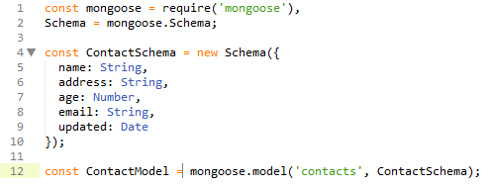
Mongoose Schemas and Models
Mongoose supports models
i.e. fixed types of documents
Needs a mongoose.Schema
Each of the properties must have a type
Number, String, Boolean, array, object

Slide 25
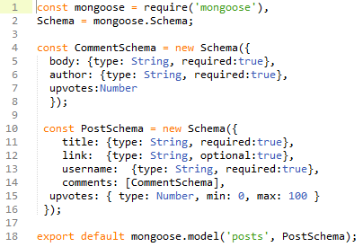
Mongoose Schemas - Arrays
Comments property is an Array of CommentSchemas

Slide 26
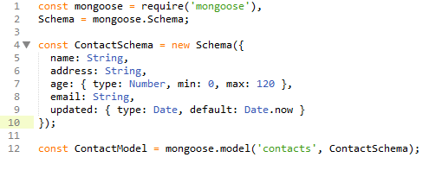
Mongoose Schema - Validation
Can define validation constraints on properties :

Slide 27
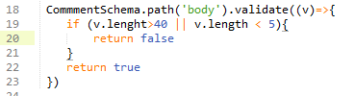
Mongoose Custom Validation
Developers can define custom validation on their properties (e.g. validate length of comment when trying to save)

Slide 28
Data Manipulation Mongoose
Mongoose supports all the CRUD operations:
Create –> Model.create()
Read –> Model.find()
Update –> Model.update(condition, props, cb)
Remove –> Model.remove()
Can operate with "error first" callback or promises.

Slide 29
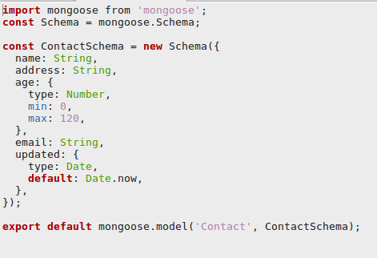
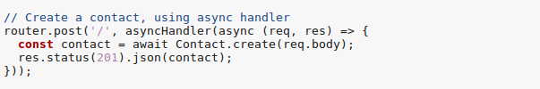
Create Contact with Mongoose

Slide 30
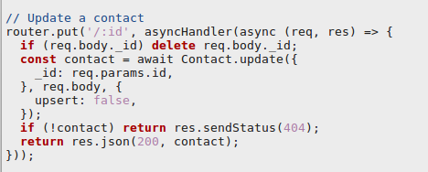
Update Contact with Mongoose

Slide 31
Mongoose Queries
Mongoose provides a mode expressive version of the native MongoDB
Instead of: {$or: [{conditionOne: true}, {conditionTwo: true}]
Do: .where({conditionOne:true}).or({conditionTwo: true})

Slide 32
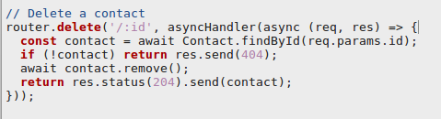
Mongoose Queries
Mongoose supports many queries:
For equality/non-equality
Selection of some properties
Sorting
Limit & skip
All queries are executed over the object returned by Model.find*()
Model.findOne() returns a single document, the first match
Model.find() returns all
Model.findById() queries on the _id field.

Slide 33

Mongoose Queries
Can build complex queries and execute them later
The above finds all contacts where age >17 and <66 and living in either Waterford, Kilkenny or Wexford

Slide 34
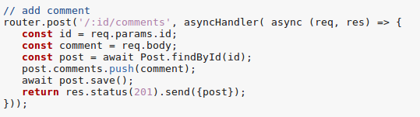
Mongoose Sub-Docs
Ex: Hacker News – Adding a comment to a post.

Slide 35
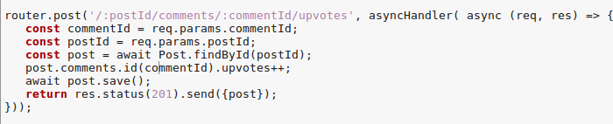
Mongoose Sub-Docs
Updating a Sub-Document(e.g. incrementing the upvotes for a comment)
Each subdocument is assigned it’s own _id from MongoDB. This is a special method to access sub documents

Slide 36
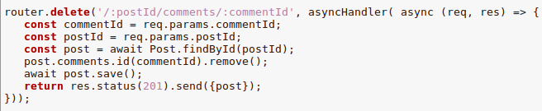
Mongo Sub docs
Removing a sub document

Slide 37
MongoDB as a Service
Best practice for initial development is to host MongDB process on your development machine
In production environments, Mongo will be hosted:
on it’s own instance or
provisioned as a service

Slide 38
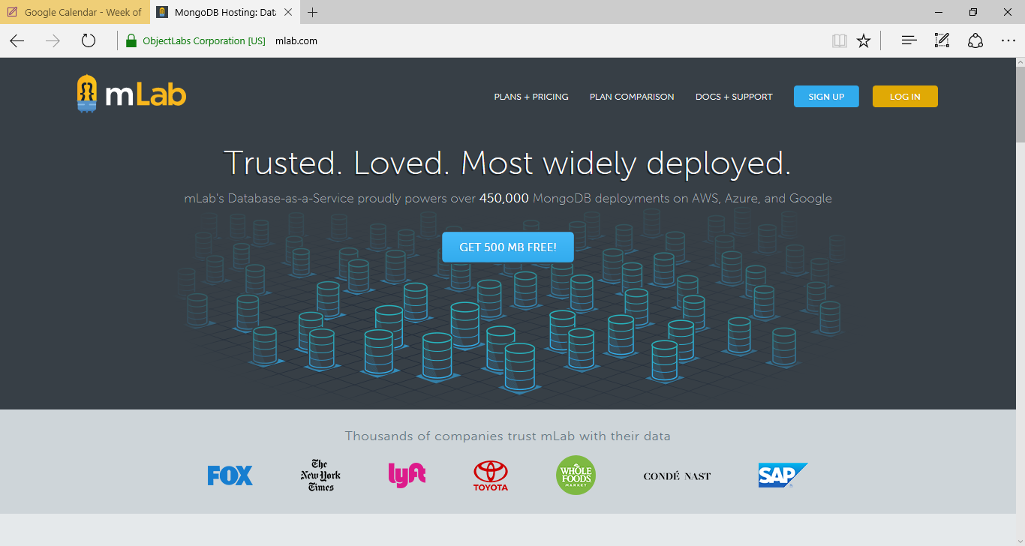
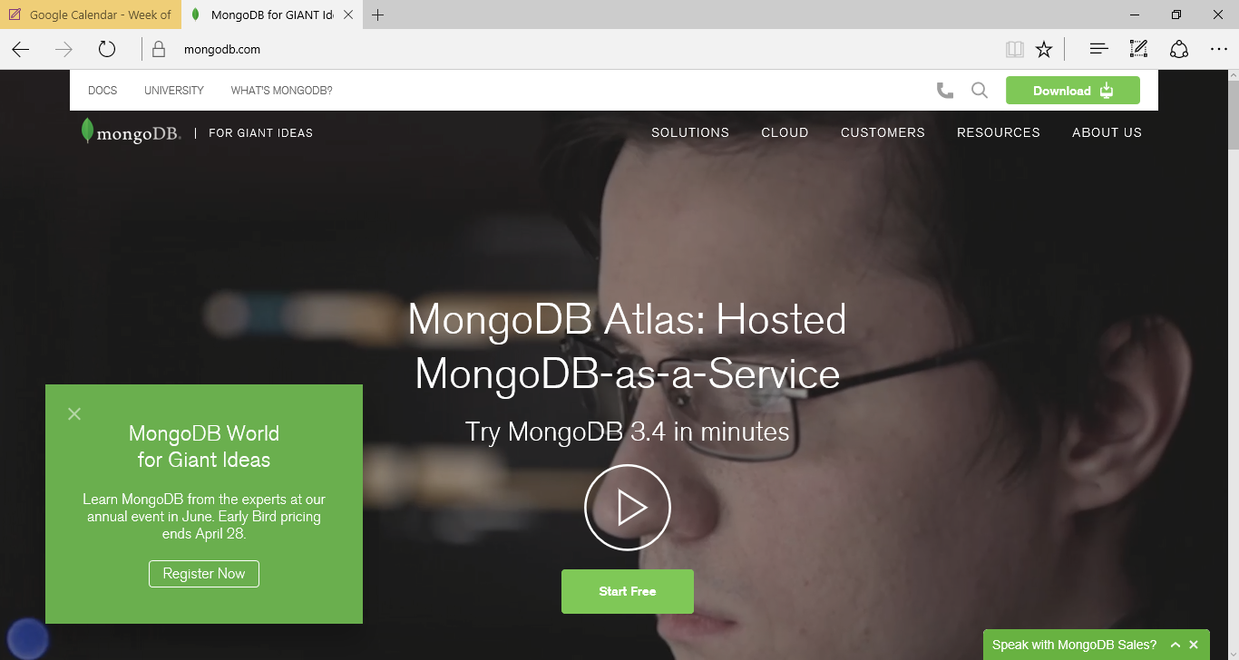
MongoDB as a Service

Slide 39
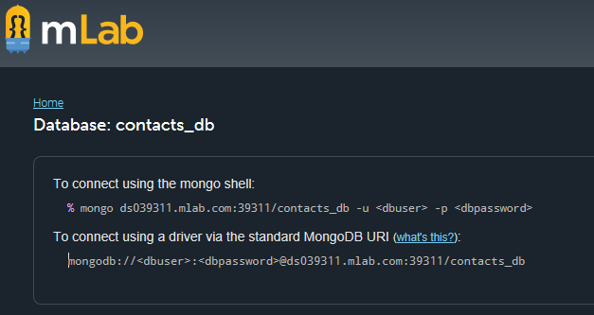
MongoDB as a Service
Most providers allow free access teir
Provide user credentials wrapped in a URL
All you need to do is update your config with the relevant URL
Careful to ignore credentials when pushing to github/public repo

