Slide 1


Slide 2
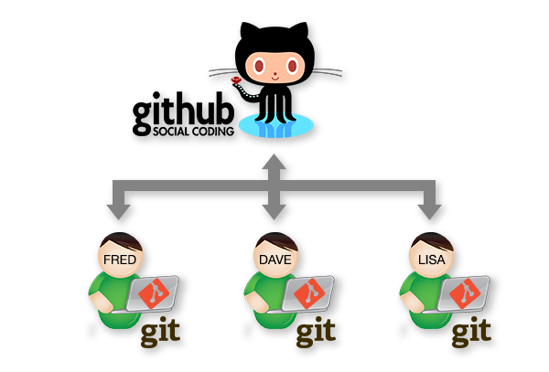
Intro
Recent times have seen changes in how developers collaborate with each other.
Source control systems are now used by teams for collaboration.
Git has had a major impact on how this is achieved.
Agenda today:
Introduction to Git basics.
Some Git Scenarios…

Slide 3

Git History
Created by Linus Torvalds for work on the Linux kernel ~2005
Used by:
Nearly everybody at this stage…
Notes:
Git was originally created by Linus for work on the Linux kernel right around 2005.
Although git has its origins in the Open source community, git is being used within close source projects also.
Visual Studio Live! Las Vegas 2011MGB 2003
© 2003 Microsoft Corporation. All rights reserved.
This presentation is for informational purposes only. Microsoft makes no warranties, express or implied, in this summary.

Slide 4
What’s Git
Distributed Version Control
Directory Content Management
Tree Based History
Everybody has complete history

Slide 5
Distributed Content
Everyone has their own copy
Work Offline
No Central Authority
Except by mutual agreement
Changes can be shared without a server…
Can be configured to work peer to peer
Can keep collaborating even if server is gone…
Notes:
Just about everything in Git can be done offline.
Not just that the system works well when it is offline. It is design from the beginning to have no real dependencies on a specific server.
The only actions you do in git where you need a server is when you push or pull changes from other team members.
In git there is no central server required. So the authority is really determined by the conventions your team puts in place.
Given Git’s nature you can even share changes in a peer-to –peer nature.
This does not happen often but Git does enable this ability. If your server is offline for some reason your team can still work.
5

Slide 6
Centralised vs Distributed
Central Server
Remote Server

Slide 7
Branching
Like a label on a graph node
All branching takes place in the same folder/directory
Things might appear to disappear depending on what branch you work on…
You can switch branches
Analogous to moving label from one node to another

Slide 8
Initialising a repo…
[ec2-user@ip-10-34-209-81 ~]$ mkdir myproject
[ec2-user@ip-10-34-209-81 ~]$ cd myproject
[ec2-user@ip-10-34-209-81 myproject]$ git init
Initialized empty Git repository in /home/ec2-user/myproject/.git/
git config --global user.name “fxwalsh“
git config --global user.email fxwalsh@wit.com
[ec2-user@ip-10-34-209-81 myproject]$ vi README.txt
[ec2-user@ip-10-34-209-81 myproject]$ git add .
[ec2-user@ip-10-34-209-81 myproject]$ git commit -m 'initial commit'
[master (root-commit) 7d738f4] initial commit
1 file changed, 1 insertion(+)
create mode 100644 README.txt
[ec2-user@ip-10-34-209-81 myproject]$
master
A
Notes:
most everything in git is done by convention. Master does not mean anything special to git.
8

Slide 9
Multiple Commits
master
A
B
C
git commit –m “updated text file”
git commit –m “updated text file again”
Notes:
a set of commits, moving master and our current pointer (*) along
9

Slide 10
Branching
master
A
B
C
bug123
git checkout -b bug123
Switched to a new branch 'bug123'
Notes:
create a local “story branch” for this work.
new branch just a pointer to the same commit (C) but our current pointer (*) is moved.
10

Slide 11
Branching
master
A
B
C
D
E
bug123
git commit –m “bug fix”
git commit –m “another code fix”

Slide 12
Branching
master
A
B
C
D
E
bug123
git checkout master
vi README.txt

Slide 13
Branching
master
A
B
C
D
E
bug123
git merge bug123

Slide 14
Delete Branch
master
A
B
C
D
E
git branch -d bug123
Deleted branch bug123 (was 0e85eb8).

Slide 15
Branching
master
A
B
C
D
E
F
G
bug456
Suppose another bug branch off of (C).
Also, changes have happened in master (bug 123 which we just merged) since then.
Also, two commits in bug456.

Slide 16
Merging
master
A
B
C
D
E
F
G
bug456
git checkout master

Slide 17
Merging
master
A
B
C
D
E
H
F
G
bug456
git merge bug456
if there are conflicts, they need to be resolved manually
Also deleting the bug456 branch can leave a non-linear, messy structure.

Slide 18
Merging - Rebase
master
A
B
C
D
E
F
G
bug456
As before, but this time we rebase first….

Slide 19
Merging: Rebase
master
A
B
C
D
E
F’
G’
bug456
Changes on (C) are undone and applied to (E) instead.

Slide 20
Merging: Rebase
master
A
B
C
D
E
F’
G’
bug456
git checkout master
git merge bug456
Linear, causal flow of changes.
Less snapshots in repository

Slide 21
Branching and Merging: Key points
Quick and Easy to create ‘Feature’ Branches
Very capable tool to manage changes
Rebasing helps keep things clearer.

Slide 22
Collaborating with Git

Slide 23
Peer – to Peer
Tom’s Repo
Matt’s Repo
A
B
C
A
B
C
My Local Repo
Tracey’s Repo
You can work this way but it might get complicated
A
B
C
A
B
C

Slide 24
Central Repository (e.g. GitHub)
Tom’s Repo
Matt’s Repo
A
B
C
D
A
B
C
D
Remote Repo
A
B
C
D
My Local Repo
Tracey’s Repo
A
B
C
D
A
B
C
D

Slide 25
Adding a Remote Repo to Existing Project
git remote add origin https://github.com/fxwalsh/BSc4Repo.git
git remote -v
origin https://github.com/fxwalsh/BSc4Repo.git (fetch)
origin https://github.com/fxwalsh/BSc4Repo.git (push)

Slide 26
Setting up Remote via Cloning
git clone
……
git remote -v
origin https://github.com/fxwalsh/BSc4Repo.git (fetch)
origin https://github.com/fxwalsh/BSc4Repo.git (push)

Slide 27
Branching with Remote
origin/master
master
A
B
C
D
E
bug123
Changes on Bug123 branch are only local.

Slide 28
Branching with Remote
origin/master
master
origin/master
A
F
G
B
C
D
E
bug123
Can have situation where there’s two versions of the origin/master
what was last known about the upstream master
what is actually up there (which we don’t know about).

Slide 29
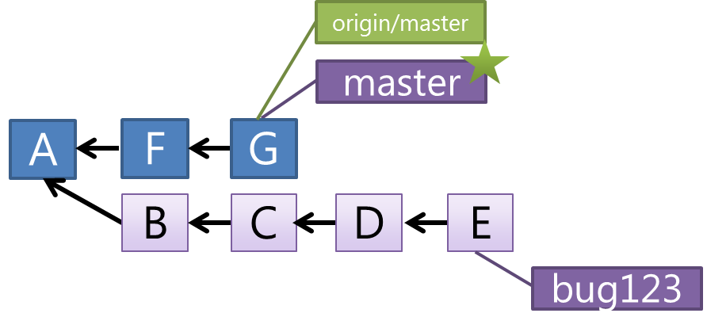
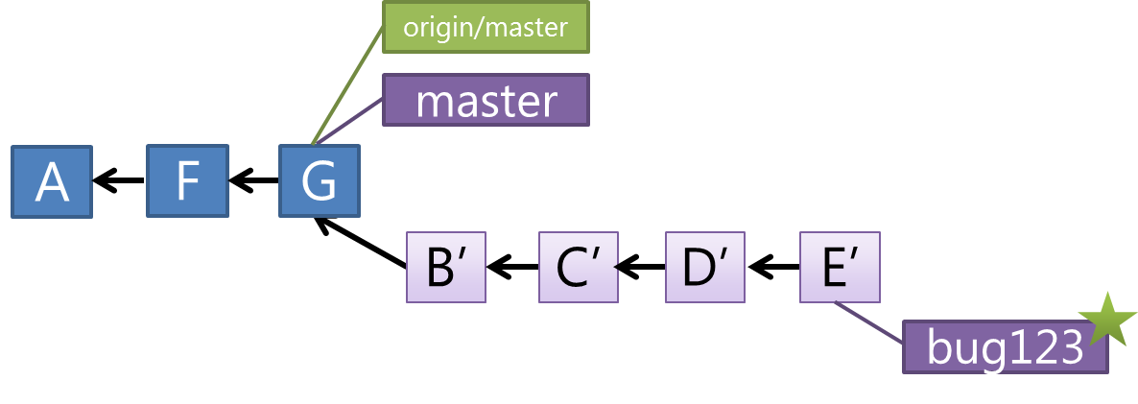
Branching with Remote
Update Master to what’s on remote
git checkout master
git pull origin
Rebase the bug123 branch
git checkout bug123
git rebase

Slide 30
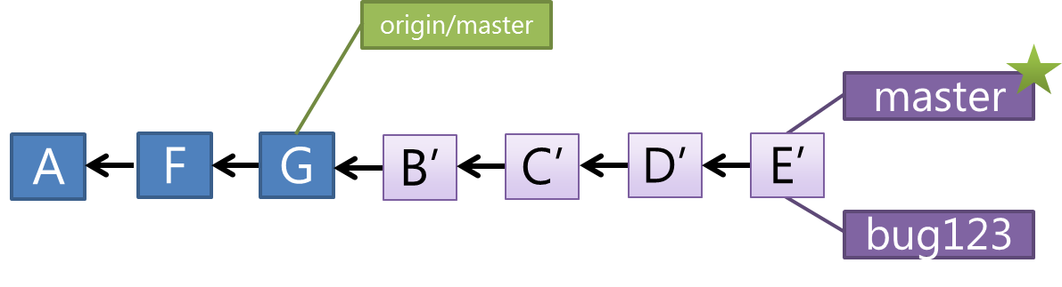
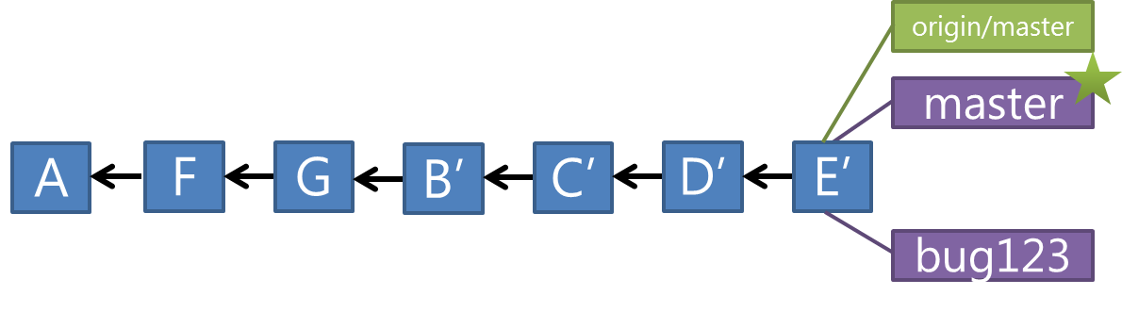
Branching with Remote
git merge bug123
git push origin

Slide 31
Push
Pushes your changes to remote
Changes will be rejected if newer changes exist on remote
Good to pull then push
merge locally, then push the results.

Slide 32
Summary
Add, Commit, Push
This will get you through this module
Branch, Merge, Rebase
Allow for collaborations, bug fixes, multiple versions…

