Slide 1
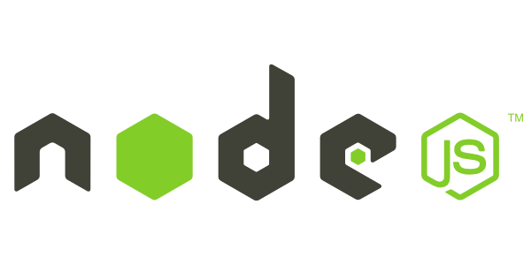
Introduction to Node.js
Frank Walsh
Diarmuid O'Connor

Slide 2
Agenda
What is node.js
Non Blocking and Blocking
Event-based processes
Callbacks in node
Node Package Manager
Creating a node app
Introduction to Express

Slide 3
What's Node: Basics
Put simply, Node.js is ‘server-side JavaScript’.
More accurately, Node.js is a high performance network applications framework, well optimized for high concurrent environments.
In ‘Node.js’ , ‘.js’ doesn’t mean that its solely written in JavaScript. It is
40% JS and 60% C++.
From the official site: ‘Node's goal is to provide an easy way to build scalable network programs.

Slide 4
What’s Node, V8.
Embeddable C++ component
Can expose C++ objects to Javascript
Very fast and multi-platform
Find out a bit about it's history here: http://www.google.com/googlebooks/chrome/big_12.html

Slide 5
What's Node.js: Event-based
Generally, input/output (io) is slow.
Reading/writing to data store, probably across a network.
Calculations in cpu are fast.
2+2=4
Most time in programs spent waiting for io to complete.
In applications with lots of concurrent users (e.g. web servers), you can't stop everything and wait for io to complete.
Solutions to deal with this are:
Blocking code with multiple threads of execution (e.g. Apache, IIS)
Non-blocking, event-based code in single thread (e.g. NGINX, Node.js)

Slide 6
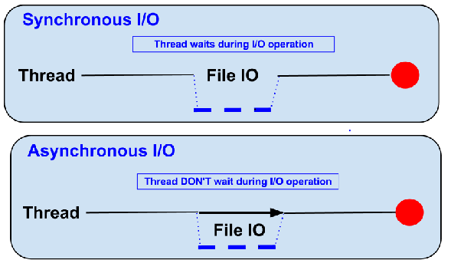
Blocking (Traditional)
Traditional code waits for input before proceeding (Synchronous)
The thread on a server "blocks" on io and resumes when it returns.

Slide 7
Non-blocking (Node)
Node.js code runs in a Non-blocking, event-based Javascript thread
No overhead associated with threads
Good for high concurrency (i.e. lots of client requests at the same time)

Slide 8
Blocking/Non-blocking Example
Blocking
Read from file and set equal to contents
Print Contents
Do Something Else...
Non-blocking
Read from File
Whenever read is complete, print contents
Do Something Else...

Slide 9
Blocking/Non-blocking Example
Blocking
const contents = fs.readFileSync('./text.txt'); console.log(contents);
console.log('Doing something else');
Non-blocking
fs.readFile(‘./text.txt', (err, contents)=>{ console.log(contents); });
console.log('Doing something else');

Slide 10
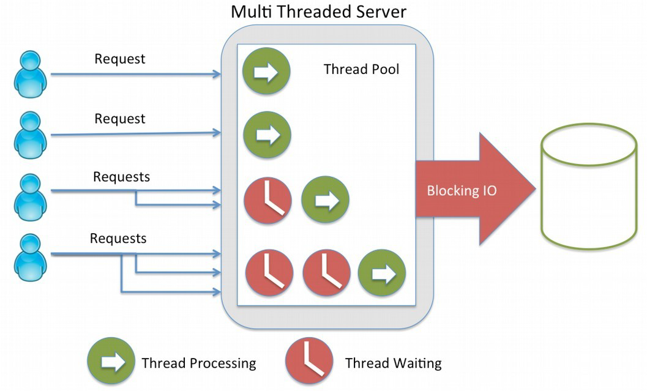
Blocking vs. Non-blocking
Threads consume resources
Memory on stack
Processing time for context switching etc.
No thread management on single threaded apps
Just execute “callbacks” when event occurs
Callbacks are usually in the form of anonamous functions.

Slide 11
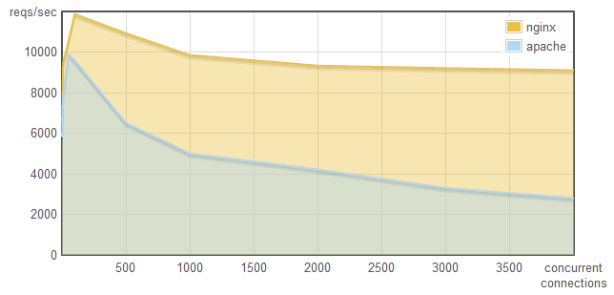
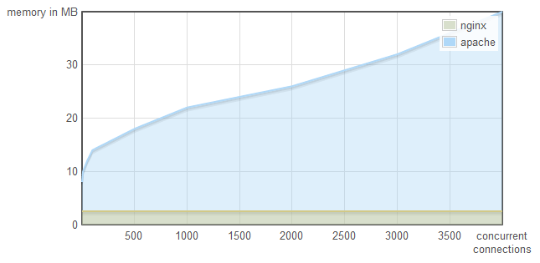
Why does it matter...
This is why:
http://blog.webfaction.com/a-little-holiday-present

Slide 12
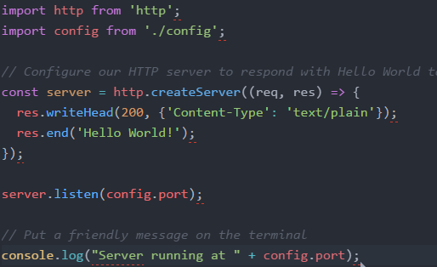
Node.js Event Loop
EVENT LOOP STARTS WHEN FINISHED
Event Queue
Known Events
request
request
request

Slide 13
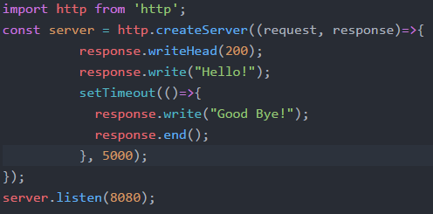
Callbacks
“Request” Callback
“Timeout” Callback

Slide 14
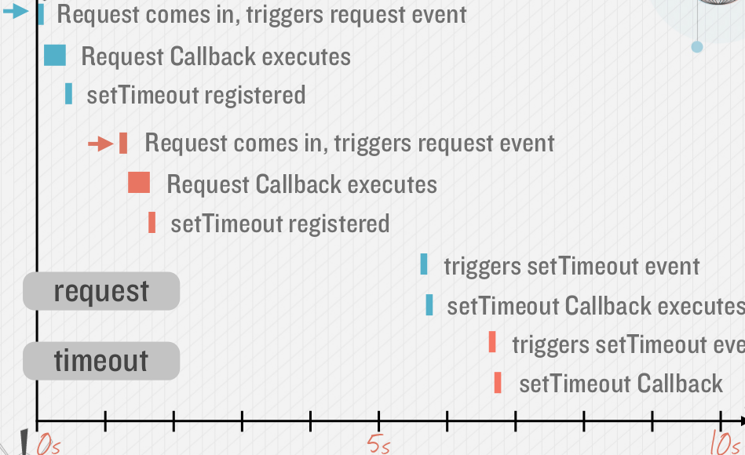
Callback Timeline, Non Blocking

Slide 15
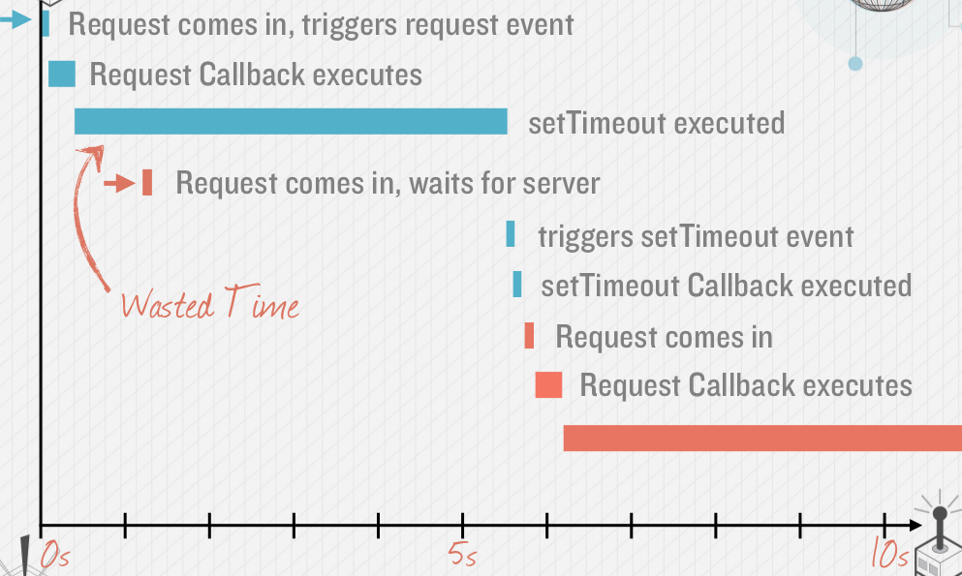
Callback Timeline, Blocking

Slide 16
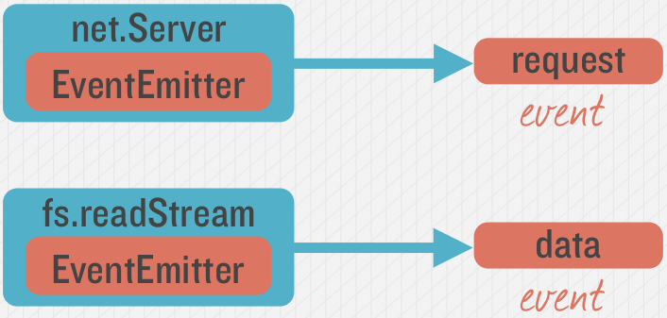
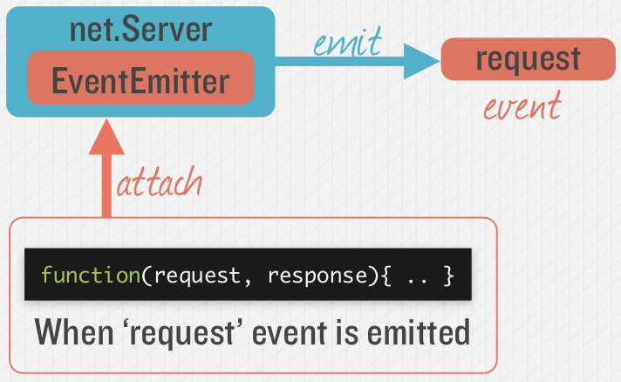
Emitting Event in Node
Many objects can emit events in node.
See here for a description of how HTTP Server works

Slide 17
Node Callbacks
“If Google’s V8 Engine is the heart of your Node.js application, then callbacks are its veins”.
They enable a balanced, non-blocking flow of asynchronous control across modules and applications.
But for callbacks to work at scale you need a common, reliable protocol.
The “error-first” callback (also known as an “errorback”, “errback”, or “node-style callback”) was introduced to solve this problem, and is a standard for Node.js callbacks.
A callback is basically a function called at the completion of a given task. This prevents any blocking, and allows other code to be run in the meantime.

Slide 18
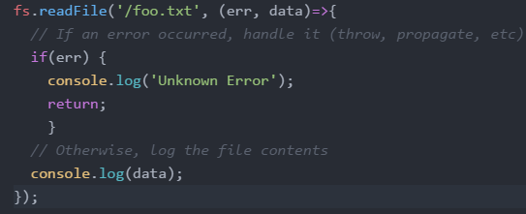
Error First Callbacks
The first argument of the callback is reserved for an error object. If an error occurred, it will be returned by the first err argument.
The second argument of the callback is reserved for any successful response data. If no error occurred, err will be set to null and any successful data will be returned in the second argument.

Slide 19

Node: Caution!
In node, event callback functions should execute fast
Do not perform computationally expensive operations in the event callback function.
Always use callback functions. Better for high concurrency.

Slide 20
Node Modules

Slide 21

Node Modules
Node has a small core API
Most applications depend on third party modules
Thisd party modules curated in online registry called the Node Package Manager system (NPM)
NPM downloads and installs modules, placing them into a node_modules folder in your current folder.

Slide 22
NPM init
You can use NPM to manage your node projects
Run the following in the root folder of your app/project:
npm init
This will ask you a bunch of questions, and then write a package.json for you.
It attempts to make reasonable guesses about what you want things to be set to, and then writes a package.json file with the options you've selected.

Slide 23
Node Modules
Installing a NPM Module is easy:
Navigate to the application folder and run:
npm install express --save
This installs into a “node_module” folder in the current folder.
The –save bit updates your package.json with the dependency
To use the module in your code, use:
var express = require('express');
This loads express from local node_modules folder.

Slide 24
Global Node Modules
Sometimes you may want to access modules from the shell/command line.
You can install modules that will execute globaly by including the '-g'.
Example, Grunt is a Node-based software management/build tool for Javascript.
npm install -g grunt-cli
This puts the “grunt” command in the system path, allowing it to be run from any directory.

Slide 25
NPM Common Commands
Common npm commands:
– npm init initialize a package.json file
– npm install <package name> -g install a package, if –
g option is given package will be installed globally, --save
and --save-dev will add package to your dependencies
– npm install install packages listed in package.json
– npm ls –g listed local packages (without –g) or global
packages (with –g)
– npm update <package name> update a package

Slide 26
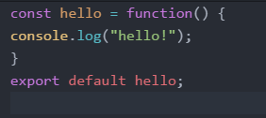
Creating your own Node Modules
We want to create the following module called greeting.js:
To access in our application, app.js:
import hello from './custom_hello'; hello();
Export defines what
import returns

Slide 27
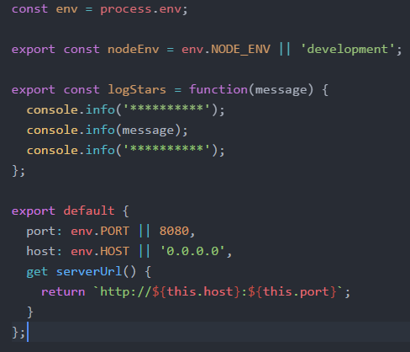
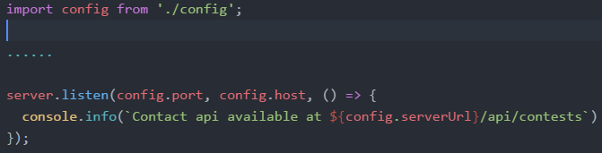
Creating your own Node Modules
Exporting Multiple Properties
Accessing in other scripts

Slide 28


The import search
Import searches for modules based on path specified:
Just providing the module name will search in node_modules folder

Slide 29
The Express Package

Slide 30
What is Express?
Web application framework for Node
Built on the Connect middleware package
It's popular because it‘s
Minimalist,
Fast
Simple

Slide 31
What Express Gives Us...
Parses arguments and headers
Easy Routing
Route a URL to a Javascript callback function
Views
Partials
Layouts
Environment-based Configuration
Sessions
File Uploads

Slide 32
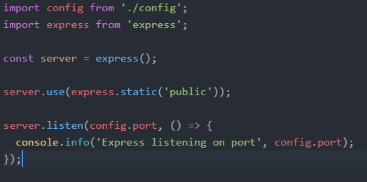
Simple Express App (server.js)
Loads Express module
Instantiates Express server
Define static content for HTTP GET

Slide 33
Getting Started with Express
Installing Express
[local install] C:\> npm install express
[global install] C:\> npm install express -g

Slide 34
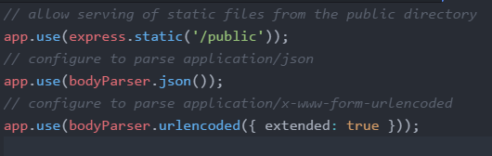
Express Configuration
Express allows you to easily configure your web app behaviour...

Slide 35
Routing Examples
//Catch-all
app.all('/app(/*)?', requiresLogin);
// Routes
app.get('/', routes.index);
app.get('/about', routes.about);
app.get('/contact', routes.contact);
app.get('/app/list', routes.listapps);
app.get('/app/new', routes.newapp);
app.post('/app/new', routes.saveapp);
app.get('/app/:app', routes.getapp);
app.get('/app/:app/edit', routes.editapp);
Catch-all – works for all HTTP verbs
HTTP GET request
HTTP POST request
Accepts :app route argument
Syntax follows the pattern:
App.[verb](path, (req,res)=>{});

Slide 36
Node Applications Structure

Slide 37
Structuring Node Apps
Node Server Code needs to be structured
Manage code base
Keeps code maintainable
Nodes packaging system supports this approach
Typical Node.js application code:
main server code
api implementation code
helper code

Slide 38
Example Approach:
Use a “project root” folder is the top level and contains the “entry point” or main server code
Always run npm in this folder to ensure just one node_modules folder
Use a public folder within the node folder for static content

Slide 39
Basic Project Structure
Root of your actual application
/projectroot/
package.json
readme.md
server.js
public/
/images
/stylesheets
/scripts
index.html
node_modules/
api/
Tells Node and NPM what packages are required
The main entry point for the Express application
Static content
Output directory for all NPM installations

