Slide 1
Testing Web APIs
Frank Walsh
M.Sc. Enterprise Software Systems

Slide 2
aGenda
Unit testing
Mocha
Should
SuperTest
Asynchronous testing
Mocking
Reporting

Slide 3
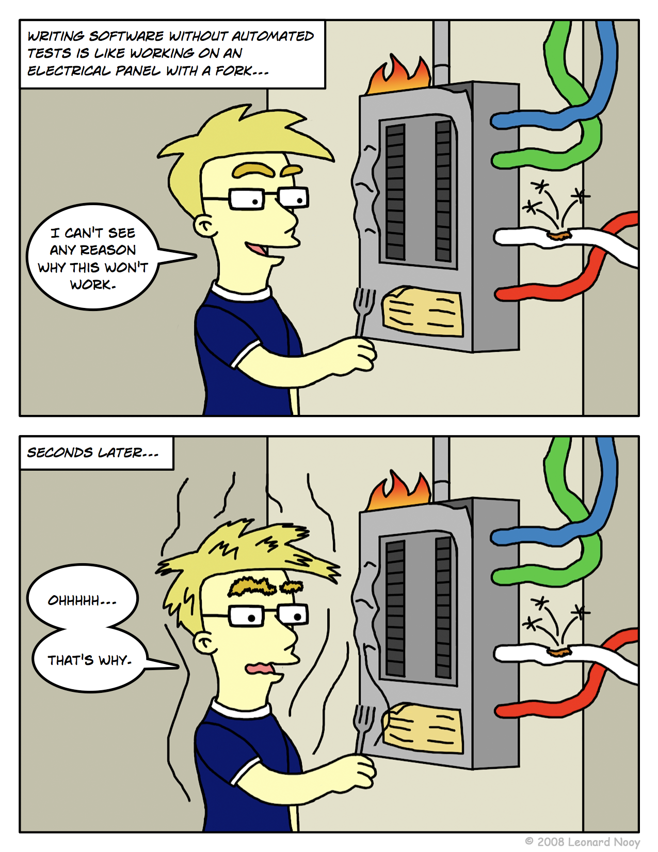
Unit Testing
Code written by developer that exercises a small, specific area of functionality.
“Program testing can be used to show the presence of bugs, but never to show their absence!” – Dijkstra
Up to now – Manual tests with Postman
Not structured
Not repeatable
Not easy

Slide 4
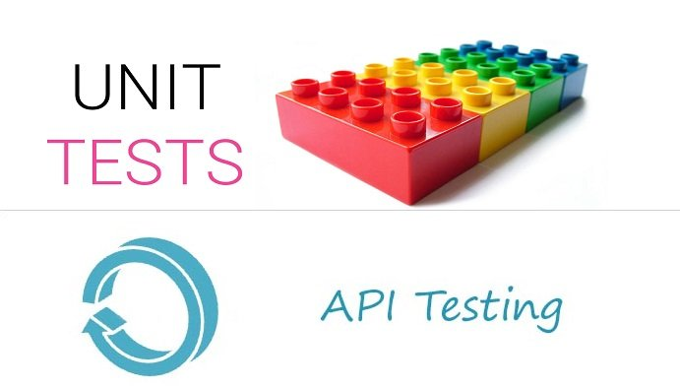
Unit Tests for APIs
Unit Tests are specific pieces of code
Tests are written by developers of the code, usually
Sometimes before the code is written
Part of the code repository
They go where the code goes
Use a framework
Junit, Jasmine, Mocha

Slide 5
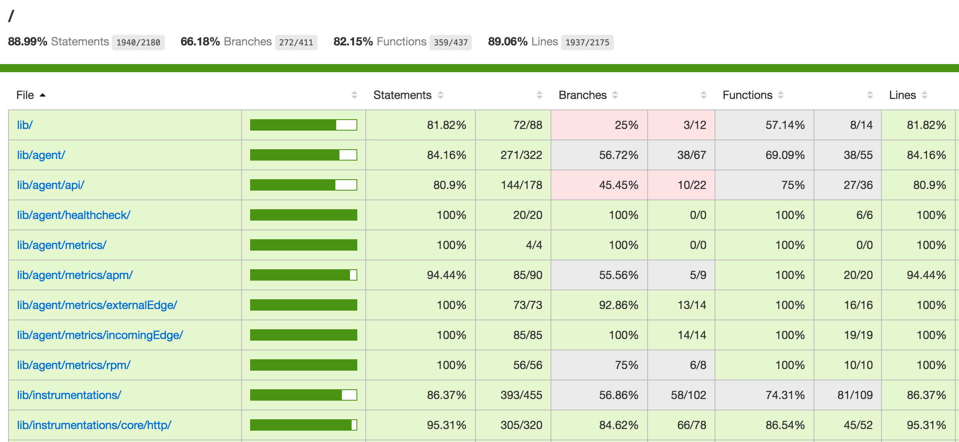
Unit Test convention
All objects and methods
Look for 100% coverage
Although property getters/setters are sometimes omitted
All tests should pass before commits?

Slide 6
Aside – TDD and BDD
Test Driven Development
define tests first
tests will fail
implement the unit
tests will pass
Developer from requirements spec.
assertTheSame(user.name,’tj’)
Behaviour Driven Development
Specify desired behaviour of the unit
Based on requirements set by the business
Behavioural specification from business and developer
user.should.have.property('name', 'tj');

Slide 7

Test with Mocha
Open Source framework for Javascript unit testing
Run in browser and server-side (e.g. node)
Features
Expressive syntax
Can test Async code
Pluggable
Compatible with test runners such as Karma

Slide 8
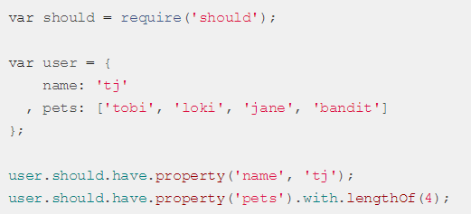
Assertions with SHOULD
Mocha allows you to use any assertion library you wish.
should is an expressive, readable, framework-agnostic assertion library.
Can use with Mocha to write cleaner tests
Generates nice error messages (there’s always error messages!)
Works with Node and browsers
Can use in asyc tests with Mocha

Slide 9
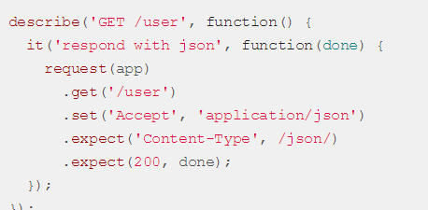
Testing Over HTTP with supertest
Provide a high-level abstraction for testing HTTP
Works with any test framework
In our case, Mocha

Slide 10
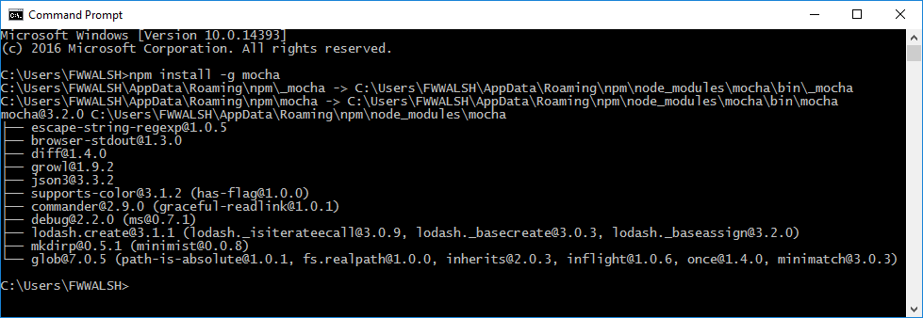

Getting Mocha etc.
Use NPM and install Mocha, Should and Supertest
npm install --save-dev mocha
npm install --save-dev should
npm install --save-dev supertest

Slide 11
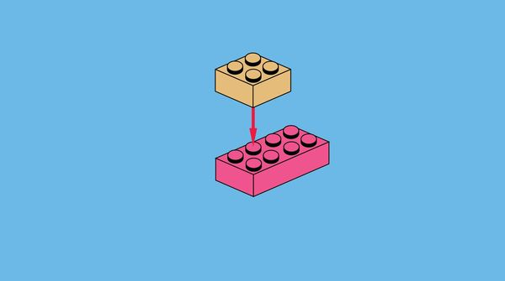
How it works…
Provide description of unit test using “describe”
Use “it” to define several unit test cases into it.
“it” provides a “done” function, used to indicate the end of test case.

Slide 12
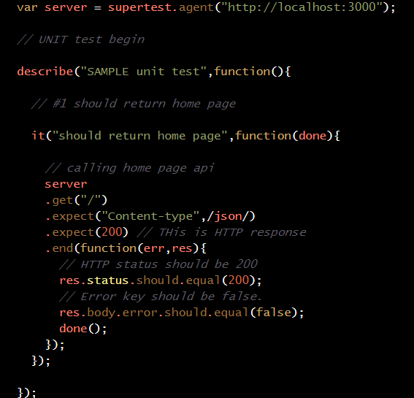
Example – home page test
Supertest.agent(…) returns server object constructed with test URL
“describe” takes test name and test function
“it” specifies the unit test that uses the server object to
Do a HTTP GET on the URL.
Define what’s expected (e.g. content type, status
Use “should” to check status of response object

Slide 13
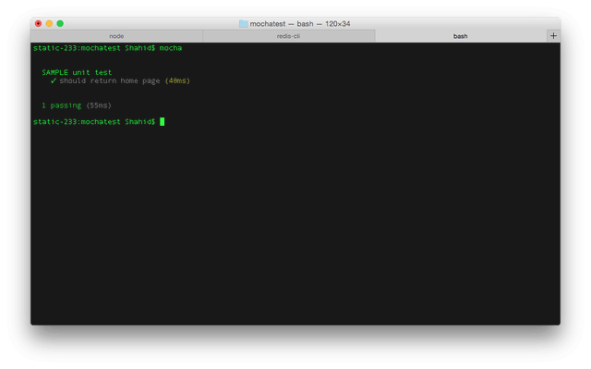
Running the test Manually
Assuming node API listening on port 3000
From command prompt, type
Mocha
Will run test scripts in the local folder

Slide 14
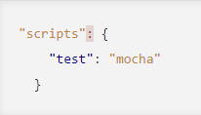

Include in node project
Can associate tests with node project by including new script property
Set up a test script in package.json
Run tests with npm run test

Slide 15
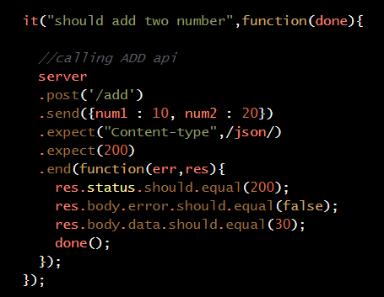
Testing a route
‘/add’ route should add two numbers provided in HTTP body
Should return json response
Data item of body should equal sum of initial numbers
“post” does a HTTP post on URL
send inserts HTTP body
Contents of reponse validated using should

Slide 16
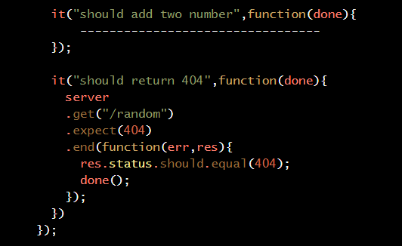
Testing failure
Can test for non-existant/removed resources
E.g. after delete
Check status of HTTP response is 404
Check status of res object is also 404

Slide 17
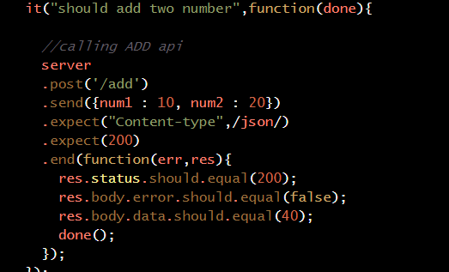
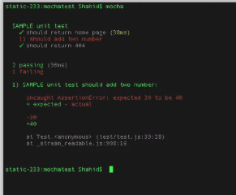
Failing Test
Equal value of addition test is changed.
40 (should be 30)
Result is test failure
Indicated clearly by test report.

Slide 18
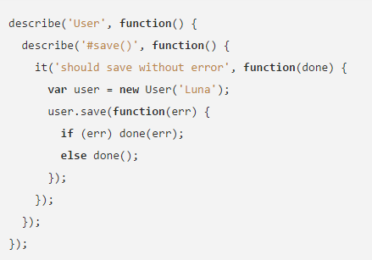
ASYNCHRONOUS CODE Test Anatomy
Uses the callback pattern.
The callback (usually named done) lets Mocha know when the test is complete
Mocha waits for this function to be called before completing the test.
“done()” called after test is complete. In this case after user.save(..) returns

Slide 19
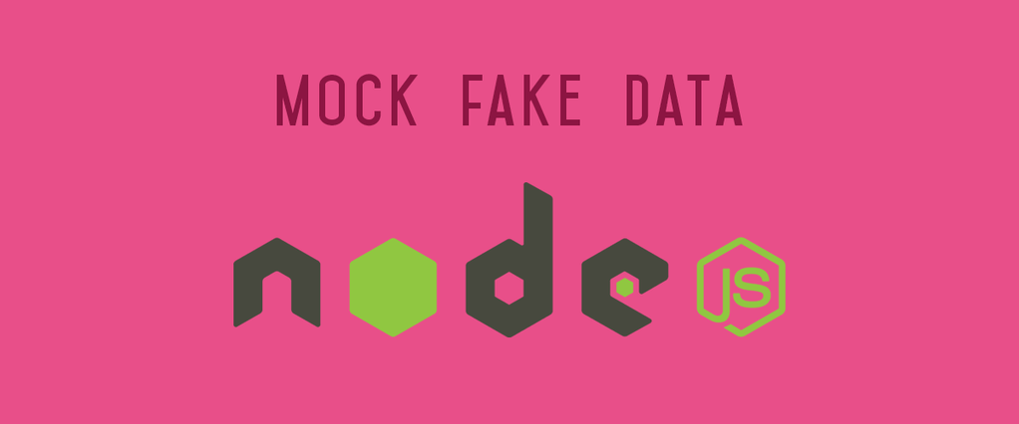
Improvements - Mocking
Unit testing should only concern the unit you’re testing
Should be independent of servers/db dependencies
Tests should just test the unit in question
Unit under test may have dependencies on other (complex) units, e.g. database
To isolate the behaviour of a unit, replace dependencies by “mocks” that simulate the behaviour
DBs are impractical to incorporate into the unit test.
In short, mocking is creating objects that simulate the behaviour of real objects.

Slide 20

Mocking Mongodb
Several mocking frameworks out there
Mockery, PowerMockito
We use Mongoose
How about “Mockgoose”?!
Turns out it exists!
NPM install –save-dev Mockgoose

Slide 21
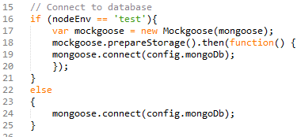
Mockgoose
Mockgoose spins up mongod when mongoose.connect call is made.
Just uses memory store with no persistence.
Can take a while on first test, after which it’s fast
Tests may time out
You can increase mocha wait time describe (…){ this.timeout(10000);

Slide 22

Running in test environment
Notice in the last slide we only use Mockgoose in “test” envornment
We need to set the NodeEnv environment variable as ‘test’ when we run out test script
Setting environment variables is differs across Operating Systems/platforms
Cross-Env uses a single command to set env variables without worrying about the platform
npm install save-dev cross-env
Update the test script in **package.json** to set the correct environment(s)

Slide 23
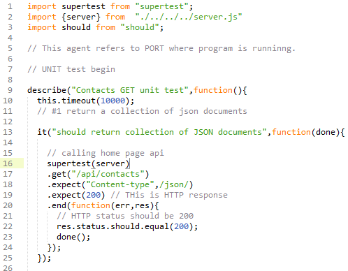
Running Server as part of Test
SuperTest allows you to create the Express API as part of the test
You can pass instance of the server to SuperTest
if the server is not already listening for connections then SuperTest will bind to a port for you so there is no need to keep track of ports.
So no need to start the server/bind to port in order to run the unit test.
Very useful for automated testing.

Slide 24
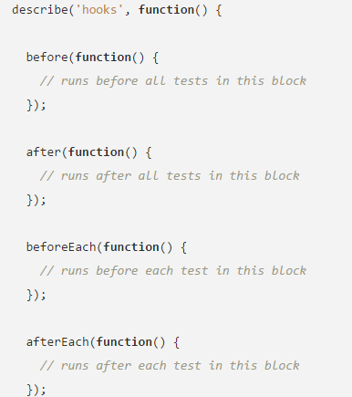
Mocha Hooks
Mocha provides the hooks
before()
after()
beforeEach()
afterEach()
used to set up preconditions and clean up after your tests

Slide 25
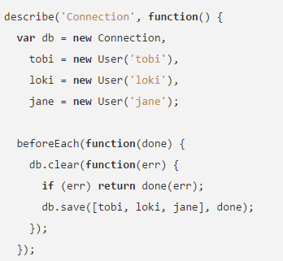
Mocha Hooks
Hooks can by synchronous or asynchronous
Example
Populate DB with test data before each test
Reset DB after tests
Close any IO connections.

Slide 26
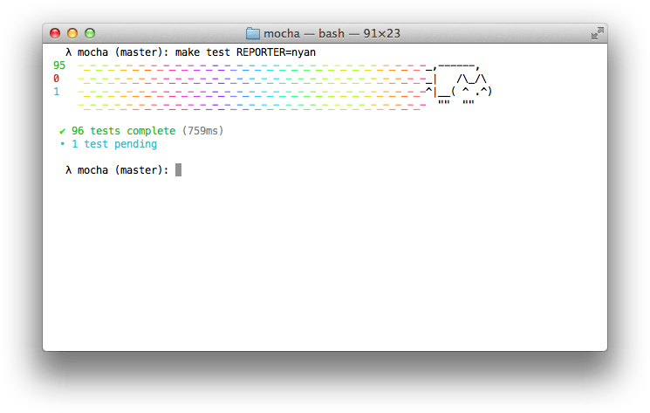
Mocha Reporters
Mocha reporters can be used to present your test your results
https://mochajs.org/#reporters
Nyan Cat
Landing Strip
HTML
Markdown

Slide 27
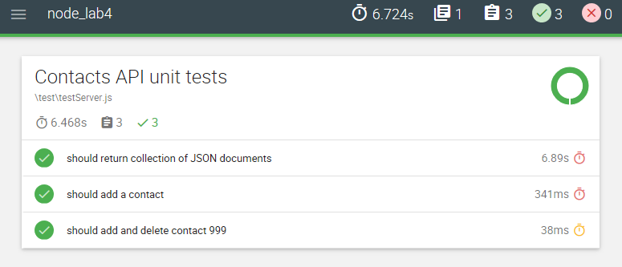
Mochawesome
Also, third party reporters available
http://adamgruber.github.io/mochawesome/
Generates a full fledged HTML/CSS report
Puts it in reports folder in project
Visualize your test suites.
Getting it: npm install --save-dev mochawesome
Using it: mocha --reporter mochawesome

