Slide 1
Server side rendering
Frank Walsh

Slide 2
Agenda
Quick history
Isomophism
Server-Side vs. Client Side Rendering
React and Server-Side Rendering

Slide 3

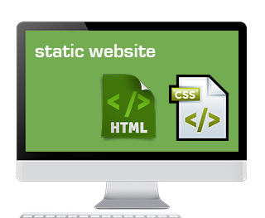
Web apps history Static
Web App definition:
Highly interactive and dynamic
Adaptable and transient
Web Site
Informational and static

Slide 4
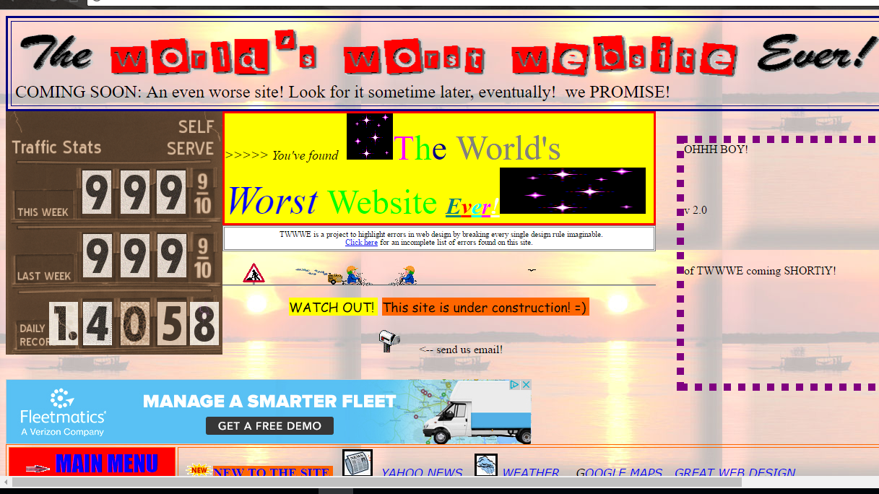

Web App history Dynamic
Static (to 1995)
HTTP GET is King
Gopher
DHTML, Flash and Javascript (1995-)
Some functionality
No personalisation
Simple and easy to create
Classic examples opposite…

Slide 5

Web app history server side scripting
Need to create HTML content Dynamically
Common Gateway Interface
Perl
Generally needed to invoke new process to serve request
Not designed for web.

Slide 6
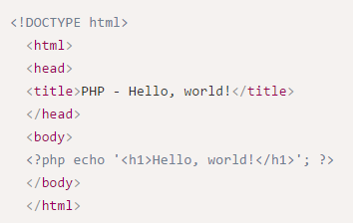
Web app history server Pages
Server Page characteristics
write server-side code directly in the HTML
better for developers
PHP, ASP, JSP….
Server-side modules allowed you to run code inside containers
JEE

Slide 7
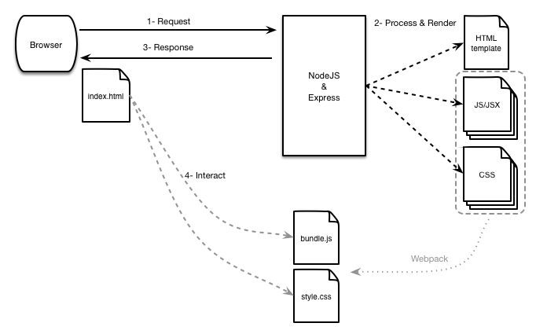
Universal Web application
Some probs with server pages:
spreading presentation logic between client and server
Complicated skill sets evolved around certain stacks (JEE, Spring)
Universal web applications (isomorphism)
Ability to run same code on both client and server
What we’re kind of approaching with react.

Slide 8
Univ. Web apps considerations
Performance
Initial load time can be an issue
Mobile Devices
Increasing RAM/CPU power but also increasingly complex apps
Search Engine Optimisation
Apps maybe should be written for machines as well as humans
Discoverability and Rank depend on content
Many SEO machines apparently aren’t willing to run JavaScript
Maintenance
UWA promotes1 solution for all.
Do not need diverse set of skills to maintain different versions.

Slide 9
Server Side Rendering Why
SPA applications (e.g. React apps) are rendering data from the server using JavaScript.
No Javascript – no data
Try it by switching off javascript in your browser.
Most search engines will see this when they request the app
Can simulate this by doing a curl on your app you pushed to Bluemix last week
Would be good if machined(i.e. search engines) could “see” what we see when we request the app.
Need to pre-render all components with data on server on initial request.

Slide 10
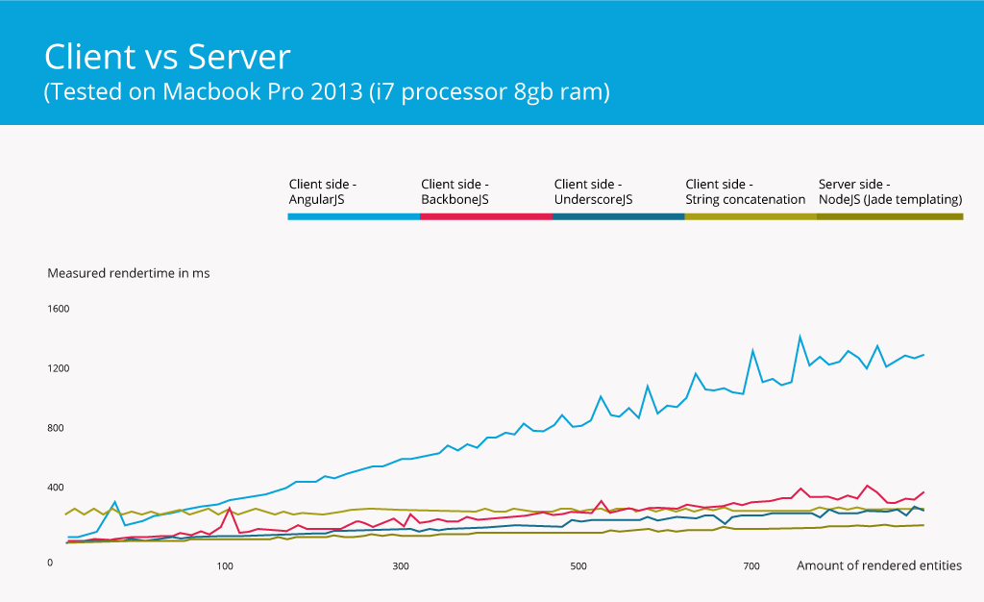
Server Side vs Client side Test
Server side rendering needed almost a constant amount of time for rendering
Client side shows almost linear growth.*

Slide 11
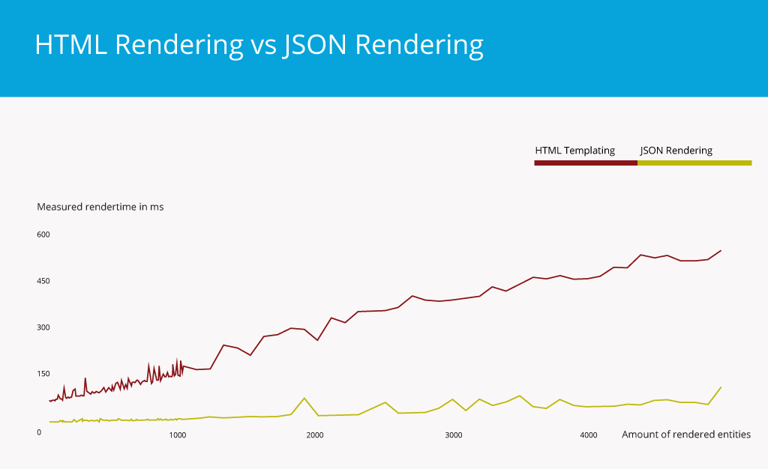
JSON Rendering vs HTML Rendering
An advantage of client side rendering is that the server can generate JSON faster than a complete HTML template.
JSON is also smaller than HTML
Can reduce server and traffic costs by sourcing out the rendering on the client.
For Smartphone access, less traffic by serving a JSON object instead of a HTML document is an advantage

Slide 12
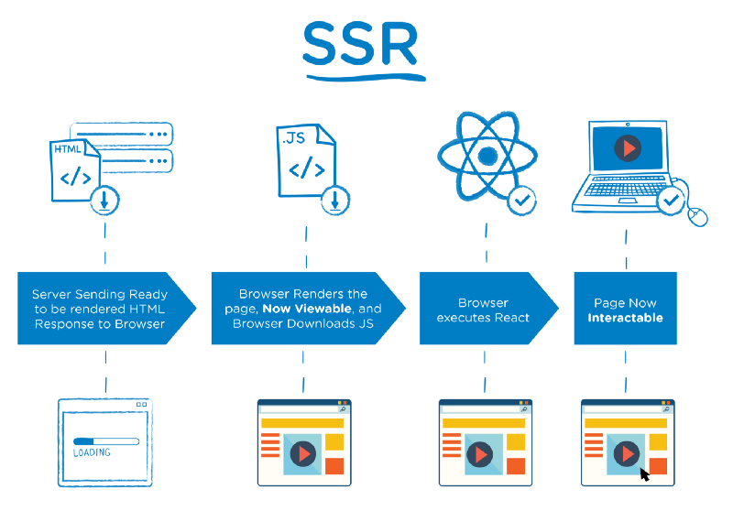
Server Side Rendering

Slide 13
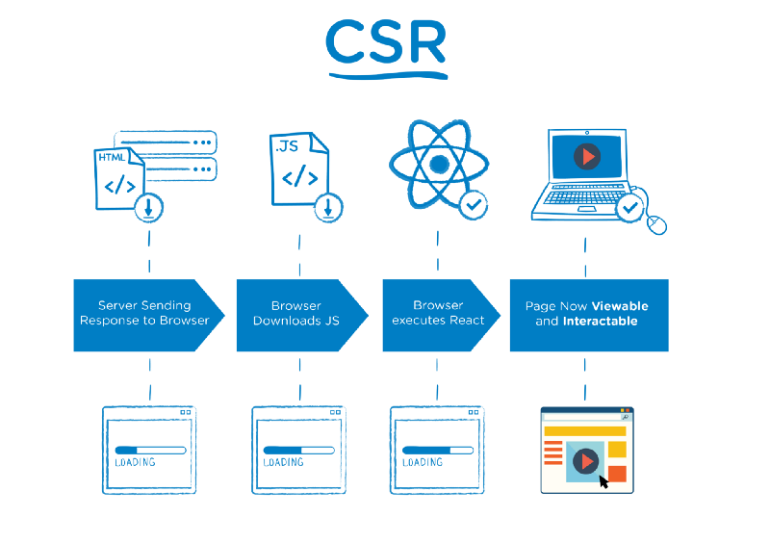
Client side rendering

Slide 14
Server-side rendering options for react
React-redux
https://github.com/reactjs/redux/blob/master/docs/recipes/ServerRendering.md
Flux
reactDomServer.
Comes with React
React-Server

Slide 15
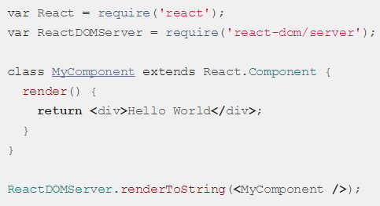
Reactdomserver
Allows you to render your components on the server.
renderToString() renders a React element to its initial HTML.
renderToStaticMarkup() doesn't create extra DOM attributes, can save lots of bytes.

Slide 16
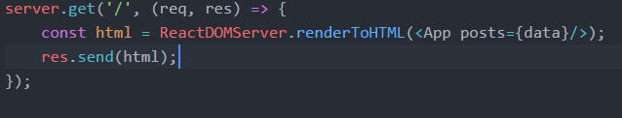
Server-side rendering With express
For server-side rendering, you need to add the relevant routes in to the express server.
Requires install babel-preset-react
Also works well with Templating Engines

Slide 17
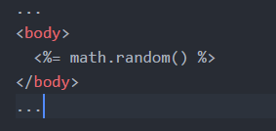
Templating using EJS
Lets you generate HTML markup with plain JavaScript
EJS files are regular HTML files, but we can embed JavaScript using template tags
Opposite ejs returns a random number.

Slide 18
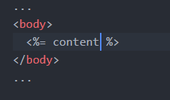
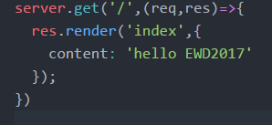
Ejs and express
index.ejs
Requires EJS dependency
Configure your express app to use EJS as the view engine
Use the response object to render EJS views
Can pass variables from express into EJS as second argument of render() method
server.js

Slide 19
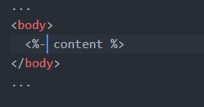
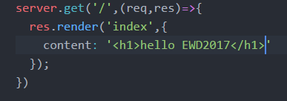
Ejs and express
index.ejs
Can also pass in HTML
<%=…> will escape content
<%-…> will display HTML in template
server.js

Slide 20
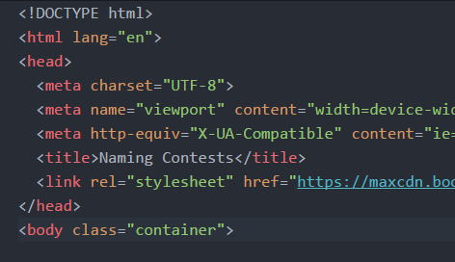
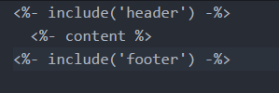
EJS Partials
header.ejs
Can combine several partial EJS files
For example header.ejs can be used in several templates
Can also create a footer.ejs
Use the <%- include(‘ ’) -%> statement to include partials
index.ejs

Slide 21


Other Templating FrameWorks
PUG
Handlebars

Slide 22
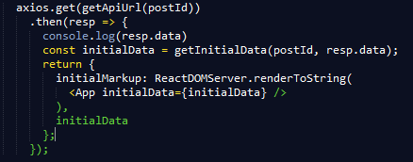
Get initial data on the server
ServerRender.js
For server side rendering, we need to request the initial data from API
We’ve been doing this from the client so far (proxied through the web server)
Use axios again
PreRender all components with initial data

Slide 23
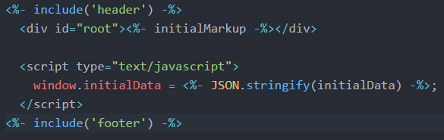
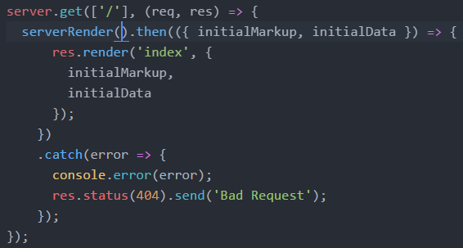
Return markup and Initial data
index.ejs
Pass mark-up and initial data to the templating engine
Can define/use initialData property on the window object in Javascript
Pass in the initialMarkup into the root element.
Server.js

Slide 24

Scaffolding react-server using yeoman

Slide 25
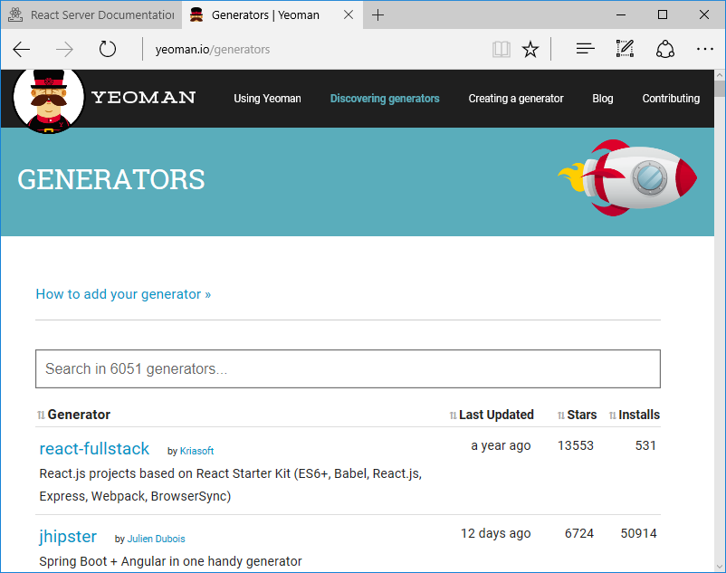
Yeoman generators
Node Modules
Typically available from NPM
Can write your own generator

Slide 26
Yeoman Install

Slide 27

React server app with yeoman
“Blazing fast page load with seamless navigation”
Framework designed to make universal (née isomorphic) React easier to write
Concentrate on your React components.

Slide 28
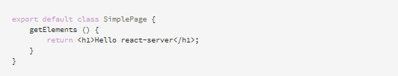
React server PAge
A hypertext document suitable for the world wide web and a web browser
Roughly match one-to-one to urls for a web site.
Pages have lifecycle methods that are called on them by react-server, which produce the html, either on the server or in the browser.
Written as classes

Slide 29
Page lifecycle methods
renderTitle
renderMetaTags
getBodyClasses
renderScripts
renderStyleSheets
renderLinkTags
renderBaseTag
getBodyStartContent
getElements
Once we reach the above, starts sending javascript.

Slide 30
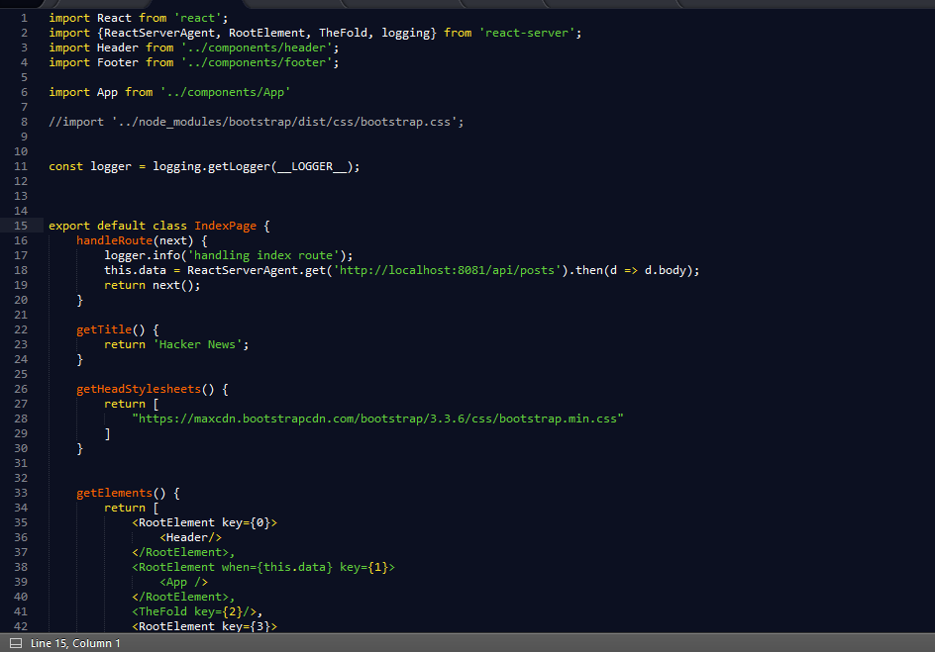
Example page
Example in class…

Slide 31
References
ReactDomServer: https://facebook.github.io/react/docs/react-dom-server.html
Templating: http://www.embeddedjs.com/
Scaffolding: http://yeoman.io/
Isomorphic React: https://react-server.io/

