Slide 1


Internet of Things Workshop
Computing Summer Camp 2016

Slide 2
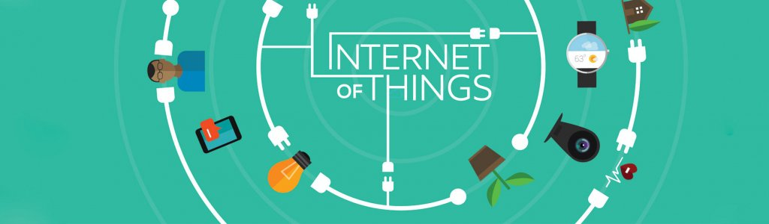
What's the Internet of Things?

Slide 3
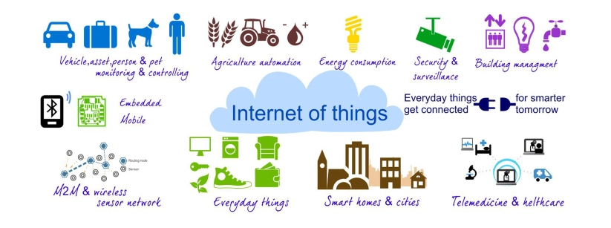
What's the Internet of Things?

Slide 4

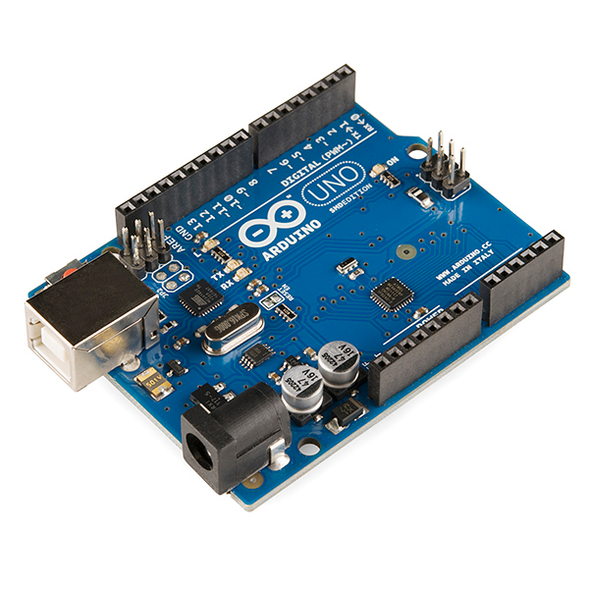
How did it all start...

Slide 5
Arduino
Microcontroller
Small programmable device
Open Source
Can be connected to other stuff

Slide 6
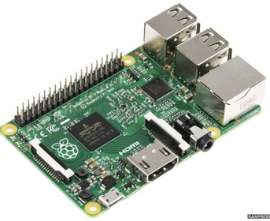
Arduino vs Pi
Hardware orientated
Good for sensors
Computer
More software/networking orientated

Slide 7
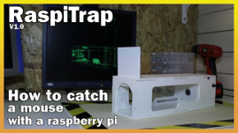
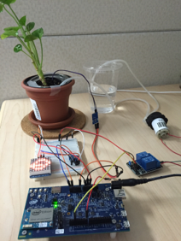
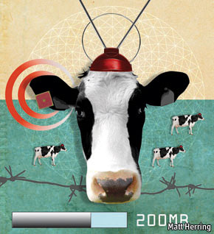
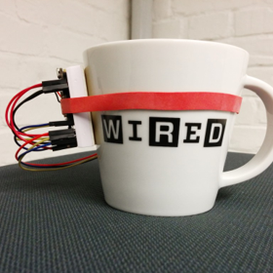
Examples

Slide 8
Electric Circuits
Voltage
Potential energy of electrical charge
Current
Flow of electrons
Resistance
Circuit's ability to resist current flow

Slide 9
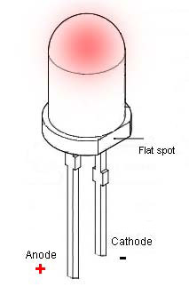
Components
Light Emitting Diode(LED)

Slide 10
Components
Breadboard

Slide 11
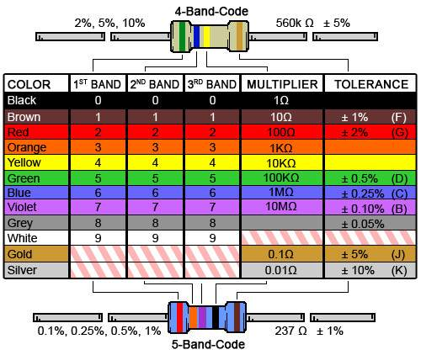
Components
Resistor

Slide 12
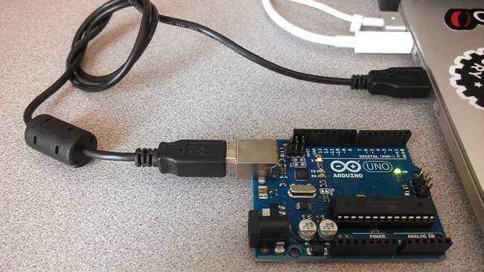
Getting Started: Connect the Arduino to your PC

Slide 13
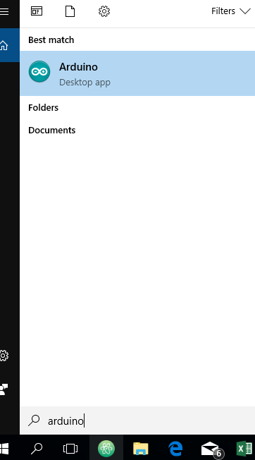
Getting Started: Open Arduino IDE
On your PC, click on Search and enter "Arduino“.

Slide 14
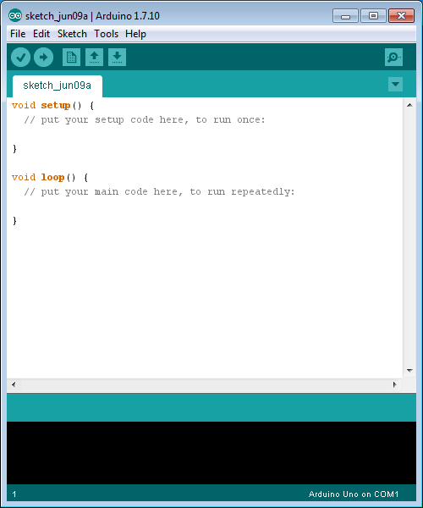
Getting Started: Open Arduino IDE
All going well, you'll see this...

Slide 15
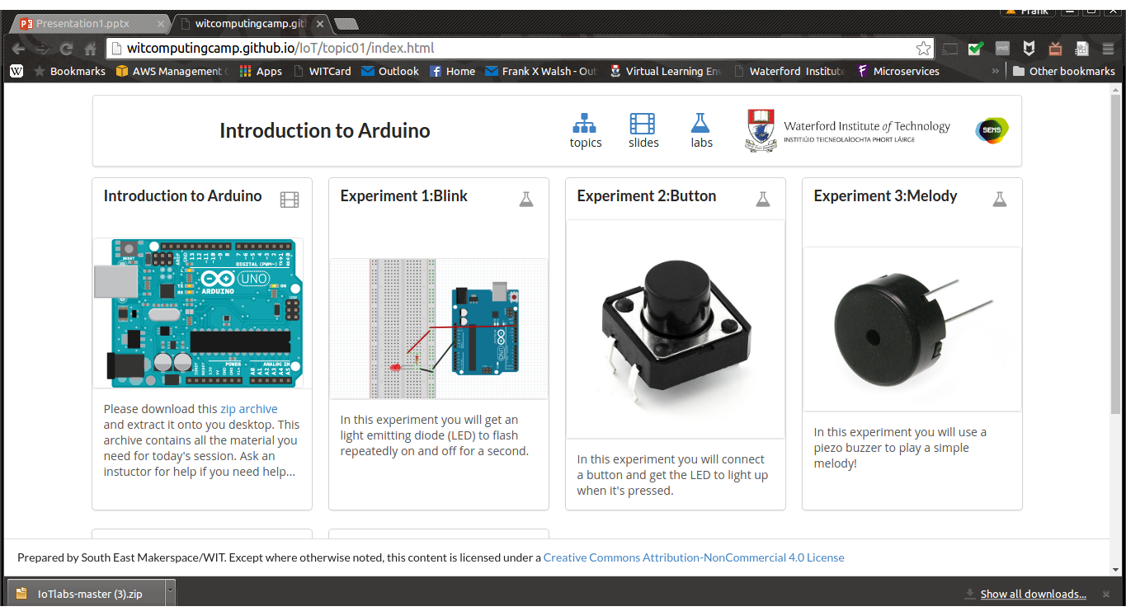
Getting Started: Get the resources
Open a browser and go to
http://witcomputingcamp.github.io/IoT/
Click on Experiment 1 and get going…

