Slide 1
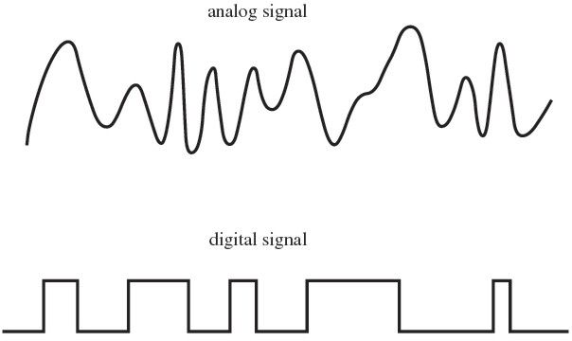
Analog and Digital Signals
This Photo by Unknown Author is licensed under CC BY-SA-NC

Slide 2
Todays Topics
What’s the difference between analog and digital signals
Review Electricity Equations
General Purpose Input / Output (GPIO)
Pulse Width Modulation (PWM)
Analog to Digital Converters (ADC)
Microcontrollers and Computer

Slide 3
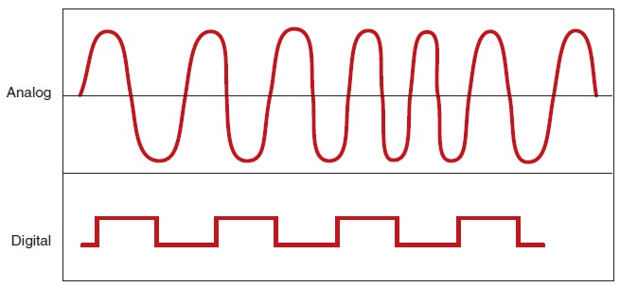
Electronic Signals
Image from http://autosystempro.com/analog-and-digital-principles/

Slide 4
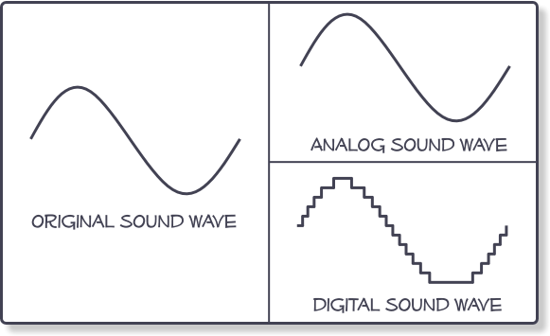

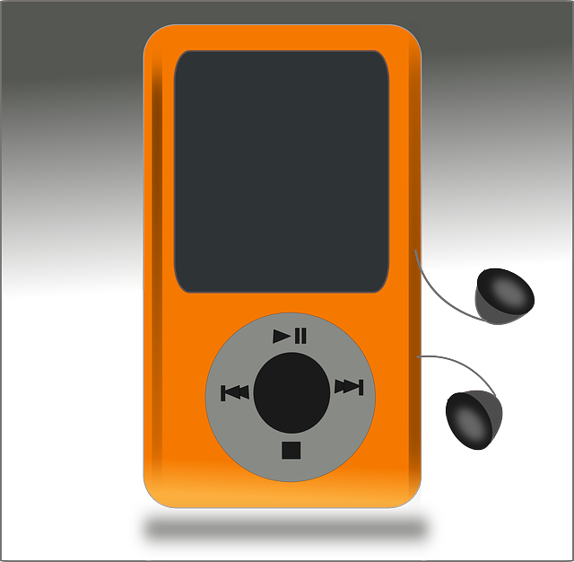
Analog and Digital
Digital devices can only store digital signals
Using 1 or several bits / sample
We store an array of numbers
Parameters
Bits per sample
Sampling rate
Example: Audio…
This Photo by Unknown Author is licensed under CC BY-SA
Image from http://www.centerpointaudio.com/Analog-VS-Digital.aspx

Slide 5
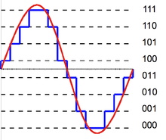
Bits per sample
Using just 1 bit
Just 2 possible values/states: LOW (0) and HIGH (1)
digital
Using >1 bit ( n bits where n>1)
2^{n} possible values/states
Example: using 3 bits:
2³ = 8 possible values/states
Called Quantisation
More bits -> higher resolution -> higher accuracy

Slide 6
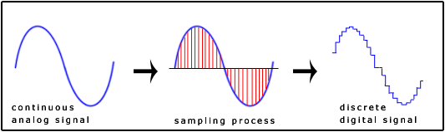
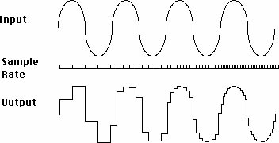
Sampling
Sensor signals are analog
Temp -> voltage -> value
Sampling Rate
Higher sampling rate( frequency) will give higher the accuracy
Image from http://www.snotmonkey.com/work/school/405/overview.html
Image from http://www.jazzpoparkisto.net/audio/audio32.html

Slide 7
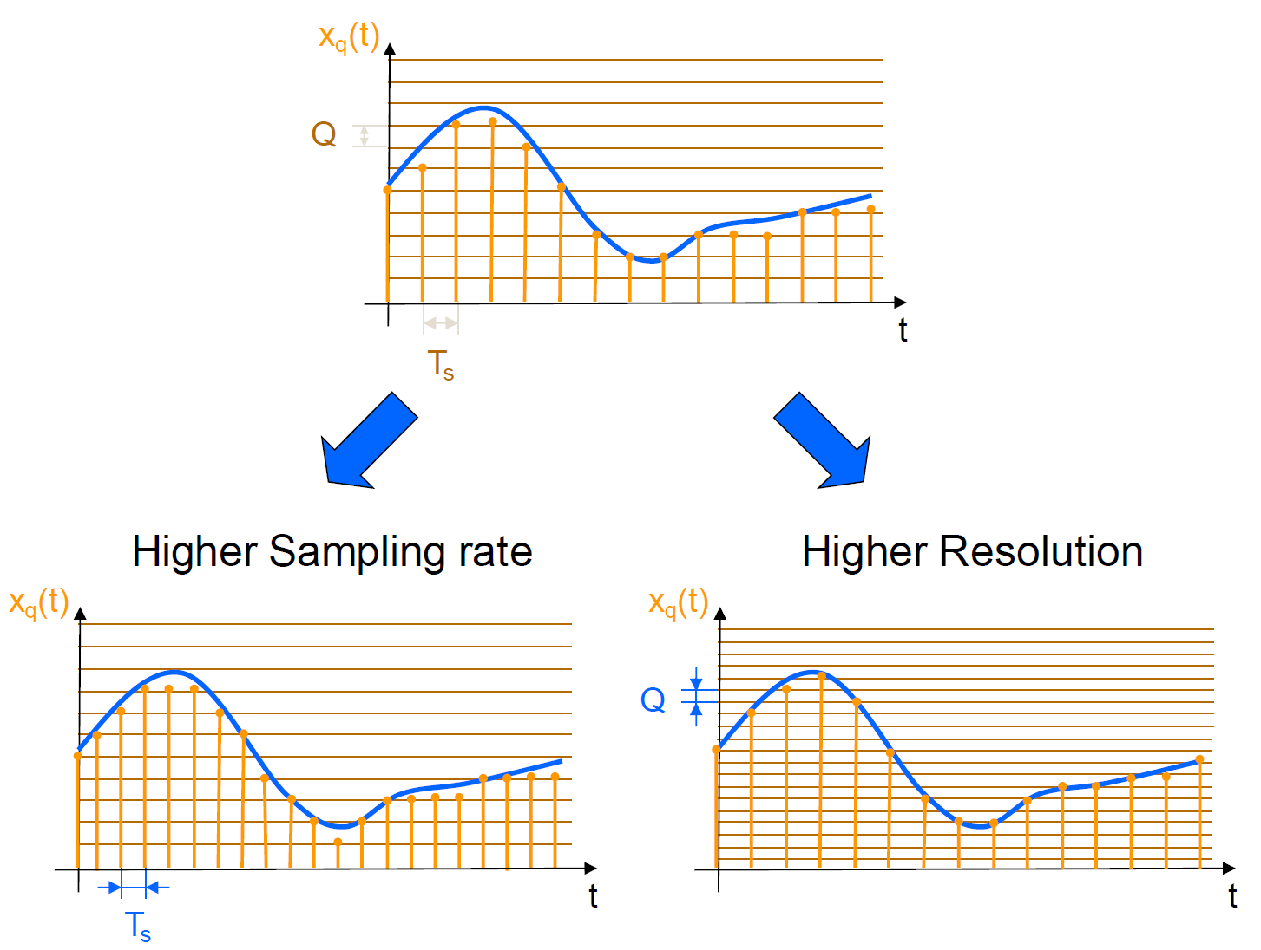

Slide 8
Analog and Digital Convertsion
Measure voltage
Parameters
Bits per sample
Sampling rate
For 1 bit we have …
GPIO Input
For n bits we have …
0 – 2^{n}-1
Image from http://www.centerpointaudio.com/Analog-VS-Digital.aspx

Slide 9
Electricity Equations

Slide 10
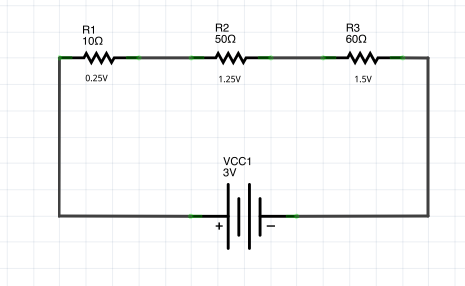
Ohm’s Law

Slide 11
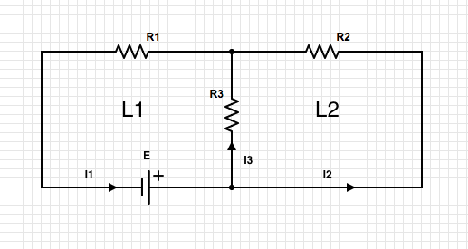
Kirchhoff Law I

Slide 12
Kirchhoff’s Law II

Slide 13
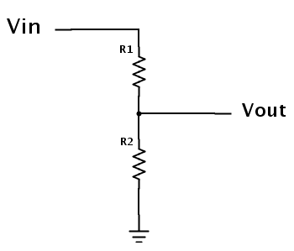
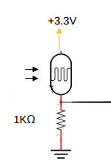

Voltage Divider
If current in output wire is 0, then:
$$Vout=\frac{R2}{R1+R2}Vin$$
This Photo by Unknown Author is licensed under CC BY-SA

Slide 14
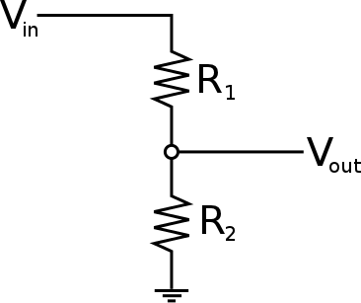

Voltage Divider
$$Vout=\frac{R2}{R1+R2}Vin$$

Slide 15

Voltage Divider
$$Vout=\frac{R2}{R1+R2}Vin$$

Slide 16

Voltage Divider
$$Vout=\frac{R2}{R1+R2}Vin$$

Slide 17
Voltage Divider
$$Vout=\frac{R2}{R1+R2}Vin$$

Slide 18

Voltage Divider
$$Vout=\frac{R2}{R1+R2}Vin$$
SHORT CIRCUIT!

Slide 19
Development Boards

Slide 20
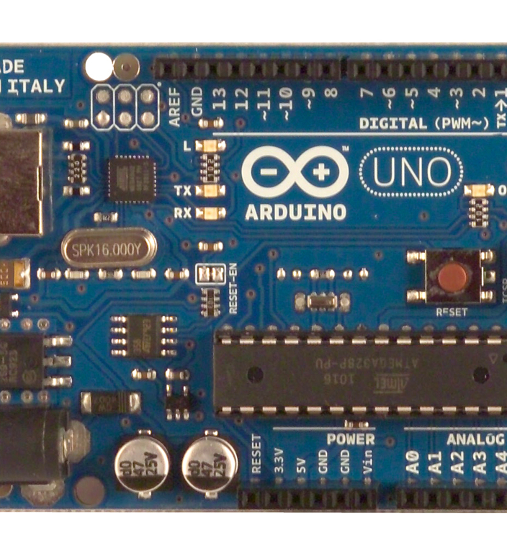
Microcontrollers (e.g. Arduino)
Simple, low cost
Runs one software program
Connect sensors/hardware via GPIO
Constrained Resources
Low speed
small memory
(usually) no disk
No general audio/video/networking (added as needed)
PWM
Can have built in Analog to Digital Conversion.
This Photo by Unknown Author is licensed under CC BY-SA

Slide 21

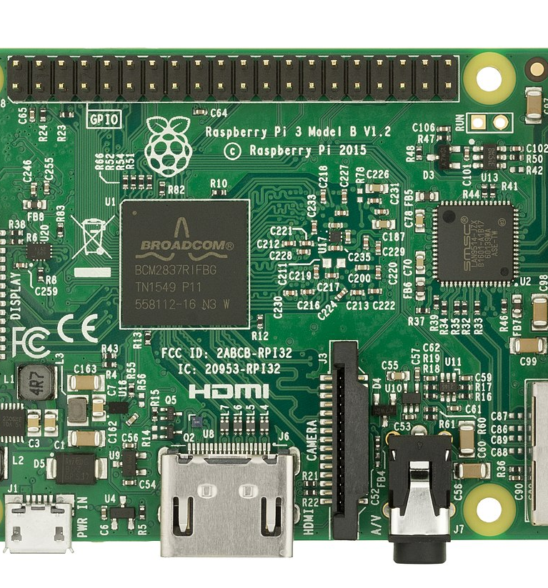
Single Board Computers (e.g. Rpi)
CPU
Memory and Storage
General interfaces for audio/video
Operating System
General Purpose Input and Output
Usually no built in ADC.
This Photo by Unknown Author is licensed under CC BY-SA

Slide 22
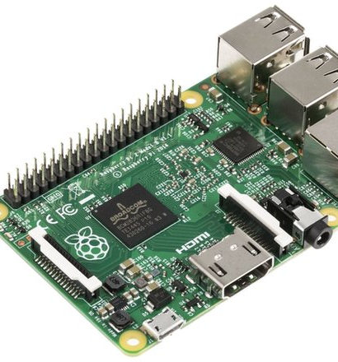
Output and Input on RPi
Digital Pins
Value LOW (0) or HIGH (1)
Write programs to set pins to Low(0) or High(1)
0V or 3.3V
Write programs to read pin values
High(1)
Low(0)

Slide 23
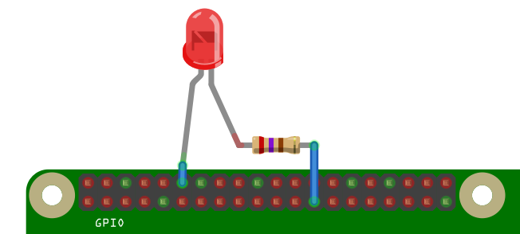
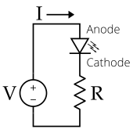
Output
3.3V(HIGH) or 0V(LOW)
Default 8 mA max per pin.
Switching a pin High is like connecting a 3.3V battery to device.
Switching a pin Low is like disconnecting the battery
This Photo by Unknown Author is licensed under CC BY-SA

Slide 24
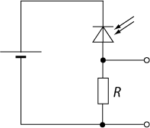
Input
Can be Voltage Divider Circuit
Can measure Vout…
via analogue input on Arduino
Required Analog to Digital converter on RPi. (unless you want it to act like a switch)
This Photo by Unknown Author is licensed under CC BY-SA

Slide 25
Pulse With Modulation

Slide 26
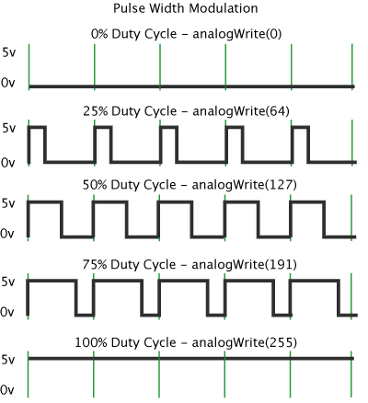
Pulse Width
Arduino's PWM frequency at about 500Hz, the green lines would measure 2 milliseconds each.
We set the % of “high” cycle
0 – 0%
255 – 100%
Typical for Arduino. Depends on the library
Implementation
Hardware
Software
Usage
LED dimming
Servo Motors
Notes:
Pulse Width Modulation, or PWM, is a technique for getting analog results with digital means. Digital control is used to create a square wave, a signal switched between on and off.
In the graphic below, the green lines represent a regular time period. This duration or period is the inverse of the PWM frequency. In other words, with Arduino's PWM frequency at about 500Hz, the green lines would measure 2 milliseconds each. A call to analogWrite() is on a scale of 0 - 255, such that
analogWrite(255) requests a 100% duty cycle (always on), and analogWrite(127) is a 50% duty cycle (on half the time) for example.

Slide 27
Microcontrollers and Computers

Slide 28
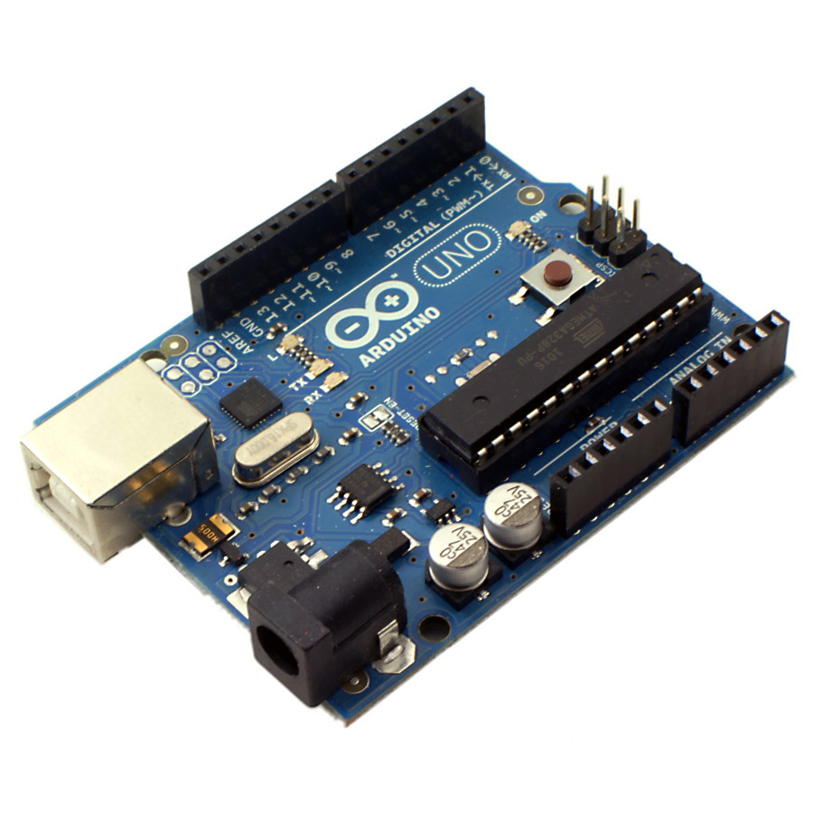
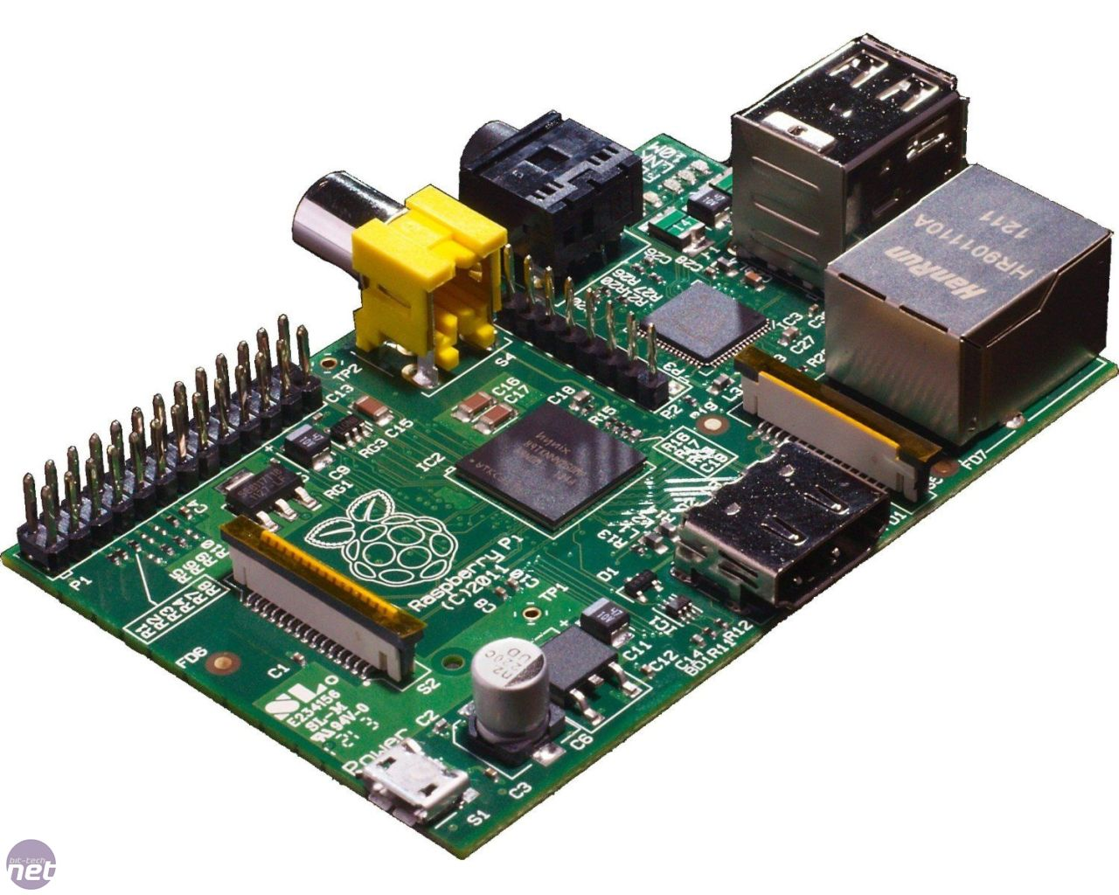
Microcontrollers and computers
Firmware
Software

