Slide 1

Project II
introduction

Slide 2

Agenda
The Project Concept
Project II
Module Content
Module Assessment
What You'll Learn

Slide 3




A bit about Me
Frank Walsh
https://www.wit.ie/about_wit/contact_us/staff_directory/frank_x_walsh
Contact me via Moodle
Github (https://github.com/fxwalsh)
Research Gate (https ://www.researchgate.net/profile/Frank_Walsh)
LinkedIn(https://ie.linkedin.com/in/frank-walsh-a2b8867)

Slide 4

The Overall Project Concept
What’s IoT: https://www.youtube.com/watch?v=6mBO2vqLv38
The IoT stream aims to produce graduates who can immediately engage in industry and research
"Challenged to combine the knowledge and skills acquired in the key disciplines for IoT"
Ethos of "permissionless innovation"
Encourage experimentation with the various technologies

Slide 5

Project II - Aims
You will combine skill and knowledge learned in other modules to create a project.
You will learn fundamentals of distributed version control systems.
You will learn and demonstrate basic communication skills
You will present your ideas and work.

Slide 6

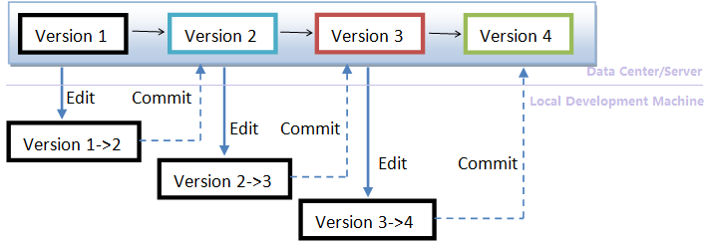

Project II Content
Come up with a an idea for a project/piece of work
Using this idea, start developing a solution
Use this to start a "digital portfolio" using a distributed version control system.
Communication of ideas and concepts in a correct, clear and modern format.

Slide 7
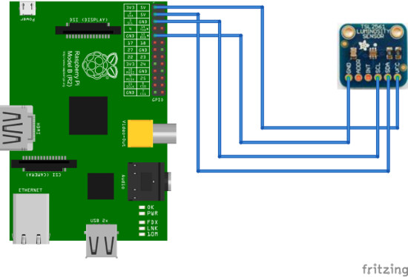
Project II - You'll learn how to
Create a working "artifact" that:
combines core skills and knowledge from at least two domains of your programme (i.e. Programming, Computer Systems... )
Has an IoT “flavour”
Manage your project using a suitable version control system.
Report and communication you work though suitable documents and presentations

Slide 8

Project II - High Level Syllabus(Tentative)
Source Control
Git/Github/Bitbucket
Single Board Computer(SBC) Programming Basics
Pi/ Galileo programming
Microcontroller Basics
Arduino/Galileo
Communication Modalities and Skills
Presentation Tools (PP/Prezzi/Trello)
Design Tools (Fretzig)
Documentation Tools(Markdown, Doc generation
SBC breakout and General IO
Bread boards, Soldering, Sensing

Slide 9
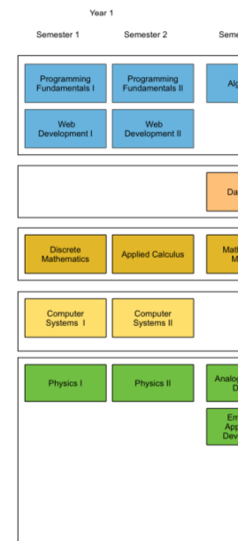
Domains

Slide 10
Project II - Delivery & Assessment (Tentative)
Lectures will cover supporting topics
Version control Systems
Project planning and design
Technical presentation
Module is 100% Continuous Assessment
Milestones to keep you on track
All Formative until final submission (used for feedback)
Date | Activity
TODAY! | 1st Lecture
Week 5 (Feb 24) | Project Concept
Week9 (March 24) | Status Report
Week 12/13 (April 21/28) | Final Submission/Presentation

Slide 11
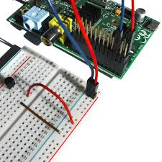
Project II - Example
Title: Temperature Sensing Application:
Overview: Application that reads the temperature data from a digital temp sensor
Description: Writes data to a file and standard output(console). To connect the temperature sensor, the student constructs their own "breakout board" for the Single Board Computer (i.e pi) which will allow them to easily integrate various sensing and acuation circuits to the SPC via the GPIO. The application allows the user to enter a lower and upper bound for the temperature. The application displays "Too Cold" if temp is less than lower bound, "Too Hot" if temp is greater than upper bound, and "OK" otherwise.
Candidate Technologies/Domain:
Single Board Computer (e.g. Raspberry Pi,Edison) / Networks & Cloud
Programming Language: Java,Python,Javascript/Programming
Sensor: DS18B20 "one wire" sensor/ Devices & Systems
Electronic Equipment: Resistors, breakout board/bread board/ Devices & Systems
Other Practical Skills/Domains: Programming(fundamentals), soldering and wiring, computer architecture, operating systems, digital electronics.

Slide 12
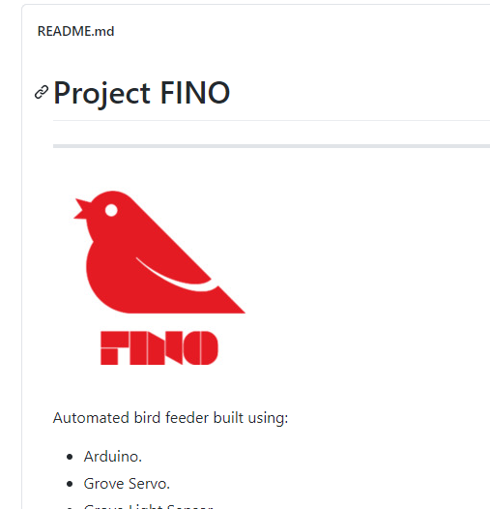
Previous Project

Slide 13
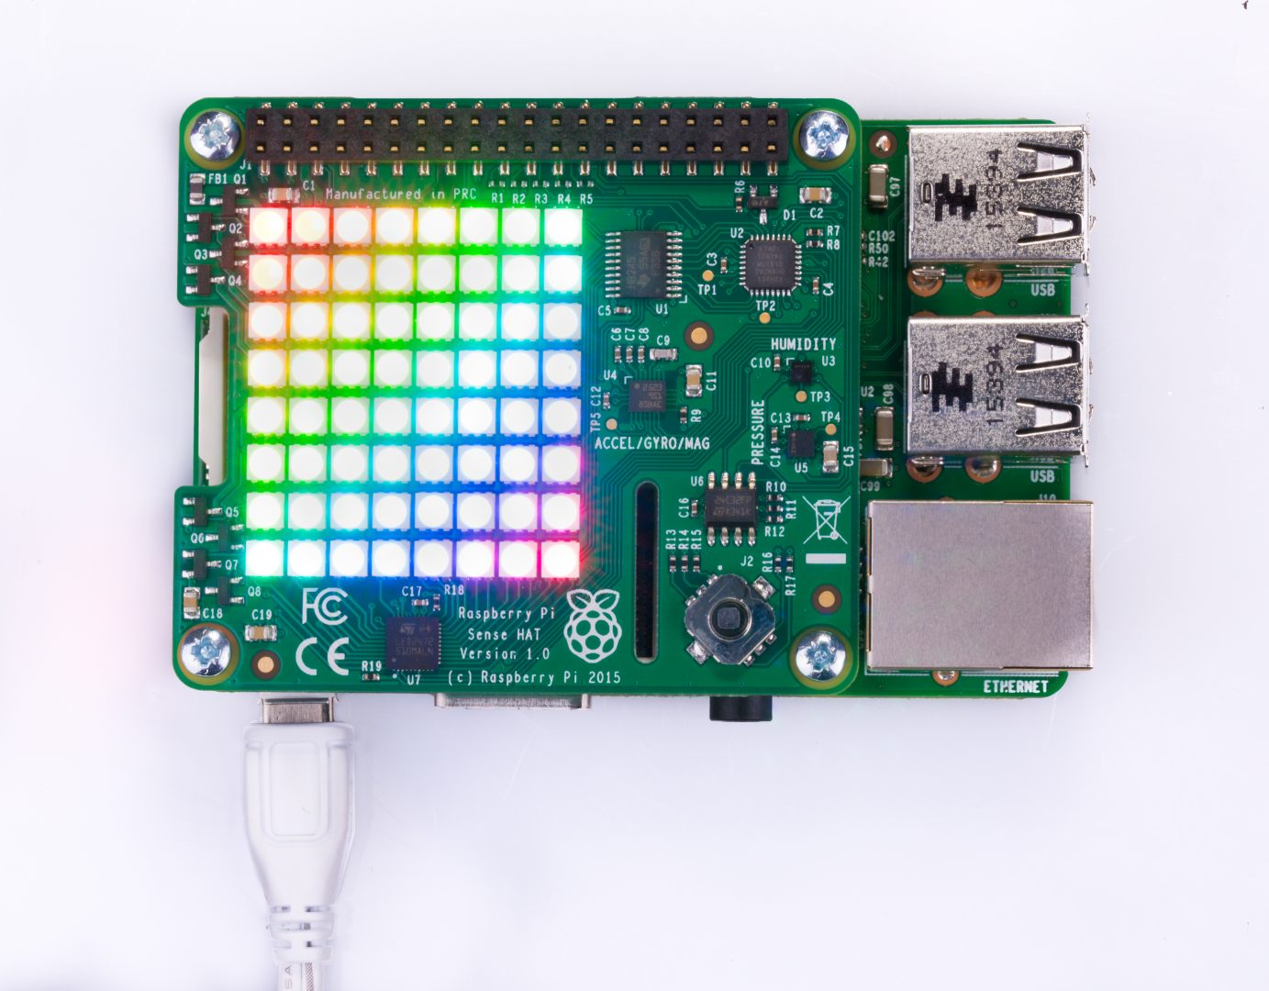
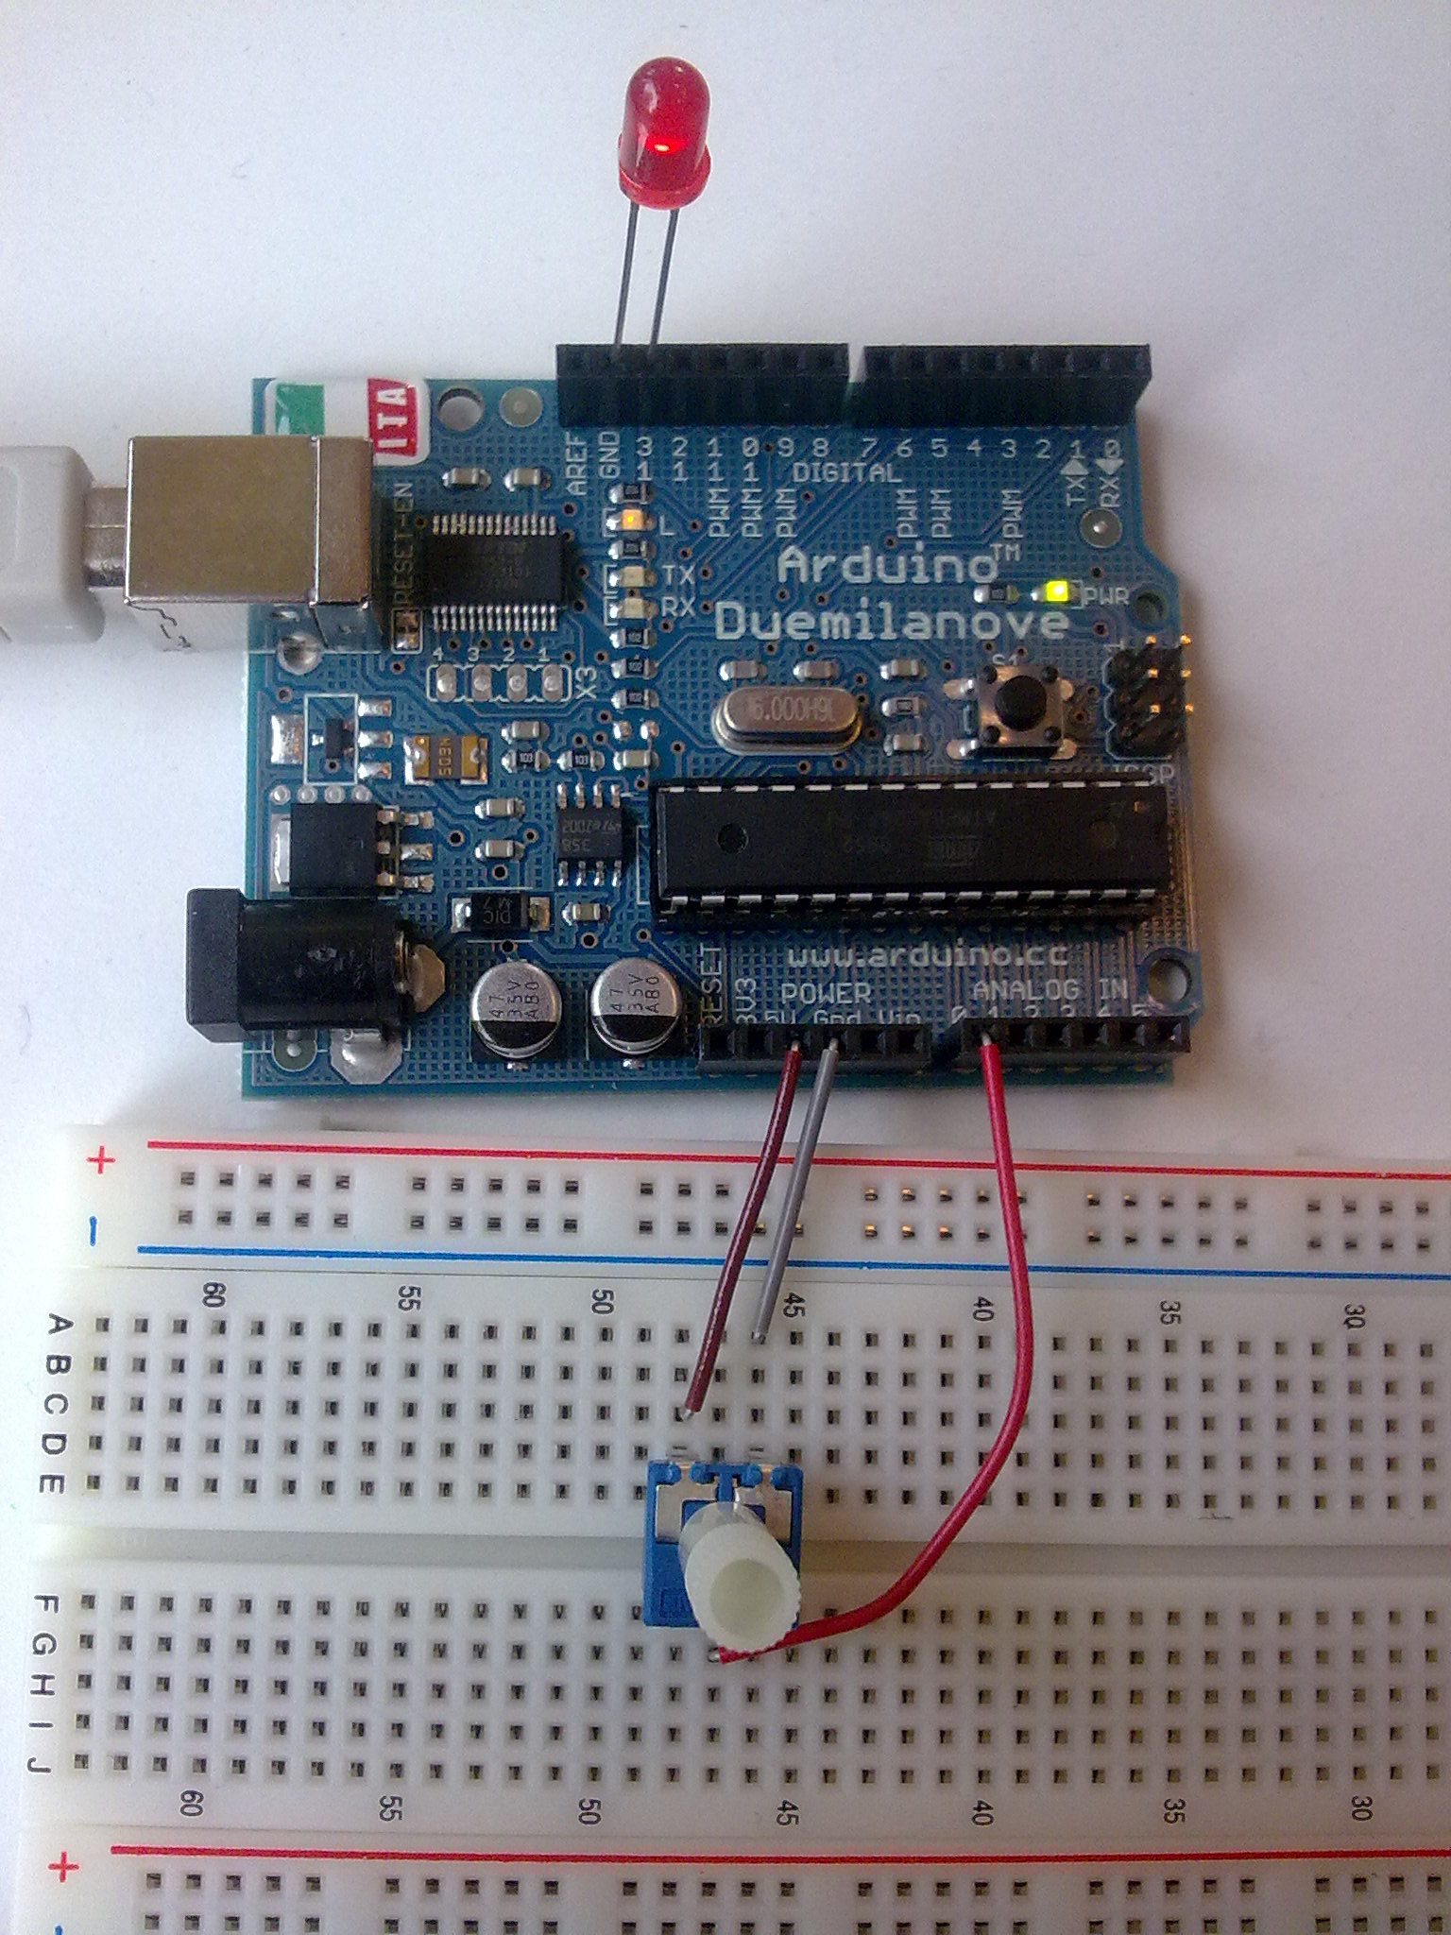

Equipment
This Photo by Unknown Author is licensed under CC BY-NC
This Photo by Unknown Author is licensed under CC BY-SA

Slide 14
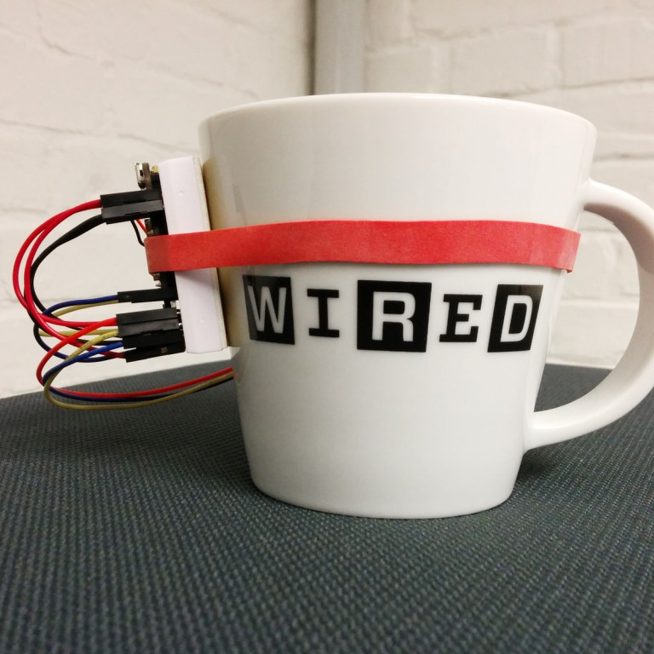
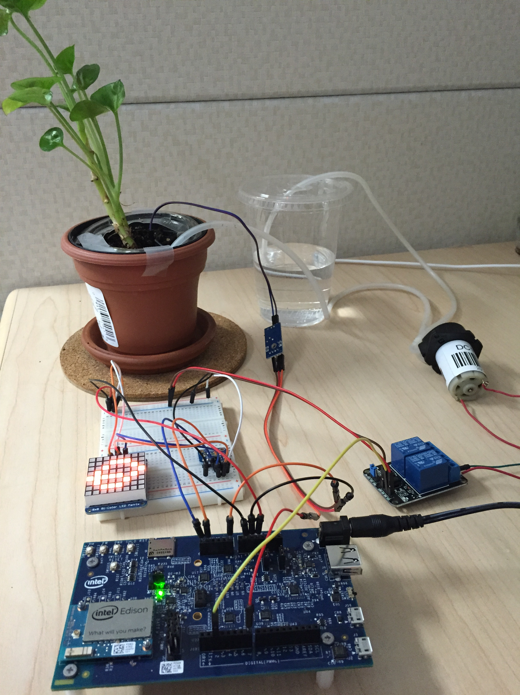
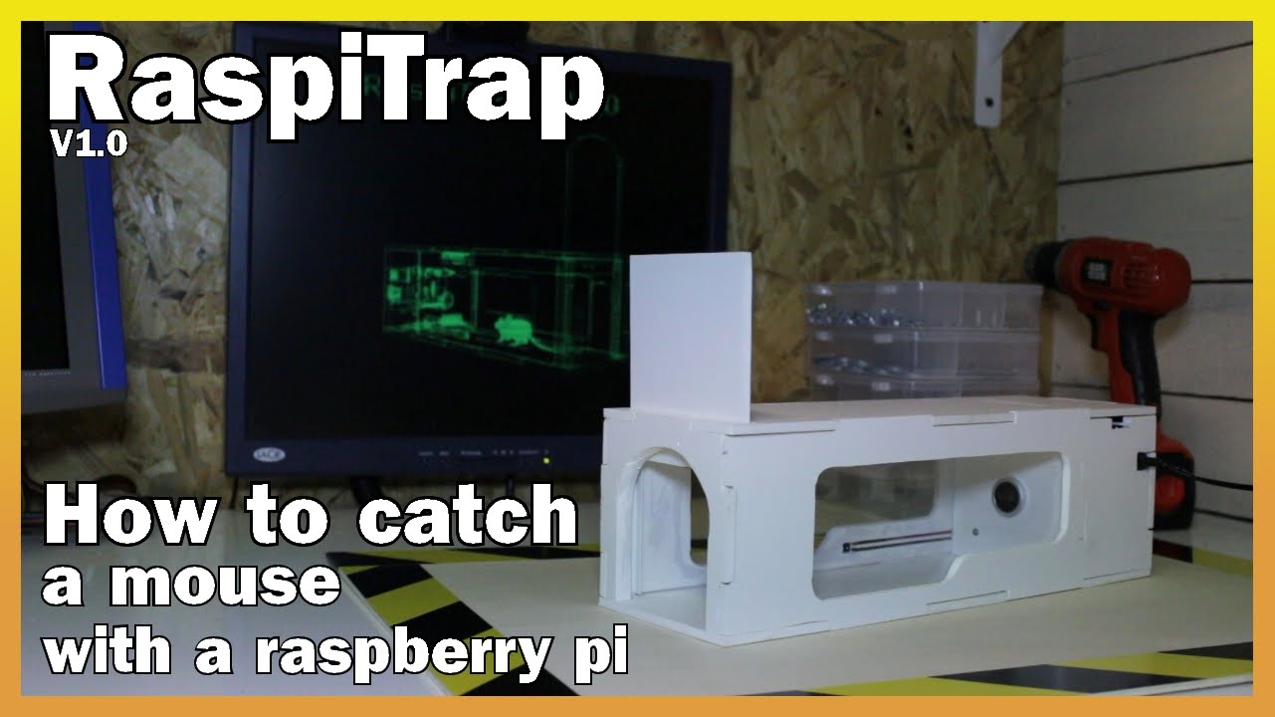
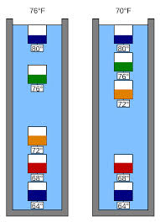
Project II - Ideas

