Slide 1

Project II: Assignment Specification
Assignment Specification
Produced by: Dr. Frank Walsh
This Photo by Unknown Author is licensed under CC BY-SA-NC

Slide 2
Context
For this assignment you are required to:
Create a working IoT project using a suitable distributed version control system.
Present and communicate your work in a clear, correct manner.
Begin to develop a digital portfolio.
Assessment will be based on technical (e.g., features), communication, organisational and presentation skills.
100% CA
1 overall project

Slide 3
Requirements
Propose
Propose a project
High level concept: Title; Description; Tools and Tech.
Model/ implement
Model/implement a solution to your proposal
Use the knowledge, skills and practices from other modules
Version Control
Use a suitable version control system to manage your portfolio of "artifacts".
Communictate
Produce clear documentation and/or training material for your project (e.g. project report, user guide, sushi cards)

Slide 4
Timeline
1st March(week6)
Proposal document (for 8th March)
One page document with general concept.
Github repo
22nd March (week9)
Interim Review
Updated Readme.md
Feedback on progress
26th April–3rd May (week12/13)
Presentation and interview
Full submission.
Present your work.

Slide 5
Grade Spectrum
 | Combined knowledge (25) | Working Artifact (25) | Digital Portfolio (25) | Communication (25)
Base (40-49) | 2 programme strands present in output. Basic knowledge of each exhibited. | Basic working artifact consisting of a single device. | Basic structured portfolio. No coherent structure | Minimal (1) communication resource used (simple read me).
Good (50-64) | apply concepts from more than two modules/strands.. | Working artifact that connects >= two devices. | Well structured portfolio in source control. | Portfolio includes clear presentation, documentation.
Excellent (65-80) | >2 strands as above and including more advanced knowledge and concepts. | All above, multiple device types to provide functional application. | Continuous update and progression of portfolio. Public site. | In addition, additional communication resources (e.g. instruction video, learning resources)
Outstanding (80-100) | All above, including self-acquired knowledge over and above module content. | All previous to excellent level. | All the above including advanced tools and features (e.g. branches, forks). | All the above, accessible project platform (e.g. web site)

Slide 6
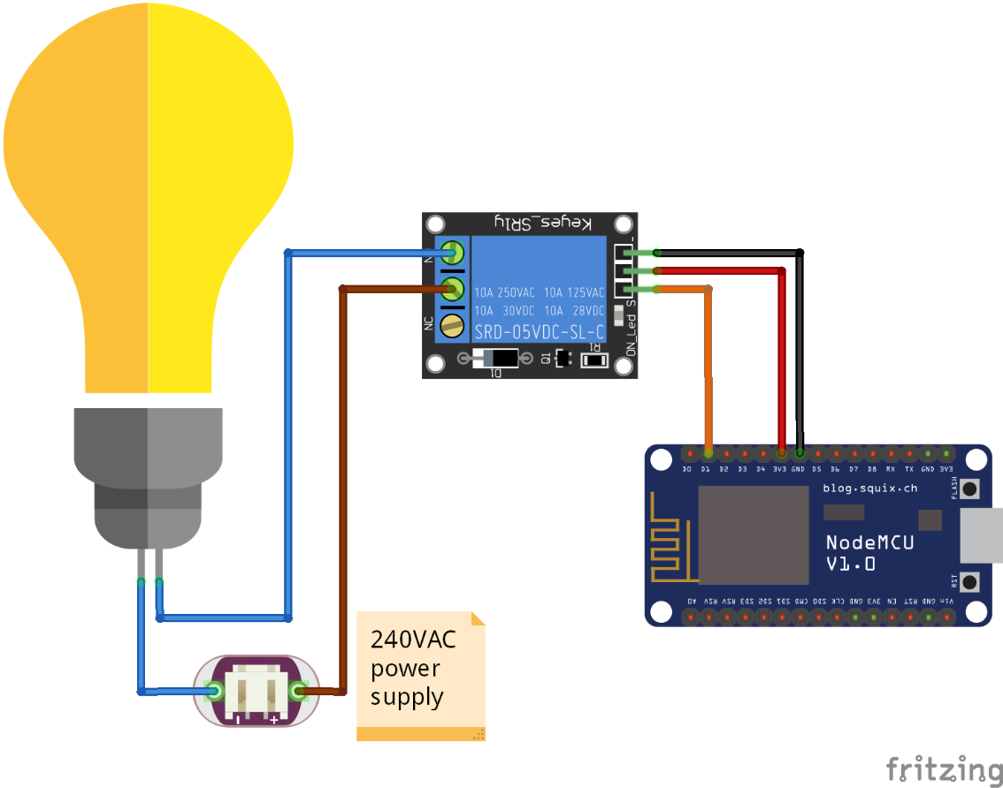
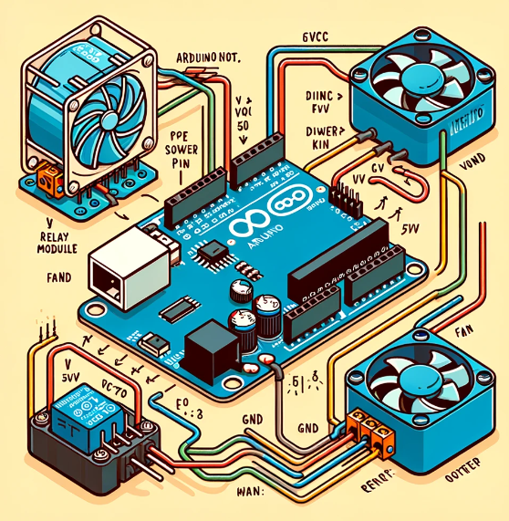
Possible Projects: Smart Device Creation
Turn a device into a “connected” device.
Control it from your mobile phone.

Slide 7
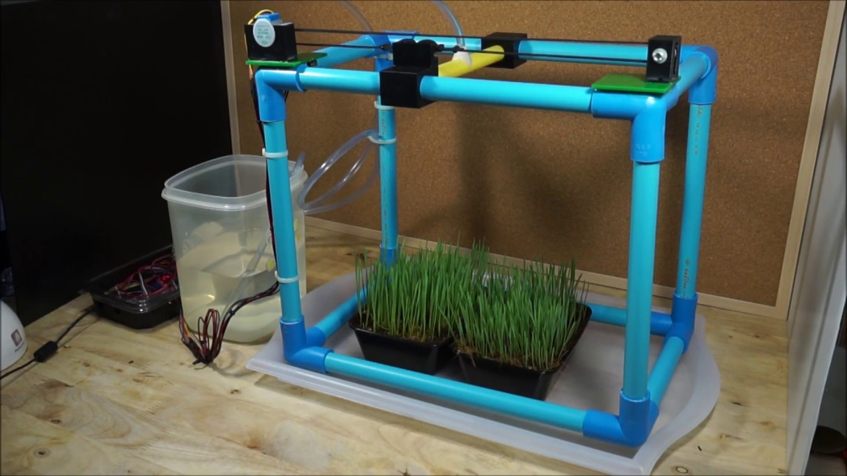
Possible Projects: Plant Monitoring and Watering System
Extend existing lab to include watering action
Log actions

Slide 8
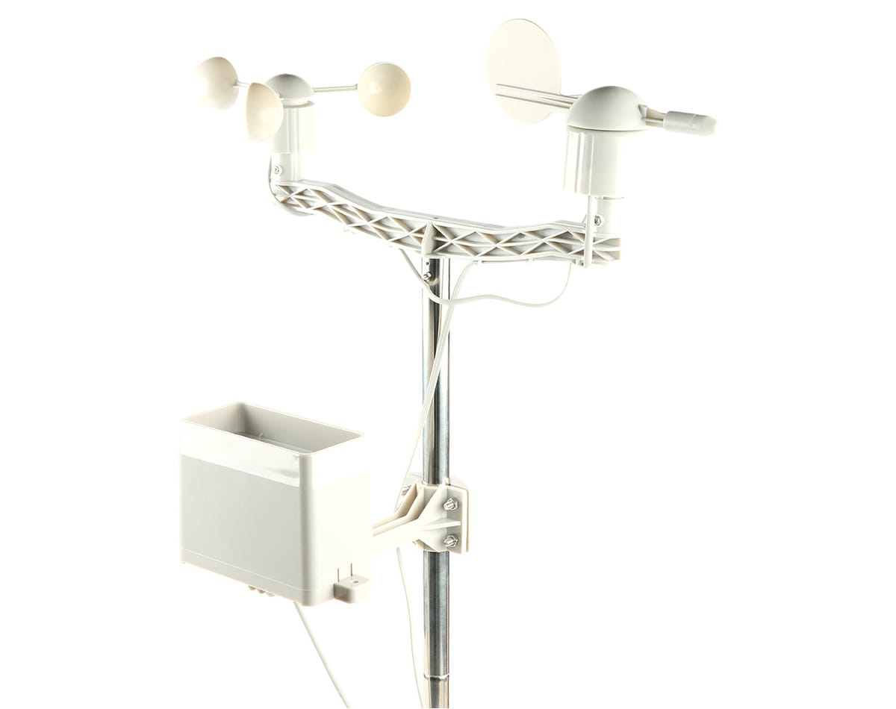
Possible Projects: Weather Monitoring
Connect wind/rain/temp sensor.
Create Dashboard to remote monitor.

