Slide 1
IoT Platforms
Frank Walsh

Slide 2
What are IoT platforms
IoT applications combine sensors, devices, data, analytics and integrations in a seamless and unified way
e.g. your project!
IoT Platforms provide software tools and components to:
connect sensors, devices, and data networks
Analyse and store data
Integrate with other apps
So what? We know the tech for that now (I2C, SPI, BLE, MQTT, Python...)
Main selling point of an IoT platform is software that it
accelerates the IoT development process
Focuses on IoT: brings in best of breed features
Provides initial scaffolding for IoT projects

Slide 3
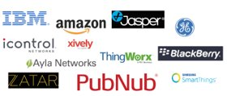
What are IoT Platform
Many(not all) are cloud-based platforms that require subscription
Provide device/language agnostic set of Software Development kits
Arduino/RPi/beagleboard
IoT development is generally iterative:
Starts with initial simple use case
Once operational, data/insights result in new usecased
IoT platforms should promote scalable, iterative development
Allow for quick app development
Ability to adapt/optimise apps quickly

Slide 4
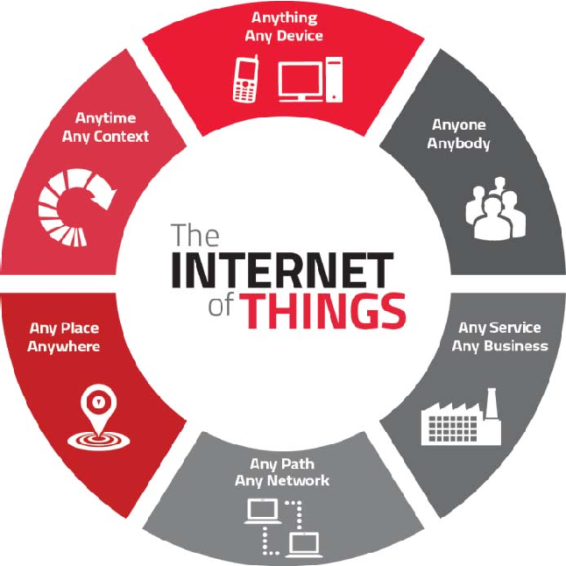
IoT Platform Characteristics
Manage many concurrent device connections
Connectivity across several connection types
"Off-the-peg" IoT protocol stack
Manage/analyse/visualise data
Integrations to other services/apps
App Development

Slide 5

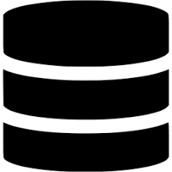






IoT Platform – general architechture
Configure analytics/visuals/apps
Data/commands
IoT Platform
Deploy algorithms to devices

Slide 6
IoT Platform Advantages
Use sofware component that has been pre-built and pre-tested. This increases the reliability of your application and reduces development effort.
IoT frameworks constantly evolve, providing new features, integrations etc.
Encourages better "design pattern" for your IoT app.
Predefined APIs and docs
Great for collaboration
"Baked-in" standards and features:
Security, authentication, scalability...

Slide 7

Which one?
Connectivity
Does the platform provide suitable capability and integrations (WiFi/Cellular/LPWan-Sigfox)
Maturity
In business for long? Critical mass in developer community?
Free
Is there a free tier (handy for evaluation)?
Service type
Platforms try to distinguish themselves – what specialisms/USP does it have?
Security
What security model do they use? Is there security issues reported in past?
Geographic area
Does it operate well at your location (can you select edges/data centres)

Slide 8


Examples:

Slide 9
Thingspeak

Slide 10
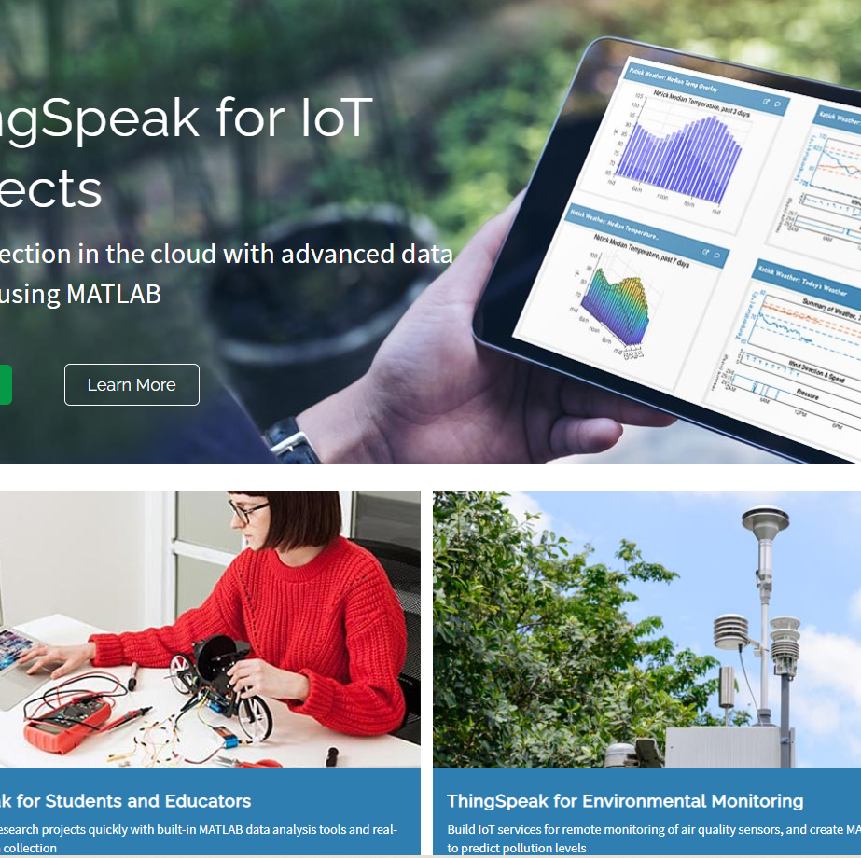
Thingspeak
ThingSpeak is a cloud-based IoT platform to store and retrieve data from devices.
Uses HTTP protocol/Restful APIs
"Collect and analyse data quickly and easily"

Slide 11
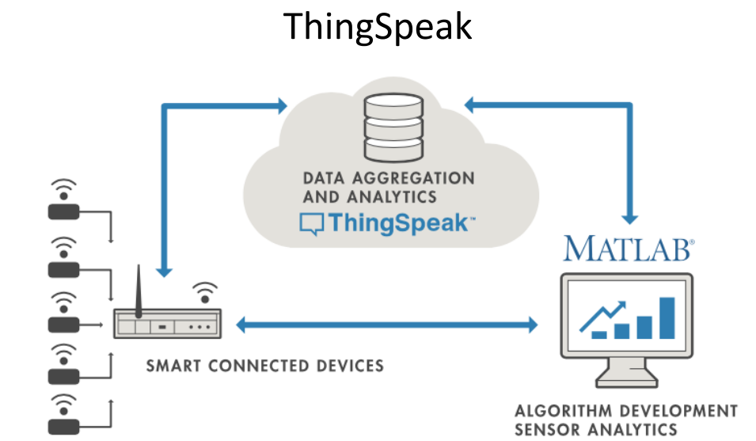
Thingspeak Overview
Account-based
Can create free account online
Brought to you by the people who made Matlab
Uses Matlab features/toolboxs
SDKs/librarys for popular languages/devices
Restful API means should work with any device

Slide 12
Thingspeak – basic use
Create a new channel
Test for certain conditions and perform actions
Act on the data
Run analytical algorithms/visualise your data
Analyse the data
Devices write data to channels
Collect data in the channel
Channels collect data

Slide 13
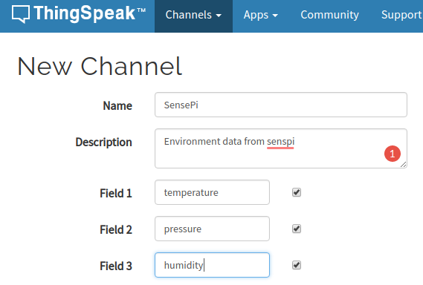
ThingSpeak – Create new channel
Create a new channel to collect data from devices
Define data fields for the channel(max 8)
Can also input location(lat/long) of channel source)

Slide 14
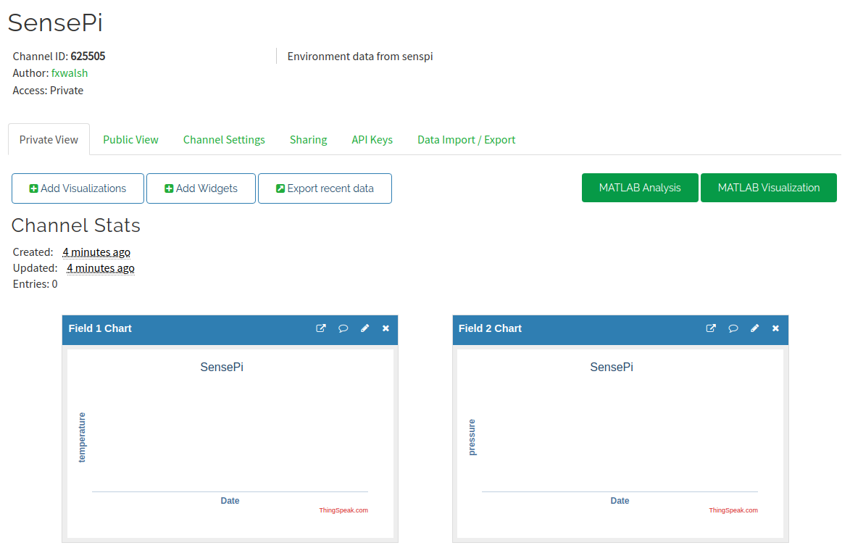
Thingspeak - New channel
Once saved you can access channel page:

Slide 15
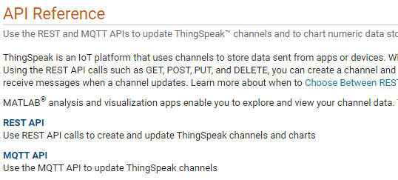
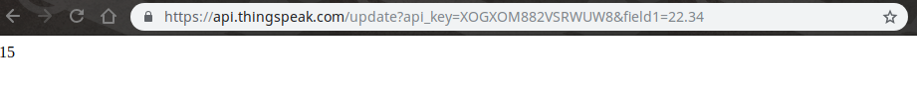
Thingspeak - Add data to channel
Programmatically, many ways!
Construct HTTP GET request and include field values in query string
MQTT (see in Lab)
GET https://api.thingspeak.com/update?api_key=<WRITE-KEY>&field1=12
Using HTTP GET request, can test from a browser:

Slide 16
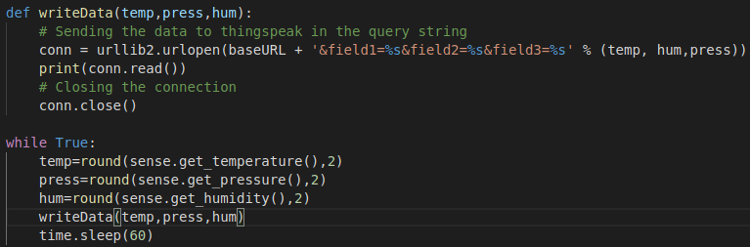
Thingspeak – Add data with python
Make HTTP request from Python:

Slide 17
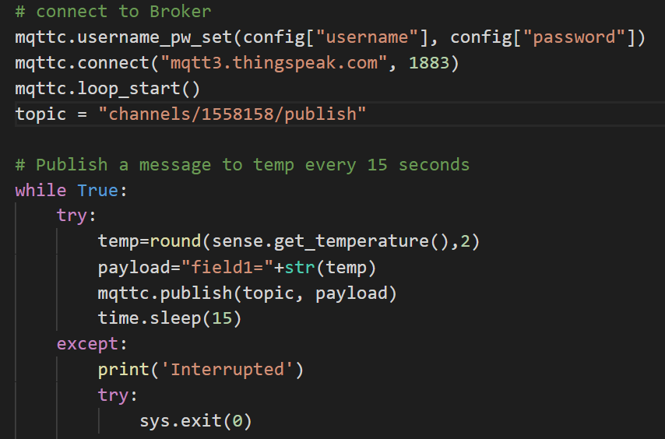
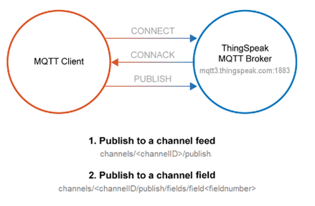
Thingspeak – Add data with python
Create a MQTT client:

Slide 18
Which to use: HTTP or MQTT API
HTTP (REST) API
You need to retrieve any historical data, such as data within a defined time range.
You want to Create Channel, Read Settings, Clear Channel, Delete Channel, or Create Chart.
You need a response!
MQTT
Your device is power-constrained, and you want lower battery consumption to send data to ThingSpeak. Also, an MQTT PUBLISH operation is typically faster in this scenario.
Your device connectivity is intermittent, and you have limited bandwidth usage.
You want immediate updates of data posted to a channel.
You want messages pushed to you instead of needing to poll the server for new messages.

Slide 19
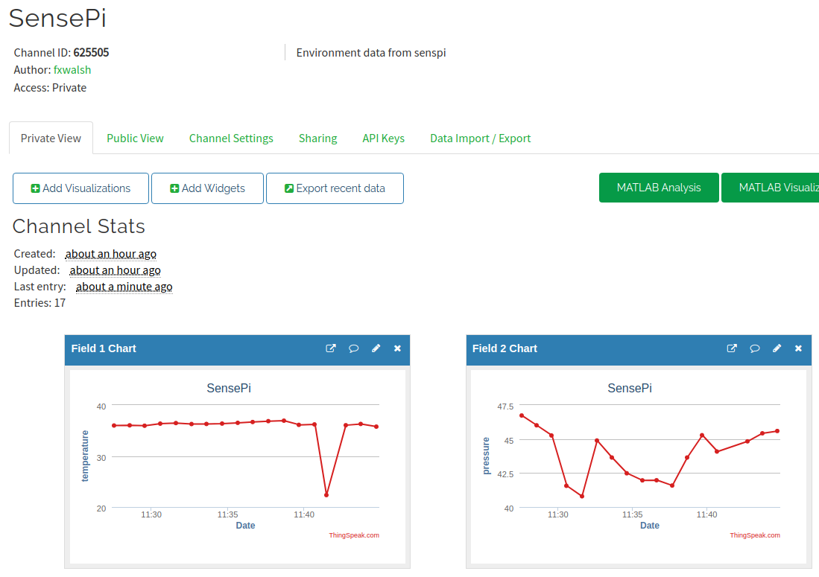
Think Speak – Analyse data
Thingspeak will visualise each field by default in channel view

Slide 20
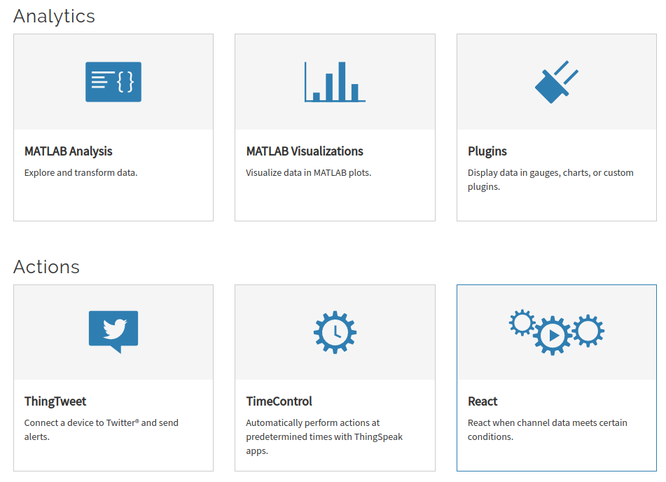
Thingspeak - Apps
The Apps tab provides various mechanism to transform, analyse,visualise and act on data.

Slide 21
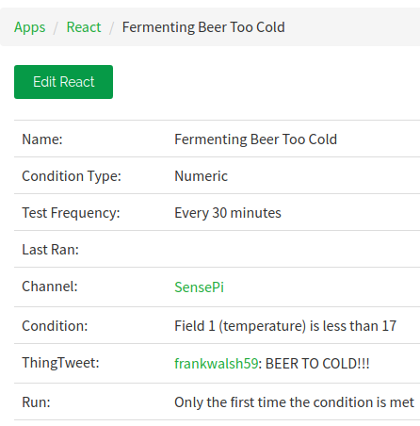
ThingSpeak Example: ThingTweet
Link Twitter account to Thingspeak
Create a React to tweet when a certain condition is met.
Also tweet from device using HTTP POST:
POST https://api.thingspeak.com/apps/thingtweet/1/statuses/update
api_key=WLKX9PPPWCRZ6H1
status=I just posted this from my thing!

Slide 22
ThingSpeak Example: Analysis
Can write Matlab Code to analyse and transform data
Possible uses:
Clean data (remove outliers)
Statistical analysis
Transfomations
Data Fusion
Generally write results to second channel for further analysis/visualisation.

Slide 23
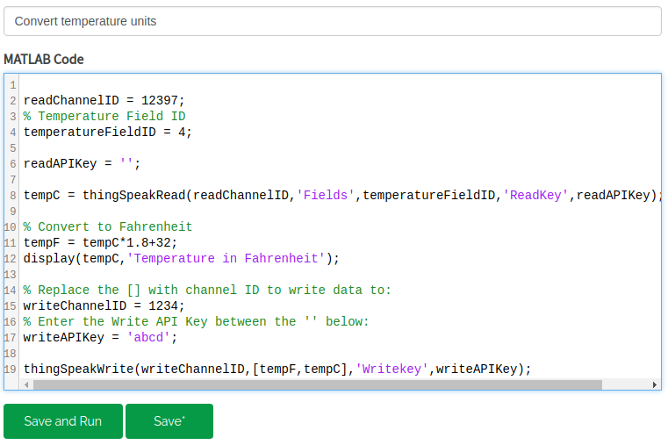
Thinkspeak: Convert Celcius to Fahrenheit

Slide 24
Other Platforms
Ubidots
Amazon Web Services
Microsoft Azure
Evothings

