Slide 1


Slide 2
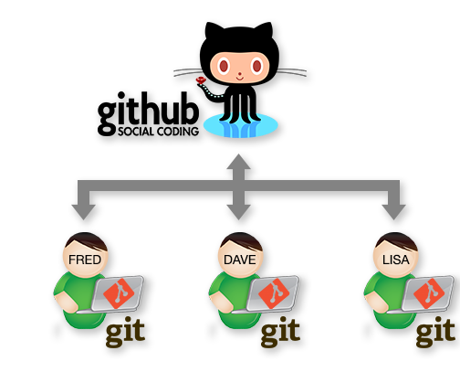
Intro
Developers collaborate
  Source control systems help teams collaborate
Git has had a major impact on how this is achieved.
Agenda:
  Introduction to Git basics.
  Collaborating with git
  Branching

Slide 3

Some History
Created by Linus Torvalds for work on the Linux kernel ~2005
Used by:
  Nearly everybody at this stage…

Slide 4
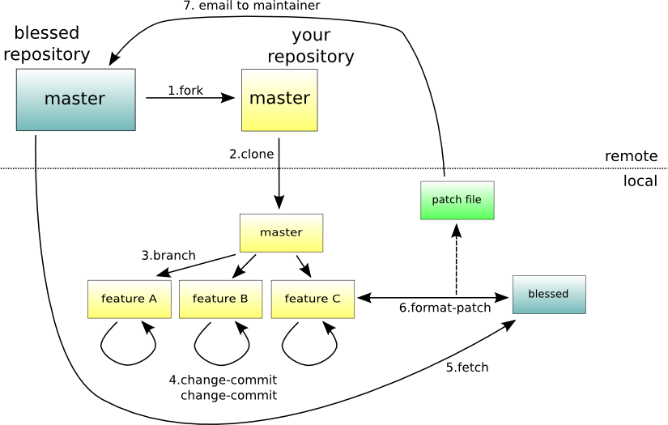
What is Git
Distributed Version Control
Directory Content Management
Tree Based History
Everybody has complete history
I get confused sometimes…

Slide 5
Centralised vs Distributed
Central Server
Remote Server

Slide 6
Initialising a repo…
$ mkdir myproject
$ cd myproject
$ git init
Initialized empty Git repository in /home/ec2-user/myproject/.git/
$ git config --global user.name “fxwalsh“
$ git config --global user.email fxwalsh@wit.com
$ vi README.txt
$ git add .
$ git commit -m 'initial commit'
[master (root-commit) 7d738f4] initial commit
1 file changed, 1 insertion(+)
create mode 100644 README.txt
master
A
Notes:
most everything in git is done by convention. Master does not mean anything special to git.

Slide 7
Multiple Commits
master
A
B
C
git add --all
git commit –m “updated text file”
git add --all
git commit –m “updated text file again”
Notes:
a set of commits, moving master and our current pointer (*) along

Slide 8
Github

Slide 9
Adding a Remote Repo to Existing Project
git remote add origin https://github.com/fxwalsh/BSc4Repo.git
git remote -v
origin https://github.com/fxwalsh/BSc4Repo.git (fetch)
origin https://github.com/fxwalsh/BSc4Repo.git (push)

Slide 10
Setting up Remote via Cloning
git clone
……
git remote -v
origin https://github.com/fxwalsh/BSc4Repo.git (fetch)
origin https://github.com/fxwalsh/BSc4Repo.git (push)

Slide 11
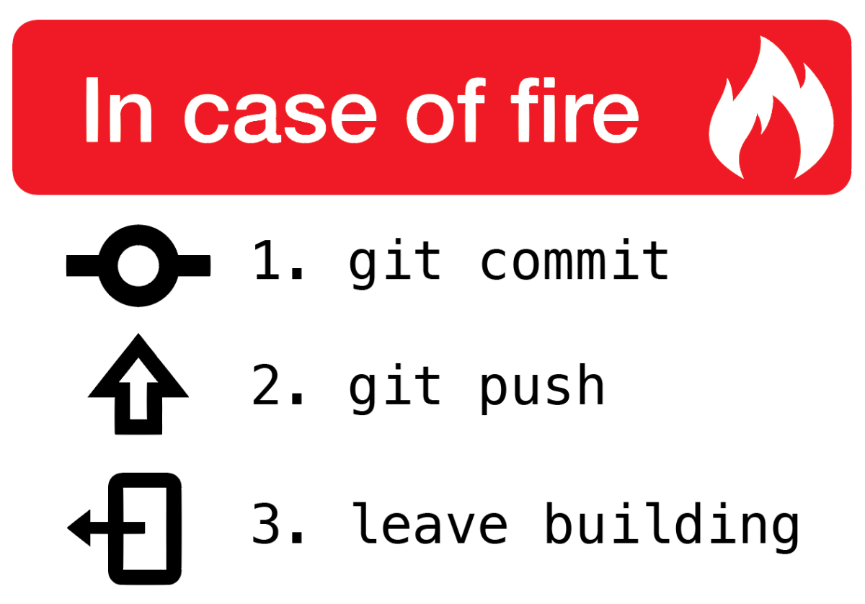
git push
Pushes your changes to remote
Changes will be rejected if newer changes exist on remote
  If this is the case, do a git pull
  merge locally, then push the results.

Slide 12
Pushing to remote
By default, remote repo is labelled origin.
Say you want to stage, commit, and push all your latest changes to origin…
git add --all
git commit –m “some important update to important stuff”
git push origin master

Slide 13
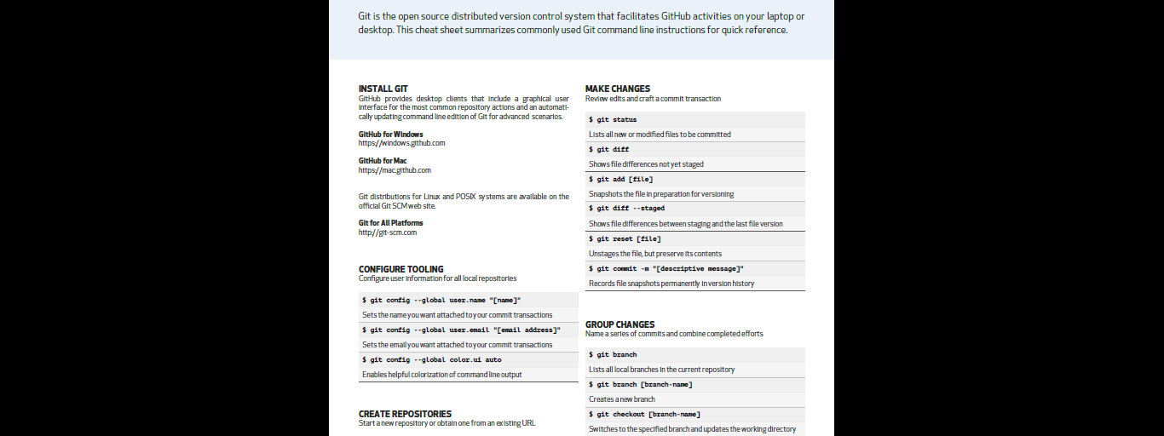
Final Word
Cheat sheet is always handy…

