Slide 1
Outline
Electronic Signals
Electricity Equations
General Purpose Input / Output (GPIO)
Pulse Width Modulation (PWM)
Analog to Digital Converters (ADC)
Microcontrollers and Computers
Questions

Slide 2
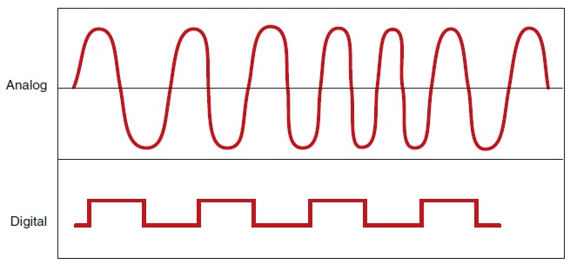
Electronic Signals
Image from http://autosystempro.com/analog-and-digital-principles/

Slide 3
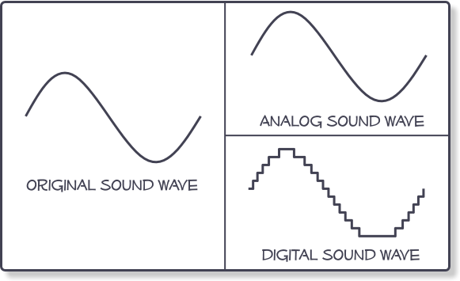
Analog and Digital
We can only store digital signals
Using 1 or several bits / sample
We store an array of numbers
Parameters
Bits per sample
Sampling rate
Image from http://www.centerpointaudio.com/Analog-VS-Digital.aspx

Slide 4
Bits per sample
1 bit signals sample
Values LOW (0) and HIGH (1)
digital
n bits signals sample
Values 0 .. ^{2n}-1
digital representation of an analog signal (analog)
Image from http://www.centerpointaudio.com/Analog-VS-Digital.aspx

Slide 5
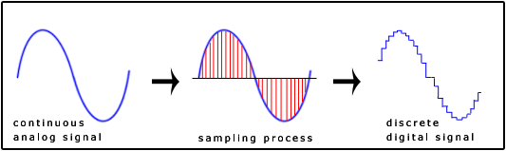
Sampling
Sensor signals are analog
Image from http://www.snotmonkey.com/work/school/405/overview.html

Slide 6
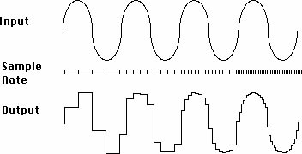
Sampling Rate
The faster we sample the higher the accuracy
Image from http://www.jazzpoparkisto.net/audio/audio32.html

Slide 7
Electricity Equations

Slide 8
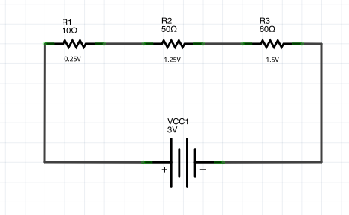
Ohm’s Law

Slide 9
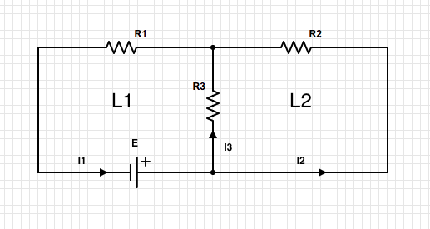
Kirchhoff Law I

Slide 10
Kirchhoff’s Law II

Slide 11
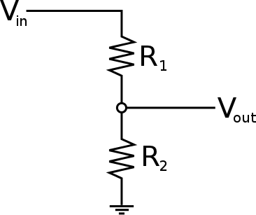
Voltage Divider
We measure V_{out}

Slide 12
Voltage Divider

Slide 13
Voltage Divider

Slide 14
Voltage Divider

Slide 15
Voltage Divider

Slide 16
Voltage Divider

Slide 17
Voltage Divider
Short circuit

Slide 18
General Purpose Input / Output

Slide 19
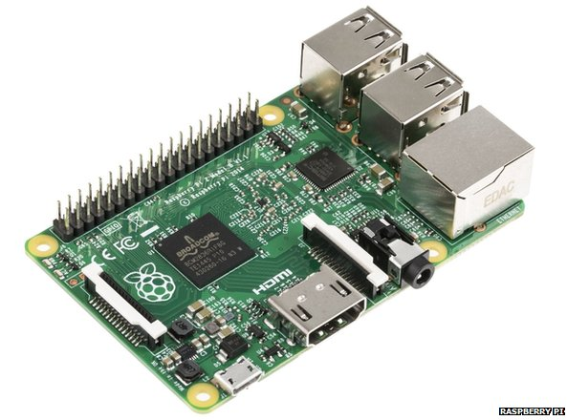
Output and Input
Digital Pins
Value LOW (0) or HIGH (1)
Each pin acts like a
battery (OUTPUT)
voltage meter (INPUT)

Slide 20
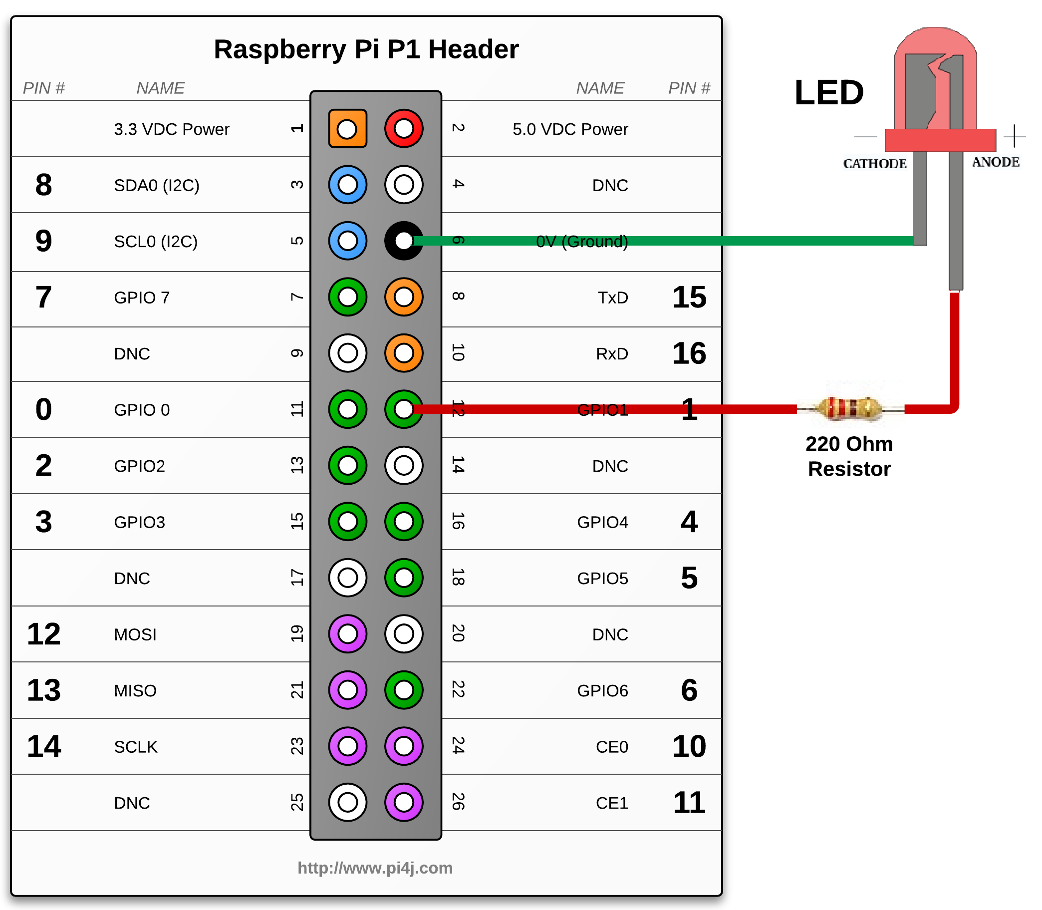
Output
Pins act like a battery
LOW – 0V
HIGH – 5V, 3.3V or 1.8V

Slide 21
Input
We measure V_{out}
It goes into the pin

Slide 22
Pulse With Modulation

Slide 23
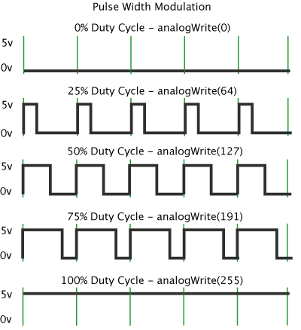
Pulse Width
We set the % of “high” cycle
0 – 0%
255 – 100%
Depends on the library
Implementation
Hardware
Software
Usage
LED dimming
Servo Motors

Slide 24
Analog to Digital Converters

Slide 25
Analog and Digital Converters
Measure voltage
Parameters
Bits per sample
Sampling rate
For 1 bit we have …
Image from http://www.centerpointaudio.com/Analog-VS-Digital.aspx

Slide 26
Analog and Digital Converters
Measure voltage
Parameters
Bits per sample
Sampling rate
For 1 bit we have …
GPIO Input
Image from http://www.centerpointaudio.com/Analog-VS-Digital.aspx

Slide 27
Analog and Digital Converters
Measure voltage
Parameters
Bits per sample
Sampling rate
For 1 bit we have …
GPIO Input
Image from http://www.centerpointaudio.com/Analog-VS-Digital.aspx

Slide 28
Analog and Digital Converters
Measure voltage
Parameters
Bits per sample
Sampling rate
For 1 bit we have …
GPIO Input
For n bits we have …
Image from http://www.centerpointaudio.com/Analog-VS-Digital.aspx

Slide 29
Analog and Digital Converters
Measure voltage
Parameters
Bits per sample
Sampling rate
For 1 bit we have …
GPIO Input
For n bits we have …
0 – 2^{n}-1
Image from http://www.centerpointaudio.com/Analog-VS-Digital.aspx

Slide 30
Microcontrollers and Computers

Slide 31
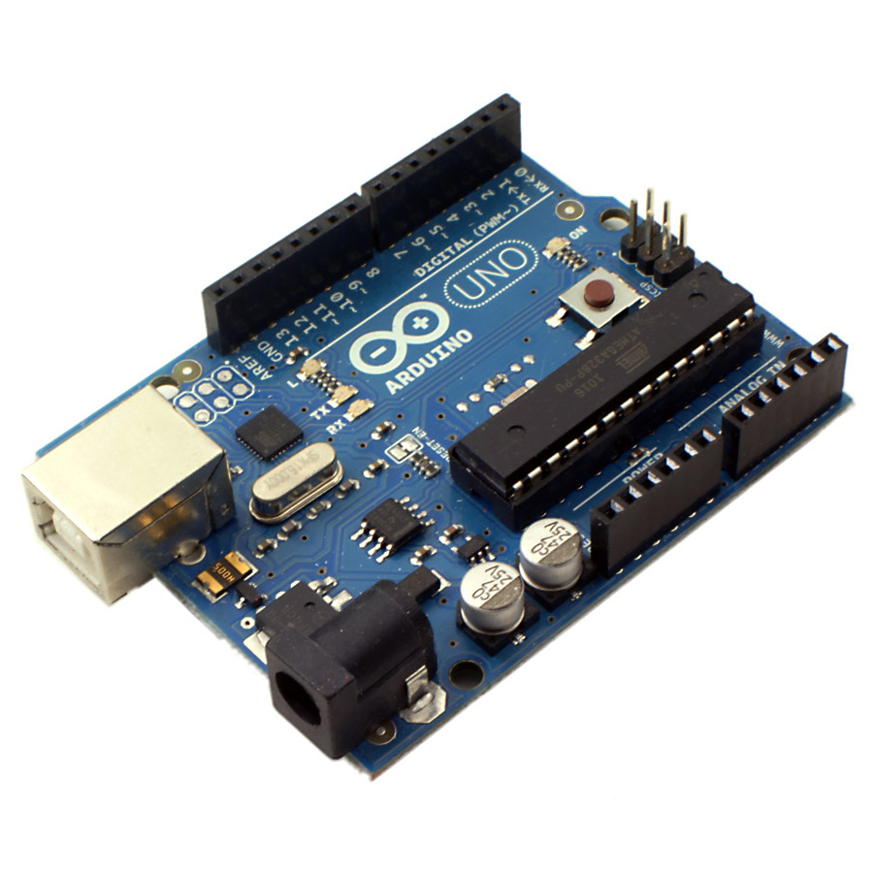
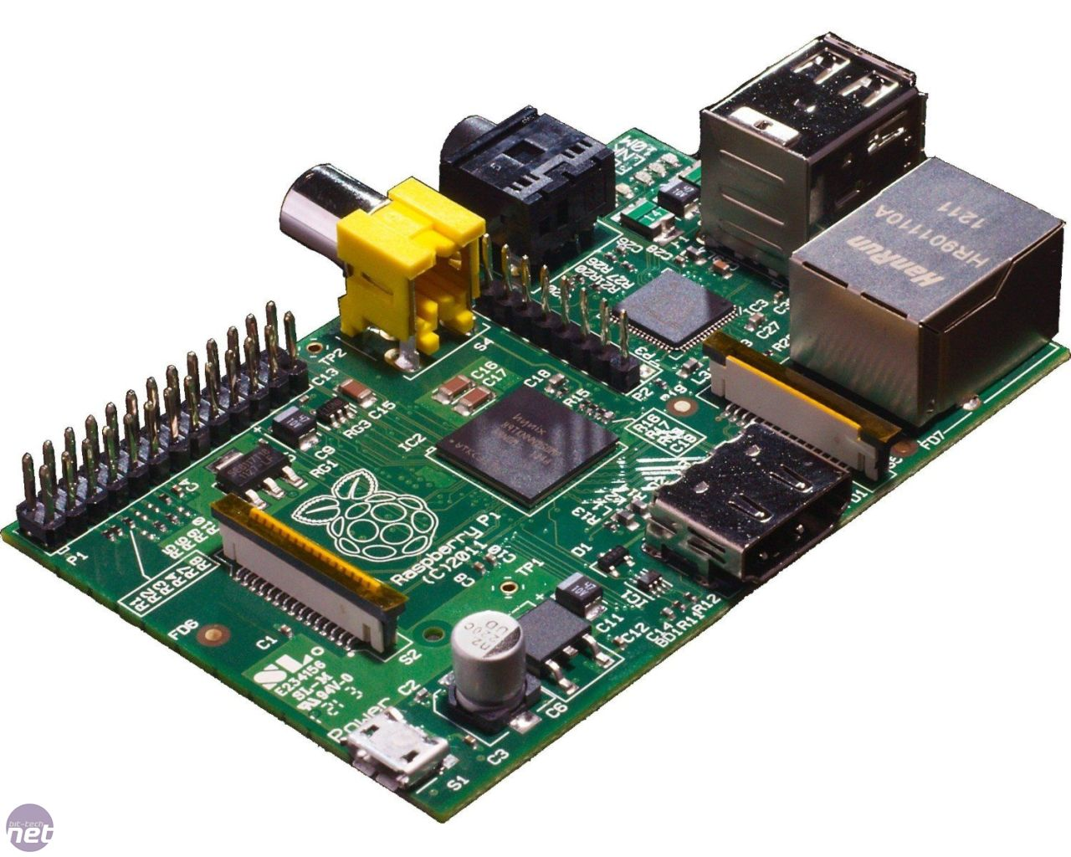
Microcontrollers and Computers
Simple systems
Control hardware
Low speeds
Small memory
GPIO
PWM
ADC
Run single software
Full CPUs
High speeds
Large memory
GPIO
Run OS

Slide 32
Microcontrollers and computers
Firmware
Software

