Slide 1
Algorithms
1. Objects and Classes
Robert O’Connor, Frank Walsh

Slide 2
Objectives
Objects and Classes
Using Methods in a Java Class
References and Aliases
Arguments and Parameters
Defining a Java Class
Passing Arguments
Constructors
The toString Method
Static Fields and Methods
Packages – The Java Class Library
Algorithms - 1. Objects and Classes

Slide 3
Objectives
Composition
Adapters
Inheritance
Invoking constructors from within constructors
Private fields and methods of the base class
Overriding, overloading methods
Protected access
Multiple inheritance
Type compatibility and base classes
The class Object
Abstract classes and methods
Polymorphism

Slide 4
Objectives
Encapsulation
Specifying Methods
Java Interfaces
Writing an Interface
Implementing an Interface
An Interface as a Data Type
Type Casts Within an Interface Implementation
Extending an Interface
Named Constants Within an Interface
Interfaces Versus Abstract Classes

Slide 5
Objects
An object is a program construct that
Contains data
Performs certain actions
The actions are called methods
The actions interact to form the solution to a given problem

Slide 6
Classes
A class is a type or kind of object
Objects of the same class have
The same kinds of data
The same methods
A class definition is a general description of
What the object is
What it can do

Slide 7
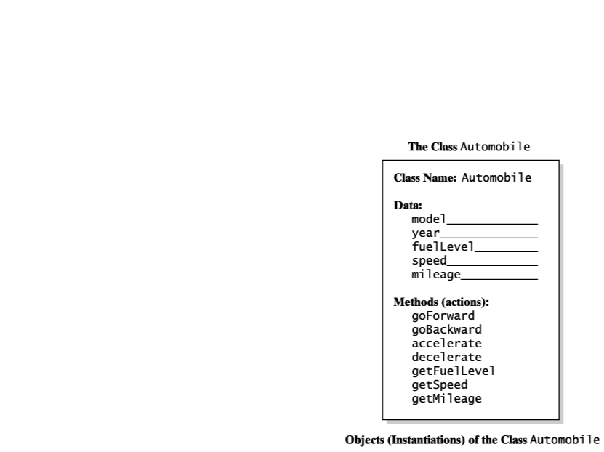
Classes
Fig. 1-1 An outline of a class

Slide 8
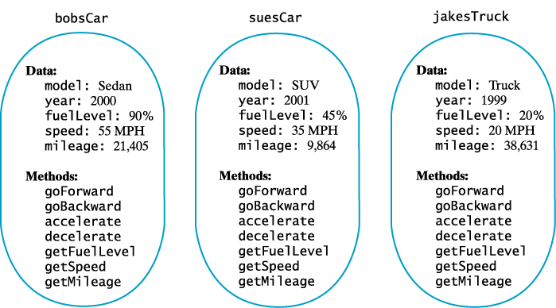
Class Instantiation
Fig. 1-2 Three instances of the class automobile

Slide 9
Methods in Java
Given: Name joe = new Name();
The new operator creates an instance of the class
Invokes the constructor method
Valued methods return a single value
void methods do not return a value

Slide 10
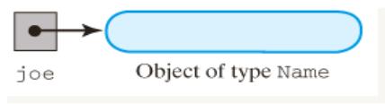
Methods in a Java Class
Fig. 1-3 A variable that references an object.

Slide 11
References and Aliases
Primitive types: byte, short, int, long float, double, char, boolean
All other types are reference or class types String greeting = "Howdy";
greeting is a reference variable
When two variables reference the same instance, they are considered aliases

Slide 12
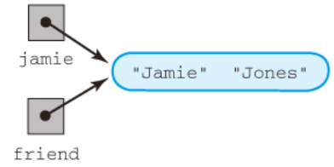
References and Aliases
Fig. 1-4 Aliases of an object

Slide 13
Arguments and Parameters
Given Name joe = new Name(); joe.setFirst ("Joseph"); joe.setLast ("Brown");
"Joseph" and "Brown" are arguments sent to the methods
Invocation of method must have same number of arguments as there are formal parameters in the declaration

Slide 14

Defining a Class
Given
These are the data fields (instance variables)
Note they are private
They will require accessor and mutator methods
public class Name
{ private String first; // first name private String last; // last name
< Definitions of methods are here. >
} // end Name

Slide 15
Methods
Given
This is a valued method
Returns a String
Given
This is a void method
public String getLast()
{ return last; } // end getLast
public void setLast(String lastName)
{ last = lastName; } // end setLast

Slide 16
Naming Convention
Start method name with lowercase letter
Use verb or action phrase e.g. getLast
Start class name with uppercase
Use noun or descriptive phrase
e.g public class Name
Local variables
A variable declared within a method

Slide 17
Passing Arguments
Call by value
For primitive type, parameter initialised to value of argument in call
Call by reference
For a class type, formal parameter is initialised to the address of the object in the call
public void giveLastNameTo(Name child)
{ child.setLast(last);
} // end giveLastNameTo

Slide 18
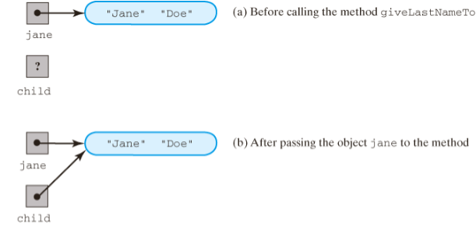
Passing Arguments
Name jamie = New Name(“Jamie”, “Jones”);
Name jane = New Name(“Jane”, “Doe”);
jamie.giveLastNameTo(jane);
Fig.1-5 a & b The method giveLastNameTo modifies the object passed to it as an argument.
Also see: http://www.javaworld.com/javaworld/javaqa/2000-05/03-qa-0526-pass.html

Slide 19
Constructors
A method that
Allocates memory for the object
Initialises the data fields
Properties
Same name as the class
No return type, not even void
Any number of formal parameters
Often method name = class name

Slide 20
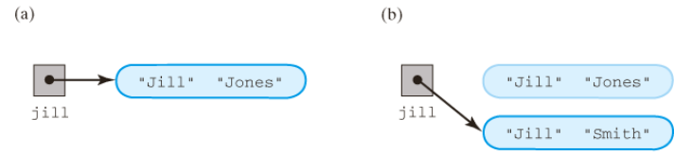
Constructors
public Name (String firstName, String lastName) {
first = firstName;
last = lastName;
} // end constructor
…..
Name jill = new Name(“Jill”, “Jones”);
Name jill = new Name (“Jill”, “Smith”);
Fig. 1-7 An object (a) after its initial creation; (b) after its reference is lost

Slide 21
Static Fields & Methods
A data field that does not belong to any one object
One instance of that data item exists to be shared by all the instances of the class
Also called: static field, static variable, class variable
Data Structures - 1. Objects and Classes

Slide 22
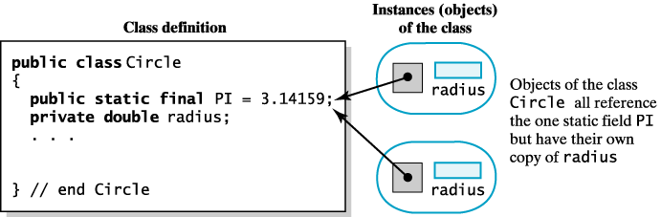
Static Fields & Methods
Fig. 1-8 A static PI versus a non static field
Data Structures - 1. Objects and Classes

Slide 23
Packages
Multiple related classes can be conveniently grouped into a package
Begin each file that contains a class within the package package myStuff;
Place all files within a directory
Give folder same name as the package
To use the package, begin the program with import myStuff.*;
Data Structures - 1. Objects and Classes

Slide 24
Java Class Libraries
Many useful classes have already been declared
Collection exists in Java Class Library
Example
The class Math is part of the package java.lang
Data Structures - 1. Objects and Classes

Slide 25

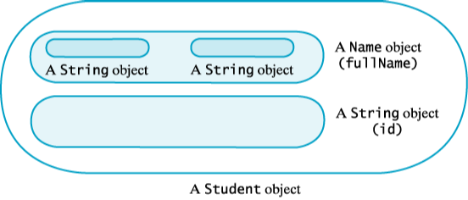
Composition
When a class has a data field that is an instance of another class
Example – an object of type Student.
A "has a" relationship
Fig. 1-9 A Student object composed of other objects
Data Structures - 1. Objects and Classes

Slide 26
Adapters
Use composition to write a new class:
Has an instance of an existing class as a data field
Defines new methods needed for the new class
Example:
public class NickName { private Name nick; public NickName() { nick = new Name(); }// end default constructor public void setNickName(String nickName) { nick.setFirst(nickName); }// end setNickName public String getNickName() { return nick.getFirst(); }// end getNickName } // end NickName
Data Structures - 1. Objects and Classes

Slide 27
Inheritance
A general or base class is first defined
Then a more specialised class is defined by …
Adding to details of the base class
Revising details of the more general class
Advantages
Saves work
Common properties and behaviors are define only once for all classes involved
Algorithms - 1. Objects and Classes

Slide 28
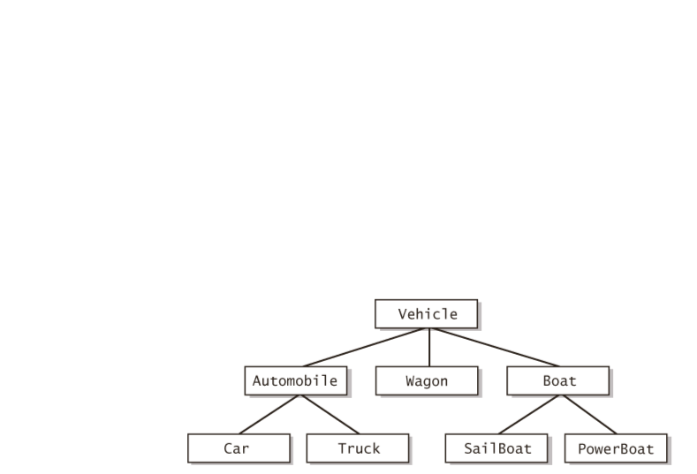

Inheritance
An "is a" relationship
public class Car extends Automobile { …
} // end Car
…
Car toyota = new Car();
Fig. 1-10 A hierarchy of classes.
Algorithms - 1. Objects and Classes

Slide 29
Base Class Constructor
Constructors usually initialise data fields
In a derived class
The constructor must call the base class constructor
Can use the reserved word super as a name for the constructor of the base class
When super is used, it must be the first action in the derived constructor definition
Must not use the name of the constructor
Data Structures - 1. Objects and Classes

Slide 30
Base Class Constructor
public class Automobile extends Vehicle{
private int year; // year of manufacture
private String colour;
public Automobile(int iYear, String sColour){
year = iYear;
colour = sColour;
}
} // end Automobile
public class Car extends Automobile{
private int engineSize;
private String modelType; // saloon, hatchback
public Car (int iYear, String sColour, int iEngine,
String sModel){
super (iYear, sColour);
engineSize = iEngine;
modelType = sModel;
}
} // end Car
Data Structures - 1. Objects and Classes

Slide 31
Accessing Inherited Data Fields
Private data field in base class
Not accessible by name within definition of a method from another class – including a derived class
Still they are inherited by the derived class
Derived classes must use public methods of the base class e.g. getModel();
Note that private methods in a base class are also unavailable to derived classes
But usually not a problem – private methods are used only for utility duties within their class
Data Structures - 1. Objects and Classes

Slide 32
Overriding Methods
When a derived class defines a method with the same signature as in base class
Same name
Same return type
Same number, types of parameters
Objects of the derived class that invoke the method will use the definition from the derived class
It is possible to use super in the derived class to call an overridden method of the base class
Data Structures - 1. Objects and Classes

Slide 33
Overriding Methods
public class Automobile extends Vehicle{
private int year; // year of manufacture
private String colour;
…
public String toString(){
return year + “, “ + colour;
}
} // end Automobile
public class Car extends Automobile{
private int engineSize;
private String modelType; // saloon, hatchback ….
public String toString(){
return super.toString() + “, “ + engineSize + “, “ +
modelType;
}
} // end Car
Data Structures - 1. Objects and Classes

Slide 34
Overriding Methods
Multiple use of super
Consider a class derived from a base … that itself is derived from a base class
All three classes have a method with the same signature
The overriding method in the lowest derived class cannot invoke the method in the base class's base class
The construct super.super is illegal
Data Structures - 1. Objects and Classes

Slide 35
Overloading Methods
When the derived class method has
The same name
The same return type … but …
Different number or type of parameters
Then the derived class has available
The derived class method … and
The base class method with the same name
Java distinguishes between the two methods due to the different parameters
Data Structures - 1. Objects and Classes

Slide 36
Overloading Methods
A programmer may wish to specify that a method definition cannot be overridden
So that the behavior of the constructor will not be changed
This is accomplished by use of the modifier final
public final void whatever() { . . . }
Data Structures - 1. Objects and Classes

Slide 37
Protected Access
A method or data field modified by protected can be accessed by name only within
Its own class definition
Any class derived from that base class
Any class within the same package
Data Structures - 1. Objects and Classes

Slide 38
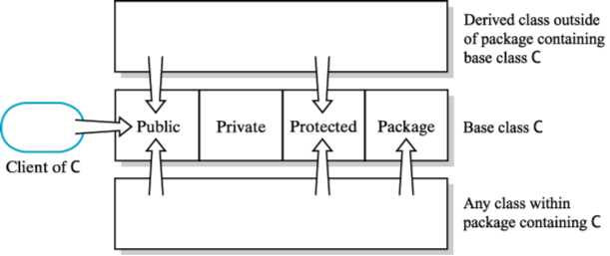
Protected Access
Fig. 1-11 Public, private, protected, and package access
Data Structures - 1. Objects and Classes

Slide 39
Multiple Inheritence
Some languages allow programmer to derive class C from classes A and B
Java does not allow this
A derived class can have only one base class
Multiple inheritance can be approximated
A derived class can have multiple interfaces
Data Structures - 1. Objects and Classes

Slide 40
Object Types of Derived Classes
Given :
Class Car,
Derived from class Automobile
Then a Car object is also an Automobile object
In general … An object of a derived class is also an object of the base class
Data Structures - 1. Objects and Classes

Slide 41
The class Object
Every class is a descendant of the class Object
Object is the class that is the beginning of every chain of derived classes
It is the ancestor of every other class
Even those defined by the programmer
Data Structures - 1. Objects and Classes

Slide 42
Abstract Classes
Some base classes are not intended to have objects of that type
The objects will be of the derived classes
Declare that base class to be abstract public abstract class Whatever { . . . }
The designer often specifies methods of the abstract class without a body public abstract void doSomething();
This requires all derived classes to implement this method
Data Structures - 1. Objects and Classes

Slide 43


Polymorphism
When one method name in an instruction can cause different actions
Happens according to the kinds of objects that invoke the methods
Example
public void displayAt(int numLines){
for (int count=0;count<numLines;count++){
system.out.println();}
display();
}
UndergradStudent ug = new UndergradStudent(. . .); Student s = ug; // s and ug are aliases s.displayAt(2); ug.displayAt(4);
The object still remembers it is of type UndergradStudent
Data Structures - 1. Objects and Classes

Slide 44
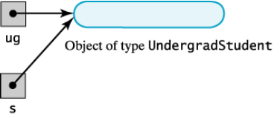
Polymorphism
Which displayAt is called …
Depends on the invoking object's place in the inheritance chain and is not determined by the type of the variable naming the object
Fig. 1-12 The variable “s” is another name for an undergraduate object.
http://download.oracle.com/javase/tutorial/java/IandI/polymorphism.html
Data Structures - 1. Objects and Classes

Slide 45
Encapsulation
Hides the fine detail of the inner workings of the class
The implementation is hidden
Often called "information hiding"
Part of the class is visible
The necessary controls for the class are left visible
The class interface is made visible
The programmer is given only enough information to use the class
Data Structures - 1. Objects and Classes

Slide 46
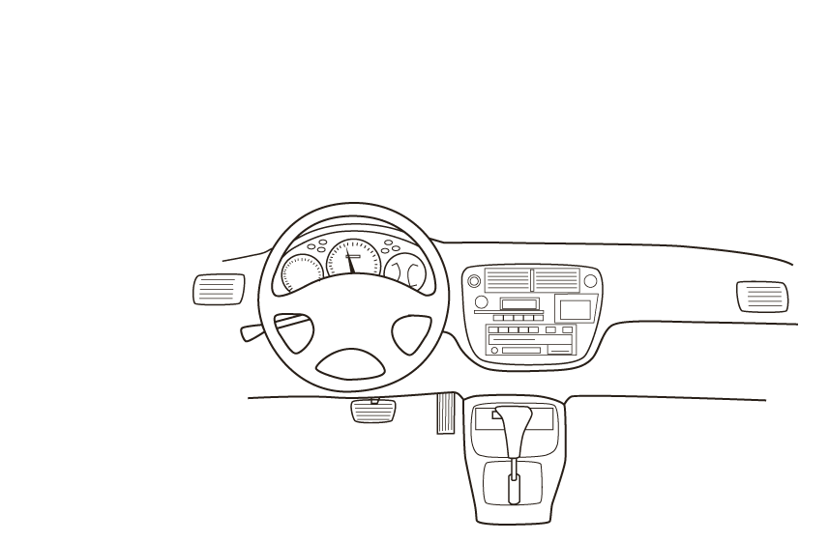
Encapsulation
Fig. 1-13 An automobile's controls are visible to the driver, but its inner workings are hidden.
Data Structures - 1. Objects and Classes

Slide 47
Abstraction
A process that has the designer ask what instead of how
What is it you want to do with the data
What will be done to the data
The designer does not consider how the class's methods will accomplish their goals
The client interface is the what
The implementation is the how
Data Structures - 1. Objects and Classes

Slide 48
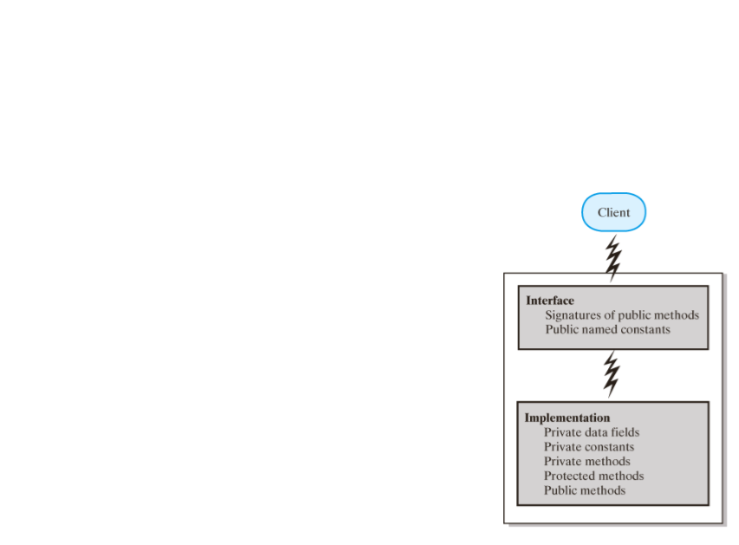
Abstraction
Fig. 1-14 An interface provides well-regulated communication between a hidden implementation and a client.
Data Structures - 1. Objects and Classes

Slide 49
Specifying Methods
Specify what each method does
Precondition
Defines responsibility of client code
Postcondition
Specifies what will happen if the preconditions are met
Assertions can be written as comments to identify design logic // Assertion: intVal >= 0
Algorithms - 1. Objects and Classes

Slide 50
Java Interface
A program component that contains
Public constants
Signatures for public methods
Comments that describe them
Begins like a class definition
Use the word interface instead of class public interface someClass { public int someMethod(); }
Data Structures - 1. Objects and Classes

Slide 51
Java Interface Example
public interface NameInterface
{ /** Task: Sets the first and last names.
* @param firstName a string that is the desired first name
* @param lastName a string that is the desired last name */
public void setName(String firstName, String lastName);
/** Task: Gets the full name.
* @return a string containing the first and last names */
public String getName();
public void setFirst(String firstName);
public String getFirst();
public void setLast(String lastName);
public String getLast();
public void giveLastNameTo(NameInterface child);
public String toString();
} // end NameInterface
Algorithms - 1. Objects and Classes

Slide 52
Implementing an Interface
A class that implements an interface must state so at start of definition public class myClass implements someInterface
The class must implement every method declared in the interface
Multiple classes can implement the same interface
A class can implement more than one interface
An interface can be used as a data type public void someMethod (someInterface x)
Data Structures - 1. Objects and Classes

Slide 53
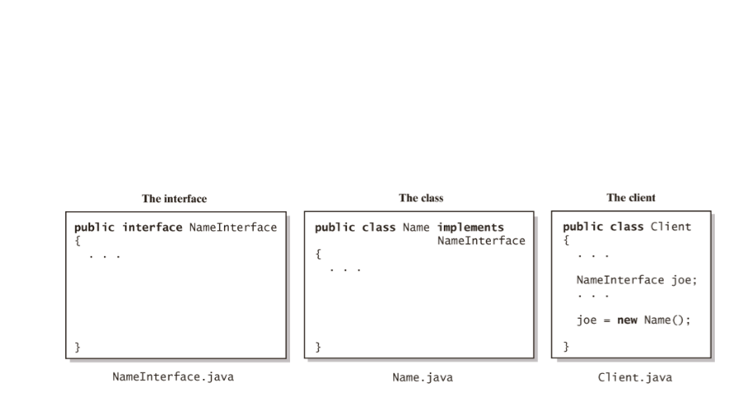
Implementing an Interface
Fig. 1-15 The files for an interface, a class that implements the interface, and the client.
Data Structures - 1. Objects and Classes

Slide 54
Extending an Interface
Use inheritance to derive an interface from another
When an interface extends another
It has all the methods of the inherited interface
Also include some new methods
Also possible to combine several interfaces into a new interface
Not possible with classes
Data Structures - 1. Objects and Classes

Slide 55
Extending an Interface
public interface Nameable{
public void setName(String petName);
public String getName();
} // end Nameable
…
public interface Callable extends Nameable{
public void come(String petName);
} // end Callable
…
public interface Capable{
public void hear();
public void respond();
} // end capable
…
public interface Trainable extends Callable, Capable{
public void sit();
public void speak();
public void lieDown();
} // end Trainable
Data Structures - 1. Objects and Classes

Slide 56
Named Constants
An interface can contain named constants
Public data fields initialised and declared as final
Consider an interface with a collection of named constants
Then derive variety of interfaces that can make use of these constants
Data Structures - 1. Objects and Classes

Slide 57
Interfaces vs Abstract Classes
Purpose of interface similar to purpose of abstract class
But … an interface is not a base class
It is not a class of any kind
Use an abstract base class when
You need a method or private data field that classes will have in common
Otherwise use an interface
Data Structures - 1. Objects and Classes

Slide 58
Choosing Classes
Look at a prospective system from a functional point of view
Ask
What or who will use the system
What can each actor do with the system
Which scenarios involve common goals
Use a case diagram
Data Structures - 1. Objects and Classes

Slide 59
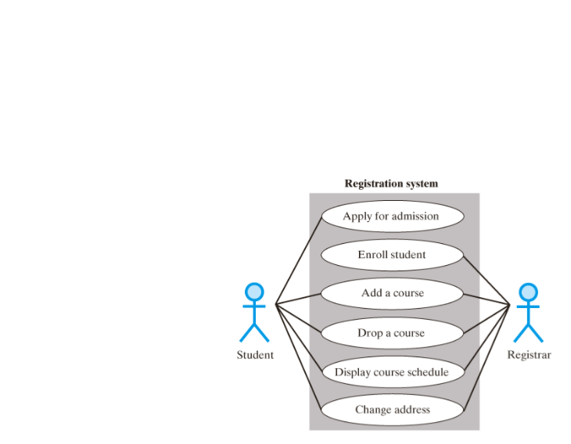
Choosing Classes
Fig. 1-16 A use case diagram for a registration system
Data Structures - 1. Objects and Classes

Slide 60
Identifying Classes
Describe the system
Identify nouns and verbs
Nouns suggest classes
Students
Transactions
Customers
Verbs suggest appropriate methods
Print an object
Post a transaction
Bill the customer
Data Structures - 1. Objects and Classes

Slide 61
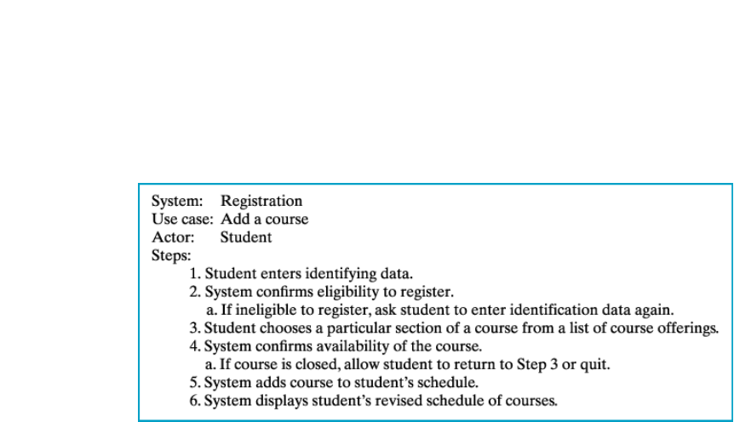
Identifying Classes
Fig. 1-17 A description of a use case for adding a course
Data Structures - 1. Objects and Classes

Slide 62
Reusing Classes
Much software combines:
Existing components
New components
When designing new classes
Plan for reusability in the future
Make objects as general as possible
Avoid dependencies that restrict later use by another programmer
Data Structures - 1. Objects and Classes

Slide 63
Summary
An Object is a program construction that contains data and methods
A Class is a type or kind of Object
Data and methods can be public or private
Data Structures - 1. Objects and Classes

Slide 64
Summary
A constructor allocates memory for the object and initialises the data fields
A static field/method is associated with the Class and not the Object
A package is a group of related classes
Data Structures - 1. Objects and Classes

Slide 65
Summary
Composition defines a ‘has a’ relationship between classes
Inheritance groups classes that have common properties (an ‘is a’ relationship)
Derived class methods can override base class methods
Methods can be overloaded when two+ methods have the same name, but different parameters
Data Structures - 1. Objects and Classes

Slide 66
Summary
Protected methods can be accessed within its own class, derived class or package. Other classes CANNOT invoke it
Every class is a descendant of the class Object
An Abstract class has no instance and only acts as a base class
Data Structures - 1. Objects and Classes

Slide 67
Summary
Polymorphism is where an object decides at runtime which action of an overridden method to use
Encapsulation is a design principal that hides details of class implementation (“Black Box”)
Abstraction focuses on what not how
An Interface declares methods that a class must implement and also data constants
Data Structures - 1. Objects and Classes

Slide 68
Summary
A class that implements an Interface must have an implements statement in the class definition
A Java class can implement any number of Interfaces
Data Structures - 1. Objects and Classes

Slide 69
Bibliography
Frank M. Carrano & Walter Savitch, “Data Structures and Abstractions with Java”, Prentice Hall/Pearson Education, 2003
David J. Barnes & Michael Kölling, “Objects First with Java: A Practical Introduction using BlueJ”, Prentice Hall / Pearson Education, 2006
Eclipse Software Development Kit www.eclipse.org
Data Structures - 1. Objects and Classes

