Slide 1
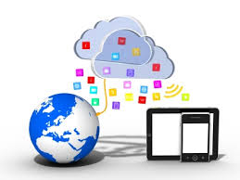
Web Services Development
1. Introduction
Frank Walsh

Slide 2
Agenda
Me
Module Outline
What is a Web Service?
Brief History of Web Services
Current trends in Web Services

Slide 3
Me
Frank Walsh
Room F21
fxwalsh@wit.ie
Contact/message me via Moodle

Slide 4
Module Outline(Tentative)
Introduction to Web Services
Javascript overview
Representational State Transfer
Web APIs
Microservices

Slide 5
Technical Content(Tentative)
Javascript
Node.js
  Express package
NoSQL data stores
  Mongo/Dynamo
Cloud Platforms
  Amazon/Azure/Bluemix

Slide 6
Module Assessment Structure
50% Continuous Assessment
  2 assignments
50% Exam
Content administered via Moodle
All assignment submission though Moodle
Late assignments will be deducted 20% per day.
  Please submit on time
  Extensions only with proper certification.

Slide 7
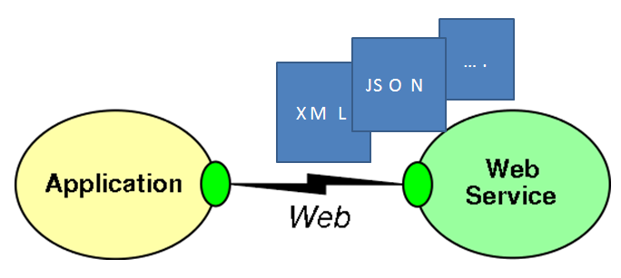
What's a Web Service
Apps that communicate over the World Wide Web(www)
Based on open standards
Interoperation between apps running on a varaiety of platforms and devices
Web services can be combined to perform more complex processes.

Slide 8

WWW
World Wide Web resulted in simple,
straightforward technologies
Limiting web use to browsers
restricts potential applications
What about using web infrastructure for richer interoperability between clients and servers?
Allows provision of services that integrate several other services
  Even across different organisations

Slide 9
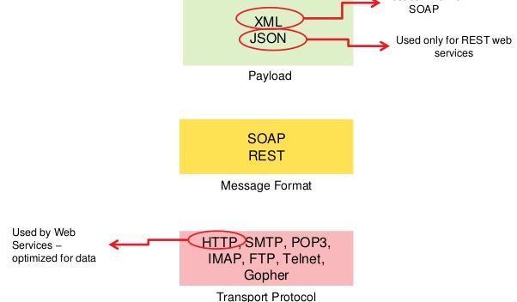
Open Standards
Web Services are “a software system designed to support inter-operable machine-to-machine interaction over a network“ using open protocols
Examples of typical open sandards used in Web Service Development are:
  HTTP
  XML, JSON
  SOAP

Slide 10
Web Service Interoperability
Different languages on different platforms to communicate with each other in a standards-based way( not like proprietary middleware in the old days).
Helps to address heterogeneity in DS systems.
Component nature of web services promotes flexibility, modularity.

Slide 11
Brief History
Web services evolved from older, legacy technologies used to develop Distributed Systems
  RPC, ORPC (DCOM, CORBA and JAVA RMI)
These old solutions had the following issues:
  Interoperability
  Firewalls
  Complexity

Slide 12
Brief History
Old Distributed systems had interoperability issues because vendor implemented its own proproetry technology for interprocess communciation.
  DCOM apps strictly bound to Windows Operating system.
  RMI bound to Java programming language.

Slide 13
Bibliography
Java EE tutorial: https://docs.oracle.com/javaee/6/tutorial/doc/gijvh.html
Data Structures - 1. Objects and Classes

