Slide 1
Swagger and yaml
Frank Walsh
BSc IT year 4

Slide 2
Agenda
Web APIs
“API First” Methodology
API Design
API Specifications
YAML
Swagger/YAML
Example

Slide 3

Swagger
Swagger provides a specification for creating RESTful API documentation formatted in JSON or YAML.
Similar to Web Service Description Language (WSDL)
YAML: YAML Ain't Markup Language
YAML is a human friendly data serialization standard for all programming languages.
Generates API documentation automatically.

Slide 4
API Design
To consume an API you must
Know the routes
Know where it is
Know the documentation (RTFM)
To develop an API you must
Do the design

Slide 5
Swagger benefits
Interactive documentation.
Discoverability.
Client SDK generation.

Slide 6
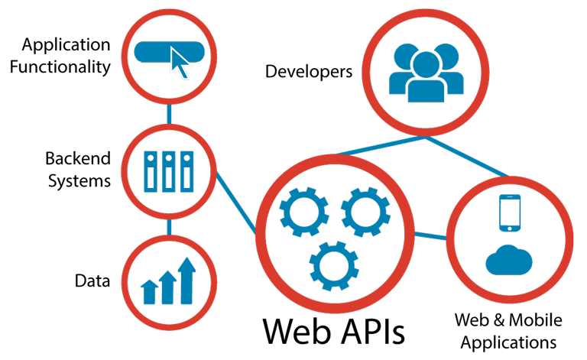
Web APIs
Programmatic interface exposed via the web
Uses open standards typically with request-response messaging.
E.g messages in JSON or XML
HTTP as transport
URIs
Example would be Restful web service described in previous lectures.
Typical use:
Expose application functionality via the web
Machine to machine communication
Distributed systems

Slide 7



Web APIs
There’s APIs available to do pretty much anything:
XAAS, stripe, AWS services, Stripe, Facebook, Twitter
Can be further abstracted using SDKs for developers
You’ve been using the AWS sdk in your labs, both on server and client side.
This has led to a very broad and large set of capabilities.
APIs have moved on from being an “add on” to the central product
E.g. Stripe, Pubnub, Salesforce.

Slide 8

“API First” approach
Collaboratively design, mockup, implement and document an API before the application or other channels that will use it even exist.
Uses “clean-room” approach.
the API is designed with little consideration for the existing IT estate.
the API is designed as though there are no constraints.

Slide 9
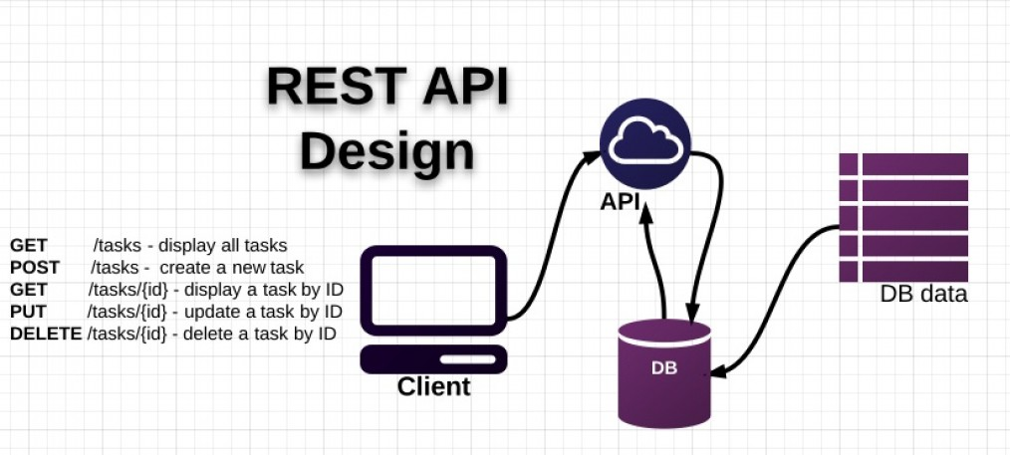
Traditional API Design
API design happens after the release of some a data-rich application
Existing application “wrapped” in API
Created as an afterthought.
Tightly bound application needs data/function exposed as API.
Shoe-horned in as a separate entity.

Slide 10
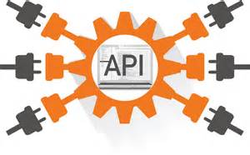
Advantages of API First
Suits multi-device environment of today.
An API layer can serve multiple channels/devices.
Mobile/tablet/IoT device
Scalable, modular, cohesive and composeable
If designed properly(e.g. microservice architecture)
See later slides
Concentrate on function first rather than data

Slide 11
API Design
Use
Use principle of developer-first
put target developers’ interests ahead of other considerations
Strive for a better developer experience
Commit
Commit to RESTful APIs
Use
Use a Interface Description Language like:
RESTful API Markup Language (RAML)
Swagger
Take
Take a grammatical approach to the functionality
Keep
Keep interface simple and intuitive

Slide 12
API Design
In Rest, everything is based around resources
the “things” you’re working with are modelled as resources described by URI paths--like /users, /groups, /dogs
Notice they are nouns .
Verbs in URLs are BAD
The things that you do on these things (or nouns) are characterised by the fixed set of HTTP methods
What GET,POST,PUT does is something that the designer/developer gets to put into the model.
The metadata (the adjectives) is usually encoded in HTTP headers, although sometimes in the payload.
The responses are the pre-established HTTP status codes and body. (200, 404, 500 etc.)
The representations of the resource are found inside the body of the request and response

Slide 13
API Design using Swagger
Swagger provides a specification for creating RESTful API documentation formatted in JSON or YAML.
Similar to Web Service Description Language (WSDL)
YAML: YAML Ain't Markup Language
YAML is a human friendly data serialization standard for all programming languages.
Generates API documentation automatically.

Slide 14
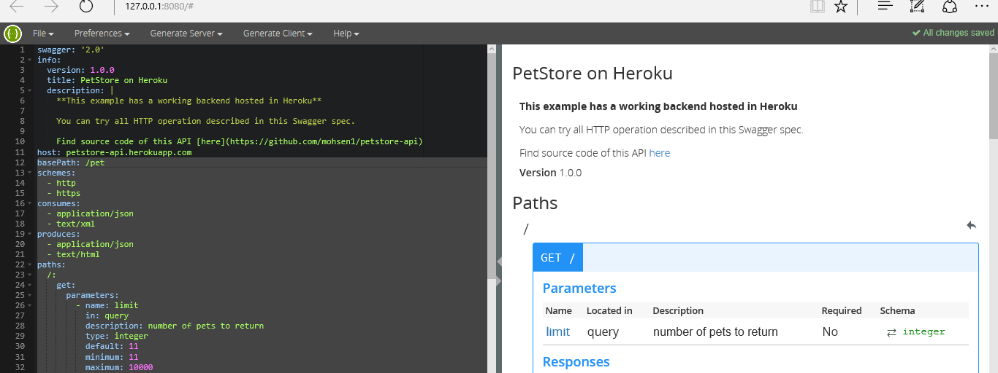
Swagger example in class

Slide 15

Documentation
Standards are not set
Ad hoc approach to specification
Manually manages sometimes
What if API changes?
Sometimes not up to date

Slide 16
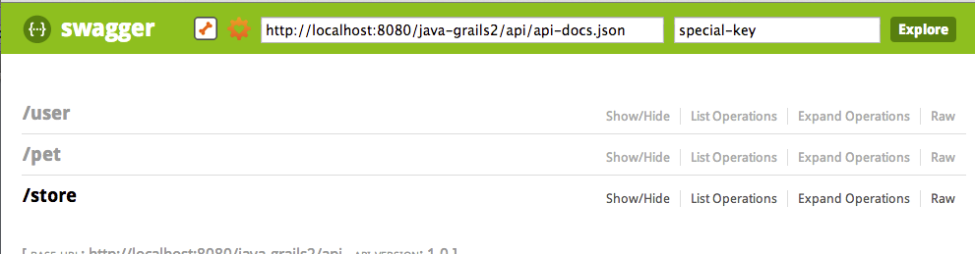
API Listing

Slide 17
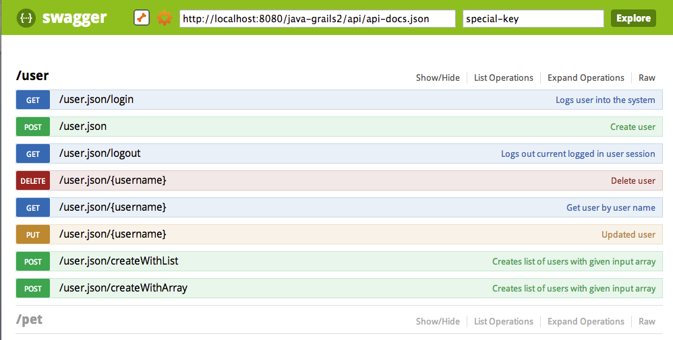
API OPeration

Slide 18
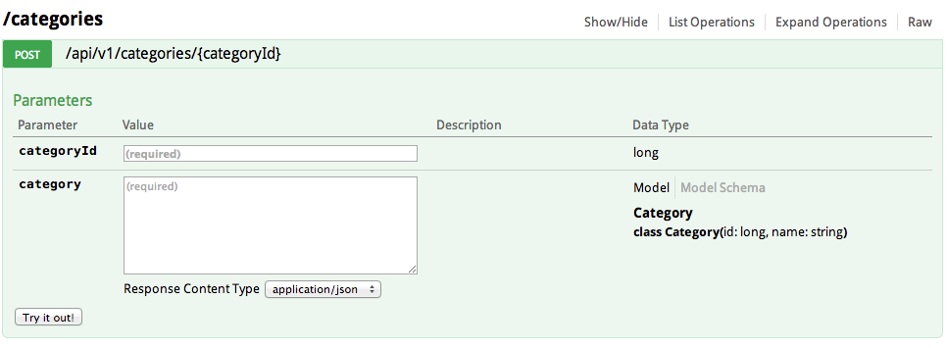
API Parameters and return types

Slide 19
Swagger Provides…
APIs
Producing
Consuming
visualising
APIs
Documenting
Maintaining
Describing
Technology for…
Methodology for…

