Slide 1
MapReduce Based SVD
毕业设计
自02 冯喜伟

Slide 2






背景
Web Portals
Specially-designed website which presents information from diverse sources in a uniform way
Search Engine
Software system designed to search for information on the World Wide Web.
Information Overload!

Slide 3










实际应用
Music
Video
e-Business
SNS

Slide 4
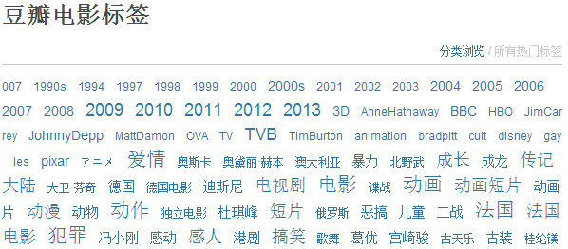
Content-Based Method
主流算法

Slide 5





Collaborate Filtering
主流算法
 | A | B | C | D | E

Slide 6
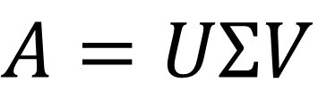
Model Based Method
主流算法
SVD
$$A=UΣV$$
 | 搞笑 | 恐怖
User1 | 1 | 0.1
User2 | 0.2 | 1
 | A | B | C
User1 | 5 | 3 | ?
User2 | 2 | 4 | 5
 | 搞笑 | 恐怖
A | 5 | 0
B | 3 | 3
C | 0 | 5

Slide 7

问题与挑战
With billions of items and millions of users, there will be very serious scalability problem.
On an online retail website, there may be billions of items. However, each user may only cover a very small amount.

Slide 8


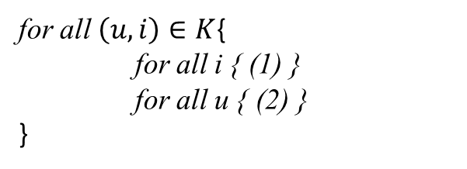
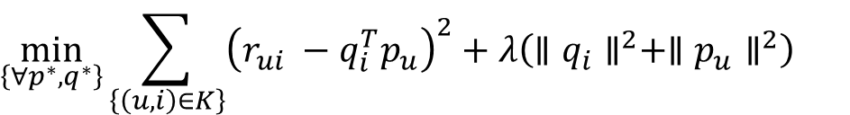


SVD数学表述
$$R=PQ$$
for all $\left(u,i\right)∈K${
(1)
(2)
}
$$\min_{\left\{∀p^{∗},q^{∗}\right\}}{\sum_{\left\{\left(u,i\right)∈K\right\}}{{\left(r_{ui} −q_{i}^{T}p_{u}\right)}^{2}+λ\left(∥q_{i}∥^{2}+∥p_{u}∥^{2}\right)}}$$
$$p_{u}^{t+1}=\left(1 −2λσ^{t}\right)p_{u}^{t}+2\left(r_{ij} −q_{i}^{t}p_{u}^{t}\right)q_{i}^{t} (1)$$
for all $\left(u,i\right)∈K${
for all i { (1) }
for all u { (2) }
}
$$q_{i}^{t+1}=\left(1 −2λσ^{t}\right)q_{i}^{t}＋2\left(r_{ij} −q_{i}^{t}p_{u}^{t}\right)p_{u}^{t} (2)$$

Slide 9
时间表
3月中旬到4月中旬，完成算法设计和离线测试
4月中旬到5月中旬，使用来自企业的数据完成算法的在线测试和分析，并将成果移植到GPU
5月中旬到六月中旬，总结成果，提出进一步改进方案，撰写论文

Slide 10
Thank you!
毕业设计

