Slide 1
⚡
SyncFlow Automator
Zero-friction folder generation & context-aware renaming
for multi-character video post-production pipelines
Python · Tkinter
Windows + macOS
Zero dependencies
Product Overview & Improvement Roadmap | v1.1.0

Slide 2
THE PROBLEM
Manual folder work costs hours — and invites errors
🗂 Deeply nested trees
⏱ Dozens of man-hours
Every character × every scene needs 5 format folders. One reel can mean hundreds of folders built by hand.
Repetitive setup and delivery prep drains editor time that should go to the actual cut.
⚠ Naming mistakes ship
🔁 No standard, no memory
Hand-typed export names drift from convention — wrong shot, wrong suffix, broken sync downstream.
Each editor does it slightly differently; nothing enforces the pipeline's structure.
SyncFlow Automator
02

Slide 3
THE SOLUTION
One lightweight desktop app, three jobs
A
B
C
Instant Folder Trees
Context-Aware Rename
Integrated Quick Search
Deploy a full character → scene → format structure in one click.
Renames the selected file to spec by reading its own folder path.
Jump into any deeply-nested folder as you type — no digging.
Native tkinter only — no pip installs, no background hooks, near-zero latency on remote cloud workstations.
SyncFlow Automator
03

Slide 4
FEATURE A
Directory Tree Generator — 3 modes
Mode A All Structure
Generated by Mode C
Full macro ecosystem: Projects / Media / Exports and every delivery folder.
Character Exports/
└─ bubu/
└─ Scene_01/
├─ MP4/
├─ Quicktime/
├─ SyncSO/
├─ Lipdub/
└─ Audio/
└─ Scene_02/ …
└─ meow/ …
Mode B Exports Only
Just the delivery dirs — Raw, Source, Test, Master Timeline, Character Exports.
Mode C Character Exports
The core engine: loops characters × scenes and builds 5 format folders in each.
SyncFlow Automator
04

Slide 5
FEATURE B
Context-Aware Renaming Matrix
Select a file → click Rename → type the shot number. The app reads the folder path and builds the spec name automatically.
Format Folder
Suffix
Extension
Filename Output
MP4
—
.mp4
Show_Reel_Scene_Char_Shot_01.mp4
Quicktime
—
.mov
Show_Reel_Scene_Char_Shot_01.mov
Audio
_Audio
kept*
Show_Reel_Scene_Char_Shot_01_Audio.wav
SyncSO
_Sync_so
kept*
Show_Reel_Scene_Char_Shot_01_Sync_so.mp4
Lipdub
_Lipdub
kept*
Show_Reel_Scene_Char_Shot_01_Lipdub.mov
* v1.1 fix: the file's real extension is preserved — renaming never fakes a codec (a .wav stays .wav).
SyncFlow Automator
05

Slide 6
FEATURE C
Integrated Quick Search
Type-to-filter — Live, recursive filter across the whole project tree.
bubu Scene 1
Multi-word match — “bubu Scene 1” isolates exactly that path matrix.
…/Character Exports/bubu/Scene_01
…/Character Exports/bubu/Scene_01/MP4
Double-click to open — Jump straight into the folder in Explorer / Finder.
…/Character Exports/bubu/Scene_01/Audio
…/Character Exports/bubu/Scene_01/SyncSO
v1.1: instant — Tree is cached & filtered in memory — no re-walk per keystroke.
SyncFlow Automator
06

Slide 7
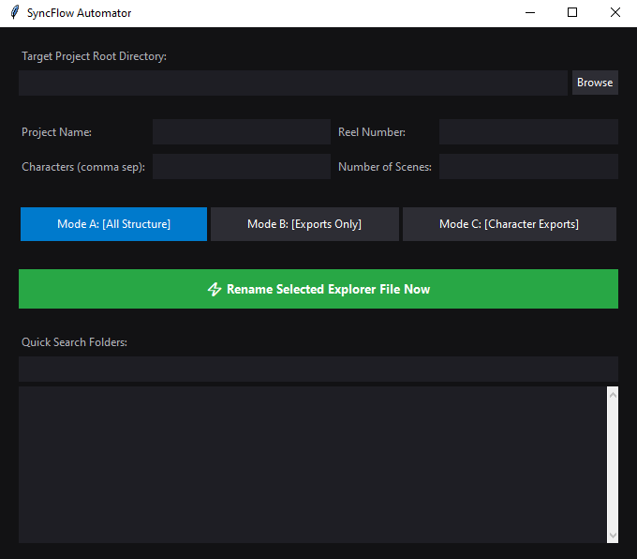
INTERFACE
Main configuration workspace
Target directory + Browse — Point it at any project root.
Project / Reel / Characters / Scenes — The four inputs that drive generation.
Mode A · B · C buttons — One click each — colour-coded by scope.
⚡ Rename Selected File — The green context-rename trigger.
Quick Search + results — Filter and open any nested folder.
SyncFlow Automator
07

Slide 8
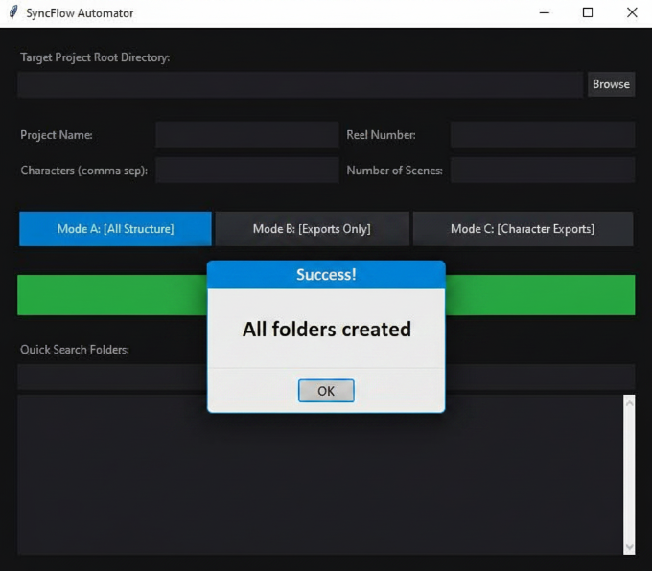
INTERFACE
The context rename overlay
Detected context, zero typing
1. You highlight an export file in Explorer / Finder.
2. App reads the path — Show, Reel, Scene, Character, Format.
3. A centered overlay shows what it detected.
4. You type only the shot number and hit Enter.
5. File is renamed to the exact delivery spec.
No global keyboard hooks → no system lag.
SyncFlow Automator
08

Slide 9
UNDER THE HOOD
How the rename engine thinks
1. Capture
2. Anchor
3. Parse
4. Build
Read selected path (CF_HDROP on Win, AppleScript on Mac)
→
Find 'Character Exports' in the path case-insensitively
→
Walk up for Reel & Show; down for Char, Scene, Format
→
Compose spec name, preserve real ext, zero-pad shot
Pure-logic core is unit-tested — parse_context_from_path() and build_new_name() run headless with no GUI.
10/10 tests pass — see test_syncflow.py
SyncFlow Automator
09

Slide 10
IMPACT
Why it matters to the team
100s → 1
~0
2 OS
0
folders per reel, in a single click
pip dependencies to install & maintain
Windows 10/11 + native macOS
naming mistakes when the path drives the name
“Managing highly nested, repetitive folder structures is prone to human error and consumes dozens of man-hours.”
SyncFlow Automator removes both — the structure and the naming become one-click, standardised, and repeatable.
SyncFlow Automator
10

Slide 11
IMPROVEMENTS
What's new in v1.1 — safer & faster
✓ Extension safety
✓ Reliable capture
Rename now preserves the real file extension — a .wav no longer becomes a mislabeled .mp3.
Reads a file already on the clipboard first, then falls back to synthetic Ctrl+C — fixes wrong-window copies.
✓ Non-blocking search
✓ One-step Undo
Tree is walked once on a background thread & filtered in memory; debounced keystrokes = no UI freeze.
Instantly revert the last rename if a shot number was wrong.
✓ Settings persistence
✓ Safety + tests
Last path / project / reel / characters are remembered between sessions.
Large-deployment confirm prompt, overwrite guard, and a headless test suite (10/10 passing).
SyncFlow Automator
11

Slide 12
ROADMAP
Where it goes next
Now — shipped v1.1
Next — high value
Later — nice to have
Extension-safe renaming
Batch rename a whole folder
Drag-and-drop onto window
Threaded quick search
Dry-run preview before apply
Rename history / audit log
Undo + settings memory
Config file for formats/suffixes
Project presets per show
Headless test suite
Custom naming templates
Optional CLI mode
SyncFlow Automator
12

Slide 13
SHIP IT
Build & deploy — cross-platform
🪟 Windows (.exe)
macOS (.app / .dmg)
pip install pyinstaller
pyinstaller --noconsole --onefile \
--name="SyncFlow_Automator" main.py
→ dist/SyncFlow_Automator.exe
pyinstaller --noconsole --onefile \
--name="SyncFlow_Automator" main.py
hdiutil create -format UDZO \
-srcfolder dist/SyncFlow_Automator.app \
dist/SyncFlow_Automator.dmg
Quick handover on Mac: no build needed — python main.py runs it straight from source (stdlib only).
SyncFlow Automator
13

Slide 14
⚡
Standardise the setup.
Ship the cut faster.
One click builds the tree · one click names the file · one search finds anything.
Try: python main.py
Tests: python test_syncflow.py
SyncFlow Automator v1.1.0 · Thank you

