Slide 1
Where Do We Meet?
Coursera Capstone Project

Slide 2
Where Do We Meet?
The Problem
Meeting in a common place is essential but the decision depends on a few things; - How far are the groups (3 km, 15 miles etc.), - How is the transportation (by car, by public transportation etc.), - Do groups have special needs/preferences in a meeting place (children, restaurant, disabled people etc.), - Is there an appropriate place in between, within the transportation?
We answer each of these questions, and that takes time.
We will decrease this time.

Slide 3
Where Do We Meet?
The Audience
We chose an extraordinary group: Refugees and Asylum Seekers in Netherlands.
They do need to meet with other people, but the decision time can be unexpectedly long because of lack of general information about the country and the vicinity.
The Problem revisited:
We will decrease the search time of AZC guests in Netherlands for finding meeting and entertaining places with friends.

Slide 4
Where Do We Meet?
Data
The main source of data is foursquare.com (fs)
The AZC location data is gathered from official AZC management site.

Slide 5
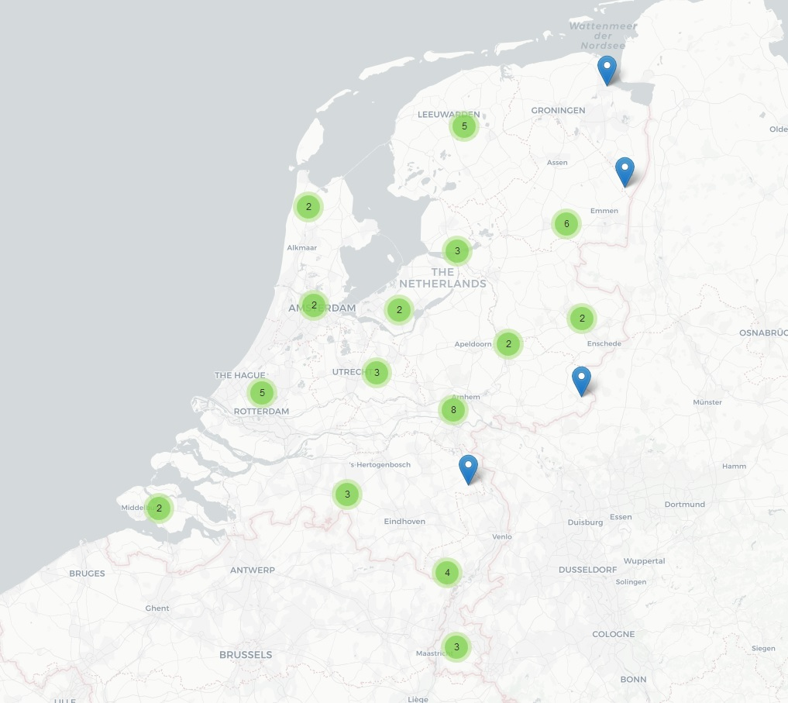
Where Do We Meet?
Methodology
The site was downloaded, and scrubbed for the location information of AZC’s.
When we plot it on the map we see that the AZC’s are dispersed all around the Netherlands.
We choose 2 of these AZC’s to go through an example.

Slide 6
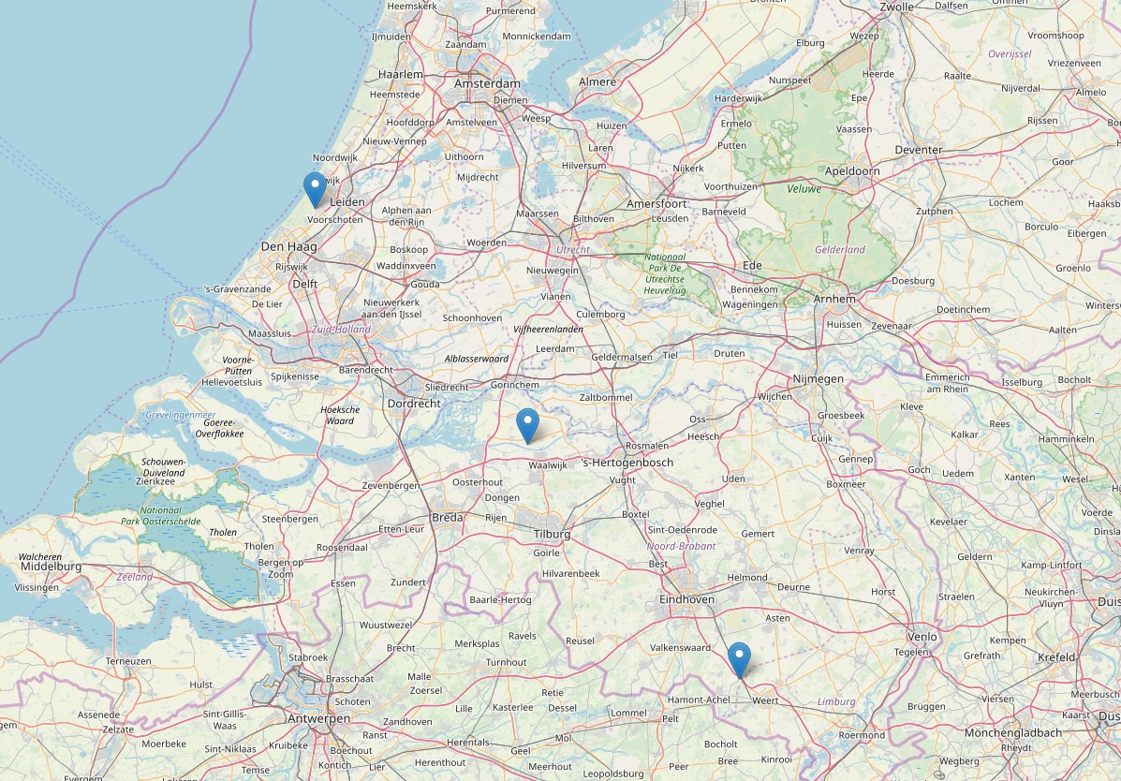
Where Do We Meet?
Methodology
The chosen 2 AZC’s are happen to be at northwest and southeast of the country.
It makes sense to find a middle point to meet in the vicinity.
After finding the middle point, we look for a train station for ease of transportation.

Slide 7
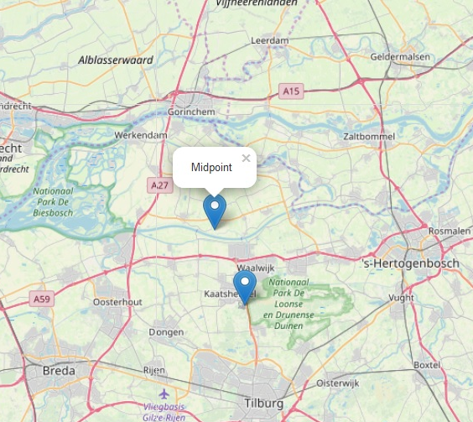
Where Do We Meet?
Methodology
We asked the fs server and found a train station nearby.
This will be our center (middle) point, because both sides will have ease of access.
Now we need to find appropriate places around this station.

Slide 8
Where Do We Meet?
Methodology
…
5 : Theme Park Ride / Attraction - D'Oude Tuffer 6 : Theme Park Ride / Attraction - Halve Maen …
12 : Train Station - Station De Oost 13 : Theme Park Ride / Attraction - Vogel Rok …
25 : History Museum - Efteling Museum 26 : Sandwich Place - Carrousel Paleis 27 : Food Truck - De Eigenheymer …
30 : Café - Wachtruimte 1e Klas …
33 : Salad Place - De Verse Oogst 34 : Theme Park Ride / Attraction - Droomvlucht 35 : Candy Store - De Verleiding …
41 : Snack Place - De Witte Walvis 42 : Theme Park Ride / Attraction - Doornroosje 43 : Playground - IJspaleis 44 : Pizza Place - 't Melkhuysje …
48 : Theater - Raveleijn 49 : Theme Park Ride / Attraction - De Trollenkoning
These are a sample of the places around.
There are various appropriate places for our focus group.
We make a route starting from the station (no.12) which includes places for kids, food and entertainment, and ends up in the station again.

Slide 9
Where Do We Meet?
Results
We also need to know approximate walking distances.
So here’s the route with walking distances :
Train Station - Café - Playground - Pizza Place - History Museum - Food Truck - Train Station
(365 m.) (518 m.) (239 m.) (368 m.) (169 m.) (485 m.)
Which looks ok.

Slide 10
Where Do We Meet?
Discussion
Although we had a nice working example, the analysis and the tool can be used in various ways. For instance :
It can be used by one individual with a child, the ‘midpoint’ can be the new school and the filter word can be ‘playground’ instead of ‘station’.
Another use case can be three people, that agree on the meeting city but cannot agree on the exact place can end up this discussion with agreeing on the random ‘sports bar’ recommandation of the program.
Also, on the business side, the audience expects to see a ‘trending place’ or ‘in sequence’ place which is the place visited after a certain point, in the vicinity of their supermarket chain.

Slide 11
Where Do We Meet?
Conclusion
The problem about shortening the search time to find the appropriate city and places to meet for AZC guests in Netherland has a relative solution with this tool.
It indeed shortens the search time.
Further improvements on the user interface (or an integration to COA app) would generalize the usability of the tool.

Slide 12


Where Do We Meet Next Time ?

Slide 13
Thank you!

