Slide 1
AI Meeting Detective
TalkWeaver
Evidence-Grounded Conversation Maps for Chaotic Multi-Speaker Speech
A research system for overlap, interruptions, misheard domain terms, speaker-time evidence, and correction audits.
Live Demo
Main Demo Clip
Core Framing
https://fyangmie-talkweaver.hf.space
Earnings-22 multi-speaker term correction
Not a generic meeting summarizer; an evidence-auditing framework.
1/10

Slide 2
TalkWeaver
Motivation: Meeting Transcription Is Not Just WER
Speakers, overlap, low-energy speech, domain terms, and LLM edits interact.
A fluent transcript can still hide who spoke, when it was said, and whether a correction is justified.
Chaotic meetings introduce speaker-boundary errors, overlap, interruptions, low-confidence speech, and domain-term misrecognition.
LLM post-processing can make text look cleaner while silently adding unsupported edits.
TalkWeaver treats meeting transcription as an evidence-grounded auditing problem.
FLEURS zh-CN
AISHELL-4
CER 0.113
CER 0.537
read speech, base
meeting speech, base
AMI
Takeaway
WER 0.398
Read speech != meetings
formal meeting, base
evidence is needed
2/10

Slide 3
TalkWeaver
Research Questions and Contributions
From automatic text rewriting to evidence-aware transcript auditing.
RQ1
RQ2
RQ3
RQ4
Can speaker-time structure make transcripts more auditable?
Can overlap-aware uncertainty reduce unsafe correction?
Can RAG glossary retrieval recover domain terms?
What is the local ASR speed/quality trade-off?
Contribution 1: Temporal-anchor ConversationMap for ASR, speaker, time, overlap, retrieved terms, and audit trails.
Contribution 2: Conservative RAG-based term recovery with evidence gates and review routing.
Contribution 3: Safety-centered evaluation that separates real public data, controlled stress tests, demos, and negative results.
3/10

Slide 4
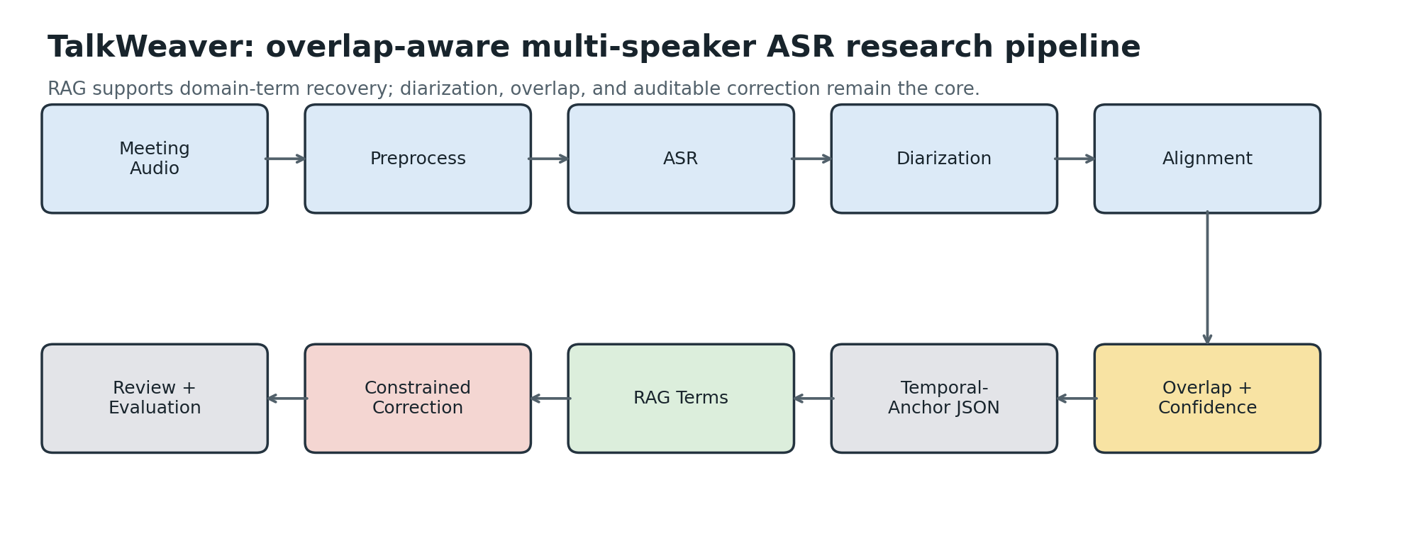
TalkWeaver
System Architecture: From Audio to EvidenceMap
Every stage preserves inputs, outputs, timestamps, and provenance.
Audio preprocessing: standardize sample rate, channels, and volume.
ASR: faster-whisper / whisper.cpp / deterministic mock fallback.
Diarization: pyannote or reference speaker-time evidence.
Overlap and event extraction: flag overlap, interruption candidates, and low-confidence regions.
RAG term rescue: retrieve domain terms, company names, and financial terminology.
Correction audit: preserve raw text, corrected text, evidence terms, and accept/reject/review decisions.
4/10

Slide 5
TalkWeaver
Web MVP: Show Exactly What Changed
The deployed demo makes the correction evidence visible to non-expert users.
Before
Default clip: real Earnings-22 financial-results call with multiple speakers.
Users can play the audio and inspect raw-to-corrected changes.
AMI/AISHELL examples remain available for speaker and overlap evidence.
Good day ... welcome to the CIFI Technologies Financial Results ...
After
Good day ... welcome to the Sify Technologies Financial Results ...
Evidence Terms
https://fyangmie-talkweaver.hf.space
Sify Technologies | non-GAAP | IFRS
5/10

Slide 6
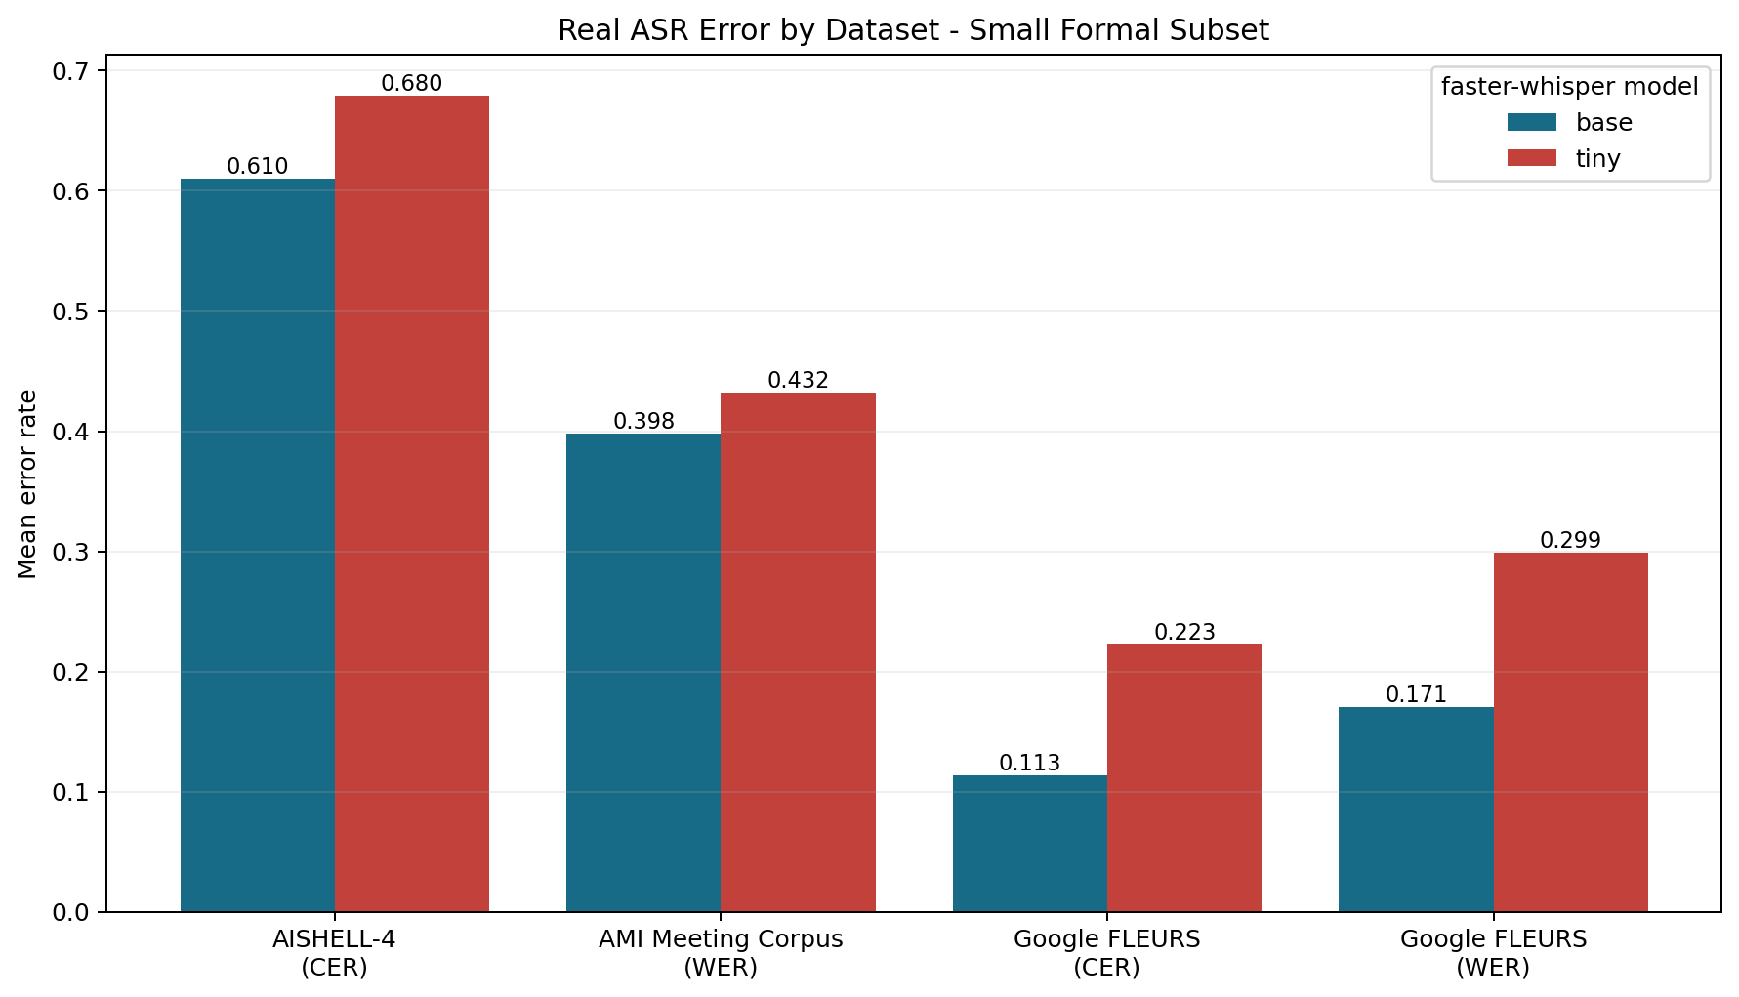
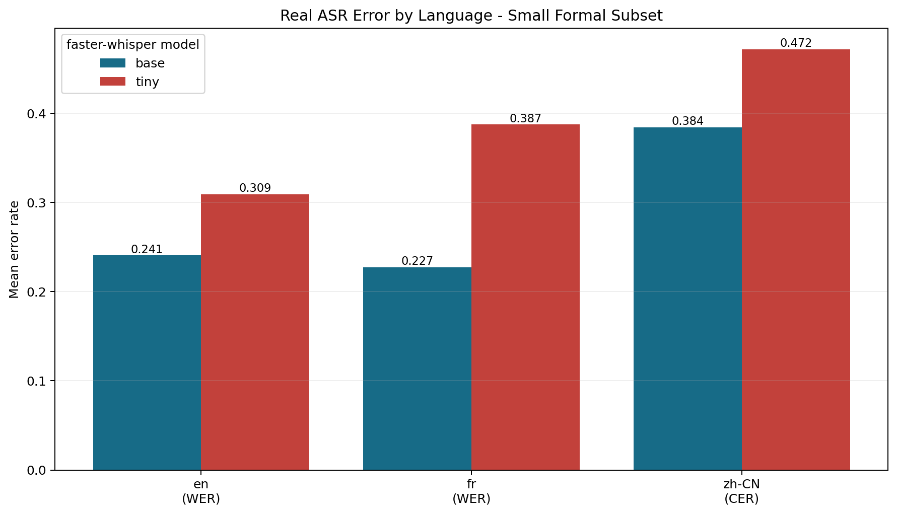
TalkWeaver
Real Public-Data Evaluation
Reported claims come from existing CSVs and docs; controlled tests are not treated as real-world generalization.
FLEURS
AMI
AISHELL-4
Earnings-22
30 clips en/fr/zh-CN read speech multilingual ASR sanity
8 formal + 24 held-out English meetings ASR + diarization + maps
60 × 20s Mandarin meetings ASR + DER/JER
financial calls RAG term correction blind/smoke subsets
6/10

Slide 7
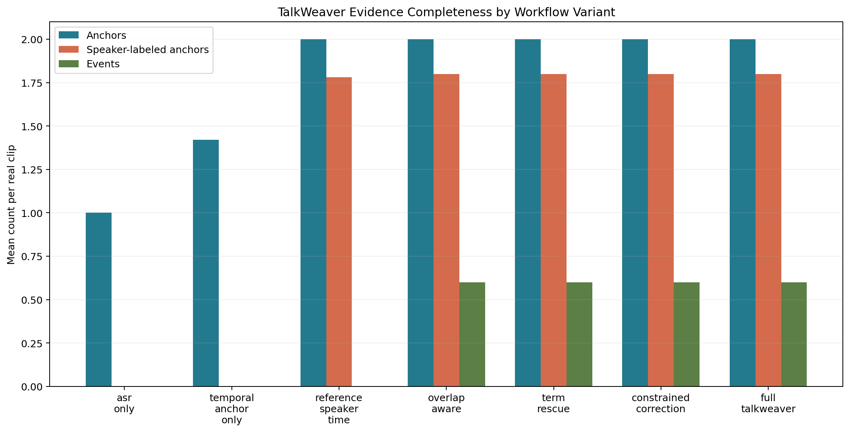
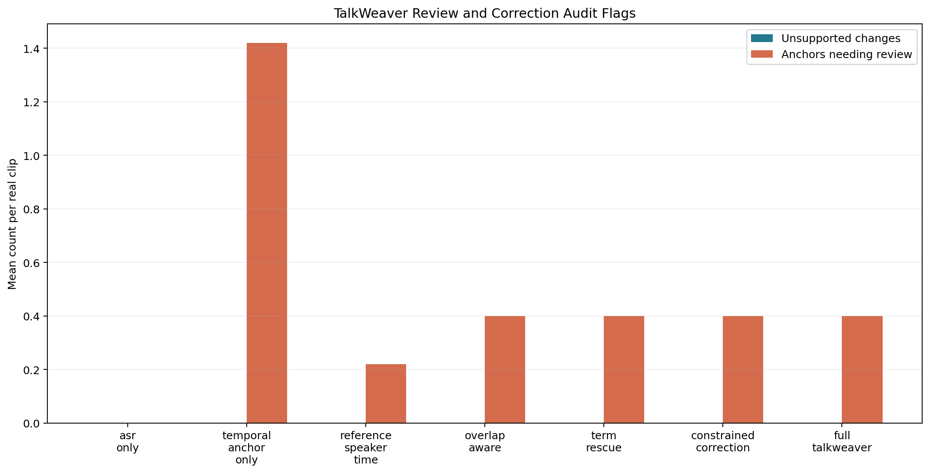
TalkWeaver
Speaker and Overlap Evidence
Diarization is useful, but overlap remains a major source of uncertainty.
AMI held-out
AMI overlap
AISHELL-4
Interruption
DER 0.106
F1 0.490
DER 0.327
10/10
JER 0.307
still difficult
JER 0.713
candidate windows verified
7/10

Slide 8
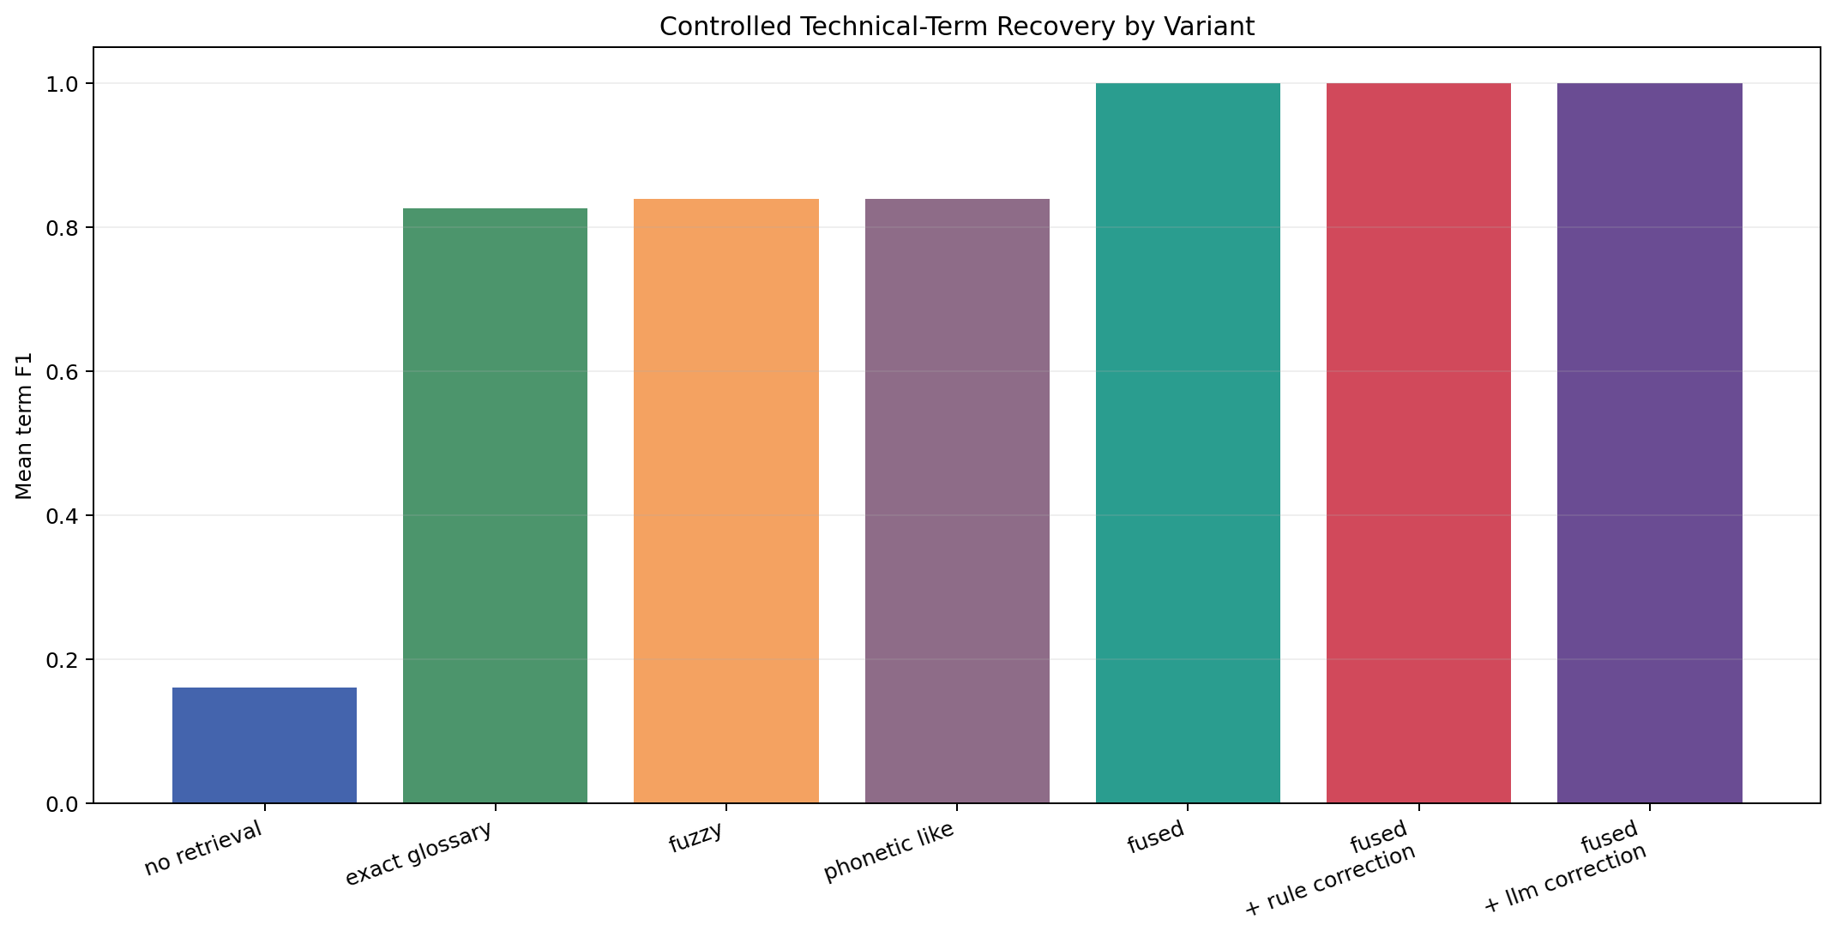
TalkWeaver
RAG Term Recovery: Useful, but Must Be Conservative
The contribution is evidence-backed term rescue, not unrestricted transcript rewriting.
Typical Fixes
Earnings-22 v3
Boundary
CIFI Technologies → Sify Technologies non-gap → non-GAAP IFR → IFRS
base term recall 0.833333 → 1.000000
WER unchanged at 0.212099 not a general ASR improvement
v2 showed that RAG can help weaker ASR but can harm stronger ASR.
v3 adds safety gates: weak evidence is not applied; common words are not blindly mapped to company names.
The web demo uses Earnings-22 to show playable, evidence-backed term correction.
8/10

Slide 9
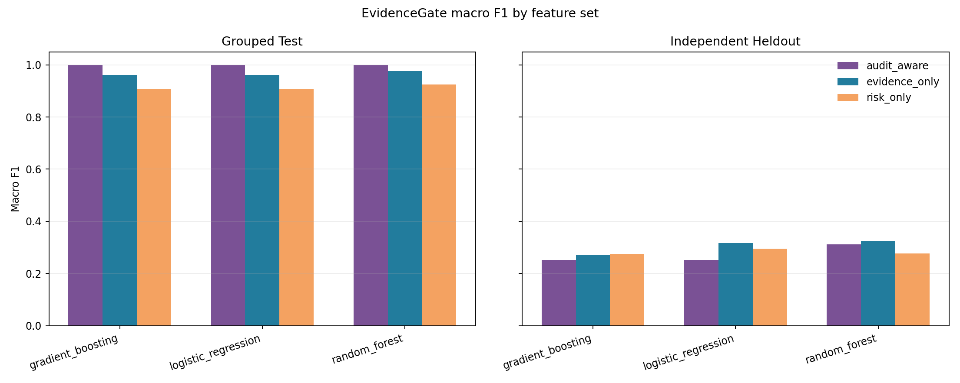
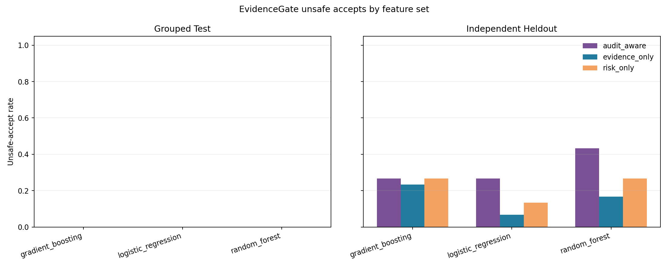
TalkWeaver
Safety Audits and Negative Results
The paper should be honest about what works, what is controlled, and what fails.
EvidenceGate independent held-out macro F1 is only about 0.325: no strong generalization claim.
Controlled overlap safety supports the design, but it is not real meeting performance.
Mobile deployment is not complete; whisper.cpp is a Level 1 local-machine benchmark.
9/10

Slide 10
TalkWeaver
Conclusion and Next Steps
TalkWeaver is about auditability, not state-of-the-art claims.
Strongest Claim
Current Limits
Next Steps
Real meeting and call transcription benefits from an EvidenceMap that links ASR, speakers, overlap, RAG, and audits.
Not SOTA; real subsets are small; RAG mainly supports term recovery; EvidenceGate generalization remains weak.
Larger held-out evaluation, human labels, true mobile benchmark, and paper/video polishing.
Demo: https://fyangmie-talkweaver.hf.space
One-line takeaway: move from trusting fluent transcripts to inspecting evidence.
10/10

