Slide 1
Master Thesis: Alzheimer Prediction
Fraj Yassine Lakhal
Munich, 3. December 2025
Notes:
I have a bold plan for the thesis but I think it is feasible

Slide 2
Motivation

Slide 3
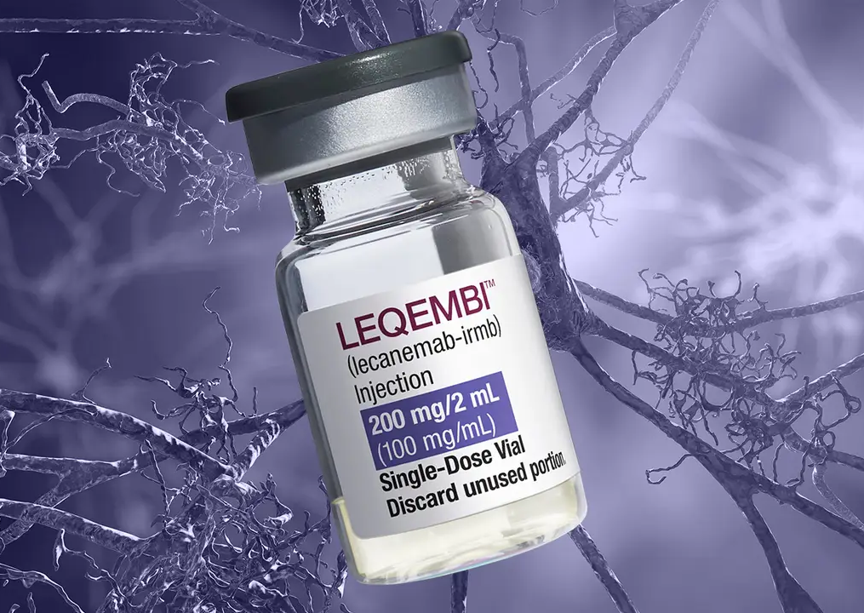
Alzheimer’s Disease Modifying treatment
Lecanemab approved for prescription on 15. April in Germany
Diagnosis is no longer just about memory tests; it now requires biological proof of Alzheimer's via biomarkers.
Approved for Early AD (Mild Cognitive Impairment or Mild Dementia)
It clears amyloid plaques to slow cognitive decline by ~27%. It does not restore lost memory; it preserves what is left.

Slide 4
Current Paradigm
1. Cognitive test: e.g., MOCA or MMSE
If you score below a certain threshold
(e.g., <26/30 on MOCA)
2. Blood test: Plasma p-tau217
radioactive tracer amyloid plaques
Highly suspicious for Alzheimer’s. The patient moves to the "Gold Standard" confirmation required for insurance and treatment approval.
3. Scans
Amyloid PET Scan: radioactive tracer amyloid plaques.
or
CSF Analysis (Lumbar Puncture): Spinal fluid is drawn to measure the ratio of amyloid/tau proteins.
Notes:
1) If you report memory issues, a Primary Care Physician (PCP) will perform a short cognitive test
2) How it works: It detects phosphorylated tau protein in the blood, which correlates 90-95% with amyloid plaque buildup in the brain.

Slide 5
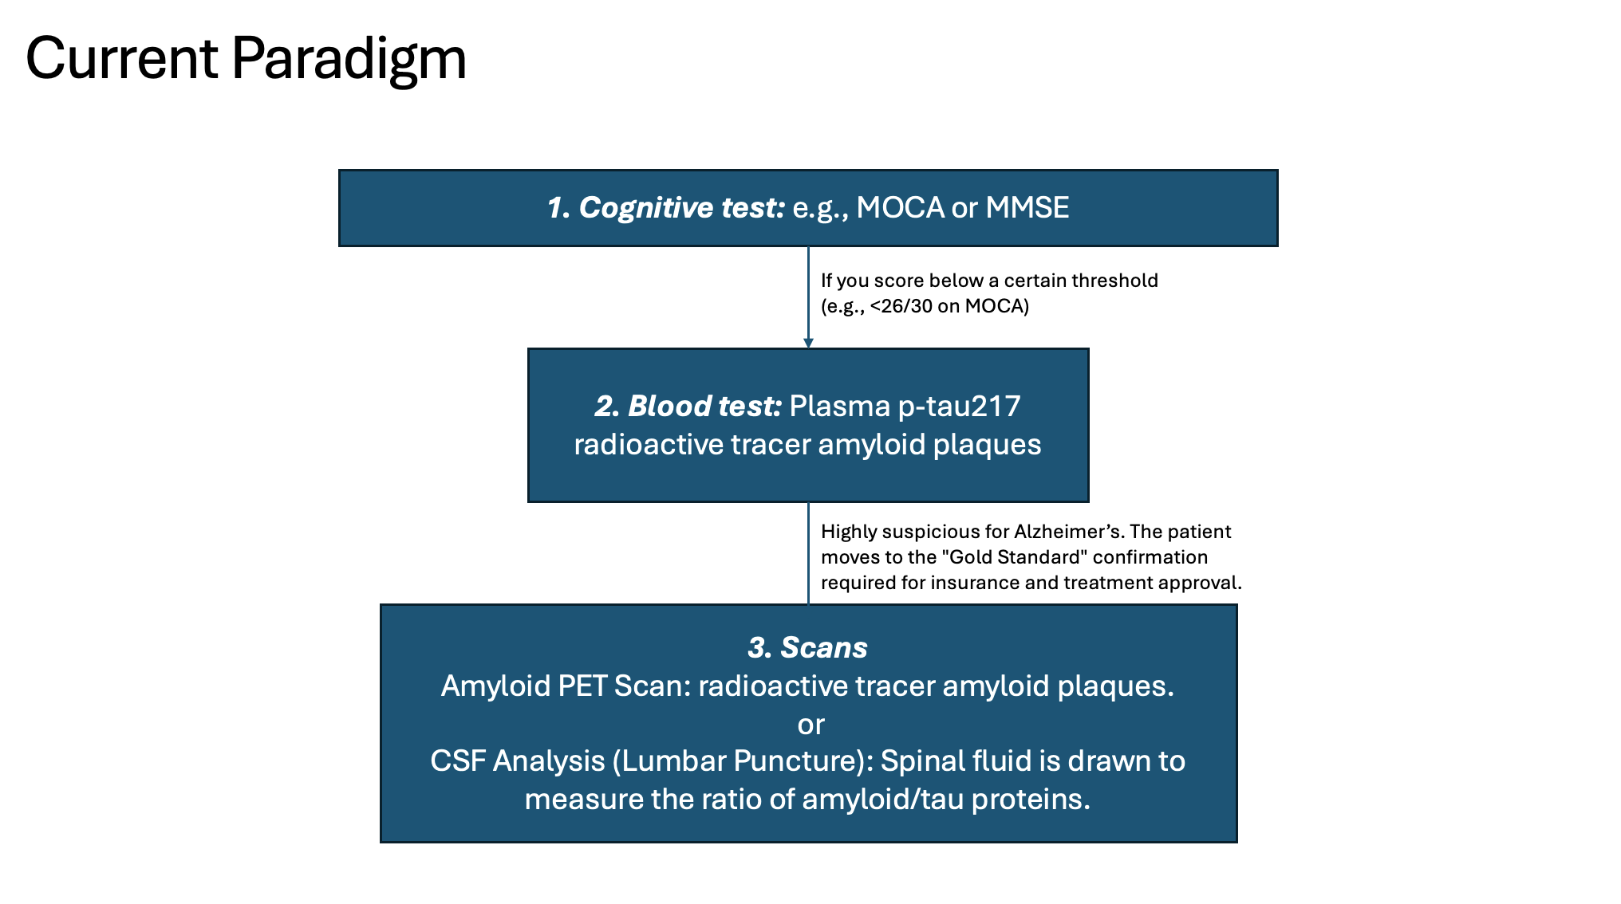
Several Issues: 1. Functional "Collapse" Precedes Structural Atrophy 2. Burdensome for elderly patients.

Slide 6
Several Issues: 1. Functional "Collapse" Precedes Structural Atrophy 2. Burdensome for elderly patients. Can we identify functionally vulnerable patients early on?

Slide 7
Why resting-state fMRI?
A. Detecting "Synaptic Failure" Before "Cell Death”
rs-fMRI detects functional connectivity breakdown. Often, synapses usually fail before neurons die.
B. Safety (Radiation)
Amyloid PET scans expose patients to radiation (~3–7 mSv, equivalent/more to a year of natural background radiation).
C. Scalability
. PET: $2,300 to over $9,5001 + Rare in rural areas (radioactive tracers' availability)
rs-fMRI: <$8003 has zero radiation.
1 https://www.carecredit.com/well-u/health-wellness/pet-scan-cost/#:~:text=Depending%20on%20the%20specific%20type%20of%20procedure,range%20between%20$1711%20and%20$12848.%20Learn%20more.
2 Young P, Heeman F, Axelsson J, Collij LE, Hitzel A, Sanaat A, Niñerola-Baizan A, Perissinotti A, Lubberink M, Frisoni GB, Zaidi H, Barkhof F, Farrar G, Baker S, Gispert JD, Garibotto V, Rieckmann A, Schöll M; AMYPAD
consortium. Impact of simulated reduced injected dose on the assessment of amyloid PET scans. Eur J Nucl Med Mol Imaging. 2024 Feb;51(3):734-748. doi: 10.1007/s00259-023-06481-0. Epub 2023 Oct 28.
PMID: 37897616; PMCID: PMC10796642.
3 https://www.mdsave.com/procedures/functional-mri-fmri/d584f5cc
Notes:
A. Deep Learning’s Role: A human radiologist cannot "see" functional connectivity in raw data. A DL model (e.g., a Graph Neural Network or 4D-CNN) can identify non-linear disruptions in the Default Mode Network (DMN)—specifically the uncoupling between the Posterior Cingulate Cortex (PCC) and the hippocampus—often years before atrophy is visible on T1 scans.

Slide 8
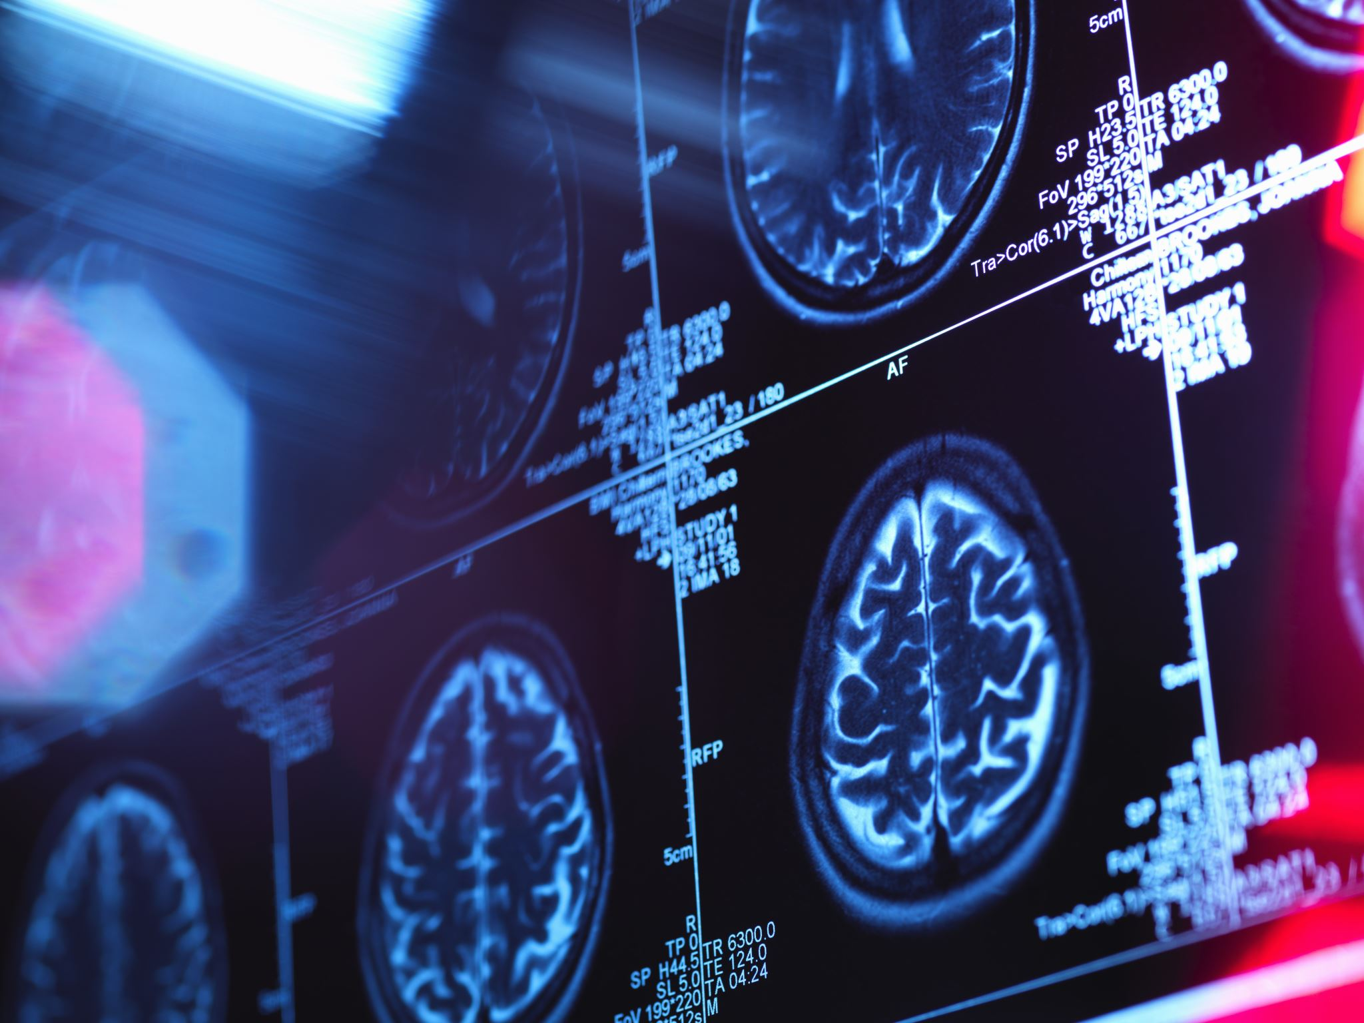
Why combine with deep learning?
A human radiologist cannot "see" functional connectivity in raw data.
A DL model (e.g., a Graph Neural Network) can identify non-linear disruptions in the Default Mode Network (DMN), often years before atrophy is visible on T1 scans1.
1 Xue, C., Yuan, B., Yue, Y., Xu, J., Wang, S., Wu, M., Ji, N., Zhou, X., Zhao, Y., Rao, J., Yang, W., Xiao, C., & Chen, J. (2019). Distinct Disruptive Patterns of Default Mode Subnetwork Connectivity Across the Spectrum of Preclinical Alzheimer’s Disease. Frontiers in Aging Neuroscience, 11. https://doi.org/10.3389/fnagi.2019.00307
Notes:
DMN stands for active regions when a person is not focused on the outside world

Slide 9
SoTA

Slide 10
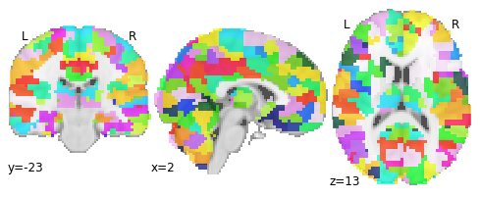
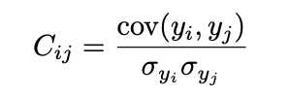
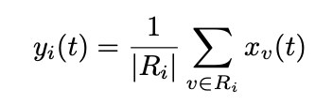

Usual Workflow for fMRI Preprocessing
1. ATLAS Parcellation
e.g. Harvard Oxford
2. Compute mean at time t
3. Pearson Correlation
Notes:
We end up with a symmetric N×N matrix where N is the number of ROIs

Slide 11
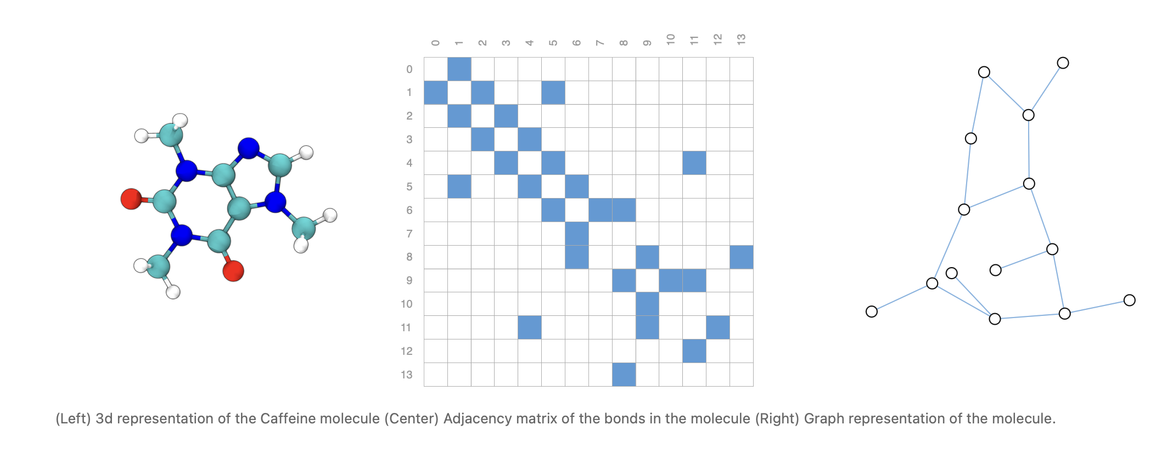
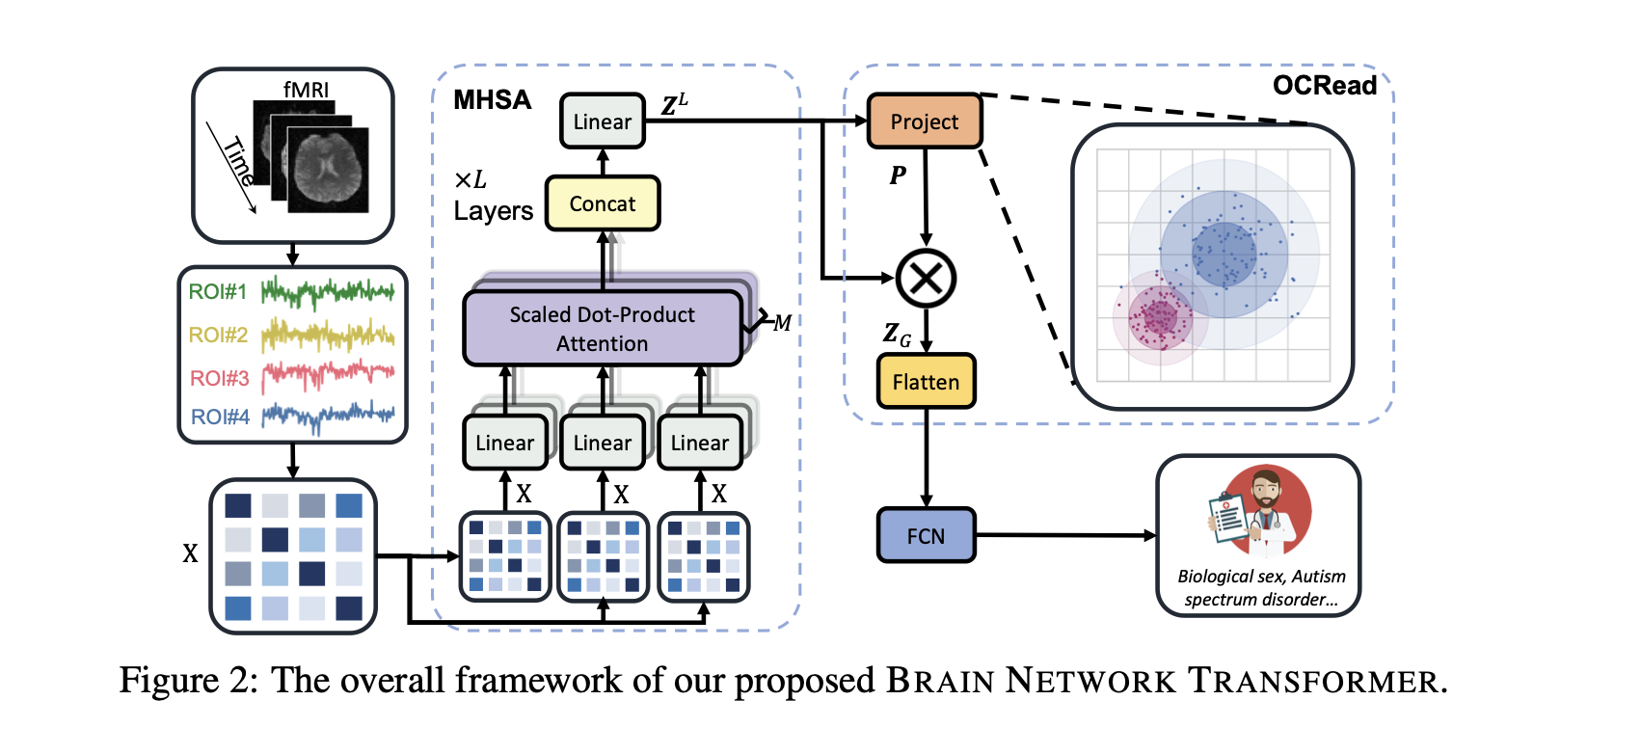
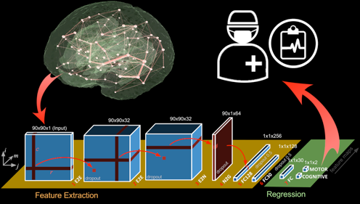
DL Frameworks (Related Work)
Graph Neural Networks
(e.g. GAAE)
Transformers
CNNs
Notes:
I can send you a list of the related work

Slide 12
Proposal

Slide 13
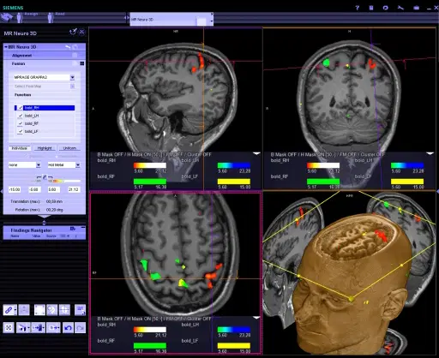
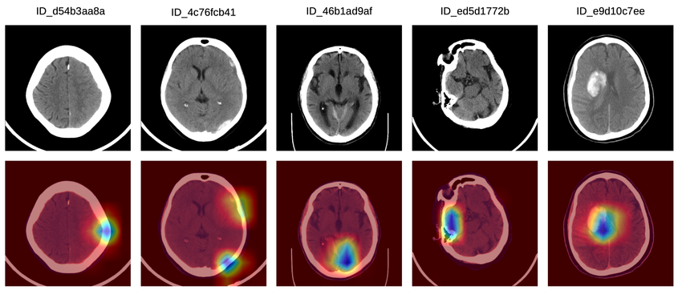
My Proposal
A platform for diagnosis: from 4D fMRI Scans to xAI Diagnosis
Code free
Visualization (e.g. gradCAM) +
Detailed Diagnosis (e.g. clinical LLM)
Burduja, Mihail & Ionescu, Radu Tudor & Verga, Nicolae. (2020). Accurate and Efficient Intracranial Hemorrhage Detection and Subtype Classification in 3D CT Scans with Convolutional and Long Short-Term Memory Neural Networks. Sensors. 20. 10.3390/s20195611.
Notes:
As I don’t want my work to end up on a shelf, I want to propose a tool
Stephan mentioned that this could very interesting in

Slide 14
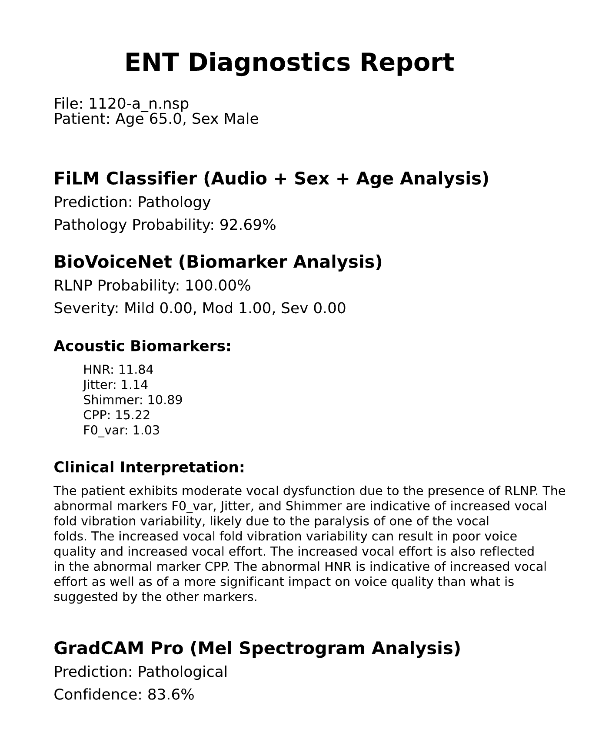
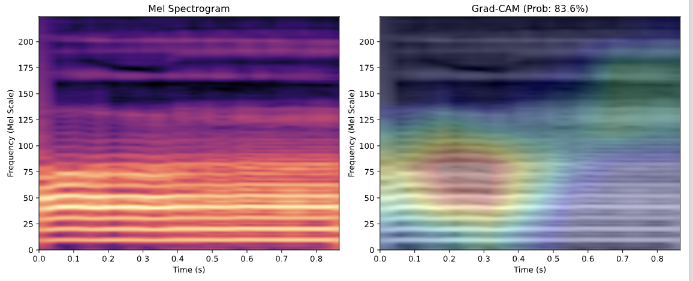
Inspiration (Project Week Applied Surgineering)
Deliverable:
PDF File for the ENT Doctor
(what the doctor sees in the report)

Slide 15
FOUR Parts for my Proposal 1. Explore other Parcellation Techniques 2. Improve Model + Explore SoTA Approaches 3. Explainability 4. Packaging in a UI Friendly Tool

Slide 16
Parcellation
Atlas-based
Going beyond the mean
Principal component extraction: Instead of mean, use first principal component of voxel time series within ROI to capture dominant signal pattern
ROI consistency weighting: Weight connections by ROI consistency to discount spurious links from heterogeneous regions
Homologous-Functional-Regions
Performing group-level functional image analyses based on homologous functional regions mapped in individuals
Deep Learning-Based Parcellation (OpenMAP‐T1)
Modern approaches use neural networks for rapid, accurate parcellation. OpenMAP-T1 integrates several CNN models across six phases: preprocessing, cropping, skull-stripping, parcellation, hemisphere segmentation, and final merging—parcellating the brain into 280 anatomical structures covering gray and white matter within minutes on a standard desktop.

Slide 17
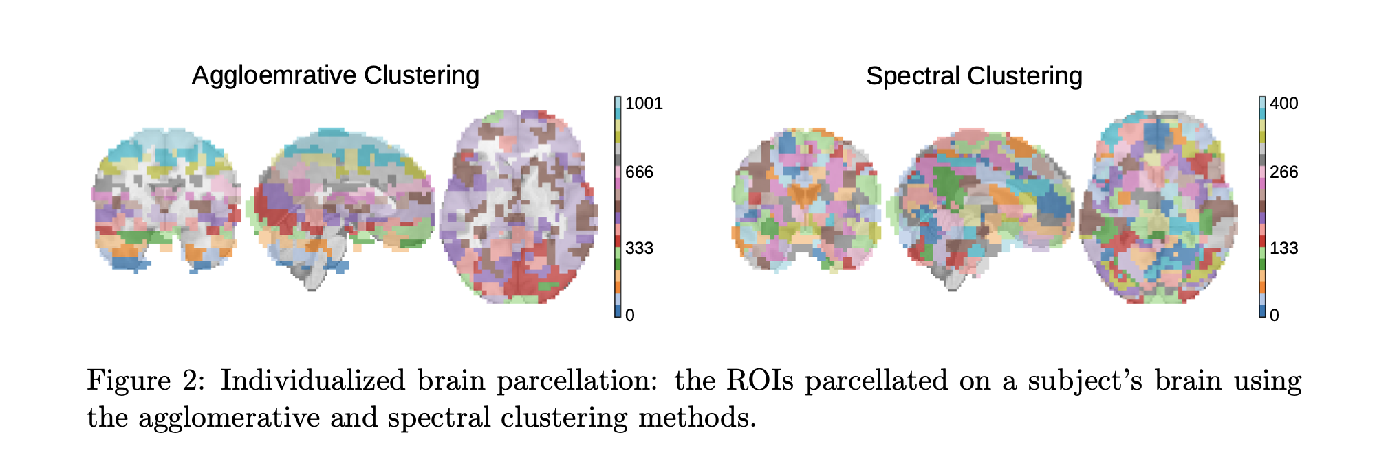
Parcellation
Individualized (Atlas-Free) Parcellation
Step 1:
Spatially-constrained Agglomerative Clustering: Works bottom-up, iteratively merging spatially adjacent voxels with high functional connectivity (Pearson correlation).
Spectral Clustering: Partitions voxels using the eigenspectrum of a similarity graph (the Pearson correlation matrix).
Atlas-free Brain Network Transformer
Notes:
Step 1:
Step 3:
The ROI-to-voxel connectivity vectors are:
Projected to lower dimensions via PCA
Organized into multi-channel brain maps in 3D space
Partitioned into overlapping 3D blocks
Processed through TRANSFORMER architecture (self-attention) to learn standardized representations​

Slide 18
Parcellation
Individualized (Atlas-Free) Parcellation
Step 1:
Spatially-constrained Agglomerative Clustering: Works bottom-up, iteratively merging spatially adjacent voxels with high functional connectivity (Pearson correlation).
Spectral Clustering: Partitions voxels using the eigenspectrum of a similarity graph (the Pearson correlation matrix).
Step 2: ROI-to-Voxel Connectivity
Since each subject's parcellation is unique, direct ROI-to-ROI comparisons across subjects become impossible.
Atlas-free methods solve this by computing connectivity in a standardized voxel-based feature space:​
This produces a high-dimensional feature vector for each ROI that can be compared across subjects
Notes:
Step 1:
Step 3:
The ROI-to-voxel connectivity vectors are:
Projected to lower dimensions via PCA
Organized into multi-channel brain maps in 3D space
Partitioned into overlapping 3D blocks
Processed through TRANSFORMER architecture (self-attention) to learn standardized representations​

Slide 19
Parcellation
Individualized (Atlas-Free) Parcellation
Step 1:
Spatially-constrained Agglomerative Clustering: Works bottom-up, iteratively merging spatially adjacent voxels with high functional connectivity (Pearson correlation).
Spectral Clustering: Partitions voxels using the eigenspectrum of a similarity graph (the Pearson correlation matrix).
Step 2: ROI-to-Voxel Connectivity
Since each subject's parcellation is unique, direct ROI-to-ROI comparisons across subjects become impossible.
Atlas-free methods solve this by computing connectivity in a standardized voxel-based feature space:​
This produces a high-dimensional feature vector for each ROI that can be compared across subjects
Step 3: Dimensionality Reduction and Feature Extraction (PCA + Transformers)
Notes:
Step 1:
Step 3:
The ROI-to-voxel connectivity vectors are:
Projected to lower dimensions via PCA
Organized into multi-channel brain maps in 3D space
Partitioned into overlapping 3D blocks
Processed through TRANSFORMER architecture (self-attention) to learn standardized representations​

Slide 20
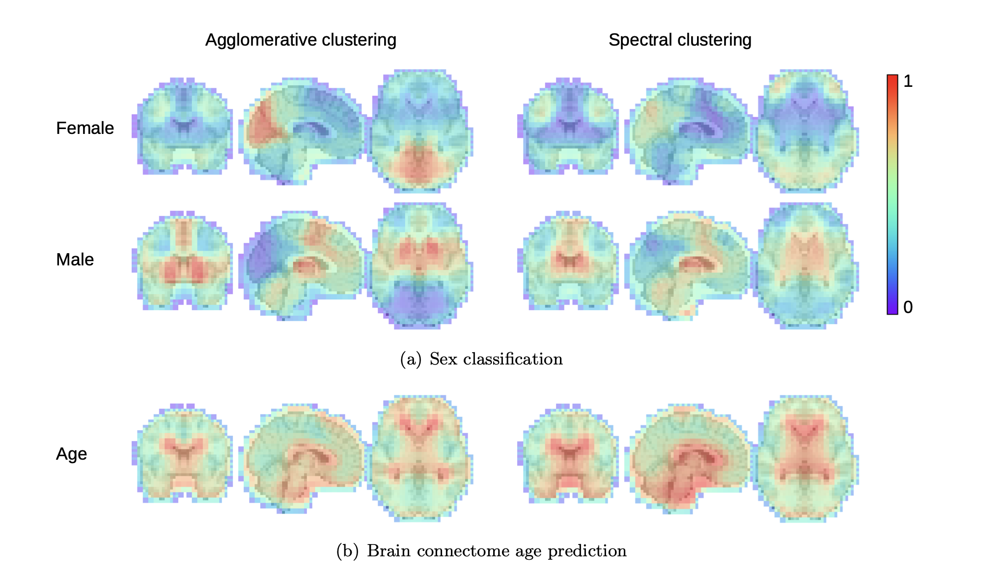
Atlas-free
→ Atlas-free BNT achieves 89.2% accuracy on sex classification compared to 87.9% for the best atlas-based method (BNT with Craddock-400).
For brain age prediction, atlas-free achieves MAE = 4.03 years vs 4.21 years for the best atlas-based approach
Atlas-free Brain Network Transformer

Slide 21
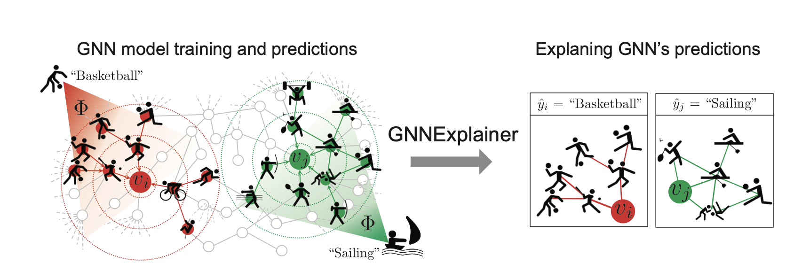
Diagnosis xAI
Extend GAAE
GNNExplainer: Generating Explanations for Graph Neural Networks
Notes:
Since we want to keep GNNs
GNNExplainer explains a prediction of a trained GNN by learning:
an edge mask (important subgraph), and
a feature mask (important feature dimensions), such that, using only the masked graph/features, the model’s output for that target stays almost the same.
--->Then GNNExplainer can tell you:
which neighboring nodes/edges most affect that reconstruction,
which input feature dimensions (of node ii and its neighbors) matter most.

Slide 22
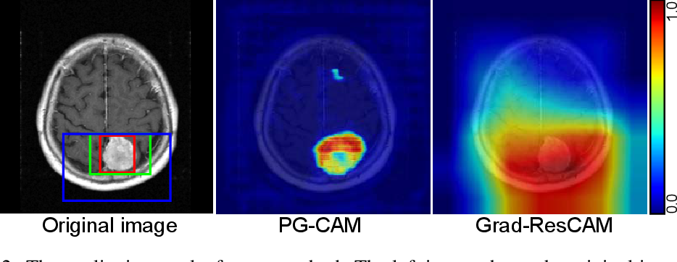
Diagnosis xAI
CNN + RNNs/LSTM + GradCAM
Robust Tumor Localization with Pyramid Grad-CAM

Slide 23
Diagnosis xAI
Transformer (Atlas-free Approach)
Robust Tumor Localization with Pyramid Grad-CAM

Slide 24
Focus: Find what works

Slide 25
Focus: Find what works Finetune

Slide 26
Focus: Find what works Finetune
Explain Results (in medical
Notes:
So I don’t want my focus just to improve the accuracy of a single model

Slide 27
Resting-state fMRI detects alterations in whole brain connectivity related to tumor biology in glioma patients

Slide 28
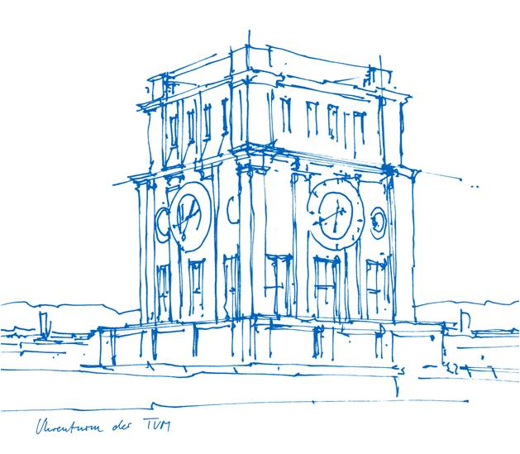
Literature Review & Next Steps
Fraj Yassine Lakhal
TUM School of Computation, Information and Technology
Functional Neuroimaging, LMU
Supervisor: Dr. med. Stephan Wunderlich
Chair for Computer Aided Medical Procedures & Augmented Reality, TUM
Supervisor(s): M.Sc. Chantal Pellegrini, Dr. Shahrooz Faghihroohi
München, 17. Dezember 2025

Slide 29
Outline
Theoretical Framework
Current Approach
Literature Review

Slide 30
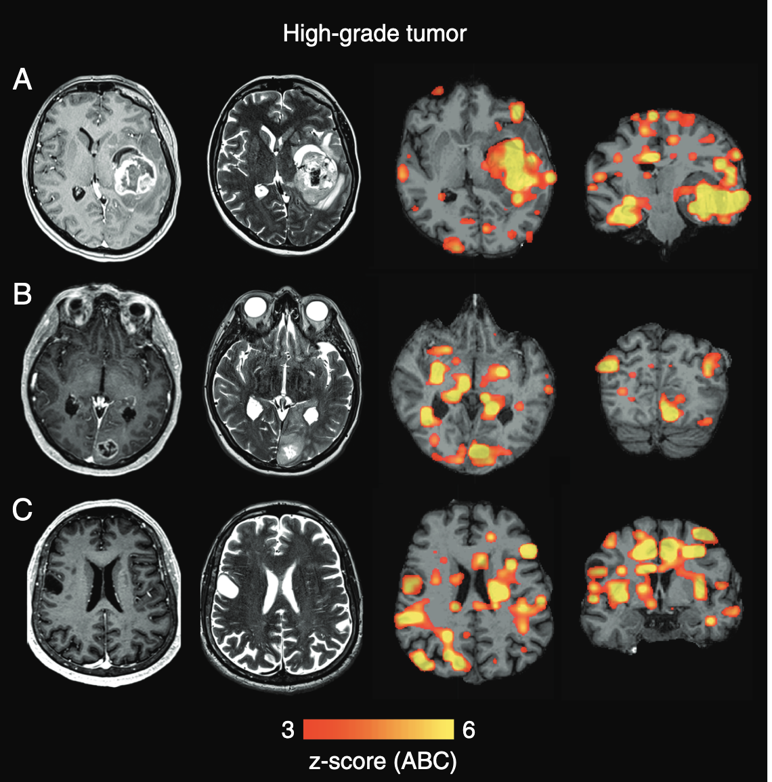
Theoretical Framework: fMRI as a Reliable Method for Brain Pathologies
(Stoecklein et al., 2020)
Find damage beyond the Lesion:
abnormalities in functional connectivity could be detected not only adjacent to the visible lesion but also in distant brain tissue, even in the contralesional hemisphere.
Define imaging markers to quantify disease Aggressiveness:
ABI* showed a close correlation with the aggressiveness of the tumor: correlates with MOCA tests, IDH Mutation Status and WHO Grade (Pathological Severity)
Feasibility:
fMRI sequences can be "tacked onto a clinical routine MRI scan without major modification to the scanning procedure," and the post-analysis can be done automatically
*quantitative imaging marker, quantifies whole-brain functional connectivity damage
(Stoecklein et al., 2020)
Stoecklein VM, Stoecklein S, Galiè F, Ren J, Schmutzer M, Unterrainer M, Albert NL, Kreth FW, Thon N, Liebig T, Ertl-Wagner B, Tonn JC, Liu H. Resting-state fMRI detects alterations in whole brain connectivity related to tumor biology in glioma patients. Neuro Oncol. 2020 Sep 29;22(9):1388-1398. doi: 10.1093/neuonc/noaa044. PMID: 32107555; PMCID: PMC7523460.

Slide 31
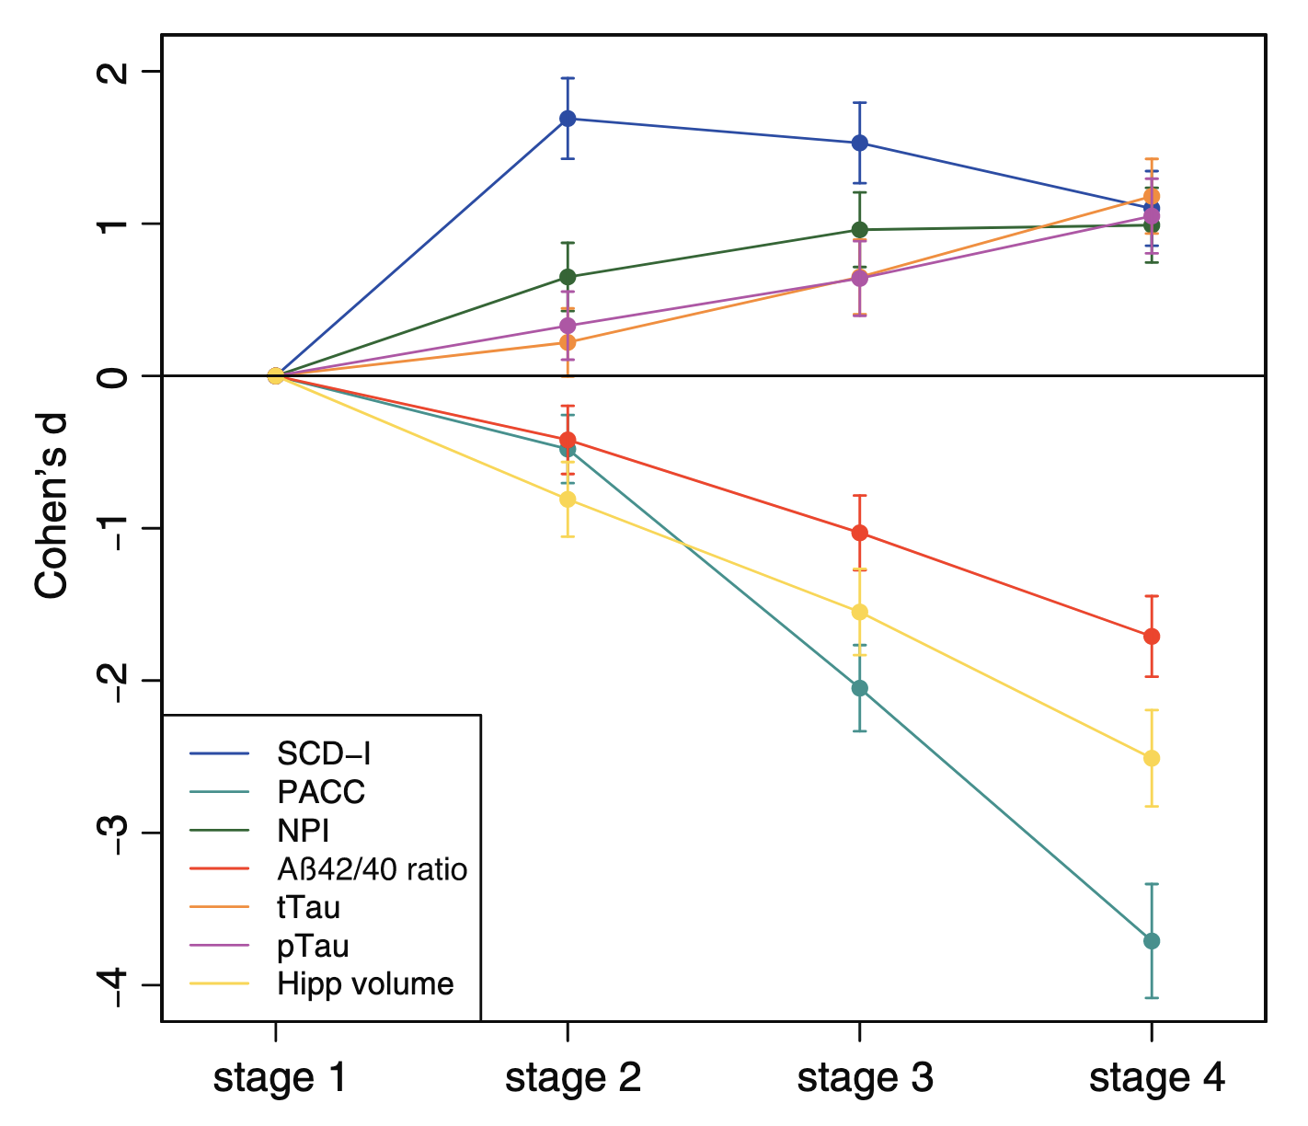
Theoretical Framework: MCI and The Alzheimer’s Disease Continuum
(Jessen et al., 2023)
AD Continuum is defined:
Stage 1 (asymptomatic, A+ Controls)
→ Stage 2 (SCD-A+)
→ Stage 3 (MCI-A+)
→ Stage 4 (DAT-A+)
Cognitive and Aß define the AD Continuum:
Preclinical Alzheimer's Cognitive Composite (PACC5) drastic cognitive decline as the disease progresses
Aβ positivity (A+) based on the Aβ42/Aβ40 ratio cut-off to define all cases
(Jessen et al., 2023)
Jessen F, Wolfsgruber S, Kleineindam L, Spottke A, Altenstein S, Bartels C, Berger M, Brosseron F, Daamen M, Dichgans M, Dobisch L, Ewers M, Fenski F, Fliessbach K, Freiesleben SD, Glanz W, Görß D, Gürsel S, Janowitz D, Kilimann I, Kobeleva X, Lohse A, Maier F, Metzger C, Munk M, Preis L, Sanzenbacher C, Spruth E, Rauchmann B, Vukovich R, Yakupov R, Weyrauch AS, Ziegler G, Schmid M, Laske C, Perneczky R, Schneider A, Wiltfang J, Teipel S, Bürger K, Priller J, Peters O, Ramirez A, Boecker H, Heneka MT, Wagner M, Düzel E. Subjective cognitive decline and stage 2 of Alzheimer disease in patients from memory centers. Alzheimers Dement. 2023 Feb;19(2):487-497. doi: 10.1002/alz.12674. Epub 2022 Apr 22. PMID: 35451563.
Notes:
DAT: Dementia of the Alzheimer's Type
A+: amyloid positive

Slide 32
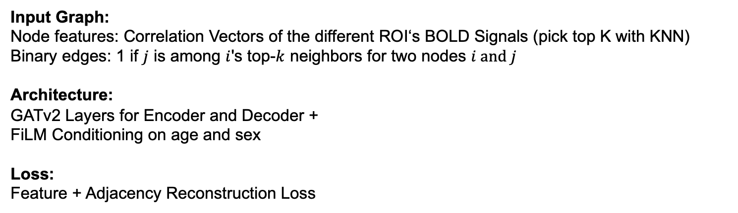
Current Approach: GAAE Model for Anomaly Detection
Input Graph:
Node features: Correlation Vectors of the different ROI‘s BOLD Signals (pick top K with KNN)
Binary edges: 1 if $j$ is among $i$'s top-$k$ neighbors for two nodes $i and j$
Architecture: GATv2 Layers for Encoder and Decoder +
FiLM Conditioning on age and sex
Loss:
Feature + Adjacency Reconstruction Loss
Notes:
FiLM: Feature-wise Linear Modulation

Slide 33
Literature Review
The Diagnosis vs. Prognosis Problem
Searching literature was not straightforward:
Papers confuse prediction of AD with the DL term
Papers only mention MRI in their approach, without being specific
Most papers include some form of structural imaging sMRI, PET..

Slide 34
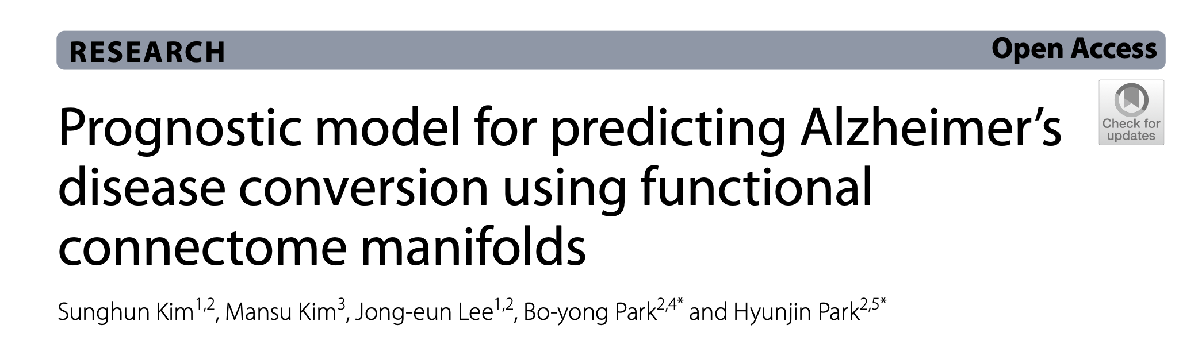
Literature Review
The Diagnosis vs. Prognosis Problem
Only 1 paper does the temporal prognosis of conversion from MCI to AD using fMRI:
(Kim et al., 2024)
Kim S, Kim M, Lee JE, Park BY, Park H. Prognostic model for predicting Alzheimer's disease conversion using functional connectome manifolds. Alzheimers Res Ther. 2024 Oct 9;16(1):217. doi: 10.1186/s13195-024-01589-3. PMID: 39385241; PMCID: PMC11465528.

Slide 35
Literature Review
The Diagnosis vs. Prognosis Problem
Only 1 paper does the temporal prognosis of conversion from MCI to AD using fMRI:
(Kim et al., 2024)
All other papers treat it as a classification problem (comparing sMCI to pMCI) - Will the MCI patient convert in 1/3/5 years, or no?
- Will this MCI patient ever convert to AD?
- …
→ choosing a best paper is not given as the comparison of performance is not feasible
Although some approaches can be slightly modified to produce a continuous result!
e.g. change the last classification layer to a regression layer

Slide 36
Literature Review: Conversion Risk and Temporal Prognosis
(Kim et al., 2024)
Dataset
ADNI and OASIS
Architecture: Time-to-Event Modeling (Survival Analysis)+The exact conversion time is interval-censored (it occurred between the last MCI and first AD diagnosis date)
Kim S, Kim M, Lee JE, Park BY, Park H. Prognostic model for predicting Alzheimer's disease conversion using functional connectome manifolds. Alzheimers Res Ther. 2024 Oct 9;16(1):217. doi: 10.1186/s13195-024-01589-3. PMID: 39385241; PMCID: PMC11465528.

Slide 37
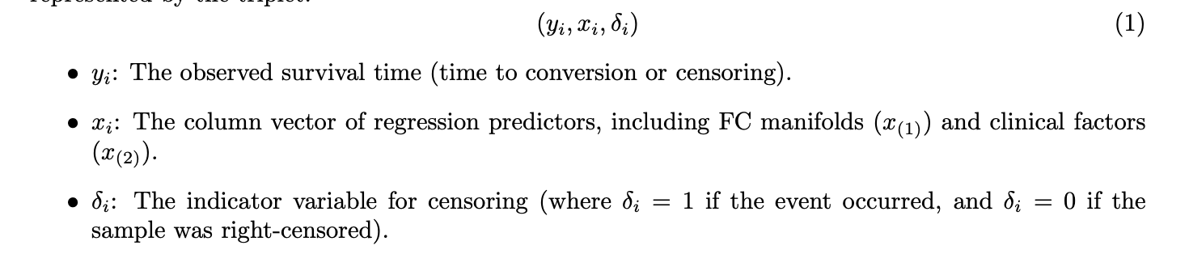
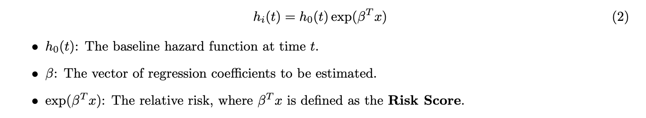
Literature Review: Conversion Risk and Temporal Prognosis
(Kim et al., 2024)
Survival analysis: Each subject i is represented by the triplet:
Risk of conversion at time t:
Using Cox Proportional Hazards Model
Kim S, Kim M, Lee JE, Park BY, Park H. Prognostic model for predicting Alzheimer's disease conversion using functional connectome manifolds. Alzheimers Res Ther. 2024 Oct 9;16(1):217. doi: 10.1186/s13195-024-01589-3. PMID: 39385241; PMCID: PMC11465528.

Slide 38
Literature Review: Conversion Risk and Temporal Prognosis
(Kim et al., 2024)
Model Evaluation and Validation
• Concordance Index (C-index):
Used to evaluate how well the model predicts the ordering of conversion times.
• Risk Groups:
Participants were stratified into fast and slow conversion groups based on a zero cutoff of the predicted risk score
Kim S, Kim M, Lee JE, Park BY, Park H. Prognostic model for predicting Alzheimer's disease conversion using functional connectome manifolds. Alzheimers Res Ther. 2024 Oct 9;16(1):217. doi: 10.1186/s13195-024-01589-3. PMID: 39385241; PMCID: PMC11465528.

Slide 39
Literature Review: SOTA Papers List
(OneNote Notebook)
Different Architectures for Baseline Conversion to AD: sMCI vs pMCI (CNNs, LSTMs..)
+ Foundation Models (Brain-JEPA..)
+ SOTA Methods for fMRI Preprocessing
+ GNN Graph Generation (Task-aware GNN-based fMRI..)
+ Accuracy Improvements when including Genotypes, Aß, Cognitive Scores…

Slide 40
Pretraining: Model Architecture Fraj Yassine Lakhal TUM School of Computation, Information and Technology
Functional Neuroimaging, LMU
Supervisor: Dr. med. Stephan Wunderlich
Computer Aided Medical Procedures & Augmented Reality, TUM
Supervisor(s): M.Sc. Chantal Pellegrini, Dr. Shahrooz Faghihroohi
München, 13. Januar 2026

Slide 41
Outline
DELCODE Dataset
Statistical Tests
Pretrained Model Architecture: Supervised vs Unsupervised Learning

Slide 42
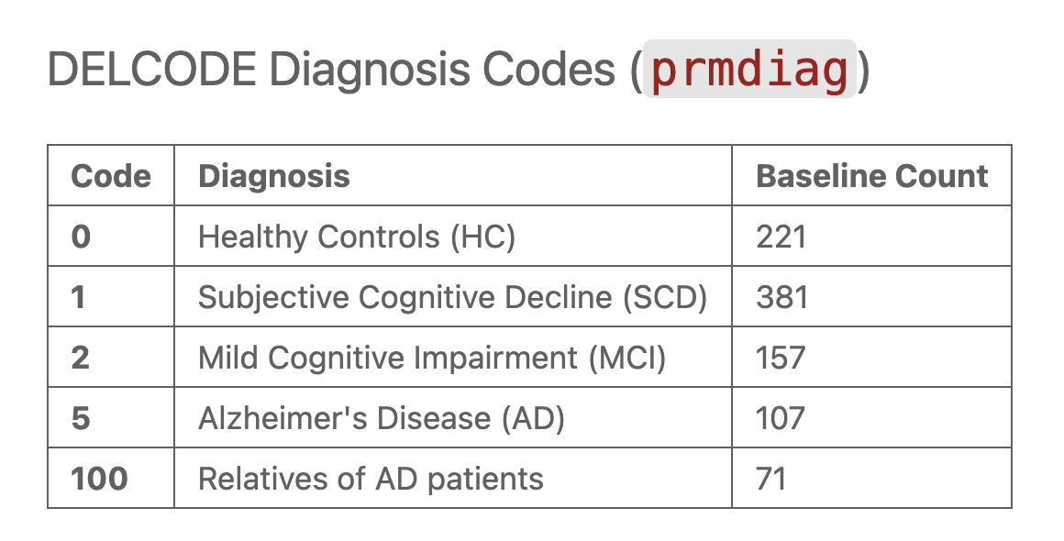
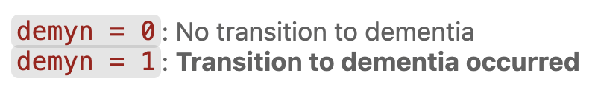
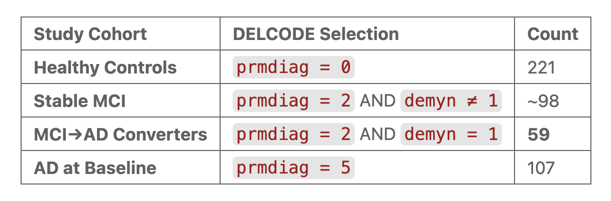
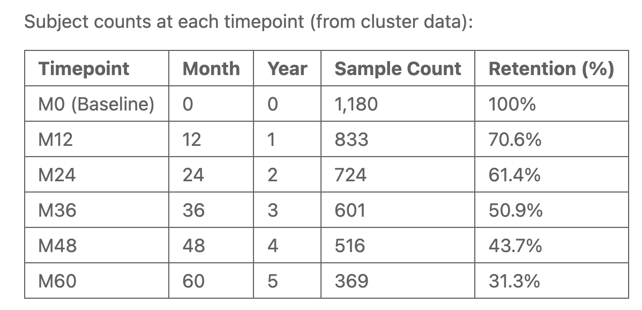
DELCODE Dataset
Cohorts

Slide 43
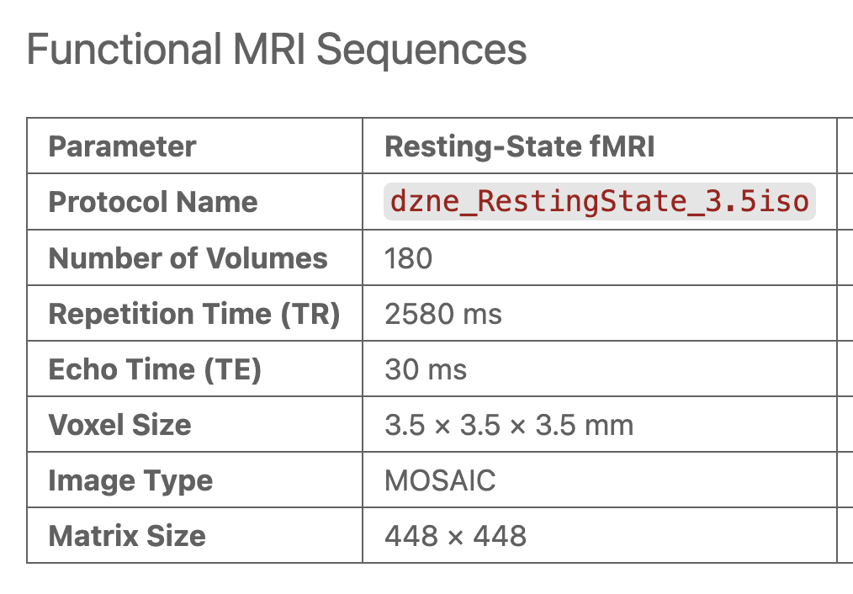
DELCODE Dataset
Scanning Procedure

Slide 44
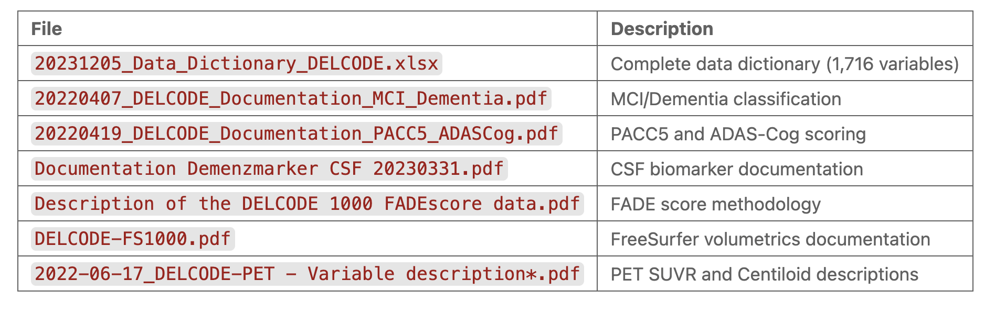
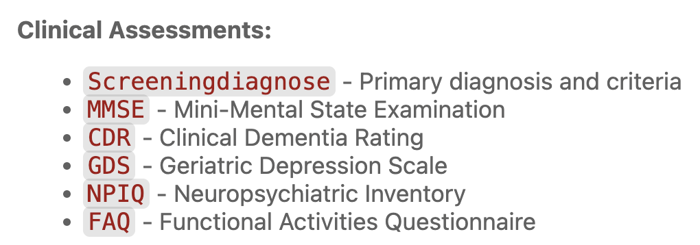
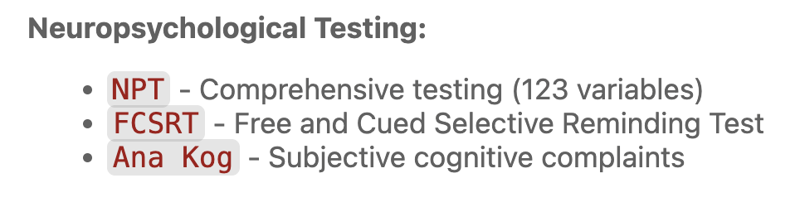
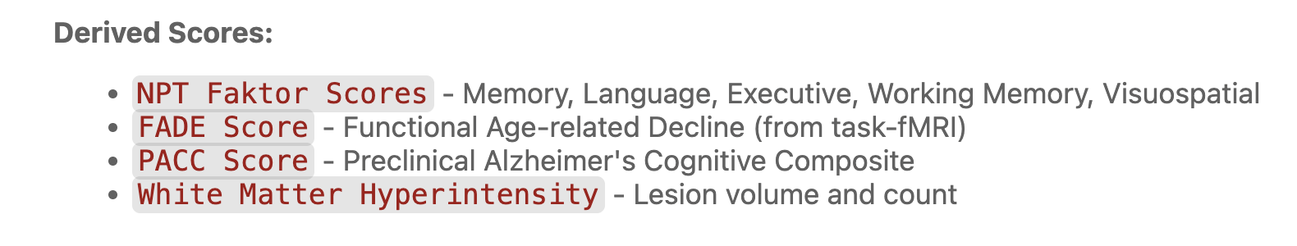
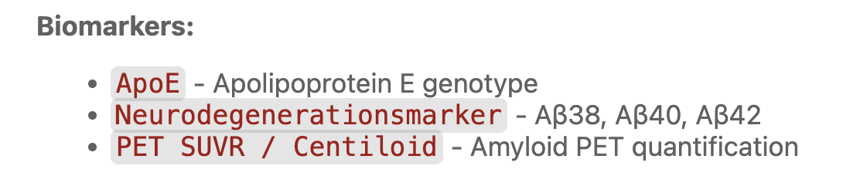
DELCODE Dataset
Clinical Biomarkers

Slide 45
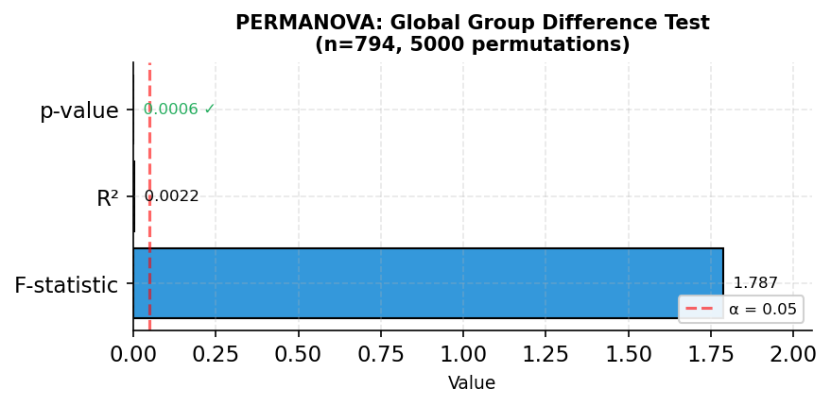
Statistical Tests (Converters vs non-Converters)
PERMANOVA Test
Rasero, J., Amoroso, N., La Rocca, M., Tangaro, S., Bellotti, R., & Stramaglia, S. (2017). Multivariate regression analysis of structural MRI connectivity matrices in Alzheimer's disease. PLOS ONE, 12(11), e0187281. https://doi.org/10.1371/journal.pone.0187281
Notes:
PERMANOVA tests whether the overall connectivity patterns differ between converters and non-converters.
A significant p-value (< 0.05) indicates that the groups have different multivariate distributions. The R² value shows how much variance is explained by group membership.
F < 1: Within-group variation is larger than between-group differences
α = 0.05 means you're willing to accept a 5% chance of a false positive (Type I error)

Slide 46
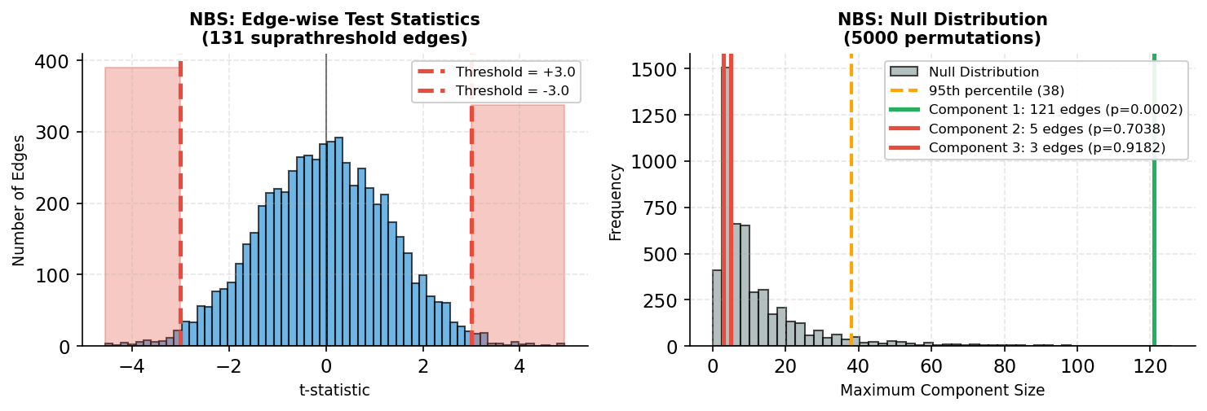
Statistical Tests (Converters vs non-Converters)
NBS Tests
Zalesky, A., Fornito, A., & Bullmore, E. (2010). Network-based statistic: Identifying differences in brain networks. NeuroImage, 53(4), 1197-1207. https://doi.org/10.1016/j.neuroimage.2010.06.041
Notes:
Network-Based Statistic (NBS) identifies connected components of edges that show group differences.
The left plot shows the distribution of t-statistics for all edges, with red areas indicating suprathreshold edges.
The right plot compares observed component sizes to the null distribution. Only components larger than expected by chance (above the orange line) are significant. → NBS identified 1 significant network component(s), suggesting localized connectivity differences.

Slide 47
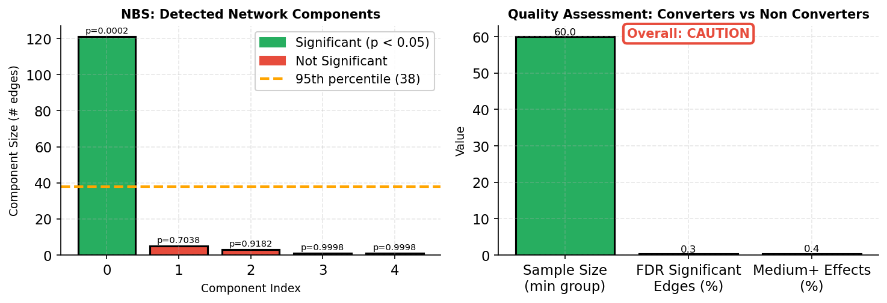
Statistical Tests (Converters vs non-Converters)
NBS Tests
Zalesky, A., Fornito, A., & Bullmore, E. (2010). Network-based statistic: Identifying differences in brain networks. NeuroImage, 53(4), 1197-1207. https://doi.org/10.1016/j.neuroimage.2010.06.041
Notes:
Left: Individual network components detected by NBS, with significance indicated by color (green = significant, red = not significant).
Right: Quality metrics for the analysis. Small sample sizes or low signal can affect reliability and increase caution.

Slide 48
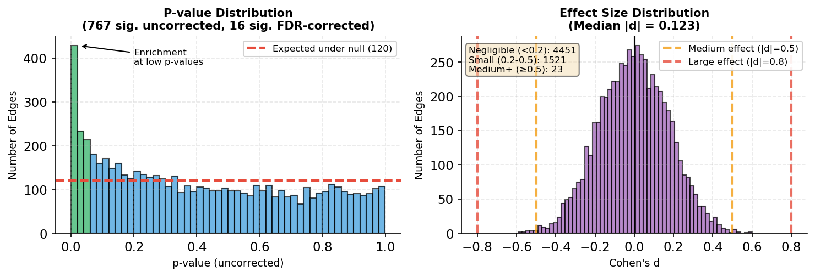
Statistical Tests (Converters vs non-Converters)
FDR, Cohen’s d
Rechberger S, Li Y, Kopetzky SJ, Butz-Ostendorf M; for the Alzheimer's Disease Neuroimaging Initiative. (2022). Automated High-Definition MRI Processing Routine Robustly Detects Longitudinal Morphometry Changes in Alzheimer's Disease Patients. Frontiers in Aging Neuroscience, 14:832828. doi: 10.3389/fnagi.2022.832828
Miao D, Zhou X, Wu X, Chen C, Tian L. (2022). Distinct profiles of functional connectivity density aberrance in Alzheimer's disease and mild cognitive impairment. Frontiers in Psychiatry, 13:1079149. doi: 10.3389/fpsyt.2022.1079149
Notes:
Left: P-value distribution shows enrichment at low values (green bars), indicating true effects beyond chance. A uniform distribution would suggest no real differences.
Right: Effect sizes (Cohen's d) show the magnitude of differences. Most effects are small (d < 0.3), which is typical for brain connectivity studies.

Slide 49
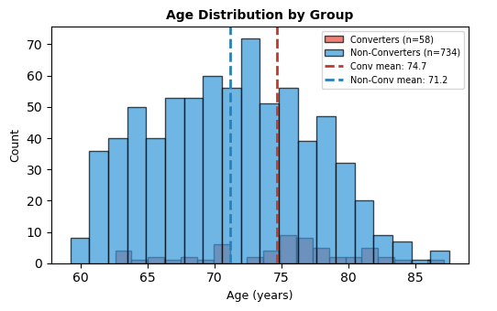
Statistical Tests (Converters vs non-Converters)
Age Effect: Age distribution

Slide 50
Statistical Tests (Converters vs non-Converters)
Age Effect: Regressing out the age
1) Connectivity = β₀ + β₁ × Age + ε
We fit a linear regression model
2) Cᵢⱼᶜᵒʳʳᵉᶜᵗᵉᵈ = Cᵢⱼ - β₁ × Ageᵢ + β₁ × Age_mean
For each subject, we predict their connectivity based solely on their age using this model, then subtract this age-driven prediction from their actual connectivity values.
We add back the mean connectivity so the corrected values stay in a meaningful range

Slide 51
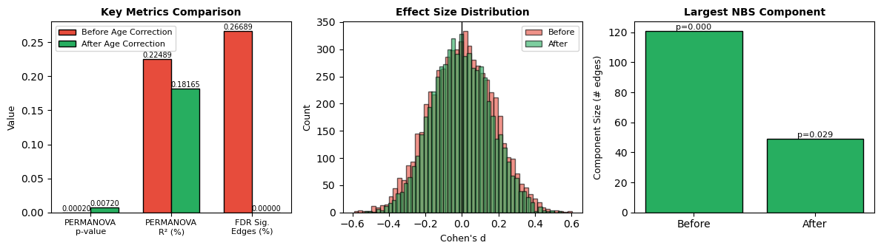
Statistical Tests (Converters vs non-Converters)
Age Effect: Before and after regressing out the age

Slide 52
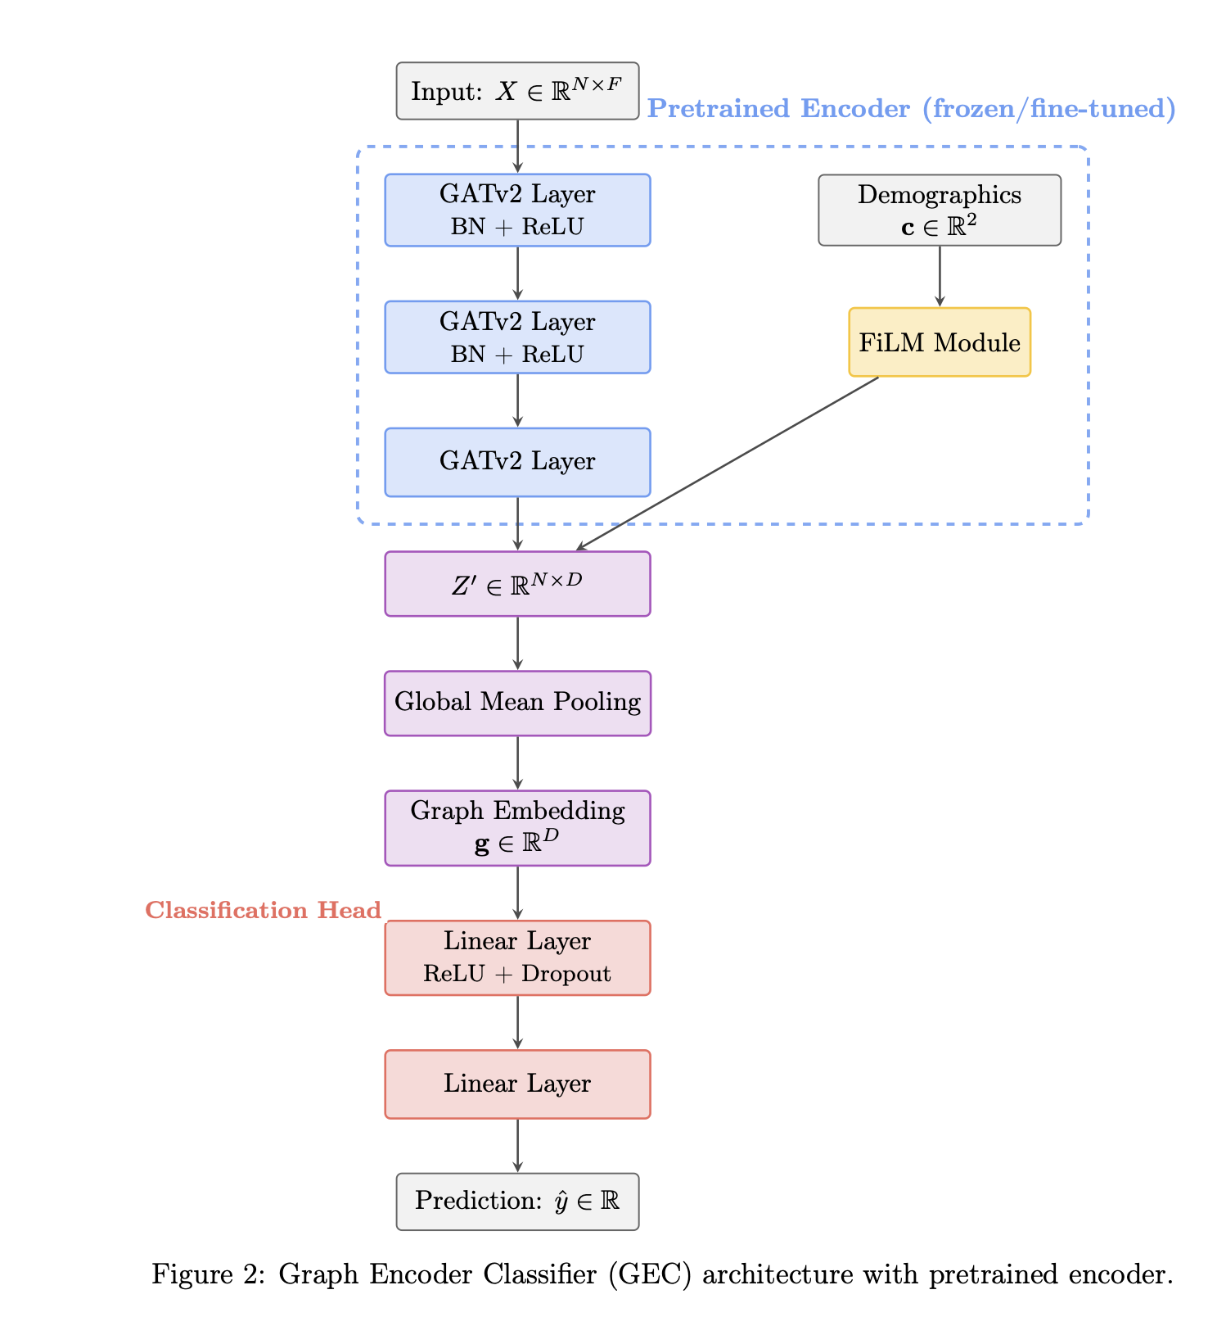
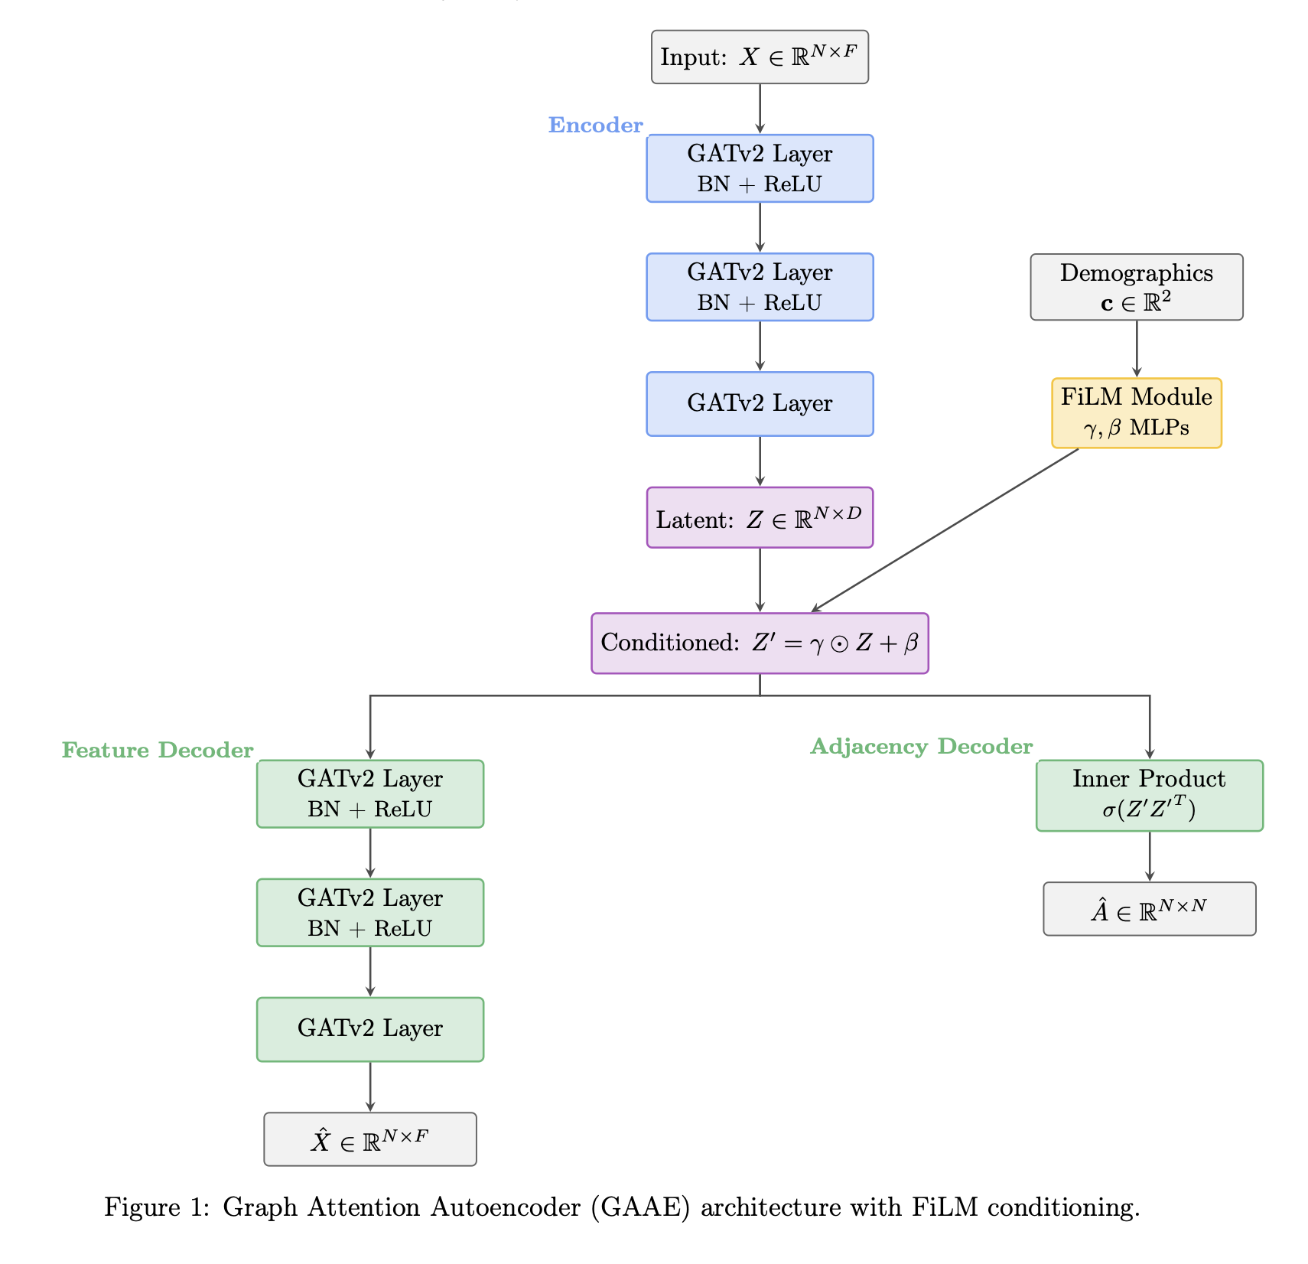
Pretrained Model Architecture
GAAE vs GEC: Architectures

Slide 53
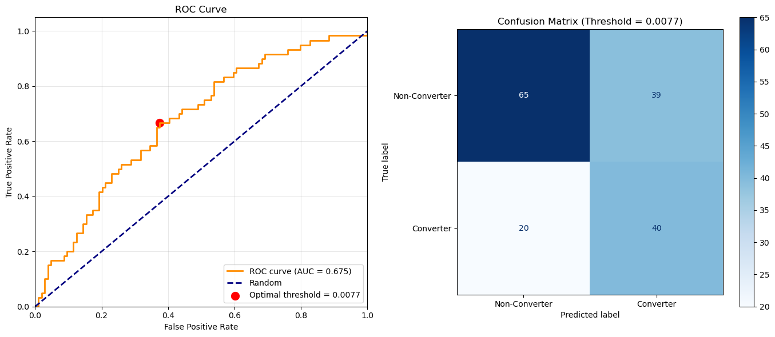
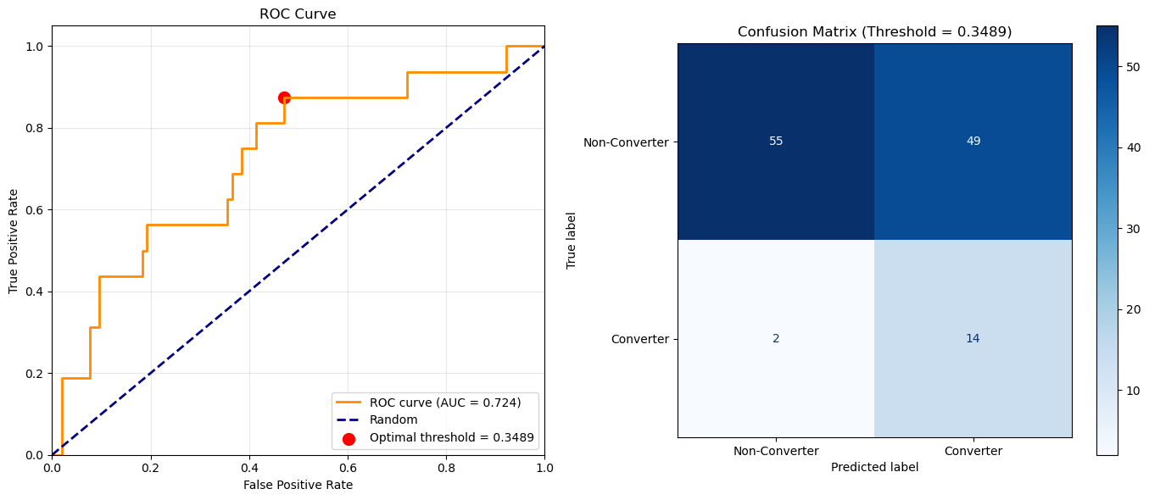
Pretrained Model Architecture
GAAE vs GEC: Evaluation on Classification
Graph Attention Auto-Encoder (GAAE)
Graph Encoder Classifier (GEC)

Slide 54
Pretrained Model Architecture
GAAE vs GEC: Evaluation on Classification
Discriminative Learning (Inter-Cohort Variability): The GEC uses supervised learning with labeled data, which forces the model to focus on the variability between cohorts (e.g., Converters vs. Non-Converters) rather than the variability within them.
→ The GEC allows the model to identify specific nodes and edges in the brain graph that are critical for differentiating the cohorts, rather than trying to model the global brain structure.
Noise Reduction: The reconstruction-based GAAE approach learned "noisy features" because the differences between patients within the same group were large.

Slide 55
Pretraining: Results + Classification Fraj Yassine Lakhal TUM School of Computation, Information and Technology
Functional Neuroimaging, LMU
Supervisor: Dr. med. Stephan Wunderlich
Computer Aided Medical Procedures & Augmented Reality, TUM
Supervisor(s): M.Sc. Chantal Pellegrini, Dr. Shahrooz Faghihroohi
München, 13. Januar 2026

Slide 56
Outline
Papers Review
Latent Vector Study (from Pretrained Encoder)
Preparing for Kickoff Presentation

Slide 57
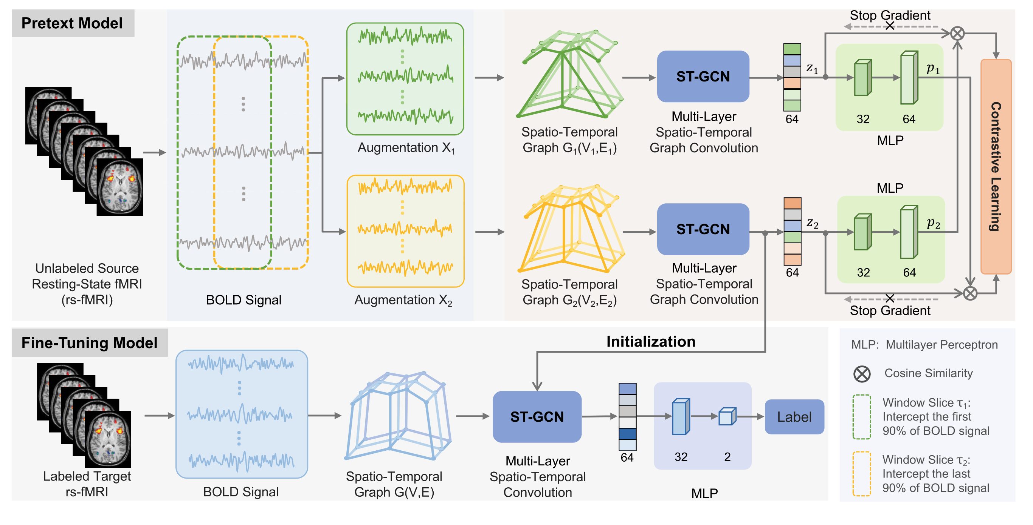
Unsupervised contrastive graph learning for resting-state functional MRI analysis and brain disorder detection (Weng et al. 2023)
- ST-GCN (Spatio-temporal GCN)
Pretext Model (Unsupervised)
Fine-Tuning Model (Supervised)
They jointly model the brain's network structure and how that activity evolves
Spatial Edges: connect different ROIs (nodes) within the same time point using Pearson correlation (what we do so far)
Temporal Edges: no “edges”, but they rather apply a standard 1D convolution kernel (size 1×L) that slides across the time axis
- Statistical Significance Analysis
Used a paired sample t-test to evaluate the difference in prediction probability distributions between their proposed UCGL model and nine competing methods
Wang X, Chu Y, Wang Q, Cao L, Qiao L, Zhang L, Liu M. Unsupervised contrastive graph learning for resting-state functional MRI analysis and brain disorder detection. Hum Brain Mapp. 2023 Dec 1;44(17):5672-5692. doi: 10.1002/hbm.26469. Epub 2023 Sep 5. PMID: 37668327; PMCID: PMC10619386.

Slide 58
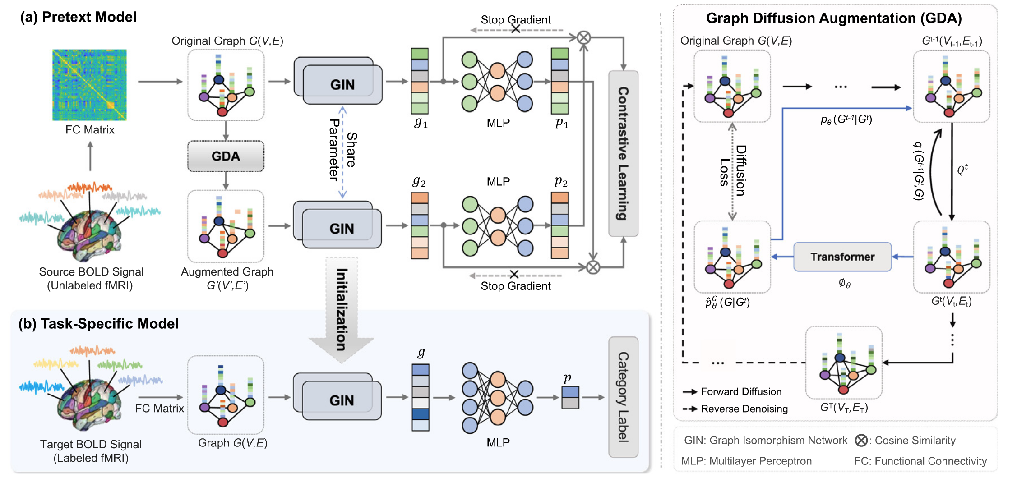
Self-supervised graph contrastive learning with diffusion augmentation for functional MRI analysis and brain disorder detection (Weng et al. 2025)
Window Slicing for Contrastive Learning
They minimize the difference between two sliced BOLD Signals of the same patient
Authors Claim: Slicing does not alter temporal dependencies
Graph Diffusion Augmentation (GDA)
Authors add Gaussian noise to nodes and edges
Authors Claim: Graph Transformer can denoise the augmented samples during the generation process.
Wang X, Fang Y, Wang Q, Yap PT, Zhu H, Liu M. Self-supervised graph contrastive learning with diffusion augmentation for functional MRI analysis and brain disorder detection. Med Image Anal. 2025 Apr;101:103403. doi: 10.1016/j.media.2024.103403. Epub 2024 Nov 29. PMID: 39637557; PMCID: PMC11875923.

Slide 59
Diffusion Models and Slicing Windows
Critique 1: Invalid Invariance Assumption
In CV, an object remains the same regardless of orientation (e.g., we can still identify a rotated cat). In fMRI, we cannot assume a "sliced" or "noisy" brain signal retains the same disease pathology
Problem: Brain disorders like AD are potentially defined by subtle, millisecond-scale synchronizations between specific regions
Consequence: A "disrupted functional connection" critical for diagnosis might disappear completely if the time-series is sliced or if noise is added

Slide 60
Diffusion Models and Slicing Windows
Critique 1: Invalid Invariance Assumption
In CV, an object remains the same regardless of orientation (e.g., we can still identify a rotated cat). In fMRI, we cannot assume a "sliced" or "noisy" brain signal retains the same disease pathology
Problem: Brain disorders like AD are potentially defined by subtle, millisecond-scale synchronizations between specific regions
Consequence: A "disrupted functional connection" critical for diagnosis might disappear completely if the time-series is sliced or if noise is added
Critique 2: Overfitting and Memorization on Small Datasets
Diffusion models require large amounts of data to learn true distributions. Our dataset is relatively small (e.g., ~600 subjects)
Problem: As you noted, diffusion models trained on small datasets tend to memorize training samples rather than learning a generalizable distribution.
Consequence: The "new" generated graphs might just be noisy copies of the training data

Slide 61
Diffusion Models and Slicing Windows
Critique 1: Invalid Invariance Assumption
In CV, an object remains the same regardless of orientation (e.g., we can still identify a rotated cat). In fMRI, we cannot assume a "sliced" or "noisy" brain signal retains the same disease pathology
Problem: Brain disorders like AD are potentially defined by subtle, millisecond-scale synchronizations between specific regions
Consequence: A "disrupted functional connection" critical for diagnosis might disappear completely if the time-series is sliced or if noise is added
Critique 2: Overfitting and Memorization on Small Datasets
Diffusion models require large amounts of data to learn true distributions. Our dataset is relatively small (e.g., ~600 subjects)
Problem: As you noted, diffusion models trained on small datasets tend to memorize training samples rather than learning a generalizable distribution.
Consequence: The "new" generated graphs might just be noisy copies of the training data
Critique 3: The Signal-to-Noise Ratio Issue
BOLD signals are already dominated by noise (heartbeat, respiration, scanner drift), with the disease signal being a fraction of the variance.
Problem: Adding more noise (via diffusion) adds to the low SNR problem.
Consequence: The augmentation strategies might drown out the weak, subtle modulation that characterizes the disease

Slide 62
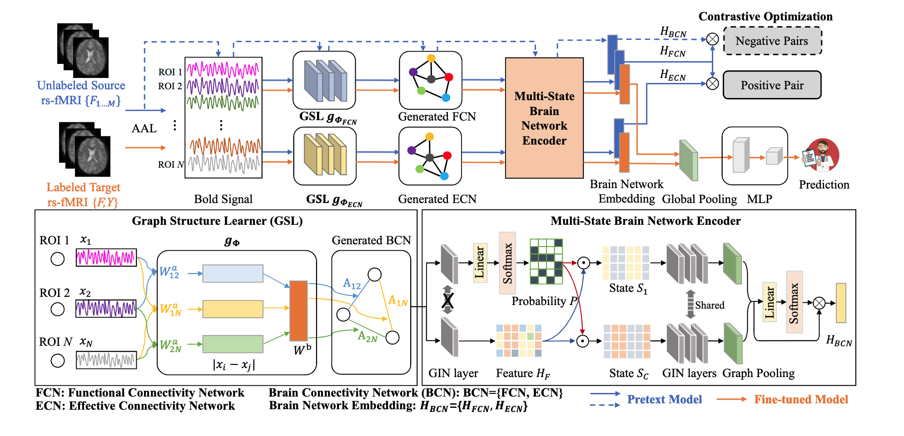
Self-supervised Learning with Adaptive Graph Structure and Function Representation for Cross-Dataset Brain Disorder Diagnosis (Chen et al. 2024)
- Functional Connectivity (FC) and Effective Connectivity (EC)
With EC, we can capture the directional effects that one brain region exerts over another.
Authors use structural relationships (measured via transfer entropy) with attention relationships (measured via learnable weights).
- Ablation Studies
Removing the Pretrained model for example.
Che_Selfsupervised_MICCAI2024, Chen, Dongdong and Yao, Linlin and Liu, Mengjun and Shen, Zhenrong and Hu, Yuqi and Song, Zhiyun and Wang, Qian and Zhang, Lichi}, Self-supervised Learning with Adaptive Graph Structure and Function Representation For Cross-Dataset Brain Disorder Diagnosis } }, {proceedings of Medical Image Computing and Computer Assisted Intervention -- MICCAI 2024},

Slide 63
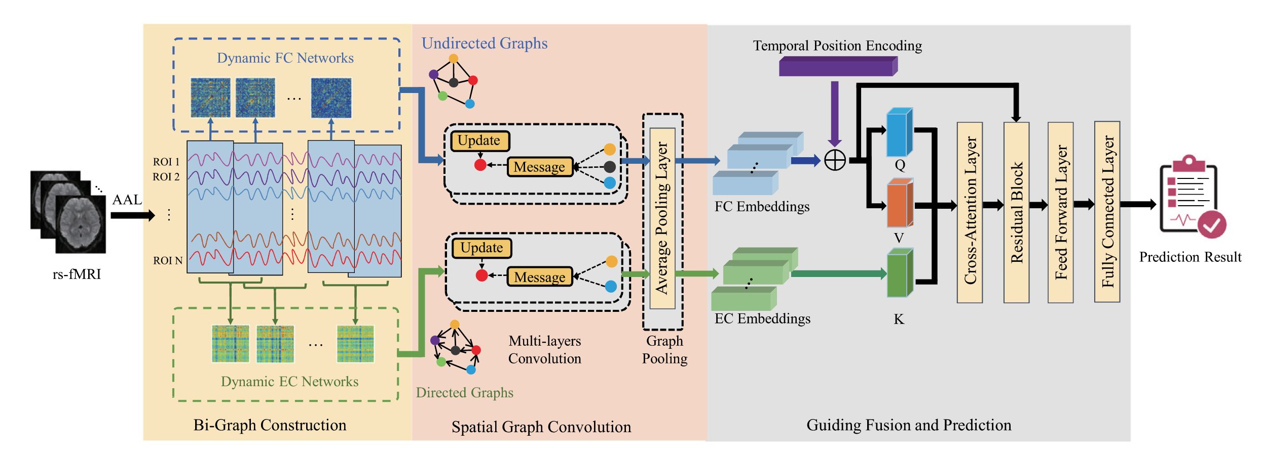
Guiding fusion of dynamic functional and effective connectivity in spatio-temporal graph neural network for brain disorder classification (Chen et al. 2025)
- Bi-Graph Modeling with raw BOLD Signals:
They model the brain as a dual evolving system where Dynamic FC (undirected) captures spatial correlations and Dynamic EC (directed) captures temporal causal progression simultaneously.
- Grad-CAM
Authors analyze salient brain regions in the brain network, by using class activation value of all testing subjects in the multi-class classification task.
Dongdong Chen, Mengjun Liu, Sheng Wang, Zheren Li, Lu Bai, Qian Wang, Dinggang Shen, Lichi Zhang,Guiding fusion of dynamic functional and effective connectivity in spatio-temporal graph neural network for brain disorder classification,Knowledge-Based Systems, https://doi.org/10.1016/j.knosys.2024.112856.

Slide 64
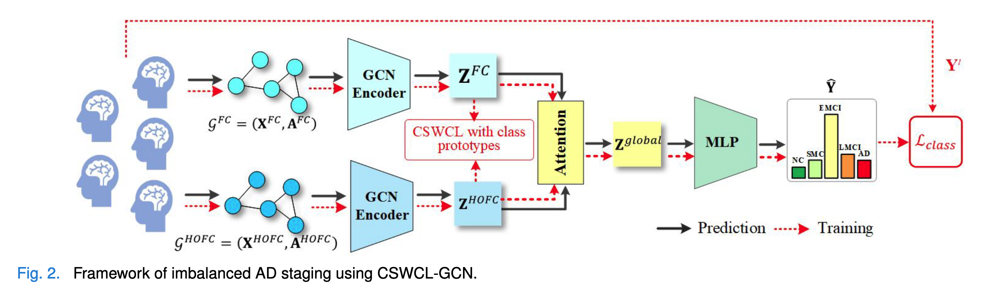
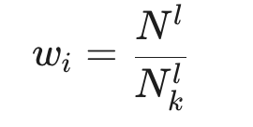
Cost-Sensitive Weighted Contrastive Learning Based on Graph Convolutional Networks for Imbalanced Alzheimer’s Disease Staging (Hu et al. 2024)
- Inter-Subject Graph
- High Order FC
They consider each row of the FC matrix as a feature vector describing a brain region. They then calculate the Pearson correlation between these rows.
- Minority Class Issue (Multi-View Contrastive Learning, Cost-Sensitive Weighting)
Under/Oversampling don’t capture more knowledge from minority class
Maximize agreement between FC and HOFC + while applying cost-sensitive weighting
Hu Y, Wang J, Zhu H, Li J, Shi J. Cost-Sensitive Weighted Contrastive Learning Based on Graph Convolutional Networks for Imbalanced Alzheimer's Disease Staging. IEEE Trans Med Imaging. 2024 Sep;43(9):3126-3136. doi: 10.1109/TMI.2024.3389747. Epub 2024 Sep 3. PMID: 38625767.

Slide 65



Pretrained Model: Latent Vector Study
Encoder Trained on All Cohorts

Slide 66


Results GEC
Mean Pooling (left) vs Attention Pooling (right)
after removing duplicates from the data of stable MCI and Converters, performance dropped significantly!

