Slide 1
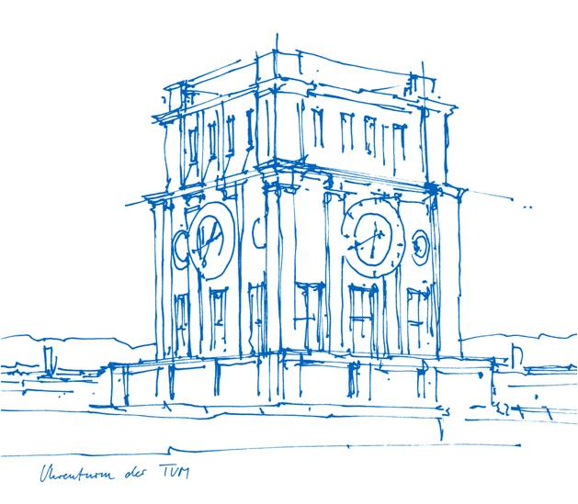
Training: Results Fraj Yassine Lakhal TUM School of Computation, Information and Technology
Functional Neuroimaging, LMU
Supervisor: Dr. med. Stephan Wunderlich
Computer Aided Medical Procedures & Augmented Reality, TUM
Supervisor(s): M.Sc. Chantal Pellegrini, Dr. Shahrooz Faghihroohi
München, 24. March 2026

Slide 2
Outline
Last Meeting’s Recap – Consider Weighted Cost Averaging and cleaner data
Restricting Input to DMN (Binary Classifier: Converters vs. Non-Converters) – Parcellate and restrict the input to the Schaefer Default Mode Network and compare results to the whole brain as input (DMN only model is smaller in dimension)
Weighted Cost Averaging – Fixing Minority Class Issue
Prediction Robustness Testing (Pretext Model: All Cohorts) – Alter Input of 5 correctly samples per cohort with different methods to see if the prediction changes

Slide 3
Last Meeting’s Recap
Main talking points:
Discussed Recommended Papers from Shahrooz
Diffusion Models and Contrastive Learning
Effective Connectivity
Weighted Cost Predictions for unbalanced dataset
Spatiotemporal Graphs
- Discussed the need for cleaner data due to data leakage (subjects appearing in multiple cohorts)

Slide 4
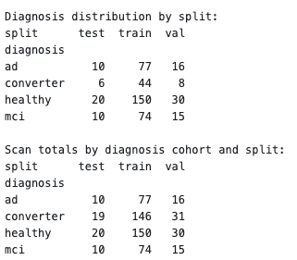
Cohort Stratification
Balanced split (with followup visits of same subjects only appearing at one split)
We ended up with sticking to the “prmdiag” column from the DELCODE study

Slide 5
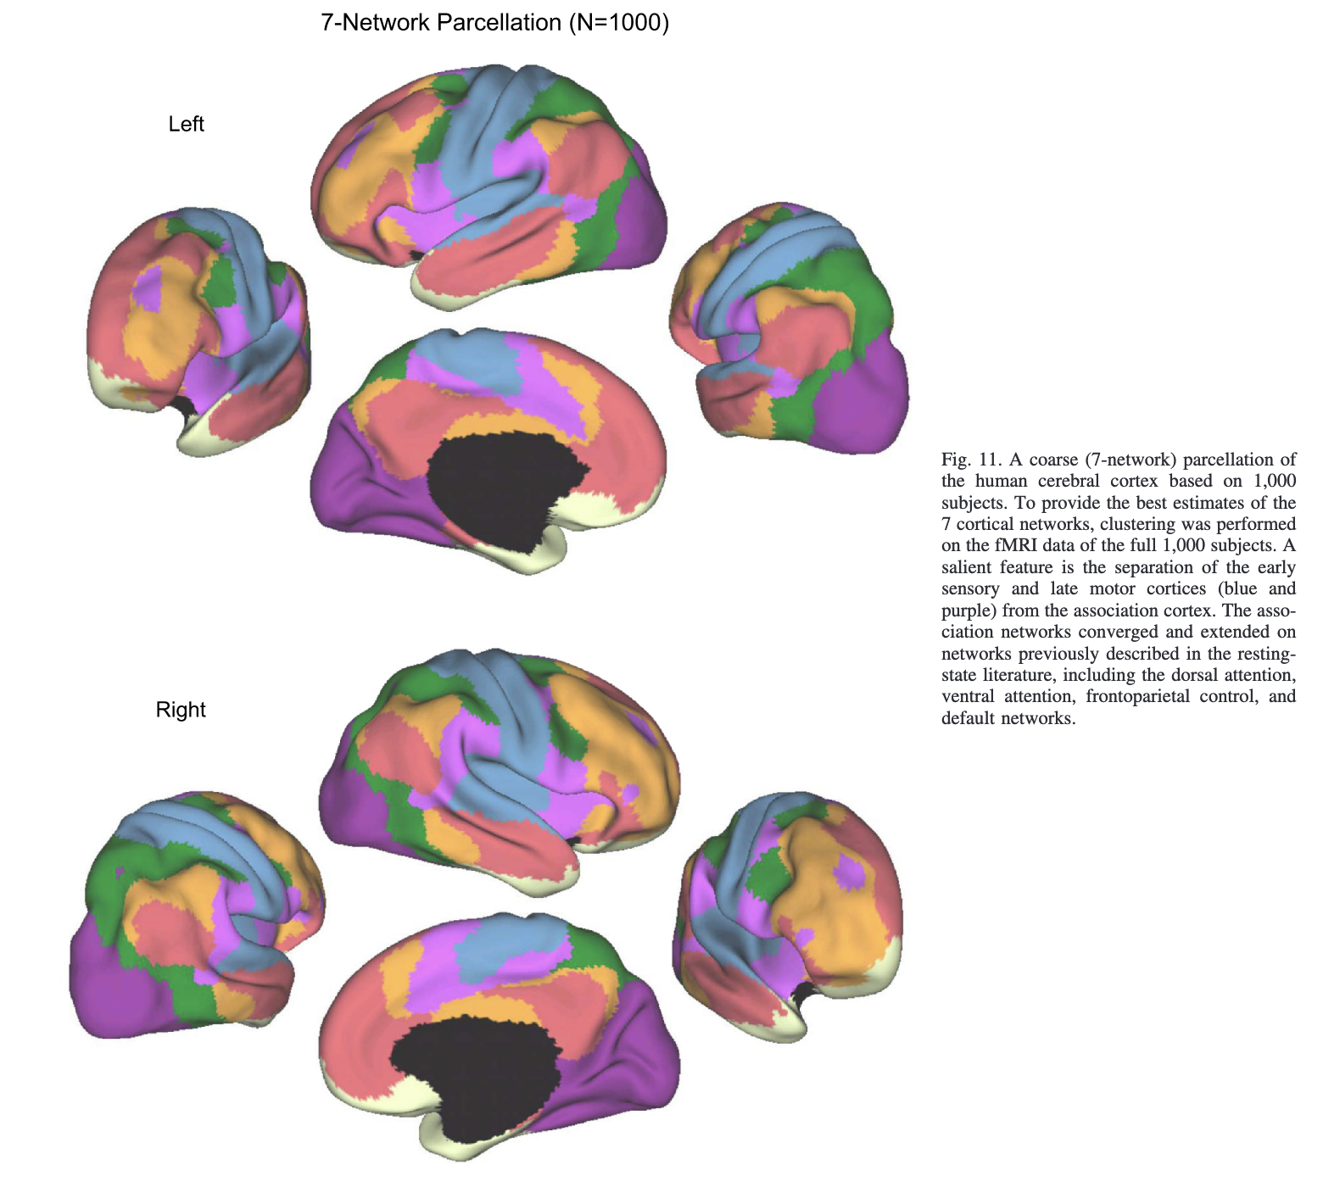
Restricting Input to DMN
Different AD affected brain regions
DMN
Limbic region
Dorsal Attention
→ useable using the Schaefer Atlas and selecting the mentioned brain region in the 7 Yeo Networks
DMN + Hippocampus
Hub regions highly connected regions
active mode network (Dosenbach et al.)
Attention Network (Dorsal)
Franzmeier Hyperconn drives tau spread
→ require more adaptation like using an additional atlas or cross-atlas mapping
Yeo BTT, Krienen FM, Sepulcre J, Sabuncu MR, Lashkari D, Hollinshead M, Roffman JL, Smoller JW, Zöllei L, Polimeni JR, Fischl B, Liu H, Buckner RL. The organization of the human cerebral cortex estimated by intrinsic functional connectivity. J Neurophysiol.2011;106(3):1125-1165. doi:10.1152/jn.00338.2011. Verfügbar unter: https://pmc.ncbi.nlm.nih.gov/articles/PMC3174820/ [Zugriff: 24. Mär 2026].

Slide 6
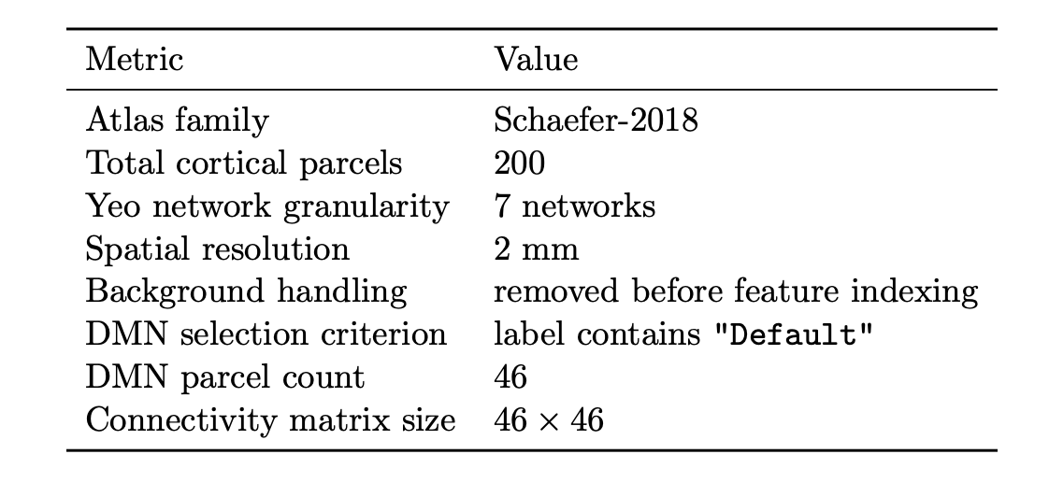
Restricting Input to Specific Brain Regions
Selecting DMN in the Schaefer atlas
Remark: using the z-transformed correlations values yields more stable predictions

Slide 7
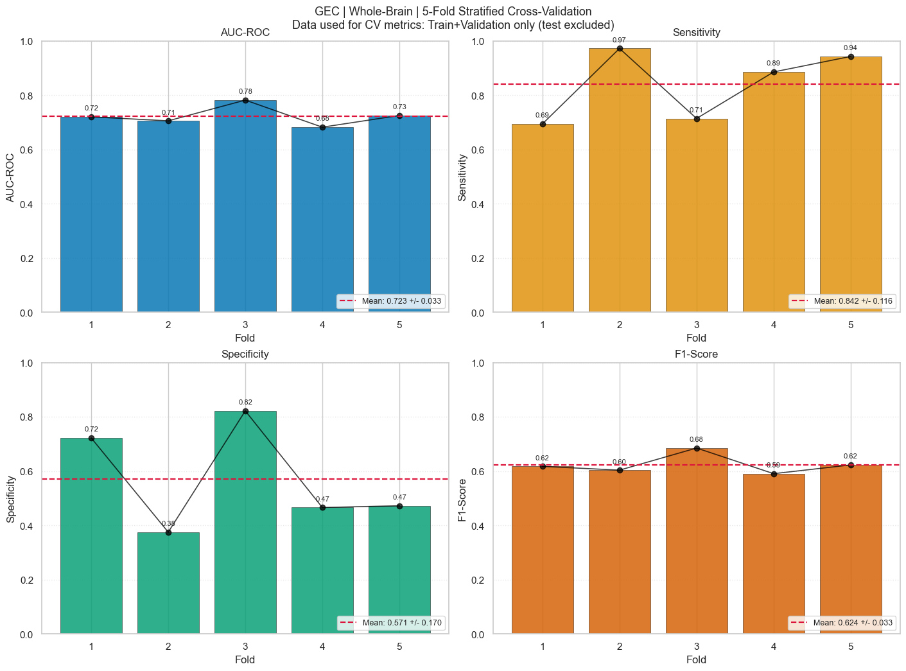
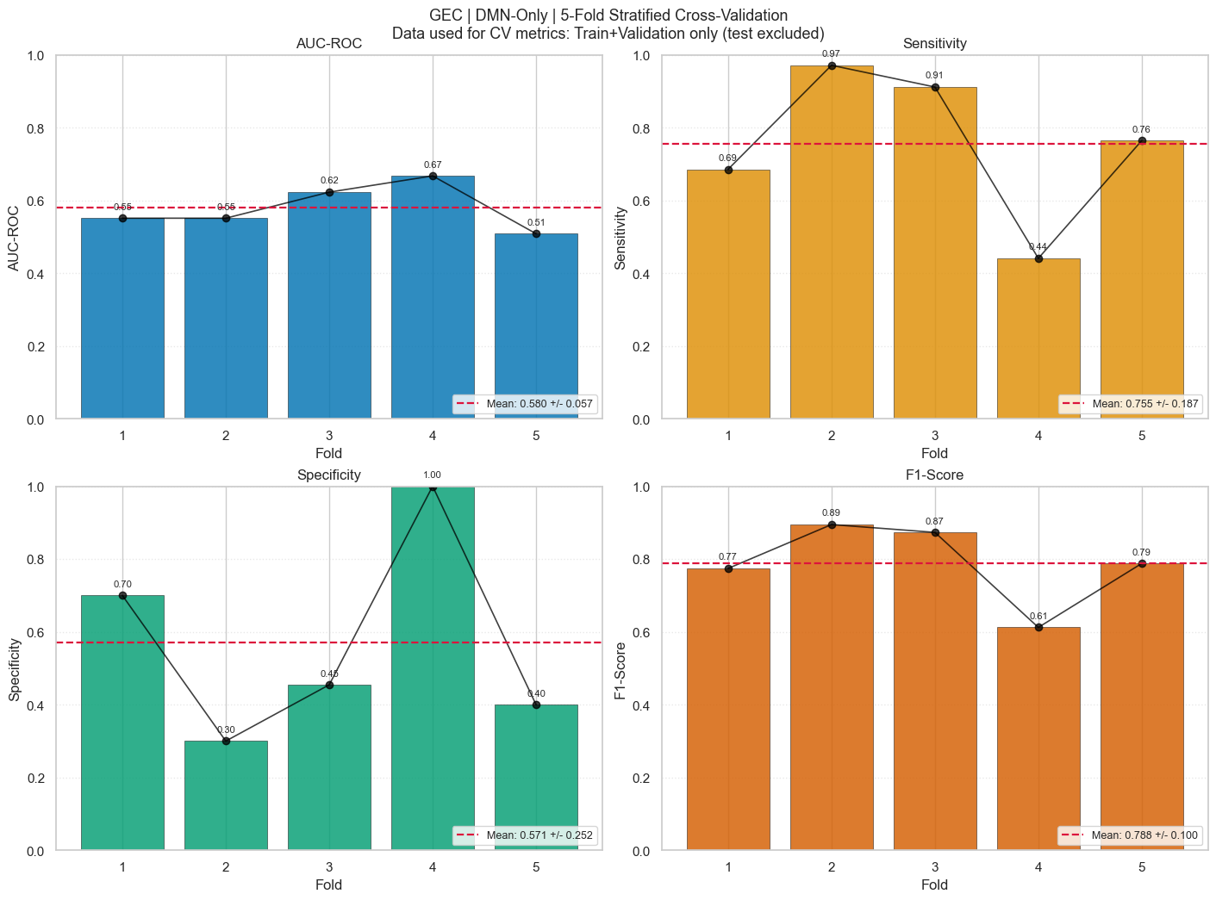
Converters vs. Non-converters - Cross Validation Results
Whole Brain vs DMN Only as Input

Slide 8
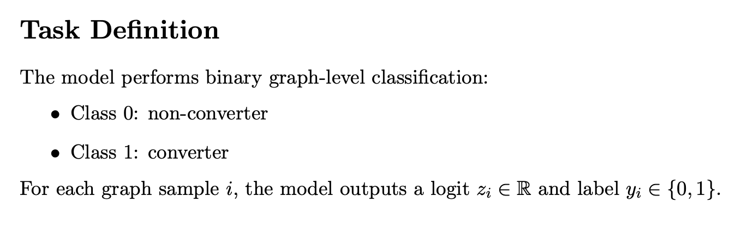
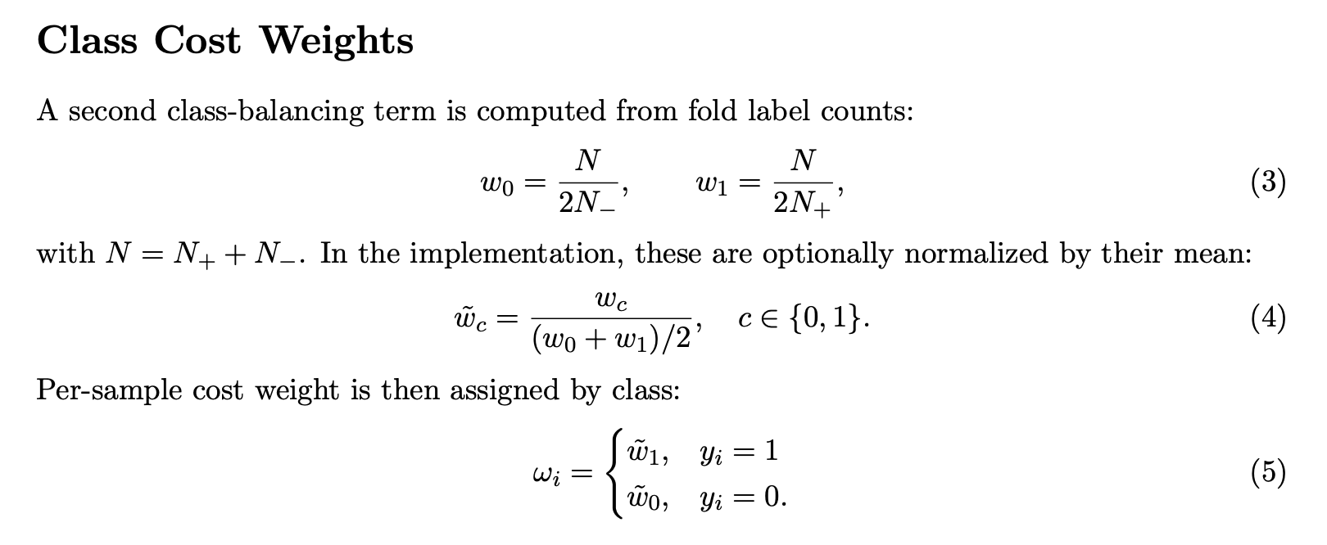
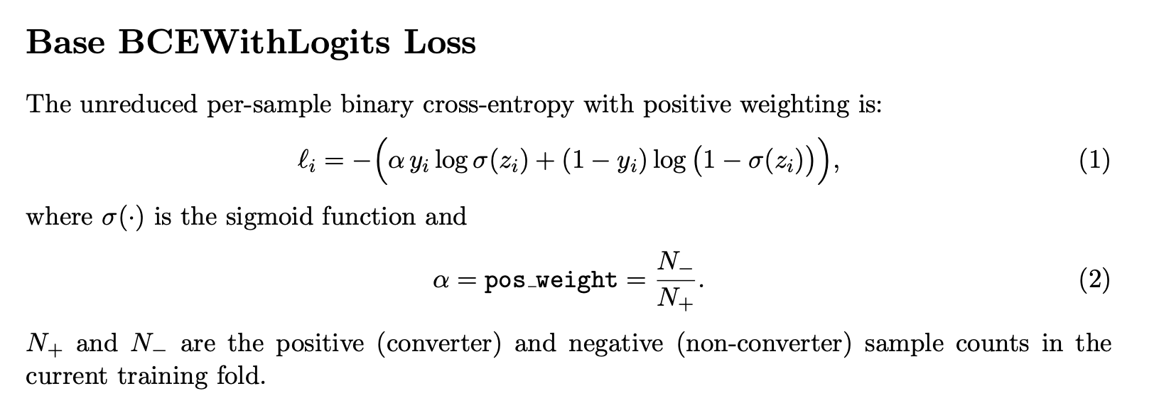
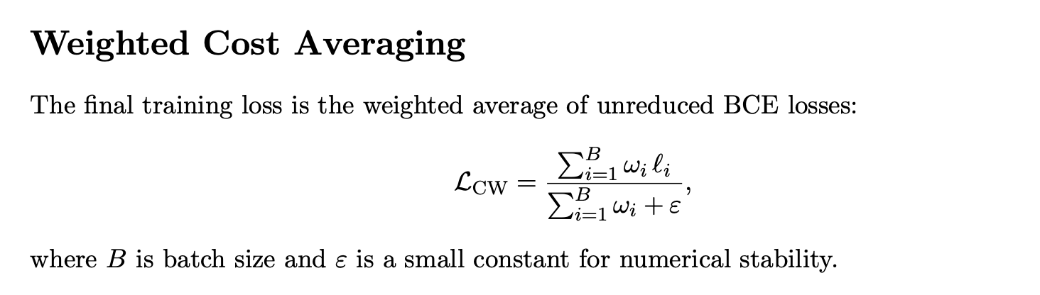
Weighted Cost Averaging
Balancing converter and non-converter reconstruction loss
Hu Y, Wang J, Zhu H, Li J, Shi J. Cost-Sensitive Weighted Contrastive Learning Based on Graph Convolutional Networks for Imbalanced Alzheimer’s Disease Staging. *IEEE Trans Med Imaging.* 2024;43(9):3126-3136. doi:10.1109/TMI.2024.3389747. Verfügbar unter: https://pubmed.ncbi.nlm.nih.gov/38625767/ [Zugriff: 24. Mär 2026]. [pubmed.ncbi.nlm.nih](https://pubmed.ncbi.nlm.nih.gov/38625767/)

Slide 9
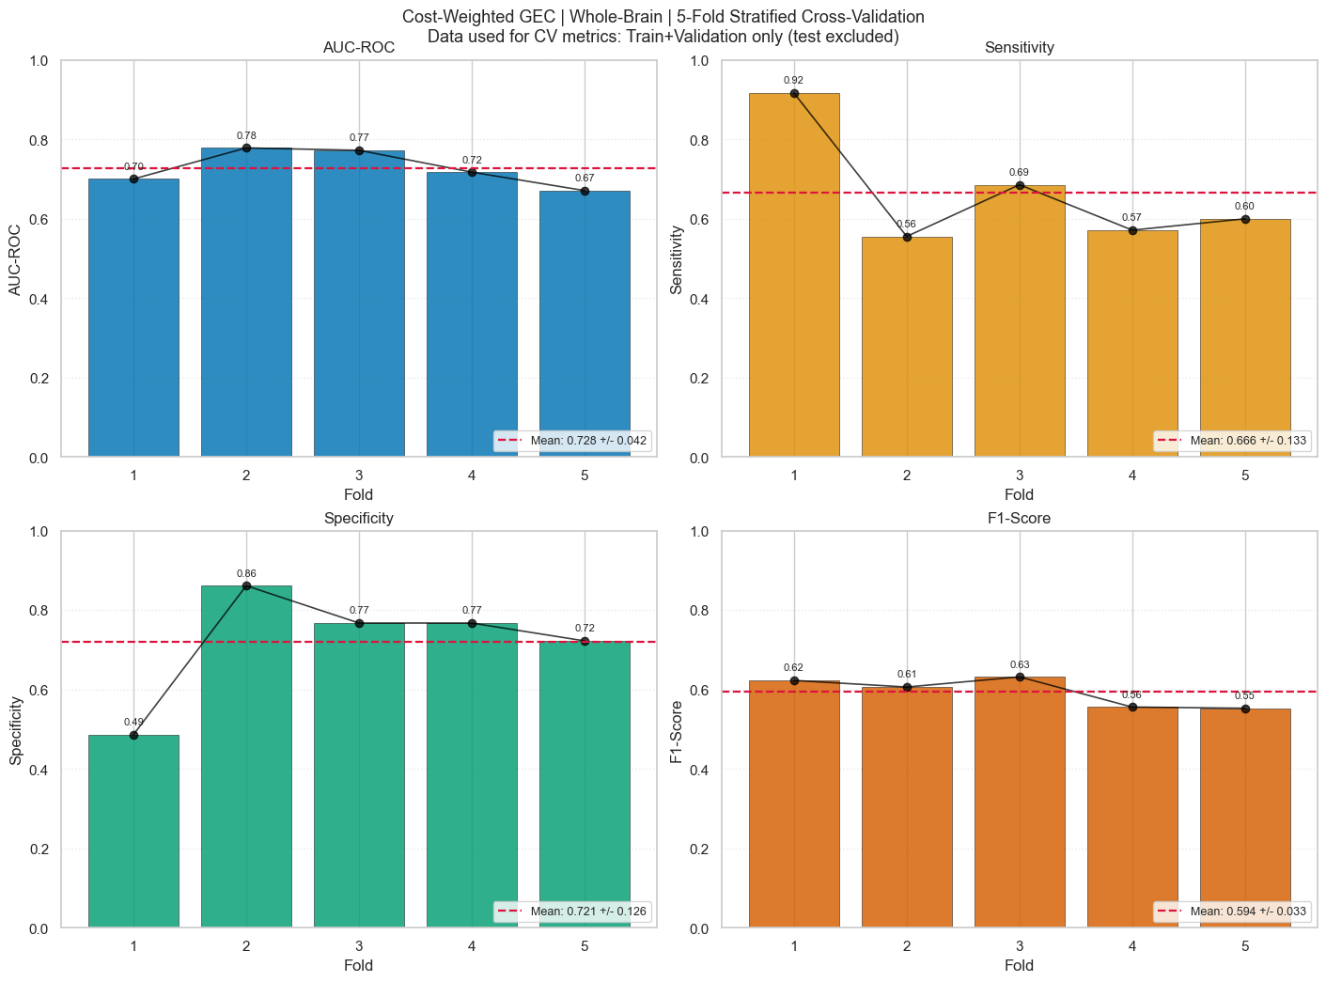
Converters vs. Non-converters - Cross Validation Results
Unweighted vs. Cost Weighted Predictions

Slide 10
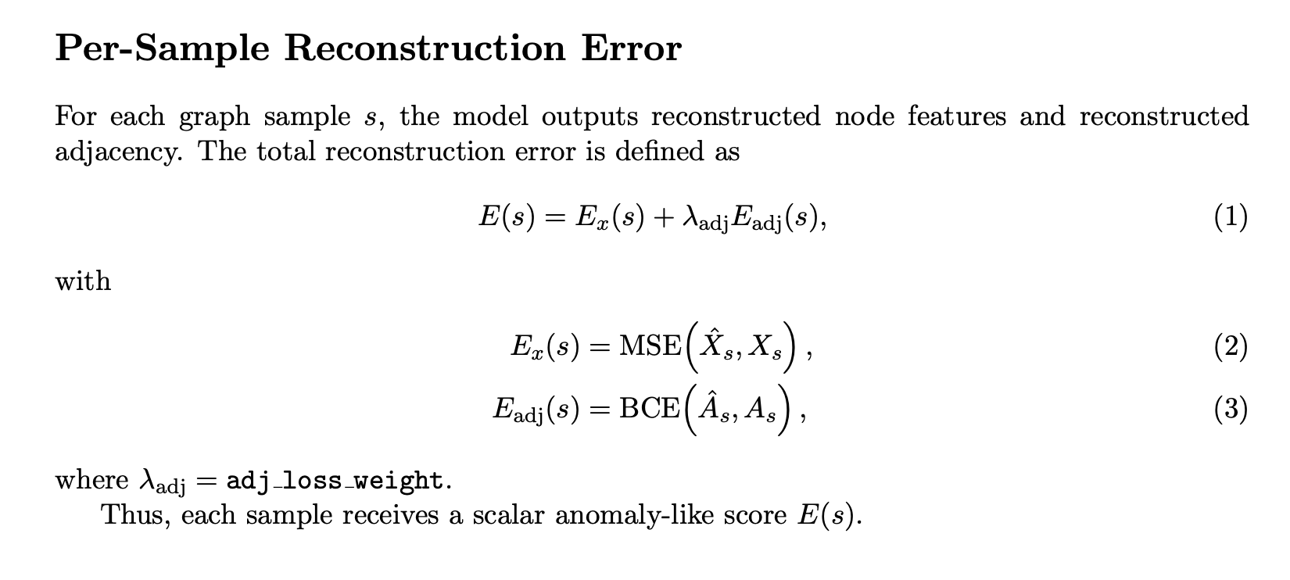
Prediction Robustness Testing
Recap

Slide 11
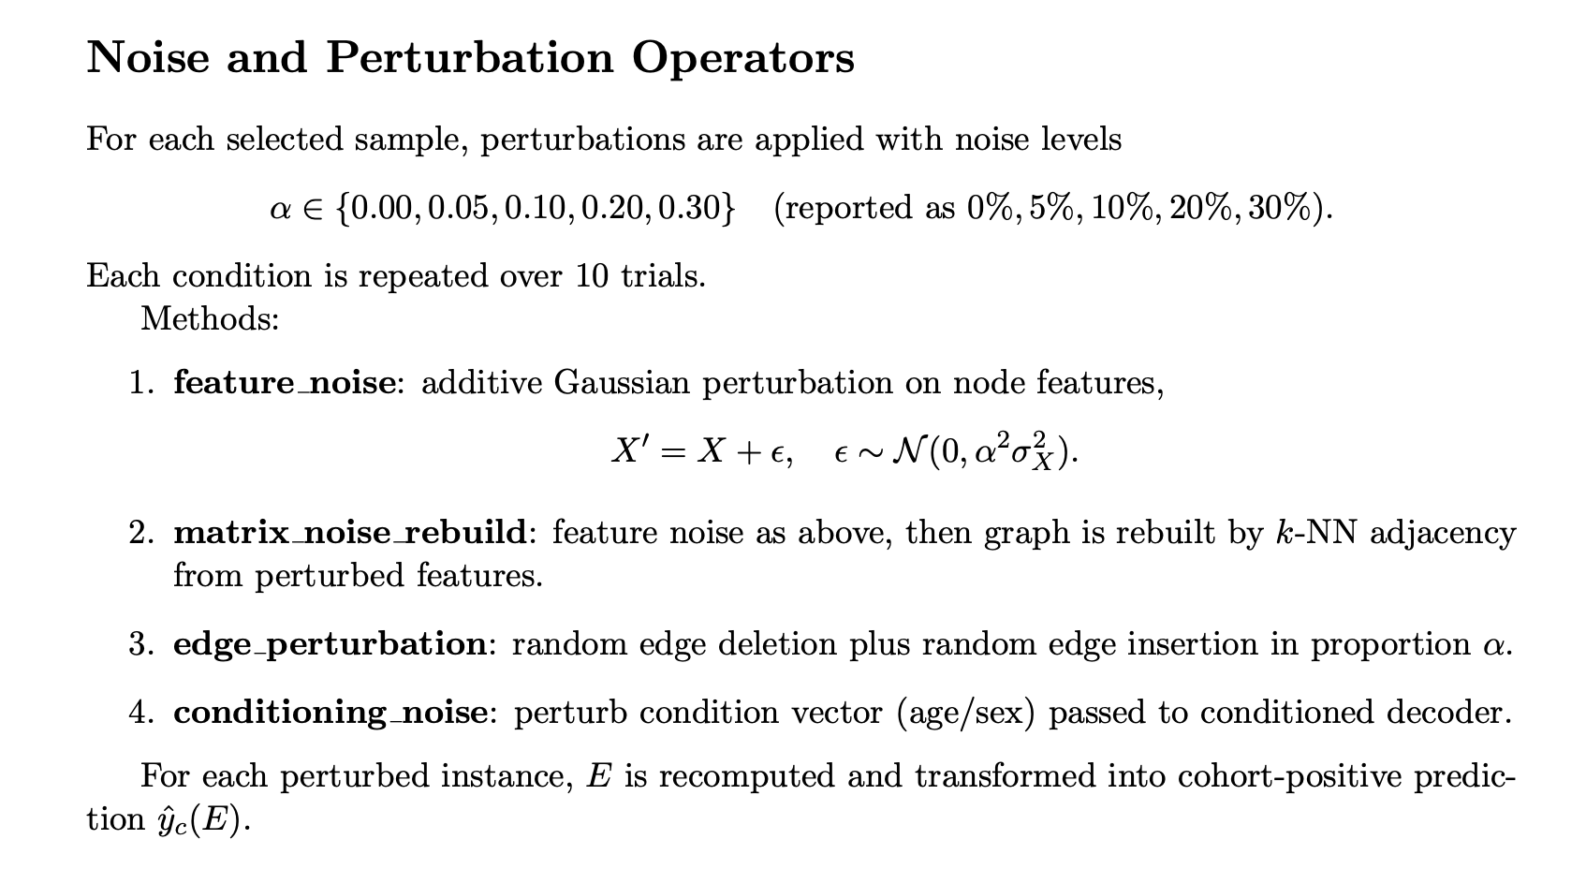
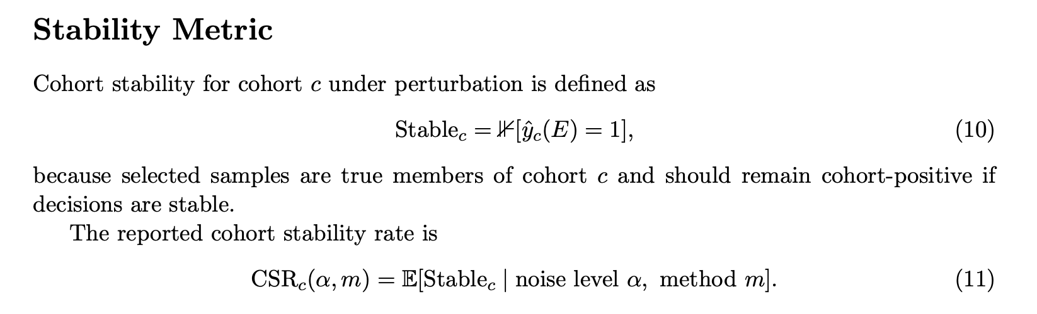
Prediction Robustness Testing
Recap

Slide 12
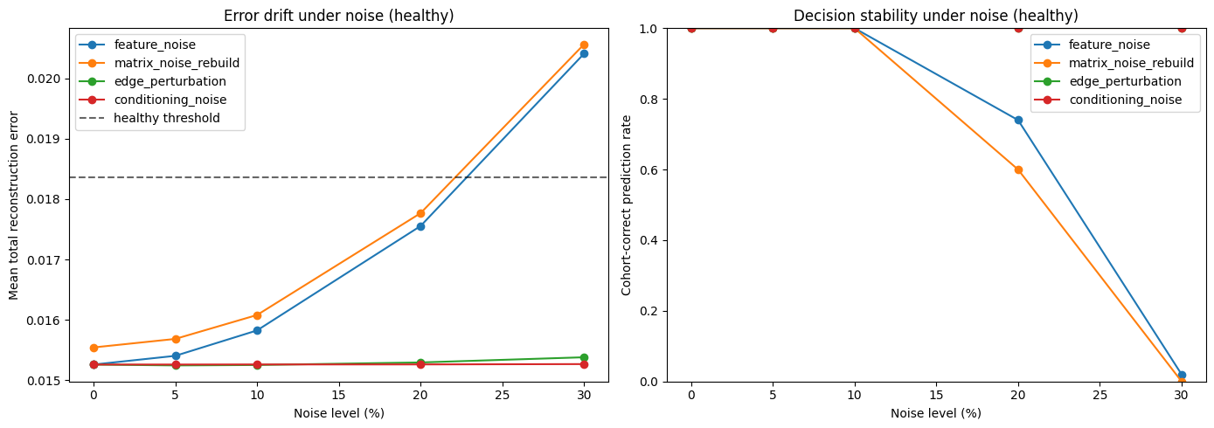
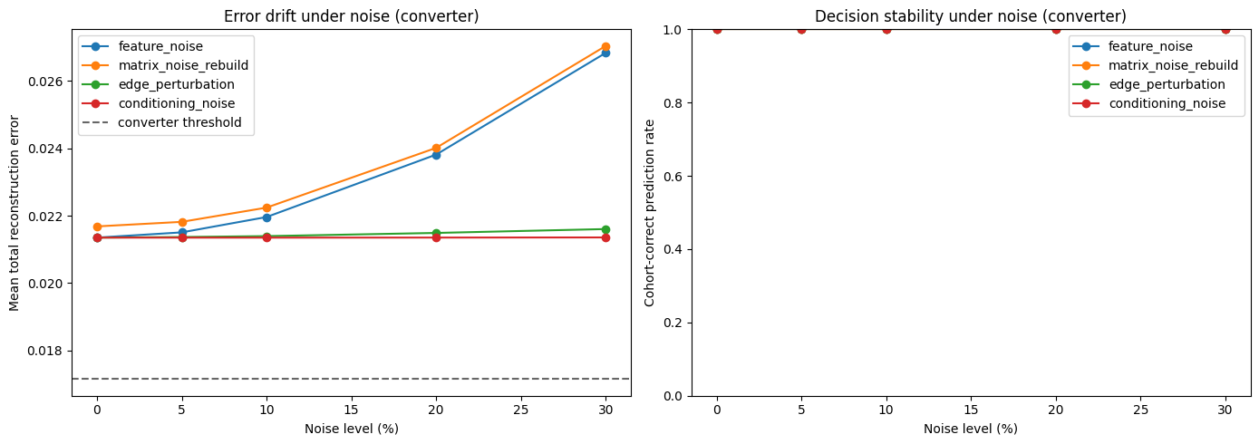
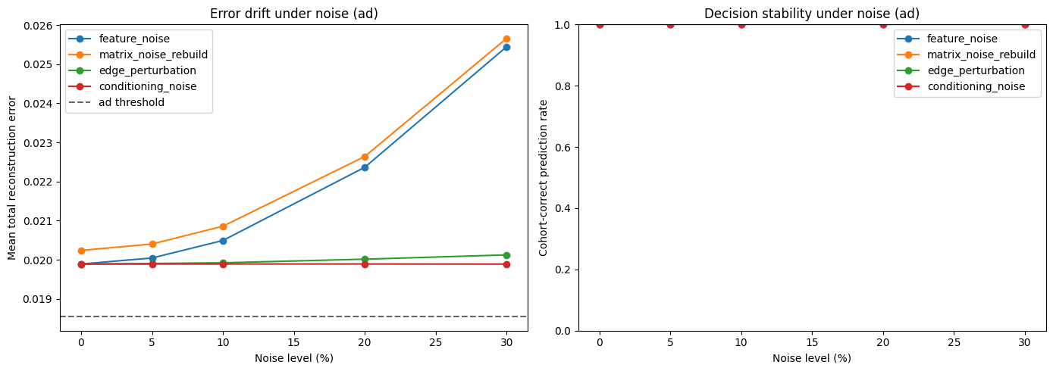
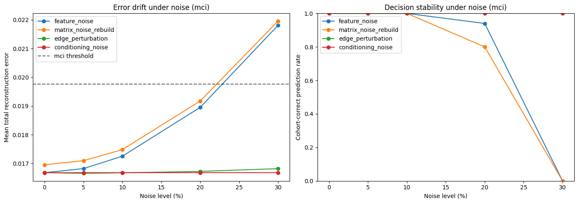
Prediction Robustness Testing on Pretext Model (all cohorts)
Plots
Noble S, Pradeep CS, Sinha N, Issac TG. Classification of Alzheimer's Dementia vs. Healthy subjects by studying structural disparities in fMRI Time-Series of DMN. *arXiv* [Preprint]. 2024:arXiv:2407.19990. doi:10.48550/arXiv.2407.19990. Verfügbar unter: https://arxiv.org/abs/2407.19990 [Zugriff: 24. Mär 2026]. [arxiv](https://arxiv.org/abs/2407.19990)

Slide 13
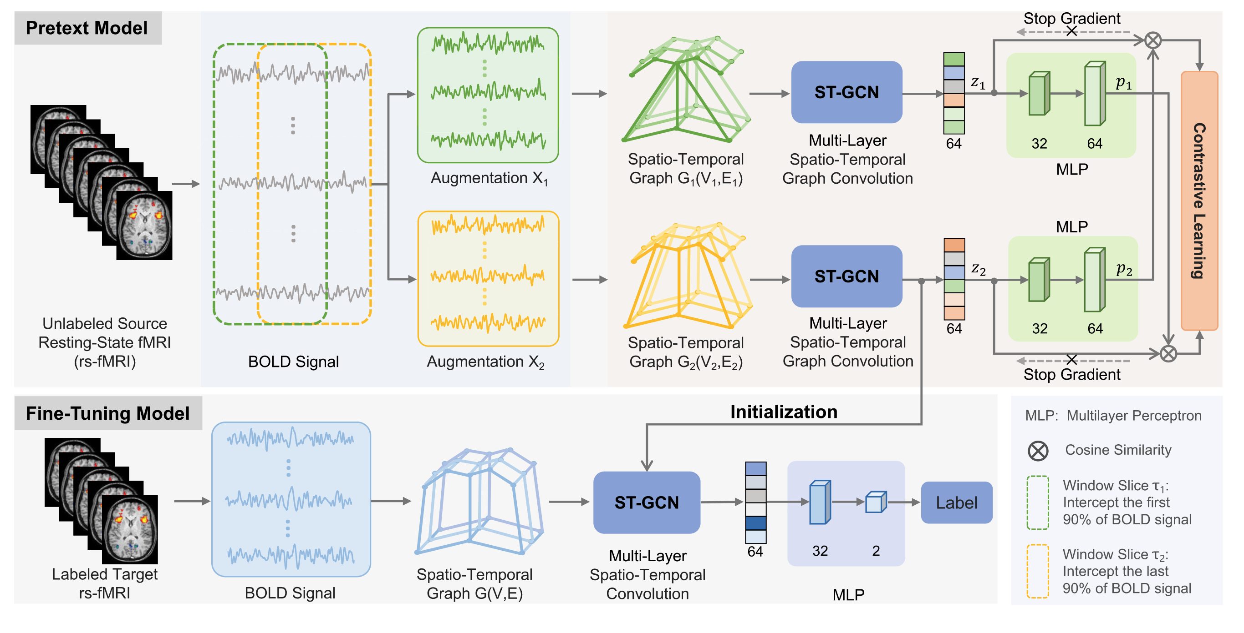
Unsupervised contrastive graph learning for resting-state functional MRI analysis and brain disorder detection (Weng et al. 2023)
- ST-GCN (Spatio-temporal GCN)
Pretext Model (Unsupervised)
Fine-Tuning Model (Supervised)
They jointly model the brain's network structure and how that activity evolves
Spatial Edges: connect different ROIs (nodes) within the same time point using Pearson correlation (what we do so far)
Temporal Edges: no “edges”, but they rather apply a standard 1D convolution kernel (size 1×L) that slides across the time axis
- Statistical Significance Analysis
Used a paired sample t-test to evaluate the difference in prediction probability distributions between their proposed UCGL model and nine competing methods
Wang X, Chu Y, Wang Q, Cao L, Qiao L, Zhang L, Liu M. Unsupervised contrastive graph learning for resting-state functional MRI analysis and brain disorder detection. Hum Brain Mapp. 2023 Dec 1;44(17):5672-5692. doi: 10.1002/hbm.26469. Epub 2023 Sep 5. PMID: 37668327; PMCID: PMC10619386.

Slide 14
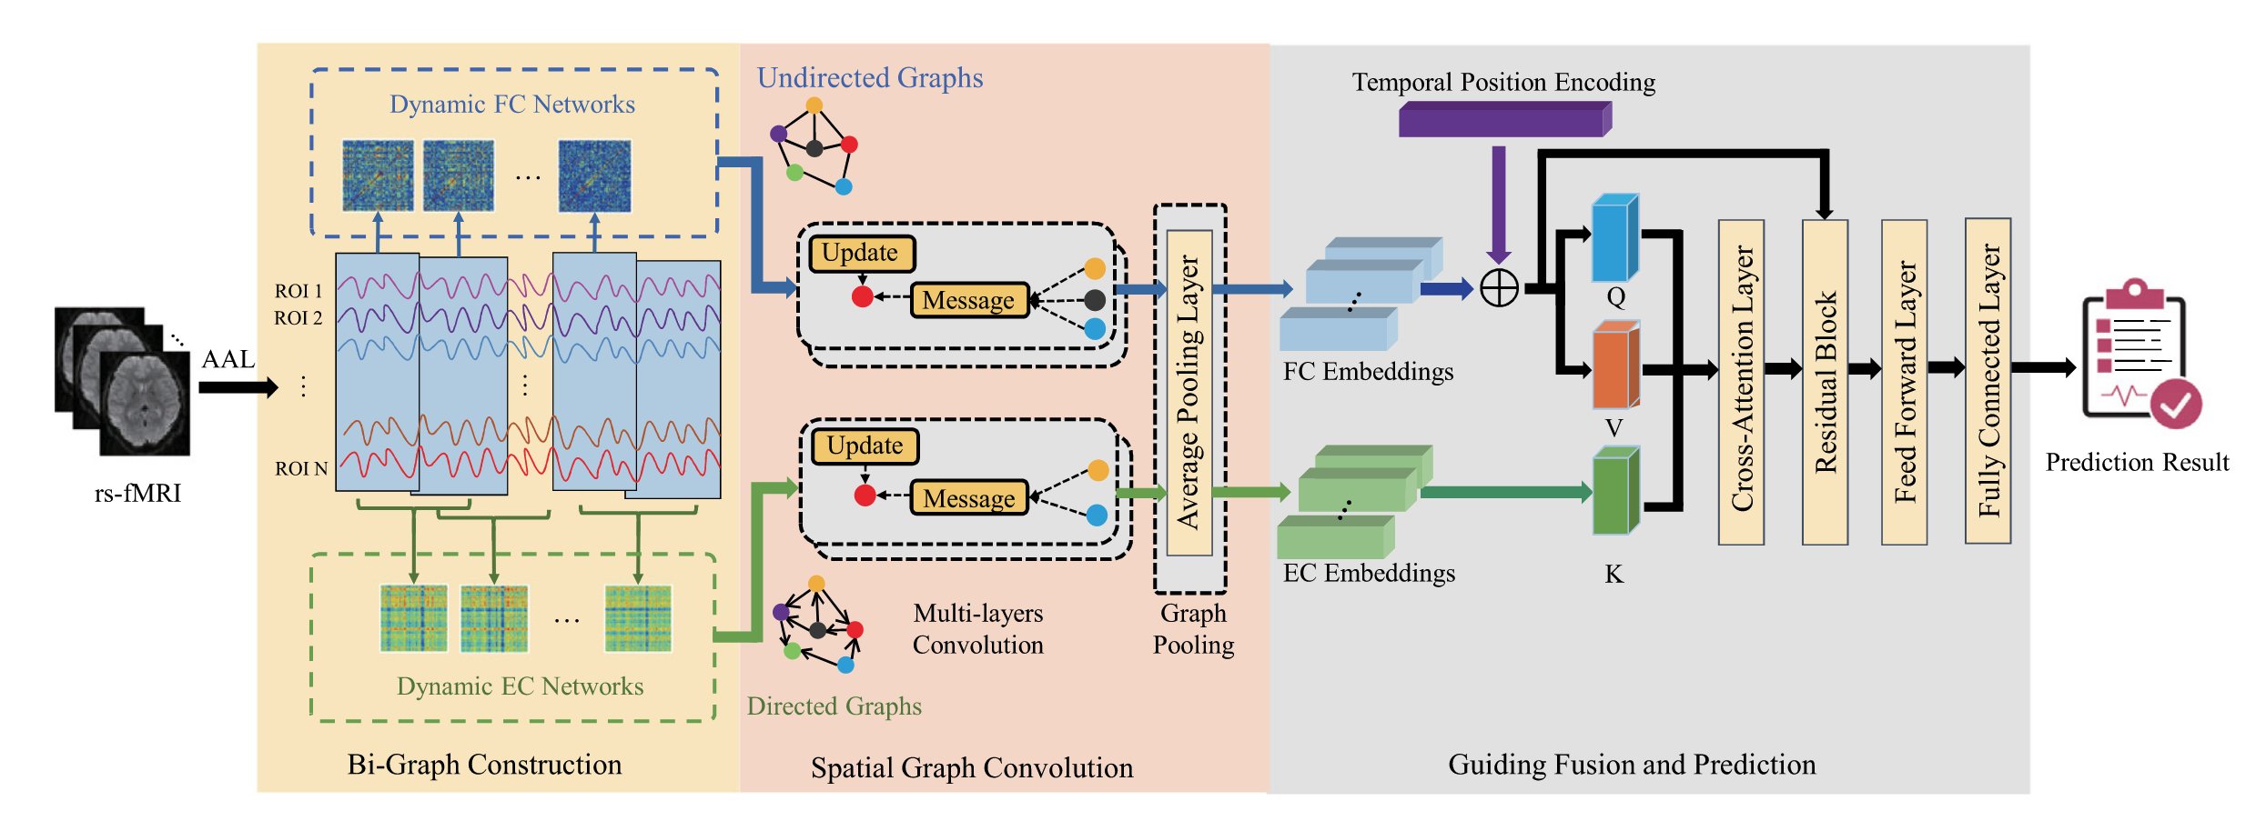
Guiding fusion of dynamic functional and effective connectivity in spatio-temporal graph neural network for brain disorder classification (Chen et al. 2025)
- Bi-Graph Modeling with raw BOLD Signals:
They model the brain as a dual evolving system where Dynamic FC (undirected) captures spatial correlations and Dynamic EC (directed) captures temporal causal progression simultaneously.
- Grad-CAM
Authors analyze salient brain regions in the brain network, by using class activation value of all testing subjects in the multi-class classification task.
Dongdong Chen, Mengjun Liu, Sheng Wang, Zheren Li, Lu Bai, Qian Wang, Dinggang Shen, Lichi Zhang,Guiding fusion of dynamic functional and effective connectivity in spatio-temporal graph neural network for brain disorder classification,Knowledge-Based Systems, https://doi.org/10.1016/j.knosys.2024.112856.

Slide 15
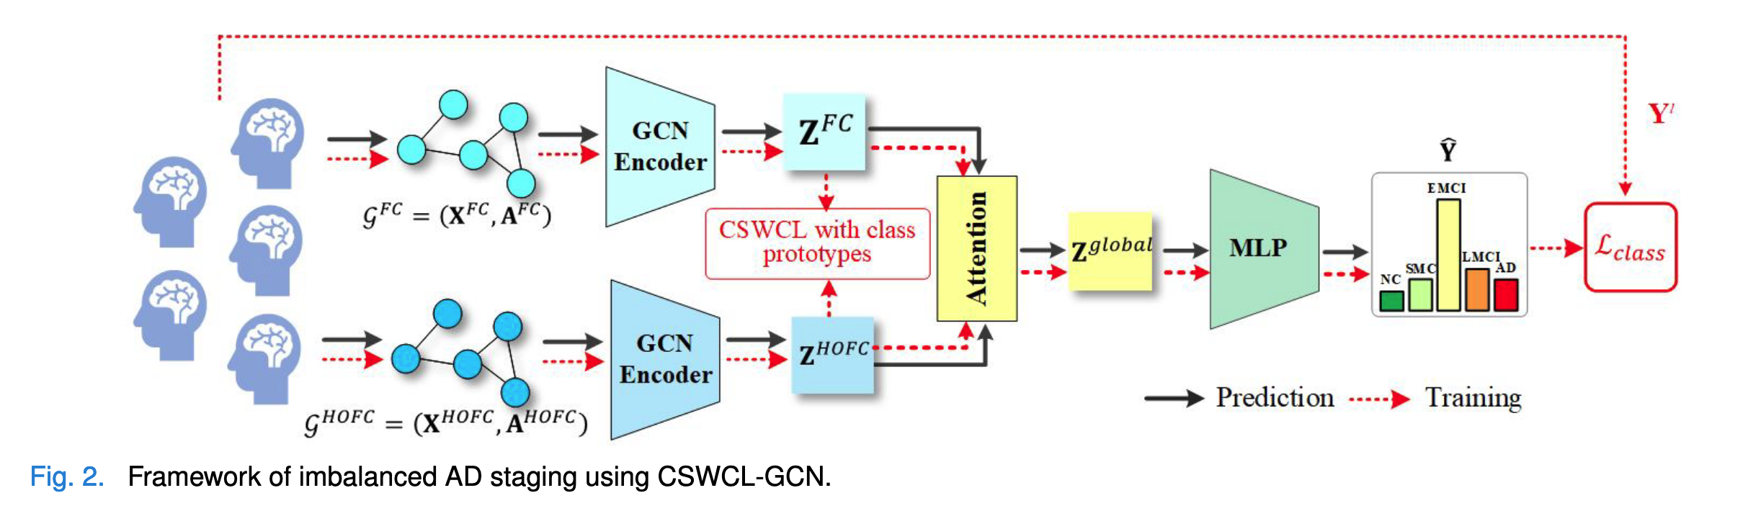
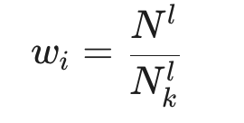
Cost-Sensitive Weighted Contrastive Learning Based on Graph Convolutional Networks for Imbalanced Alzheimer’s Disease Staging (Hu et al. 2024)
- Minority Class Issue (Multi-View Contrastive Learning, Cost-Sensitive Weighting)
Under/Oversampling don’t capture more knowledge from minority class
Maximize agreement between FC and HOFC + while applying cost-sensitive weighting
Hu Y, Wang J, Zhu H, Li J, Shi J. Cost-Sensitive Weighted Contrastive Learning Based on Graph Convolutional Networks for Imbalanced Alzheimer's Disease Staging. IEEE Trans Med Imaging. 2024 Sep;43(9):3126-3136. doi: 10.1109/TMI.2024.3389747. Epub 2024 Sep 3. PMID: 38625767.

