Slide 1
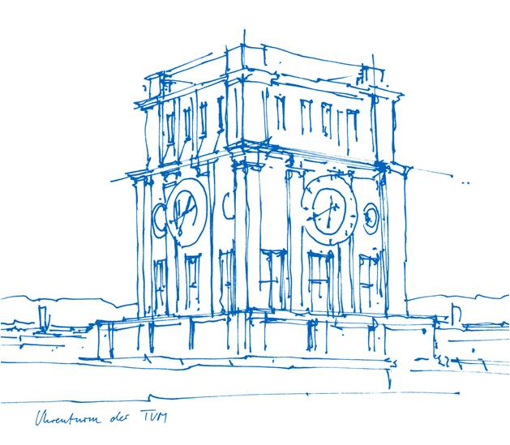
Pretraining: Results + Classification Fraj Yassine Lakhal TUM School of Computation, Information and Technology
Functional Neuroimaging, LMU
Supervisor: Dr. med. Stephan Wunderlich
Computer Aided Medical Procedures & Augmented Reality, TUM
Supervisor(s): M.Sc. Chantal Pellegrini, Dr. Shahrooz Faghihroohi
München, 13. Januar 2026

Slide 2
Outline
Papers Review
Latent Vector Study (from Pretrained Encoder)
Preparing for Kickoff Presentation

Slide 3
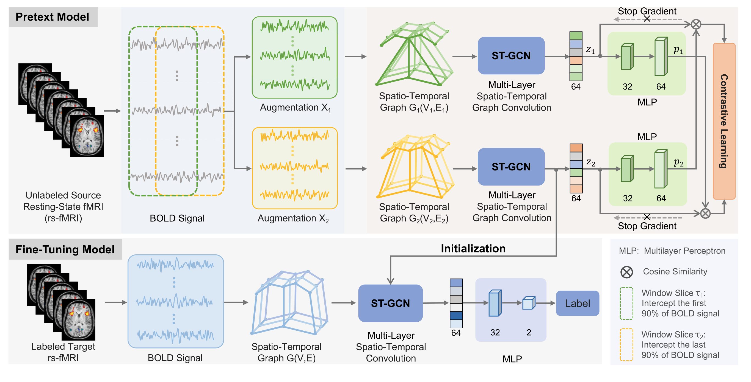
Unsupervised contrastive graph learning for resting-state functional MRI analysis and brain disorder detection (Weng et al. 2023)
- ST-GCN (Spatio-temporal GCN)
Pretext Model (Unsupervised)
Fine-Tuning Model (Supervised)
They jointly model the brain's network structure and how that activity evolves
Spatial Edges: connect different ROIs (nodes) within the same time point using Pearson correlation (what we do so far)
Temporal Edges: no “edges”, but they rather apply a standard 1D convolution kernel (size 1×L) that slides across the time axis
- Statistical Significance Analysis
Used a paired sample t-test to evaluate the difference in prediction probability distributions between their proposed UCGL model and nine competing methods
Wang X, Chu Y, Wang Q, Cao L, Qiao L, Zhang L, Liu M. Unsupervised contrastive graph learning for resting-state functional MRI analysis and brain disorder detection. Hum Brain Mapp. 2023 Dec 1;44(17):5672-5692. doi: 10.1002/hbm.26469. Epub 2023 Sep 5. PMID: 37668327; PMCID: PMC10619386.

Slide 4
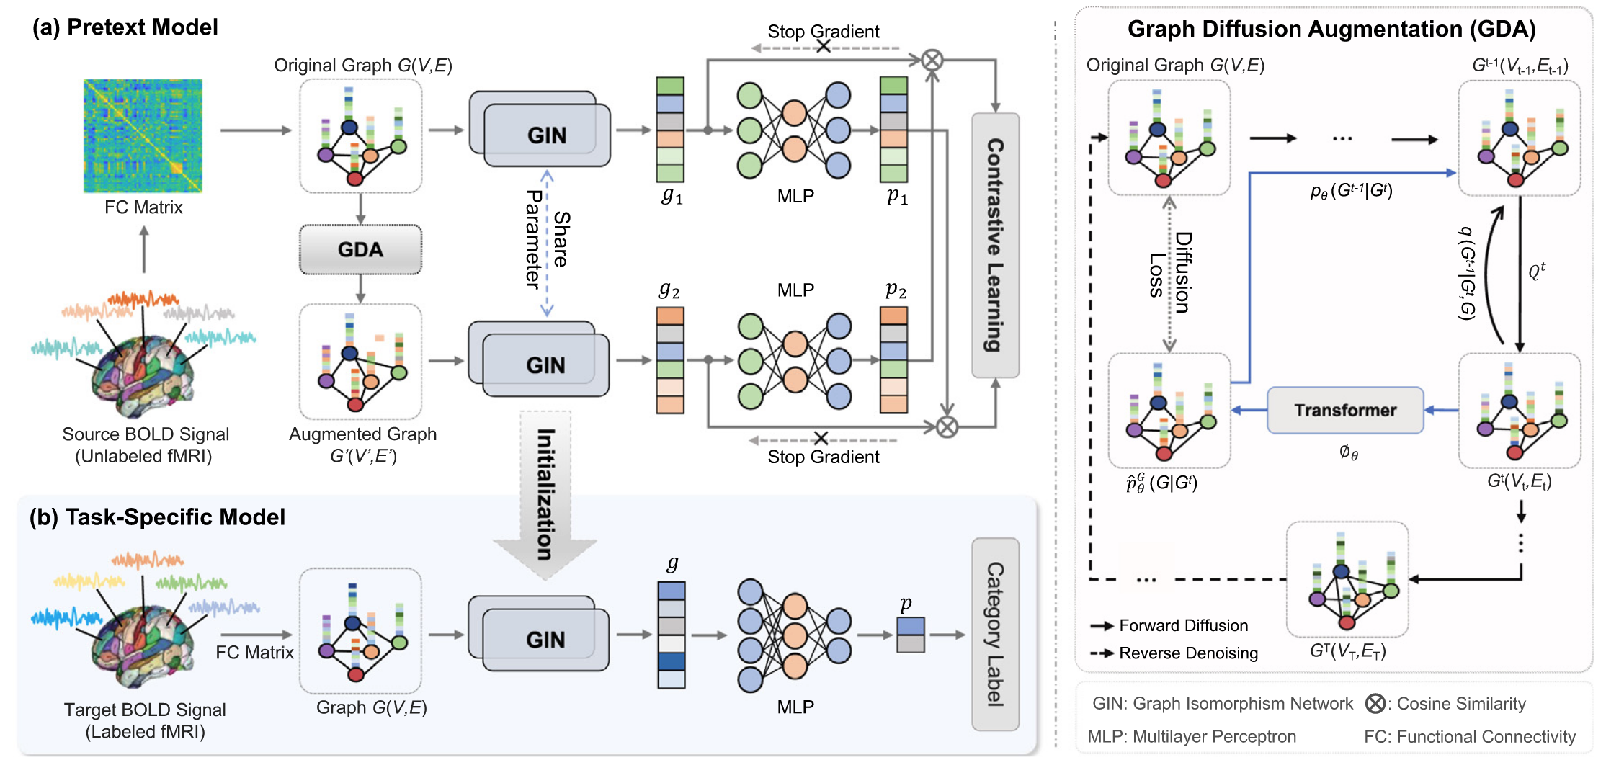
Self-supervised graph contrastive learning with diffusion augmentation for functional MRI analysis and brain disorder detection (Weng et al. 2025)
Window Slicing for Contrastive Learning
They minimize the difference between two sliced BOLD Signals of the same patient
Authors Claim: Slicing does not alter temporal dependencies
Graph Diffusion Augmentation (GDA)
Authors add Gaussian noise to nodes and edges
Authors Claim: Graph Transformer can denoise the augmented samples during the generation process.
Wang X, Fang Y, Wang Q, Yap PT, Zhu H, Liu M. Self-supervised graph contrastive learning with diffusion augmentation for functional MRI analysis and brain disorder detection. Med Image Anal. 2025 Apr;101:103403. doi: 10.1016/j.media.2024.103403. Epub 2024 Nov 29. PMID: 39637557; PMCID: PMC11875923.

Slide 5
Diffusion Models and Slicing Windows
Critique 1: Invalid Invariance Assumption
In CV, an object remains the same regardless of orientation (e.g., we can still identify a rotated cat). In fMRI, we cannot assume a "sliced" or "noisy" brain signal retains the same disease pathology
Problem: Brain disorders like AD are potentially defined by subtle, millisecond-scale synchronizations between specific regions
Consequence: A "disrupted functional connection" critical for diagnosis might disappear completely if the time-series is sliced or if noise is added

Slide 6
Diffusion Models and Slicing Windows
Critique 1: Invalid Invariance Assumption
In CV, an object remains the same regardless of orientation (e.g., we can still identify a rotated cat). In fMRI, we cannot assume a "sliced" or "noisy" brain signal retains the same disease pathology
Problem: Brain disorders like AD are potentially defined by subtle, millisecond-scale synchronizations between specific regions
Consequence: A "disrupted functional connection" critical for diagnosis might disappear completely if the time-series is sliced or if noise is added
Critique 2: Overfitting and Memorization on Small Datasets
Diffusion models require large amounts of data to learn true distributions. Our dataset is relatively small (e.g., ~600 subjects)
Problem: As you noted, diffusion models trained on small datasets tend to memorize training samples rather than learning a generalizable distribution.
Consequence: The "new" generated graphs might just be noisy copies of the training data

Slide 7
Diffusion Models and Slicing Windows
Critique 1: Invalid Invariance Assumption
In CV, an object remains the same regardless of orientation (e.g., we can still identify a rotated cat). In fMRI, we cannot assume a "sliced" or "noisy" brain signal retains the same disease pathology
Problem: Brain disorders like AD are potentially defined by subtle, millisecond-scale synchronizations between specific regions
Consequence: A "disrupted functional connection" critical for diagnosis might disappear completely if the time-series is sliced or if noise is added
Critique 2: Overfitting and Memorization on Small Datasets
Diffusion models require large amounts of data to learn true distributions. Our dataset is relatively small (e.g., ~600 subjects)
Problem: As you noted, diffusion models trained on small datasets tend to memorize training samples rather than learning a generalizable distribution.
Consequence: The "new" generated graphs might just be noisy copies of the training data
Critique 3: The Signal-to-Noise Ratio Issue
BOLD signals are already dominated by noise (heartbeat, respiration, scanner drift), with the disease signal being a fraction of the variance.
Problem: Adding more noise (via diffusion) adds to the low SNR problem.
Consequence: The augmentation strategies might drown out the weak, subtle modulation that characterizes the disease

Slide 8
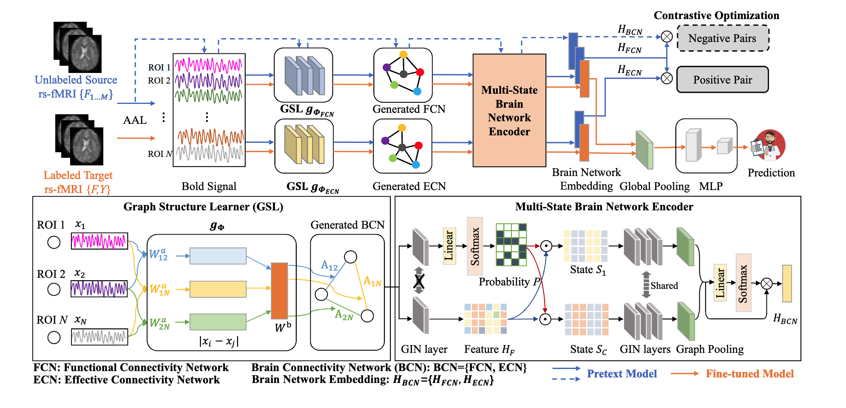
Self-supervised Learning with Adaptive Graph Structure and Function Representation for Cross-Dataset Brain Disorder Diagnosis (Chen et al. 2024)
- Functional Connectivity (FC) and Effective Connectivity (EC)
With EC, we can capture the directional effects that one brain region exerts over another.
Authors use structural relationships (measured via transfer entropy) with attention relationships (measured via learnable weights).
- Ablation Studies
Removing the Pretrained model for example.
Che_Selfsupervised_MICCAI2024, Chen, Dongdong and Yao, Linlin and Liu, Mengjun and Shen, Zhenrong and Hu, Yuqi and Song, Zhiyun and Wang, Qian and Zhang, Lichi}, Self-supervised Learning with Adaptive Graph Structure and Function Representation For Cross-Dataset Brain Disorder Diagnosis } }, {proceedings of Medical Image Computing and Computer Assisted Intervention -- MICCAI 2024},

Slide 9
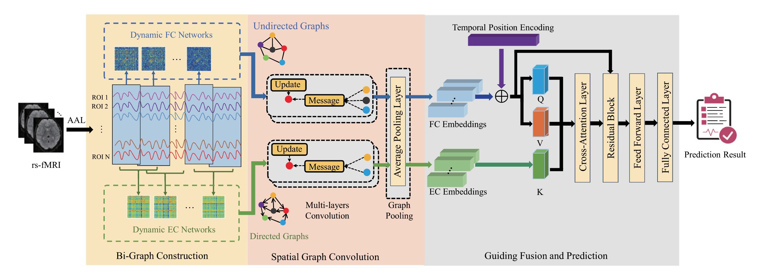
Guiding fusion of dynamic functional and effective connectivity in spatio-temporal graph neural network for brain disorder classification (Chen et al. 2025)
- Bi-Graph Modeling with raw BOLD Signals:
They model the brain as a dual evolving system where Dynamic FC (undirected) captures spatial correlations and Dynamic EC (directed) captures temporal causal progression simultaneously.
- Grad-CAM
Authors analyze salient brain regions in the brain network, by using class activation value of all testing subjects in the multi-class classification task.
Dongdong Chen, Mengjun Liu, Sheng Wang, Zheren Li, Lu Bai, Qian Wang, Dinggang Shen, Lichi Zhang,Guiding fusion of dynamic functional and effective connectivity in spatio-temporal graph neural network for brain disorder classification,Knowledge-Based Systems, https://doi.org/10.1016/j.knosys.2024.112856.

Slide 10
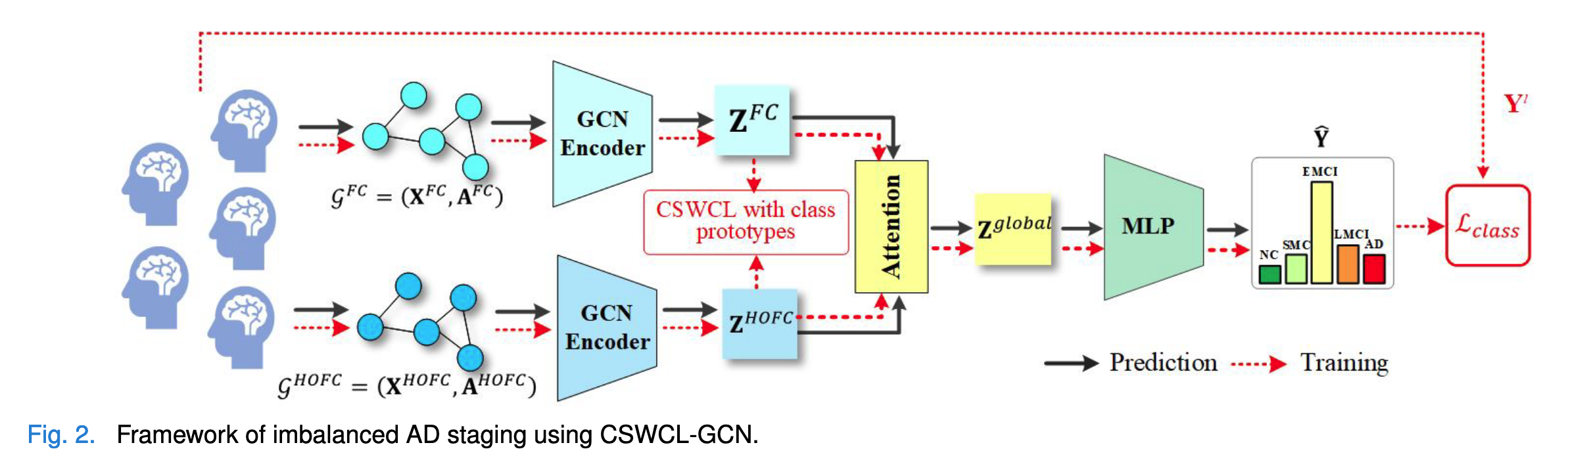
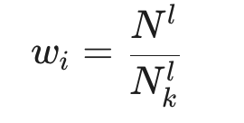
Cost-Sensitive Weighted Contrastive Learning Based on Graph Convolutional Networks for Imbalanced Alzheimer’s Disease Staging (Hu et al. 2024)
- Inter-Subject Graph
- High Order FC
They consider each row of the FC matrix as a feature vector describing a brain region. They then calculate the Pearson correlation between these rows.
- Minority Class Issue (Multi-View Contrastive Learning, Cost-Sensitive Weighting)
Under/Oversampling don’t capture more knowledge from minority class
Maximize agreement between FC and HOFC + while applying cost-sensitive weighting
Hu Y, Wang J, Zhu H, Li J, Shi J. Cost-Sensitive Weighted Contrastive Learning Based on Graph Convolutional Networks for Imbalanced Alzheimer's Disease Staging. IEEE Trans Med Imaging. 2024 Sep;43(9):3126-3136. doi: 10.1109/TMI.2024.3389747. Epub 2024 Sep 3. PMID: 38625767.

Slide 11
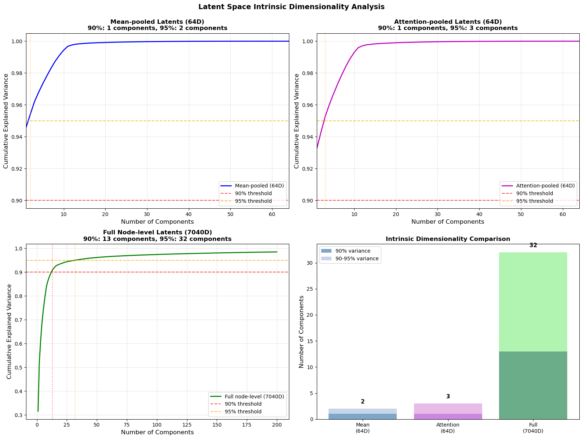
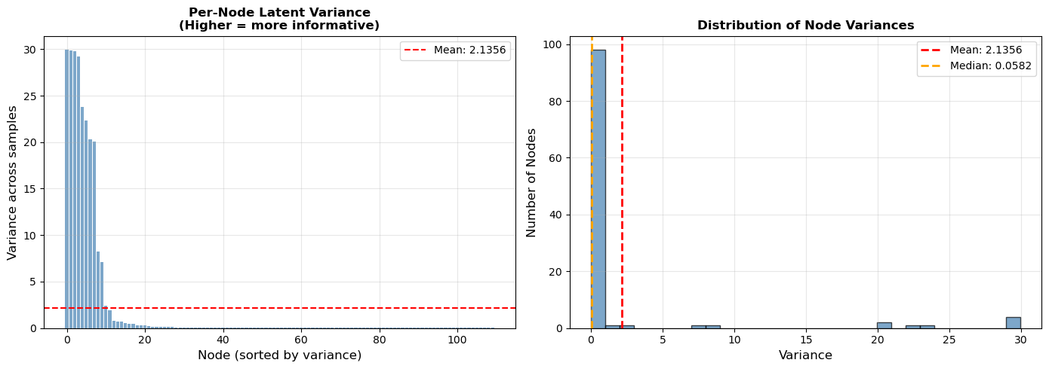
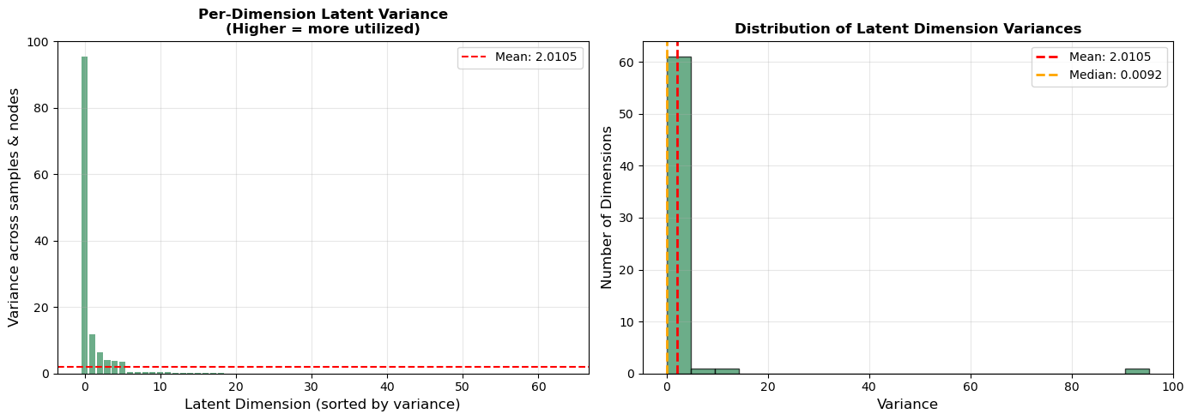
Pretrained Model: Latent Vector Study
Encoder Trained on All Cohorts

Slide 12
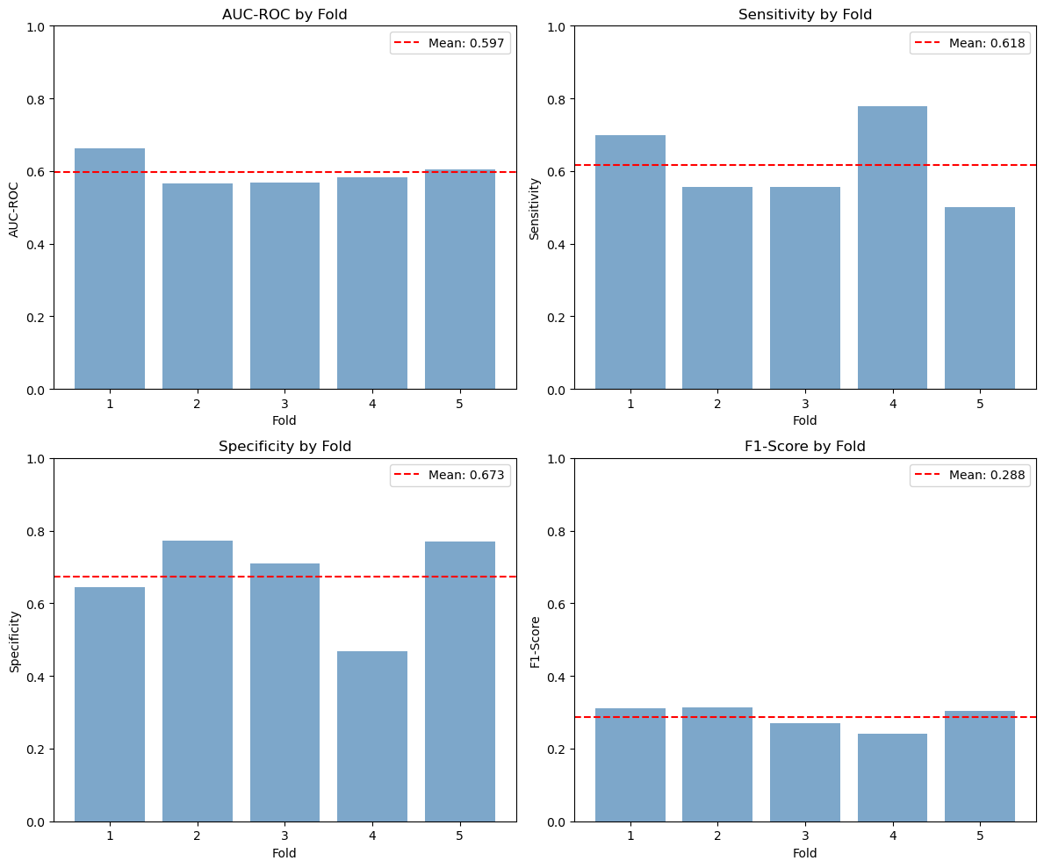
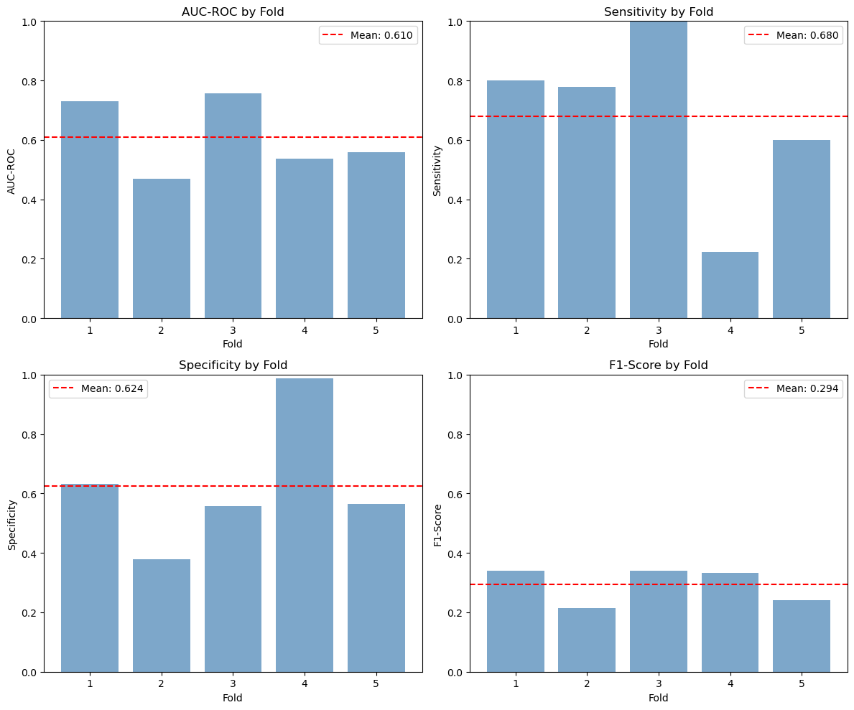
Results GEC
Mean Pooling (left) vs Attention Pooling (right)
after removing duplicates from the data of stable MCI and Converters, performance dropped significantly!

