Slide 1

Literature Review & Next Steps
Fraj Yassine Lakhal
TUM School of Computation, Information and Technology
Functional Neuroimaging, LMU
Supervisor: Dr. med. Stephan Wunderlich
Chair for Computer Aided Medical Procedures & Augmented Reality, TUM
Supervisor(s): M.Sc. Chantal Pellegrini, Dr. Shahrooz Faghihroohi
München, 17. Dezember 2025

Slide 2
Outline
Theoretical Framework
Current Approach
Literature Review

Slide 3
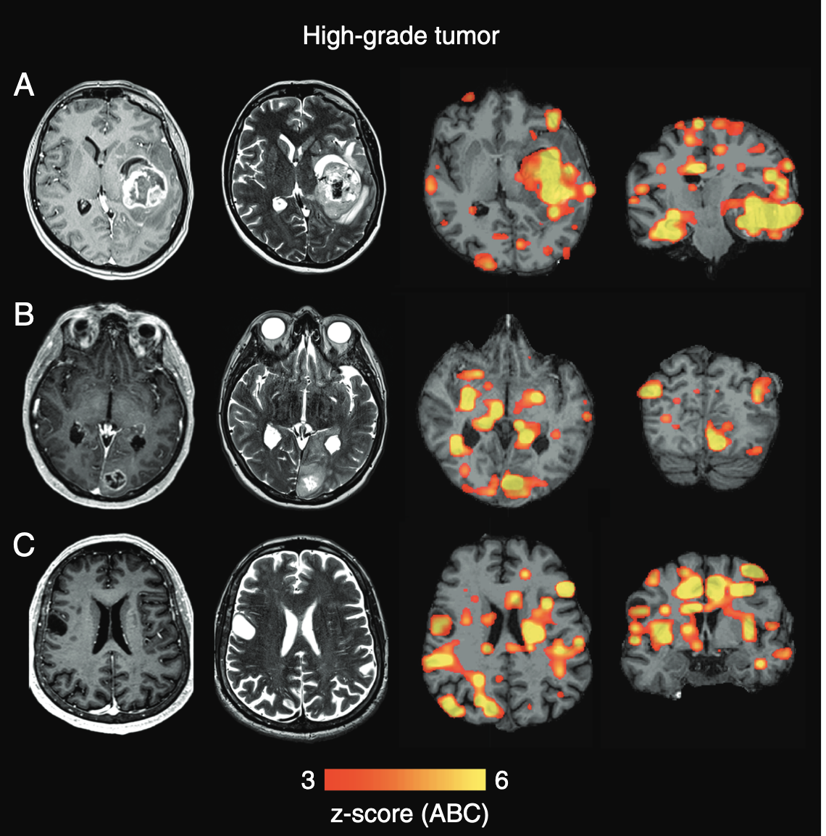
Theoretical Framework: fMRI as a Reliable Method for Brain Pathologies
(Stoecklein et al., 2020)
Find damage beyond the Lesion:
abnormalities in functional connectivity could be detected not only adjacent to the visible lesion but also in distant brain tissue, even in the contralesional hemisphere.
Define imaging markers to quantify disease Aggressiveness:
ABI* showed a close correlation with the aggressiveness of the tumor: correlates with MOCA tests, IDH Mutation Status and WHO Grade (Pathological Severity)
Feasibility:
fMRI sequences can be "tacked onto a clinical routine MRI scan without major modification to the scanning procedure," and the post-analysis can be done automatically
*quantitative imaging marker, quantifies whole-brain functional connectivity damage
(Stoecklein et al., 2020)
Stoecklein VM, Stoecklein S, Galiè F, Ren J, Schmutzer M, Unterrainer M, Albert NL, Kreth FW, Thon N, Liebig T, Ertl-Wagner B, Tonn JC, Liu H. Resting-state fMRI detects alterations in whole brain connectivity related to tumor biology in glioma patients. Neuro Oncol. 2020 Sep 29;22(9):1388-1398. doi: 10.1093/neuonc/noaa044. PMID: 32107555; PMCID: PMC7523460.

Slide 4
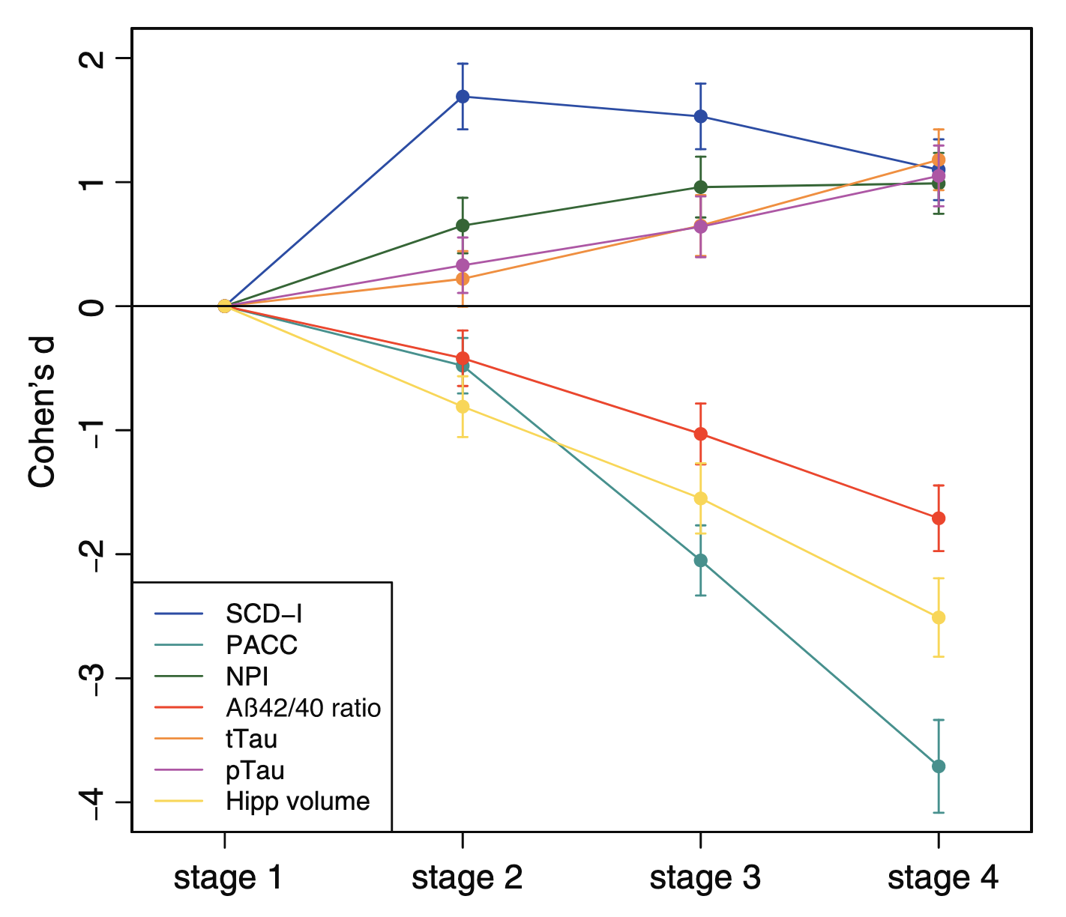
Theoretical Framework: MCI and The Alzheimer’s Disease Continuum
(Jessen et al., 2023)
AD Continuum is defined:
Stage 1 (asymptomatic, A+ Controls)
→ Stage 2 (SCD-A+)
→ Stage 3 (MCI-A+)
→ Stage 4 (DAT-A+)
Cognitive and Aß define the AD Continuum:
Preclinical Alzheimer's Cognitive Composite (PACC5) drastic cognitive decline as the disease progresses
Aβ positivity (A+) based on the Aβ42/Aβ40 ratio cut-off to define all cases
(Jessen et al., 2023)
Jessen F, Wolfsgruber S, Kleineindam L, Spottke A, Altenstein S, Bartels C, Berger M, Brosseron F, Daamen M, Dichgans M, Dobisch L, Ewers M, Fenski F, Fliessbach K, Freiesleben SD, Glanz W, Görß D, Gürsel S, Janowitz D, Kilimann I, Kobeleva X, Lohse A, Maier F, Metzger C, Munk M, Preis L, Sanzenbacher C, Spruth E, Rauchmann B, Vukovich R, Yakupov R, Weyrauch AS, Ziegler G, Schmid M, Laske C, Perneczky R, Schneider A, Wiltfang J, Teipel S, Bürger K, Priller J, Peters O, Ramirez A, Boecker H, Heneka MT, Wagner M, Düzel E. Subjective cognitive decline and stage 2 of Alzheimer disease in patients from memory centers. Alzheimers Dement. 2023 Feb;19(2):487-497. doi: 10.1002/alz.12674. Epub 2022 Apr 22. PMID: 35451563.
Notes:
DAT: Dementia of the Alzheimer's Type
A+: amyloid positive

Slide 5
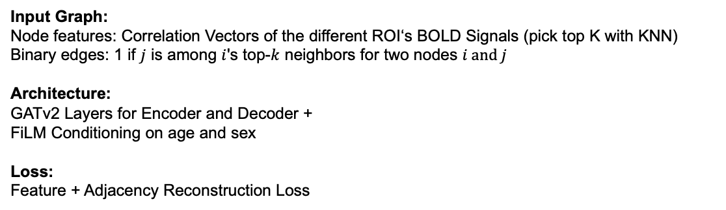
Current Approach: GAAE Model for Anomaly Detection
Input Graph:
Node features: Correlation Vectors of the different ROI‘s BOLD Signals (pick top K with KNN)
Binary edges: 1 if $j$ is among $i$'s top-$k$ neighbors for two nodes $i and j$
Architecture: GATv2 Layers for Encoder and Decoder +
FiLM Conditioning on age and sex
Loss:
Feature + Adjacency Reconstruction Loss
Notes:
FiLM: Feature-wise Linear Modulation

Slide 6
Literature Review
The Diagnosis vs. Prognosis Problem
Searching literature was not straightforward:
Papers confuse prediction of AD with the DL term
Papers only mention MRI in their approach, without being specific
Most papers include some form of structural imaging sMRI, PET..

Slide 7
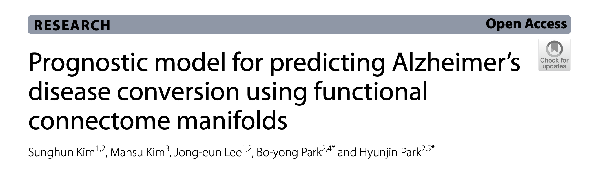
Literature Review
The Diagnosis vs. Prognosis Problem
Only 1 paper does the temporal prognosis of conversion from MCI to AD using fMRI:
(Kim et al., 2024)
Kim S, Kim M, Lee JE, Park BY, Park H. Prognostic model for predicting Alzheimer's disease conversion using functional connectome manifolds. Alzheimers Res Ther. 2024 Oct 9;16(1):217. doi: 10.1186/s13195-024-01589-3. PMID: 39385241; PMCID: PMC11465528.

Slide 8
Literature Review
The Diagnosis vs. Prognosis Problem
Only 1 paper does the temporal prognosis of conversion from MCI to AD using fMRI:
(Kim et al., 2024)
All other papers treat it as a classification problem (comparing sMCI to pMCI) - Will the MCI patient convert in 1/3/5 years, or no?
- Will this MCI patient ever convert to AD?
- …
→ choosing a best paper is not given as the comparison of performance is not feasible
Although some approaches can be slightly modified to produce a continuous result!
e.g. change the last classification layer to a regression layer

Slide 9
Literature Review: Conversion Risk and Temporal Prognosis
(Kim et al., 2024)
Dataset
ADNI and OASIS
Architecture: Time-to-Event Modeling (Survival Analysis)+The exact conversion time is interval-censored (it occurred between the last MCI and first AD diagnosis date)
Kim S, Kim M, Lee JE, Park BY, Park H. Prognostic model for predicting Alzheimer's disease conversion using functional connectome manifolds. Alzheimers Res Ther. 2024 Oct 9;16(1):217. doi: 10.1186/s13195-024-01589-3. PMID: 39385241; PMCID: PMC11465528.

Slide 10
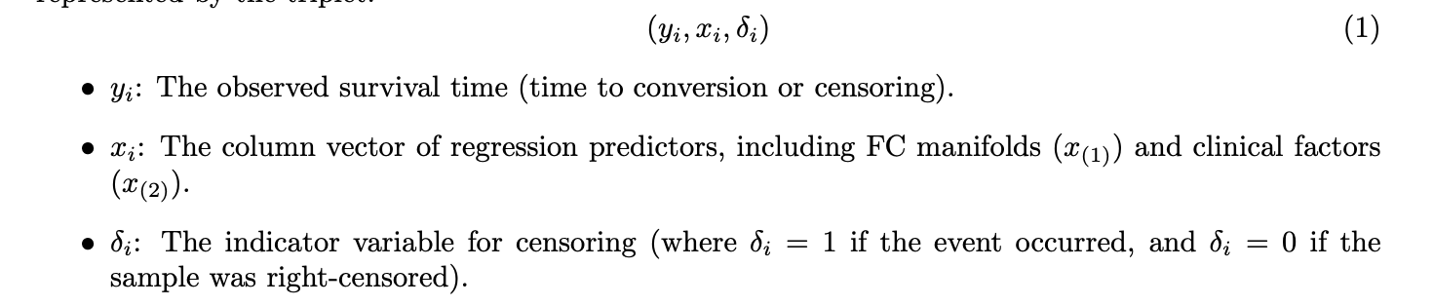
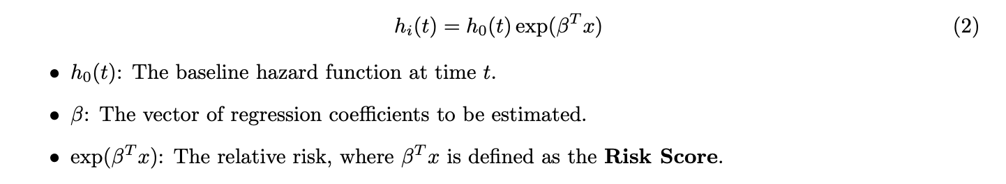
Literature Review: Conversion Risk and Temporal Prognosis
(Kim et al., 2024)
Survival analysis: Each subject i is represented by the triplet:
Risk of conversion at time t:
Using Cox Proportional Hazards Model
Kim S, Kim M, Lee JE, Park BY, Park H. Prognostic model for predicting Alzheimer's disease conversion using functional connectome manifolds. Alzheimers Res Ther. 2024 Oct 9;16(1):217. doi: 10.1186/s13195-024-01589-3. PMID: 39385241; PMCID: PMC11465528.

Slide 11
Literature Review: Conversion Risk and Temporal Prognosis
(Kim et al., 2024)
Model Evaluation and Validation
• Concordance Index (C-index):
Used to evaluate how well the model predicts the ordering of conversion times.
• Risk Groups:
Participants were stratified into fast and slow conversion groups based on a zero cutoff of the predicted risk score
Kim S, Kim M, Lee JE, Park BY, Park H. Prognostic model for predicting Alzheimer's disease conversion using functional connectome manifolds. Alzheimers Res Ther. 2024 Oct 9;16(1):217. doi: 10.1186/s13195-024-01589-3. PMID: 39385241; PMCID: PMC11465528.

Slide 12
Literature Review: SOTA Papers List
(OneNote Notebook)
Different Architectures for Baseline Conversion to AD: sMCI vs pMCI (CNNs, LSTMs..)
+ Foundation Models (Brain-JEPA..)
+ SOTA Methods for fMRI Preprocessing
+ GNN Graph Generation (Task-aware GNN-based fMRI..)
+ Accuracy Improvements when including Genotypes, Aß, Cognitive Scores…

